Slide 1

Computer Network Research @ Tsinghua
Institute of Computer Network Technology
Dan Pei peidan@tsinghua.edu.cn
2021.09

Slide 2




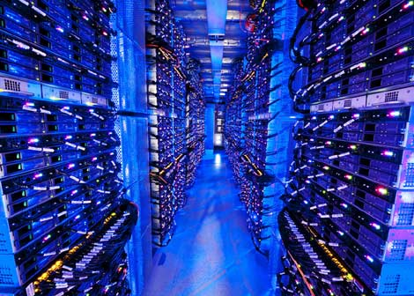



















What’s the Internet: “nuts and bolts” view
millions of connected computing devices:
  hosts = end systems
  running network apps
PC
mobile network
server
wireless
laptop
global ISP
smartphone
home
network
Wi-Fi
3G/4G/5G
regional ISP
communication links
  fiber, copper, radio, satellite
  transmission rate: bandwidth
wired
links
Packet switches: forward packets (chunks of data)
  routers and switches
router
institutional
network
Notes:
2

Slide 3
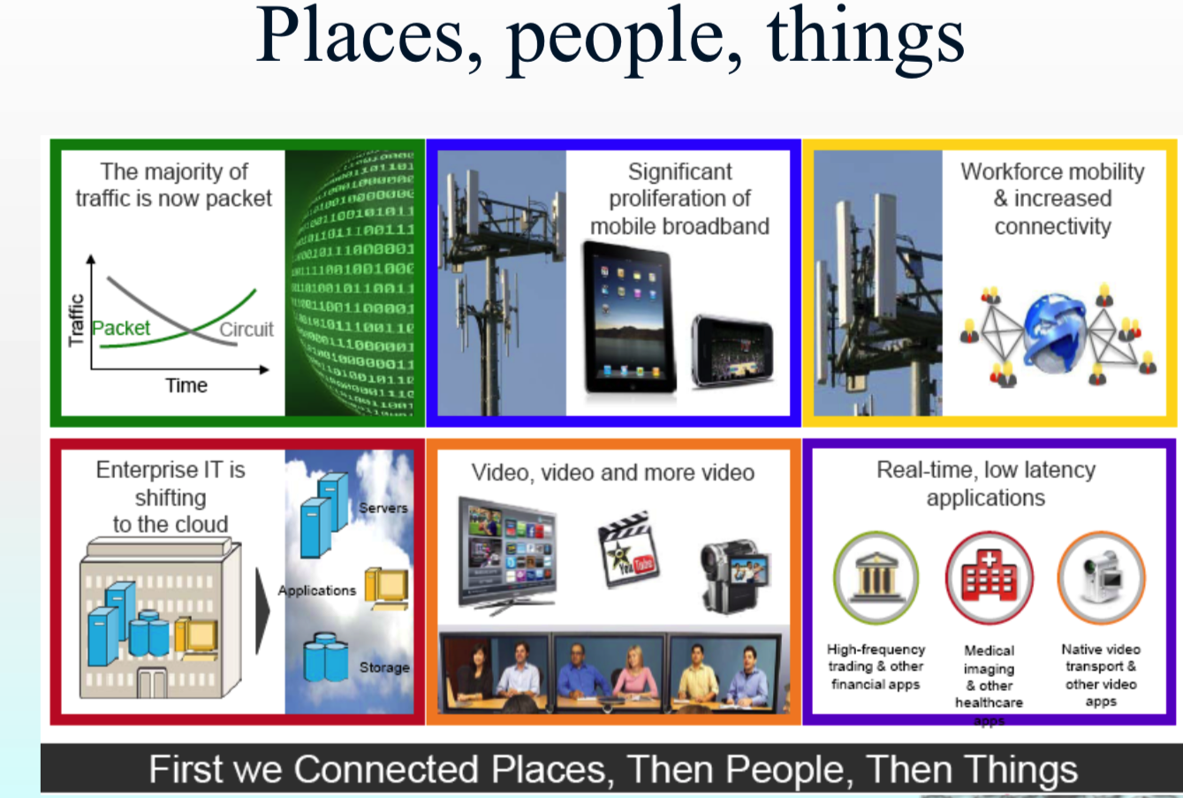
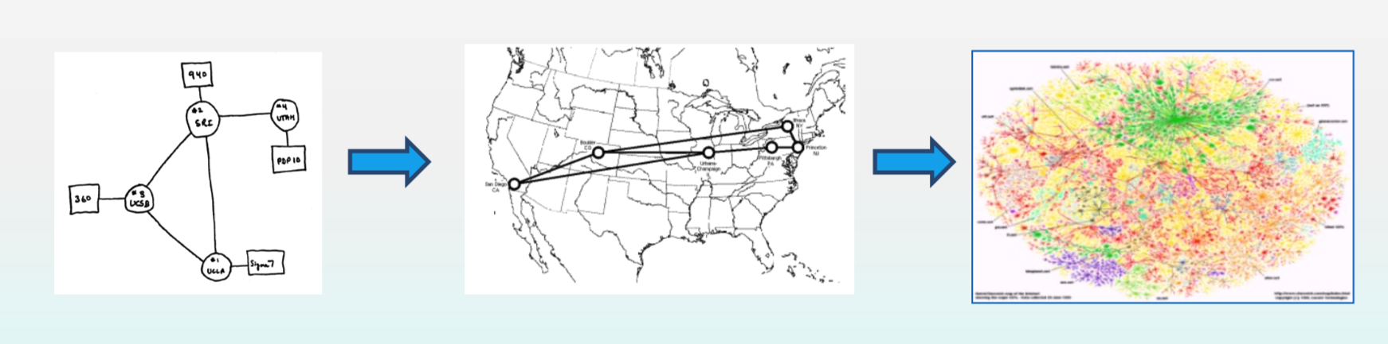
Internet Evolution: from 4 nodes to 50 billions
Internet: connecting

Slide 4
Major Challenges and Research Approaches
Major Approaches
Architecture Design
Build and Operate large-scale networks and systems
  CERNET (IPv4)
  CERNET2 (IPv6)
  China National College Application and Admission System
Internet Standard
Tackle critical networking challenges for latest applications
  Software-Defined Networks/Network Function Virtualization
  Networks for AI
  AI for Networks
  Many more….
Major Challenges:
Scalability
Security
Performance
Real-Time
Mobility
Management
Notes:
计算机网络诞生以来，经历了10多年的技术演进和创新，才发展成功IPv4互联网。
90年代初，IPv4互联网大规模发展，国际互联网组织IETF用了5年时间，在全球众多方案中，最终选择IPv6作为下一代互联网核心协议。不仅定义了海量地址空间，还增加和优化了IPv4功能。随着2012年IPv4地址消耗殆尽，经过近20年技术准备的IPv6成为当前发展互联网的现实选择。
近些年来，国内外学者也开始探索未来互联网和未来网络体系结构。
体系结构研究的共同目标是解决互联网重大技术挑战中的核心问题。其中，扩展性和安全性首当其冲。
互联网发展规律表明，它的主要研究内容包括：开展大规模试验的示范网络，提高路由性能的核心装备和不断优化路由控制的技术创新。

Slide 5
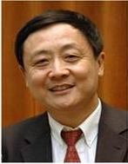


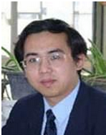

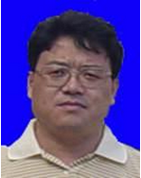


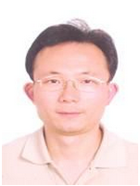


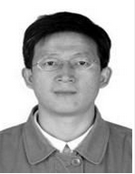

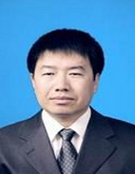


Institute of Computer Network Technology
19 Professors/Associate Professors/Assistant Professors
Honors: Internet Hall of Fame, CAE Fellow, IEEE Fellow…
About 50 Ph.D, 100 Master students
Conference Chairs and PCs: SIGCOMM, NSDI, SIGMETRICS, INFOCOM, IMC, ICNP, CoNEXT…

Slide 6

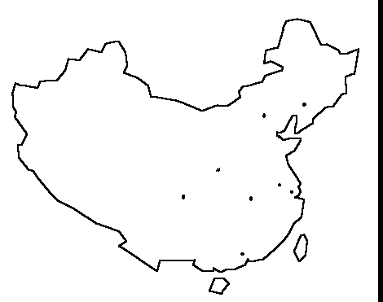
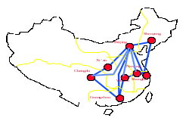
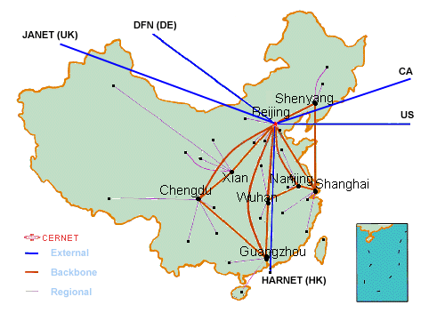
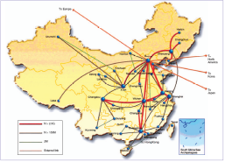
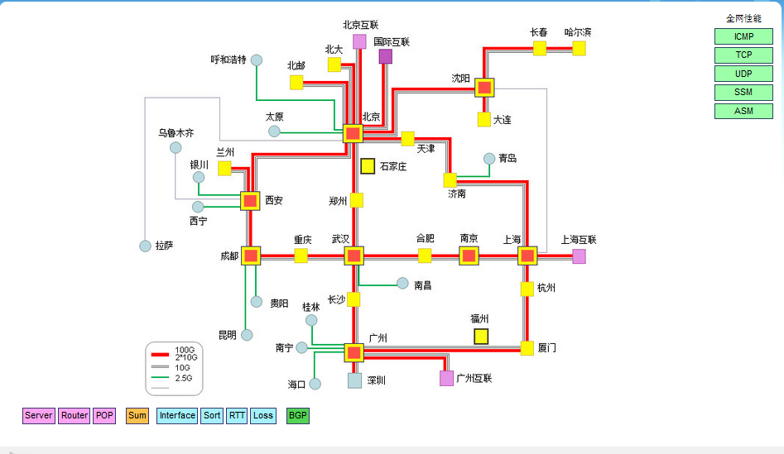
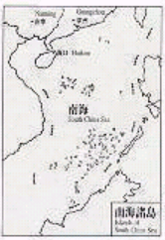
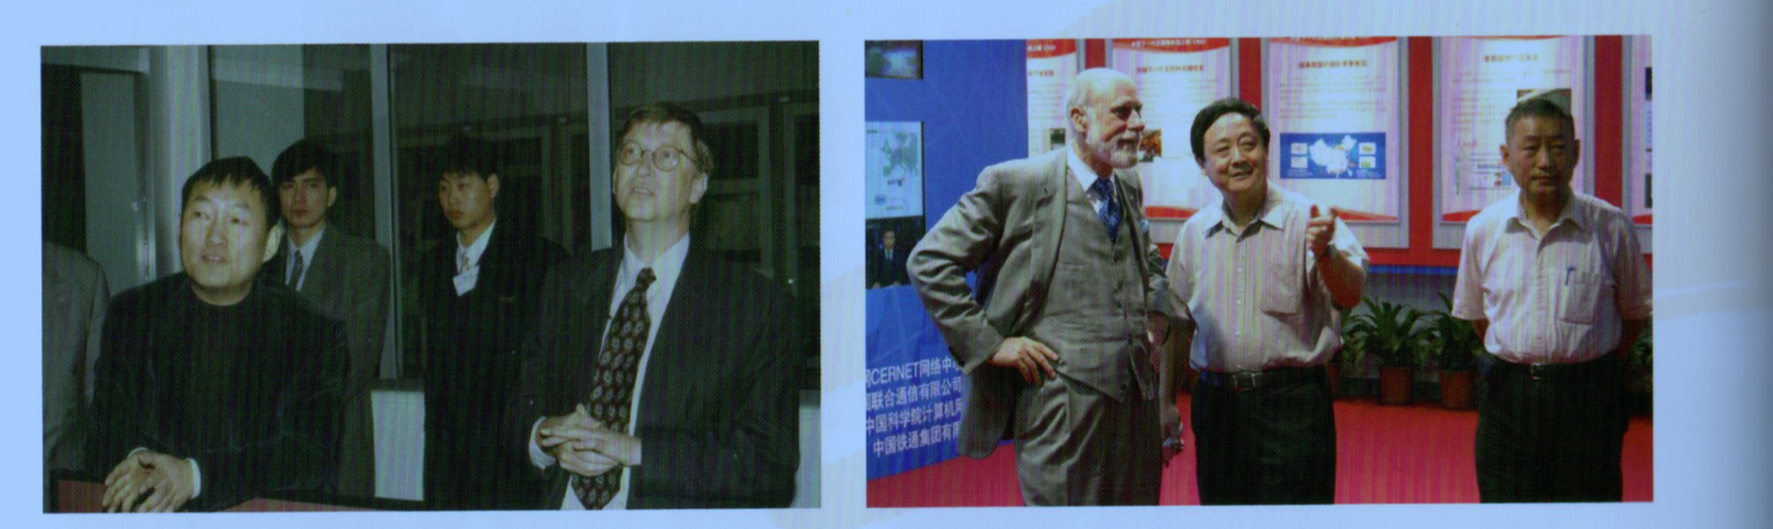
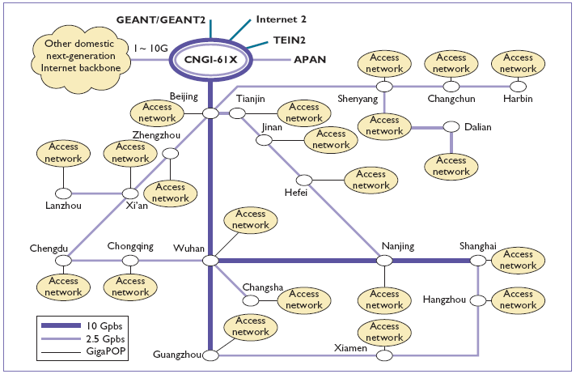
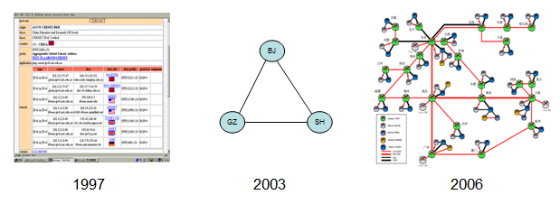
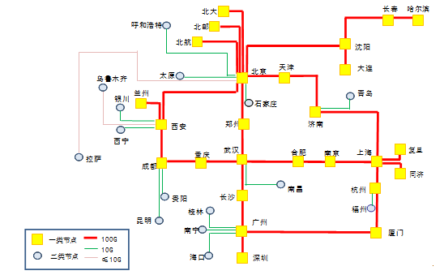
Build and Operate large-scale networks
Evolution of CERNET in China
4500
X.25
2.4K-9.6K
Beijing
Shenyang
2500
2500
2500
Xi’an
Nanjing
Chengdu
Shanghai
10 PoPs
Wuhan
1994
Guangzhou
1995
1997
President of China Hu Jintao 2011
乌鲁木齐
哈尔滨
Prime Minister of China Wen Jiabao 2009
呼和浩特
北京
沈阳
长春
唐山
银川
石家庄
天津
大连
西宁
兰州
太原
济南
烟台
汉中
西安
郑州
徐州
青岛
成都
南京
重庆
宜昌
武汉
合肥
无锡
上海
拉萨
长沙
黄梅
九江
杭州
贵阳
南昌
福州
台北
Backbone
昆明
桂林
Regional
百色
柳州
广州
厦门
GigaPop
惠州
汕头
Pop
南宁
湛江
徐闻
珠海
深圳
深圳
三亚
海口
2000
2004
2014
Evolution of Next-Generation Internet (IPv6) in China
Bill Gates
Vint Cerf
“Father of the Internet”
2018

Slide 7



International Impact
The research undertaken on the future Internet places China at the forefront of thinking about the networks and their importance in the 21st Century
- Vint Cerf, May 2007
Great progress has been made since 2007 especially with IPv6
-Vint Cerf, Aug. 2009
7

Slide 8
IETF Internet Standards
Leading Organization for 10+ IETF Internet Stardrads：
RFC 4925，RFC5565，RFC5747, RFC7040, RFC7341, RFC7596, RFC 7618
More in progress
Extension of MP-BGP
Setup 4over6 peer
Provide IPv4/IPv6 access
by IPv6 backbone
Stateless packet
Encap/Decap
IPv4 Network
IPv4 Network
4over6
4over6
Auto tunnels:
“1:N”address mapping
IPv6 Backbone
(CERNET 2)
4over6
4over6
IPv4 Network
IPv4 Network
IPv6 Network
IPv6 Network
8

Slide 9
  Software-Defined Networks
  /Network Function Virtualization
Multiple software-defined logical networks on one physical network
  Multiple logical router/switches on a single platform
  Isolation of resources, like CPU and bandwidth
  Programmability for customizing each “slice”

Slide 10
Outline
Dan Li
Dan Pei
Computer Network Research in Tsinghua
  Institute of Computer Network Technology
  CERNET/CERNET2
Major research directions
  Distributed Machine Learning
  Network Virtualization
  Mobile Internet
  Green Network
  Information-Centric Networking
  AIOps

Slide 11


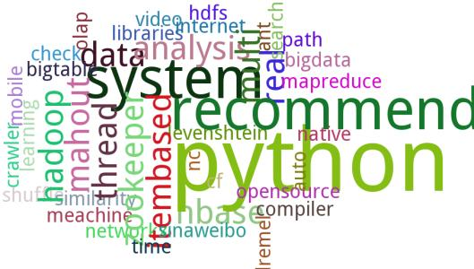
Modern Machine Learning
ImageNet Challenge
Language Model
Recommender System
Data size
  1.2M image, 136GB size
Model size
  ResNet uses 2.3M parameters
Data size
  1 billion word benchmark, 2016
Model size
  1.04 billion parameters, 2016
Data size
  1PB data, baidu
Model size
  1000 billion parameters, Baidu
Distributed Machine Learning (DML) is a must

Slide 12
DML Architecture
ML Application
Financial technology, computer vision, language processing…
ML Algorithm
Deep learning, Deep&Wide learning, reinforcement learning…
ML(DML) Framework
Tensorflow, Caffe, MxNet, Ray, Paddle…
DML Infrastructure
Our Focus: An adaptor between RDMA and DML algorithm…
MPI, Nvidia NCCL, Alibaba Pai, …
ML Chips, RDMA
CPU, GPU, TPU, FPGA, DianNao…

Slide 13
Towards Autonomous IT Operations through Machine Learning
Dan Pei
Notes:
Thanks for the introduction.
It's my great honor to be here.
Since my Ph.D. years, I have been working on IT operations. In this past 5 years, I have gradually used more and more machine learning in my research.
So today I will share what I have learned in this journey and some case studies.
First, some background.

Slide 14
IT Operations: one of the technology foundations of the increasingly digitalized world
Notes:
We are living in an increasing digitalized world, and IT operations are important techniques for ensuring the digital world run reliably, efficiently and securey.
How are IT operations doing in the real world?

Slide 15

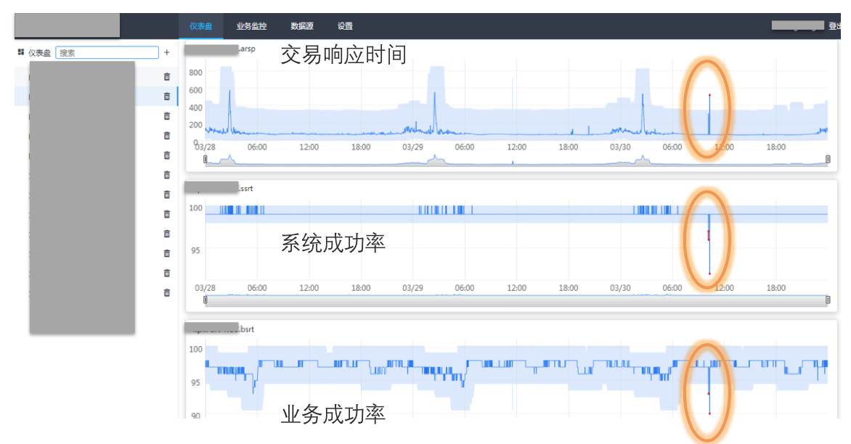
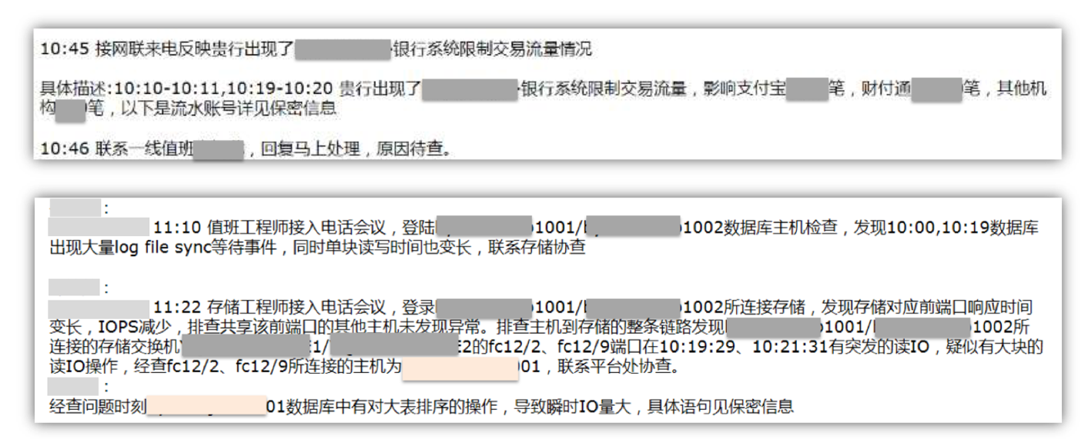
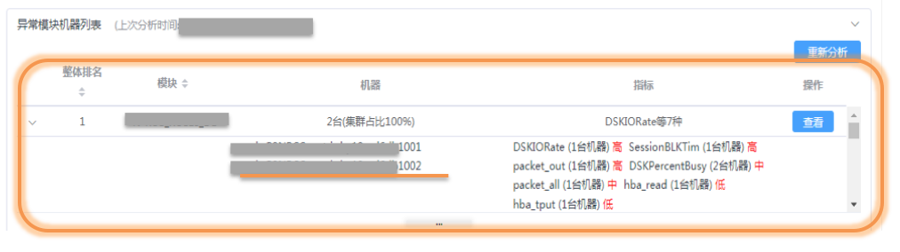
A real case in a global top bank: labor-intensive, stressful, and ineffective
Replayed the data with our ML-based failure discovery and localization algorithms
Manual
10:20 large number of transaction failures
10:21 automatically detected the failure
10:23 automatically localized the failure
Realized there was a failure when customers called
30 Engineers involved
Failure mitigation time reduced by 90%
10:45
Failure localized
11:10
Failure discovery: 25mins after the failure happened
Failure localization: 25mins after failure discovery

Slide 16
Autonomous IT Operations: use machine learning to automatically deal with all causes of changes to IT systems
Software & hardware failures
Automatic Healing
Software changes
Autonomous software deployment
Automatic Elastic Resource Allocation
Malicious attacks
Autonomous Defense
Traffic load changes

Slide 17
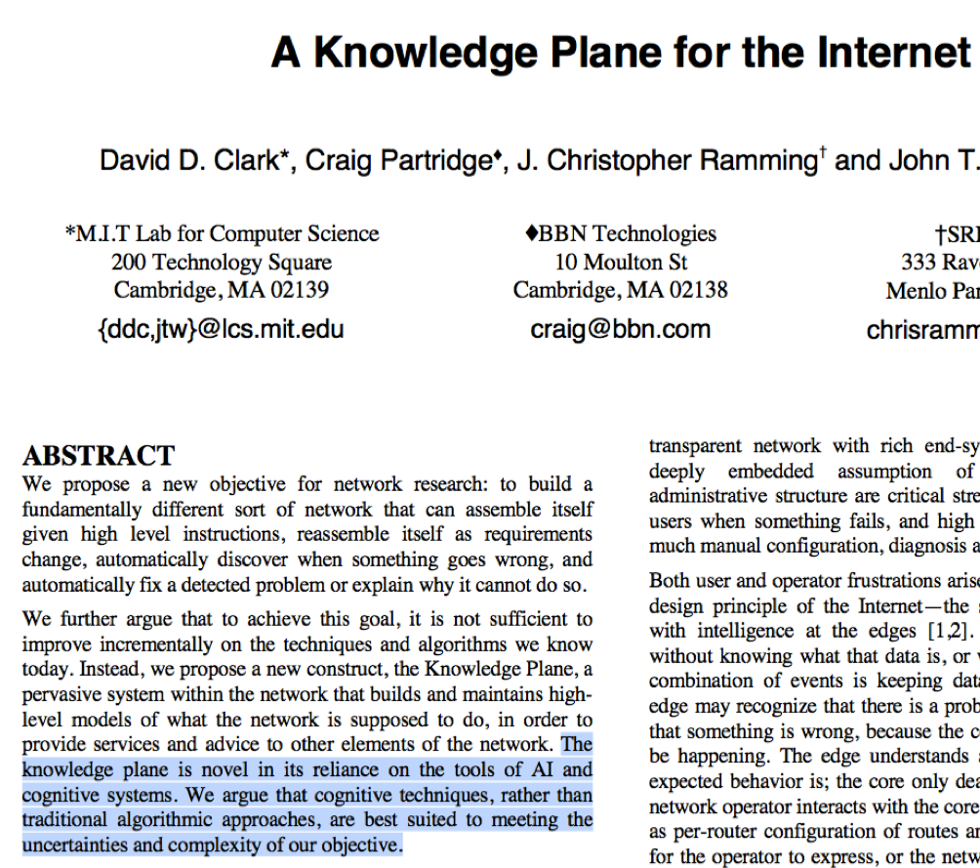
“In addition to control plane and data plane, Internet needs an AI-based knowledge plane”
--- Dave Clark in his SIGCOMM 2003 paper.

Slide 18
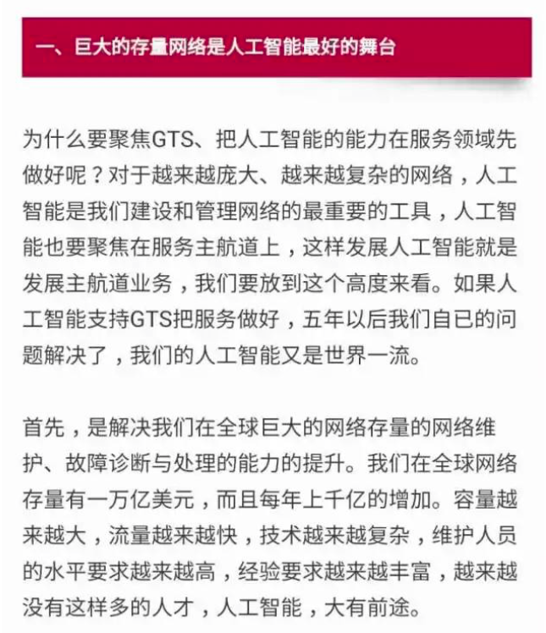
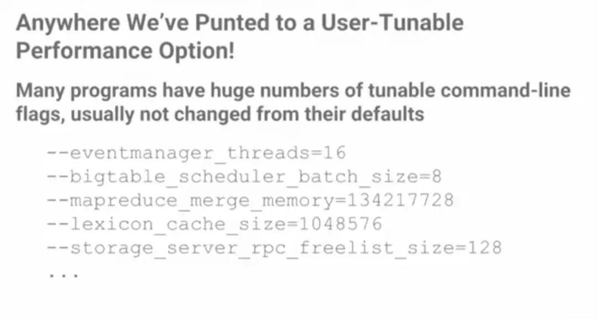
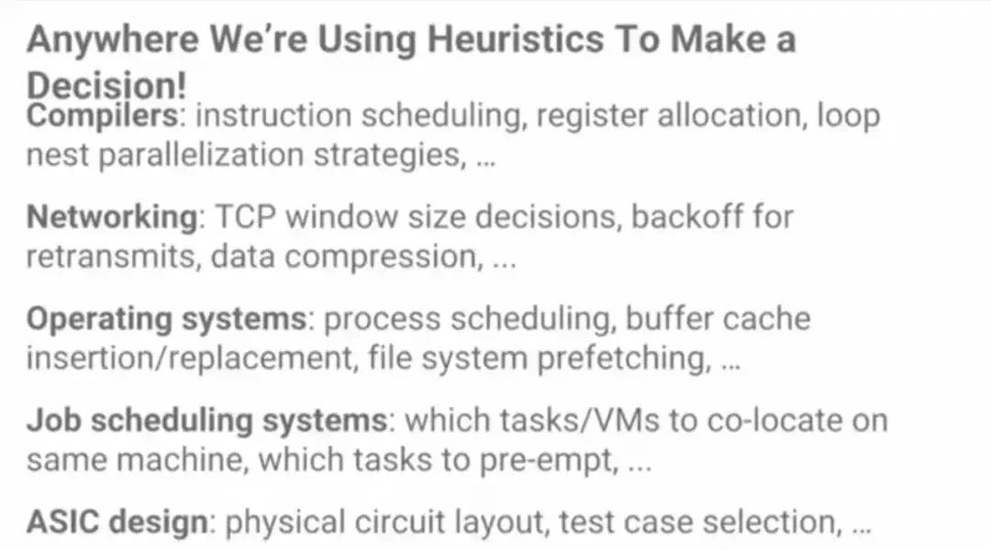
Industry opinions on machine learning’s role in IT operations
Huawei CEO Ren Zhengfei:
Jeff Dean Head of AI, Google:
“AI is the most important tool for managing the networks.
“We can (use AI to) improve everywhere in a system that have tunable parameters or heuristics”

Slide 19
Some IT Operations Companies
All collect IT Operations data and offer AIOps (AI for IT Operations) productions
Valued at 46 Billion USD
Valued at 17 Billion USD
Valued at 6 Billion USD
Valued at 12 Billion USD
Valued at 28 Billion USD

Slide 20
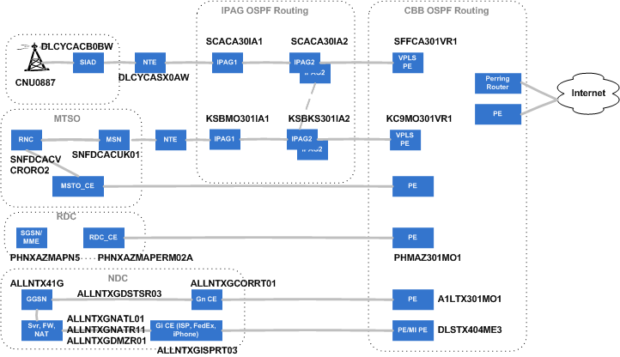

Complex Edge Networks
Notes:
It takes an end device a very complex route to reach the data centers.

Slide 21
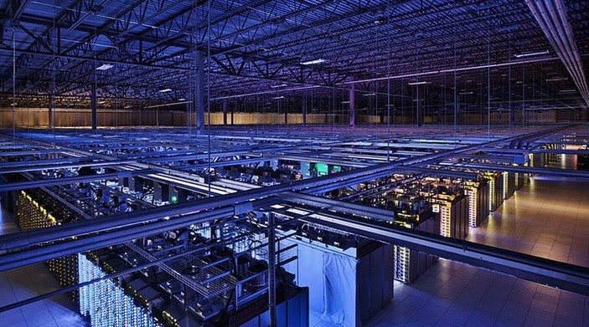
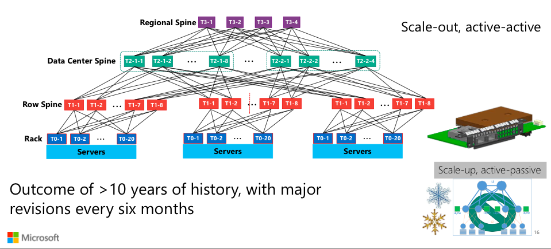
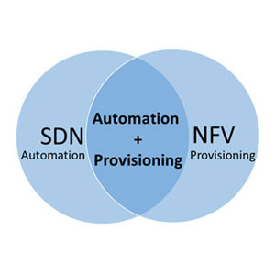
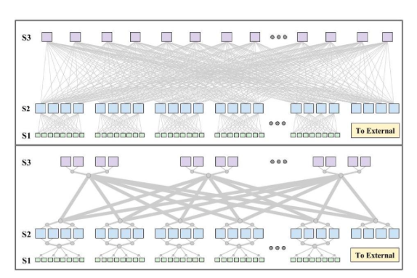
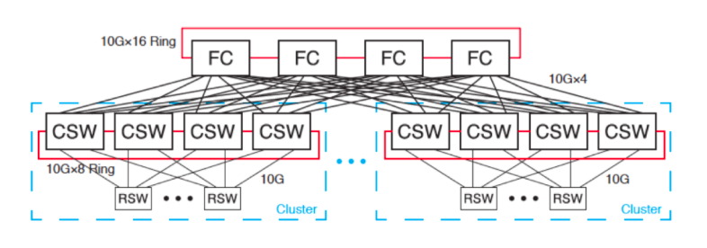
Complex and Evolving Data Center Hardwares
10s of thousands of servers
Frequent topology changes

Slide 22
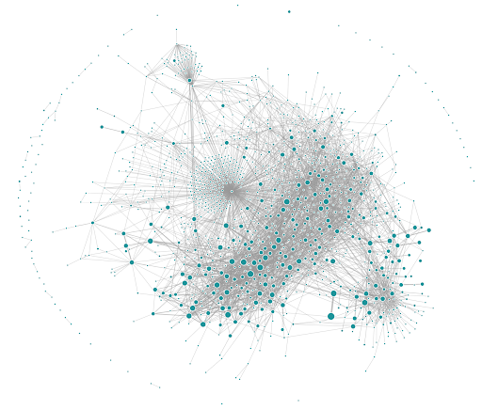
Complex Software Module Dependences
Application dependency at Uber in 2018
Notes:
Baidu: 2 万个

Slide 23
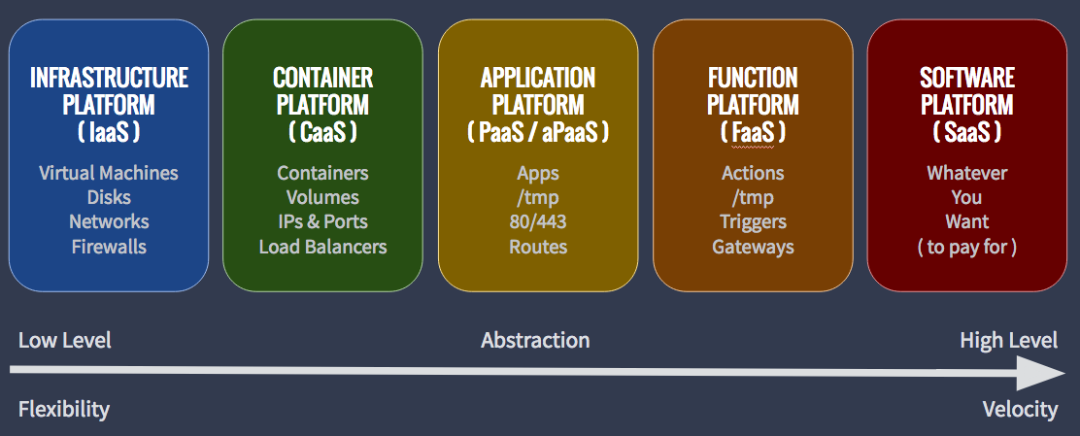
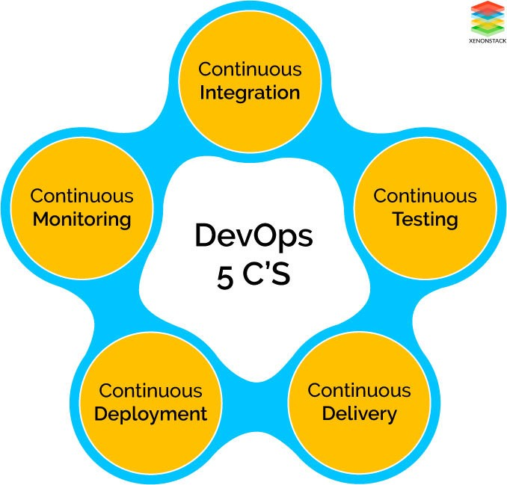
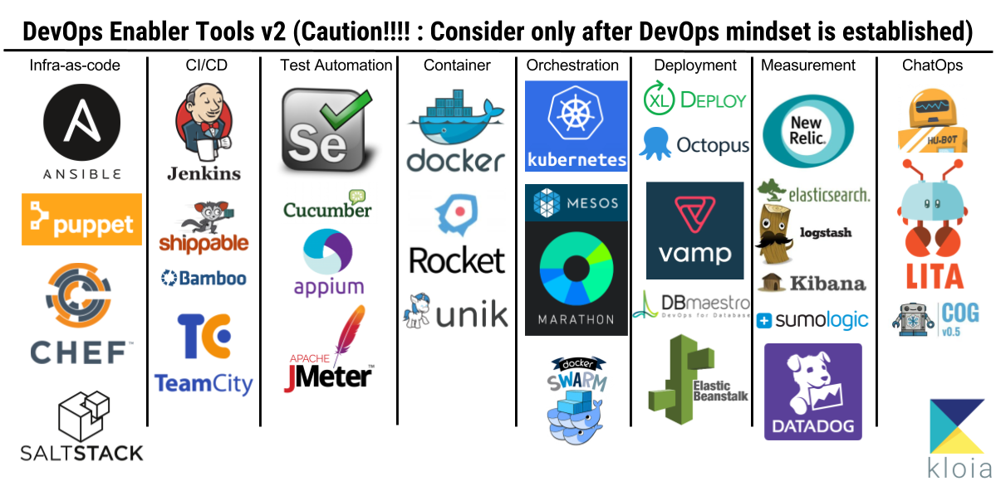
Evolving Techniques Enable Frequent Software Changes, Which Are Major Causes of Failures
10s of thousands software/config changes per day in a large company
DevOps
Continuous Integration/Continuous Delivery

Slide 24

Alert 2
Alert 4
Alert 6
Alert 8
Large-scale, complex, cross-layer, dynamic system’s digitalized running status → monitoring data
Anomaly Propagation Graph
Alert 9
Alert 1
Alert 3
Alert 5
Alert 7
Source
User
Experience
Metrics and Logs
KPI 3
KPI 7
KPI 6
KPI 8
User KPI3
2
KPI 9
User KPI1
KPI 2
KPI 4
4
5
User KPI2
KPI 5
7
KPI 1
1
3
KPI 10
6
Source
Application Dependency
App 1
App 2
App 7
App 9
App 4
access
access
App 3
App 5
App 8
App 6
Deployment
Physical Network Topology
phone
Desktop
Cellular
AP
Physical Network Topology

Slide 25
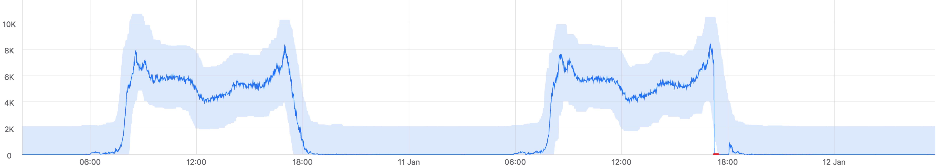
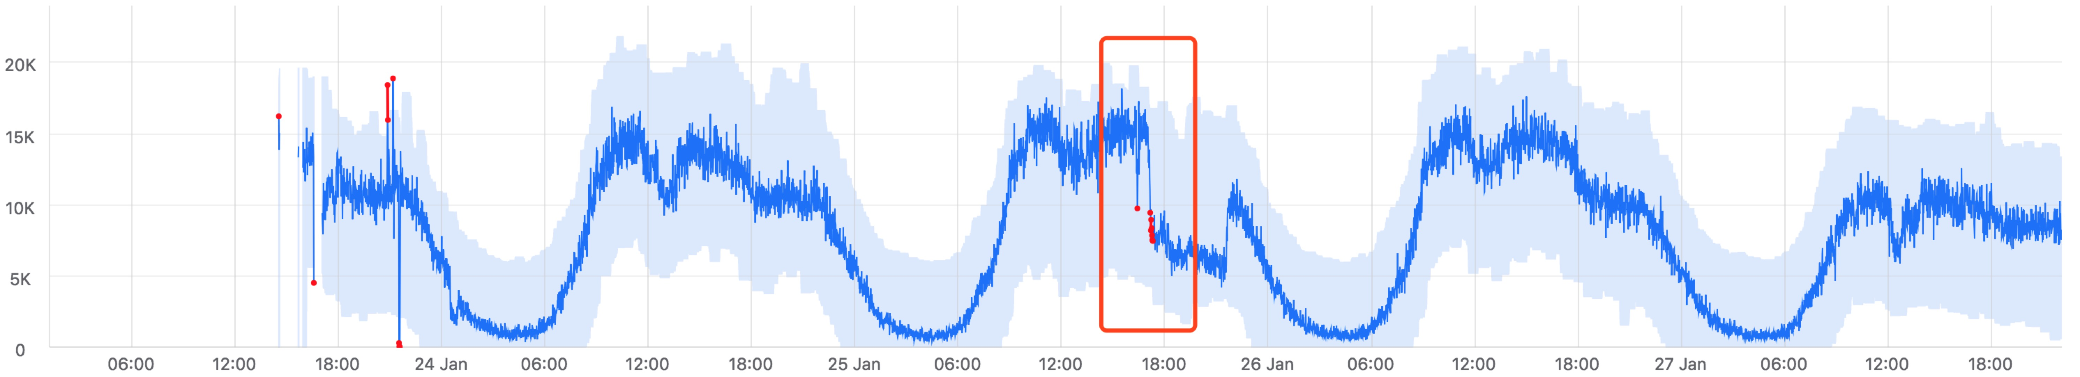
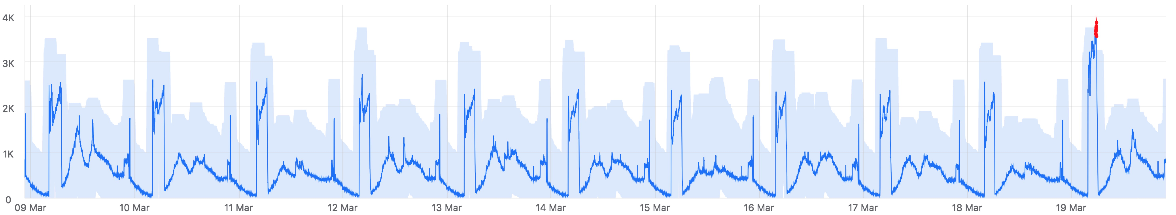
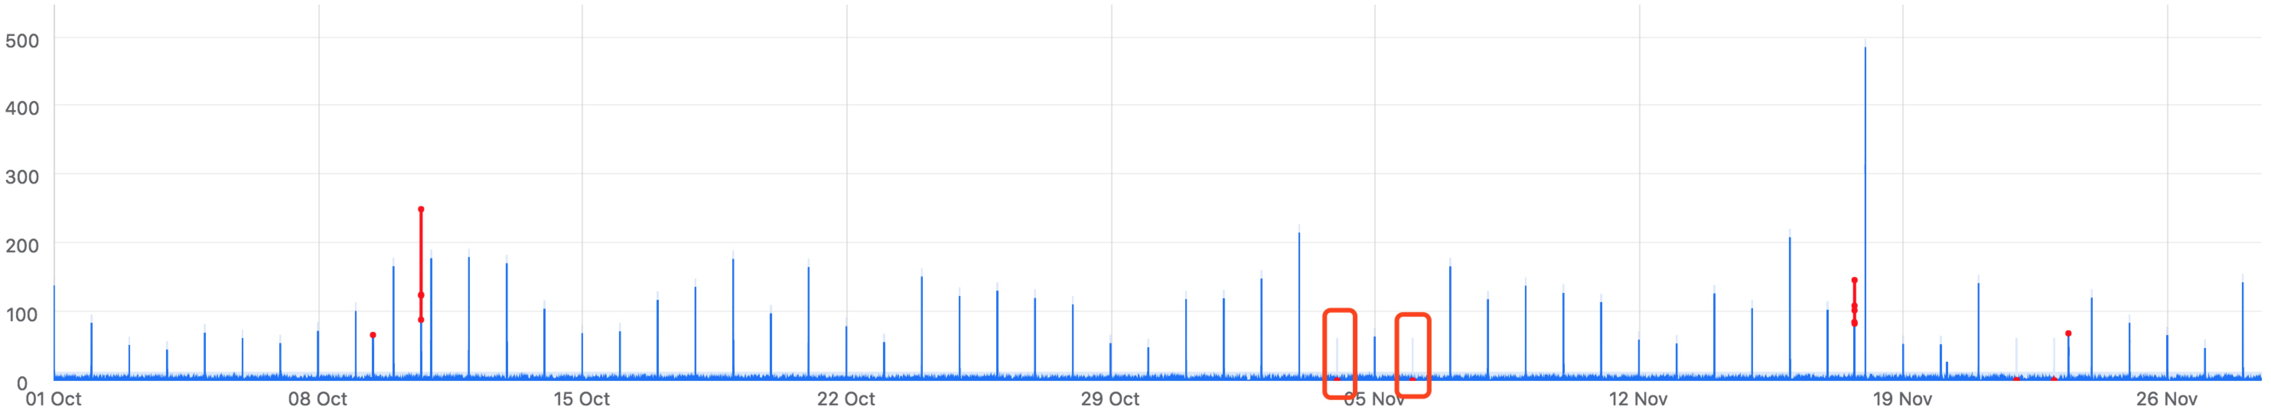
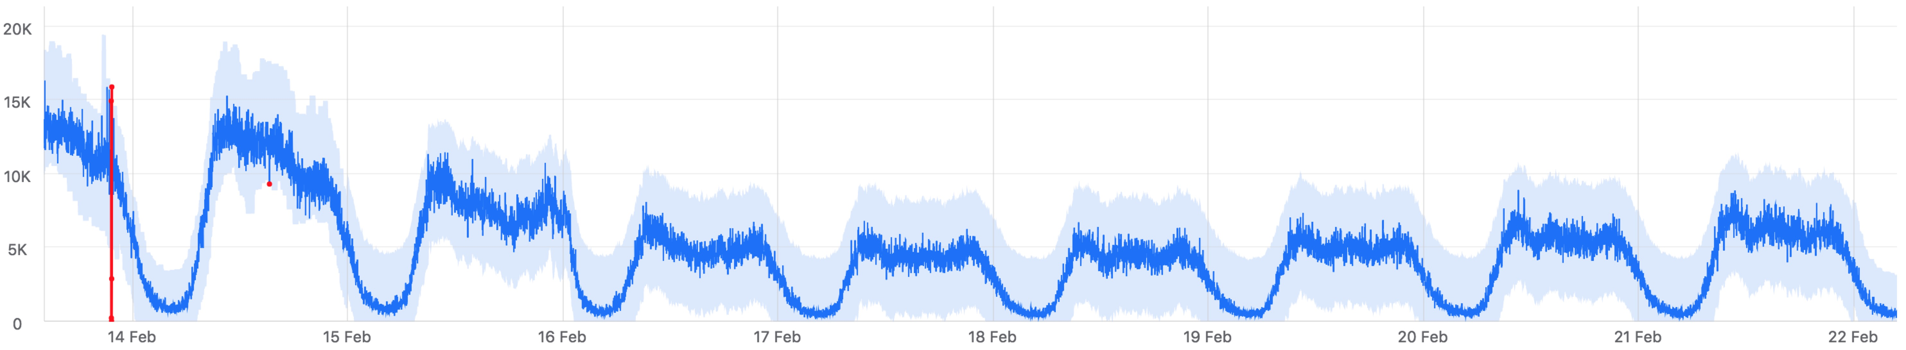
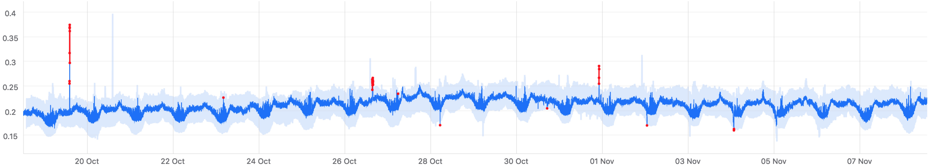
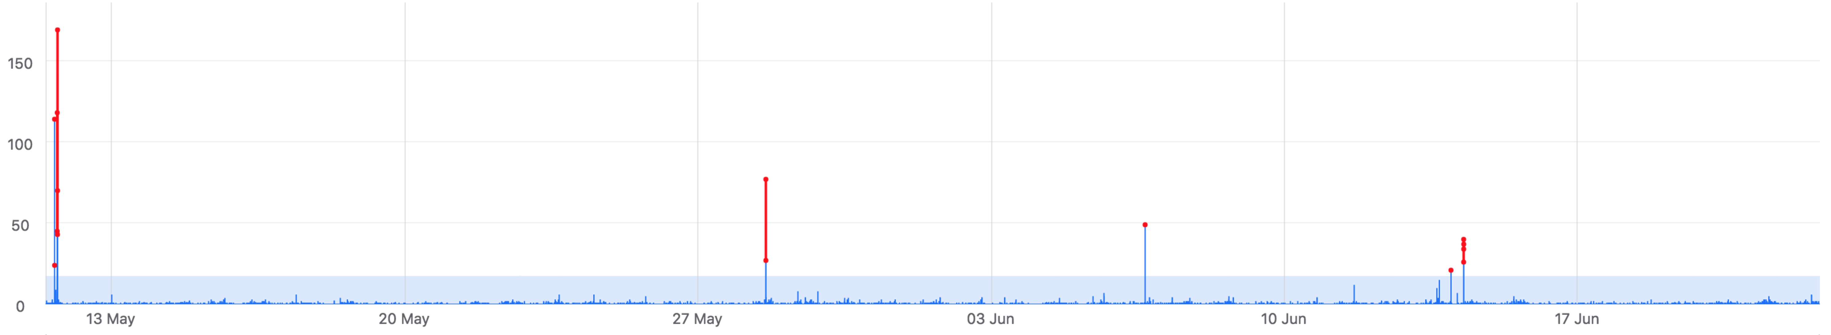
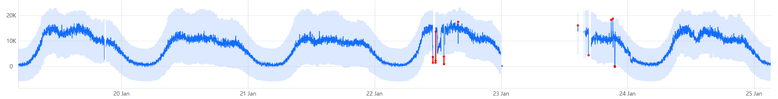
Time series algorithms are needed to parse and make sense of metrics data
Diverse Metrics and Their Diverse Anomalies
（1）Seasonal metrics
（5）Detect too rapid a change
（2）Periodicity shift
（6）Detect the lack of seasonality.
（3）Adopt to holidays
（7）Adapt to trend change
（4）Identify variable metrics and obtain extreme threshold
（8）Robust against data loss or interruption
Notes:
Vital signs to discover anomalies. 10s of millions of metrics collected. But metric patterns and their anomalies are very diverse, hard to manually analyze. Time series algorithms are needed.

Slide 26
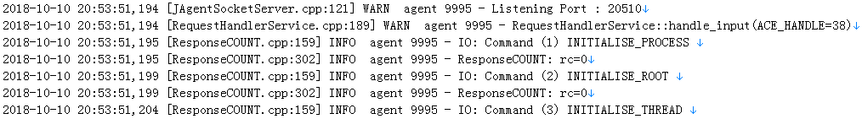
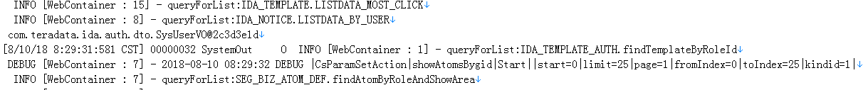
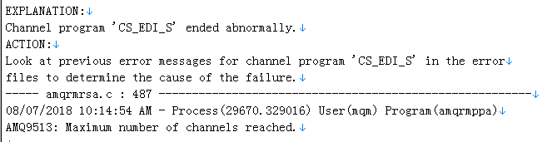
Hundreds of types of logs in a typical enterprise
NLP techniques are needed to parse and make sense of the log data
Application logs
Network Logs
Switch
Router
Load Balancer
…
System logs
UNIX
Linux
Windows
JVM
…
Security Device Logs
Firewall
IDS
IPS
WAF
…
Environment Logs
Power
A/C
…
Middleware Logs
DB logs
Message Queue
Tuxedo
Weblogic
Tomcat
Apache
…
Oracle
DB2
Informix
SQLServer
MySQL
…
Notes:
once discover some anomalies in the metrics, logs can help us further pinpoint the root cause.
But it takes some NLP techniques to process

Slide 27




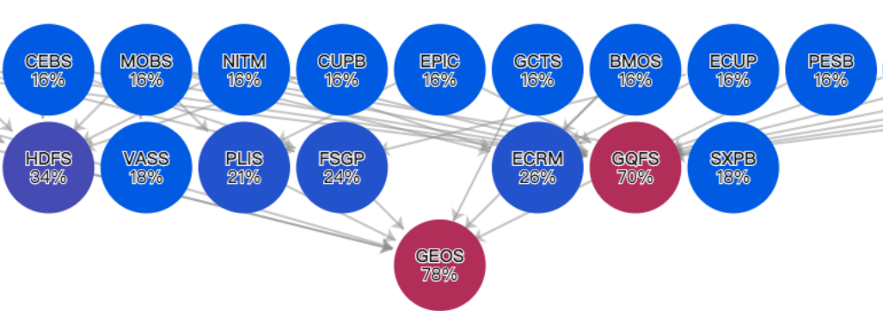
Software Module Invocation Traces
Invocation trace: 10s~100s of module-to-module invocations for a unique transaction
  One module failure can manifest itself cross-invocation and cross-transaction
DB
gateway
8,399
USER
gateway
gateway
DB
CPU
7,028
I/O
DB
Table space
session
……
gateway
DB
Notes:
[Can be skipped if short of time.]
Hard to analyze manually. Graph analysis.

Slide 28
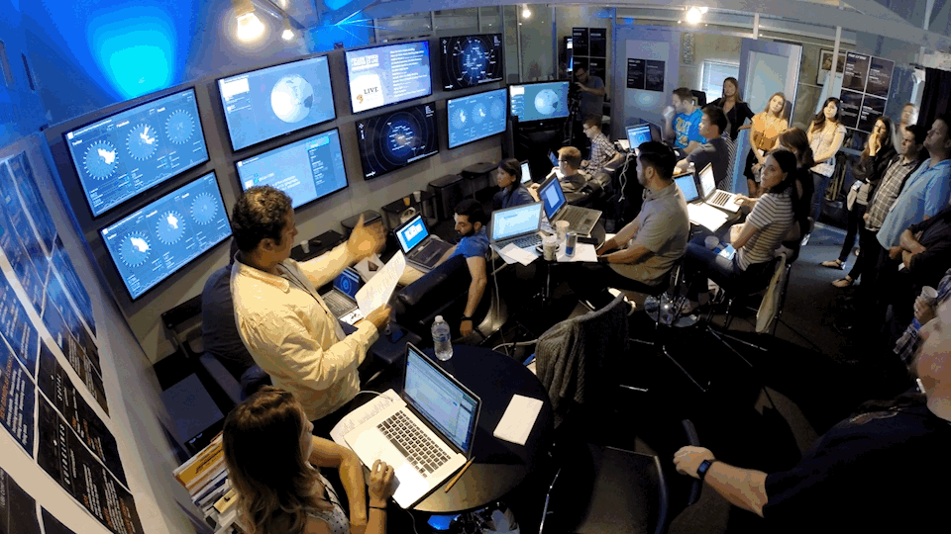
TeraBytes of Ops Data per Day Overwhelm Ops Engineers
Each offers some clues, but due to complexity and volume,
each is hard to manually analyze, let alone collectively analyze all data sources.
Software module
Invocation Traces
Application Performance
Monitoring
Metrics
Probing
Logs
Alerts
Configs
Free texts
（tickets, change, manual）
Traffic dump
Social Media
Notes:
So many data that it appears that you can find clues for any problems.
Too many data to process efficiently and rapidly.

Slide 29

We have no choice but relying on Artificial Intelligence to extract useful signals out of the Big Ops Data which have every low signal-to-noise ratio.
We have no choice but relying on Artificial Intelligence to incorporate (expert or mined) knowledge (topology, call graph, causal relationship) to correlate signals.
Volume
Velocity
Variety
Value

Slide 30



Towards Autonomous IT Operations
Manual and few data
Lots of data but manual decision
Autonomous
Spaceship Avalon: 5000 passengers and 258 crew members in hibernation. Flying towards Planet Homestead II, 120-year trip.

Slide 31

Levels of AIOps
HUMAN
RoadMap of AIOps
AI/MACHINE
LEVEL 0
LEVEL 1
LEVEL 2
LEVEL 3
LEVEL 4
LEVEL 5
trouble analysis
partial trouble analysis
manual decision in special scene
manual intervention in special scene
traditional Ops
trouble disposal
partial trouble mitigation
Autonomous
operations
Automatic
decision
Automatic
decision
Root cause
analysis
Automatic Action
Automatic Action
Anomaly detection
Manual
Action
Automatic scheduling
EYES TEMP OFF
EYES OFF
EYES OFF
EYES ON
EYES TEMP OFF
MIND TEMP OFF
MIND TEMP OFF
MIND TEMP OFF
HUMAN OFF
HANDS TEMP OFF
HANDS OFF
HANDS OFF
standard environment
complex environment
complex environment

Slide 32
Brain for IT Operations
Action
Automated Software using hard-coded logic
Brain for IT Operations
Decision Algorithm（using realtime monitoring data and knowledge graph to make decision)
Failure Discovery
Failure Localization
Failure Mitigation
Failure Avoidance
KPI Anomaly Detection
multi-KPI Anomaly Detection
Anomalous Machine Localization
mutidimensional KPI anomaly localization
automatic deployment rollback
Failover evaluation
bottleneck report
capacity prediction
Log Anomaly Detection
Trace Anomaly Detection
Change-induced Anomaly Detection
Trace Anomaly Localization
Elastic Sizing
Rate Limiting
Failure prediction
change risk evaluation
……
……
……
……
Decision
Ops Knowledge graph (Mining historical Ops data to construct varies “profiles”)
physical topology
app
topology
fault
propagation
ticket profiles
mitigation
profiles
script profile
app
profile
metric profile
log pattern profile
failure omen profile
capacity profile
bottleneck
profile
trace profile
app health profile
special data profile
data quality profile
…
Unified Ops Data Platform
Monitoring
data sources
logs, network, middleware, database, storage, server, application
Notes:
What Gartner offers is an abstract view, what I propose here is more concrete landscape.

Slide 33
Various ML algorithms used in AIOps
State-of-art Machine Learning Algorithms are applied to solve the unique challenges in AIOps:
  Deep Neural Networks for Time Series or Sequence
  Deep Generative Model (VAE, GAN)
  Deep Reinforcement Learning
  Natural Language Processing
  Causal Inference
Unsupervised Reinforcement Learning Supervised but with labels
Semi-supervised Learning Transfer Learning
Automated Software using hard-coded logic
Brain for IT Operations
KDE，DBSCAN
Learning to Rank
Decision Algorithm（using realtime monitoring data and knowledge graph to make decision)
Failure Discovery
Failure Localization
Failure Mitigation
Failure Avoidance
VAE DBSCAN DTW RLF
Self-training Transfer Learning
VAE
E2-UCB
EVT
Decision Tree
bottleneck report
LSTM
capacity prediction
KPI Anomaly Detection
multi-KPI Anomaly Detection
Anomalous Machine Localization
mutidimensional KPI anomaly localization
automatic deployment rollback
Failover evaluation
DRL
NLP LSTM DBSCAN
Log Anomaly Detection
Trace Anomaly Detection
Change-induced Anomaly Detection
Trace Anomaly Localization
Elastic Sizing
Rate Limiting
Failure prediction
change risk evaluation
SST, DiD
GMVAE
DRL
DRL
……
……
……
Random Forest
……
Ops Knowledge graph (Mining historical Ops data to construct varies “profiles”)
physical topology
app
topology
Association Mining –KPI correlation
Fluxation Correlation Causal Inference
Random Forest XGBoot
DBSCAN
fault
propagation
ticket profiles
mitigation
profiles
script profile
app
profile
metric profile
LCS^2
log pattern profile
failure omen profile
capacity profile
bottleneck
profile
trace profile
app health profile
VAE
special data profile
data quality profile
NLP LSTM DBSCAN
Decision Tree
…
Unified Ops Data Platform
logs, network, middleware, database, storage, server, application
data sources
Notes:
以

Slide 34

















Website:
http://netman.aiops.org
Contact:
Prof. Dan Pei
peidan@tsinghua.edu.cn
Industry Collaborators
Media Coverage
Publications:
100+ of AIOps papers and 20+ issued US Patents. Published in SIGCOMM、WWW、SIGMETRICS、TON、INFOCOM、IMC、CoNEXT etc.
Example project:
time series anomaly detection
IPCCC 2018
INFOCOM 2019
IPCCC 2018
Conditional VAE to detect seasonality-violating anomalies
Adversarial Training +VAE
Semi-supervise learning for fast anomaly detection of new time series
Simple statistical methods
Supervised Ensemble learning
Unsupervised Learning (VAE)
Active Learning
Clustering-based transfer learning for millions of KPIs
Transfer Learning for concept drift
INFOCOM 2012
IMC 2015
WWW2018
INFOCOM 2019
IWQOS 2018
ISSRE 2018
Best Paper

Slide 35


AIOps Challenge Algorithm Competitions
Datasets: https://github.com/netmanaiops
2018 AIOps Challenge: time series anomaly detection. Published labeled data from 5 Internet companies. More than 50 teams participated. Papers based on these data were published in KDD, IWQoS, etc.
Data Downloadable @ https://github.com/NetManAIOps/KPI-Anomaly-Detection
2019 AIOps Challenge: multi-attribute time series anomaly localization. Published data from an Internet company. More than 60 teams participated.
Data Downloadable @ https://github.com/NetManAIOps/MultiDimension-Localization
2020 AIOps Challenge: Anomaly detection and localization in a microservice system. Published data from a telecom company. More than 100 teams participated.
Data Downloadable @ https://github.com/NetManAIOps/AIOps-Challenge-2020-Data
2021 AIOps Challenge: Anomaly detection and localization in banking systems. To be published data from two banks. More than 200 teams participated

Slide 36
About the Instructor
Tenured Associate Professor.
UCLA Ph.D. Best Ph.D. Thesis Award in UCLA CS in 2005.
Joined Tsinghua CS Department in December 2012, with Government Endorsement (“ Recruitment Program of Global Talents”)
Homepage: http://netman.aiops.org/~peidan
Previously a Principal Researcher at AT&T Research, a co-founder and founding CEO of a mobile health company in Beijing, before joining Tsinghua.
Supervised interns from CMU, Cornell, Princeton, UCLA, GaTech, Michigan, Northwestern etc. Now @ Google, MSR, IBM, Purdue, Northeastern, HKUST
ACM/IEEE Senior Member

Slide 37

Advanced Network Management (course#: 80240663)
a.k.a.
AIOps: AI for IT Operations
http://course.aiops.org

Slide 38

Q & A
Notes:
38

