Slide 1
Data Mining
Association Analysis: Basic Concepts and Algorithms
Lecture Notes for Chapter 6
Introduction to Data Mining
by
Tan, Steinbach, Kumar
© Tan,Steinbach, Kumar Introduction to Data Mining 4/18/2004 1

Slide 2
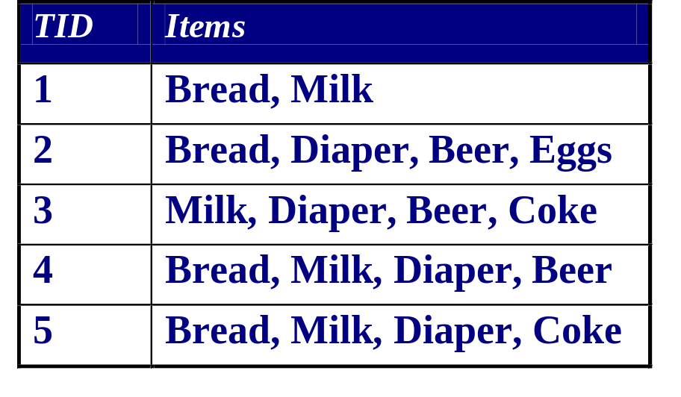
Association Rule Mining
Given a set of transactions, find rules that will predict the occurrence of an item based on the occurrences of other items in the transaction
Market-Basket transactions
Example of Association Rules
{Diaper} → {Beer},
{Milk, Bread} → {Eggs,Coke},
{Beer, Bread} → {Milk},
Implication means co-occurrence, not causality!

Slide 3
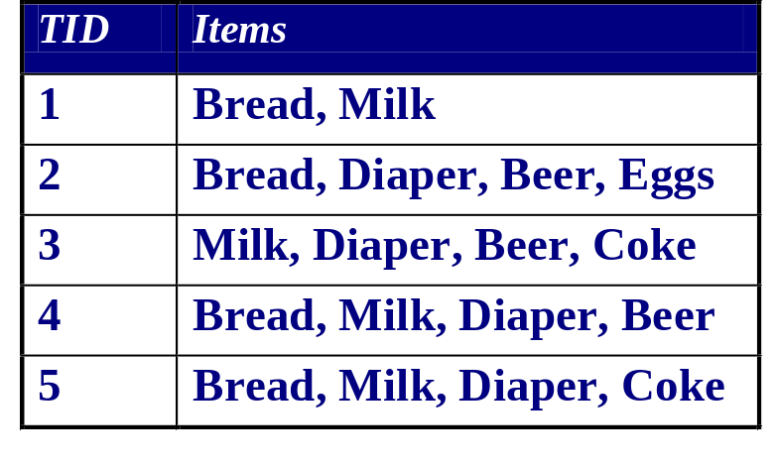
Definition: Frequent Itemset
Itemset
  A collection of one or more items
    Example: {Milk, Bread, Diaper}
  k-itemset
    An itemset that contains k items
Support count (σ)
  Frequency of occurrence of an itemset
  E.g. σ({Milk, Bread,Diaper}) = 2
Support
  Fraction of transactions that contain an itemset
  E.g. s({Milk, Bread, Diaper}) = 2/5
Frequent Itemset
  An itemset whose support is greater than or equal to a minsup threshold

Slide 4

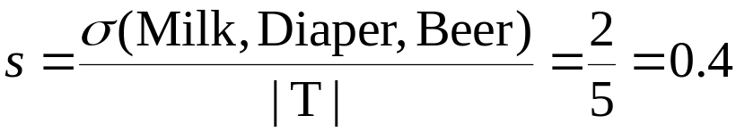
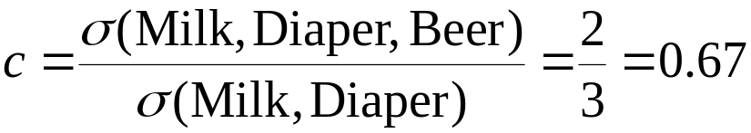
Definition: Association Rule
Association Rule
  An implication expression of the form X → Y, where X and Y are itemsets
  Example:
  {Milk, Diaper} → {Beer}
Rule Evaluation Metrics
  Support (s)
    Fraction of transactions that contain both X and Y
  Confidence (c)
    Measures how often items in Y
    appear in transactions that
    contain X
Example:

Slide 5
Association Rule Mining Task
Given a set of transactions T, the goal of association rule mining is to find all rules having
  support ≥ minsup threshold
  confidence ≥ minconf threshold
Brute-force approach:
  List all possible association rules
  Compute the support and confidence for each rule
  Prune rules that fail the minsup and minconf thresholds
  ⇒ Computationally prohibitive!

Slide 6
Mining Association Rules
Example of Rules:
{Milk,Diaper} → {Beer} (s=0.4, c=0.67)
{Milk,Beer} → {Diaper} (s=0.4, c=1.0)
{Diaper,Beer} → {Milk} (s=0.4, c=0.67)
{Beer} → {Milk,Diaper} (s=0.4, c=0.67)
{Diaper} → {Milk,Beer} (s=0.4, c=0.5)
{Milk} → {Diaper,Beer} (s=0.4, c=0.5)
Observations:
All the above rules are binary partitions of the same itemset:
{Milk, Diaper, Beer}
Rules originating from the same itemset have identical support but
can have different confidence
Thus, we may decouple the support and confidence requirements

Slide 7
Mining Association Rules
Two-step approach:
  Frequent Itemset Generation
    Generate all itemsets whose support ≥ minsup
  Rule Generation
    Generate high confidence rules from each frequent itemset, where each rule is a binary partitioning of a frequent itemset
Frequent itemset generation is still computationally expensive

Slide 8
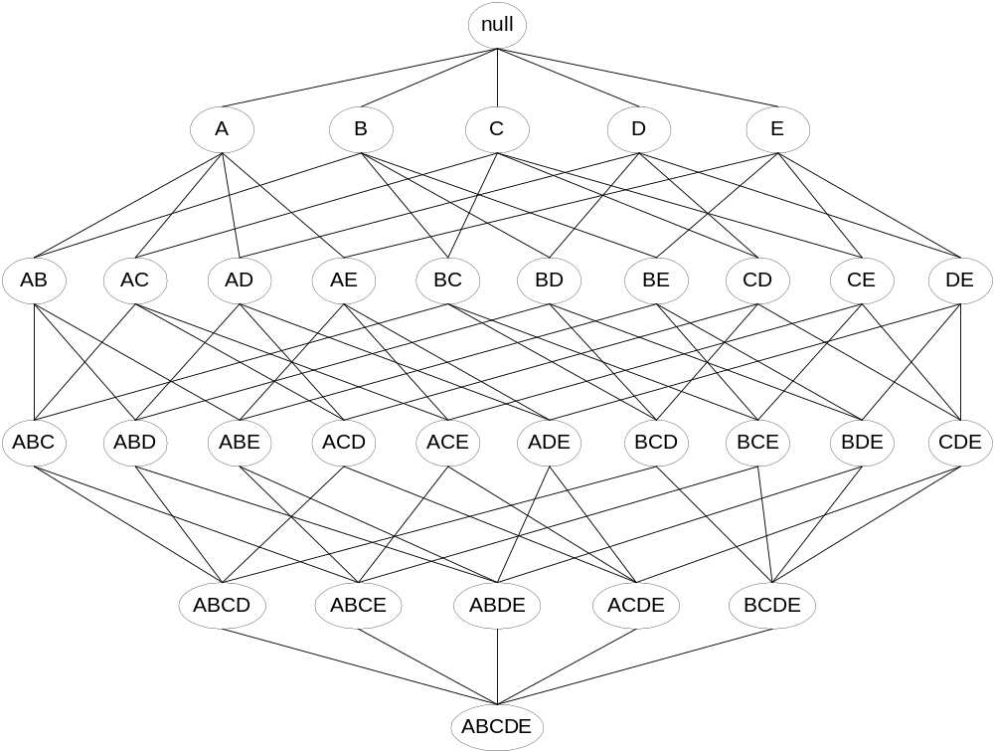
Frequent Itemset Generation
Given d items, there are 2^{d} possible candidate itemsets

Slide 9
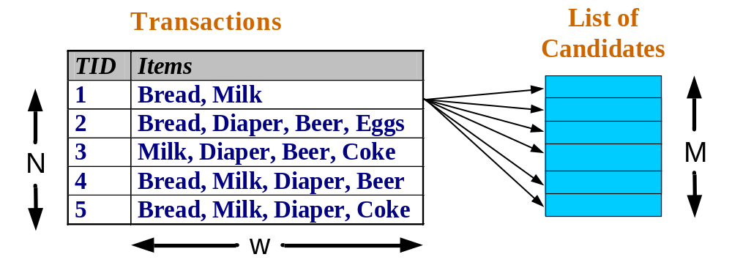
Frequent Itemset Generation
Brute-force approach:
  Each itemset in the lattice is a candidate frequent itemset
  Count the support of each candidate by scanning the database
  Match each transaction against every candidate
  Complexity ~ O(NMw) => Expensive since M = 2^{d} !!!

Slide 10
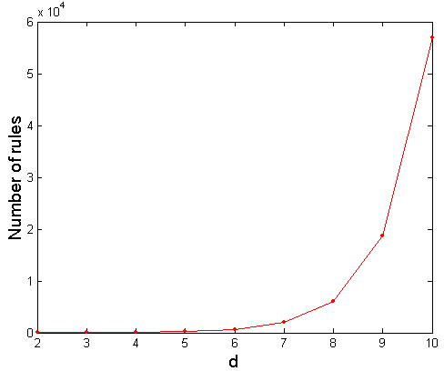
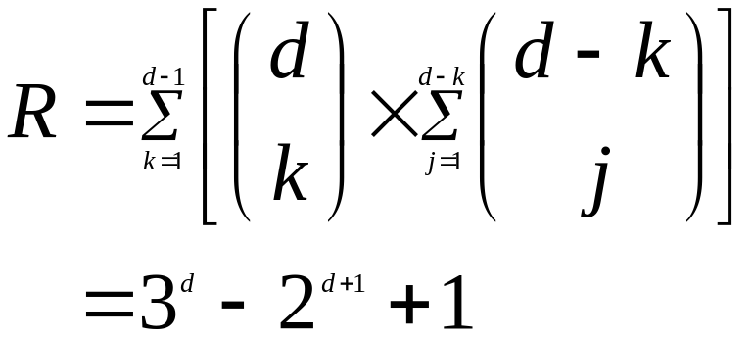
Computational Complexity
Given d unique items:
  Total number of itemsets = 2^{d}
  Total number of possible association rules:
{..} -> {..}
If d=6, R = 602 rules

Slide 11
Frequent Itemset Generation Strategies
Reduce the number of candidates (M)
  Complete search: M=2^{d}
  Use pruning techniques to reduce M
Reduce the number of transactions (N)
  Reduce size of N as the size of itemset increases
  Used by DHP and vertical-based mining algorithms
Reduce the number of comparisons (NM)
  Use efficient data structures to store the candidates or transactions
  No need to match every candidate against every transaction

Slide 12
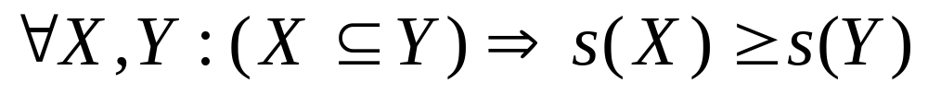
Reducing Number of Candidates
Apriori principle:
  If an itemset is frequent, then all of its subsets must also be frequent
Apriori principle holds due to the following property of the support measure:
  Support of an itemset never exceeds the support of its subsets
  This is known as the anti-monotone property of support

Slide 13
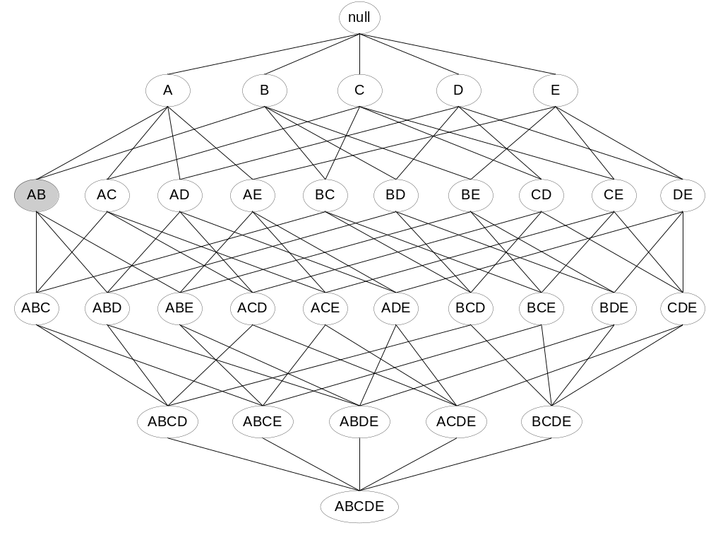
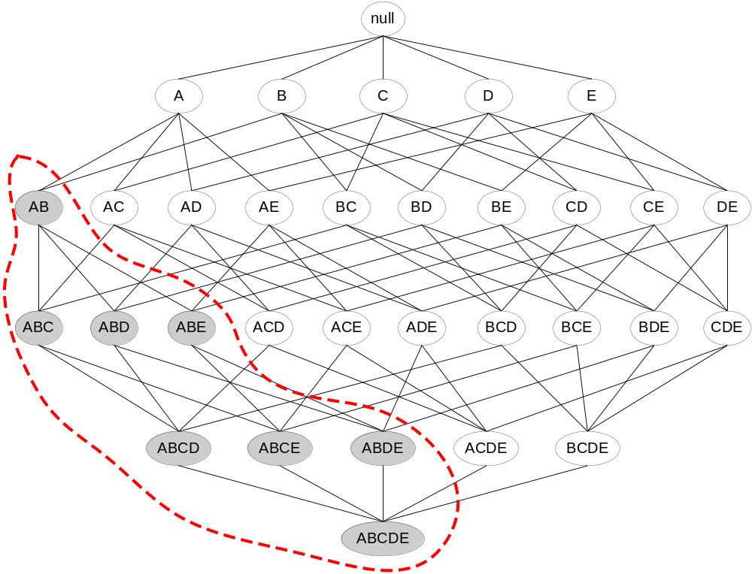
Illustrating Apriori Principle
Found to be Infrequent
Pruned supersets

Slide 14
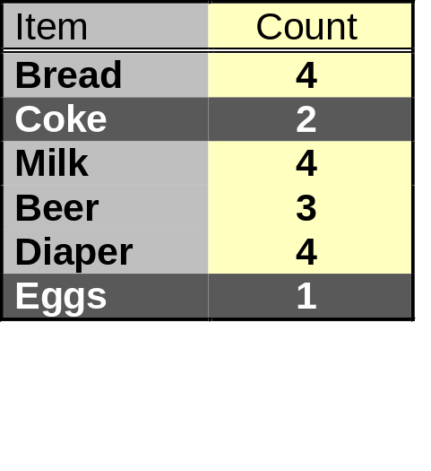
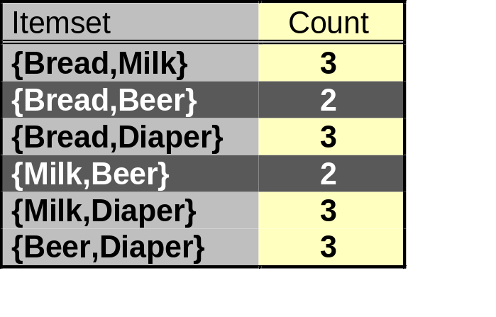
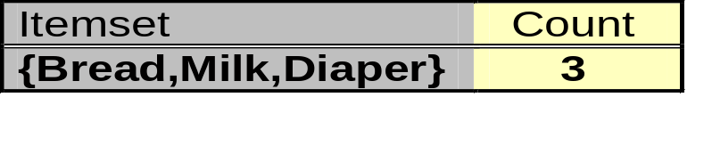
Illustrating Apriori Principle
Items (1-itemsets)
Pairs (2-itemsets)
(No need to generate
candidates involving Coke
or Eggs)
Minimum Support = 3
Triplets (3-itemsets)
If every subset is considered,
⁶C₁ + ⁶C₂ + ⁶C₃ = 41
With support-based pruning,
6 + 6 + 1 = 13

Slide 15
Apriori Algorithm
Method:
  Let k=1
  Generate frequent itemsets of length 1
  Repeat until no new frequent itemsets are identified
    Generate length (k+1) candidate itemsets from length k frequent itemsets
    Prune candidate itemsets containing subsets of length k that are infrequent
    Count the support of each candidate by scanning the DB
    Eliminate candidates that are infrequent, leaving only those that are frequent

Slide 16
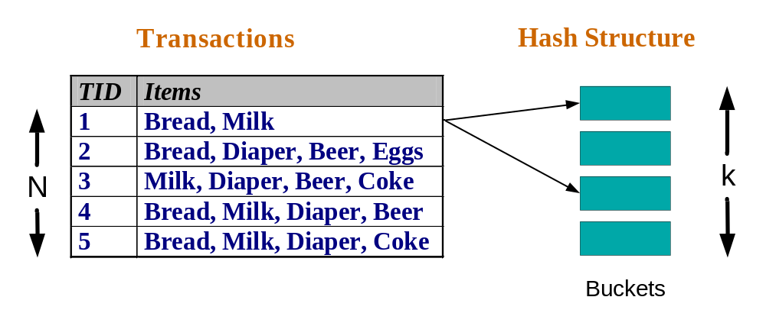
Reducing Number of Comparisons
Candidate counting:
  Scan the database of transactions to determine the support of each candidate itemset
  To reduce the number of comparisons, store the candidates in a hash structure
    Instead of matching each transaction against every candidate, match it against candidates contained in the hashed buckets

Slide 17
Generate Hash Tree
Suppose you have 15 candidate itemsets of length 3:
{1 4 5}, {1 2 4}, {4 5 7}, {1 2 5}, {4 5 8}, {1 5 9}, {1 3 6}, {2 3 4}, {5 6 7}, {3 4 5}, {3 5 6}, {3 5 7}, {6 8 9}, {3 6 7}, {3 6 8}
You need:
Hash function
Max leaf size: max number of itemsets stored in a leaf node (if number of candidate itemsets exceeds max leaf size, split the node)
Hash function
2 3 4
5 6 7
3,6,9
1,4,7
1 4 5
3 4 5
3 5 6
3 5 7
6 8 9
3 6 7
3 6 8
1 3 6
2,5,8
1 2 4
4 5 7
1 2 5
4 5 8
1 5 9

Slide 18
Association Rule Discovery: Hash tree
Hash Function
Candidate Hash Tree
1,4,7
3,6,9
2,5,8
2 3 4
5 6 7
1 4 5
1 3 6
3 4 5
3 5 6
3 6 7
Hash on 1, 4 or 7
3 5 7
3 6 8
1 2 4
1 5 9
6 8 9
1 2 5
4 5 7
4 5 8

Slide 19
Association Rule Discovery: Hash tree
Hash Function
Candidate Hash Tree
1,4,7
3,6,9
2,5,8
2 3 4
5 6 7
1 4 5
1 3 6
3 4 5
3 5 6
3 6 7
Hash on 2, 5 or 8
3 5 7
3 6 8
1 2 4
1 5 9
6 8 9
1 2 5
4 5 7
4 5 8

Slide 20
Association Rule Discovery: Hash tree
Hash Function
Candidate Hash Tree
1,4,7
3,6,9
2,5,8
2 3 4
5 6 7
1 4 5
1 3 6
3 4 5
3 5 6
3 6 7
Hash on 3, 6 or 9
3 5 7
3 6 8
1 2 4
1 5 9
6 8 9
1 2 5
4 5 7
4 5 8

Slide 21
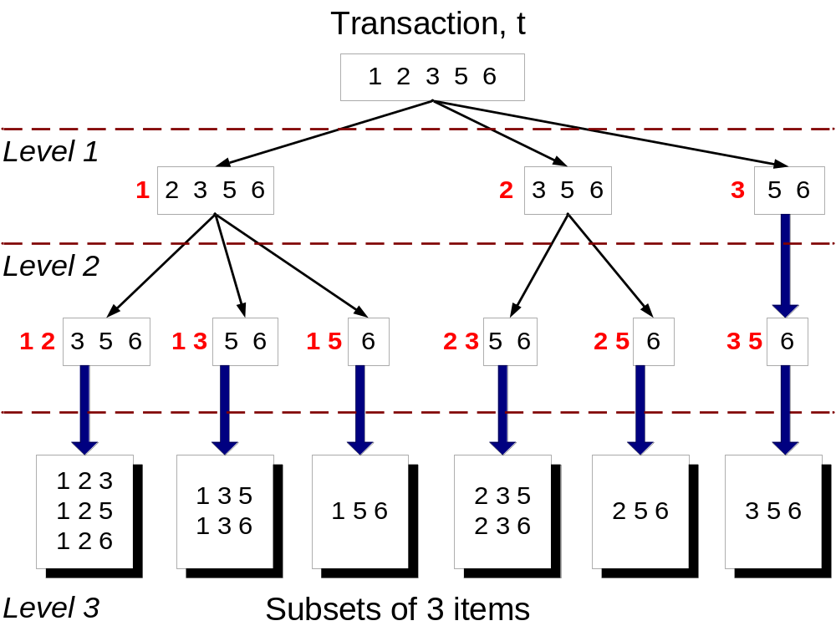
Subset Operation
Given a transaction t, what are the possible subsets of size 3?

Slide 22
Subset Operation Using Hash Tree
1 2 3 5 6
transaction
Hash Function
1 +
2 3 5 6
2 +
3 5 6
1,4,7
3,6,9
3 +
5 6
2,5,8
2 3 4
5 6 7
1 4 5
1 3 6
3 4 5
3 5 6
3 6 7
3 5 7
3 6 8
1 2 4
1 2 5
1 5 9
6 8 9
4 5 7
4 5 8

Slide 23
Subset Operation Using Hash Tree
1 2 3 5 6
transaction
Hash Function
1 +
2 3 5 6
2 +
3 5 6
1,4,7
3,6,9
1 2 +
3 5 6
3 +
5 6
2,5,8
1 3 +
5 6
2 3 4
1 5 +
6
5 6 7
1 4 5
1 3 6
3 4 5
3 5 6
3 6 7
3 5 7
3 6 8
1 2 4
1 2 5
1 5 9
6 8 9
4 5 7
4 5 8

Slide 24
Subset Operation Using Hash Tree
1 2 3 5 6
transaction
Hash Function
1 +
2 3 5 6
2 +
3 5 6
1,4,7
3,6,9
1 2 +
3 5 6
3 +
5 6
2,5,8
1 3 +
5 6
2 3 4
1 5 +
6
5 6 7
1 4 5
1 3 6
3 4 5
3 5 6
3 6 7
3 5 7
3 6 8
1 2 4
1 2 5
1 5 9
6 8 9
4 5 7
4 5 8
Match transaction against 11 out of 15 candidates

Slide 25
Factors Affecting Complexity
Choice of minimum support threshold
  lowering support threshold results in more frequent itemsets
  this may increase number of candidates and max length of frequent itemsets
Dimensionality (number of items) of the data set
  more space is needed to store support count of each item
  if number of frequent items also increases, both computation and I/O costs may also increase
Size of database
  since Apriori makes multiple passes, run time of algorithm may increase with number of transactions
Average transaction width
  transaction width increases with denser data sets
  This may increase max length of frequent itemsets and traversals of hash tree (number of subsets in a transaction increases with its width)

Slide 26
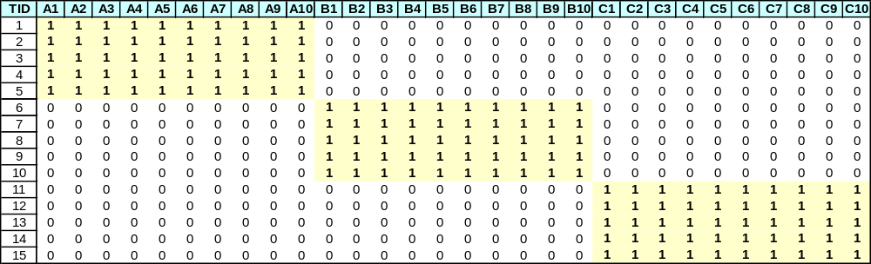
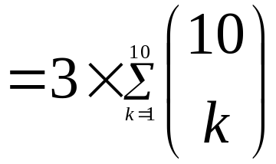
Compact Representation of Frequent Itemsets
Some itemsets are redundant because they have identical support as their supersets
Number of frequent itemsets
Need a compact representation

Slide 27
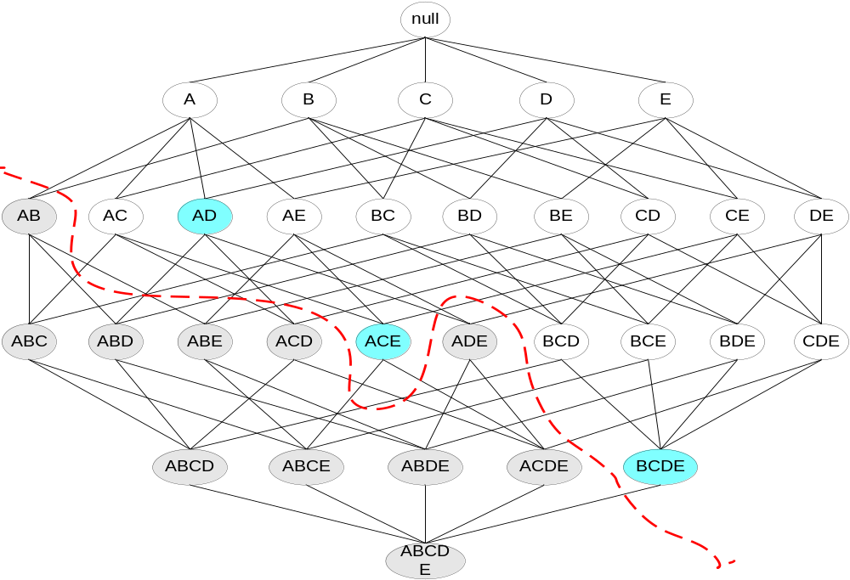
Maximal Frequent Itemset
An itemset is maximal frequent if none of its immediate supersets is frequent
Maximal Itemsets
Infrequent Itemsets
Border

Slide 28
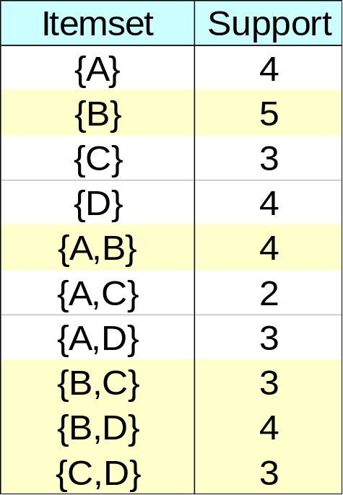
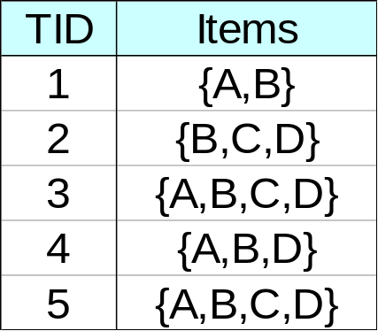
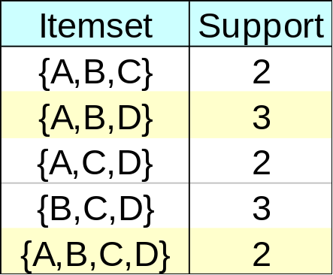
Closed Itemset
An itemset is closed if none of its immediate supersets has the same support as the itemset

Slide 29
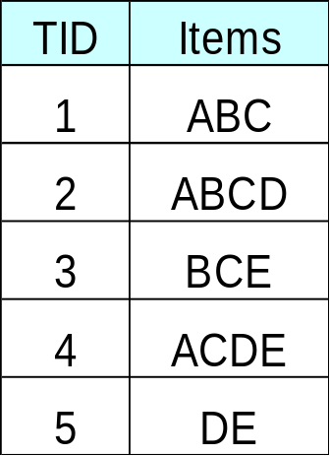
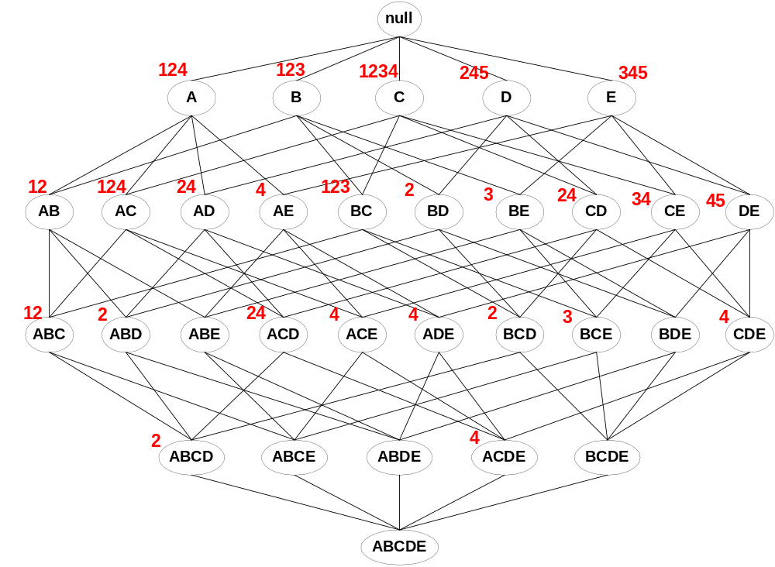
Maximal vs Closed Itemsets
Transaction Ids
Not supported by any transactions

Slide 30
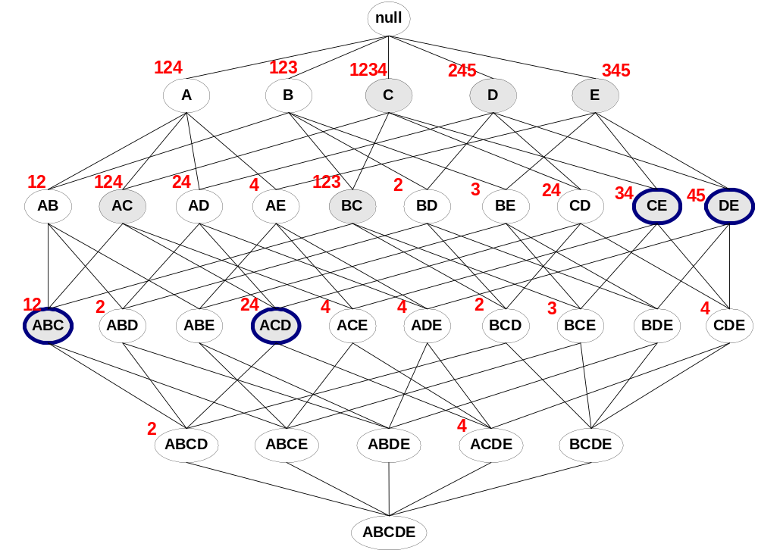
Maximal vs Closed Frequent Itemsets
Minimum support = 2
Closed but not maximal
Closed and maximal
# Closed = 9
# Maximal = 4

Slide 31
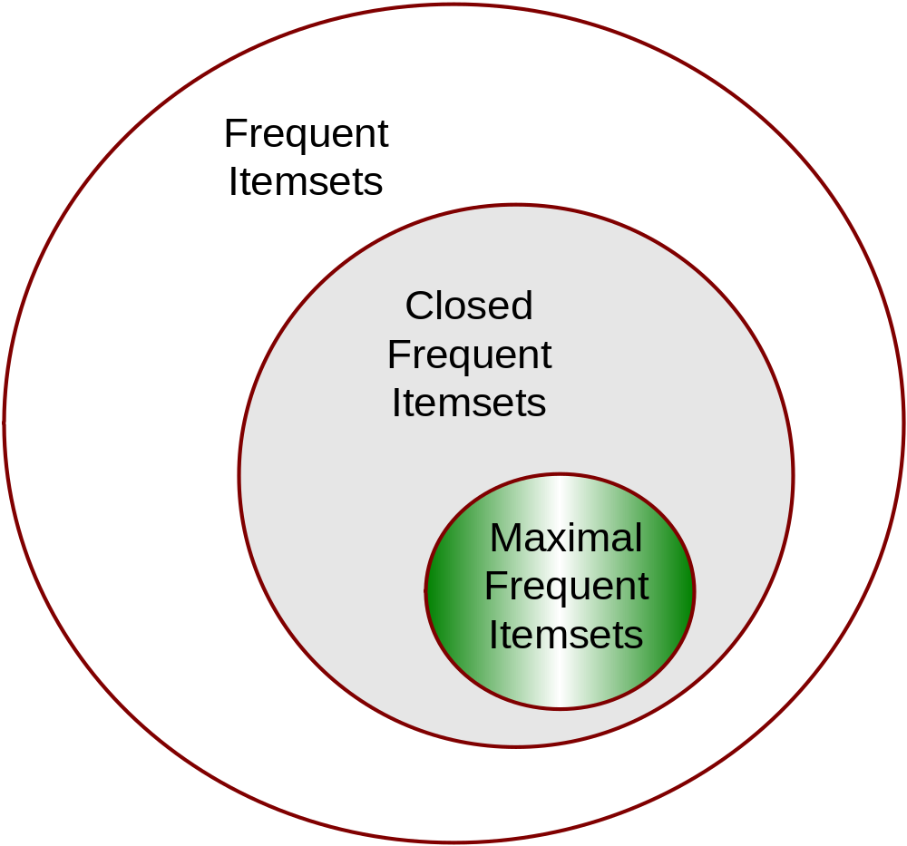
Maximal vs Closed Itemsets

Slide 32
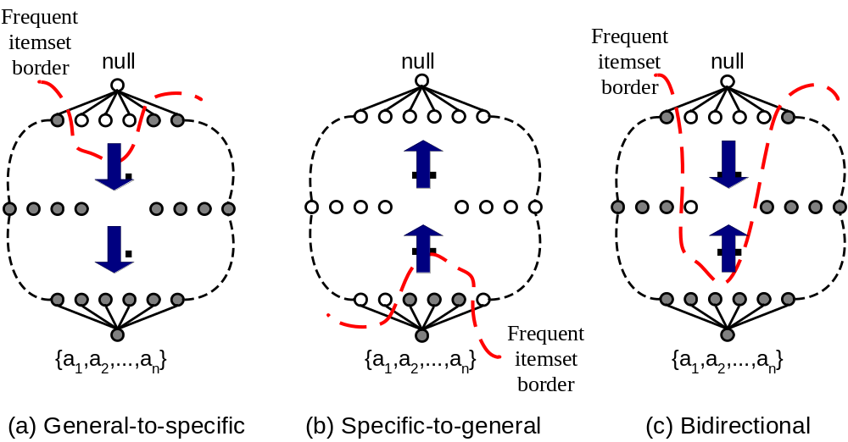
Alternative Methods for Frequent Itemset Generation
Traversal of Itemset Lattice
  General-to-specific vs Specific-to-general

Slide 33
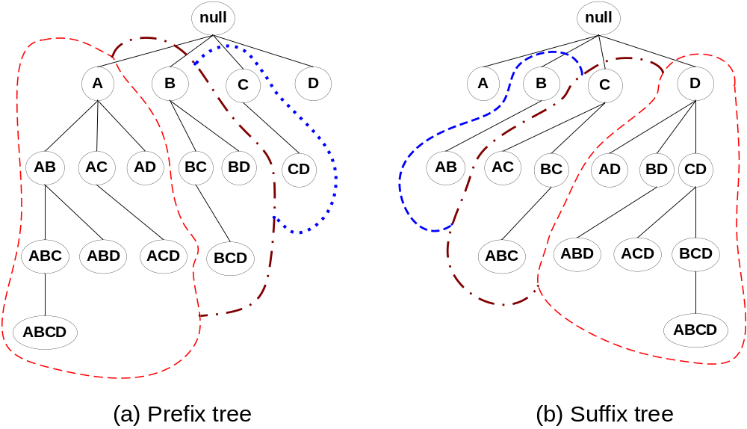
Alternative Methods for Frequent Itemset Generation
Traversal of Itemset Lattice
  Equivalent Classes

Slide 34
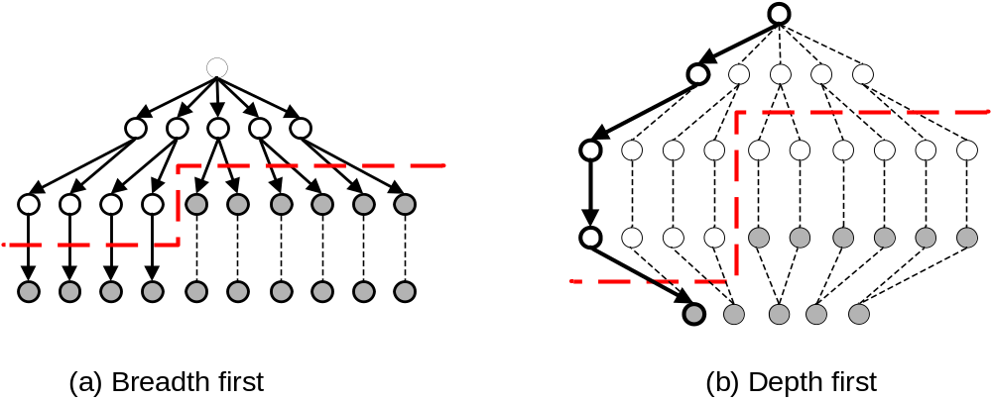
Alternative Methods for Frequent Itemset Generation
Traversal of Itemset Lattice
  Breadth-first vs Depth-first

Slide 35
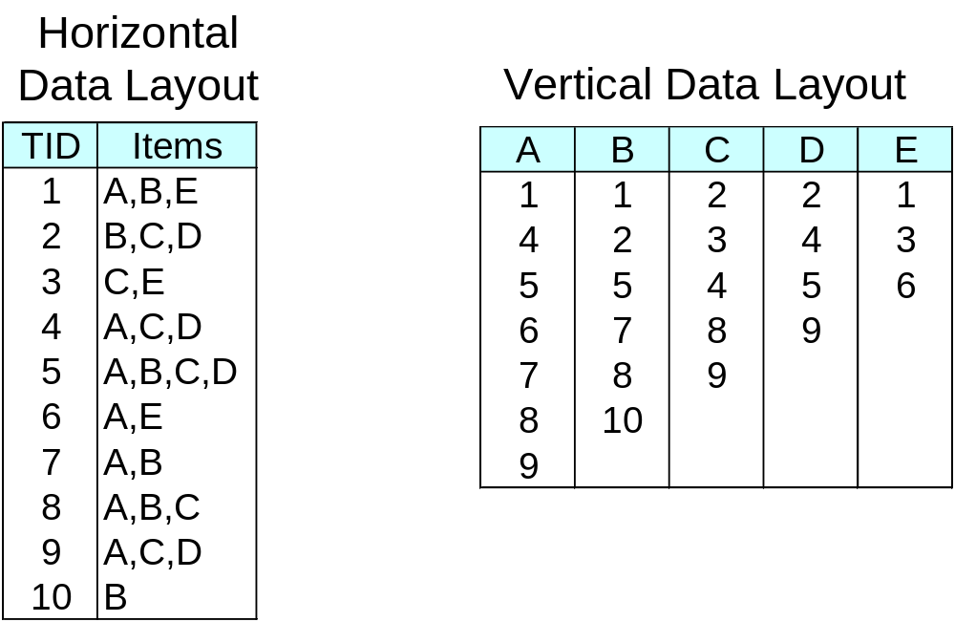
Alternative Methods for Frequent Itemset Generation
Representation of Database
  horizontal vs vertical data layout

Slide 36
FP-growth Algorithm
Use a compressed representation of the database using an FP-tree
Once an FP-tree has been constructed, it uses a recursive divide-and-conquer approach to mine the frequent itemsets

Slide 37
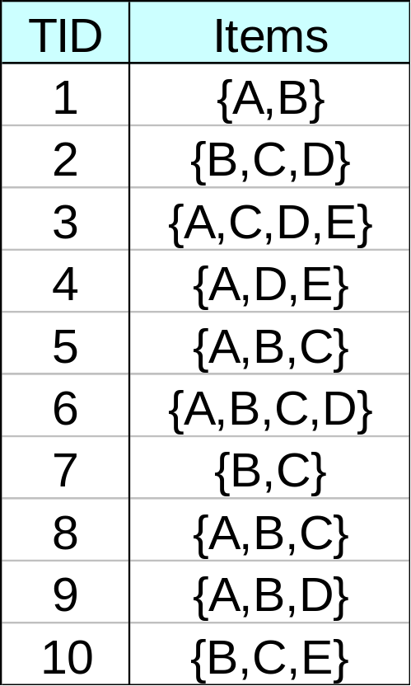
FP-tree construction
null
After reading TID=1:
A:1
B:1
After reading TID=2:
null
A:1
B:1
B:1
C:1
D:1

Slide 38
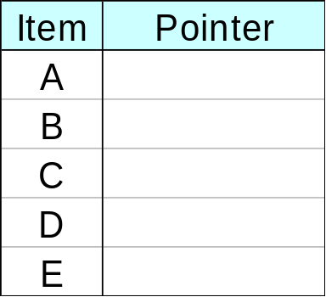
FP-Tree Construction
Transaction Database
null
A:7
B:3
B:5
C:3
C:1
D:1
Header table
D:1
C:3
E:1
D:1
E:1
D:1
E:1
D:1
Pointers are used to assist frequent itemset generation

Slide 39
FP-growth
null
Conditional Pattern base for D:
P = {(A:1,B:1,C:1),
(A:1,B:1),
(A:1,C:1),
(A:1),
(B:1,C:1)}
Recursively apply FP-growth on P
Frequent Itemsets found (with sup > 1):
AD, BD, CD, ACD, BCD
A:7
B:1
B:5
C:1
C:1
D:1
C:3
D:1
D:1
D:1
D:1

Slide 40
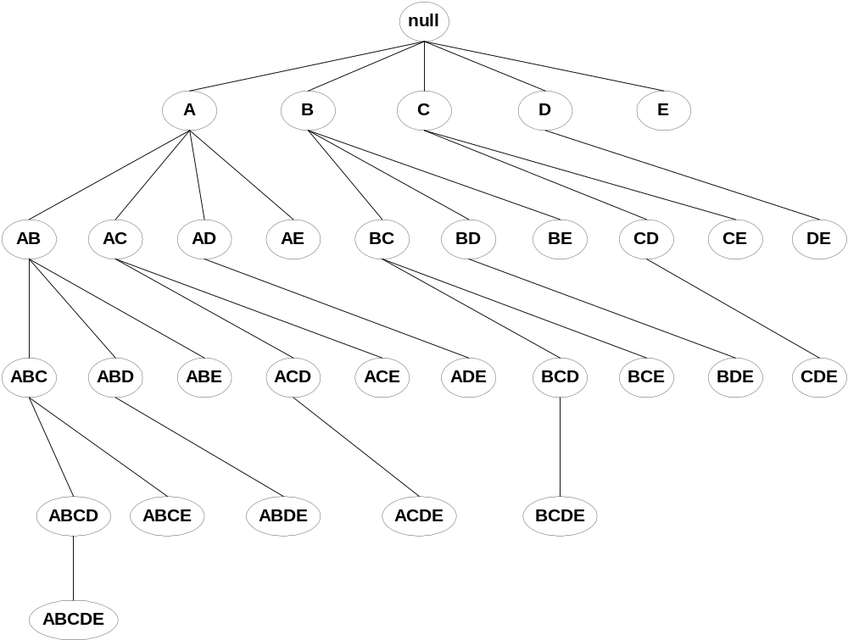
Tree Projection
Set enumeration tree:
Possible Extension: E(A) = {B,C,D,E}
Possible Extension: E(ABC) = {D,E}

Slide 41
Tree Projection
Items are listed in lexicographic order
Each node P stores the following information:
  Itemset for node P
  List of possible lexicographic extensions of P: E(P)
  Pointer to projected database of its ancestor node
  Bitvector containing information about which transactions in the projected database contain the itemset

Slide 42
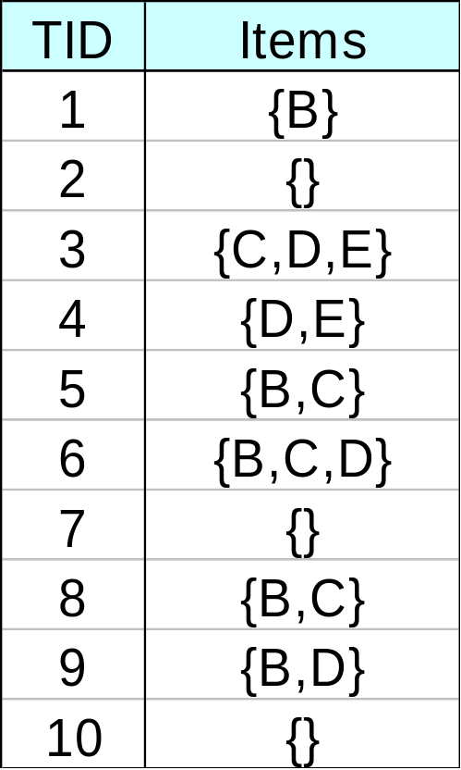
Projected Database
Projected Database for node A:
Original Database:
For each transaction T, projected transaction at node A is T ∩ E(A)

Slide 43
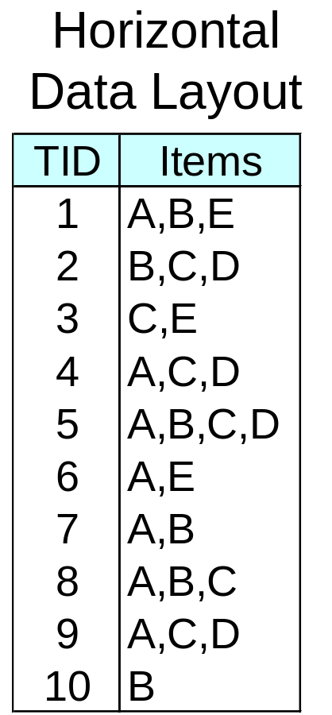
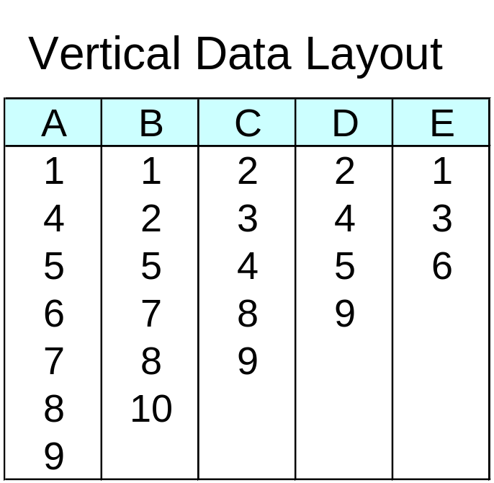
ECLAT
For each item, store a list of transaction ids (tids)
TID-list

Slide 44
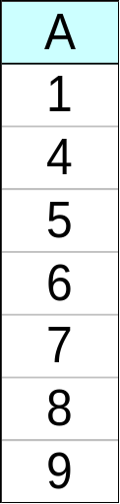
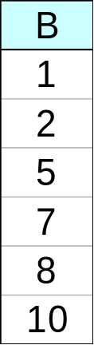
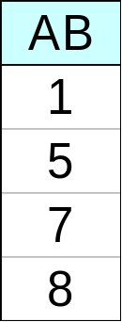
ECLAT
Determine support of any k-itemset by intersecting tid-lists of two of its (k-1) subsets.
3 traversal approaches:
  top-down, bottom-up and hybrid
Advantage: very fast support counting
Disadvantage: intermediate tid-lists may become too large for memory
∧
→

Slide 45
Mining Association Rules
Two-step approach:
  Frequent Itemset Generation
    Generate all itemsets whose support ≥ minsup
  Rule Generation
    Generate high confidence rules from each frequent itemset, where each rule is a binary partitioning of a frequent itemset

Slide 46
Rule Generation
Given a frequent itemset L, find all non-empty subsets f ⊂ L such that f → L – f satisfies the minimum confidence requirement
  If {A,B,C,D} is a frequent itemset, candidate rules:
    ABC →D, ABD →C, ACD →B, BCD →A,
    A →BCD, B →ACD, C →ABD, D →ABC
    AB →CD, AC → BD, AD → BC, BC →AD,
    BD →AC, CD →AB,
If |L| = k, then there are 2^{k} – 2 candidate association rules (ignoring L → ∅ and ∅ → L)

Slide 47
Rule Generation
How to efficiently generate rules from frequent itemsets?
  In general, confidence does not have an anti-monotone property
    c(ABC →D) can be larger or smaller than c(AB →D)
  But confidence of rules generated from the same itemset has an anti-monotone property
  e.g., L = {A,B,C,D}:
  c(ABC → D) ≥ c(AB → CD) ≥ c(A → BCD)
    Confidence is anti-monotone w.r.t. number of items on the right hand side of the rule
  c(X->Y):Measures how often items in Y appear in transactions that contain X

Slide 48
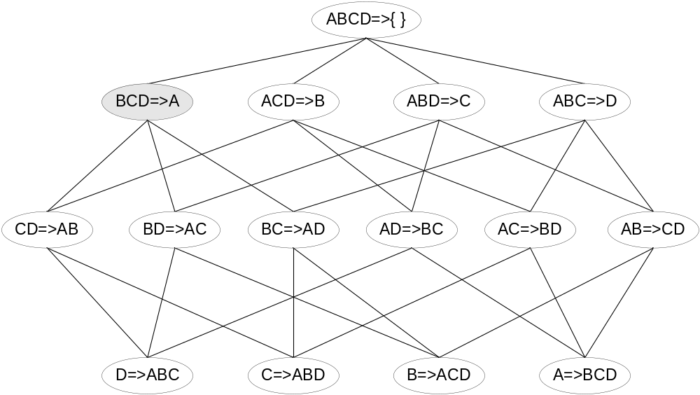
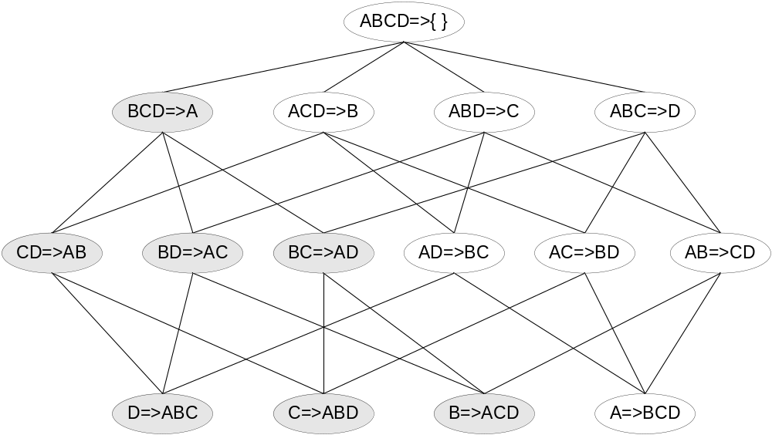
Rule Generation for Apriori Algorithm
Lattice of rules
Low Confidence Rule
Pruned Rules

Slide 49
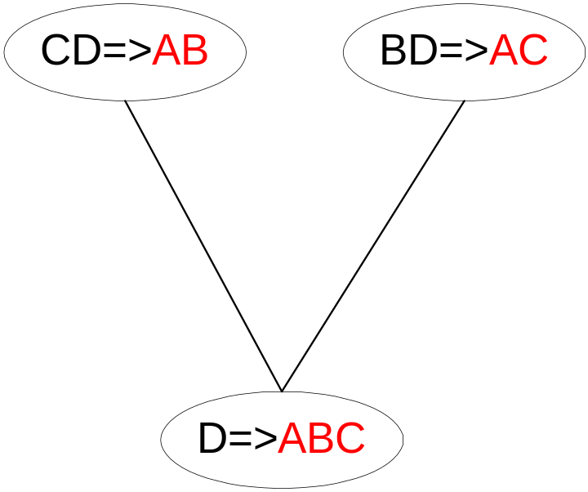
Rule Generation for Apriori Algorithm
Candidate rule is generated by merging two rules that share the same prefix
in the rule consequent
join(CD=>AB,BD=>AC)
would produce the candidate
rule D => ABC
Prune rule D=>ABC if its
subset AD=>BC does not have
high confidence

Slide 50
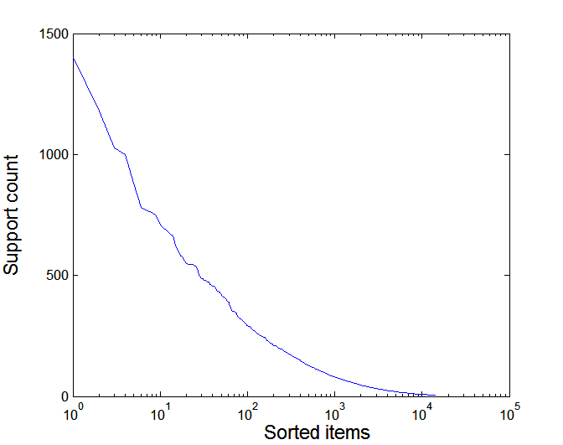
Effect of Support Distribution
Many real data sets have skewed support distribution
Support distribution of a retail data set

Slide 51
Effect of Support Distribution
How to set the appropriate minsup threshold?
  If minsup is set too high, we could miss itemsets involving interesting rare items (e.g., expensive products)
  If minsup is set too low, it is computationally expensive and the number of itemsets is very large
Using a single minimum support threshold may not be effective

Slide 52
Multiple Minimum Support
How to apply multiple minimum supports?
  MS(i): minimum support for item i
  e.g.: MS(Milk)=5%, MS(Coke) = 3%,
  MS(Broccoli)=0.1%, MS(Salmon)=0.5%
  MS({Milk, Broccoli}) = min (MS(Milk), MS(Broccoli))
  = 0.1%
  Challenge: Support is no longer anti-monotone
    Suppose: Support(Milk, Coke) = 1.5% and
    Support(Milk, Coke, Broccoli) = 0.5%
    {Milk,Coke} is infrequent but {Milk,Coke,Broccoli} is frequent

Slide 53
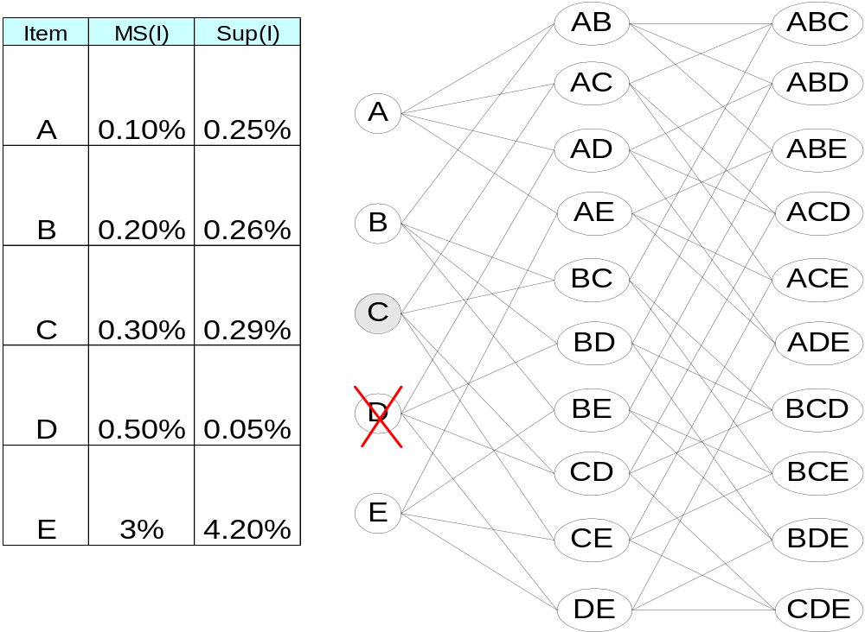
Multiple Minimum Support

Slide 54
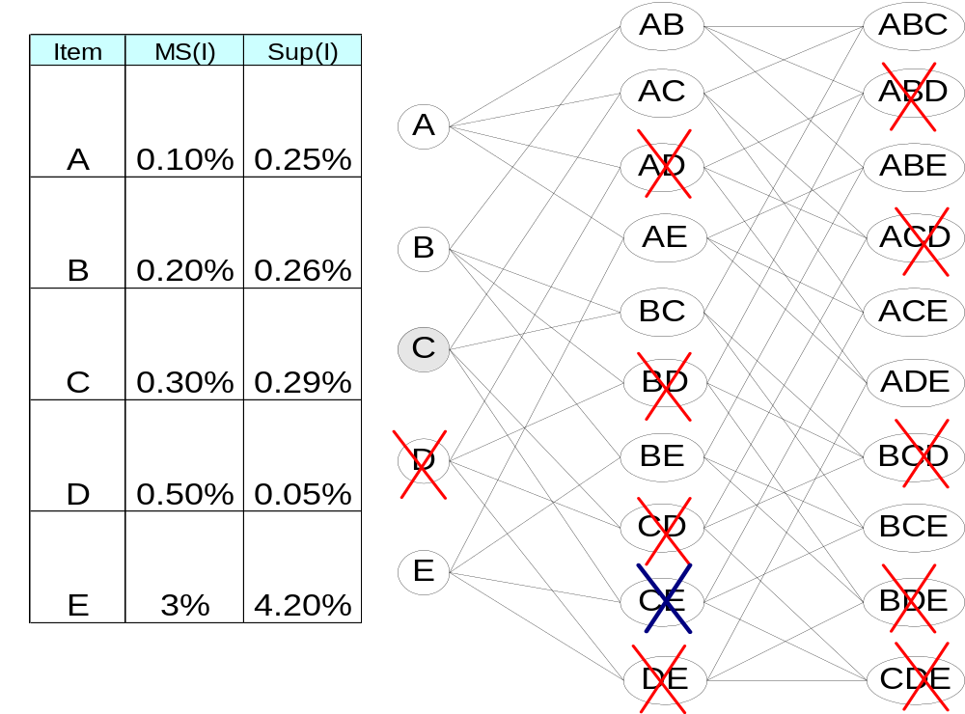
Multiple Minimum Support

Slide 55
Multiple Minimum Support (Liu 1999)
Order the items according to their minimum support (in ascending order)
  e.g.: MS(Milk)=5%, MS(Coke) = 3%,
  MS(Broccoli)=0.1%, MS(Salmon)=0.5%
  Ordering: Broccoli, Salmon, Coke, Milk
Need to modify Apriori such that:
  L₁ : set of frequent items
  F₁ : set of items whose support is ≥ MS(1)
  where MS(1) is min_{i}( MS(i) )
  C₂ : candidate itemsets of size 2 is generated from F₁
  instead of L₁

Slide 56
Multiple Minimum Support (Liu 1999)
Modifications to Apriori:
  In traditional Apriori,
    A candidate (k+1)-itemset is generated by merging two
    frequent itemsets of size k
    The candidate is pruned if it contains any infrequent subsets
    of size k
  Pruning step has to be modified:
    Prune only if subset contains the first item
    e.g.: Candidate={Broccoli, Coke, Milk} (ordered according to
    minimum support)
    {Broccoli, Coke} and {Broccoli, Milk} are frequent but
    {Coke, Milk} is infrequent
      Candidate is not pruned because {Coke,Milk} does not contain
      the first item, i.e., Broccoli.

Slide 57
Pattern Evaluation
Association rule algorithms tend to produce too many rules
  many of them are uninteresting or redundant
  Redundant if {A,B,C} → {D} and {A,B} → {D}
  have same support & confidence
Interestingness measures can be used to prune/rank the derived patterns
In the original formulation of association rules, support & confidence are the only measures used

Slide 58
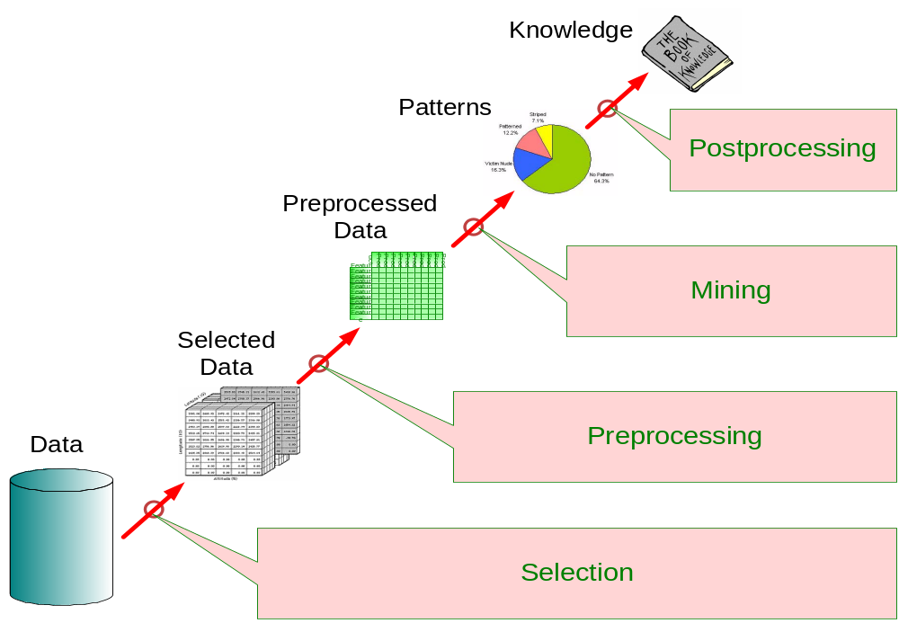
Application of Interestingness Measure
Interestingness Measures

Slide 59
Computing Interestingness Measure
Given a rule X → Y, information needed to compute rule interestingness can be obtained from a contingency table
Contingency table for X → Y
 | Y | Y
X | f₁₁ | f₁₀ | f₁₊
X | f₀₁ | f₀₀ | f_{o+}
 | f₊₁ | f₊₀ | |T|
f₁₁: support of X and Y
f₁₀: support of X and Y
f₀₁: support of X and Y
f₀₀: support of X and Y
Used to define various measures
support, confidence, lift, Gini,
J-measure, etc.

Slide 60
Drawback of Confidence
 | Coffee | Coffee
Tea | 15 | 5 | 20
Tea | 75 | 5 | 80
 | 90 | 10 | 100
Association Rule: Tea → Coffee
Confidence= P(Coffee|Tea) = 0.75
but P(Coffee) = 0.9
Although confidence is high, rule is misleading
P(Coffee|Tea) = 0.9375

Slide 61
Statistical Independence
Population of 1000 students
  600 students know how to swim (S)
  700 students know how to bike (B)
  420 students know how to swim and bike (S,B)
  P(S∧B) = 420/1000 = 0.42
  P(S) × P(B) = 0.6 × 0.7 = 0.42
  P(S∧B) = P(S) × P(B) => Statistical independence
  P(S∧B) > P(S) × P(B) => Positively correlated
  P(S∧B) < P(S) × P(B) => Negatively correlated

Slide 62
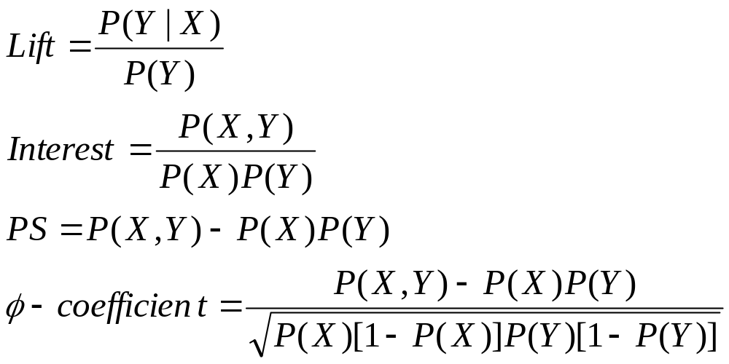
Statistical-based Measures
Measures that take into account statistical dependence

Slide 63
Example: Lift/Interest
 | Coffee | Coffee
Tea | 15 | 5 | 20
Tea | 75 | 5 | 80
 | 90 | 10 | 100
Association Rule: Tea → Coffee
Confidence= P(Coffee|Tea) = 0.75
but P(Coffee) = 0.9
Lift = 0.75/0.9= 0.8333 (< 1, therefore is negatively associated)

Slide 64
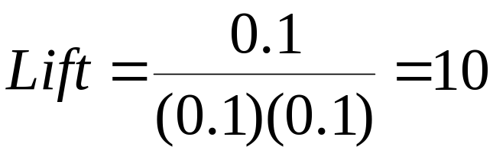
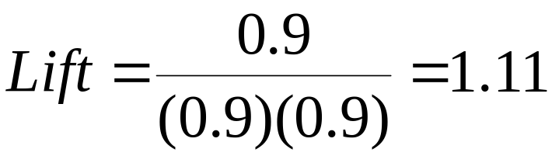
Drawback of Lift & Interest
 | Y | Y
X | 10 | 0 | 10
X | 0 | 90 | 90
 | 10 | 90 | 100
 | Y | Y
X | 90 | 0 | 90
X | 0 | 10 | 10
 | 90 | 10 | 100
Statistical independence:
If P(X,Y)=P(X)P(Y) => Lift = 1

Slide 65
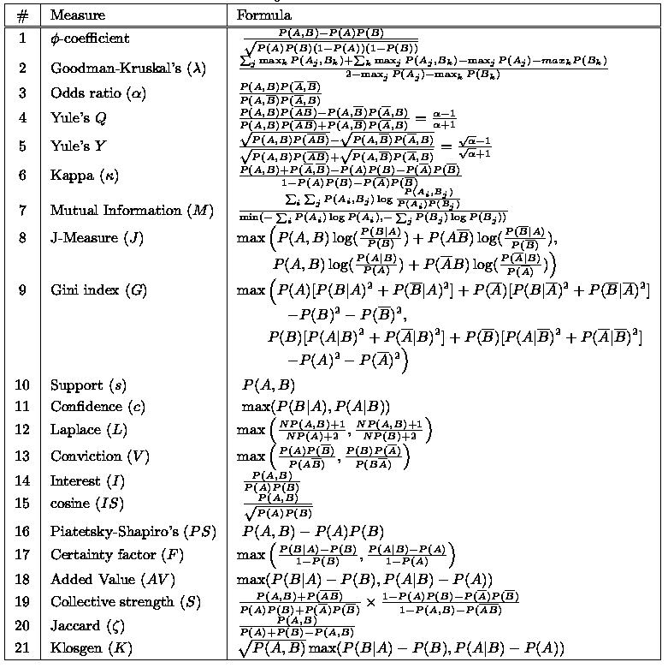
There are lots of measures proposed in the literature
Some measures are good for certain applications, but not for others
What criteria should we use to determine whether a measure is good or bad?
What about Apriori-style support based pruning? How does it affect these measures?

Slide 66
Properties of A Good Measure
Piatetsky-Shapiro:
3 properties a good measure M must satisfy:
  M(A,B) = 0 if A and B are statistically independent
  M(A,B) increase monotonically with P(A,B) when P(A) and P(B) remain unchanged
  M(A,B) decreases monotonically with P(A) [or P(B)] when P(A,B) and P(B) [or P(A)] remain unchanged

Slide 67


Comparing Different Measures
10 examples of contingency tables:
Rankings of contingency tables using various measures:

Slide 68

Property under Variable Permutation
Does M(A,B) = M(B,A)?
Symmetric measures:
  support, lift, collective strength, cosine, Jaccard, etc
Asymmetric measures:
  confidence, conviction, Laplace, J-measure, etc

Slide 69
Property under Row/Column Scaling
Grade-Gender Example (Mosteller, 1968):
 | Male | Female
High | 2 | 3 | 5
Low | 1 | 4 | 5
 | 3 | 7 | 10
 | Male | Female
High | 4 | 30 | 34
Low | 2 | 40 | 42
 | 6 | 70 | 76
2x
10x
Mosteller:
Underlying association should be independent of
the relative number of male and female students
in the samples

Slide 70

Property under Inversion Operation
Transaction 1
.
.
.
.
.
Transaction N

Slide 71


Example: φ-Coefficient
φ-coefficient is analogous to correlation coefficient for continuous variables
 | Y | Y
X | 60 | 10 | 70
X | 10 | 20 | 30
 | 70 | 30 | 100
 | Y | Y
X | 20 | 10 | 30
X | 10 | 60 | 70
 | 30 | 70 | 100
φ Coefficient is the same for both tables

Slide 72

Property under Null Addition
Invariant measures:
  support, cosine, Jaccard, etc
Non-invariant measures:
  correlation, Gini, mutual information, odds ratio, etc

Slide 73

Different Measures have Different Properties

Slide 74
Support-based Pruning
Most of the association rule mining algorithms use support measure to prune rules and itemsets
Study effect of support pruning on correlation of itemsets
  Generate 10000 random contingency tables
  Compute support and pairwise correlation for each table
  Apply support-based pruning and examine the tables that are removed

Slide 75

Effect of Support-based Pruning

Slide 76



Effect of Support-based Pruning
Support-based pruning eliminates mostly negatively correlated itemsets

Slide 77
Effect of Support-based Pruning
Investigate how support-based pruning affects other measures
Steps:
  Generate 10000 contingency tables
  Rank each table according to the different measures
  Compute the pair-wise correlation between the measures

Slide 78


Effect of Support-based Pruning
Without Support Pruning (All Pairs)
Scatter Plot between Correlation & Jaccard Measure
Red cells indicate correlation between
the pair of measures > 0.85
40.14% pairs have correlation > 0.85

Slide 79


Effect of Support-based Pruning
0.5% ≤ support ≤ 50%
Scatter Plot between Correlation & Jaccard Measure:
61.45% pairs have correlation > 0.85

Slide 80


Effect of Support-based Pruning
0.5% ≤ support ≤ 30%
Scatter Plot between Correlation & Jaccard Measure
76.42% pairs have correlation > 0.85

Slide 81
Subjective Interestingness Measure
Objective measure:
  Rank patterns based on statistics computed from data
  e.g., 21 measures of association (support, confidence, Laplace, Gini, mutual information, Jaccard, etc).
Subjective measure:
  Rank patterns according to user’s interpretation
    A pattern is subjectively interesting if it contradicts the
    expectation of a user (Silberschatz & Tuzhilin)
    A pattern is subjectively interesting if it is actionable
    (Silberschatz & Tuzhilin)

Slide 82

Interestingness via Unexpectedness
Need to model expectation of users (domain knowledge)
Need to combine expectation of users with evidence from data (i.e., extracted patterns)
+
Pattern expected to be frequent
-
Pattern expected to be infrequent
Pattern found to be frequent
Pattern found to be infrequent
+
-
Expected Patterns
-
+
Unexpected Patterns

Slide 83

Interestingness via Unexpectedness
Web Data (Cooley et al 2001)
  Domain knowledge in the form of site structure
  Given an itemset F = {X₁, X₂, …, X_{k}} (X_{i} : Web pages)
    L: number of links connecting the pages
    lfactor = L / (k × k-1)
    cfactor = 1 (if graph is connected), 0 (disconnected graph)
  Structure evidence = cfactor × lfactor
  Usage evidence
  Use Dempster-Shafer theory to combine domain knowledge and evidence from data

