Slide 1


Neural Adaptive Video Streaming with Pensieve
Hongzi Mao
Ravi Netravali Mohammad Alizadeh
Notes:
I’m going to talk about neural adaptive video streaming with Pensieve. This is a joint work with Ravi and Mohammad from MIT.

Slide 2



Users start leaving if video doesn’t play in 2 seconds
https://gigaom.com/2012/11/09/online-viewers-start-leaving-if-video-doesnt-play-in-2-seconds-says-study/
Video: La Luna (Pixar 2011)
Notes:
When we stream a video from the internet, we all have this annoying experience -- the video suddenly gets stuck and starts rebuffering ..
Studies actually show that users start leaving if the video doesn’t play in 2 seconds.
And given that fact that video streaming has been dominating today's internet traffic, this kind of bad experience will lead to tremendous loss of users. Therefore industry and academia have devoted lots efforts to improve video streaming experience.

Slide 3
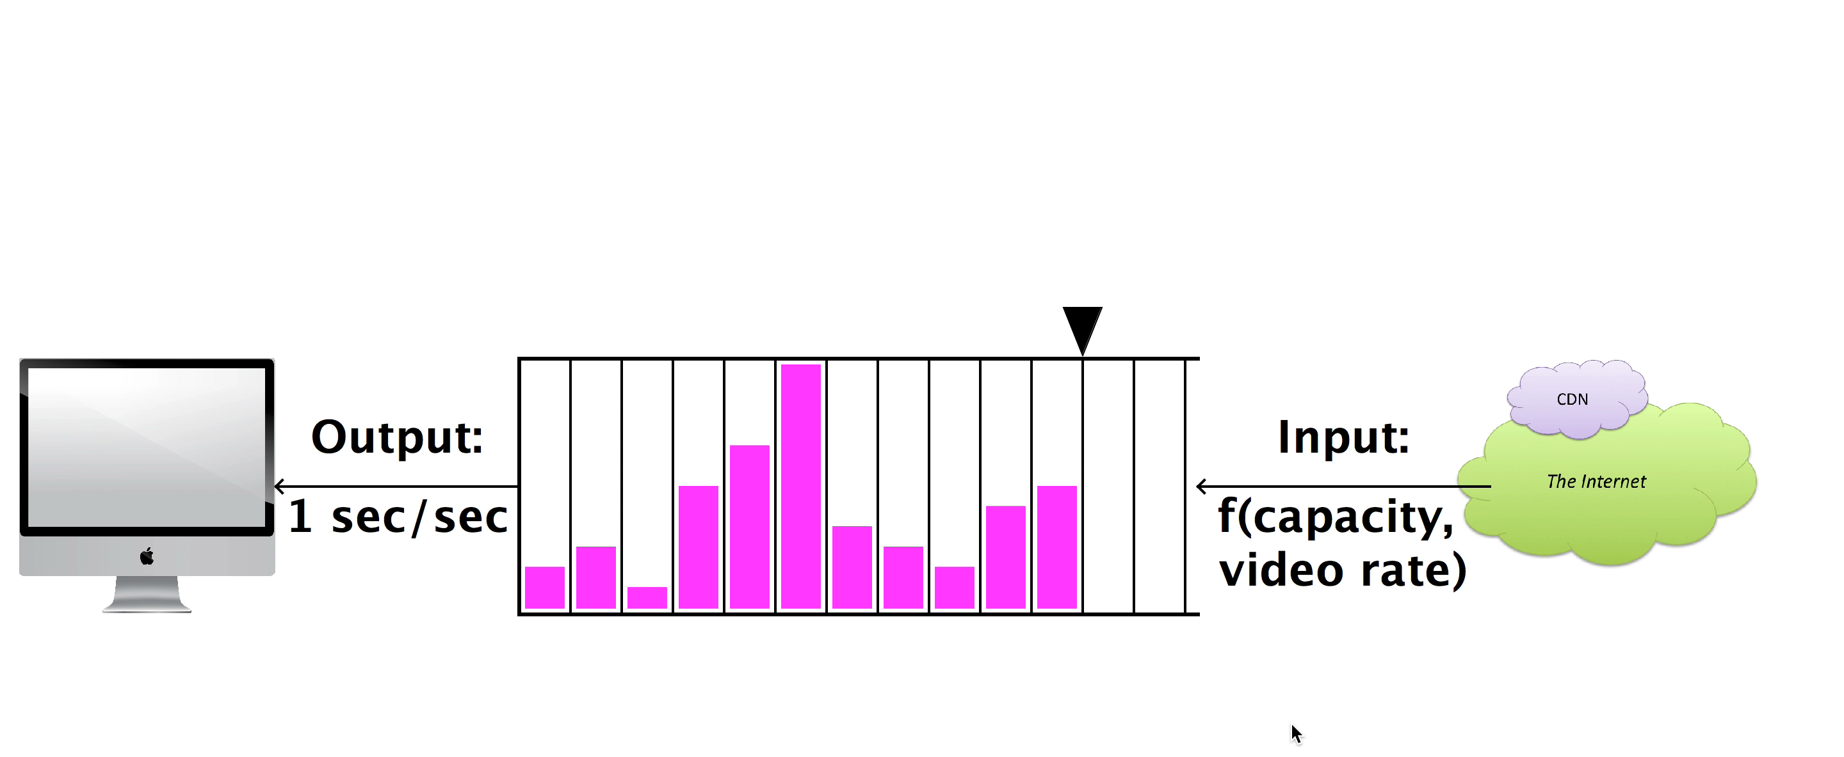






Dynamic Streaming over HTTP (DASH)
Request:
next video chunk at bitrate r
Output
1 sec/sec
Input
Response:
video content
bitrate
1 sec
video
content
Video Client
Video Server
Adaptive Bitrate (ABR)
Algorithms
bitrate
Animation borrowed from Te-Yuan Huang (SIGCOMM ‘14) http://conferences.sigcomm.org/sigcomm/2014/doc/slides/38.pdf
Notes:
The main framework to improve the quality of experience is dynamic streaming over HTTP or DASH. It's a very standard framework and I will give an overview of how it works.
To load a video, a video client periodically requests individual chunk of video from a video server. Each chunk represents several seconds of video and can be requested at one of several bitrates. As the video chunks are downloaded, they are stored in a playback buffer. In this abstract figure, each pink bar represents a video chunk in the buffer. The width of the bar is 1 second of the video and the height indicates the bitrate. The higher bitrate corresponds to higher resolution or higher quality of the video.
As the video is playing, the playback buffer is continually drained at a fixed rate since the user watches videos in ‘real time’, but the buffer will be populated at a variable rate, depending on the requested bitrate and network condition.
[play video]
This can become problematic if the chunks we request have higher bitrates than the network can support, therefore chunks are being drained faster than they are enqueued -- this ultimately leads to an empty buffer and thus a rebuffering period.
To prevent issues like this, video players use Adaptive Bitrate Algorithms, or ABR algorithms. These algorithms decide both when and at which bitrate to download each video chunk.
[click] Specifically, these algorithms choose among a few available bitrates adaptively depending on the network and playback buffer condition.
Because of that, these algorithms have a large impact on quality of experience.

Slide 4
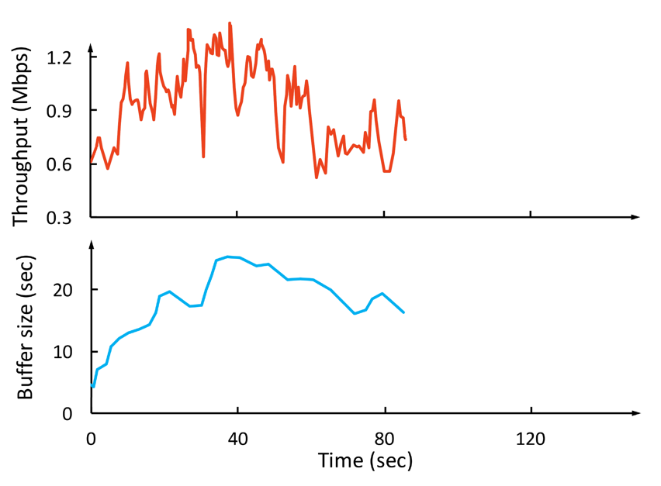
Why is ABR Challenging?
Throughput
Network throughput is variable & uncertain
Throughput
Bitrate
(Mbps)
Conflicting QoE goals
Bitrate
Rebuffering time
Smoothness
Video bitrate
Buffer size
(sec)
Cascading effects of decisions
Notes:
With this context, now let’s look at why designing ABR algorithms is so challenging? Let me use this example. Say we have streamed a video for a while..
Now at this point, how would the future throughput look like? it go higher, or it could could remain steady for a while and then drop, in fact it can be one of the many many possibilities -- past throughput observations cannot accurately predict what will happen exactly . It’s very challenging to select a bitrate that adapt to this noisy cloud of future possibilities.
Next, in practice, there’s tension and tradeoff among multiple conflicting QoE goals. People don't simply just want higher quality, they don't want rebuffering, and no bitrate fluctuations. However, selecting higher bitrates could result in rebuffering if there’s no enough playback buffer.
Finally, the bitrate decision for the next chunk can affect the decisions in the future. For example, using a high bitrate at the current time may deplete the video buffer, which leaves little cushion to deal with the risk rebuffering in case of network fluctuations. So, ABR algorithms must plan for the future.

Slide 5





Our Contribution: Pensieve
bandwidth
ABR agent
bitrates
240P
bit rate
480P
720P
buffer
720P
1080P
First network control system using modern “deep” reinforcement learning
Delivers 12-25% better QoE, with 10-30% less rebuffering than previous ABR algorithms
Tailors ABR decisions for different network conditions in a data-driven way
network and video measurements
Pensieve learns ABR algorithm automatically through experience
Notes:
In this work, we built Pensieve, a system that uses reinforcement learning to learn an ABR algorithm automatically through experience. Pensieve represents the ABR algorithm as a neural network, that takes as input the observation from video client and output the bitrate decision for the next video chunk. It trains this neural network using data from a large number of video streaming sessions in actual network conditions.
[Click]
Our contribution with Pensieve, is that, to our knowledge, this is a first network control system that uses modern "deep" reinforcement learning techniques.
It outperforms existing ABR algorithms substantially, improving the quality of experience by 12-25%, with 10-30% less rebuffering over the best previous schemes in realistic network conditions.
We found that Pensieve is able to achieve this performance fundamentally because it learns rules for ABR that are specifically tailored for the underlining network characteristics.
Further, in building Pensieve, we learned several lessons about using deep reinforcement learning for network control systems. We believe these techniques are very powerful and can be applied to many other such problems, therefore I will share a few lessons that we learned near the end of this talk.

Slide 6
Previous Fixed ABR Algorithms
Rate-based: pick bitrate based on predicted throughput
  FESTIVE [CoNEXT’12], PANDA [JSAC’14], CS2P [SIGCOMM’16]
Buffer-based: pick bitrate based on buffer occupancy
  BBA [SIGCOMM’14], BOLA [INFOCOM’16]
Hybrid: use both throughput prediction & buffer occupancy
  PBA [HotMobile’15], MPC [SIGCOMM’15]
Simplified inaccurate model leads to suboptimal performance
Notes:
Before we talk about Pensieve, let's first look at previous schemes. All existing develop fixed rules in the ABR algorithms based on human insights.
For example, there are algorithms using throughput prediction; there are some others determining the bitrates based on the buffer occupancy. Each of these schemes doesn't use all the available information.
Therefore more sophisticated methods have been proposed to combine both signals. For example MPC, the state of the art approach from SIGCOMM 2015.
However, as I mentioned, all these schemes use fixed heuristics based on designer’s insight. The problem with these approaches [click] is that they rely on simplified inaccurate models to come up with their algorithms, as I will show, this can lead to suboptimal performance under actual network conditions.

Slide 7
Example: Model Predictive Control
Solution: learn from video streaming sessions
in actual network conditions
t
t + T
Throughput
maximize QoE (t, t + T)
subject to system dynamics
Throughput
Bitrate
(Mbps)
Conservative Throughput
Prediction
Video bitrate
Buffer size
(sec)
Problem: Needs accurate throughput model
Notes:
Let me give you an example using the MPC scheme that I just mentioned. MPC uses a framework called Model Predictive Control, what it does is it looks ahead in a future horizon and solves an optimization problem. It maximizes the QoE objective over the future horizon, subject to the system dynamic. Then it picks first step of the solution as the next bitrate decision.
[click] The problem with this approach is that it needs an accurate model for network throughput. To express the optimization problem, we need to plug in some model for how future throughput would evolve. But as I explained, [click] we can’t really predict the future network trajectory. And therefore what practical schemes end up with doing is they rely on a simplified estimate of throughput, such as average throughput or conservative throughput estimation. But such heuristics are hard to get right in real networks and can lead to suboptimal decisions.
-
To overcome the issues with today's fixed ABR algorithms, we turn to design a general purposed learning algorithm. Specifically, we are proposing to learn bitrate adaptation policies, by interacting with the video streaming environment in actual network conditions
--
short future horizon -> unclear how to set the length of future horizon / fixed opt horizon, the designer is forced to design the length, if it's too long, too short.. (might drop this point)
Add a banner, solution: learn the model from actual video streaming session

Slide 8

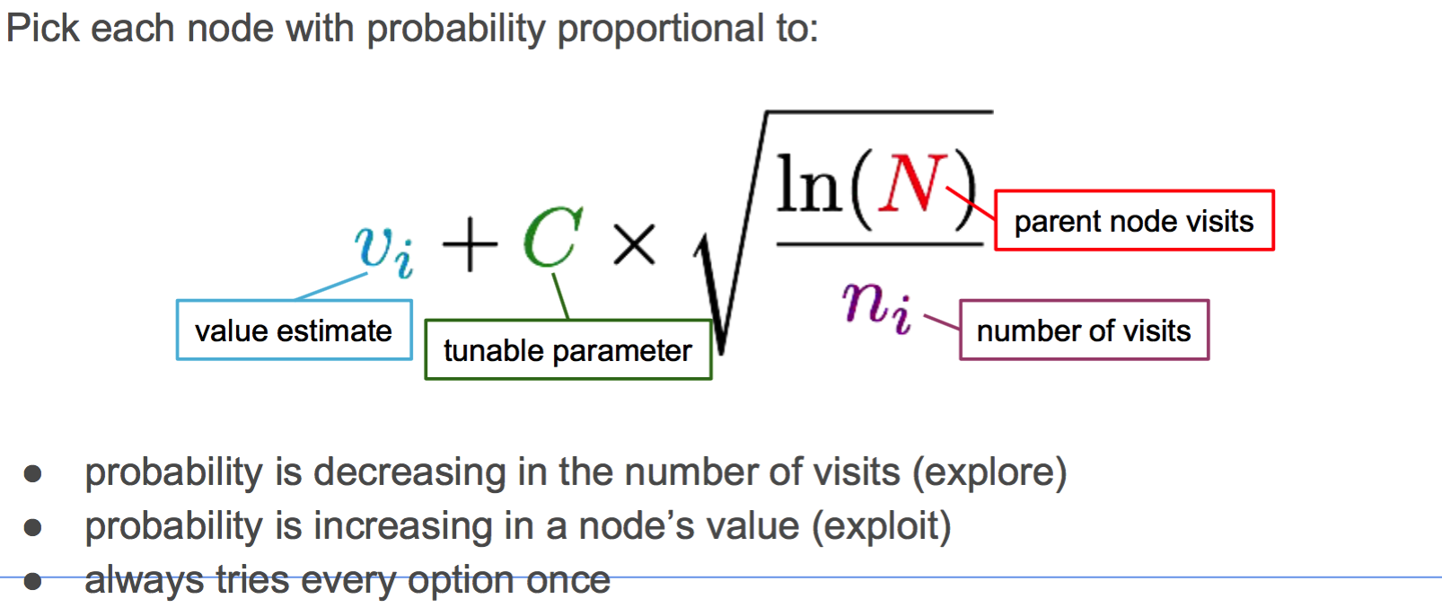



Reinforcement Learning
Reward
Agent
Environment
Take action
Observe state
Goal: maximize the cumulative reward
Notes:
[…], using Reinforcement Learning.
Let me first give you an overview of reinforcement learning
Reinforcement Learning poses a general framework, where an agent interacts with an environment. At each time step, the agent observes a state from the environment, and takes an action. As a feedback, the environment returns the agent a reward signal, indicating how good the action is. The goal of the learning agent is to maximize the total reward in the environment.
-
[…] = To overcome the issues with today's fixed ABR algorithms, we turn to design a general purposed learning algorithm. Specifically, we are proposing to learn bitrate adaptation policies, by interacting with the video streaming environment in actual network conditions

Slide 9

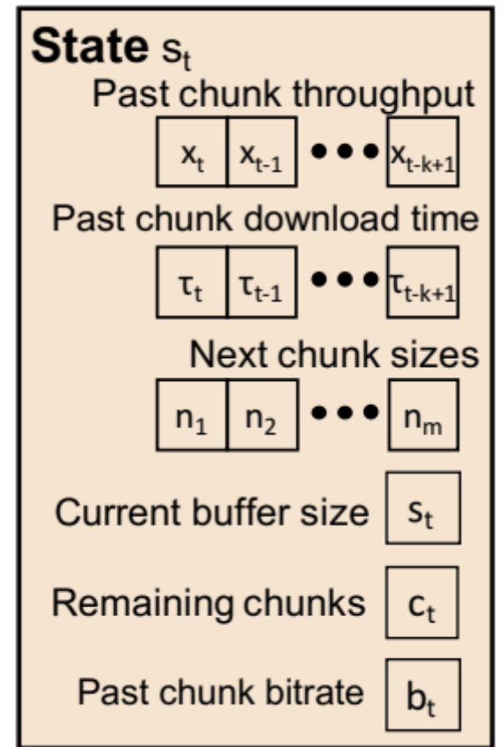


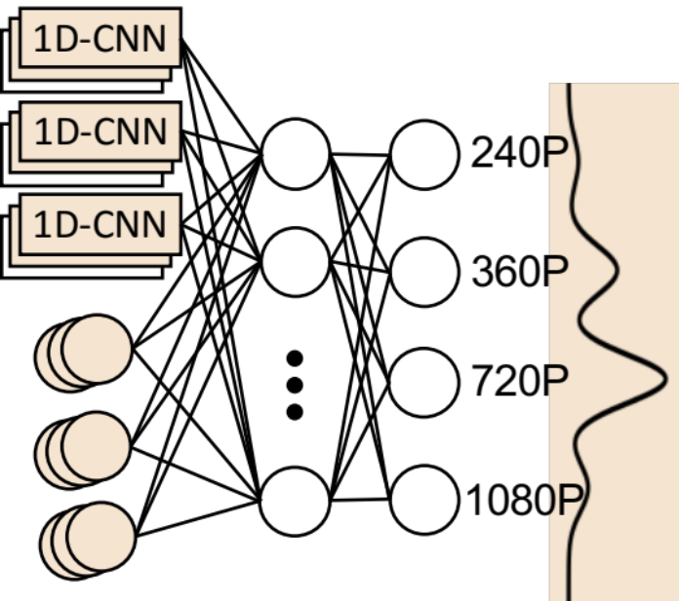
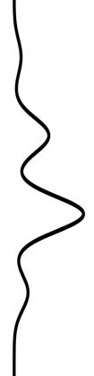



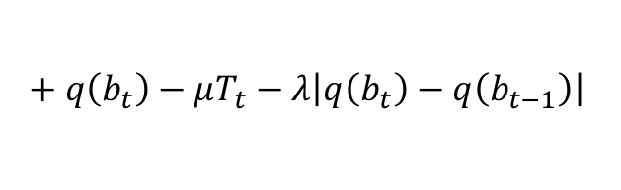
Pensieve Design
Reward
Reward r_{t}
State
Agent
$$+ q\left(b_{t}\right)−μT_{t}−λ\left|q\left(b_{t}\right)−q\left(b_{t−1}\right)\right|$$
+ (bitrate) - (rebuffering) - (smoothness)
240P
Environment
Action a_{t}
360P
Action
720P
720P
1080P
Notes:
Following the reinforcement learning framework, this is how we build the learning system for bit rate adaptation. Here the environment would be video steaming application on top a network.
To explain Pensieve's design, I need to tell you what's the state space, what's the action space and what's the reward signal.
Let's start with the state space.
The state space needs to include all the information that's relevant to make bitrate decisions. So what are these?
The first thing is throughput observation [click]. we have a sequence of throughput measurements, and the time interval of these samples. These observations are collected when past chunks are downloaded.
Next, we provided the actual file size for different bitrates of the next chunk. This is useful because the chunk sizes for different bitrates can vary across videos and even across chunks in the same video, depending on the complexity of the video frame.
Also we show the agent the playback buffer occupancy.
And we gave the agent the number chunks until the end as well. If you think about this problem, it’s finite horizon control problem. Towards the end of video playing, maintaining a large buffer doesn’t buy you too much. The bitrate selection policy towards the end can be more aggressive. And this term reflects how safe it is to be aggressive.
The last thing is the current bitrate. The agent needs to know what bitrate it’s currently at, to control the smoothness of the video.
Next, the action space. The action to take would be the bitrate for the the next chunk.
Then, as the feedback, the reward signal can be derived directly from the QoE metric, which considers the 3 QoE factors that I described earlier: bitrate, rebuffering, smoothness. Specifically, we want the quality to be higher, so positive reward. We don't want rebuffering or bitrate fluctuations, so give penalty whenever the video rebuffers or bitrate gets changed. The mu and lambda are balancing factors, which can be customized for different preference.
Now there's an neural network that maps the raw state input to the probability distribution of next bitrate. This neural network encodes the bitrate adaptation policy.
The internal architecture of the neural network has has 2 hidden layers, and it has 1D convolutional networks, which process the three sequential inputs. The entire neural network has roughly 80,000 parameters.
--
Remove the text when nn shows up

Slide 10

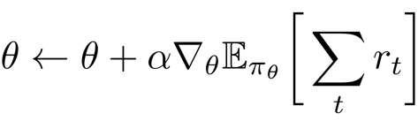
How to Train the ABR Agent
ABR agent
policy
π_{θ}(s, a)
Neural Network
240P
state
Observe state s
480P
Take action a
next bitrate
720P
1080P
parameter θ
Collect experience data: trajectory of [state, action, reward]
Training:
estimate from
empirical data
Notes:
Now how do we train the neural network? Or in other words, how do we improve the bitrate adaptation policy?
[click]
The key idea is you run the system, you collect experience data, which is the trajectory of state, action and reward: what state did I visited, what action did I take and what reward did I receive.
To train, we basically use gradient descent to move the neural network parameters in a direction that can increase the reward.
[click]
Remember, the goal is to maximize total reward, we can take the gradient of the total reward and move the neural net parameter in the direction of the gradient.
[click] In practice, the gradient of total reward can be estimated empirically from the experience data.
The details of this math and the specific algorithm is in the paper, but the key take away is that we train the neural network essentially through a guided process of trial and error, exploring different actions and learning what actions provide better reward.

Slide 11
What Pensieve is good at
Learn the dynamics directly from experience
Optimize the high level QoE objective end-to-end
Extract control rules from raw high-dimensional signals
Notes:
At a high level, there are some nice properties of this Reinforcement Learning framework that fit exactly for the bitrate adaptation problem.
First, unlike the heuristics based methods, the learning approach can adapt faithfully to the underlining characteristics of the network in a data-driven way. For example, after seeing many many examples in the cellular network, it will figure out quantitatively how much buffer it needs to build to cope for uncertainty in the nature of the network.
Also, the framework allows you to optimize for a high level QoE metric end-to-end, without having to explicitly model how it is impacted by low level decisions. We can optimize for any arbitrary QoE metric as long as we can represent it through the reward signal.
In addition, you can learn an ABR algorithm that takes as input raw high-dimensional signals, like the sequence of throughput samples, and extract useful information out of it. That's from the power of the underlining neural network.

Slide 12
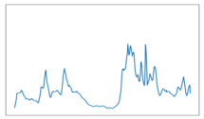


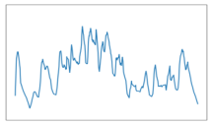

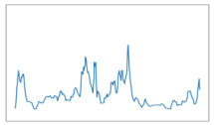
Pensieve Training System
Large corpus of
network traces
cellular, broadband, synthetic
Video playback
Fast chunk-level simulator
Model update
TensorFlow
Pensieve worker
{state, action, reward}
experiences
Pensieve worker
Pensieve master
updated neural
network parameters
Pensieve worker
Notes:
Now in our actual implementation, we built a parallel training system to speed up the training process.
We first collect large corpus of network traces from various datasets.
Using these traces, we have multiple workers that simulate the video streaming session over randomly sampled network traces.
These parallel workers collect experience in the form of [state, action, reward] and communicate with a master.
The master will compute the gradient using the method I described, and periodically update the neural net parameters, and send them back to the workers.
The training will continue for roughly 10,000 video streaming sessions, until the bitrate adaptation policy converges.

Slide 13
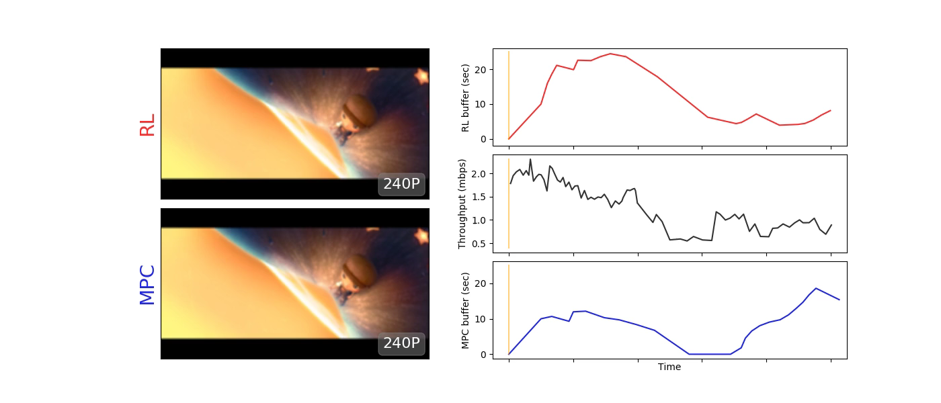
Demo
Pensieve buffer (sec)
Pensieve
chances of outage
Throughput (mbps)
Rebuffering
MPC
MPC
buffer (sec)
Notes:
Now let me show you a quick demo of Pensieve.
Pensieve is shown on the top and the state-of-the-art comparing scheme robustMPC is shown on the bottom.
The black curve shows the network throughput, you can see the inherent variability and [click] some chances of outages in the network. A good bitrate adaptation policy for this network, should strategically maintain some amount of buffer to deal with the risk of sudden degradation of network throughput.
The buffer occupancy of the two schemes are also plotted.
(Play video)
In the beginning, the network throughput is relatively stable. Since MPC only considers current and local throughput conditions, it quickly shifts to a higher bit rate. Pensieve however, has observed from many many such network examples, that understand there's a chance of outage. Therefore it plays more cautiously and builds up its buffer.
Now the network comes to an outage period, and MPC wouldn’t have any buffer to play and it suffers from severe rebuffering. Pensieve however, have enough cushion and can gracefully shift to lower bitrate without stopping.
This little example shows that Pensieve has a way to understand the underlining characteristic of this network.

Slide 14
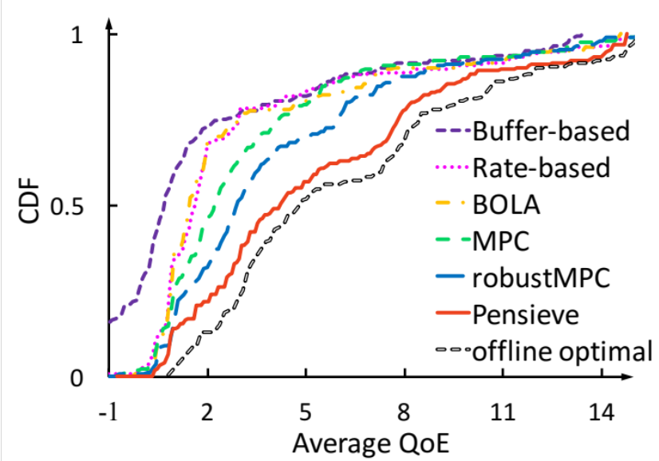
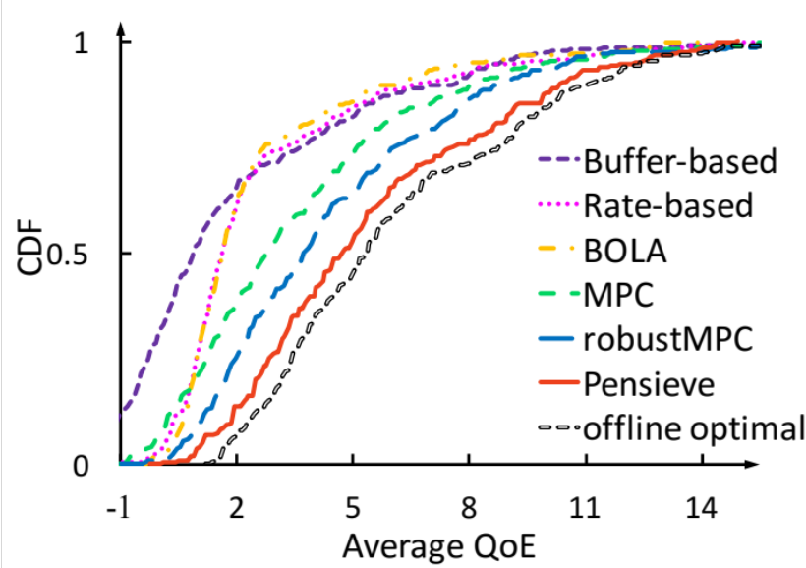
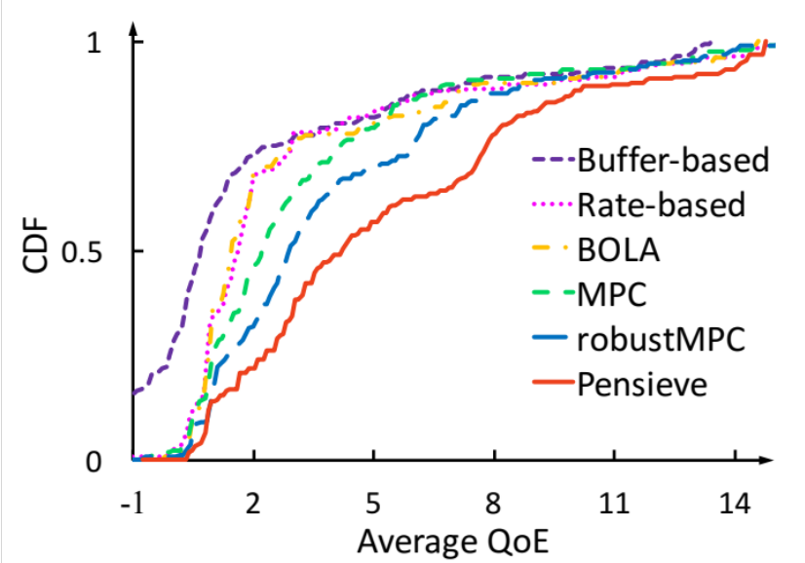
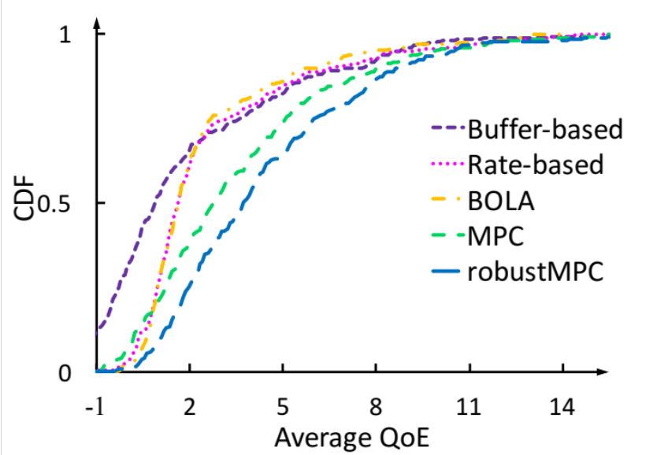
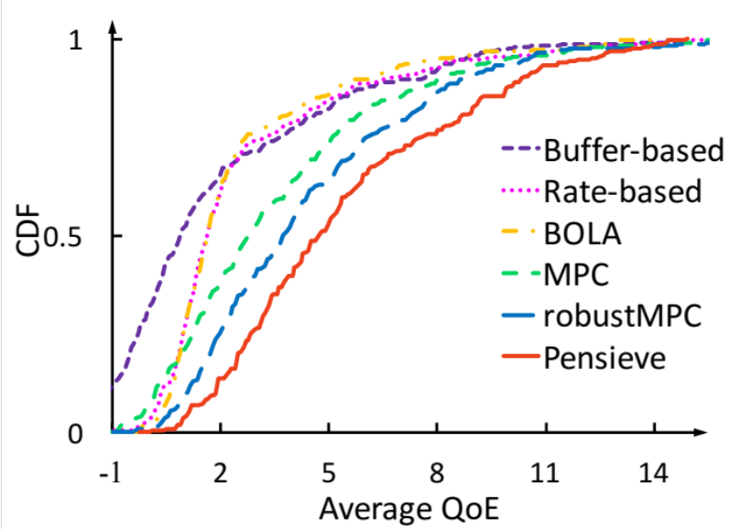
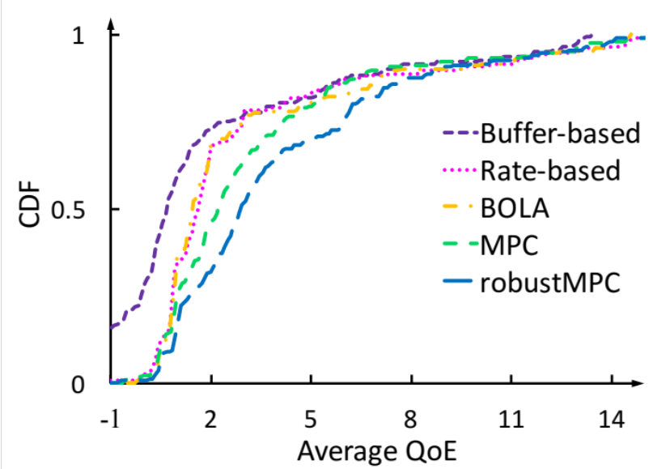
Trace-driven Evaluation
Dataset: Two datasets, each dataset consists of 1000 traces, each trace 320 seconds.
Video: 193 seconds. encoded at bitrates: {300, 750, 1200, 1850, 2850, 4300} kbps.
Video player: Google Chrome browser Video server: Apache server
Norway 3G cellular dataset
FCC broadband dataset
better
better
Pensieve improves the best previous scheme by 12-25%
and is within 9-14% of the offline optimal
Notes:
Now I will show you a wide range of experiments that we did.
We did our actual comparison with other schemes using real network traces, a 3G cellular network and a broadband network. Each dataset has 1000 traces, each about 300 seconds long. The video we tested is around 200 seconds long, and is ecnoded in 6 bitrates. We put the video server in a apache server, and a DASH video client in a google chrome browser.
Here are the the CDF of QoE of the existing schemes. This QoE objective considers bitrates, rebuffering and smoothness.
And this is what Pensieve achieves.
We can also obtain an offline optimal using dynamic programming. Offline optimal serves as an upper bound to any scheme with perfect information about future network throughput, which is not practical. Nontheless, Pensieve is still very close to the offline optimal.
Overall, Pensieve improves the average QoE by 12-25% over the best previous scheme, and only within 9-14% to the offline optimal.

Slide 15

QoE Breakdown
better
better
better
Pensieve reduces rebuffering by 10-32% over second best algorithm
Reward/QoE
+ Bitrate utility – rebuffering penalty – smooth penalty
Notes:
Dig a bit deeper, we can actually breakdown [click] each term in the QoE objective and see how each scheme performs.
[click]
This shows more clearly where Pensieve wins.
Notice that Pensieve is not outperforming existing schemes in every dimension. But Pensieve is able to achieve the best collective QoE by balancing different conflicting factors.
Pensieve achieve similar average bitrate as other schemes, [click] but reduces rebuffering by 10-30% compared with the second best scheme.

Slide 16
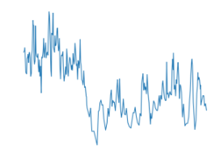
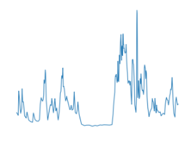
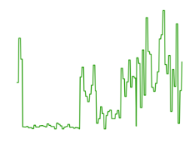
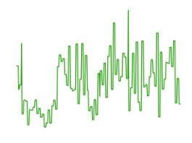
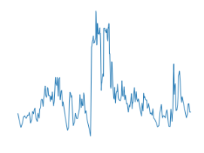
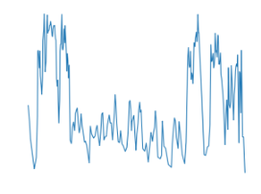
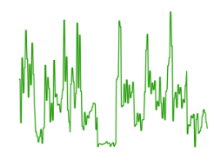
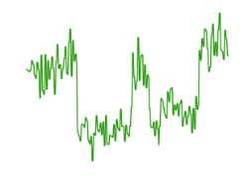
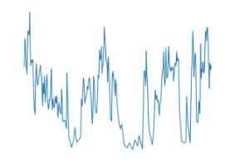
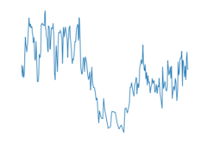
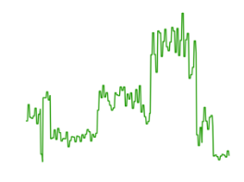
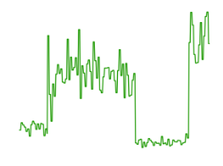
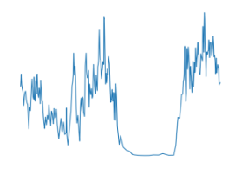
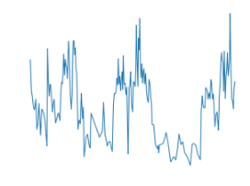
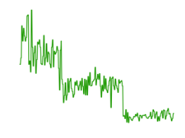
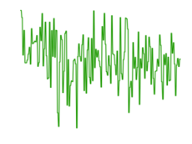
Does Pensieve Generalize?
3G network trace
Synthetic trace
Trace generated from a Hidden Markov model
Covers a wide range of average throughput and network variation
Notes:
Now a critical question you may ask about learning based system is whether or not it can generalize. In our main comparison results, Pensieve outperforms others in its testing dataset, which means Pensieve didn’t see those traces during its training time. But the training and testing data is drawn from the same dataset, which means the underlining network behavior are pretty much the same.
But in practice, video may be streamed over all different kinds of networks, some of which has never been seven before.
So we tried to evaluate Pensieve's ability to generlize.
[click] Here are the real network traces on which we will test our scheme. Instead of training the learning agent with this real network, we train it with purely synthetic network. [click]
How do we generate the synthetic network trace? Well, we actually did something very simple. We didn't try to fit the real network trace, [click] we just pick a Hidden Markov model that we thought will create a diverse set of network in terms of network throughput, variation and probability of transition between throughput levels. [click] And we sweep the parameters to crate a very diverse set of network traces. Here's some samples of the synthetic trace.
As you can see, there are some similarity between the datasets, the synthetic trace resembles the real networks to some degree, but they are not exactly the same – the synthetic network doesn’t capture all the details you may see in real networks. For example, in our case the transition between the throughput level is sudden but in reality it can be much more smooth.

Slide 17
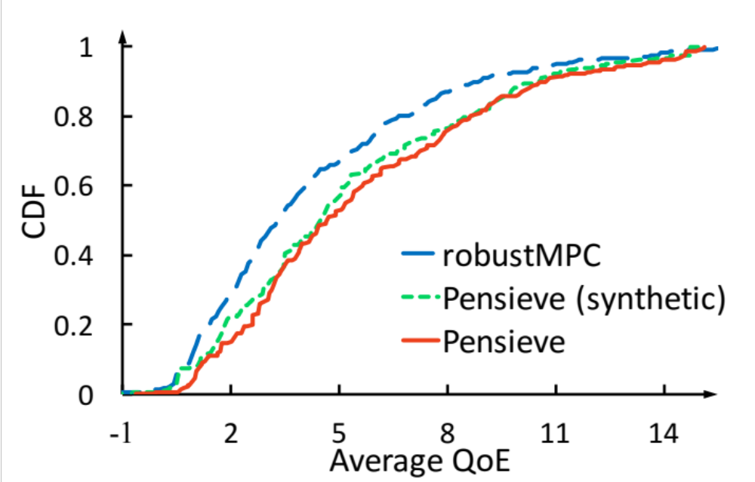
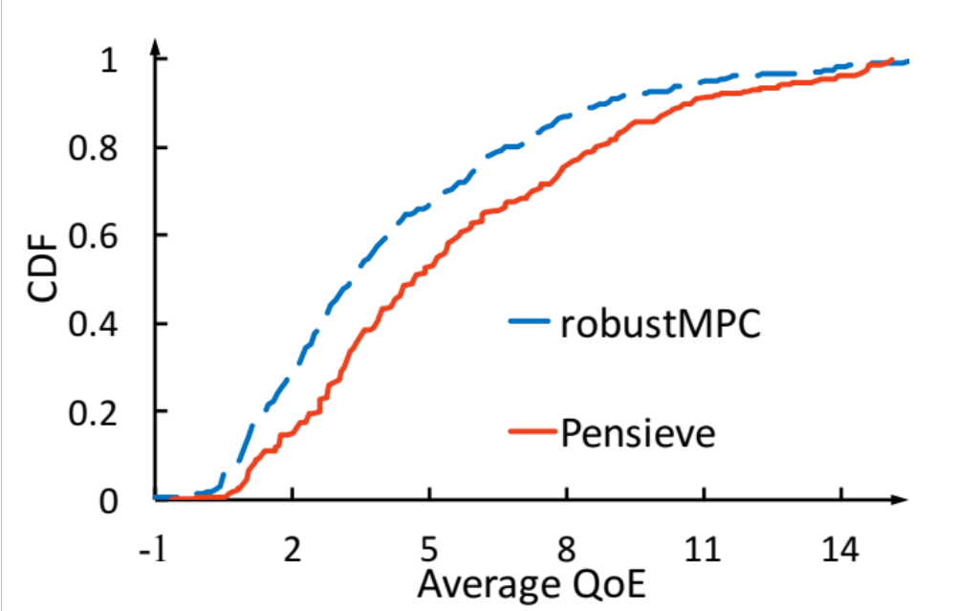
Does Pensieve Generalize?
Train on synthetic traces then test on real 3G network trace
better
Only 5% degradation compared with Pensieve trained on real network trace
Notes:
Then we take the Pensieve agent trained on synthetic network and test it on the real network trace. [click]
It turns out there’s only 5% degradation [click] compared with the Pensieve agent that was actually trained on real network, and is still better than the state-of-art scheme.
Now this suggests something very interesting. It shows we can train very robust and powerful models without even collecting a large amount of real network data. Also It means this agent is not just doing pattern recognition, it’s learning a control logic that is generalizable across datasets.

Slide 18
Other Evaluations
Experiments in the wild (LTE, public WiFi, international link)
Controlled experiment for testing optimality
Multi-video extension
Sensitivity analysis
Notes:
There are a lot more evaluations that we did in the paper but I don’t have time to cover in details, let me just summarize the highlights –
We depolyed Pensieve in the wild with different kinds of real world network conditions.
We performed a controlled experiment to test how far Pensieve is from the attainable online optimal.
We also have an extension in Pensieve’s design to support multiple videos using a single model.
And we've done sensitivity analysis about system parameters.
--
(Details:
To test real world practicality, we took the learning agent that is trained with past network traces and deploy in the wild. We tested with Verizon LTE, a public WiFi and when I travelled back to China an international link between Shanghai and Boston. It turns out Pensieve can still outperform the best comparing schemes by a sizable margin in those real networks.
We also did a controlled experiment to see how far Pensieve is from the online achievable optimal. The problem with getting a statistical optimal scheme in real network is that we can’t really determine the exact network characteristics. So we construct a controlled network and use dynamic programming to obtain an online optimal. Then we train a Pensieve agent in this environment using exactly the same setting as before. It turns out Pensieve can actually discover a policy that is very close to the achievable optimal. We think this is an interesting experiment –- It not only shows Pensieve is capable of learning the optimal scheme, it but also provide a scientific way to test how far a scheme is from the attainable optimal.
As an extension, we also have an enhancement in Pensieve’s design to support multiple videos. The key idea is we include the properties of a video in the state space, and modify the action space such that it can choose among variable number of bitrates. The experiments show this enhancement allows Pensieve to generalize well even on a new unseen video.)

Slide 19
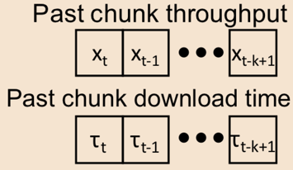
Lessons We Learned
1. Build a fast experimentation/simulation platform
2. Data diversity is more important than “accuracy”
3. Think carefully about controller state space (observation signals)
  Too large a state space ⟶ slow & difficult learning
  Too small a state space ⟶ loss of information
  ⟶ When in doubt, include rather than cut the signal
Coarse-grain chunk simulator
Pensieve agent
Notes:
Pensieve is one of the first network systems that uses the cutting edge reinforcement learning techniques. These technqiues can be applied to many other networking control problems as well. Here we just want to share a few lessons we learned over the course of developing Pensieve.
First, this kind of deep reinforcement learning techniques need a large amount of data, therefore the training of the agent is often bottlenecked by the ability to perform experiment or simulation quickly. The first thing you want is to build a very fast experimentation/simulation platform. For example, although Pensieve can be trained on real video streaming session, [click] we chose to train it with simple but fast simulator that operates at the level of video chunk. It doesn't model the network packet, it doesn't model TCP. But it's super fast, it can replay many days of video in the matter of minutes.
Next, when training these deep reinforcement learning models, data diversity helps. You want the learning agent to experience very diverse mix of network conditions. From a a statistical learning perspective, training with more varied input examples is actually a good thing for the learning algorithms to generalize. In fact, this is also why the coarse grained simulator is sufficient for Pensieve, we don’t have to have very high fidelity for any specific network trace, some noise actually helps the learning algorithm generalize.
And lastly, we need to think carefully about the design of controller state space.
There's a tradeoff between including more information in the state space and reducing the complexity of control policy. If the learning agent observes too much information, it makes the learning slow and difficult. If we confine the state space, that might lose some useful information from the environment. What we learned is, when in doubt, include rather than cut the signal. You don’t want to lose any little information that’s useful to make the control decisions. The underlining neural network is capable of extracting lots of mileage from this little but subtle information.
Let me give an example, if you remember, in our throughout representation, we include the download time of the chunk. [click] This might look strange, what we really need is throughput measurements, but reason we also include the download time is that it provides the time scale of the throughput measurements -- this is useful information, for example, the network throughput over a longer time scale is more stable than over a shorter time scale, this sequence of intervals lets you estimate the variance of the network. We found that if we omit this information, it actually hurts the performance by 2 to 3%.
So Pensieve can make use of all this kind of little information to make best decision for the next bitrate, through its experience of interacting with the environment.

Slide 20
Summary
Pensieve uses Reinforcement Learning to generate ABR algorithms
Pensieve optimizes different network conditions through experience
Pensieve outperforms existing approaches across a wide range of network environments and QoE preferences
Policies generated by Pensieve have strong ability to generalize
http://web.mit.edu/pensieve/
Notes:
As a summray, Pensieve is a system that uses reinforcement learning to genreate ABR algorithms. It optimizes for different network conditions through experience. Pensieve outperforms state-of-the-art schemes in a wide range of settings. And it generalizes well even for the network conditions on which it is not explicitly trained.
More information and the open-sourced code can be found in our website.
With that, thank you and I’m happy to take questions

