Slide 1

Experience Report: System Log Analysis for Anomaly Detection
Shilin He, Jieming Zhu, Pinjia He, and Michael R. Lyu
Department of Computer Science and Engineering,
The Chinese University of Hong Kong, Hong Kong
2016/10/26

Slide 2
Outline
Background & Motivation
Framework
Supervised Anomaly Detection
Unsupervised Anomaly Detection
Evaluation
Conclusion
2

Slide 3
Outline
Background & Motivation
Framework
Supervised Anomaly Detection
Unsupervised Anomaly Detection
Evaluation
Conclusion

Slide 4


Background
Operating systems, software frameworks, distributed systems, etc.

Slide 5






Background
Especially, many online services and applications are deployed on distributed systems.
…

Slide 6




Background
System breakdown causes significant revenue loss.
System
Failures
Anomaly detection could pinpoint issues promptly and help resolve them immediately.

Slide 7
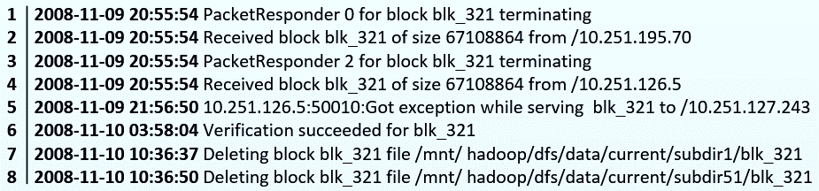
Background
Logs :
Logs are the main data source for system anomaly detection.
Logs are routinely generated by systems (e.g., 24 x 7 basis).
Logs record detailed runtime information, e.g., timestamp, state, IP address.

Slide 8

Background
Manual inspection of logs becomes impossible!
Check logs manually? Oh, NO!
Systems are often implemented by hundreds of developers.
Logs are generated at a high rate & Noisy data are hard to distinguish.
Systems generate duplicated logs due to fault tolerant mechanism.
Many automated log-based anomaly detection methods are proposed!

Slide 9
Background
Log-based anomaly detection methods:
Failure diagnosis using decision trees [ICAC’04]
Failure prediction in IBM bluegene/l event logs [ICDM’07]
Detecting largescale system problems by mining console logs [SOSP’09]
Mining invariants from console logs for system problem detection. [USENIX ATC’10]
Log Clustering based Problem Identification for Online Service Systems [ICSE’16]
…

Slide 10
Outline
Background & Motivation
Framework
Supervised Anomaly Detection
Unsupervised Anomaly Detection
Evaluation
Conclusion

Slide 11

Motivation
Developers are not aware of the state-of-the-art log-based anomaly detection methods.
No open-source tools are currently available.
Lack of comparison among existing anomaly detection methods.
Academia
Industry

Slide 12
Outline
Background & Motivation
Framework
Supervised Anomaly Detection
Unsupervised Anomaly Detection
Evaluation
Conclusion

Slide 13
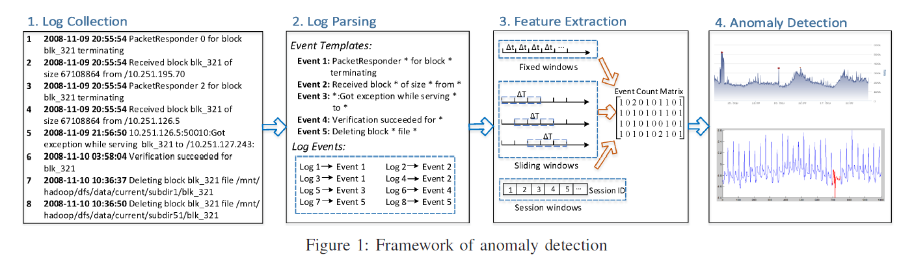
Framework

Slide 14

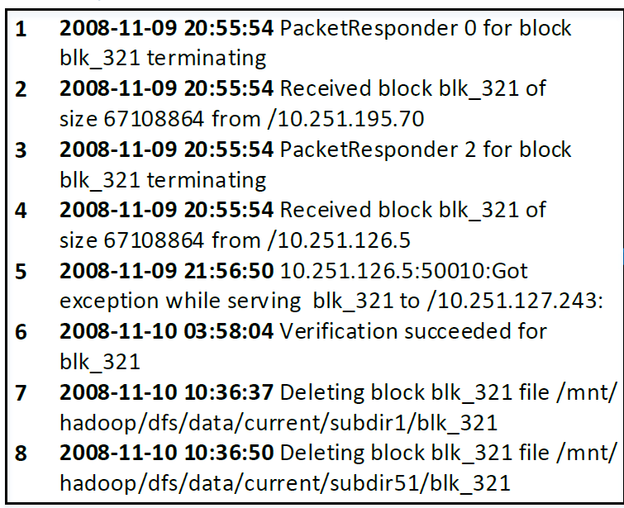
1. Log Collection

Slide 15
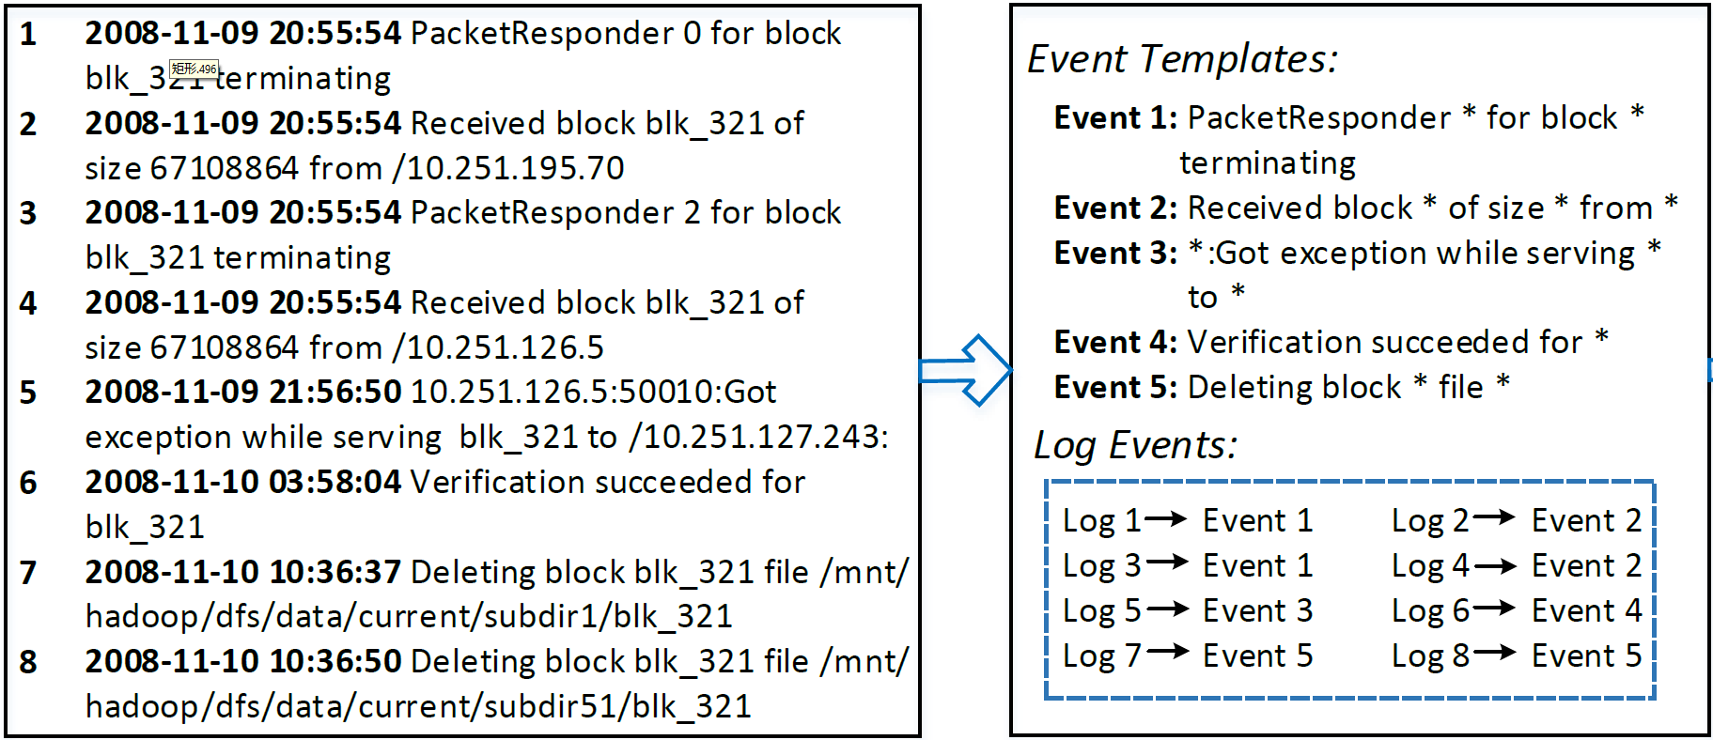


2. Log Parsing

Slide 16
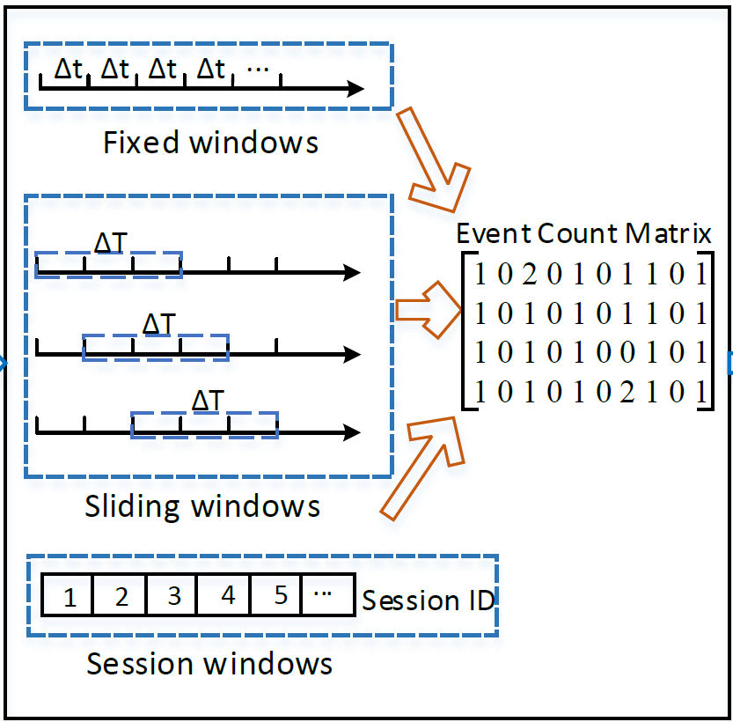
3. Feature Extraction
Divide all logs into different log sequences (windows)
log sequence <=> row in the event count matrix.
Windows | Basis
Fixed windows | Time
Sliding windows | Time
Session windows | Identifiers

Slide 17

4. Anomaly Detection
Anomaly detection methods
Supervised
Unsupervised
Logistic Regression
Decision Tree
Support Vector Machine
Log Clustering
PCA
Invariants Mining

Slide 18
Outline
Background & Motivation
Framework
Supervised Anomaly Detection
Unsupervised Anomaly Detection
Evaluation
Conclusion

Slide 19
Supervised Anomaly Detection
Logistic Regression
Decision Tree
Support Vector Machine (SVM)
Build model with training data
Apply model on testing data
Measure performance
General procedure:
Training
Testing
All data

Slide 20
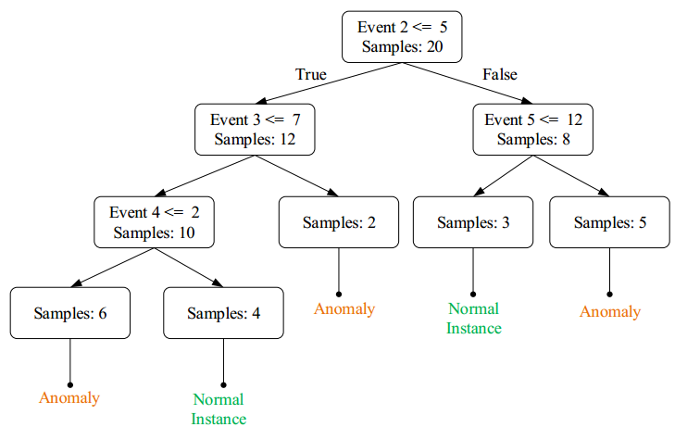

Supervised Anomaly Detection
Trained Decision Tree Example:
#
#
#
#
Anomaly

Slide 21
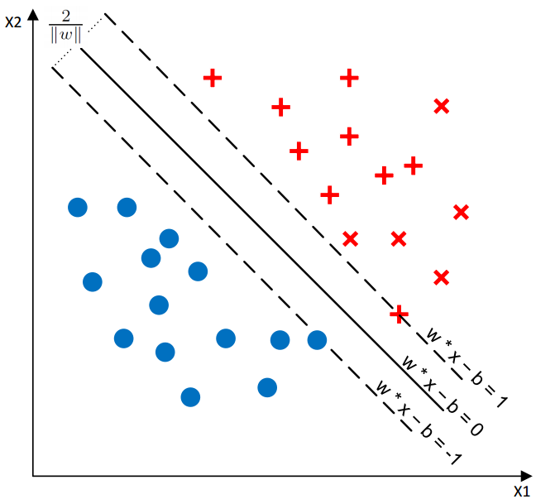
Supervised Anomaly Detection
Trained SVM Example:
Anomalies
Normal instances

Slide 22
Outline
Background & Motivation
Framework
Supervised Anomaly Detection
Unsupervised Anomaly Detection
Evaluation
Conclusion

Slide 23
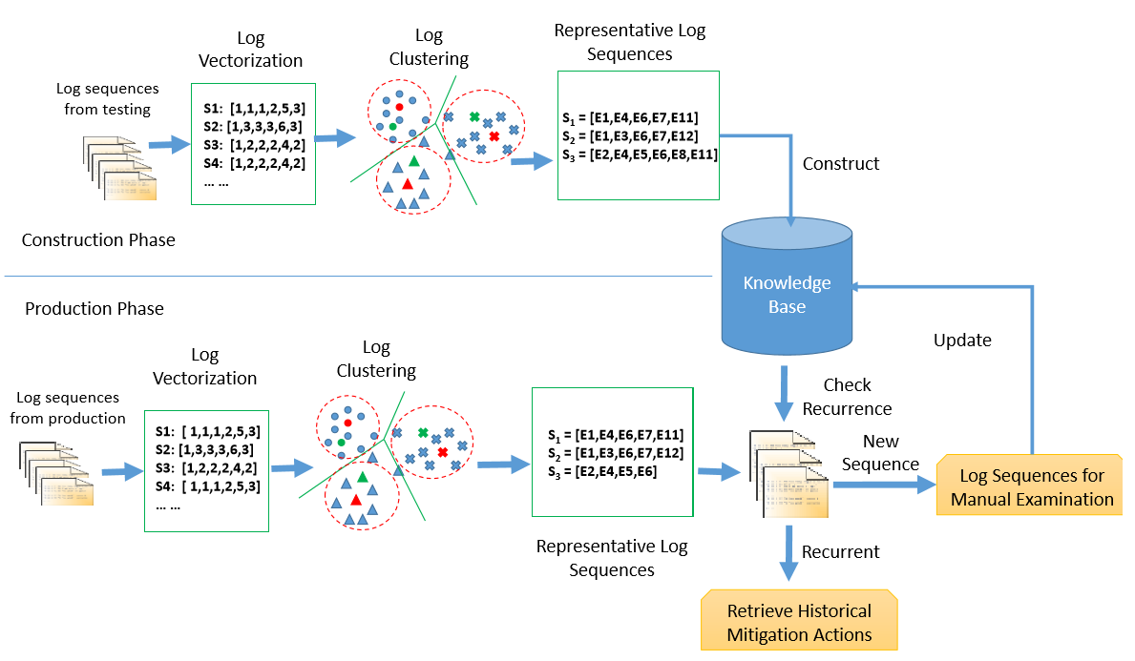
Log Clustering
Notes:
Knowledge base initialization phase contains three steps: using data from testing environment, log vectorization, log clustering, representative vectors extraction. Firstly, log sequences are vectorized as event count vectors, which are further revised by Inverse Document Frequency (IDF) [41] and normalization. Secondly, LogCluster clusters normal and abnormal event count vectors separately with agglomerative hierarchical clustering, which generates two sets of vector clusters (i.e., normal clusters and abnormal clusters) as knowledge base. Finally, we select a representative vector for each cluster by computing its centroid.
Online learning phase is used to further adjust the clusters constructed in knowledge base initialization phase. In online learning phase, event count vectors are added into the knowledge base one by one. Given an event count vector, the distances between it and existing representative vectors are computed. If the smallest distance is less than a threshold, this event count vector will be added to the nearest cluster and the representative vector of this cluster will be updated. Otherwise, LogCluster creates a new cluster using this event count vector.
After constructing the knowledge base and complete the online learning process, LogCluster can be employed to detect anomalies. Specifically, to determine the state of a new log sequence, we compute its distance to representative vectors in knowledge base. If the smallest distance is larger than a threshold, the log sequence is reported as an anomaly. Otherwise, if the nearest cluster is a normal/an abnormal cluster, the log sequence is reported as normal/abnormal.

Slide 24
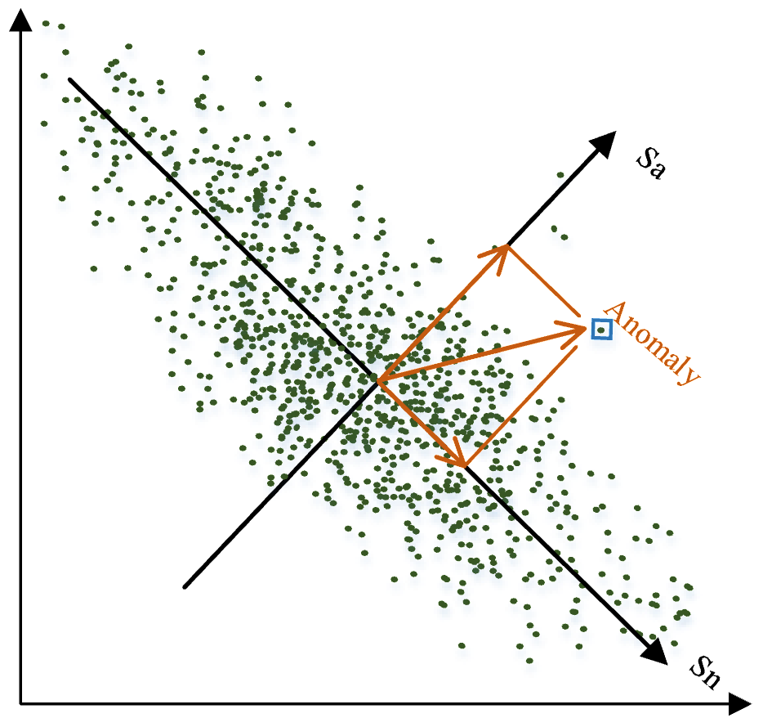

PCA
Two subspaces are generated by PCA:
Sn: Normal Space, constructed by first k principal components.
Sa: Anomaly Space, constructed by remaining (n-k) components.
Project y into anomaly space using
where P is the vector of first k principal components.
An event count vector is regarded as anomaly if
Q is the threshold
Notes:
Squared prediction error
that has been widely used to conduct dimension reduction. The
basic idea behind PCA is to project high-dimension data (e.g.,
high-dimension points) to a new coordinate system composed
of k principal components (i.e., k dimensions), where k is set
to be less than the original dimension. PCA calculates the k
principal components by finding components (i.e., axes) which
catch the most variance among the high-dimension data. Thus,
the PCA-transformed low-dimension data can preserve the
major characteristics (e.g., the similarity between two points)
of the original high-dimension data. For example, in Figure
3, PCA attempts to transform two-dimension points to onedimension
points. Sn is selected as the principal component
because the distance between points can be best described by
mapping them to Sn.
PCA was first applied in log-based anomaly detection by
Xu et al. [47]. In their anomaly detection method, each log
sequence is vectorized as an event count vector. After that,
PCA is employed to find patterns between the dimensions
of event count vectors. Employing PCA, two subspace are
generated, namely normal space Sn and anomaly space Sa.
Sn is constructed by the first k principal components and Sn
is constructed by the remaining (n−k), where n is the original
dimension. Then, the projection ya = (1−PPT )y of an event
count vector y to Sa is calculated, where P = [v1,v2, . . . , vk,]
is the first k principal components. If the length of ya is larger
A B Cond.
C
E
F
D
G
X 0
X == 0
X 0
Figure 4: An example of execution flow
than a threshold, the corresponding event count vector will be
reported as an anomaly. For example, the selected point in
Figure 3 is an anomaly because the length of its projection on
Sa is too large. Specifically, an event count vector is regarded
as anomaly if
SPE ≡ ya2 > Qα
where squared prediction error (i.e., SPE) represents the
“length”, and Qα is the threshold providing (1 − α) confidence
level. We set Q = 0.001 as in the original paper. For k,
we calculate it automatically by adjusting the PCA to capture
95% variance of the data, also same as the original paper.

Slide 25
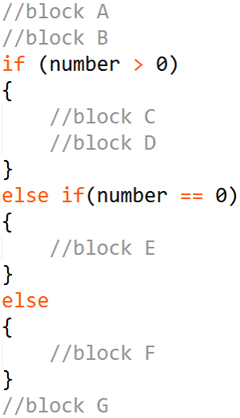
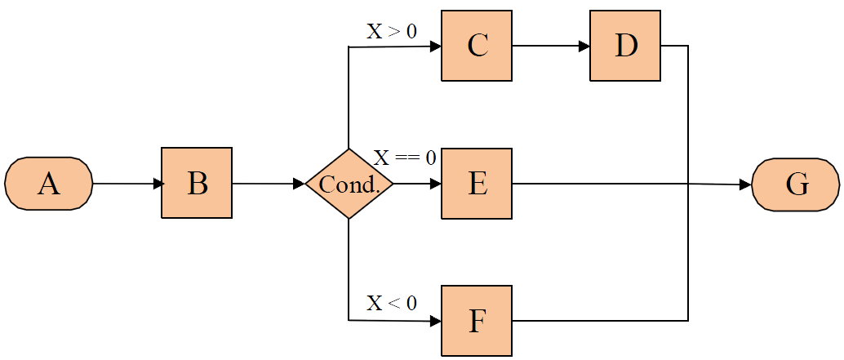
Invariants Mining
Code:
Program Execution Flow:

Slide 26
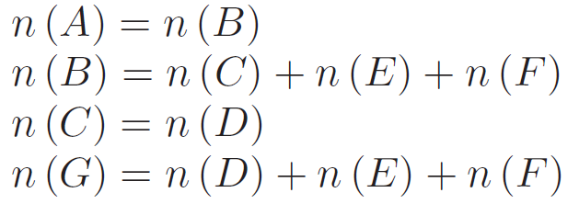
Invariants Mining
Main process:
Build event count matrix
Estimate the invariant space (r invariants) using SVD
Search invariants with a brute force algorithm
Validate the mined invariants until r invariants are obtained

Slide 27
Outline
Background & Motivation
Framework
Supervised Anomaly Detection
Unsupervised Anomaly Detection
Evaluation
Conclusion

Slide 28
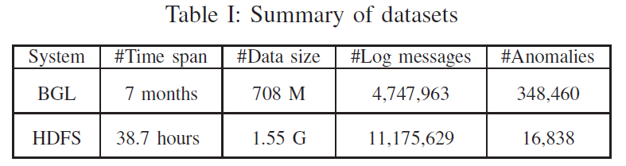
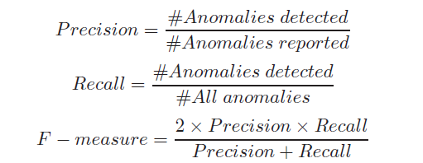

Evaluation
Data sets
Fixed windows & Sliding windows
Session windows
Performance metric
Notes:
Labels are given for each block, thus we can only use the session window to extract features.

Slide 29
Evaluation
Q1: What is the accuracy of supervised anomaly detection?
Q2: What is the accuracy of unsupervised anomaly detection?
Q3: What is the efficiency of these anomaly detection?

Slide 30
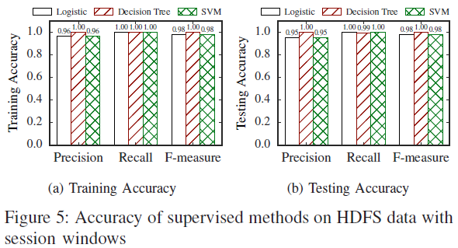
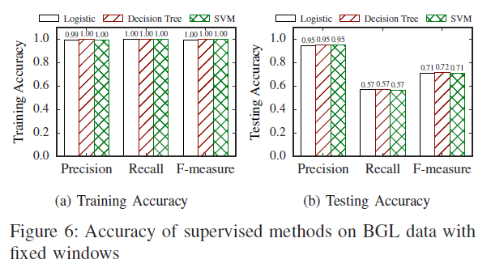
Evaluation
1. Accuracy of Supervised Methods
More sensitive
Finding 1: Supervised anomaly detection achieves high precision, while recall varies.
Notes:
anomaly patterns unseen in training data set

Slide 31
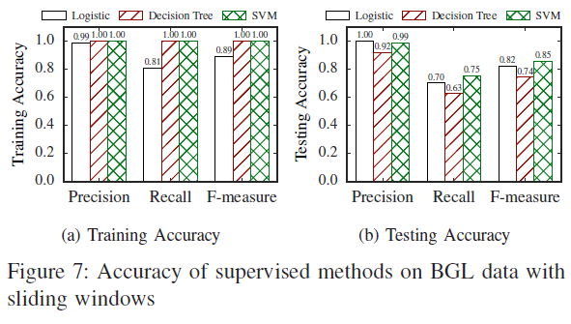
Evaluation
1. Accuracy of Supervised Methods
Finding 2: Sliding windows achieve higher accuracy than fixed windows
Notes:
Hard boundary in fixed window might make anomaly pattern broken.

Slide 32
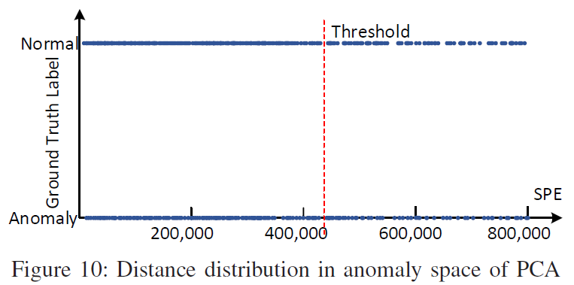
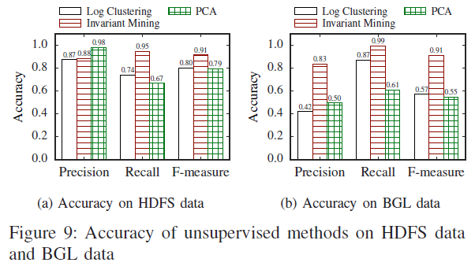
Evaluation
2. Accuracy of Unsupervised Methods
Finding 3:Unsupervised methods are not as good as supervised methods except Invariants Mining

Slide 33
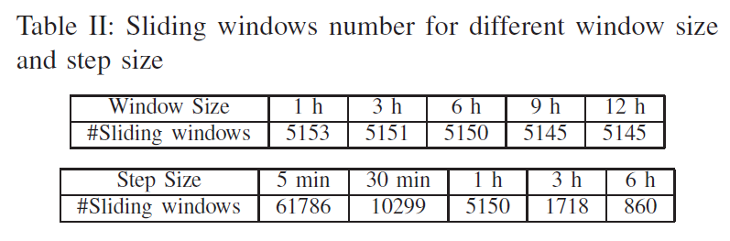
Evaluation
3. Effects of window setting on supervised & unsupervised methods

Slide 34
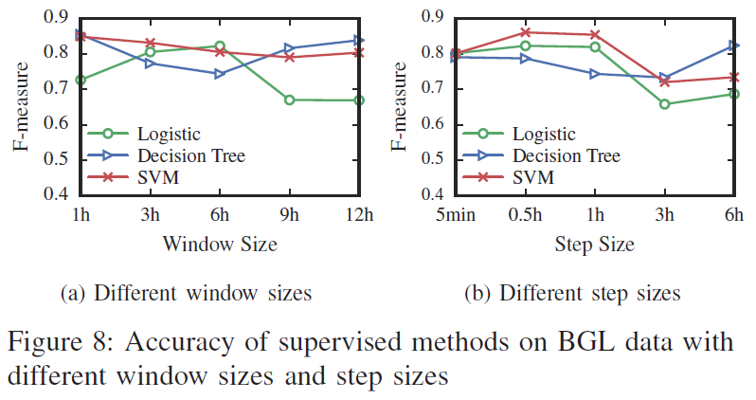
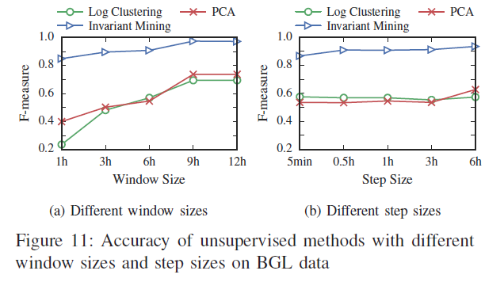
Evaluation
3. Effects of window setting on supervised & unsupervised methods
Finding 4:Different window sizes and step sizes affect the methods differently.

Slide 35
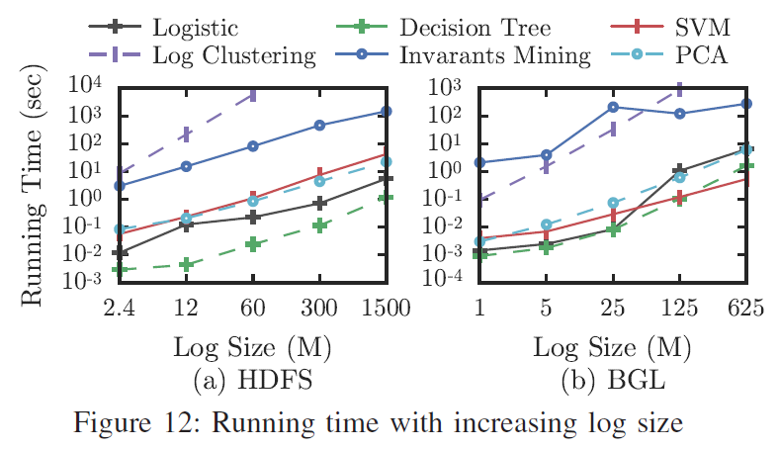
Evaluation
4. Efficiency of Anomaly Detection Methods
Finding 5: Most anomaly detection scale linearly with log size except Log Clustering and Invariants Mining.

Slide 36
Outline
Background & Motivation
Framework
Supervised Anomaly Detection
Unsupervised Anomaly Detection
Evaluation
Conclusion

Slide 37
Conclusion
In this paper, we
fill the gap by providing a detailed review and evaluation of six state-of-the-art anomaly detection methods. (over 4000 lines of Python codes)
compare their accuracy and efficiency on two representative production log datasets.
release an open-source toolkit of these anomaly detection methods for easy reuse and further study.

Slide 38
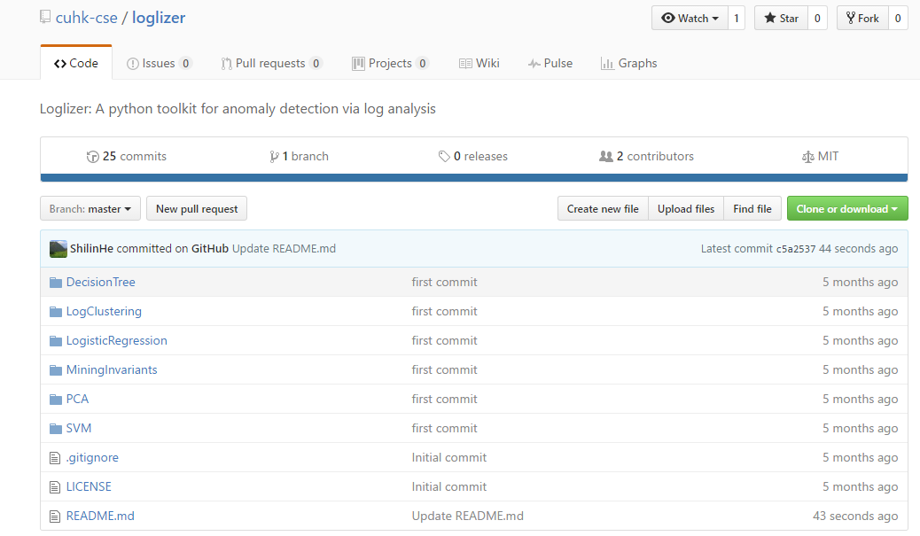



Demo
https://github.com/cuhk-cse/loglizer

Slide 39

Thanks!
Q & A

