Slide 1


LogTransfer: Cross-System Log Anomaly Detection for Software Systems with Transfer Learning
Rui Chen¹，Shenglin Zhang¹，Dongwen Li¹，Yuzhe Zhang¹，Fangrui Guo¹，Weibin Meng²，Dan Pei²， Yuzhi Zhang¹, Xu Chen¹，Yuqing Liu¹
¹Nankai University， ²Tsinghua University
Notes:
Hello, I’m Rui Chen from college of software, Nankai University. I’m going to present our work “LogTransfer Cross-System Log Anomaly Detection for Software Systems with Transfer Learning”. This is a joint work with the co-authors listed in this slide from Nankai University and Tsinghua University.

Slide 2
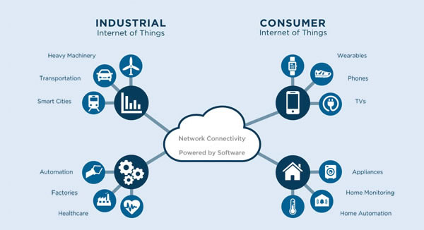
Software systems
Software systems are playing important roles in daily life.
Reliability as well as availability are highly demanded in modern software systems.
400
396
Traffic will increase more than three times
300
319
200
254
201
100
156
122
0
2017
2018
2019
2020
2021
2022
1. cited from: http://www.hidrfid.com/rfid/news/1328.html
Notes:
In the following several slides, I’d like to introduce the background and the motivation of our work briefly.
Software systems are pervasive [pəˈveɪsɪv] in our daily life. The complexity of software services increase dramatically, a large number of software systems have been deployed on different types of services. For instance, cloud computing, e-commerce, 5G [ˌet ˈsetərə]
Since the scale of software systems increases rapidly, reliability as well as availability are therefore highly demanded.

Slide 3


System anomaly
System anomalies will cause degradation, impact revenue and user experience.
How to comprehensively and precisely detect anomalies has brought about widespread attention！
1. cited from: https://www.bloomberg.com/news/articles/2016-09-02/delta-says-computer-system-breakdown-cut-revenue-by-100-million
2. cited fromhttps://www.buildings.com/news/industry-news/articleid/20588/title/data-center-outages-cost-nearly-9-000-per-minute-
Notes:
One of threats to software systems’ reliability is the system anomaly. The anomalies would cause degradation, impact revenue and user experience as can be seen from the news below. How to comprehensively and precisely detect anomalies has brought about widespread attention.

Slide 4
System anomaly
An instance of a system anomaly
Jan 10 06:35:36 192.168.193.40 : 2016 Jan 10 06:35:31 GMT: %ETH_PORT_CHANNEL-5-PORT_SUSPENDED: Ethernet11/40: Ethernet11/40 is suspended
Jan 10 06:35:36 192.168.193.40 : 2016 Jan 10 06:35:31 GMT: %ETH_PORT_CHANNEL-5-PORT_SUSPENDED: Ethernet11/41: Ethernet11/41 is suspended
Jan 10 06:35:58 192.168.193.40 : 2016 Jan 10 06:35:53 GMT: %SYSMGR-SLOT11-2-TMP_DIR_FULL: System temporary directory usage is unexpectedly high at 100%.
Jan 10 06:36:07 192.168.193.40 : 2016 Jan 10 06:36:01 GMT: %ETH_PORT_CHANNEL-5-PORT_SUSPENDED: Ethernet11/40: Ethernet11/40 is suspended
Jan 10 06:36:07 192.168.193.40 : 2016 Jan 10 06:36:01 GMT: %ETH_PORT_CHANNEL-5-PORT_SUSPENDED: Ethernet11/41: Ethernet11/41 is suspended
Jan 10 06:36:10 192.168.193.40 : 2016 Jan 10 06:36:04 GMT: %OSPF-5-ADJCHANGE: ospf-1 [6940] Nbr 10.231.36.154 on port-channel102 went DOWN
Jan 10 06:36:37 192.168.193.40 : 2016 Jan 10 06:36:32 GMT: %ETH_PORT_CHANNEL-5-PORT_SUSPENDED: Ethernet11/40: Ethernet11/40 is suspended
Jan 10 06:36:37 192.168.193.40 : 2016 Jan 10 06:36:32 GMT: %ETH_PORT_CHANNEL-5-PORT_SUSPENDED: Ethernet11/41: Ethernet11/41 is suspended
Jan 10 06:36:53 192.168.193.40 : 2016 Jan 10 06:36:48 GMT: %ETH_PORT_CHANNEL-5-PORT_DOWN: port-channel102: Ethernet12/18 is down
Jan 10 06:36:53 192.168.193.40 : 2016 Jan 10 06:36:48 GMT: %ETH_PORT_CHANNEL-5-FOP_CHANGED: port-channel102: first operational port changed from Ethernet12/18 to Ethernet12/19
Jan 10 06:36:53 192.168.193.40 : 2016 Jan 10 06:36:48 GMT: %ETHPORT-5-IF_BANDWIDTH_CHANGE: Interface port-channel102,bandwidth changed to 20000000 Kbit
Jan 10 06:36:53 192.168.193.40 : 2016 Jan 10 06:36:48 GMT: %ETHPORT-5-IF_DOWN_INITIALIZING: Interface Ethernet12/18 is down (Initializing)
Jan 10 06:36:53 192.168.193.40 : 2016 Jan 10 06:36:48 GMT: %ETH_PORT_CHANNEL-5-PORT_DOWN: port-channel102: Ethernet12/19 is down
Jan 10 06:36:53 192.168.193.40 : 2016 Jan 10 06:36:48 GMT: %ETH_PORT_CHANNEL-5-FOP_CHANGED: port-channel102: first operational port changed from Ethernet12/19 to Ethernet12/20
Jan 10 06:36:53 192.168.193.40 : 2016 Jan 10 06:36:48 GMT: %ETHPORT-5-IF_BANDWIDTH_CHANGE: Interface port-channel102,bandwidth changed to 10000000 Kbit
Jan 10 06:36:53 192.168.193.40 : 2016 Jan 10 06:36:48 GMT: %ETHPORT-5-IF_DOWN_INITIALIZING: Interface Ethernet12/19 is down (Initializing)
Jan 10 06:36:57 192.168.193.40 : 2016 Jan 10 06:36:52 GMT: %ETHPORT-5-IF_DOWN_PORT_CHANNEL_MEMBERS_DOWN: Interface port-channel102 is down (No operational members)
Jan 10 06:36:57 192.168.193.40 : 2016 Jan 10 06:36:52 GMT: %ETH_PORT_CHANNEL-5-PORT_DOWN: port-channel102: Ethernet12/20 is down
Jan 10 06:36:57 192.168.193.40 : 2016 Jan 10 06:36:52 GMT: %ETH_PORT_CHANNEL-5-FOP_CHANGED: port-channel102: first operational port changed from Ethernet12/20 to none
Jan 10 06:36:57 192.168.193.40 : 2016 Jan 10 06:36:52 GMT: %ETHPORT-5-IF_BANDWIDTH_CHANGE: Interface port-channel102,bandwidth changed to 100000 Kbit
Jan 10 06:36:57 192.168.193.40 : 2016 Jan 10 06:36:52 GMT: %ETHPORT-5-IF_DOWN_INITIALIZING: Interface Ethernet12/20 is down (Initializing)
Jan 10 06:36:57 192.168.193.40 : 2016 Jan 10 06:36:52 GMT: %ETHPORT-5-IF_DOWN_PORT_CHANNEL_MEMBERS_DOWN: Interface port-channel102 is down (No operational members)
Notes:
This is an example of an anomalous sequence collected from a switch system. This log sequence indicates that a certain interface in the switch changes the state to down due to the system anomaly.

Slide 5
System logs
System logs are unstructured text.
A log message is composed of constant part and variable part.
……
[SIF pica_sif] Interface te-1/1/11, changed state to down.
……
Type | Contents
Variable Part | Te-1/1/11
Constant Part | Interface *** changed state to down
Notes:
Now that logs could report the current working status of the system. Logs are supposed to be able to record the system anomalies as well. We investigate some basic features of system logs. First, System logs are mostly unstructured text and second a log message is composed of constant parts and variable parts as shown in this slide.

Slide 6
Previous methods
Type | Input of Template | Method
Supervised | Template index | Decision tree
 |  | SVM
 |  | CNN-based model
 |  | Linear regression
Unsupervised | Template count | PCA
 | Template index | DeepLog
 |  | LogCluster
 |  | Isolation forest
 |  | Invariant mining
 | Template embedding | LogAnomaly
Supervised methods：Massive labelling efforts & no semantics information of logs.
Unsupervised methods: Suffering from low accuracy in real-world service systems.
Notes:
In this slide, we simply classify the existing anomaly detection methods into two categories[ˈkætɪgəriz] - supervised learning and unsupervised learning based methods. In a real-world large software services or data center with diverse types of software systems, it is difficult to deploy current anomaly detection methods. For supervised methods, massive labelling efforts are needed, moreover, no semantics information of logs is considered in current supervised methods. For unsupervised methods, the accuracy is quite low due to the high diversity of logs.

Slide 7
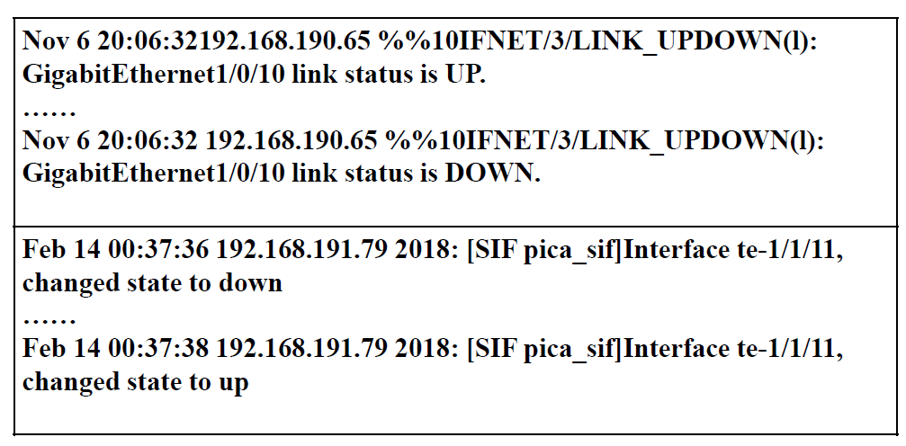
System logs in anomaly detection
Service Type A
Service Type B
Different type of systems/services event generate log sequences with similar semantics.
Notes:
After taking a glance at different types of system logs in the same software service, we found that different type of systems/services generate log sequences with similar semantics when the same events occur.
. In this slide, both of the list syslogs indicate that the system is suffering from the interface flop。

Slide 8
Can we transfer anomalous patterns from one software system to another one?
Notes:
So , can we transfer anomalous patterns from one software system to another one?

Slide 9
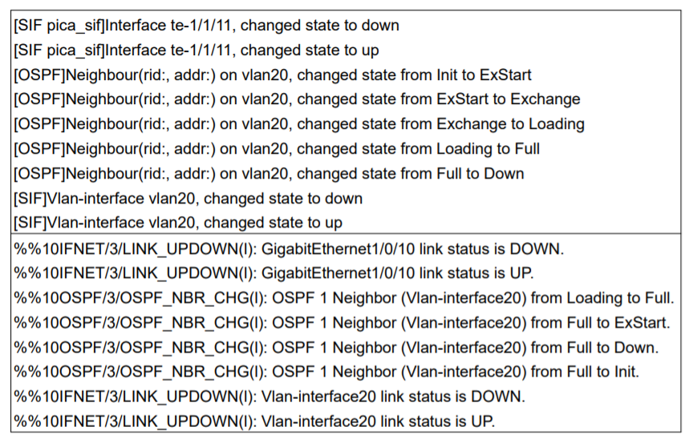
Challenges
Different types of systems are different in log syntax.
Service Type A
Service Type B
Notes:
We would like to apply transfer learning technique in anomaly detection. However our core idea faces mainly two aspects of challenges.
Firstly, Different types of systems are different in log syntax.
Logs generated by service Type A apparently have different log syntax with logs generated by service type b

Slide 10
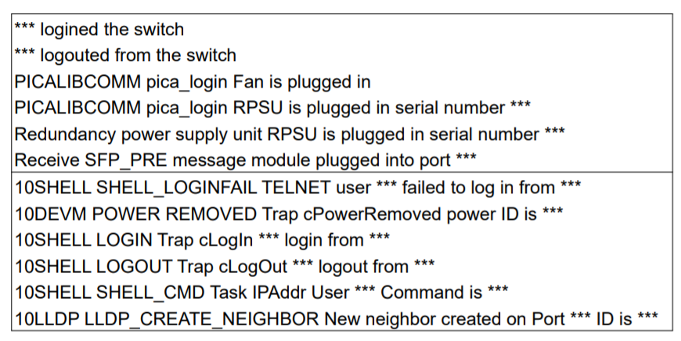
Challenges
Noises in anomalous log sequences
Service Type A
Service Type B
Notes:
Secondly, Noises in anomalous log sequences
The anomalous log sequences usually have noises which irrelevant to system anomaly and the noises can degrade the performance of anomaly detection.
For example user login information here and working status info.

Slide 11
Framework of LogTransfer
Logs of source system
Template vector sequences of source system
Labels of source system
Template
vectors
Transfer learning
Anomaly detection model for target system
An accurate representation construction method
Logs of target system
Template vector sequences of target system
Labels of target system
Representation construction
Transfer learning
Offline model training process
Notes:
To address the above two challenges, in the following slides we are going to discuss about the design of LogTransfer
This is the overall framework of Offline model of training process in LogTransfer.
There are mainly two parts in this process.
First, we design An accurate representation construction method here.

Slide 12

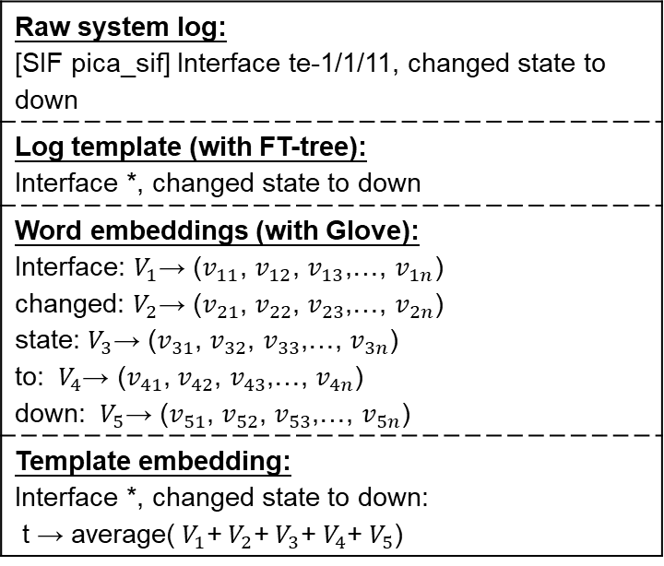
Representation construction
Building the template embedding:
  Containing semantic and syntactic information of a log entry.
Raw system log: [SIF pica_sif] Interface te-1/1/11, changed state to down
Log template (with FT-tree): Interface *, changed state to down
Word embeddings (with Glove): Interface: $V_{1}$→ ($v_{11}$, $v_{12}$, $v_{13}$,…, $v_{1n}$) changed: $V_{2}$→ ($v_{21}$, $v_{22}$, $v_{23}$,…, $v_{2n}$) state: $V_{3}$→ ($v_{31}$, $v_{32}$, $v_{33}$,…, $v_{3n}$) to: ${ V}_{4}$→ ($v_{41}$, $v_{42}$, $v_{43}$,…, $v_{4n}$) down: ${ V}_{5}$→ ($v_{51}$, $v_{52}$, $v_{53}$,…, $v_{5n}$)
Template embedding: Interface *, changed state to down: t → average(${ V}_{1}$+${ V}_{2}$+${ V}_{3}$+${ V}_{4}$+${ V}_{5}$)
the objective function of Glove:
Example of how to generate a template embedding.
Notes:
This is an example of how LogTransfer generates a template embedding. Representation construction component in LogTransfer accept raw system logs as the inputs, log template is generated with FT-tree, then Glove is utilized as the word distributed representation methods. Lastly, template embedding is the average of the embedding of each word in the template.
**click**
Specifically, to accurately measure the similarities of cross-system logs, we use Glove to construct logs’ representations since Glove could not only extracts the local context information but also considers the global word co-occurrence information of template set.

Slide 13
Transfer learning
Logs of source system
Template vector sequences of source system
Labels of source system
Template
vectors
Transfer learning
Anomaly detection model for target system
A novel transfer learning method.
Logs of target system
Template vector sequences of target system
Labels of target system
Representation construction
Transfer learning
Notes:
We also design a novel transfer learning method in LogTransfer.

Slide 14
Transfer learning
Fully Connected Network
Fully Connected Network for anomaly detection
LSTM Networks
LSTM networks to extract the pattern of log sequences
Template Vector sequences
Template vector sequences with syntactic and semantic info.
Notes:
Simply speaking, base model of LogTransfer is composed of the following three parts:
The template vector sequences generated in the former step contains syntactic and semantic info. of system logs
Then, LSTM networks are utilized to extract the pattern of log sequences
Lastly, Fully Connected Network for anomaly detection

Slide 15
Transfer learning
Labels of source system
Shared fully connected networks
Source LSTM networks
Target LSTM networks
Labels of
target system
Template vector sequences of source system
Template vector sequences of target system
Source system
Target system
Notes:
This is the detailed process of transfer learning part
Template vector sequences and labels from the source system are firstly fed into the model, then we fix the parameters in shared fully connected networks and Template vector sequences and labels in target system are used to finetune the model

Slide 16
Framework of LogTransfer
Online anomaly detection process
New logs of target system
Target LSTM networks
Template vector sequences
Shared fully connected networks
Anomaly detection result
Notes:
To deploy LogTransfer in real world software systems. this is Online anomaly detection process for the new logs, new logs of target system are fed into LogTransfer and anomaly detection result would be generated.

Slide 17
Dataset introduction
Three switch system log from a top cloud service provider
The Hadoop application dataset & the HDFS dataset
Source of dataset | Type of system | Source of labels | # chunks | # anomalous chunks | # switches/log files
Switch | Type A | Real-world anomalies | 2,345,646 | 6,406 | 22
 | Type B |  | 49,946 | 1,096 | 14
 | Type C |  | 525,427 | 4,939 | 21
Hadoop application | PageRank & WordCount | Manually injected | 121,878 | 73,936 | 1008
Hadoop file system | HDFS | Real-world anomalies | 3,725,203 | 108,024 | 575,061
Notes:
In the following slides ,we’ll present the evaluation results and conclusion of our work.
We use five dataset listed in this table
All the dataset have the anomalous labels.

Slide 18
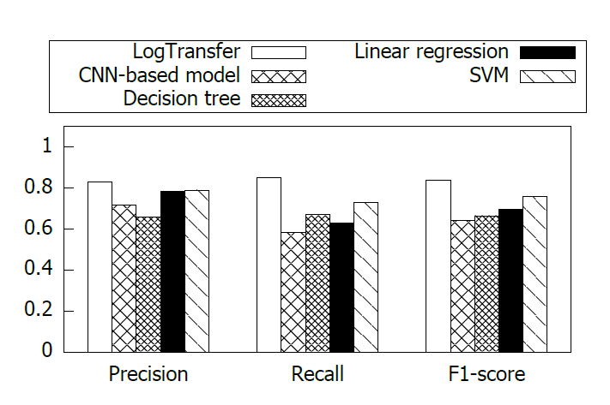
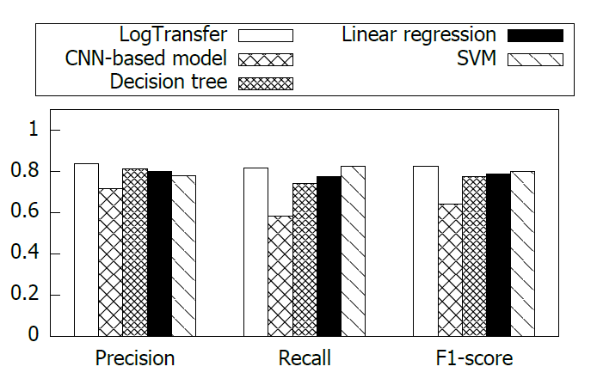
Overall Performance
Evaluation results on switch logs dataset with supervised learning-based model
Switch log A -> Switch log B accuracy comparison
Switch log C -> Switch log B accuracy comparison
Notes:
First, I’d like to present the overall performance of LogTransfer. We compared LogTransfer with supervised learning based model and unsupervised based model respectively. This slide present the Evaluation Results on Switch Logs Dataset with Supervised learning-based Model, LogTransfer could achieve an averaged 0.84 F1-score which
outperforms the state-of-the-art methods. It is because labels for supervised learning is insufficient.

Slide 19
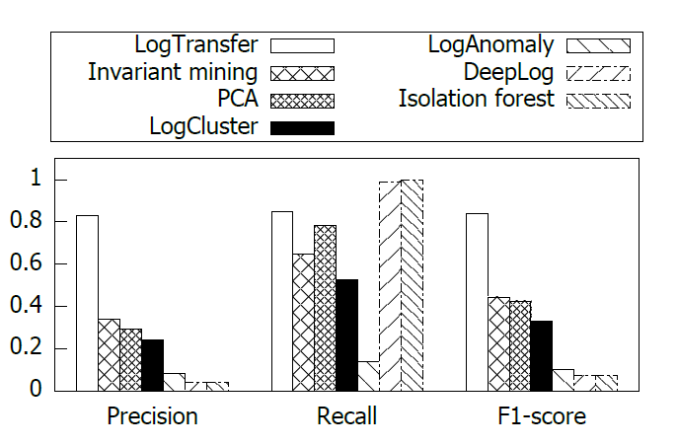
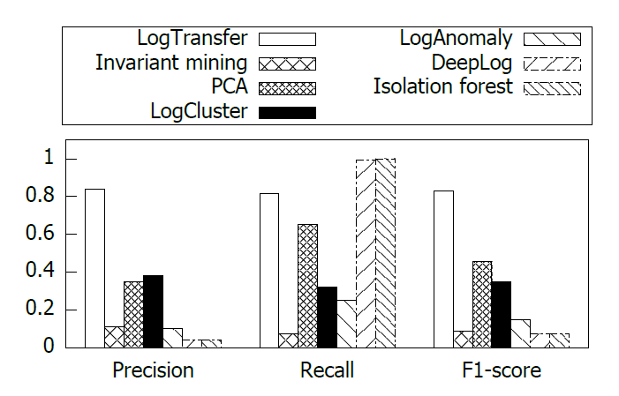
Overall Performance
Evaluation results on switch logs dataset with unsupervised learning-based model
Switch log A -> Switch log B accuracy comparison
Switch log C -> Switch log B accuracy comparison
Notes:
This is the Evaluation Results on Switch Logs Dataset with Unsupervised learning-based Model. Unsupervised learning based models suffer from low accuracy due to the high diversity of logs

Slide 20
Word embedding method evaluation
Comparison between LogTransfer with word2Vec & LogTransfer
Method | F1-score | AUC score | #False positive | #False negative
LogTransfer w/ word2Vec | 0.8368 | 0.8881 | 88 | 84
LogTransfer | 0.8606 | 0.9243 | 80 | 59
Notes:
Since word2vec is famous word embedding method, to prove that our template representation method could help improving the model performance ,we compare LogTransfer using word2Vec as the representation method with LogTransfer.

Slide 21
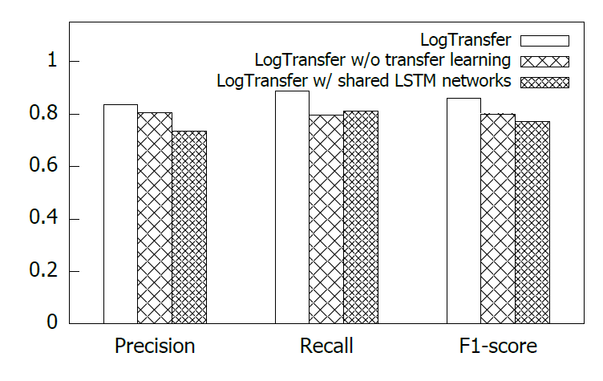
Transfer learning evaluation
Evaluation of the transfer learning method
Notes:
To prove that our transfer learning approach could improve the model performance, We also compare LogTransfer with LogTransfer without transfer learning and LogTransfer with shared LSTM networks. In this figure,
Without transfer learning, the insufficient number of anomaly labels can lead the anomaly detection model to be biased
Sharing LSTM networks only transfer sequential knowledge from the source system to the target system, the performance of which is easily impacted by the noises.

Slide 22
Contributions
A new anomaly detection method
We are the first to apply transfer learning for log anomaly detection
A new log representation method
We propose to use Glove to construct logs’ representations to accurately measure the similarities of cross-system logs.
A new transfer learning approach
We propose a novel transfer learning approach that shares fully connected networks between source and target systems, addressing the impact induced by the noises in log sequences.
An extensive evaluation
We have conducted extensive evaluation experiments using real-world logs to demonstrate LogTransfer’s performance.
We identify the challenges lying in that for a large software service.
Notes:
To sum up, we mainly have the following four contributions,
A new anomaly detection method
we are the first to apply transfer learning for log anomaly detection and identify the
challenges lying in that for a large software service.
A new logs’ representations
We propose to use Glove to construct logs’ representations to accurately measure the similarities of cross-system logs.
A new transfer learning approach
We propose a novel transfer learning approach that shares fully connected networks between source and target systems, addressing the impact induced by the noises in log sequences.
An extensive evaluation
We have conducted extensive evaluation experiments using real-world logs to demonstrate LogTransfer’s performance.

Slide 23
Thanks
Q&A

