Slide 1

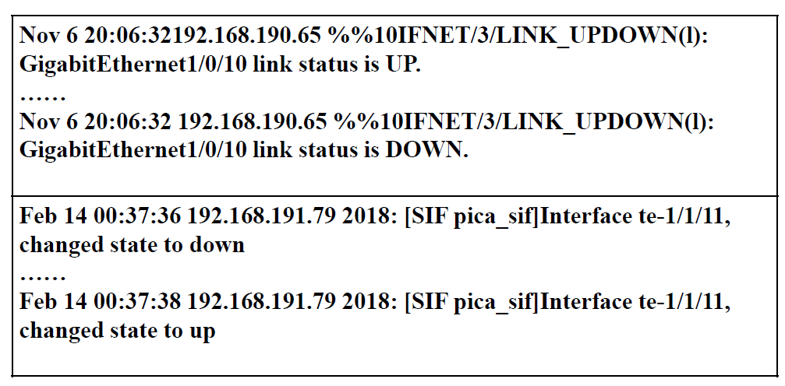
System logs in anomaly detection
Service Type A
Service Type B
Different type of systems/services event generate log sequences with similar semantics.
Notes:
After taking a glance at different types of system logs in the same software service, we found that different type of systems/services generate log sequences with similar semantics when the same events occur.
. In this slide, both of the list syslogs indicate that the system is suffering from the interface flop。

Slide 2
Can we transfer anomalous patterns from one software system to another one?
Notes:
So , can we transfer anomalous patterns from one software system to another one?

Slide 3
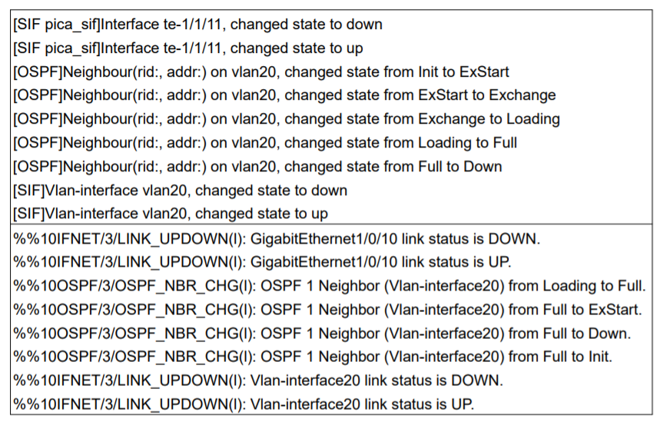
Challenges
Different types of systems are different in log syntax.
Service Type A
Service Type B
Notes:
We would like to apply transfer learning technique in anomaly detection. However our core idea faces mainly two aspects of challenges.
Firstly, Different types of systems are different in log syntax.
Logs generated by service Type A apparently have different log syntax with logs generated by service type b

Slide 4
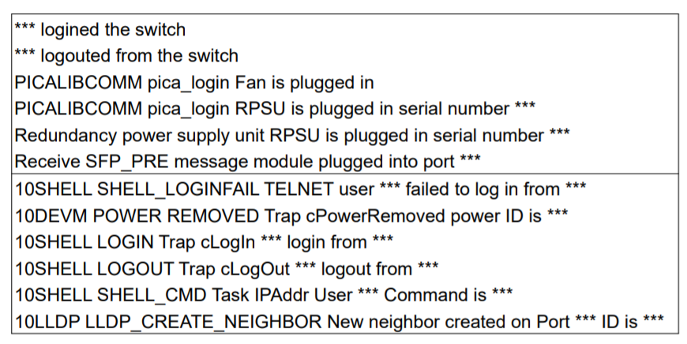
Challenges
Noises in anomalous log sequences
Service Type A
Service Type B
Notes:
Secondly, Noises in anomalous log sequences
The anomalous log sequences usually have noises which irrelevant to system anomaly and the noises can degrade the performance of anomaly detection.
For example user login information here and working status info.

Slide 5
Framework of LogTransfer
Logs of source system
Template vector sequences of source system
Labels of source system
Template
vectors
Transfer learning
Anomaly detection model for target system
An accurate representation construction method
Logs of target system
Template vector sequences of target system
Labels of target system
Representation construction
Transfer learning
Offline model training process
Notes:
To address the above two challenges, in the following slides we are going to discuss about the design of LogTransfer
This is the overall framework of Offline model of training process in LogTransfer.
There are mainly two parts in this process.
First, we design An accurate representation construction method here.

Slide 6

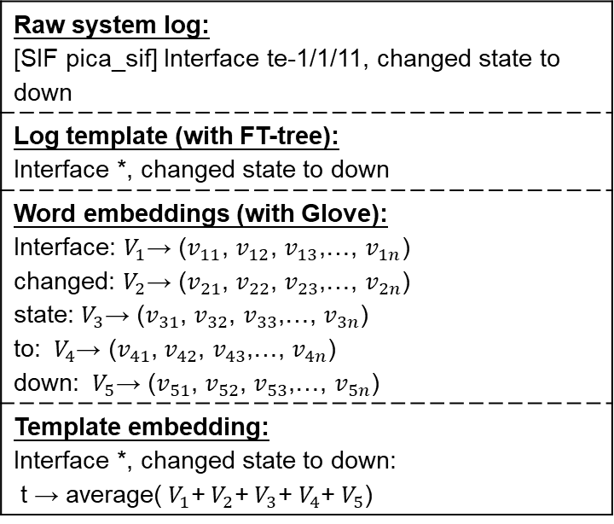
Representation construction
Building the template embedding:
  Containing semantic and syntactic information of a log entry.
Raw system log: [SIF pica_sif] Interface te-1/1/11, changed state to down
Log template (with FT-tree): Interface *, changed state to down
Word embeddings (with Glove): Interface: $V_{1}$→ ($v_{11}$, $v_{12}$, $v_{13}$,…, $v_{1n}$) changed: $V_{2}$→ ($v_{21}$, $v_{22}$, $v_{23}$,…, $v_{2n}$) state: $V_{3}$→ ($v_{31}$, $v_{32}$, $v_{33}$,…, $v_{3n}$) to: ${ V}_{4}$→ ($v_{41}$, $v_{42}$, $v_{43}$,…, $v_{4n}$) down: ${ V}_{5}$→ ($v_{51}$, $v_{52}$, $v_{53}$,…, $v_{5n}$)
Template embedding: Interface *, changed state to down: t → average(${ V}_{1}$+${ V}_{2}$+${ V}_{3}$+${ V}_{4}$+${ V}_{5}$)
the objective function of Glove:
Example of how to generate a template embedding.
Notes:
This is an example of how LogTransfer generates a template embedding. Representation construction component in LogTransfer accept raw system logs as the inputs, log template is generated with FT-tree, then Glove is utilized as the word distributed representation methods. Lastly, template embedding is the average of the embedding of each word in the template.
**click**
Specifically, to accurately measure the similarities of cross-system logs, we use Glove to construct logs’ representations since Glove could not only extracts the local context information but also considers the global word co-occurrence information of template set.

Slide 7
Transfer learning
Logs of source system
Template vector sequences of source system
Labels of source system
Template
vectors
Transfer learning
Anomaly detection model for target system
A novel transfer learning method.
Logs of target system
Template vector sequences of target system
Labels of target system
Representation construction
Transfer learning
Notes:
We also design a novel transfer learning method in LogTransfer.

Slide 8
Transfer learning
Fully Connected Network
Fully Connected Network for anomaly detection
LSTM Networks
LSTM networks to extract the pattern of log sequences
Template Vector sequences
Template vector sequences with syntactic and semantic info.
Notes:
Simply speaking, base model of LogTransfer is composed of the following three parts:
The template vector sequences generated in the former step contains syntactic and semantic info. of system logs
Then, LSTM networks are utilized to extract the pattern of log sequences
Lastly, Fully Connected Network for anomaly detection

Slide 9
Transfer learning
Labels of source system
Shared fully connected networks
Source LSTM networks
Target LSTM networks
Labels of
target system
Template vector sequences of source system
Template vector sequences of target system
Source system
Target system
Notes:
This is the detailed process of transfer learning part
Template vector sequences and labels from the source system are firstly fed into the model, then we fix the parameters in shared fully connected networks and Template vector sequences and labels in target system are used to finetune the model

Slide 10
Dataset introduction
Three switch system log from a top cloud service provider
The Hadoop application dataset & the HDFS dataset
Source of dataset | Type of system | Source of labels | # chunks | # anomalous chunks | # switches/log files
Switch | Type A | Real-world anomalies | 2,345,646 | 6,406 | 22
 | Type B |  | 49,946 | 1,096 | 14
 | Type C |  | 525,427 | 4,939 | 21
Hadoop application | PageRank & WordCount | Manually injected | 121,878 | 73,936 | 1008
Hadoop file system | HDFS | Real-world anomalies | 3,725,203 | 108,024 | 575,061
Notes:
In the following slides ,we’ll present the evaluation results and conclusion of our work.
We use five dataset listed in this table
All the dataset have the anomalous labels.

Slide 11
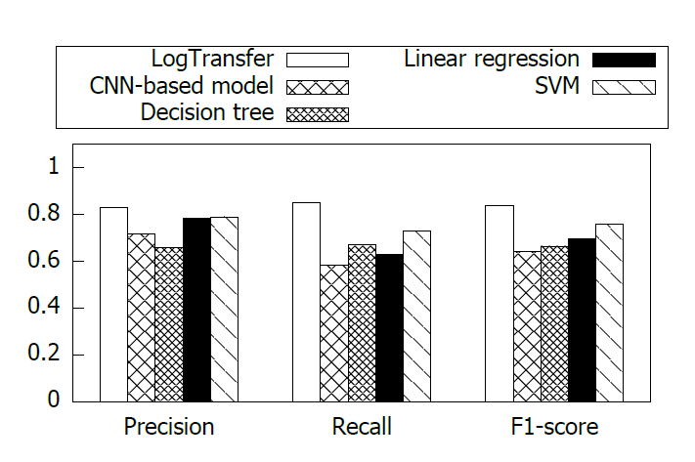
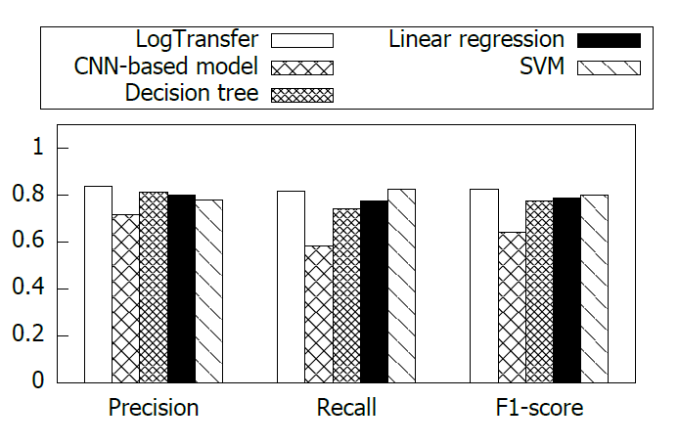
Overall Performance
Evaluation results on switch logs dataset with supervised learning-based model
Switch log A -> Switch log B accuracy comparison
Switch log C -> Switch log B accuracy comparison
Notes:
First, I’d like to present the overall performance of LogTransfer. We compared LogTransfer with supervised learning based model and unsupervised based model respectively. This slide present the Evaluation Results on Switch Logs Dataset with Supervised learning-based Model, LogTransfer could achieve an averaged 0.84 F1-score which
outperforms the state-of-the-art methods. It is because labels for supervised learning is insufficient.

Slide 12
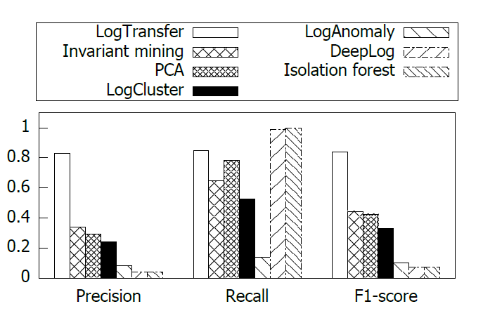
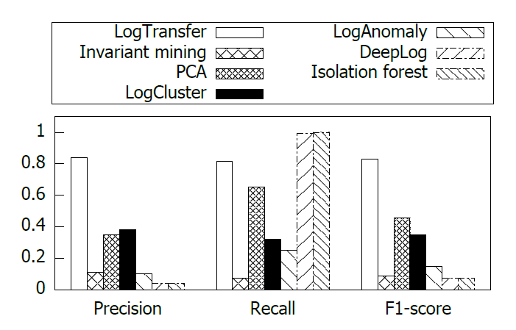
Overall Performance
Evaluation results on switch logs dataset with unsupervised learning-based model
Switch log A -> Switch log B accuracy comparison
Switch log C -> Switch log B accuracy comparison
Notes:
This is the Evaluation Results on Switch Logs Dataset with Unsupervised learning-based Model. Unsupervised learning based models suffer from low accuracy due to the high diversity of logs

