Slide 1

Unsupervised Detection of Microservice Trace Anomalies through Service-Level Deep Bayesian Networks
Ping Liu¹, Haowen Xu¹, Qianyu Ouyang¹, Rui Jiao¹, Zhekang Chen⁴
Shenglin Zhang³, Jiahai yang^{1,5}, Linlin Mo², Jice Zeng², Wenman Xue², Dan Pei¹
1
2
3
4
5
Notes:
hello, everyone. I’m Ping Liu from Tsinghua University. It’s an honor to present my work. Unsupervised Detection of Microservice Trace Anomalies through Service-Level Deep Bayesian Networks

Slide 2
Background
Design
Evaluation
Conclusion
Notes:
My presentation includes four parts: background, design, evaluation and conclusion

Slide 3
Background
Design
Evaluation
Conclusion
Notes:
First, let us start with the background of this work

Slide 4
Background
What is a trace?
Notes:
The first question is: what is a trace

Slide 5
Microservice architecture
Web Service S1
External service (S2)
Request
Microservice a
Microservice c
Microservice e
Microservice b
Microservice d
…
External service (…)
Response
Remote Procedure Call (RPC) Framework
Notes:
This page shows a microservice architecture. The service consists of many microservices, and some microservices may call other external services.

Slide 6
Microservice architecture
Web Service S1
External service (S2)
Request
Microservice a
Microservice c
Microservice e
Microservice b
Microservice d
…
External service (…)
Response
Remote Procedure Call (RPC) Framework
When microservice m calls microservices n, m sends a message to n
Notes:
When microservice m calls microservices n, m sends a message to n

Slide 7
Microservice architecture
Web Service S1
External service (S2)
Request
Microservice a
Microservice c
Microservice e
Microservice b
Microservice d
…
External service (…)
Response
Remote Procedure Call (RPC) Framework
Both messages are routed via the RPC framework
Notes:
Both messages are routed via the RPC framework

Slide 8
Tracing mechanism
Web Service S1
External service (S2)
Request
(UUID-1)
Microservice a
Microservice c
Microservice e
Microservice b
Microservice d
…
External service (…)
Response
(UUID-1)
Remote Procedure Call (RPC) Framework
The tracing mechanism can naturally record these messages with timestamps and UUIDs
Notes:
Therefore, the The tracing mechanism can naturally record these messages with timestamps and UUIDs

Slide 9
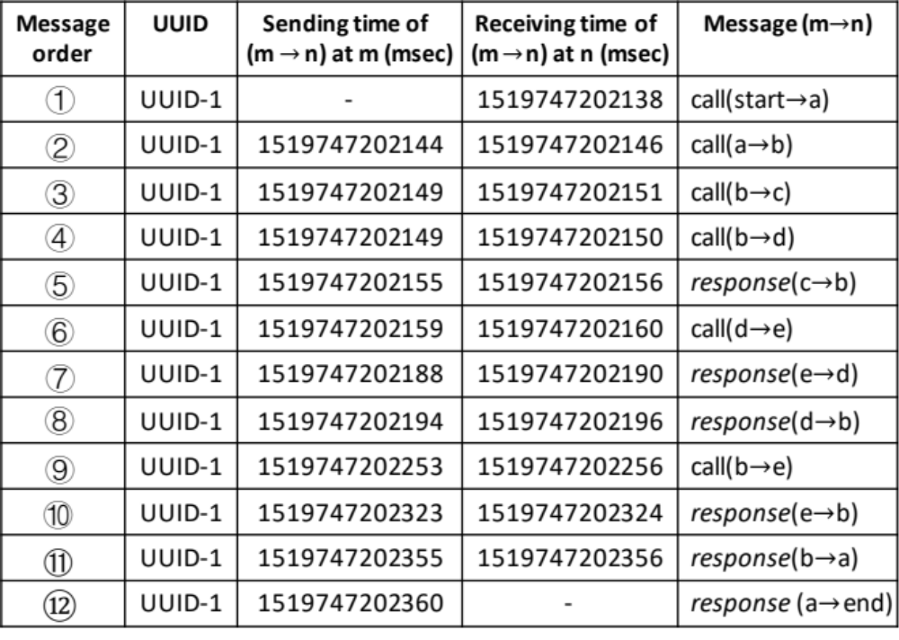
Trace
All messages with the same UUIDs constitute one trace
Notes:
All messages with the same UUIDs constitute one

Slide 10
Background
How to detect trace anomalies?
Notes:
The second question is: how to detect trace anomalies

Slide 11
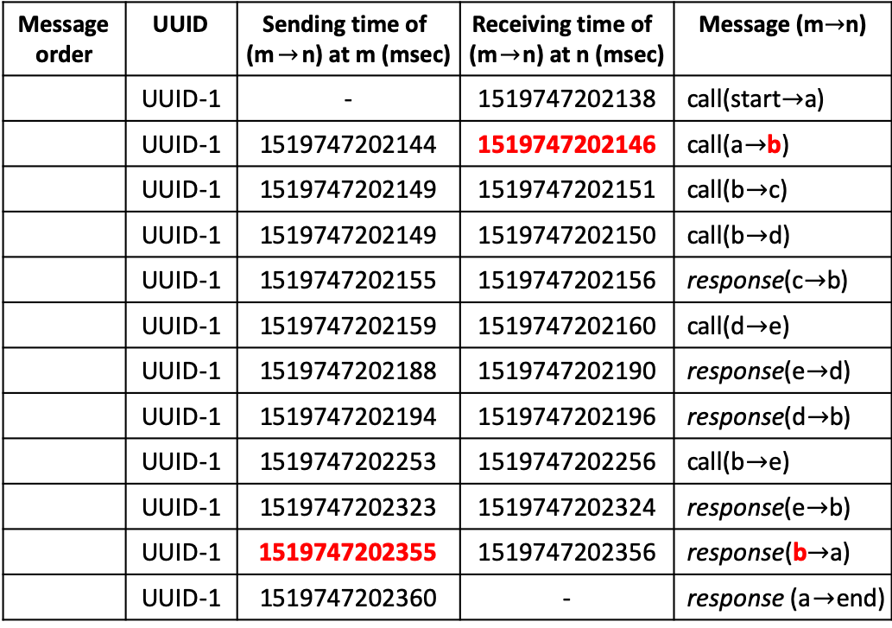
Response time
Message order | UUID | Sending time of (m$→$n) at m (msec) | Receiving time of (m$→$n) at n (msec) | Message (m$→$n)
 | UUID-1 | - | 1519747202138 | call(start$→$a)
 | UUID-1 | 1519747202144 | 1519747202146 | call(a$→$b)
 | UUID-1 | 1519747202149 | 1519747202151 | call(b$→$c)
 | UUID-1 | 1519747202149 | 1519747202150 | call(b$→$d)
 | UUID-1 | 1519747202155 | 1519747202156 | response(c$→$b)
 | UUID-1 | 1519747202159 | 1519747202160 | call(d$→$e)
 | UUID-1 | 1519747202188 | 1519747202190 | response(e$→$d)
 | UUID-1 | 1519747202194 | 1519747202196 | response(d$→$b)
 | UUID-1 | 1519747202253 | 1519747202256 | call(b$→$e)
 | UUID-1 | 1519747202323 | 1519747202324 | response(e$→$b)
 | UUID-1 | 1519747202355 | 1519747202356 | response(b$→$a)
 | UUID-1 | 1519747202360 | - | response (a$→$end)
①
②
Response time of microservice b:
1519747202355 – 1519747202146 = 209
③
④
⑤
⑥
⑦
⑧
⑨
⑩
⑪
⑫
Notes:
Firstly, we introduce the response time of a microservice. The response time can be computed by the timestamp of messages.

Slide 12
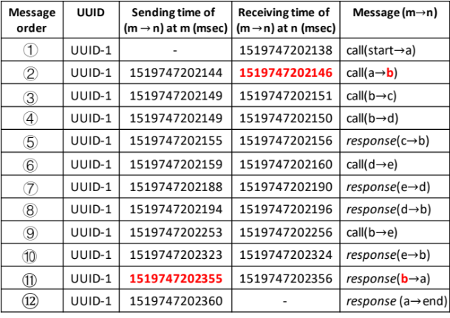
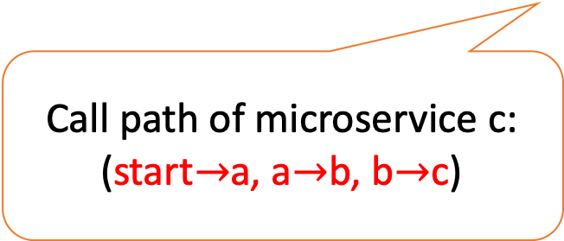
Call path
⑨
⑩
⑥
①
②
④
d
e
a
b
⑧
⑦
⑫
⑪
③
⑤
c
Call path of microservice c: (start$→$a, a$→$b, b$→$c)
Notes:
Secondly, let us see the call path of a microservice. The call path is the invocation path from the entrance microservice to it.

Slide 13
Trace anomaly
Call path anomaly,
like call interruption
⑨
⑩
⑥
①
②
④
d
e
a
b
⑧
⑦
⑫
⑪
③
⑤
c
Response time anomaly, like too long response time
Notes:
The trace anomaly can reflect on the call path or response time.

Slide 14
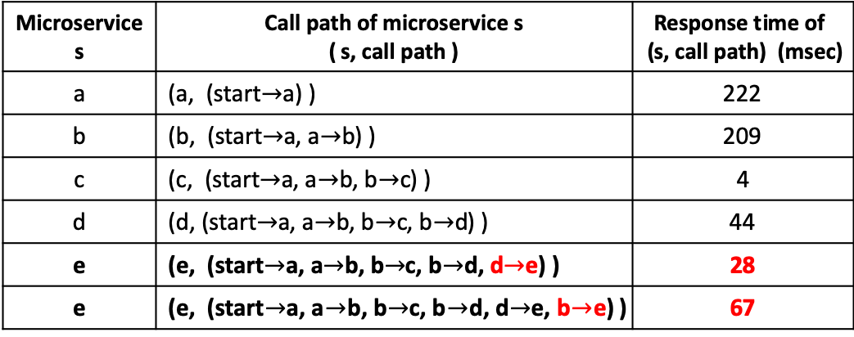
Response time & call path
⑨
For a microservice, its response time is determined by both itself and its call path
⑩
⑥
①
②
④
d
e
a
b
⑧
⑦
⑫
⑪
③
⑤
c
Microservice s | Call path of microservice s ( s, call path ) | Response time of (s, call path) (msec)
a | (a, (start$→$a) ) | 222
b | (b, (start$→$a, a$→$b) ) | 209
c | (c, (start$→$a, a$→$b, b$→$c) ) | 4
d | (d, (start$→$a, a$→$b, b$→$c, b$→$d) ) | 44
e | (e, (start$→$a, a$→$b, b$→$c, b$→$d, d$→$e) ) | 28
e | (e, (start$→$a, a$→$b, b$→$c, b$→$d, d$→$e, b$→$e) ) | 67
Microservice e is invoked twice, with different response time
Notes:
For a microservice, its response time is determined by both itself and its call path.
**click**
For example, microservice e is invoked twice, with different response time

Slide 15
Response time & call path
⑨
For a microservice, its response time is determined by both itself and its call path
⑩
⑥
①
②
④
d
e
a
b
⑧
⑦
⑫
⑪
③
This mandates that response times and call paths must be unified
⑤
c
Microservice s | Call path of microservice s ( s, call path ) | Response time of (s, call path) (msec)
a | (a, (start$→$a) ) | 222
b | (b, (start$→$a, a$→$b) ) | 209
c | (c, (start$→$a, a$→$b, b$→$c) ) | 4
d | (d, (start$→$a, a$→$b, b$→$c, b$→$d) ) | 44
e | (e, (start$→$a, a$→$b, b$→$c, b$→$d, d$→$e) ) | 28
e | (e, (start$→$a, a$→$b, b$→$c, b$→$d, d$→$e, b$→$e) ) | 67
Microservice e is invoked twice, with different response time
Notes:
For a microservice, its response time is determined by both itself and its call path.
**click**
For example, microservice e is invoked twice, with different response time

Slide 16
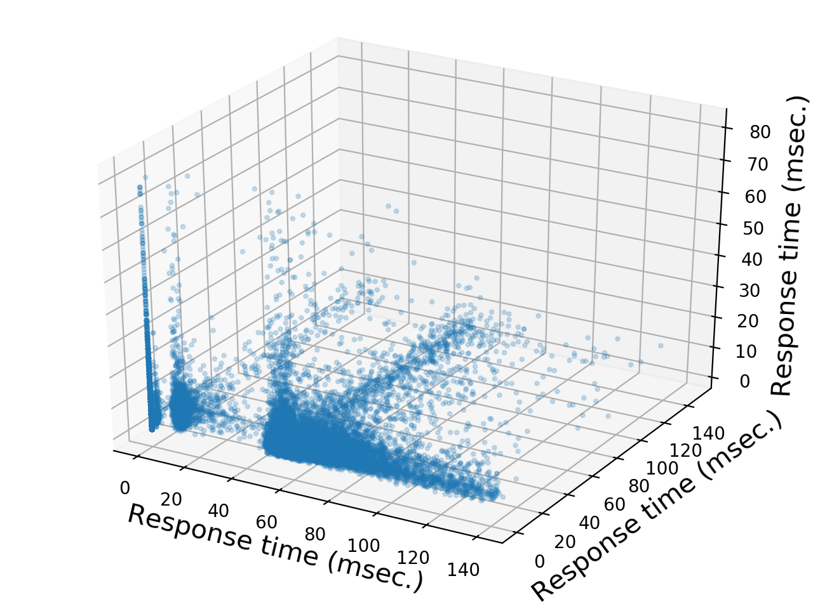
The distribution of response time
The distribution of traces' response time without anomalies from a small online service in a company, This service only contain three microservices.
The three axes denote the three microservices' response time, respectively.
Although there are only three microservices in this service, the response time varies significantly without being anomalous.

Slide 17
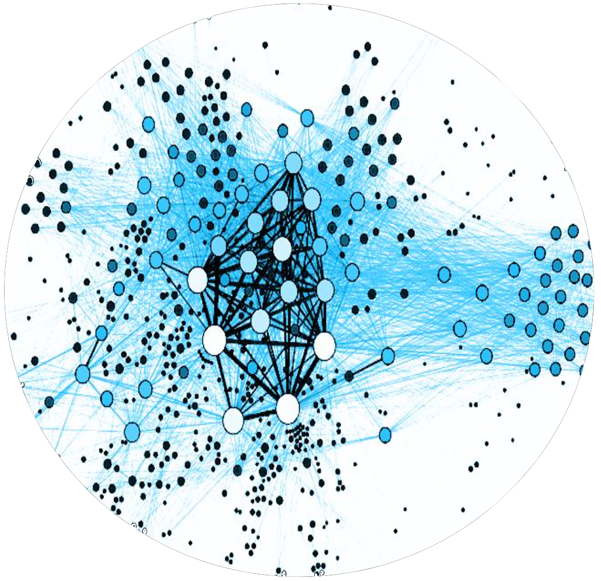
Trace anomaly detection
Microservice a
Microservice b
Microservice c
Microservice …
Hundreds of microservices
Complex call relationships
Notes:
Hundreds of microservices can generate Complex call relationships

Slide 18

Trace anomaly detection
Microservice a
Microservice b
Microservice c
Microservice …
Hundreds of microservices
Complex call relationships

Slide 19
Core idea
Hundreds of thousands of traces per day
A Web Service
generate
Notes:
Then we will introduce the core idea of our work

Slide 20
Core idea
Hundreds of thousands of traces per day
A Web Service
generate
It is infeasible to accurately label the large number of traces for supervised learning

Slide 21
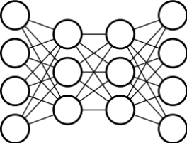
Core idea
A large number of traces for a service
Unsupervised Learning
Normal Pattern

Slide 22
Core idea
A large number of traces for a service
New Trace
Deviate from normal pattern?
Unsupervised Learning
Normal Pattern
Yes
Anomalous Trace

Slide 23
Background
Design
Evaluation
Conclusion
Notes:
Then, I will talk about the design of traceanomaly

Slide 24
Design of TraceAnomaly
Offline Training for a service
Service Trace Vector
Construction
Unsupervised Training
Periodically Retrain
Traces
Model
Online Detection
for a service
Unseen Call Path
Anomaly Detection
Root Cause Localization
New Trace
Whitelist
Likelihood Computation
Notes:
This page shows the architecture of traceanomaly,

Slide 25
Design of TraceAnomaly
Offline Training for a service
Service Trace Vector
Construction
Unsupervised Training
Periodically Retrain
Traces
Model
Online Detection
for a service
Unseen Call Path
Anomaly Detection
Root Cause Localization
New Trace
Whitelist
Likelihood Computation
Notes:
During offline training for a service, training traces are encoded as service trace vectors

Slide 26
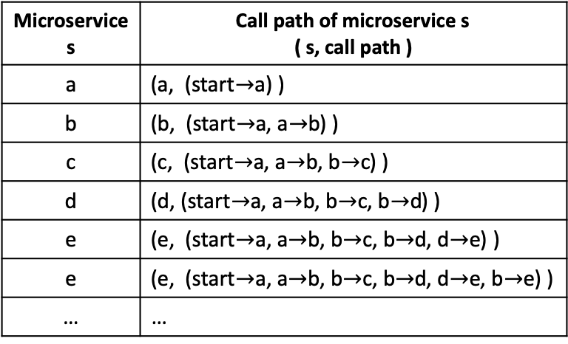
Service trace vector construction
Unify response time and call paths of traces in an interpretable way
  Encode the response time and call paths of a trace in a service into a STV (Service Trace Vector)
Microservice s | Call path of microservice s ( s, call path )
a | (a, (start$→$a) )
b | (b, (start$→$a, a$→$b) )
c | (c, (start$→$a, a$→$b, b$→$c) )
d | (d, (start$→$a, a$→$b, b$→$c, b$→$d) )
e | (e, (start$→$a, a$→$b, b$→$c, b$→$d, d$→$e) )
e | (e, (start$→$a, a$→$b, b$→$c, b$→$d, d$→$e, b$→$e) )
… | …
STV
rt
rt
rt
rt
rt
rt
…
Traces
Notes:
Service trace vector unify response time and call paths of traces

Slide 27
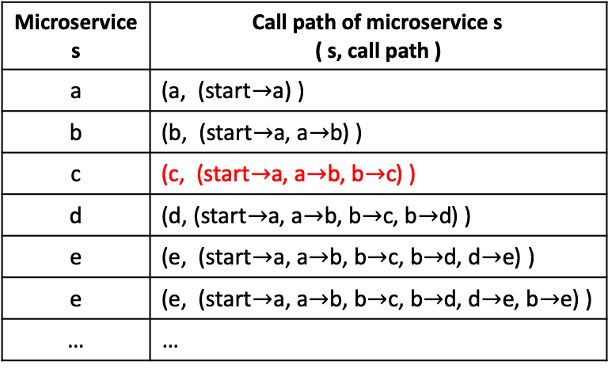
Service trace vector construction
Unify response time and call paths of traces in an interpretable way
  Encode the response time and call paths of a trace in a service into a STV (Service Trace Vector)
The dimension ID of the STV corresponds to the call path of microservice s
Microservice s | Call path of microservice s ( s, call path )
a | (a, (start$→$a) )
b | (b, (start$→$a, a$→$b) )
c | (c, (start$→$a, a$→$b, b$→$c) )
d | (d, (start$→$a, a$→$b, b$→$c, b$→$d) )
e | (e, (start$→$a, a$→$b, b$→$c, b$→$d, d$→$e) )
e | (e, (start$→$a, a$→$b, b$→$c, b$→$d, d$→$e, b$→$e) )
… | …
STV
rt
rt
rt
rt
rt
rt
…
Traces
Notes:
The first question is: what is a trace

Slide 28
Service trace vector construction
Unify response time and call paths of traces in an interpretable way
  Encode the response time and call paths of a trace in a service into a STV (Service Trace Vector)
The value of the dimension corresponds to the response time of microservice s
Microservice s | Call path of microservice s ( s, call path )
a | (a, (start$→$a) )
b | (b, (start$→$a, a$→$b) )
c | (c, (start$→$a, a$→$b, b$→$c) )
d | (d, (start$→$a, a$→$b, b$→$c, b$→$d) )
e | (e, (start$→$a, a$→$b, b$→$c, b$→$d, d$→$e) )
e | (e, (start$→$a, a$→$b, b$→$c, b$→$d, d$→$e, b$→$e) )
… | …
STV
rt
rt
rt
rt
rt
rt
…
Traces
Notes:
The first question is: what is a trace

Slide 29
Design of TraceAnomaly
Offline Training for a service
Service Trace Vector
Construction
Unsupervised Training
Periodically Retrain
Traces
Model
Online Detection
for a service
Unseen Call Path
Anomaly Detection
Root Cause Localization
New Trace
Whitelist
Likelihood Computation
Notes:
The vectors are then fed into the training model to learn the patterns of traces

Slide 30
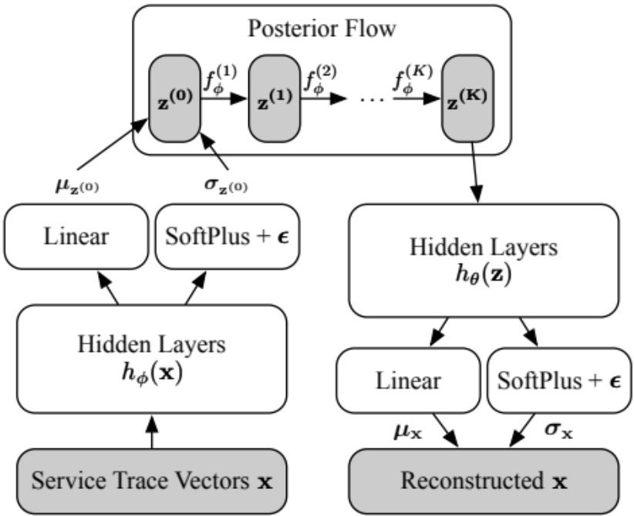
Unsupervised Learning
The architecture of Bayesian Networks
Notes:
We design a unsupervised Bayesian Networks to learn the pattern

Slide 31
Unsupervised Learning
The architecture of Bayesian Networks
  Unsupervised learning through the encode-decode network
Encode Network
Decode Network
Notes:
Unsupervised learning through the encode-decode network

Slide 32
Unsupervised Learning
The architecture of Bayesian Networks
  Posterior Flow allows network to learn more complex patterns
Notes:
And the Posterior Flow allows network to learn more complex patterns

Slide 33
Design of TraceAnomaly
To adapt to potential service upgrade
Offline Training for a service
Service Trace Vector
Construction
Unsupervised Training
Periodically Retrain
Traces
Model
Online Detection
for a service
Unseen Call Path
Anomaly Detection
Root Cause Localization
New Trace
Whitelist
Likelihood Computation
Notes:
the model will be retrained periodically.

Slide 34
Design of TraceAnomaly
Offline Training for a service
Service Trace Vector
Construction
Unsupervised Training
Periodically Retrain
Traces
Model
Online Detection
for a service
Unseen Call Path
Anomaly Detection
Root Cause Localization
New Trace
Whitelist
Likelihood Computation
The previously unseen call paths are handled by a whitelist approach
Notes:
During online detection, a new trace firstly be encoded as service trace vector. The previously unseen call paths are handled by a whitelist approach

Slide 35
Design of TraceAnomaly
Offline Training for a service
Service Trace Vector
Construction
Unsupervised Training
Periodically Retrain
Traces
Model
Online Detection
for a service
Unseen Call Path
Anomaly Detection
Root Cause Localization
New Trace
Whitelist
Likelihood Computation
The smaller the likelihood, the higher the degree of abnormality
Notes:
If there is no unseen call path, then the trained model outputs a likelihood.

Slide 36
Design of TraceAnomaly
Offline Training for a service
Service Trace Vector
Construction
Unsupervised Training
Periodically Retrain
Traces
Model
Online Detection
for a service
Unseen Call Path
Anomaly Detection
Root Cause Localization
New Trace
Whitelist
Likelihood Computation
Localize the possible root cause microservice
Notes:
Finally, the localization algorithm can localize the root cause of the anomalous trace

Slide 37
Background
Design
Evaluation
Conclusion
Notes:
Well, let’s move on the evaluation part.

Slide 38
Evaluation of TraceAnomaly
Testbed evaluation
Real service evaluation
Notes:
Trace anomaly

Slide 39
Evaluation of TraceAnomaly
Testbed evaluation
  The open source TrainTicket^{[1]} testbed
Real service evaluation
[1]. Zhou, Xiang, et al. "Fault Analysis and Debugging of Microservice Systems: Industrial Survey, Benchmark System, and Empirical Study." IEEE Transactions on Software Engineering 14.8 (2018): 1-1.

Slide 40
Testbed evaluation
Notes:
Our dataset contains 70 real failures cases from five different online software services.
P one is the largest system, which contains 29 modules and eleven thousands 5 hundreds and nineteen machines.
P five is the smallest system, which contains 7 modules and 2 hundreds and thirty eight machines

Slide 41
Testbed evaluation
Outperforming other baseline approaches
Notes:
Our dataset contains 70 real failures cases from five different online software services.
P one is the largest system, which contains 29 modules and eleven thousands 5 hundreds and nineteen machines.
P five is the smallest system, which contains 7 modules and 2 hundreds and thirty eight machines

Slide 42
Evaluation of TraceAnomaly
Testbed evaluation
Real service evaluation
  Four large evaluation services from WeBank company
Notes:
The table shows the details of the four services

Slide 43
Real service evaluation

Slide 44
Real service evaluation
Outperforming other baseline approaches
Notes:
we use forty seven standard machine KPIs of the Linux system for the evaluation, consisting of states of CPU, memory, disk, network and OS kernel.

Slide 45
Real service evaluation
The precision is accurate, the recall might be biased towards 1 for our label approach
Notes:
we use forty seven standard machine KPIs of the Linux system for the evaluation, consisting of states of CPU, memory, disk, network and OS kernel.

Slide 46
Real service evaluation
Label Approach
It is infeasible to manually label hundreds of thousands of traces per day
The union of all detected anomalous traces by all these baselines during the evaluation period was considered as the candidate anomaly trace set, and manually validated by two experienced operators separately.
All the anomalous traces confirmed by both operators are labeled as anomalous, and labeled as normal otherwise.
The precision is accurate, the recall might be biased towards 1 for our label approach
Notes:
we use forty seven standard machine KPIs of the Linux system for the evaluation, consisting of states of CPU, memory, disk, network and OS kernel.

Slide 47
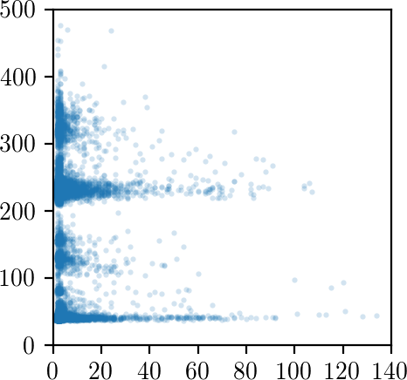
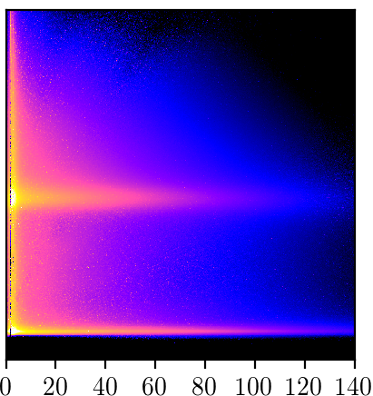
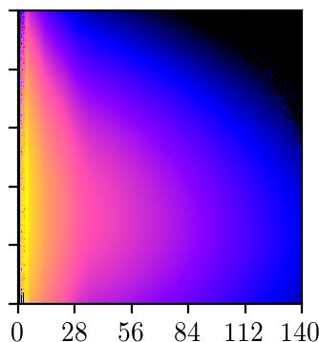
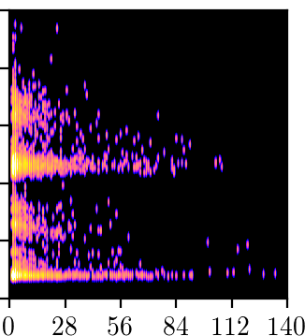
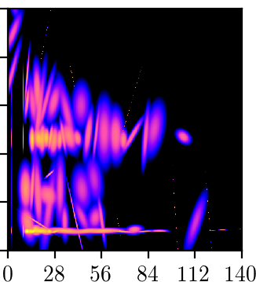
Algorithm analysis
The distribution of traces' response time
The learned distribution of TraceAnomaly
The learned distribution of VAE
The learned distribution of KDE
The learned distribution of GMM
Notes:
we use forty seven standard machine KPIs of the Linux system for the evaluation, consisting of states of CPU, memory, disk, network and OS kernel.

Slide 48
Evaluation of TraceAnomaly
Testbed evaluation
Real service evaluation
…
More details of the evaluation can be found in the paper

Slide 49
Background
Design
Evaluation
Conclusion
Notes:
Finally, let me conclude my presentation.

Slide 50
Conclusion
We propose STV to encode both the response time information and the call path information of traces
We propose an unsupervised deep learning algorithm for anomaly detection
Detailed evaluations on four large online services and a TrainTicket testbed show good performance
We propose a root cause localizing algorithm based on our designed STV
We have open-sourced the prototype of TraceAnoamly: https://github.com/NetManAIOps/TraceAnomaly

Slide 51
Open-sourced TraceAnomaly
We have received 172 stars

Slide 52
Thank you!
Q&A
liuping15@mails.tsinghua.edu.cn
https://github.com/NetManAIOps/TraceAnomaly
ISSRE 2020
Notes:
That’s all, thank you
Thanks for your question
We can discuss it after the meeting

