Slide 1



ADS: Rapid Deployment of Anomaly Detection Models
Jiahao Bu, Ying Liu, Shenglin Zhang, Weibin Meng
Qitong Liu, Xiaotian Zhu, Dan Pei
IPCCC 2018
Notes:
Thanks for the kind introduction. Hello everyone. I’m Jiahao Bu from Tsinghua University. Today I’m going to talk about rapid deployment of anomaly detection models for large number of emerging KPI streams. This is a joint work with collaborators Ying Liu from Tsinghua University, Shenglin Zhang from Naikai University, Weibin Meng from Tsinghua University, Qitong Liu and Xiaotian Zhu from Tencent, Dan Pei from Tsinghua University

Slide 2
Outline
Background
Problem definition
Design
Evaluation
Conclusion

Slide 3
Outline
Background
Problem definition
Design
Evaluation
Conclusion
Notes:
First, let me introduce the background of our work.

Slide 4
Background
Servers
Processes
Key Performance
Indicators
e.g. , CPU Utilization
Search Response Time…
Notes:
Internet-based services (e.g., online games, online shopping, social networks, search engine) monitor KPIs (Key Performance Indicators) of their applications and systems in order to keep their services reliable. They deploy an agent on each server to get the status of each process and collect the KPI measurements, such as CPU Utilization Search Response Time

Slide 5
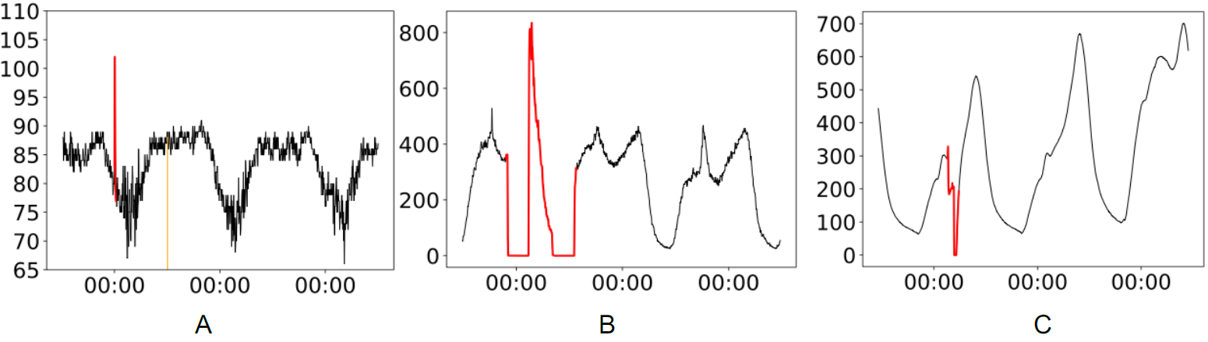
Background
However, the anomalies on KPI likely indicate underlying failures on Internet services
  E.g., a spike or dip in a KPI stream
Notes:
The figure is the examples of anomalies in KPI streams. The red parts in the KPI stream denote anomalous points, and the orange part denotes missing points (filled with zeros).

Slide 6
Background
Alarm!
TSD
Anomaly Detector
[Sigcomm13]
Detection boundary
Mon. Tue. Wed.
Time
Notes:
This demo shows an anomaly, which is straightforward to visually inspect.
In order to accurately detect KPI anomalies, operators carefully select detectors
then, need to manually and iteratively tune the parameters and thresholds based on their domain knowledge
Suppose that operators use TSD for anomaly detection, the blue line is the detection boundary.
If the KPI value excess the boundary, it will generate alarm to operators to handle.

Slide 7
Background
Anomaly
Select / combine detectors
Moving Average
Anomaly Detector
Holt-Winters
Operator
Time Series
Decomposition
[IMC15,KDD15]
…
Tune parameters & thresholds
Mon. Tue. Wed.
Time
Notes:
operators also can combine multiple detectors, for example, moving average, holt-Winters and Time series decomposition and so on to train machine learning model.
Each detector is one of the features.

Slide 8
Background
However, there remains one common and important scenario that large number of KPI streams emerge continuously and frequently, which has not been studied !!!!

Slide 9


Background
Case 1:
Case 2:
#1
#1
6000 new KPI streams per
10 days on average.
Software upgrades become
more and more frequent
New games are launched
Software upgrades
[ISSRE15,CoNext15]
Notes:
Case1:
New products can be frequently launched, such as in gaming platform. For example, in a top gaming company G studied in this paper, on average over ten new games are launched per quarter, which results in more than 6000 new KPI streams per 10 days on average.
Case2:
With the popularity of DevOps and micro-service, software upgrades become more and more frequent, many of which result in the pattern changes of existing KPI streams, making the previous anomaly detection algorithms/parameters outdated.

Slide 10
Outline
Background
Problem definition
Design
Evaluation
Conclusion
Notes:
Then I'll talk about why it is challenging and problem definition

Slide 11



Problem definition
Why it's challenging?
Select / combine detectors
Anomaly
Moving Average
False Alarm
Holt-Winters
Time Series
Decomposition
…
Missing Alarm
Tune parameters & thresholds
New anomaly labeling
Lack of training data
Notes:
In the above scenario, the algorithm needs to overcome the following difficulties while maintaining high performance:
manual algorithm selection and parameter tuning
new anomaly labeling
lack of training data
Unfortunately, none of the existing anomaly detection approaches are feasible to deal with the above difficulties well

Slide 12
Problem definition
Why it's challenging?
Select / combine detectors
Anomaly
Moving Average
False Alarm
Holt-Winters
Time Series
Decomposition
…
Missing Alarm
New anomaly labeling
Lack of training data
Tune parameters & thresholds
Traditional statistical algorithms
Notes:
For traditional statistical algorithms, since no anomaly detector is perfectly suitable for all types of KPI streams, to achieve the best accuracy, operators have to manually select an anomaly detection algorithm and tune its parameters for each KPI stream, which is infeasible for the large number of emerging KPI streams.

Slide 13
Problem definition
Why it's challenging?
Select / combine detectors
Anomaly
Moving Average
False Alarm
Holt-Winters
Time Series
Decomposition
…
Missing Alarm
Tune parameters & thresholds
Lack of training data
New anomaly labeling
Supervised learning based methods
[IMC15,KDD15]
Notes:
Supervised learning based methods require manually labeling anomalies for each new KPI stream,
which is not feasible for the large number of emerging KPI streams either

Slide 14
Problem definition
Why it's challenging?
Select / combine detectors
Anomaly
False Alarm
Moving Average
Holt-Winters
Time Series
Decomposition
…
Missing Alarm
Tune parameters & thresholds
New anomaly labeling
Lack of training data
[ICDM08,WWW18]
Notes:
Unsupervised learning based methods do not require algorithm
selection, parameter tuning, or manual labels, but they either
suffer from low accuracy or require large amounts of
training data for each new KPI stream (e.g., six months
worth of data) , which do not satisfy the requirement of
rapid deployment (e.g., within 3 weeks) of accurate anomaly
detection.

Slide 15
Outline
Background
Problem definition
Design
Evaluation
Conclusion
Notes:
To tackles the above problem
We propose the first framework
ADS (Anomaly Detection through Self-training) that, via clustering and semi-supervised learning.
Next I will introduce our framework

Slide 16
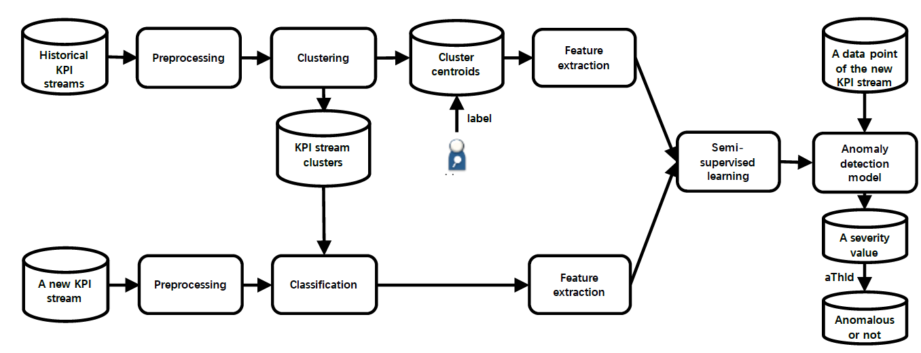
Design
Notes:
This is the overview of ads
ADS proposes to cluster all existing/historical KPI streams into clusters, assign each newly emerging KPI stream into one of the existing clusters, and then combine the data of the new KPI stream (unlabeled) and it’s cluster centroid (labeled) and use semi-supervised learning to train a new model for each new KPI stream.

Slide 17
Design
Notes:
OK, next, I will introduce the detail of ADS. First, let’s take a look at how it preprocess KPIs

Slide 18
Preprocessing
Fill these missing points using linear interpolation
Standardization
Notes:
In Internet-based services, monitoring system malfunctions
and/or operator misconfigurations, though occur infrequently,
can lead to missing points in KPI streams. These missing
points can bring significant biases to ADS. Therefore, we fill
these missing points using linear interpolation
In addition, to make KPI steams of different amplitudes
and/or length scales comparable, we also standardize KPI
streams. This way, different KPI streams are clustered based
on their shapes, rather than the absolute values of amplitudes
and/or length scales.

Slide 19
Design
Notes:
After processing, we group historical KPI streams into a few clusters, and obtains a centroid KPI stream for each cluster. we can label anomaly points on cluster centroid. Once the new KPI emerge, we can assign the unlabeled KPIs by their distances to these centroids.

Slide 20
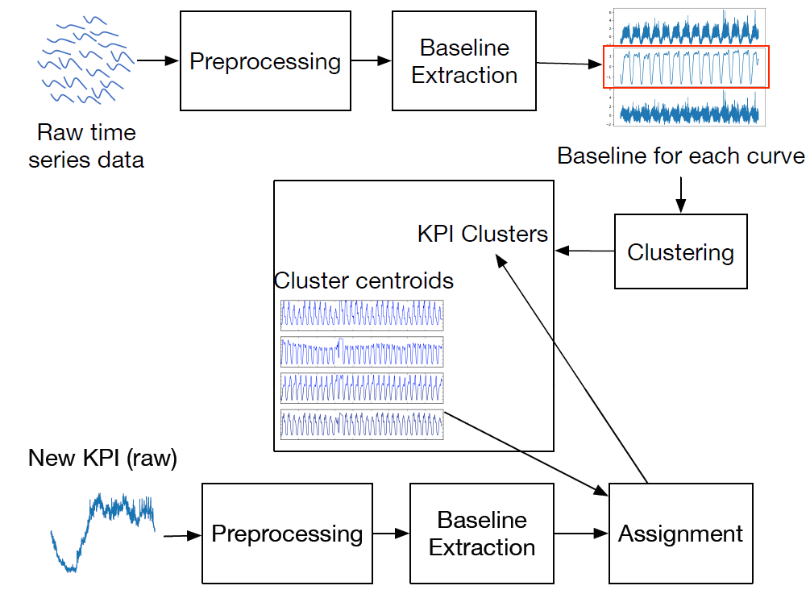
Clusering
ADS adopts ROCKA to group KPI streams into a few clusters.
Then we obtain a centroid KPI stream for each cluster and can label anomaly points.
[IWQoS 18]
Notes:
ADS adopts ROCKA to group historical KPI streams into a few clusters.
It applies moving average to extract baselines which successfully reduce
the biases of noises and anomalies. In addition, it uses shapebased
distance as the distance measure, and reduces its algorithm
complexity to O(mlog(m)) using Fast Fourier Transform.
Finally, it uses DBSCAN to cluster KPI streams and
chooses the centroid for every cluster
Extensive experiments
in [15] have demonstrated ROCKA’s superior performance in
clustering KPI streams for large Internet-based services

Slide 21
Design
Notes:
Here we introduce how to extract features for KPI streams for training machine learning model

Slide 22
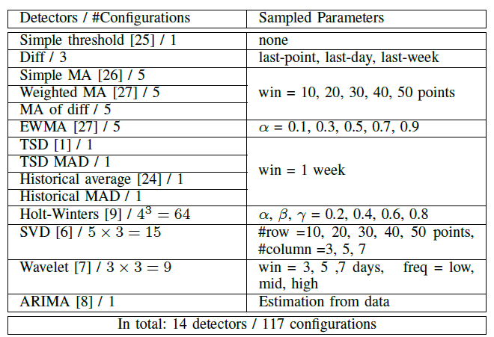
Feature extraction
Detector: Feature extractor
Feature: Measure how anomalous that data point is.
Feature vector: All feature values extracted by specific detectors.
Notes:
Here we list detectors and their sampled parameters used in ADS
When an anomaly detector receives an incoming data point
of a KPI stream, it internally produces a non-negative value,
called severity, to measure how anomalous that data point is.
For example, historical average applies how many times
of standard deviations the point is away from the mean as
the severity, based on the assumption that the KPI stream data
follows Gaussian distribution;
we use the output results of different
anomaly detectors (namely, the anomaly severities measured
by anomaly detectors) as the features of KPI streams. This
way, each detector serves as a feature extractor.

Slide 23
Design
Notes:
Finally, I will introduce the detail of our semi-supervised learning.

Slide 24
Semi-Supervised Learning
In this work, we adopt contrastive pessimistic likelihood estimation
(CPLE) , an extension model of self-training.
CPLE has the four following advantages:
CPLE is flexible to change base-model
CPLE needs low memory complexity
CPLE is more robust than other semi-supervised learning algorithms
CPLE supports incremental learning.
[TPAMI15]

Slide 25
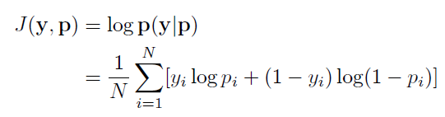
Semi-Supervised Learning
In addition, the negative log loss for binary classifiers takes on the general form:
where N is the number of the data points in the KPI streams of training set, y_{i} is the label of the i-th data point and p_{i} is the i-th discriminative likelihood (DL)
Notes:
Then I'll talk about the Mathematical derivation of CPLE

Slide 26


Semi-Supervised Learning
The objective of CPLE is to minimize the function:
where X is the data set of labeled data points, U is the unlabeled data points, and y’ = H(q), where:
This way, (the parameter vector of) the base-model, which serves as the anomaly detection model, is trained based on (X U U) using actual and hypothesized labels (y U y’), as well as the weights of data points w, where:

Slide 27
Outline
Background
Problem definition
Design
Evaluation
Conclusion
Notes:
OK, The above is an introduction to our algorithm,
now I will demonstrate the validity of the algorithm.
Cooperating with operators, we have deployed a prototype of ADS in Tencent.

Slide 28
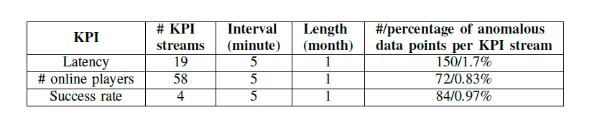
Data Set
The following table is description of 81 new ones :
Notes:
We randomly pick 70 historical KPI streams for clustering and 81 new ones for anomaly detection from tencent
These KPI streams are of the most important three KPIs, including success rate, number of online players and latency. The Table lists the detailed information of the 81 new KPI streams, including the number, interval and length of the KPI streams of each KPI. In addition, it also lists the averaged number and percentage of anomalous data
points per KPI stream of each KPI, respectively.
Note that the KPI streams of the same KPI may have very different shapes and thus belong to different clusters.

Slide 29
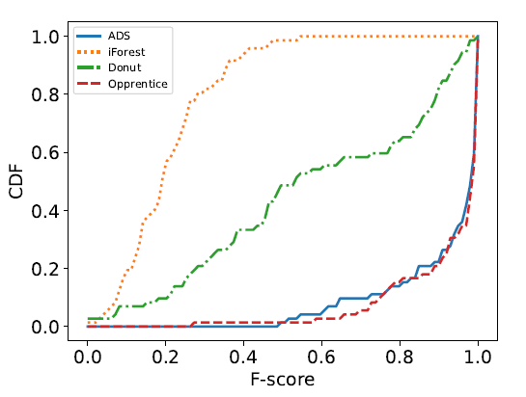
Evaluation of The Overall Performance
To evaluate the performance of ADS in anomaly detection for KPI streams, we calculate its best F-score, and compare it with that of iForest, Donut and Opprentice. The picture is the CDFs of the best F-scores of each new KPI stream
Notes:
We can see that both ADS and Opprentice perform superior in detecting anomalies for KPI streams, with 80% of best Fscores
over 0.8. Their performance is much better than that of iForest and Donut,
for the following reasons: (1) iForest
is sensitive to noises in the training set because it does not
utilize any labels (2) Donut is a deep Bayesian model,
which requires a lot of training data to get good results (say
six months worth of KPI streams) . However we can’t wait the model for six months

Slide 30
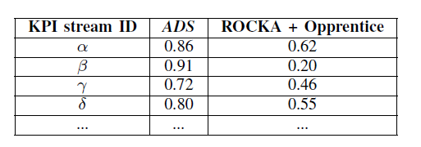
Evaluation of CPLE
ROCKA + Opprentice: we train Opprentice using the features and manual labels of its centroid KPI streams. After that, we detect anomalies for the each new KPI stream using the Opprentice model trained based on this new KPI stream’s cluster centroid.
The following table is new KPI streams where ADS performs significantly better than ROCKA + Opprentice.
Notes:
To the best of our knowledge, this is the first work to apply semi-supervised learning CPLE to the KPI anomaly detection problem. We want to evaluate the performance of CPLE.
To evaluate the performance of CPLE, we compare the
performance of ADS, which is the combination of ROCKA
and CPLE, to that of the combination of ROCKA and a state of-
art supervised learning method – Opprentice

Slide 31
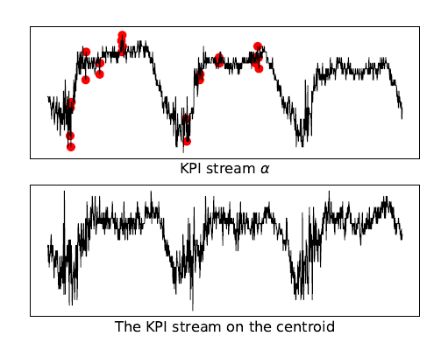
Evaluation of CPLE
The anomaly detection results of ROCKA + Opprentice on KPI stream α, and α’s cluster centroid KPI stream.
The red data points are anomalous determined by ROCKA + Opprentice while in actual they are normal.
Notes:
Here we explain why ADS performs better than ROCKA +
Opprentice.
KPI stream clustering methods such as ROCKA usually extract baselines (namely underlying shapes) from KPI streams and ignore fluctuations. However, the fluctuations of KPI streams can impact anomaly detection.
KPI stream alpha and the centroid KPI
stream have very similar baselines, but they have different fluctuation degrees, which is not uncommon in practice. This
lead to that ROCKA + Opprentice, which is trained based only on the centroid KPI stream, generates a lot of false alarms.

Slide 32
Evaluation of CPLE
ADS addresses the above problem effectively using semi-supervised
learning. In other words, it learns not only from the labels of the centroid KPI stream, but also from the fluctuation degree of the new KPI stream.

Slide 33
Outline
Background
Problem definition
Design
Evaluation
Conclusion
Notes:
.

Slide 34
Conclusion
ADS is the first to identify the common and important problem of rapid deployment of anomaly detection models for large number of emerging KPI streams
ADS is the first to apply semi-supervised learning on this field
ADS achieves an averaged best F-score of 0.92 on 81 new KPI streams, almost the same as the state-of-art supervised approach
Notes:
To draw a conclusion

Slide 35

Thank you
ADS
IPCCC 2018
bjh16@mails.tsinghua.edu.cn

