Slide 1




AutoKAD: Empowering KPI Anomaly Detection
with Label-Free Deployment
Zhaoyang Yu¹, Changhua Pei², Shenglin Zhang³, Xidao Wen⁴, Jianhui Li², Gaogang Xie², Dan Pei¹
¹Tsinghua University, ²Chinese Academy of Science
³Nankai University, ⁴BizSeer Technology

Slide 2





Background
Design
Evaluation
Conclusion

Slide 3



Unavoidable Failures
December 2022 AliCloud outage lasts more than 12 hours, many customer services severely impacted
October 2021 Facebook's apps had a total outage of their external services for up to seven hours, evaporating nearly $50bn in market value overnight
In 2020 alone, Google's global services have experienced four major downtimes, each of which has resulted in huge economic losses
Even the world’s leading companies are not immune to the huge financial losses caused by failures.
How can we minimize the occurrence of catastrophic level failures and reduce economic losses?

Slide 4
KPI Anomaly Detection
Key Performance Indicator (KPI)
Time-series data collected from a myriad of sources
Reflect the health status of a service
Most KPIs in the real world are seasonal
KPI anomaly detection is essential for service reliability
Labels are expensive
Most algorithms are unsupervised
Identifying potential issues by detecting anomalies in KPIs

Slide 5
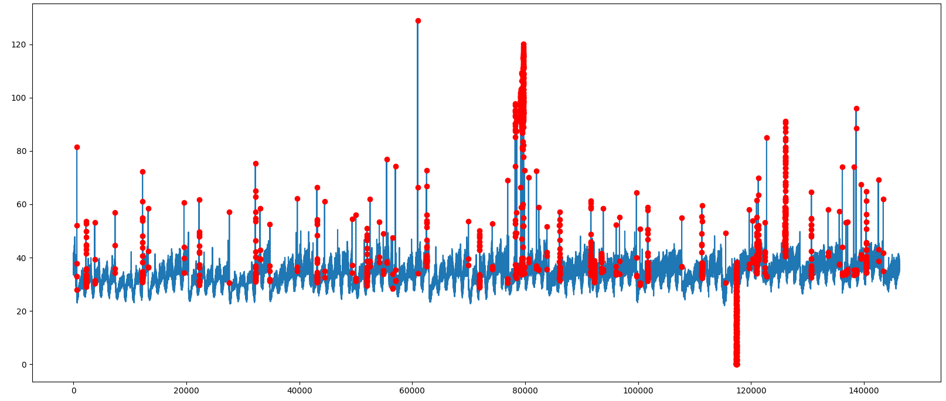
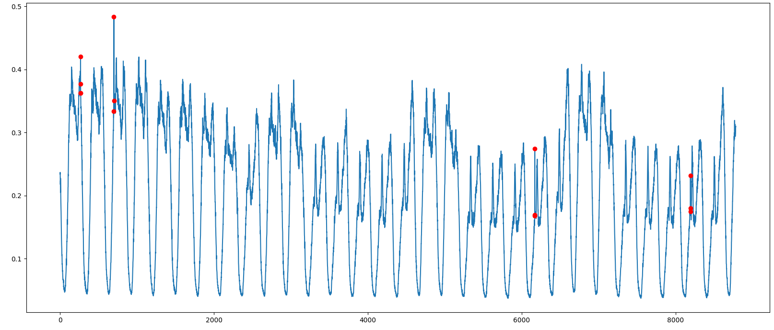
Configurations Matter
Configuration = Algorithm + Hyperparameter
One configuration will not work well for all KPIs
Finding a satisfying configuration is challenging for IT operators
Configuration affects detection performance
Same configuration performs very differently on different datasets
Same LSTM detector with the same hyperparameters
F1-Score: 0.267
F1-Score: 0.917

Slide 6





Deployment of KPI Anomaly Detection
What do operators need to do when deploying an anomaly detection model for a KPI?
Manually labeling partial data to generate a test set
Selecting algorithm candidates by analyzing KPI characteristics
Evaluate different hyperparameters based on some evaluation metrics
A New KPI
Operators
Labeled Test Set
Algorithm Candidates
Evaluated Configurations
Updating candidates based on evaluation results

Slide 7
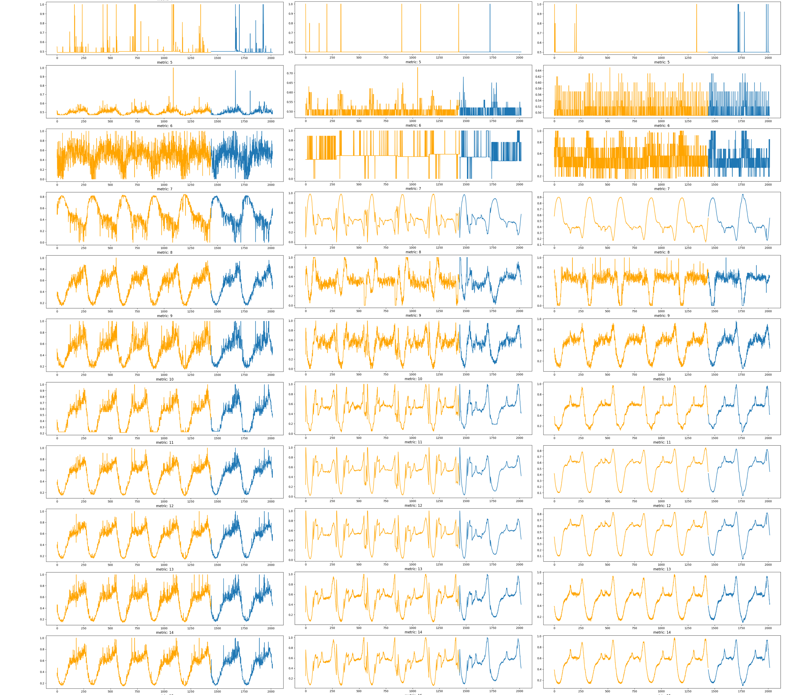




Deployment Dilemma
Up To Millions of KPIs
Dozens of Algorithms
For each KPI, there are millions of configuration candidates !
OP
Learning Rate Batch Size Number of Epochs Momentum Weight Decay Dropout Rate Number of Layers Activation Function Kernel Size Stride Pooling Size Tree Depth Minimum Split Size Maximum Leaf Nodes Number of Clusters Learning Rate Decay Window Length Sequence Length Optimizer
Dozens of Hyperparameters

Slide 8

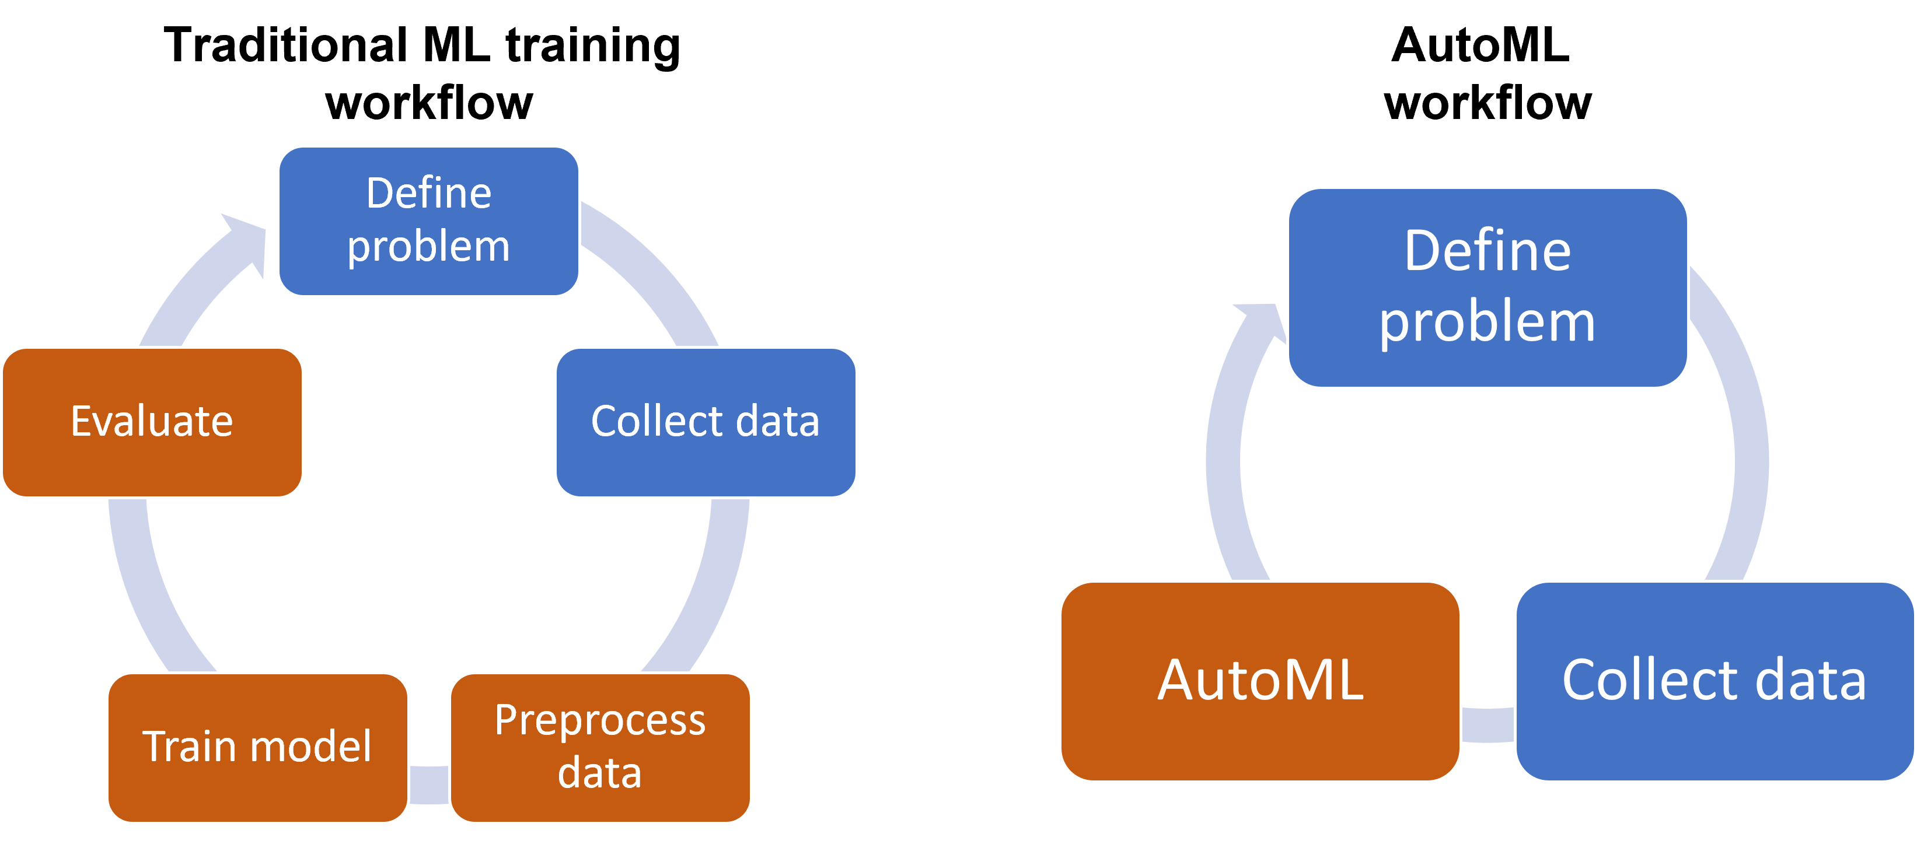
CASH Problem and AutoML
What operators need is an end-to-end solution that automatically selects algorithms and hyperparameters for different KPIs.
CASH problem
Combined Algorithm Selection and Hyperparameter optimization
AutoML
Automated Machine Learning
Automate facets of the machine learning pipeline
e.g. algorithm selection, data preprocessing, hyperparameter optimization
Automatically find a satisfying configuration
Black-box optimization
Existing methods are mainly based on labeled test sets for searching configurations
Labeling thousands and
even millions of KPIs is impossible
Not Practical

Slide 9
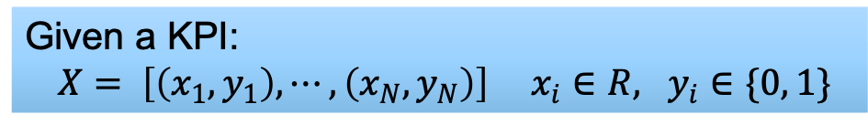
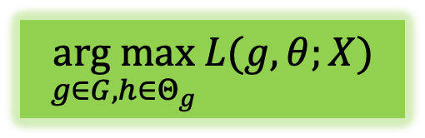


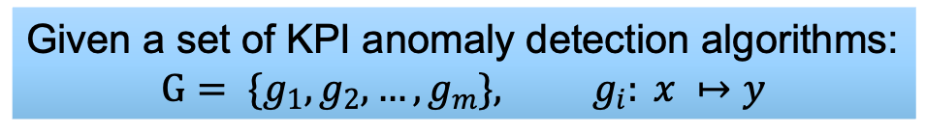
Our Goal
Given a KPI:
$X= \left[\left(x_{1}, y_{1}\right), ⋯, \left(x_{N}, y_{N}\right)\right] x_{i}∈R, y_{i}∈\{0, 1\}$
Our goal is to design an effective and efficient AutoML framework for unsupervised KPI anomaly detection under a Label-Free condition.
Our goal is to find the best $g_{i}$ and the corresponding $θ_{j}$
Given a set of KPI anomaly detection algorithms:
$$G= \{g_{1}, g_{2}, …, g_{m}\}, g_{i}: x ↦y$$
For each algorithm$g_{i}$,
a set of possible hyperparameters:
$Θ_{i}= \{θ_{1}^{i}, θ_{2}^{i}, …, θ_{n_{j}}^{i}$}
$$\underset{g∈G, h∈Θ_{g}}{arg max}{L(g, θ;X)}$$

Slide 10
Challenges
Unattainable objective function
High time complexity
The number of KPI in practice is huge
Without labels, it is unable to calculate the evaluation metrics (e.g., Precision, Recall, F1-score)
Without these metrics, it is unfeasible to evaluate the performance of a configuration
The objective function is used to evaluate the performance of a configuration given by the AutoML framework
Training a machine learning model is time consuming
AutoML needs to train models several times

Slide 11


Background
Design
Evaluation
Conclusion

Slide 12
AutoKAD: Overview

Slide 13
Cluster-Based Warm Start
Cold Start
Random initial configuration leads to a time-consuming cold start
Core idea
Intuitively the promising configurations of similar KPIs are likely to be similar
AutoML will give a random configuration as a starting point for the search
Using cluster to find similar KPIs
Explore different algorithms

Slide 14
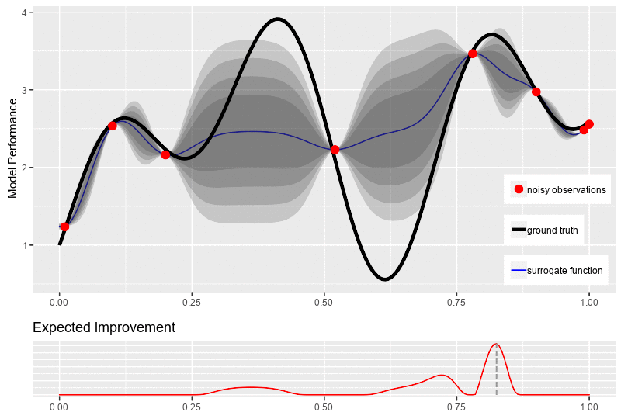
Bayesian Optimization
Bayesian Optimization is a sequential design strategy for black-box optimization and widely used to solve the CASH problem.
Surrogate Model
Build a probability model between configuration and model performance.
“Guessing” performance based on observations
Objective Function
Evaluating the performance of a configuration.
Evaluation Metric
Acquisition Function
Deciding the next configuration to observe. Exploration-Exploitation Trade-off

Slide 15
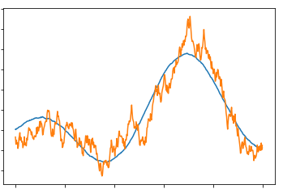

Original KPI
Objective Function
Estimated KPI
The goal of objective function is to evaluate the performance.
Estimated KPI close to the original KPI
Estimated KPI looks like
a normal KPI
The detection model learns the normal pattern of the KPI well
Prevent the detection model from learning anomalous pattern

Slide 16
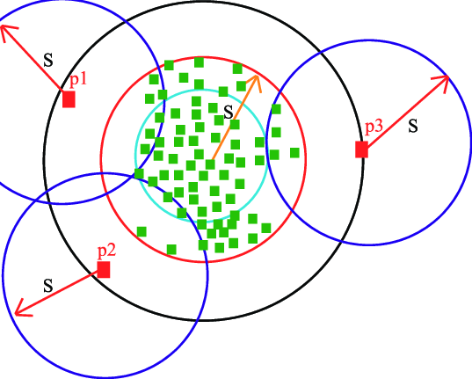
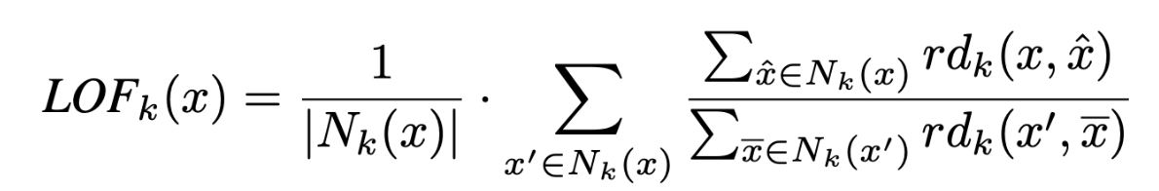
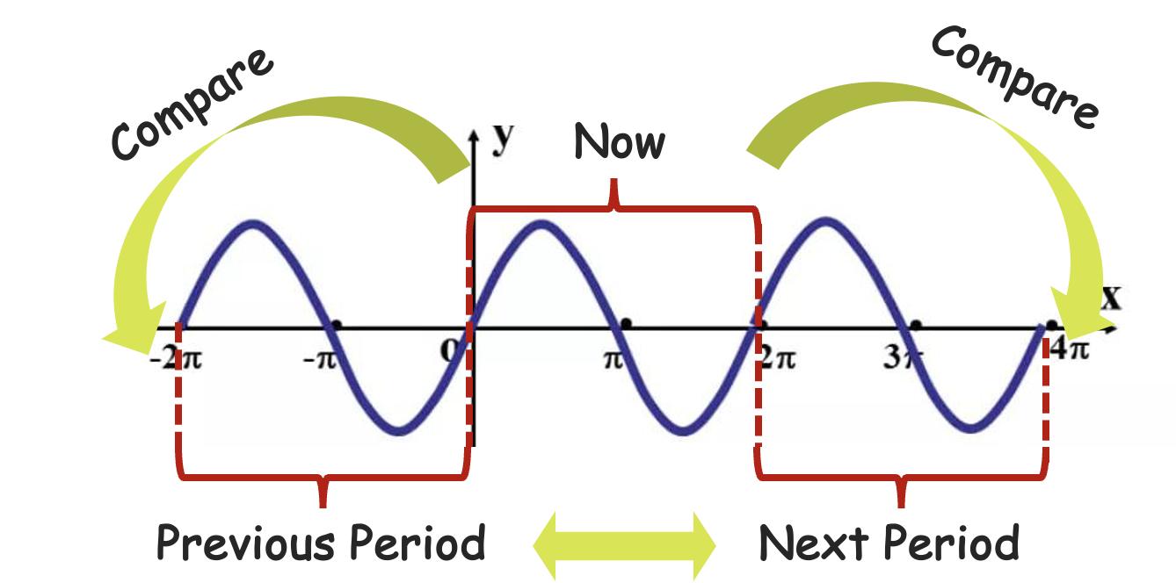
Objective Function: Normal Factor
Local Outlier Factor (LOF)
Using distance to neighbors to measure whether a point is normal or not
Period Outlier Factor (POF)
Replace neighbors with two adjacent periods
High time complexity: $O\left(n^{2}\right)$
High time complexity: 𝑂(𝑛^2 )
Lack of physical meaning for KPIs
Normal Factor (NF)
The majority of KPIs manifest seasonal trends as a result of user behaviors
Data points within adjacent periods are frequently indicative of potentially similar patterns
Normal Factor is the average POF of all data points in the estimated KPI
Our Objective Function
The coefficient α > 0 is utilized to balance between MSE and NF

Slide 17
Acquisition Function
The goal of the acquisition function is to find the next most observable configuration.
Without labels, the gap between F1 and our objective function cannot be completely eliminated
Expected Improvement (EI) is an effective and widely used acquisition function in BO-based AutoML
Similarity Weighted Expected Improvement (SW-EI)
An intuitive solution is to be more inclined to explore different configurations

Slide 18



Configuration Recommendation
Operators have different sensitivities to false alarms and missed alarms for different KPIs.
High priority KPI
Minimize missed alarm
High recall
Low priority KPI
Minimize false alarm
High precision
Preference
Operators
Selection
Sorting with MSE, NF or MSE-NF
Recommended Configurations
Observed Configurations
Remove Outliers
Configuration Candidates

Slide 19

Background
Design
Evaluation
Conclusion

Slide 20
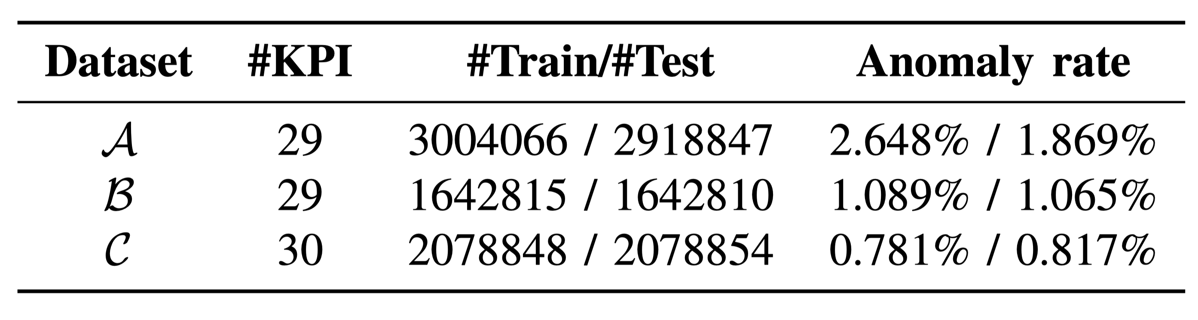
Dataset
Dataset A
Dataset B and C
Based on AIOps2018 Challenge dataset.
Collected from the two most important trading systems of an international commercial bank.
Collected from several big Internet companies’ business systems.
Dozens of operators closely monitor these KPIs to maintain service quality

Slide 21
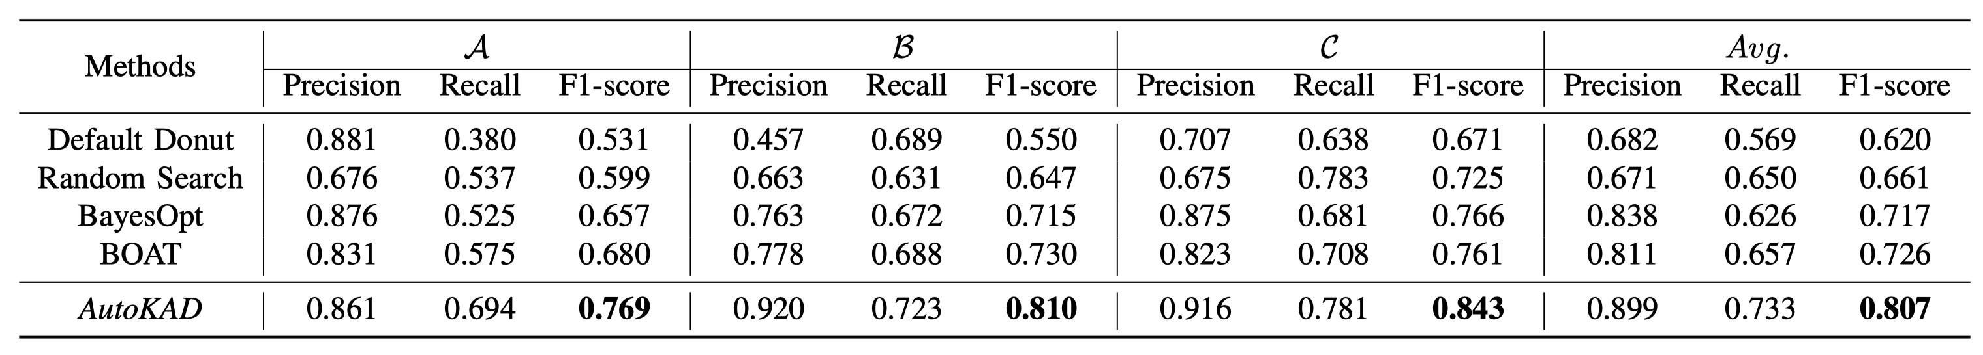
Effectiveness in Searching for Configurations
Under 100 iterations and 1 hour limitation for each KPI
Use MSE as the objective function
outstanding performance on all three datasets
Compared with baseline methods, the results show that AutoKAD is indeed effective in the CASH problem for unsupervised KAD models.

Slide 22
Time Efficiency
Under 100 and 1 hour limitation for each KPI
At 15min, the best F1-score of warm start is 164% higher than the best F1-score of cold start on average.

Slide 23
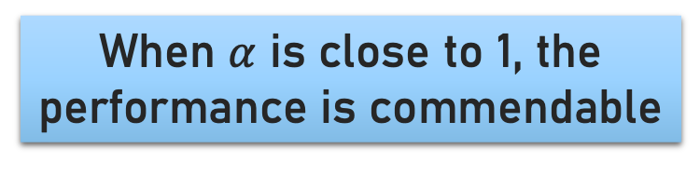
Effectiveness of the Objective Function
The performance of MSE-NF is quite close to the performance of the ideal F1-Score
When $α$ is close to 1, the performance is commendable

Slide 24
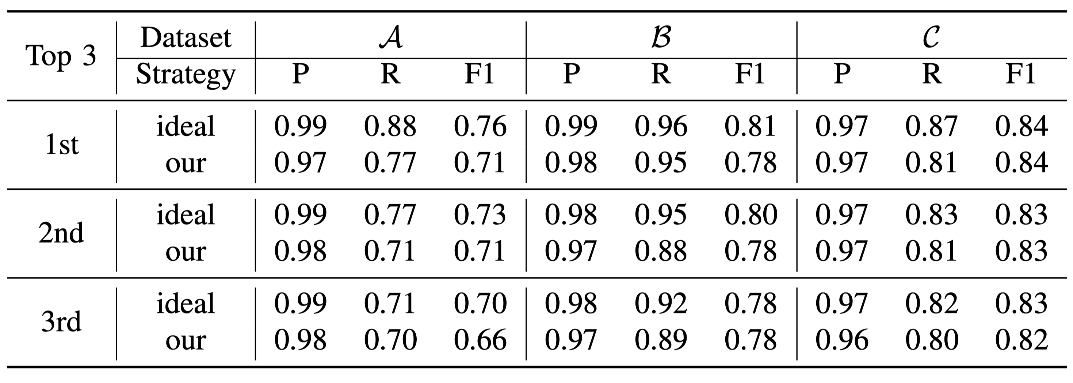
Correctness of Configuration Recommendation
Optimal Configurations
VS
Configurations given by our strategy
Difference
Precision: < 0.02
Recall: < 0.11
F1-Score: < 0.05

Slide 25

Background
Design
Evaluation
Conclusion

Slide 26
Conclusion
Automatic label-free deployment of KPI anomaly detection
AutoKAD: an AutoML framework for unsupervised KPI Anomaly Detection
Opensource AutoKAD
Operators in industry are not machine learning experts
https://github.com/NetManAIOps/AutoKAD
Automatic label-free deployment is important to ensure the detection performance
Cluster-based Warm Start => Reduce the time wasted by cold start
MSE-NF objective function => label-free configuration searching
SW-EI acquisition function => balance exploration and exploitation
Recommendation strategy => satisfy operators’ preferences for different KPIs
Effectively and efficiently find a promising configuration for KPI anomaly detection

Slide 27
Limitation
KPI Requirement
Algorithm Requirement
AutoKAD is designed for univariate KPIs and cannot tackle multivariate KPIs
The algorithm should have the ability to give the estimated KPI (most algorithms )
Algorithms like PCA and kNN cannot be used in AutoKAD
Univariate KPI
Multivariate KPI

Slide 28
Thanks
Q&A

