Slide 1
Causality Enhanced Graph Representation Learning
for Alert-Based Root Cause Analysis
Zhaoyang Yu¹, Qianyu Ouyang¹, Changhua Pei², Xin Wang³, Wenxiao Chen¹,
Liangfei Su⁴, Huai Jiang⁴, Xuanrun Wang¹, Jianhui Li² and Dan Pei¹
¹Tsinghua University
²Chinese Academy of Science
³Stony Brook University
⁴eBay Inc
Notes:
Hello, everyone.
I am Zhaoyang Yu from Tsinghua University, China.
Today I will introduce our latest work: “Causality Enhanced Graph Representation Learning for Alert-Based Root Cause Analysis” to you.

Slide 2
Background
Design
Evaluation
Conclusion
Notes:
Our presentation has 4 sections : background, design, evaluation and conclusion

Slide 3
Online Service Systems
Search Engine
Online Shopping
Social Network
The seamless functioning of large-scale online service systems is essential to people’s daily lives.
Notes:
As we know, the smooth operation of large-scale online service systems like search engines, e-commerce platforms and social networks is critical to our daily lives

Slide 4
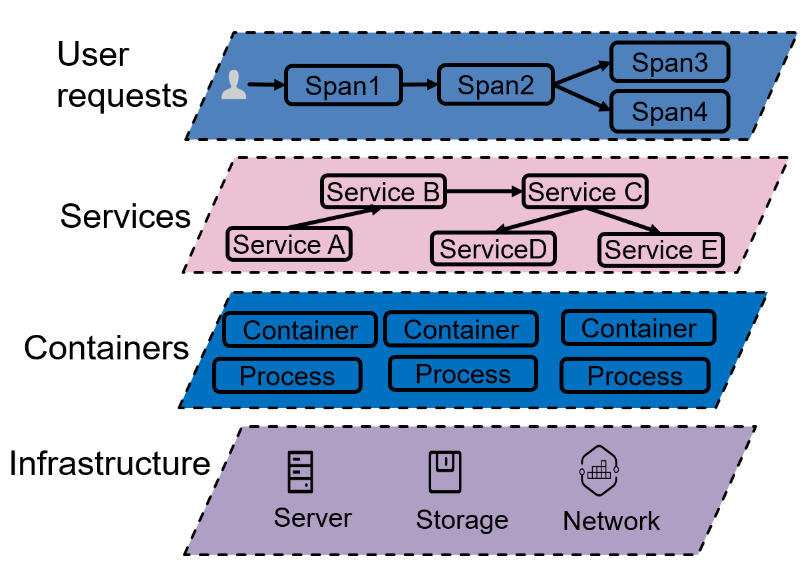
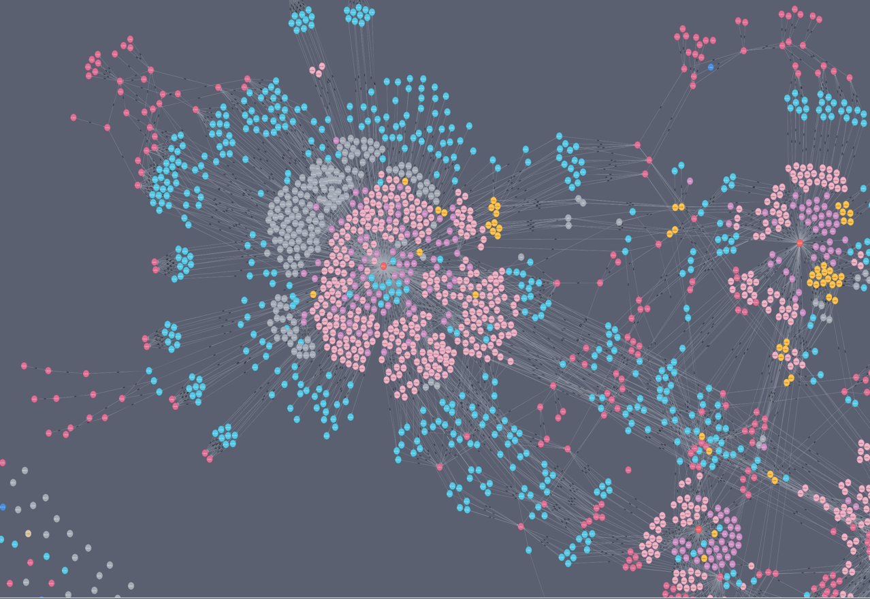
Complex Systems and Evitable Failures
Online service systems comprise
many different components.
(e.g., services, containers and servers).
Due to the intricate architecture, these systems are susceptible to failures at any component level, potentially inducing severe business impacts
Notes:
Online service systems comprise many different components.
However, these complex systems, composed of numerous interlinked components, are prone to failures that can significantly impact businesses [Slide 4].

Slide 5
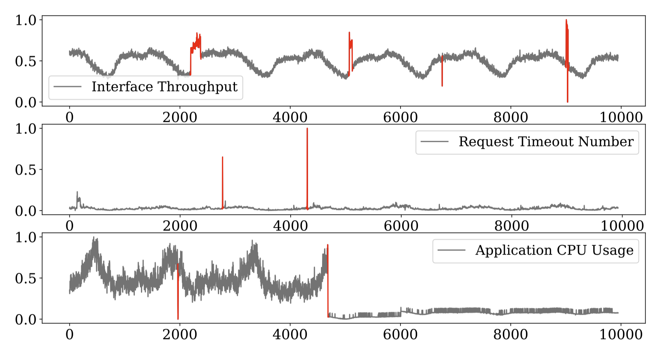
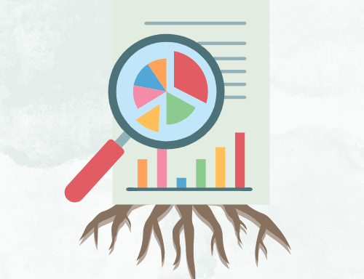
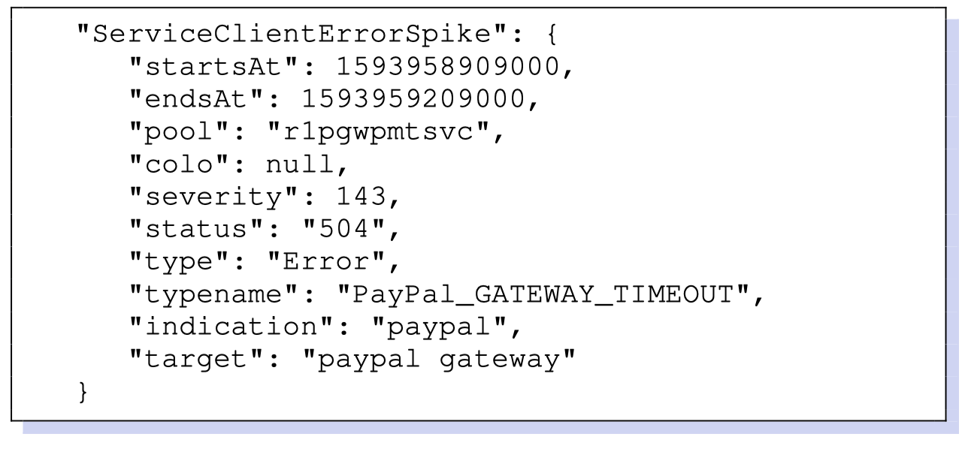
System Recovery After a Failure
Anomaly Detection
Root Cause Analysis
System Remediation
Utilizes multi-modal monitoring data such as business metrics, performance metrics and logs to detect anomaly and generate alerts.
Leverage the alert information to perform domain- and system-specific analysis to pinpoint and verify the root cause of a failure
Promptly restore the system to its normal state
Notes:
After a failure happens, what should we do?
The typical workflow after a system failure is shown on the screen:
1)The first step is Anomaly Detection. Engineer will Utilizes multi-modal monitoring data such as business metrics, performance metrics and logs to detect anomaly and generate alerts.
2) The next step is Root cause analysis (we call this RCA for short)
RCA Leverage the alert information to perform domain- and system-specific analysis to pinpoint and verify the root cause of a failure
3) The last step is to Promptly restore the system to its normal state.

Slide 6
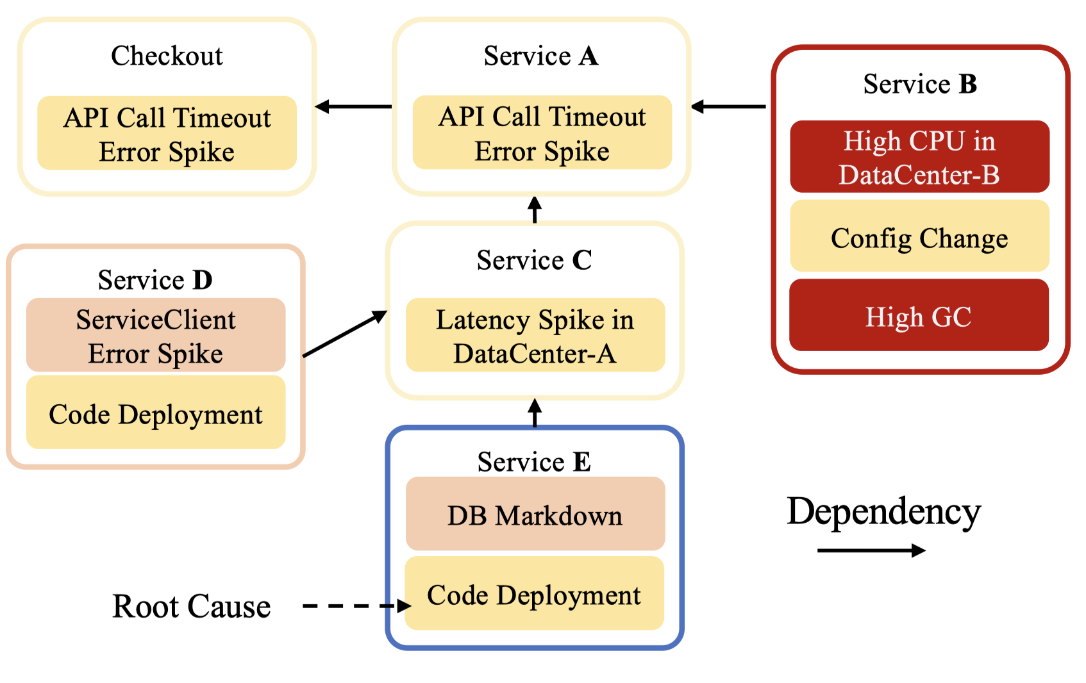
Root Cause Analysis Workflow
Root Cause Analysis
Creating a graph between various RCA entities
Localizing the root cause based on the constructed graph
Dependency Graph
Causal Graph
RCA Model
Notes:
Root cause analysis often involves two key steps: constructing a graph capturing the relationships between entities, and localizing the root cause based on that graph [Slide 6]. Two main types of graphs used in RCA are dependency graphs, showing service call relationships, and causal graphs, indicating causal interactions between services

Slide 7
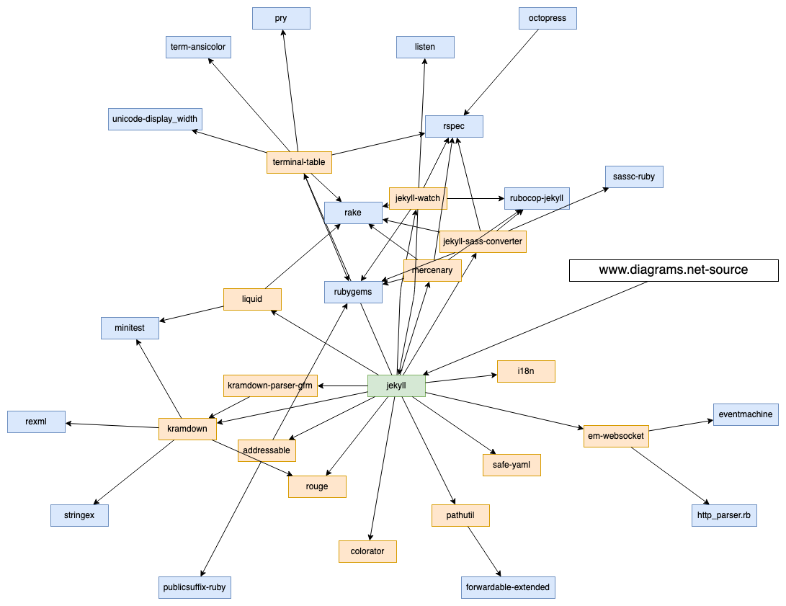
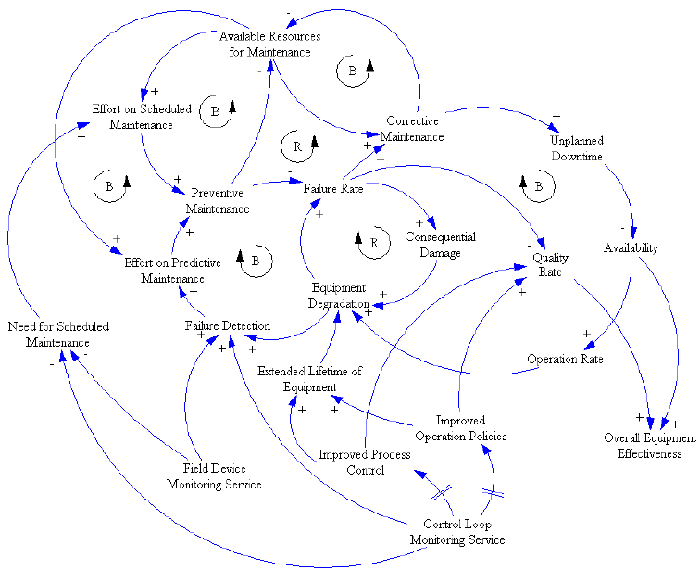
Dependency Graph & Causal Graph
Dependency Graph
Causal Graph
Indicating the calling relationship between services.
Usually available through Configuration Management Database (CMDB)
Coarse-grained graphs
Easy to construct
Indicating the causal relationship of an event between services.
Capture the flow of causality and helps in understanding events
Fine-grained graphs
Hard to construct
Notes:
Let’s take a deeper look at these two graphs.
Dependency graph indicates the calling relationship between services.
Dependency graph Are Usually available through Configuration Management Database (CMDB)
Therefore it is easy to construct
However, dependency graph is a coarse-grained graph. Thus it can provide little information for RCA
Causal Graph Indicating the causal relationship of an event between services.
It can Capture the flow of causality and helps in understanding events
It is a fine-grained graph and very useful for RCA
However, constructing such a graph costs a lot of expert knowledge.

Slide 8
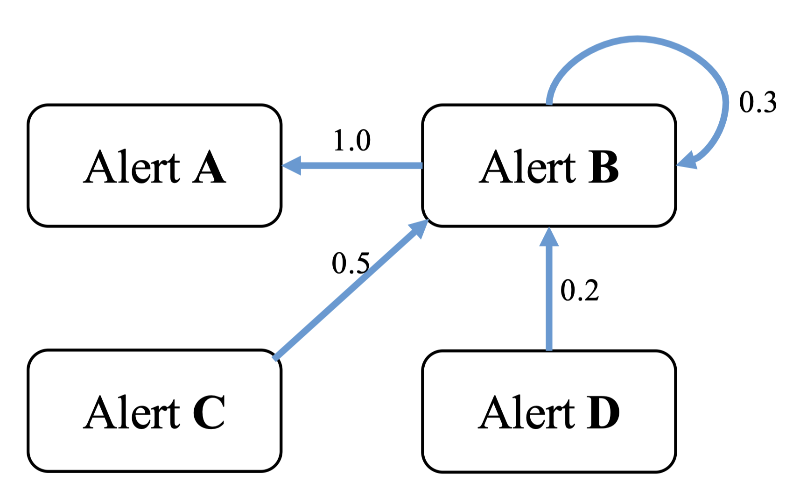
Building a Causal Graph for RCA
Characteristics of Causal Graphs
The causal graph needs to be constructed based on events (in RCA area, alerts or traces).
A causal graph cannot be obtained directly from the static configuration.
Building causal graphs requires expert knowledge.
Metrics
Log
Building Workflow
Multi-Modal Alert
Collect Data (Alert or Trace)
Determine Temporal Relationships
Analyze Contextual Information
Define Causal Relationships
Assign Confidence Levels
Automatically constructing causal graphs is challenging when faced with multimodal alerts
Notes:
The causal graph needs to be constructed based on events
Trace data are usually used for constructing causal graph. But some times, the system will not store trace data for saving storage and computational resources.
Automatically constructing causal graphs is challenging when faced only with multimodal alerts

Slide 9
Challenges
Obtaining a Practical Causal Graph
Utilizing Multi-Modal Alert Information
Lack of readily available traces
Traces are great sources for building causal graph
Traces are often unavailable in many online services due to high requirements for computational and storage resources
Scalability issues with manual construction
Building causal graph requires substantial expert knowledge
Manual construction is not practical in a real-world environment
Integration and correlation of heterogeneous alert data
Alerts often come from diverse monitoring systems and can be in various formats (e.g. metrics and logs)
Effectively combining these heterogeneous data types and identifying complex relationships between alerts across modalities is challenging.
Notes:
We summarize two key challenges in conducting RCA.
The first one is obtaining a practical Causal Graph
Though Traces are great sources for building causal graph, Traces are often unavailable in many online services due to high requirements for computational and storage resources
Besides, Building causal graph requires substantial expert knowledge, Manual construction is not practical in a real-world environment
The second one is how to effectively utilize Multi-Modal Alert Information
Alerts often come from diverse monitoring systems and can be in various formats (e.g. metrics and logs)
Effectively combining these heterogeneous data types and identifying complex relationships between alerts across modalities is challenging.

Slide 10
Our Goal
1. Utilizes widely recognized alert events as input, rather than challenging-to-obtain trace information.
2. Automatically construct causal graphs to reduce labor costs
3. Simultaneous use of information from multiple modalities in the alert data.
Notes:
Our goal is to address these challenges by developing a alert-based RCA method that. In this work, we have three goals.
The first one is Utilizes widely recognized alert events as input, rather than challenging-to-obtain trace information.
Then we want to construct Automatically causal graphs to reduce labor costs
The third one it achieving use information Simultaneous from multiple modalities in the alert data.

Slide 11
Background
Design
Evaluation
Conclusion
Notes:
Then, we will introduce our design.

Slide 12
AlertRCA: Overview
The Root Cause Analysis algorithm based on Alert events
Notes:
Now let me introduce AlertRCA, our proposed alert-based root cause analysis framework

Slide 13
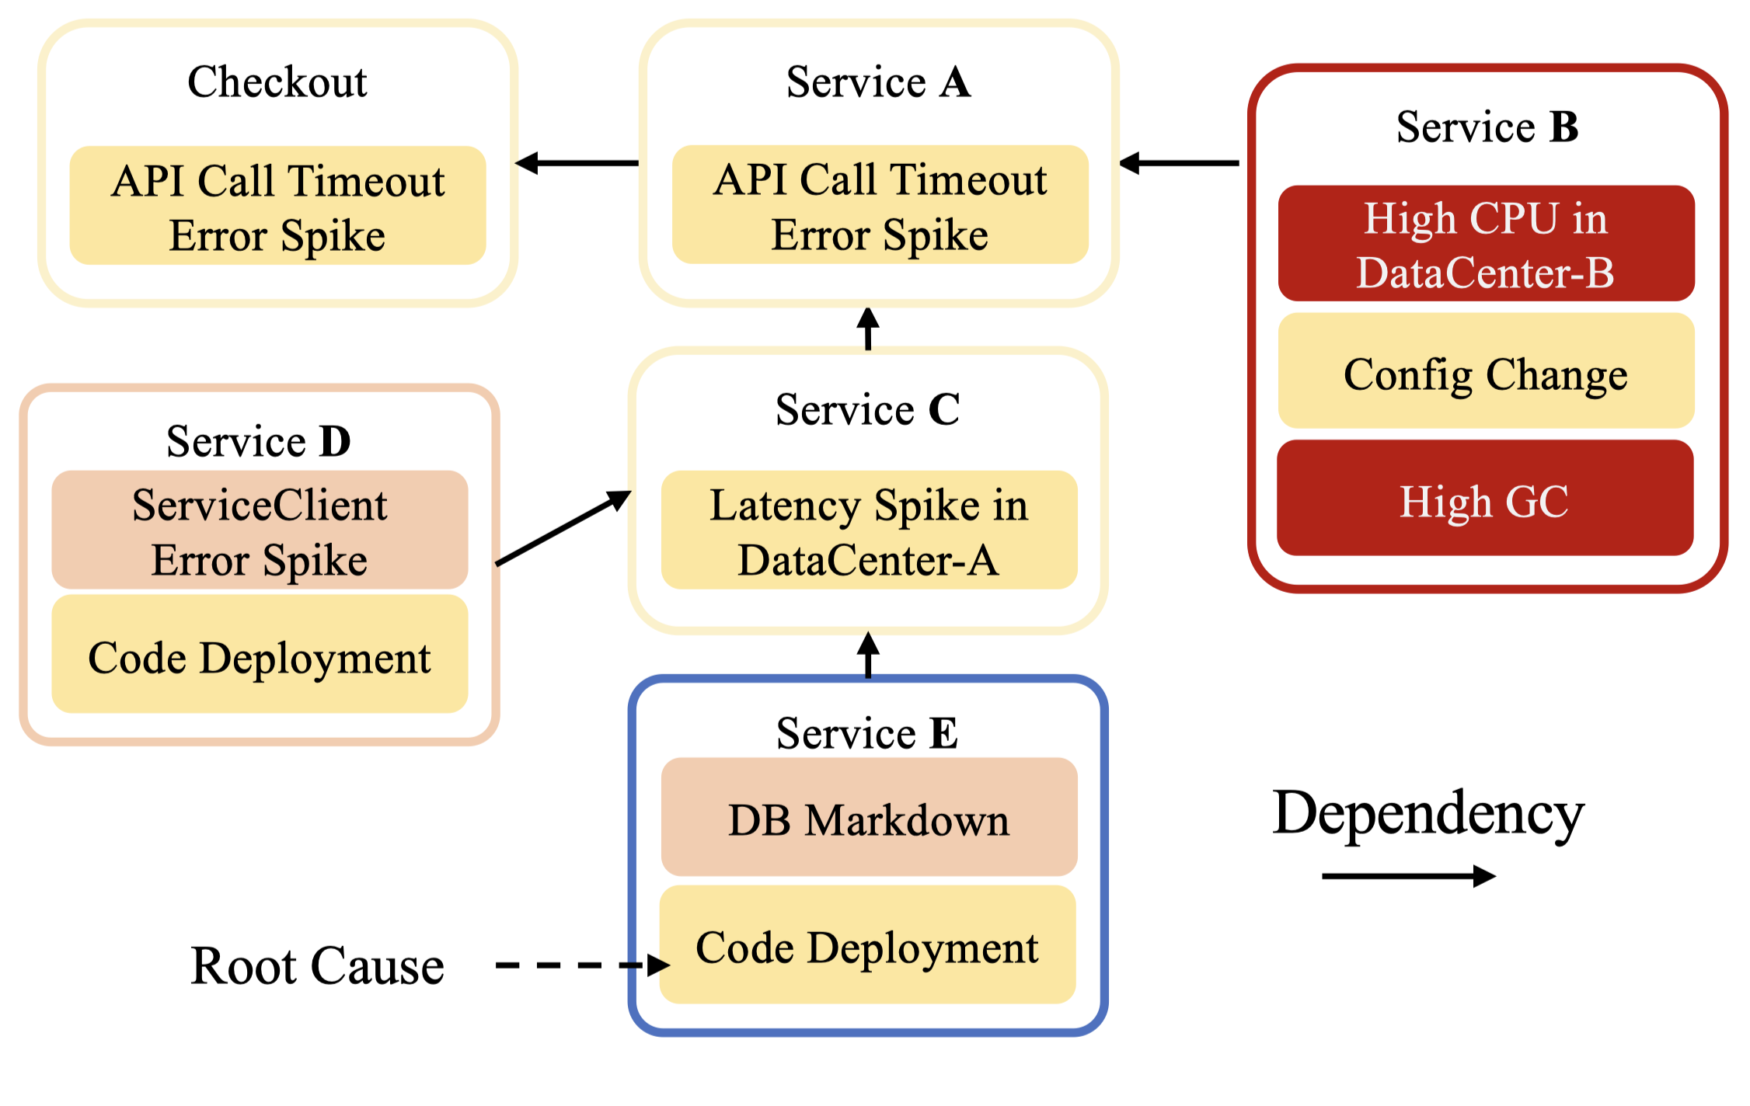
Automatically Building a Causal Graph for RCA
When we do not have high-quality trace data, constructing causal graphs is usually challenging.
Service Dependency Graph (SDG) can be easily obtained from CMDB.
Can we use to SDG automatically construct a causal graph ?
Service Dependency Graph (SDG)
Notes:
building a casual graph is important for alert-based RCA.
When we do not have high-quality trace data, constructing causal graphs is usually challenging.
Service Dependency Graph (SDG for short) can be easily obtained from CMDB.
The core idea is intuitive.
That is to automatically construct an alert causal graph by leveraging an easy-to-obtain service dependency graph or SDG

Slide 14
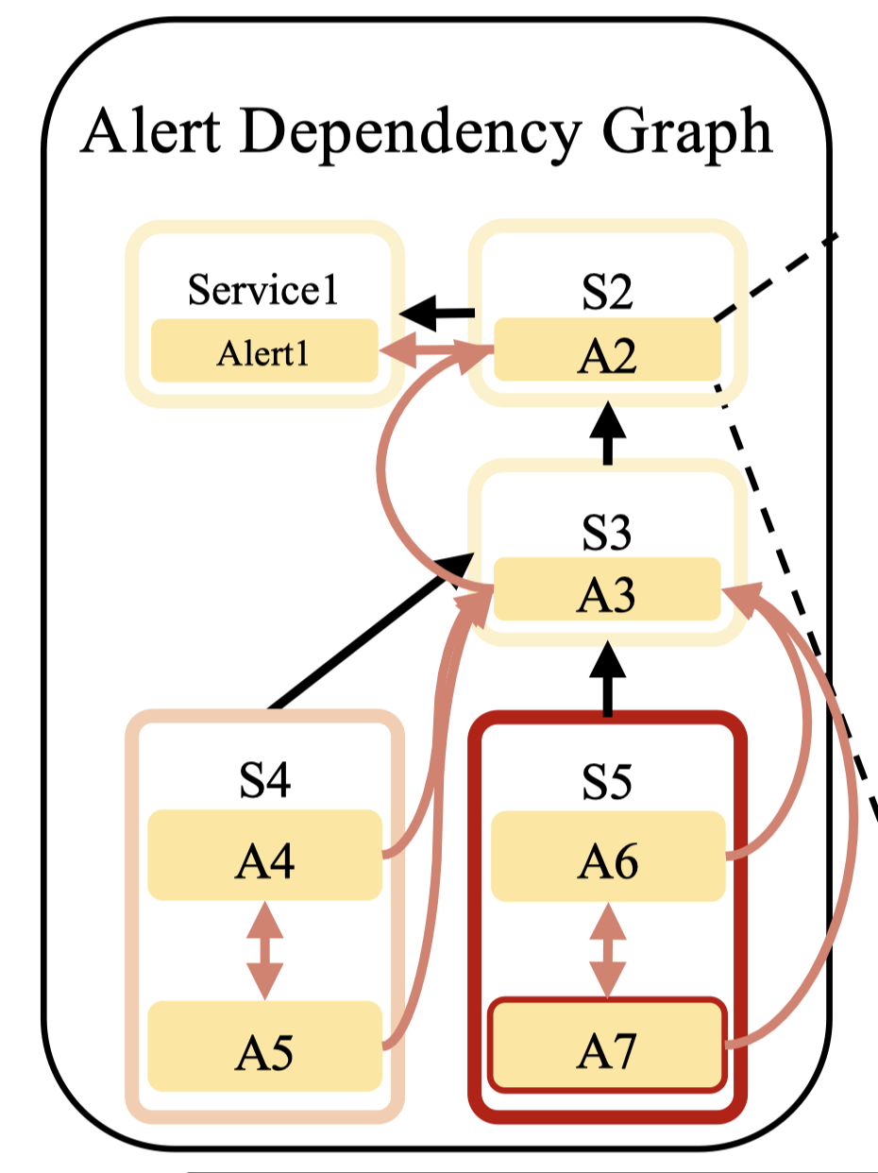
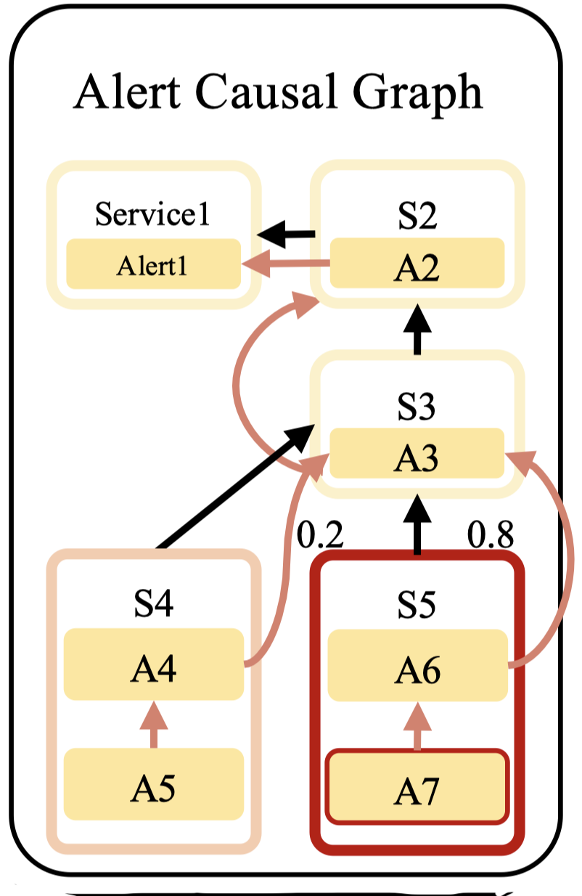
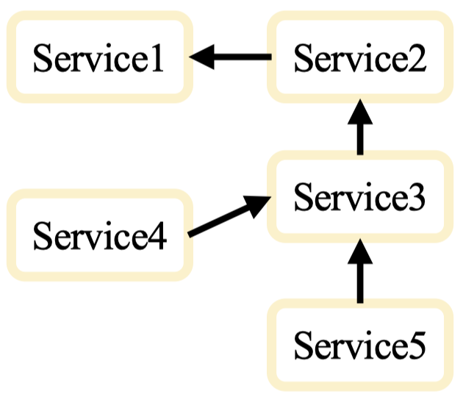
Generating Alert Causal Graph by SGD
Obtained easily from configuration management database
Nodes only consist of services
Edges exist only between services
Static topology information
Constructed from SDG and corresponding alert data
Nodes consist of alert events
Edges represent the relationship between alert events
No weights for edges
Our target
Constructed based on ADG
A subgraph of the ADG
Weights for edges should be learned automatically
Service Dependency Graph
(SDG)
Alert Dependency Graph
(ADG)
Alert Causal Graph
(ACG)
Notes:
We start with the SDG from a configuration management database.
In a SDG, nodes only consist of service. And the edge only exist between service
A SDG reveal the static topology information of an online service system
Next, we generate an alert dependency graph or ADG by mapping alerts onto the SDG.
In an ADG, Nodes consist of alert events
Edges in an ADG, represent the relationship between alert event.
But, there are no weights for edges yet.
Finally, we learn edge weights to convert the ADG into an alert causal graph or ACG
This is our target for root cause analysis.
Actually an ACG is a subgraph of ADG.

Slide 15
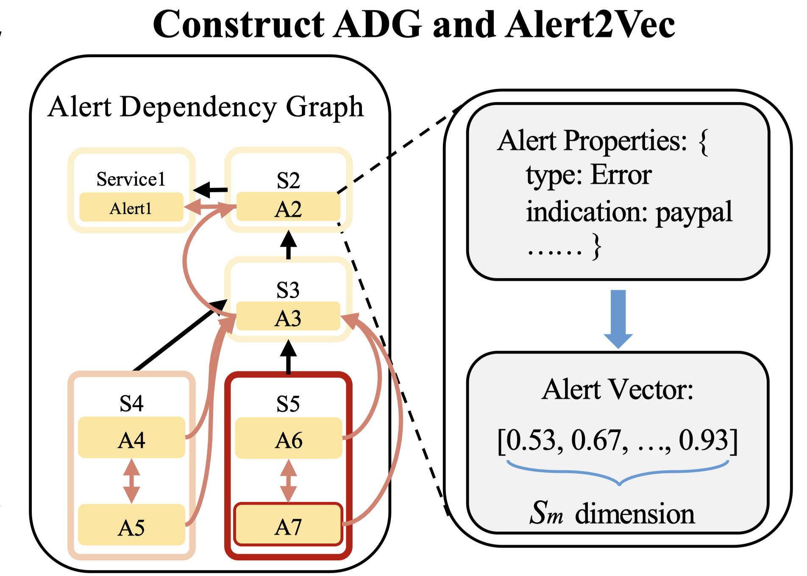
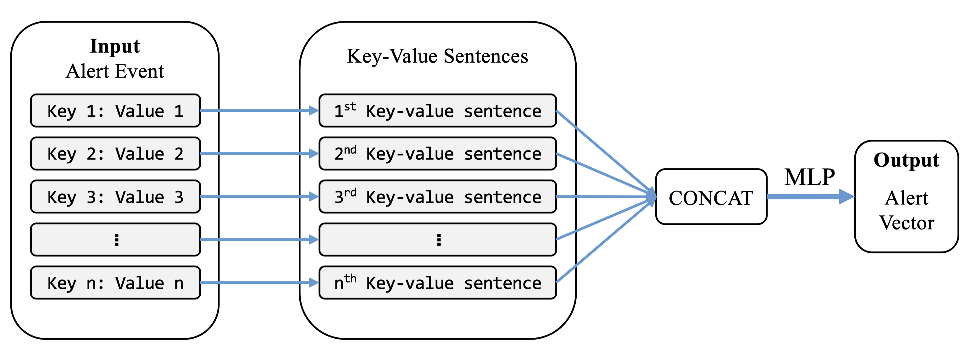
Alert2Vec
Pre-trained LM
(BERT)
Obtain the representation vectors associated with alert events
Imitate how engineers understand the alerts
Generating a semantic vector for each alert attribute by a pre-trained LM (BERT)
Pre-trained LM (BERT):
BERT is much more efficient than the LLM like GPT
Helps understand the sematic information in logs
Alert2Vec
Alert Attribute
(Raw Key Value Pair)
Alert Attribute
(Key Value Sentence)
Notes:
Now, let me briefly explain the key components of this process.
First, we have the Alert2Vec module [New Slide 1]. Its goal is to obtain representation vectors associated with alert events, mimicking how engineers understand alerts. We generate a semantic vector for each alert attribute using a pre-trained language model, specifically BERT. We chose BERT because it is much more efficient than large language models like GPT, and it also helps capture the semantic information in logs.

Slide 16
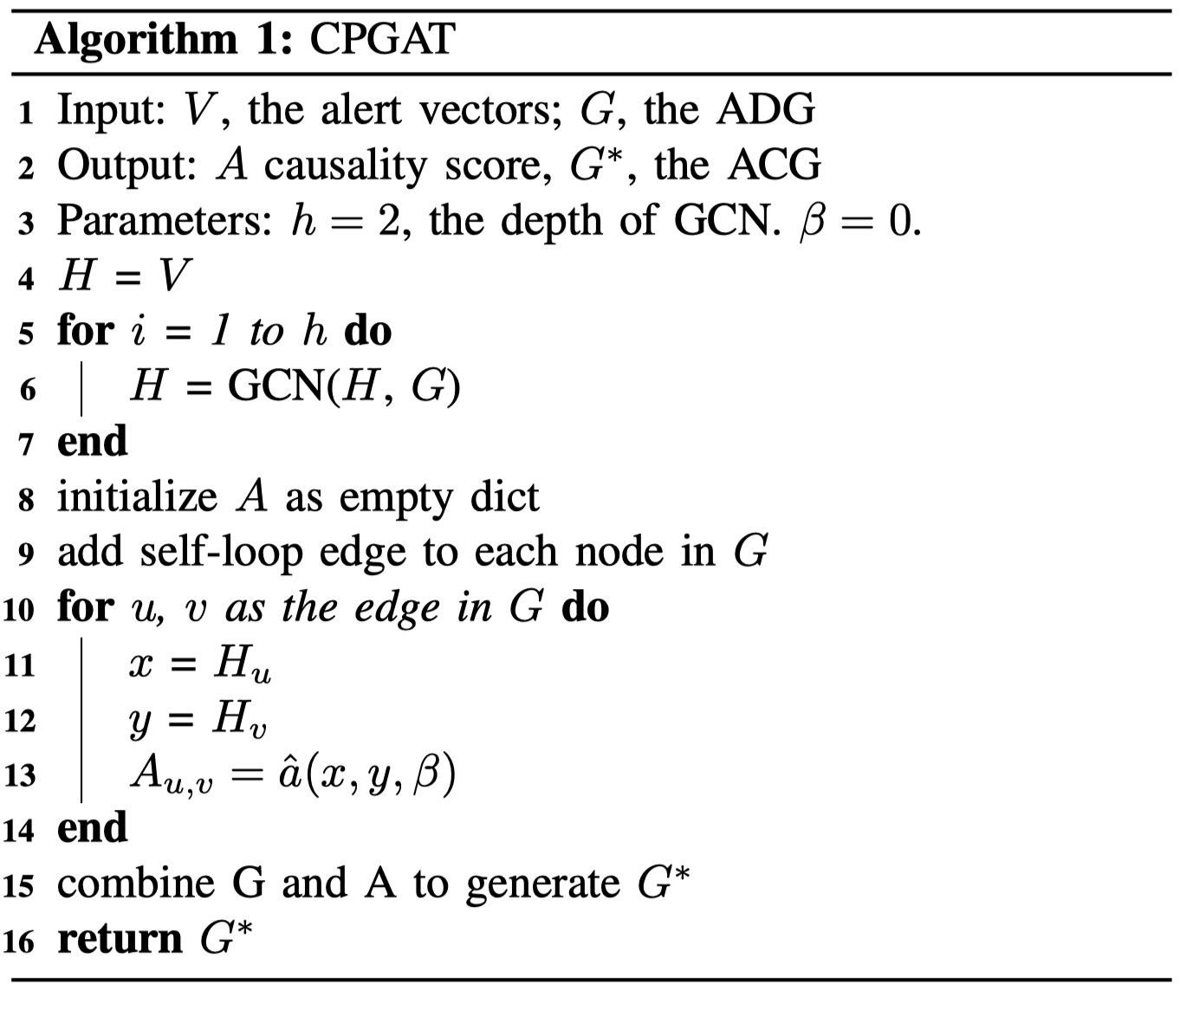
Causality Prediction Graphical Attention Network
Autonomously determine a causality score for each edge within the input ADG
Observation:
O1: Probability of a causal can vary significantly depending on the contextual environment
O2: Historical co-occurrence of alerts plays a significant role
O3: The summation of the probabilities equals to 1
1. Involve multi-modal alert data
2. Learn from historical alerts
3. Standardize causality score
Notes:
Next, we have the Causality Prediction Graphical Attention Network, or CPGAT [New Slide 2]. CPGAT autonomously determines a causality score for each edge in the input Alert Dependency Graph. This is based on three key observations:
The probability of a causal link can vary significantly depending on the context.
Historical co-occurrence of alerts plays a significant role.
The sum of the probabilities equals 1.

Slide 17
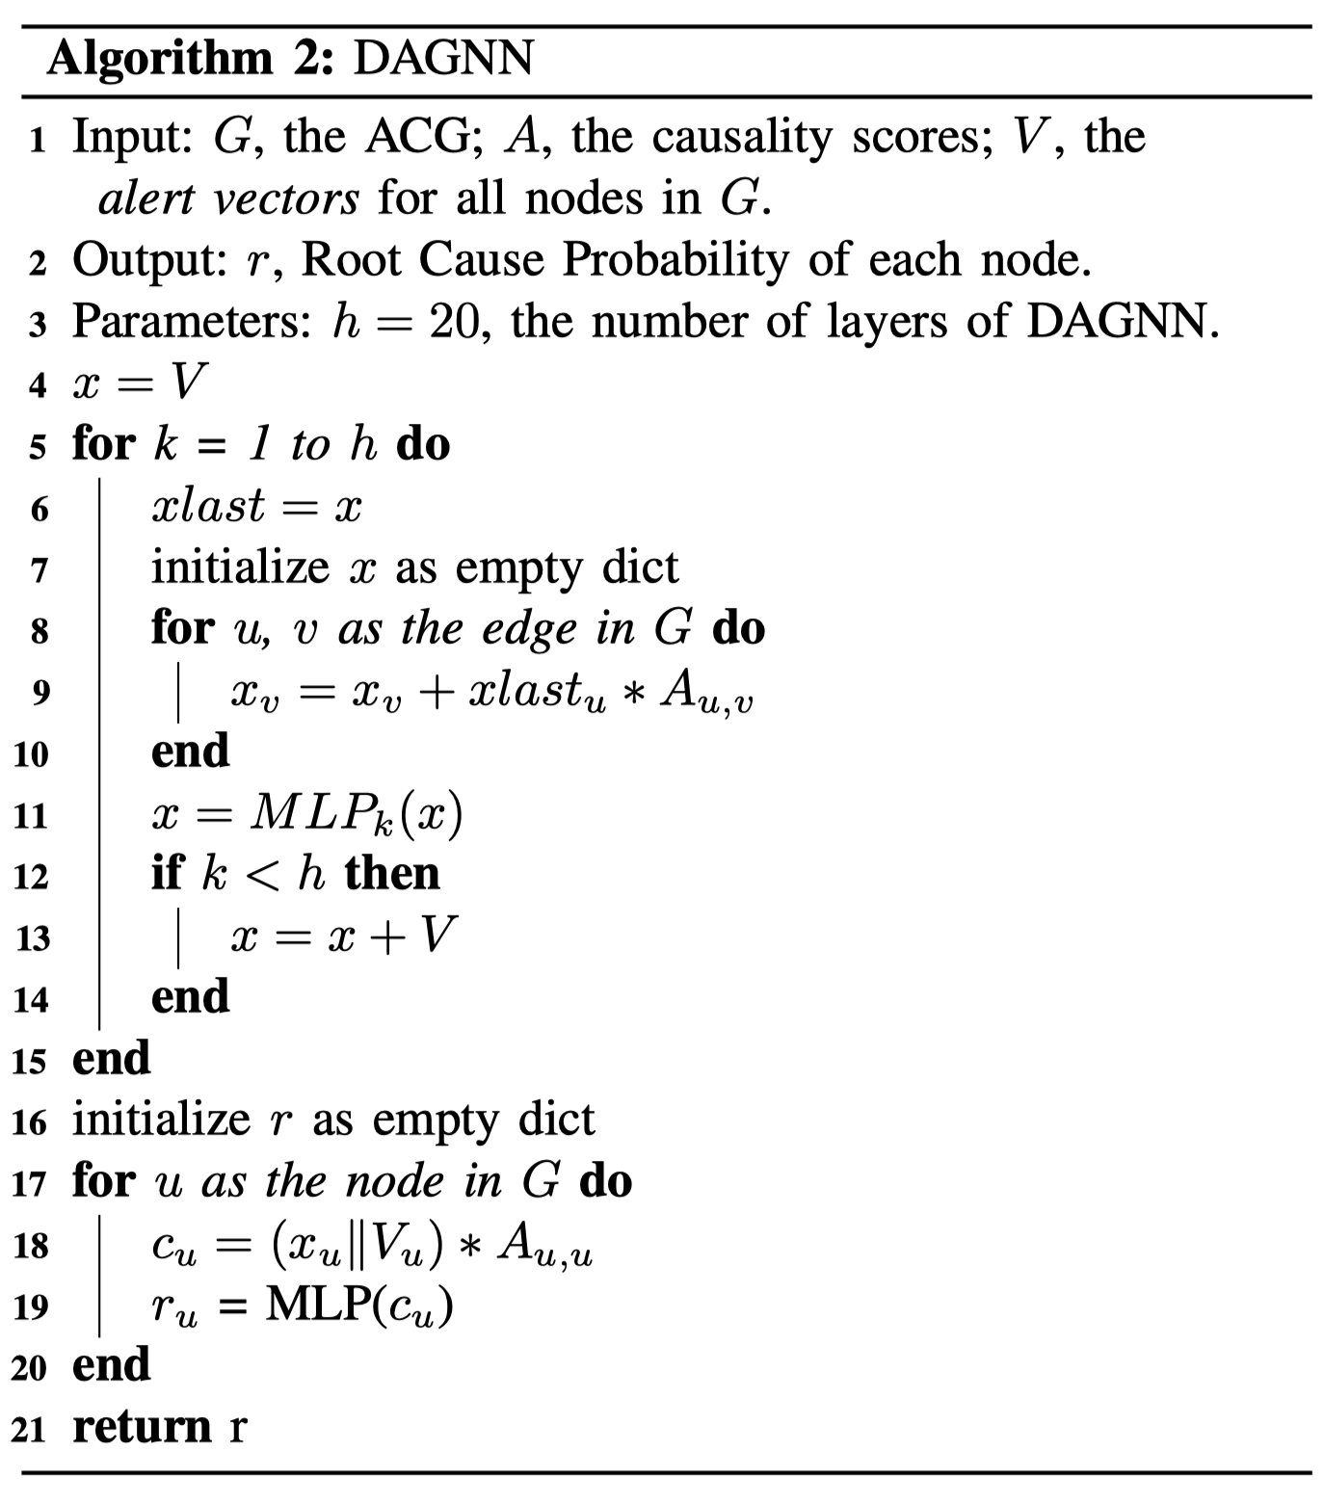
Dispersing and Aggregating Graph Neural Network
Autonomously determine the root cause alert in the constructed ACG
If A is the root cause, then it will satisfy the following three conditions:
C1: Alert A causes numerous neighbor nodes to be anomalous.
C2: Few other alerts lead to A. Mostly A is self-looping.
C3: higher frequency appearing in the history of system failures, the greater the likelihood being the root cause
Dispersing
A
Aggregating
Notes:
Finally, we have the Dispersing and Aggregating Graph Neural Network, or DAGNN [New Slide 3]. DAGNN is responsible for autonomously determining the root cause alert in the constructed Alert Causal Graph. If an alert A is the root cause, it will satisfy three conditions:
Alert A causes numerous neighbor nodes to be anomalous.
Few other alerts lead to A, and A is mostly self-looping.
The higher the frequency of A appearing in the history of system failures, the greater the likelihood of it being the root cause.

Slide 18
Background
Design
Evaluation
Conclusion
Notes:
Next, I will present some of our experimental results.

Slide 19
Dataset and Baselines
Dataset from eBay
Dataset A1 and A2
real-world e-commerce system data from Jan 2020 to Apr 2021
from a production system at a major ISP, with ten failure types.
assess CPGAT and DAGNN performance when given metric data instead of alert metadata.
serving 185 million active users across 3 data centers with 5000 services
service-based: 782 failures
business-based: 170 failures
each failure is resolved, labeled, and verified by the SRE team
from DejaVu’s^{[1]} A1 and A2 datasets
Baseline Methods
Groot: pre-defined manual rulebook to construct a causal graph
GrootN: evaluate the performance of Groot in the absence of expert rules
PageRank-SDG: PageRank to the SDG for service-level root cause localization.
GCN: Graph Convolutional Network
GraphSAGE: optimized GCN for the embedding of unseen nodes
GAT: Graph Attention Network
DejaVu: the state-of-the-art RCA method
[1] Li Z, Zhao N, Li M, et al. Actionable and interpretable fault localization for recurring failures in online service systems (ESEC/FSE 2022)
Notes:
We evaluated AlertRCA on real-world datasets from eBay and a major ISP
We benchmarked against 7 baselines including the state-of-the-art RCA method DejaVu and the manual rule-based approach Groot

Slide 20
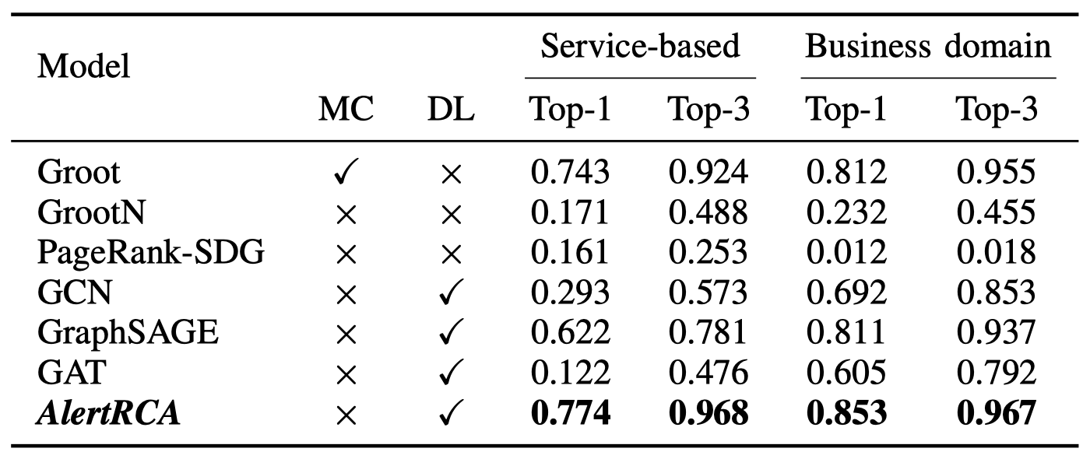
Effectiveness and Efficiency
AlertRCA is more effective in locating root cause alerts even when compared to the RCA algorithm with manual rules.
Notes:
In terms of effectiveness and efficiency, AlertRCA outperformed all baselines, even without manual configuration.
AlertRCA is more effective in locating root cause alerts even when compared to the RCA algorithm with manual rules.
数值提示，结果直接文字表达

Slide 21
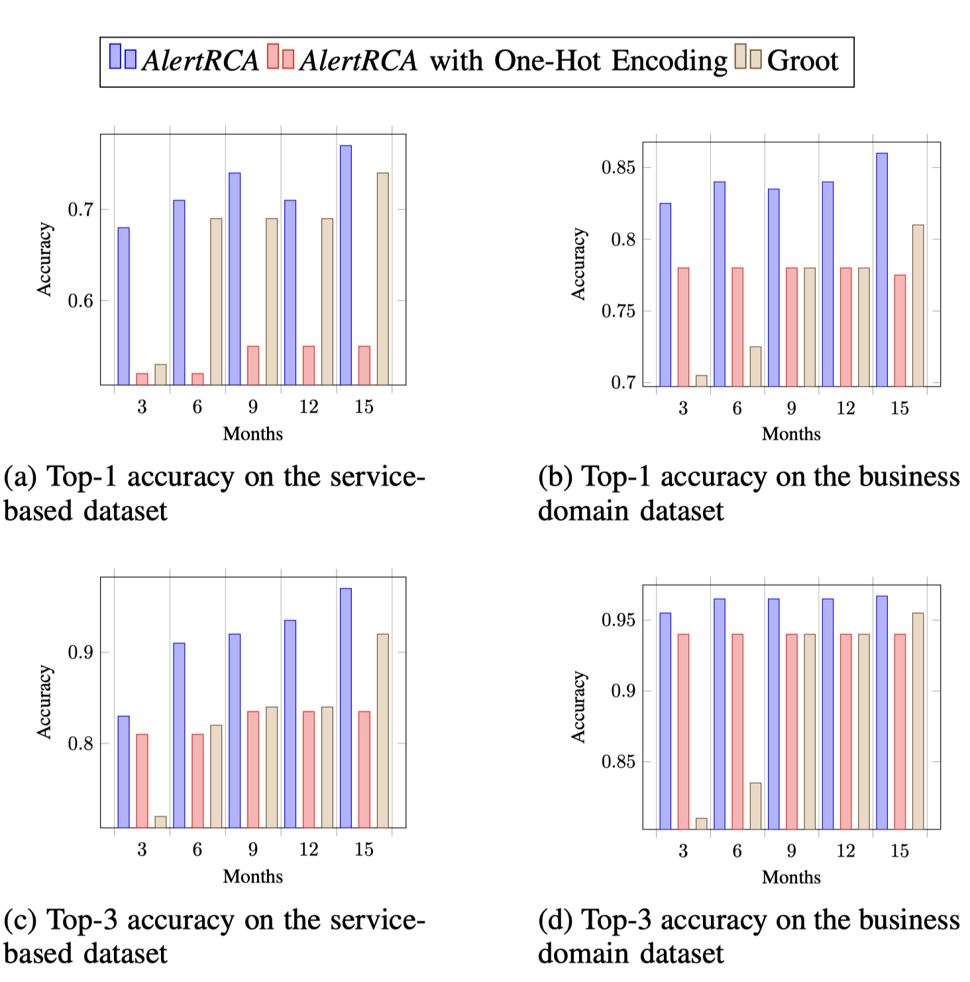
Quick-Start
AlertRCA is able to reach a promising performance after a new microservice system is started in 3 months.
AlertRCA is a quick-start RCA approach.
Notes:
We study how AlertRCA performs when the running time of the system is not very long. When deploying a new microservice system in a short time, the collected training data are insufficient
According to our results, AlertRCA is able to reach a promising performance after a new microservice system is started in 3 months.

Slide 22
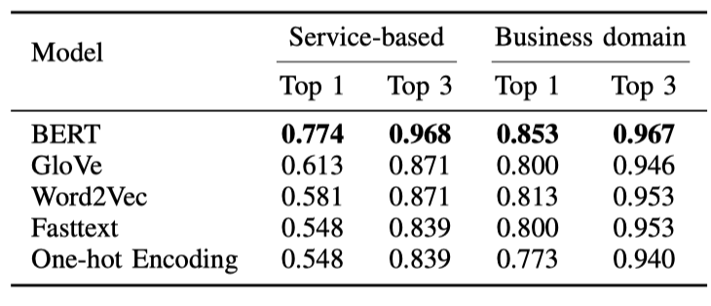
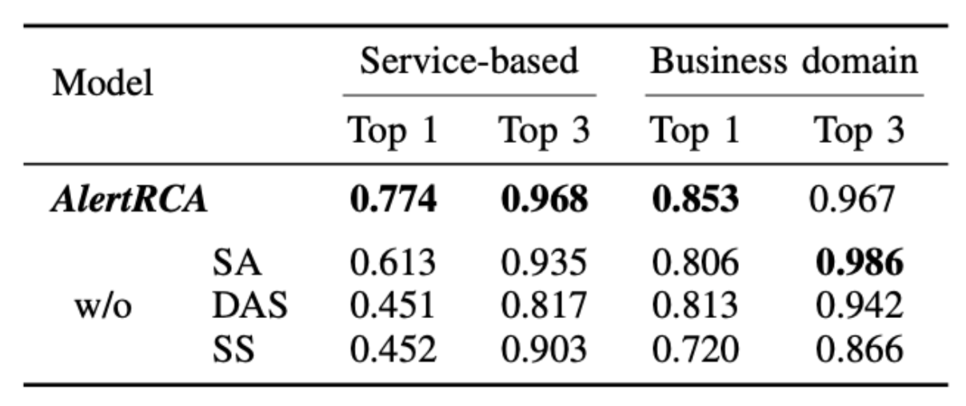
Abalation Study
Ablation Study about DAGNN
Modules for Log Processing
Compared with the simple hierarchical architecture, the self-residual structure, dispersing aggregating structure, and self-loop attention are crucial to AlertRCA
BERT is essential for the Alert2Vec module to understand the semantics in alerts.
Notes:
There are three major modules in AlertRCA, namely Alert2Vec, CPGAT, and DAGNN. To understand the function of each module, we evaluate AlertRCA with these modules removed or replaced:
Ablation studies validated the importance of key modules like BERT for alert embedding
Compared with the simple hierarchical architecture, the self-residual structure, dispersing aggregating structure, and self-loop attention are crucial to AlertRCA

Slide 23
Metric as Input
For a fair comparison with DejaVu, in this experiment AlertRCA only used the metric information.
CPGAT and DAGNN in AlertRCA can work well in other systems that do not generate alerts.
Notes:
To test the performance of our proposed framework with only metric data
We compare AlertRCA with the state-of-the-art root cause analysis method DejaVu.
For a fair comparison with DejaVu, in this experiment AlertRCA only used the metric information and not the multi-modal alert data.
The results show that CPGAT and DAGNN in AlertRCA can work well in other systems that do not generate alerts.

Slide 24
Background
Design
Evaluation
Conclusion
Notes:
In conclusion, let me summarize our work.

Slide 25
Conclusion
Introducing AlertRCA: A Novel Root Cause Analysis Model
Use more generic alert data instead of trace data
Construct a practical and accurate causal graph
Employs a deep learning-based approach for alert-based RCA
Automated Causal Graph Construction Process
Utilizes Service Dependency Graph to automatically construct causal graph
Leverages Causality Prediction Graphical Attention Network (CPGAT) to learn causal scores from historical data
Localizing root cause by the proposed Dispersing and Aggregating Graph Neural Network (DAGNN)
Effective and Efficient Root Cause Analysis
Compared with the state-of-the-art method, we achieve 24.8% and 15.7% improvements on top-1 accuracy.
Our codes are available: https://github. com/NetManAIOps/AlertRCA.
Notes:
To recap, we presented AlertRCA, a novel root cause analysis framework that enhances graph representation learning with causality.
AlertRCA automatically constructs a practical and accurate causal graph from alert data and effectively localizes root causes.
We've open-sourced our code so that the community can benefit from and build upon our work. Please check out our GitHub repo for more details.

Slide 26
Thanks
Q&A
Notes:
Thank you for your attention! I'd be happy to take any questions you may have

