Slide 1





Pre-trained KPI Anomaly Detection Model
Through Disentangled Transformer
Zhaoyang Yu¹, Changhua Pei*2, Xin Wang³, Minghua Ma⁴, Chetan Bansal⁴, Saravan Rajmohan⁴, Qingwei Lin4, Dongmei Zhang⁴, Xidao Wen⁵, Jianhui Li², Gaogang Xie², Dan Pei¹
¹Tsinghua University
²CNIC
³Stony Brook University
⁴Microsoft
⁵Bizseer
Notes:
Hello everyone, I am Zhaoyang Yu from Tsinghua University.
Today, I will introduce our work with Microsoft, titled "Pre-trained KPI Anomaly Detection Model Through Disentangled Transformer

Slide 2




Background
Design
Evaluation
Conclusion
Notes:
Our presentation has 4 sections : background, design, evaluation and conclusion

Slide 3



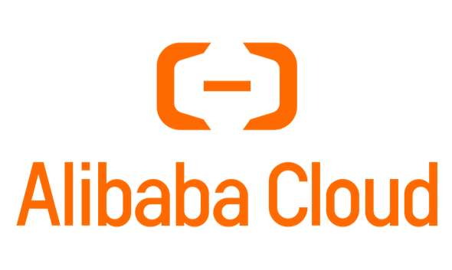
Unavoidable Failures
July 2024, CrowdStrike experienced a catastrophic failure in its security infrastructure, leading to a complete outage, impacting 8.5 million devices worldwide.
October 2021 Facebook’s apps had a total outage of their external services for up to seven hours, evaporating nearly $50 billion in market value overnight.
December 2022 AliCloud outage lasts more than 12 hours, many customer services severely impacted
Even the world’s leading companies are not immune to the huge financial losses caused by failures.
How can we minimize the occurrence of catastrophic level failures and reduce economic losses?
Notes:
First, I want to talk about Failures.
In real-world environments, online service systems are very complex.
Therefore, failures are often inevitable.
Significant system failures often result in great financial losses.
Even top-tier global companies have experienced massive financial losses due to system failures.
So, how can we minimise the occurrence of failures and reduce financial losses?

Slide 4
KPI Anomaly Detection
Key Performance Indicator (KPI)
Time-series data collected from a myriad of sources
Reflect the health status of a service
Most KPIs in the real world are seasonal
KPI anomaly detection is essential for service reliability
Labels are expensive
Most algorithms are unsupervised
Identifying potential issues by detecting anomalies in KPIs
Real-world time series data are complex and exhibit significant variations across different domains.
Collecting KPI data for model training and fine-tuning is time consuming
Notes:
An effective approach is KPI anomaly detection.
KPI stands for Key Performance Indicator.
They are time-series data, collected from various sources, that reflect the health status of a service.
Since user behavior tends to be seasonal, KPIs are usually seasonal data.
To ensure service reliability, operators closely monitor KPIs and conduct anomaly detection.
Through anomaly detection, potential issues in the system can be identified.
Labeling KPIs requires a vast amount of domain knowledge, and there's a large number of KPIs in a complex system
The number of KPIs can reach up to millions.
Thus, labels are expensive in KPI anomaly detection.
Therefore, the mainstream KPI anomaly detection algorithms are unsupervised.
Besides, Collecting KPI data for model training and fine-tuning is also time consuming
In a real world scenario, we would like to collect only a small amount of data to be able to fine-tune the model very well

Slide 5
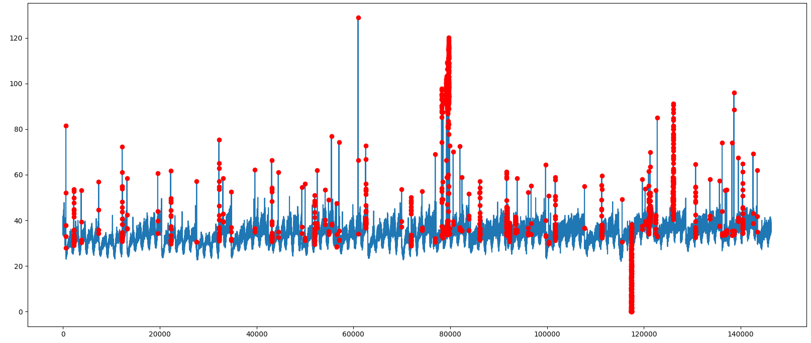
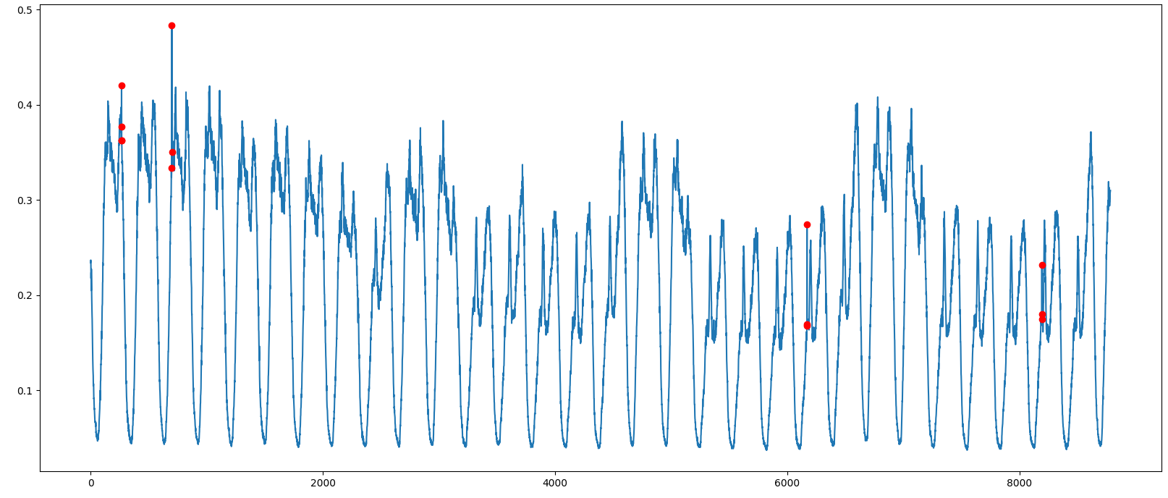
Fine-Tuning Matters
The pre-trained model will not work well for all KPIs
Fine-tuning for the incoming KPI is vital for KPI anomaly detection
Fine-tuning affects detection performance
Same pre-trained performs very differently on different datasets
When a new service goes live, it's likely to be dealing with brand new KPIs
Same Pre-trained detector has a huge difference in performance on different KPIs
F1-Score: 0.267
F1-Score: 0.917
Notes:
Moreover The pre-trained model will not work well for all KPIs
Same pre-trained performs very differently on different datasets
When a new service goes live, it's likely to be dealing with brand new KPIs
Therefore, Fine-tuning for the incoming KPI is vital for KPI anomaly detection

Slide 6

Two criteria for practical anomaly detection
Generalizable Pre-Training: The ability to detect anomalies across diverse KPI datasets using a universal model, which is pretrained on the accessible datasets and can adapt to previously unseen datasets.
Unsupervised Few-Shot Fine-Tuning: The ability to achieve a strong performance even with limited data after fine-tuning, minimizing the initialization time. This allows models to rapidly adapt to unseen KPIs or services.
Universal KAD Model
Unsupervised Few-Shot
Fine-Tuning
Different KPIs
Notes:
Therefore, for industry, anomaly detection for KPIs needs to follow two criteria：
First is Generalizable Pre-Training the ability to detect anomalies across diverse KPI datasets using a universal model, which is pretrained on the accessible datasets and can adapt to previously unseen datasets.
The second one is Unsupervised Few-Shot Fine-Tuning: The ability to achieve a strong performance even with limited data after fine-tuning, minimizing the initialization time. This allows models to rapidly adapt to unseen KPIs or services.

Slide 7
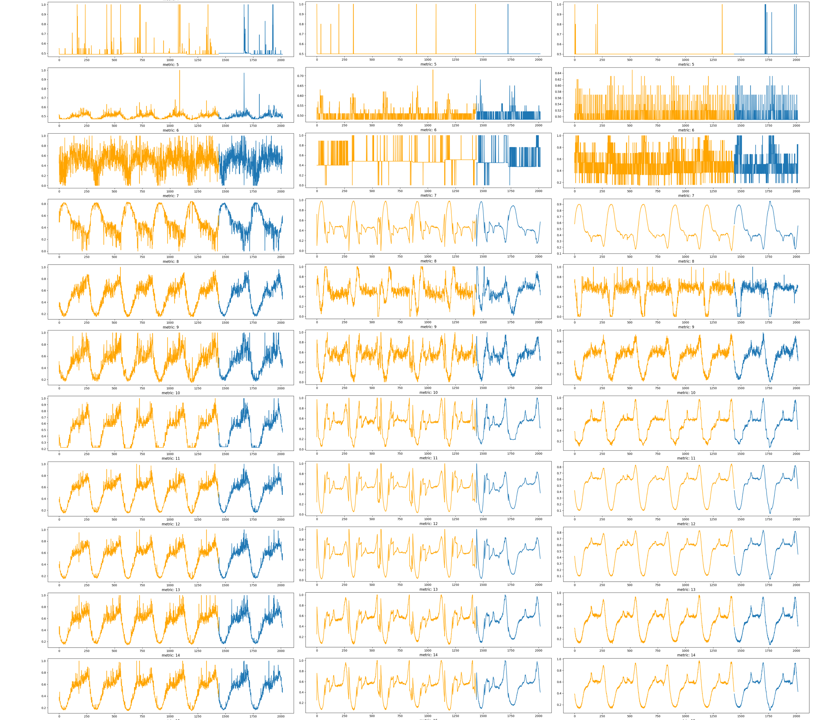
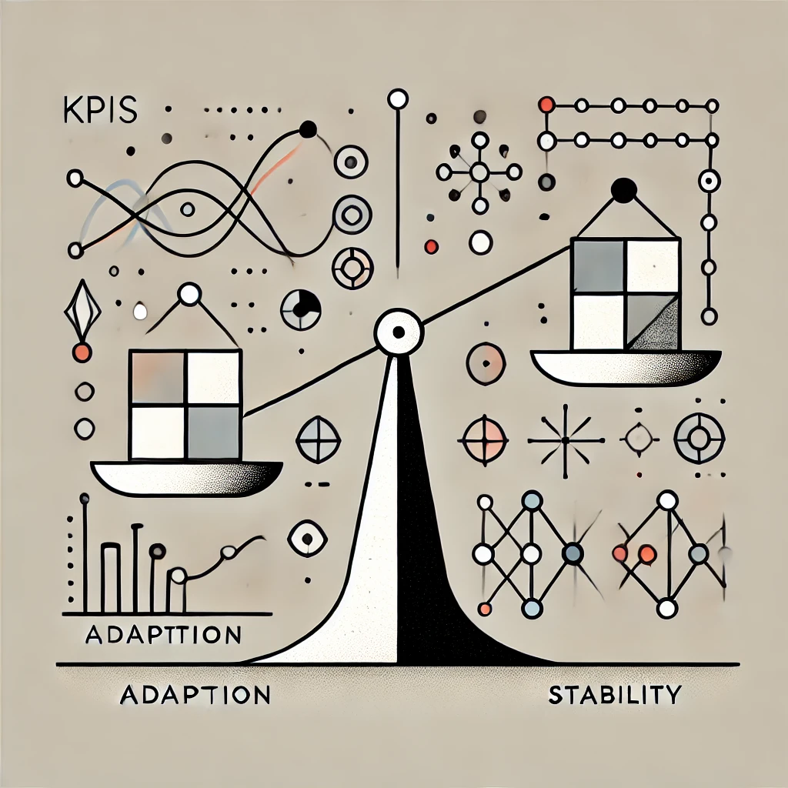
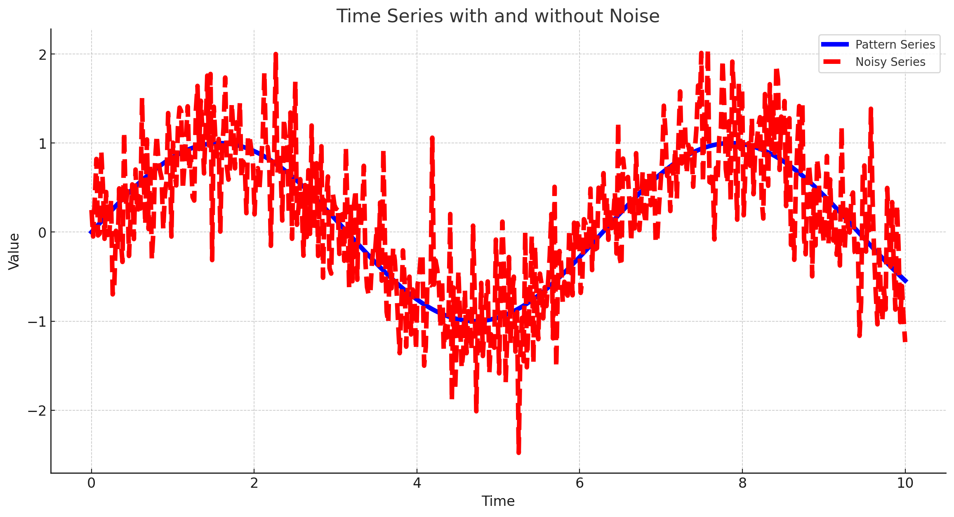
Challenges
High KPI diversity
KPIs from thousands of applications and systems have diverse, non-stationary patterns.
Tailored model adaptation
Ensure the model to quickly adapt to incoming KPIs while maintaining the good performance for historical KPIs.
Robustness to noisy data
Rapidly adapting to incoming KPIs during fine-tuning demands high-quality data, yet KPI time series often contain noises.
Notes:
To achieve these two criteria, we conclude three challenges
First, High KPI diversity. KPIs from thousands of applications and systems have diverse, non-stationary patterns
Second, Tailored model adaptation. We need to Ensure the model to quickly adapt to incoming KPIs while maintaining the good performance for historical KPIs.
Third Robustness to noisy data: Rapidly adapting to incoming KPIs during fine-tuning demands high-quality data, yet KPI time series often contain noises.

Slide 8


Background
Design
Evaluation
Conclusion
Notes:
Next, I will introduce our solution.

Slide 9
KAD-Disformer
KAD-Disformer follows an encoder-decoder architecture.
The pre-trained model can be effectively “fine-tuned” to unseen KPI using only a handful of samples from the unseen KPI.
Notes:
We design KAD-Disformer, a KPI Anomaly Detection approach through Disentangled Transformer.
KAD-Disformer pre-trains a model on existing accessible KPIs, and the pre-trained model can be effectively “fine-tuned” to unseen KPI using only a handful of samples from the unseen KPI.
Our approach have 3 core designs.

Slide 10
Disentangled Projection Matrices
Disentangle the linear projection 𝑊 into two separate components:
  Common Projection: only updated in the pre-training phase, delivering the acquired knowledge from the pre-training stage to the fine-tuning stage.
  Personal Projection: assimilate knowledge specific to a particular KPI, thereby enhancing the performance on the finetuning data
Notes:
The first one is Disentangled Projection Matrices
Our goal is to decouple the training of the base model from that of the task-specific model. To achieve this, we disentangle the linear projection 𝑊 into two separate components: a generalization projection and a personalized projection,
Common Projection: only updated in the pre-training phase, delivering the acquired knowledge from the pre-training stage to the fine-tuning stage.
The Personal Projection: learn knowledge from the specific KPI, thereby enhancing the performance on the finetuning data
The main advantage of disentangling projection matrices in universal AD is alleviating the overfitting problem in the fine-tuning procedure and keeping the knowledge learned from the pre-trained data for fine-tuning.

Slide 11
uTune
uTune, a two-stage adapter-based fine-tuning
What to update?
  Series Adapter: take the raw fine-tuning data as input to learn a time series data adapter
  Encoder Adapter: fully connected layers designed to better perform deep-level adaptation
uTune Workflow
Series Adapter
Notes:
The model adaptation for unseen incoming KPI data is a great challenge in the universal AD area
Disentangled model requires specialized fine-tuning mechanisms
To solve this problem, we propose a two-stage adapter-based fine-tuning mechanism called uTune.
To better illustrate the functioning of uTune, we center our discussion around two key questions: “What to update?" and “How to update?".
there are two adapters: Series Adapter and Encoder Adapter in our model. These adapters are the core components we need to update.
Series Adapter: take the raw fine-tuning data as input to learn a time series data adapter
And Encoder Adapter is fully connected layers designed to better perform deep-level adaptation

Slide 12
uTune
uTune, a two-stage adapter-based fine-tuning
How to update?
  Personalization Stage: focuses on the unseen KPI and pushes the pre-trained base model to learn the personal info.
  Generalization stage: utilizes the knowledge from both new data and existing data to make the backpropagation in order to alleviate the overfitting problem
uTune Workflow
Notes:
Next, I‘ll talk about the how to update these components.
In uTune, we have two different stage in one iteration.
Personalization Stage: focuses on the unseen KPI and pushes the pre-trained base model to learn the personal info.
Generalization stage: utilizes the knowledge from both new data and existing data to make the backpropagation in order to alleviate the overfitting problem

Slide 13
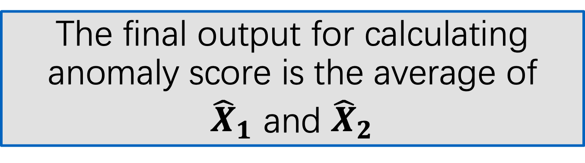
Denoising Reconstruction
Context Data Flow
Context Reconstruction comes from the context encoder without historical information
The final output for calculating anomaly score is the average of
${\hat{X}}_{1}$ and ${\hat{X}}_{2}$
History Data Flow
Capture the long-term dependency of the time series
Denoised Reconstruction comes from both context encoder and historical encoder
Notes:
To alleviate the impact of the noises in training and fine-tuning data. We design denoising reconstruction.
The core idea of denoising reconstruction is to reconstruct a denoised time series rather than the original one
We use two different sliding windows to build two different data flow.
The context flow focus the local information in KPI data. Context Reconstruction comes from the context encoder without historical information
The history data flow Capture the long-term dependency of the time series and generate Denoised Reconstruction comes from both context encoder and historical encoder

Slide 14

Background
Design
Evaluation
Conclusion
Notes:
Next, let's look at the practical performance of KAD-Disformer.

Slide 15
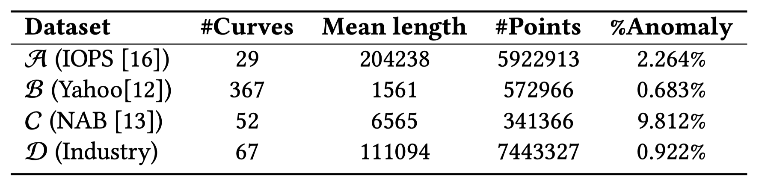
Dataset & Baselines
Dataset A
  2018 International Artificial Intelligence for IT Operations (AIOps) algorithm competition
Dataset B
  Yahoo Webscope collected from Yahoo online service systems
Dataset C
  NAB, a benchmark for evaluating time-series anomaly detection algorithms in real-time applications
Dataset D
  A real-world cloud service system in Microsoft 365， serving millions of users
15
Notes:
We use four datasets to test the performance of our approach.

Slide 16
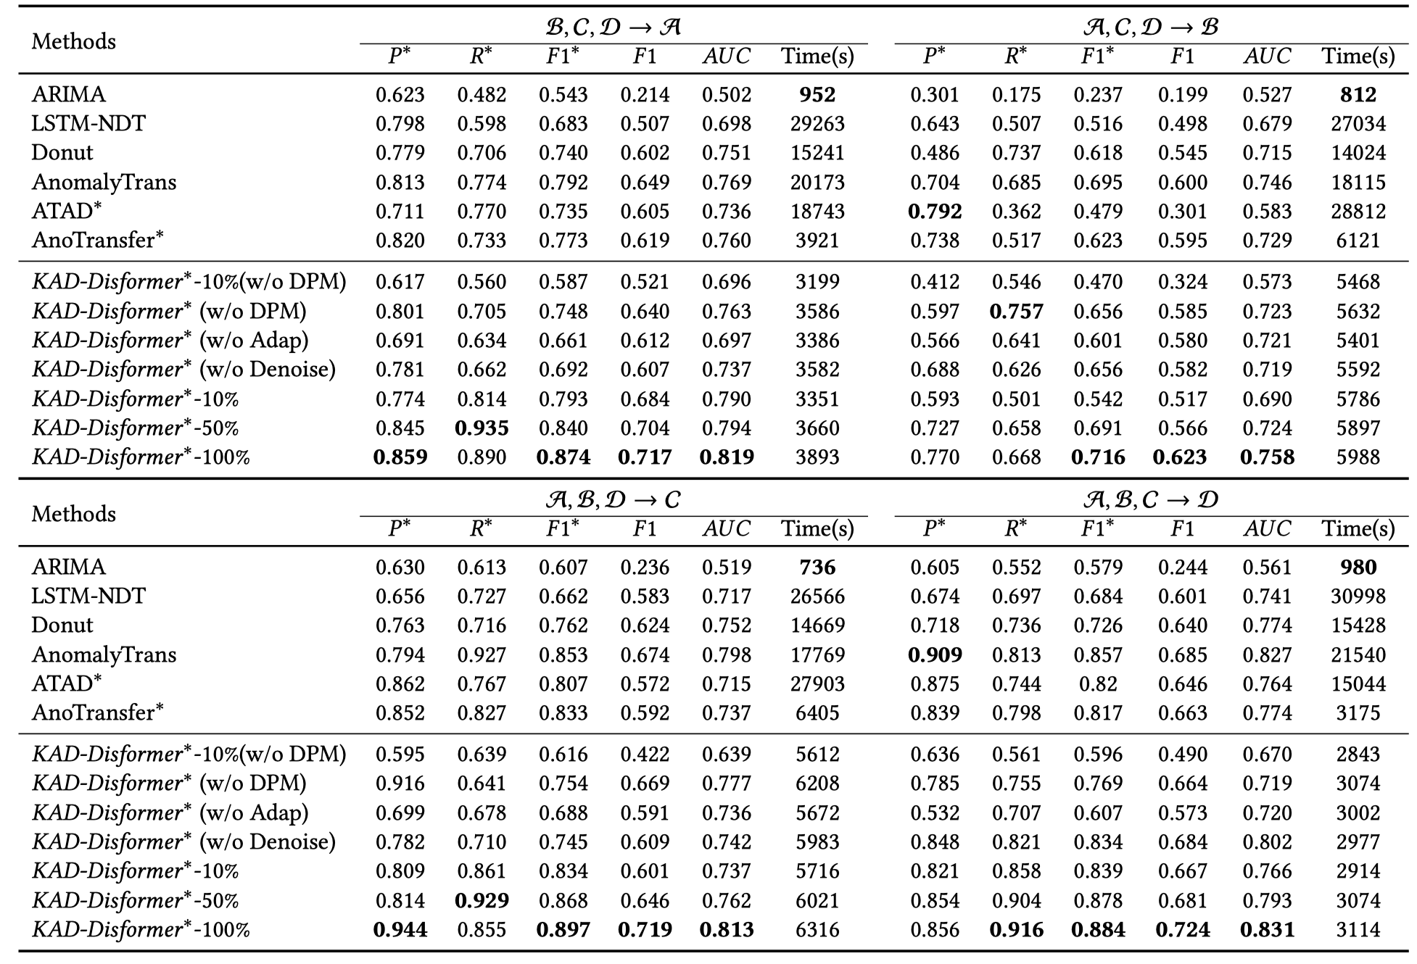
Overall Performance
In all the four datasets, KAD-Disformer achieves the best F1-score and AUC over all comparative methods
KAD-Disformer also achieves the least total time consumption (including pre-training, fine-tuning, and inference) among deep learning-based methods
Notes:
In all the four datasets, KAD-Disformer achieves the best F1-score and AUC over all comparative methods
KAD-Disformer also achieves the least total time consumption (including pre-training, fine-tuning, and inference) among deep learning-based methods

Slide 17
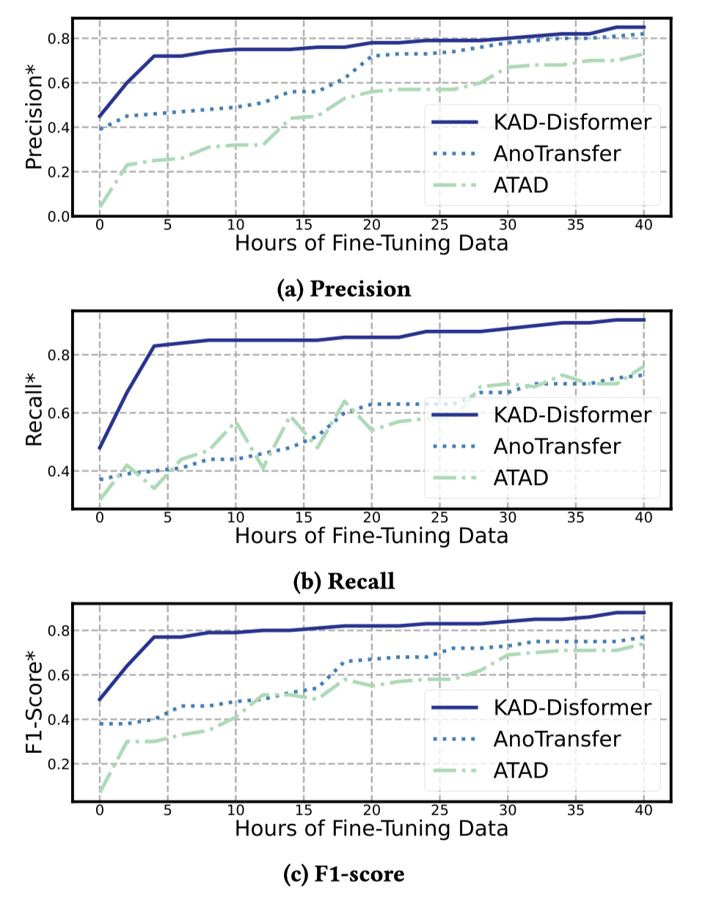
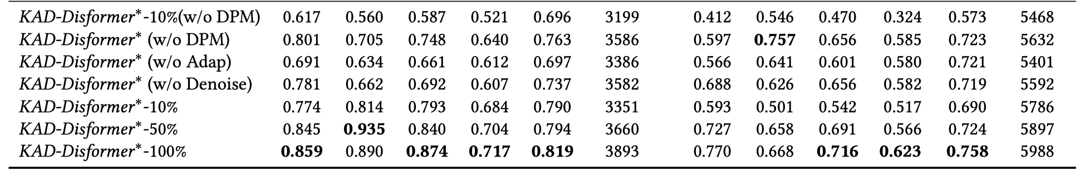
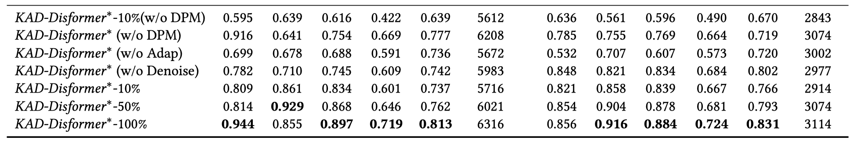
Few-Shot Learning Ability
KAD-Disformer consistently outperforms the other two comparative methods given the same quantity of data
With only 1/8 of fine-tuning samples , KAD-Disformer achieves competitive performance with AnoTransfer saving about 25 hours per KPI
Notes:
Due to our novel disentangled projection matrices and uTune mechanism, KAD-Disformer can be well-tuned with a handful of samples
Our model consistently outperforms the other two comparative methods given the same quantity of data
With only 1/8 of fine-tuning samples , KAD-Disformer achieves competitive performance with AnoTransfer saving about 25 hours

Slide 18
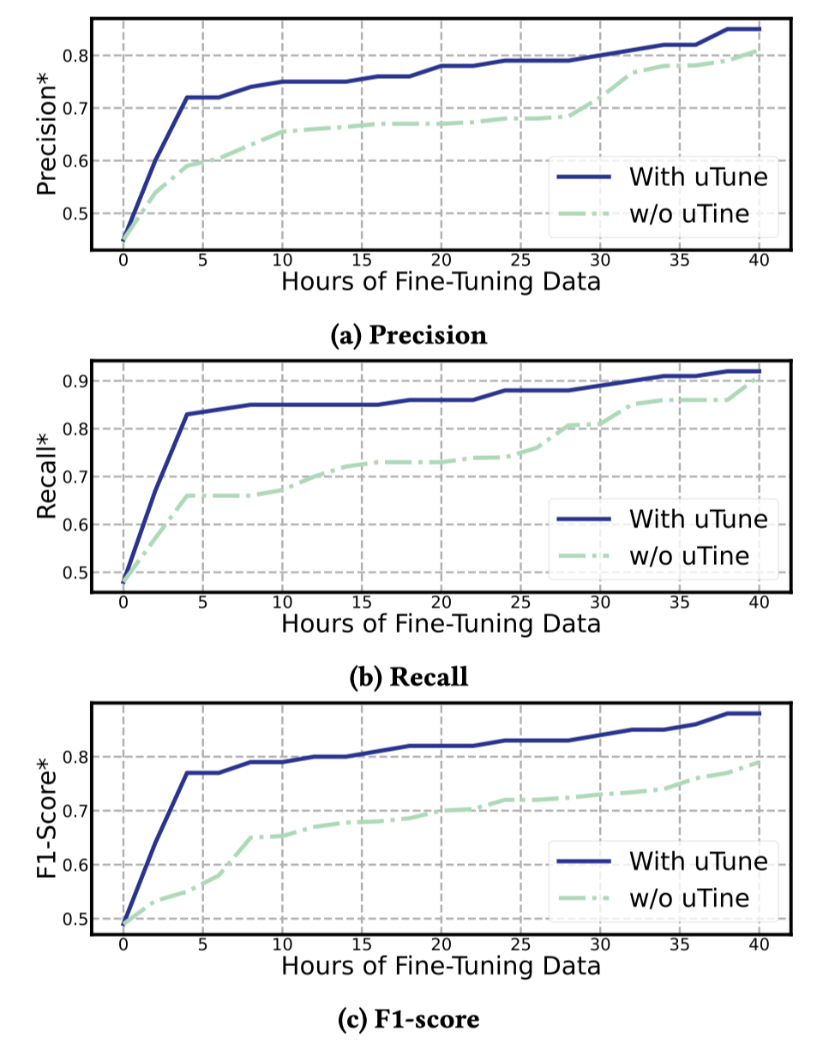
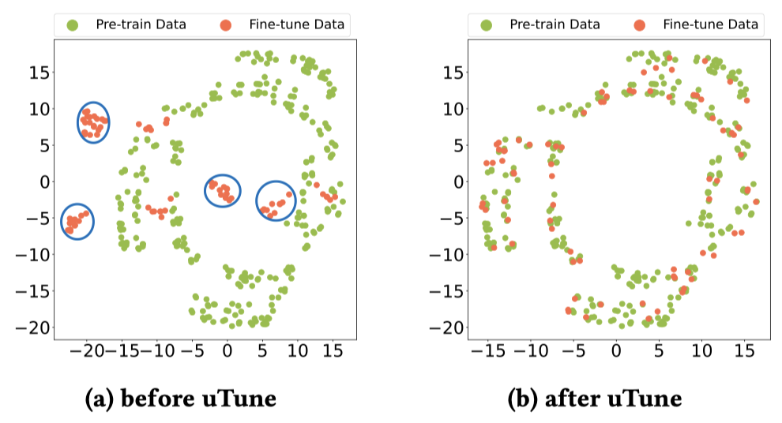
Contribution of uTune
Without uTune, the performance suffers apparent degradation when we use small-scale (10%) finetuning data.
uTune can effectively adapt the distribution of the fine-tuning data to the pre-train data.
Notes:
Next, let’s take a look at the contribution of uTune
Without uTune, the performance suffers apparent degradation when we use small-scale (10%) finetuning data.
According to our experiment, we find that uTune can effectively adapt the distribution of the fine-tuning data to the pre-train data.

Slide 19

Background
Design
Evaluation
Conclusion
Notes:
Finally, let's summarize our work.

Slide 20
Conclusion
We propose the KAD-Disformer to efficiently and effectively detect anomalies for an enormous number of KPIs.
Disentangled projection matrices and uTune mechanism help the model quickly fit the incoming KPI with limited fine-tuning samples.
Denoising Reconstruction technique can alleviate the influence of noises and make our KAD-Disformer more robust.
KAD-Disformer has been deployed in a Microsoft 365 online service system serving millions of people for months.
Notes:
We propose the KAD-Disformer to efficiently and effectively detect anomalies for an enormous number of KPIs.
Disentangled projection matrices and uTune mechanism help the model quickly fit the incoming KPI with limited fine-tuning samples.
Denoising Reconstruction technique can alleviate the influence of noises and make our KAD-Disformer more robust.
KAD-Disformer has been deployed in a Microsoft 365 online service system serving millions of people for months.

Slide 21
Thanks
Q&A
Notes:
That all for my presentation. Thank you.

