Slide 1




MonitorAssistant : Simplifying Cloud Service Monitoring
via Large Language Models
Zhaoyang Yu¹, Minghua Ma^{2*}, Chaoyun Zhang², Si Qin², Yu Kang², Chetan Bansal²,
Saravan Rajmohan², Yingnong Dang², Changhua Pei³, Dan Pei¹, Qingwei Lin², Dongmei Zhang²
¹Tsinghua University
²Microsoft
³CNIC
Notes:
Hello everyone, I am Zhaoyang Yu from Tsinghua University.
Today, I will introduce our work with Microsoft, titled "MonitorAssistant: Simplifying Cloud Service Monitoring via Large Language Models."

Slide 2




Background
Design
Evaluation
Conclusion
Notes:
Our presentation has 4 sections : background, design, evaluation and conclusion

Slide 3
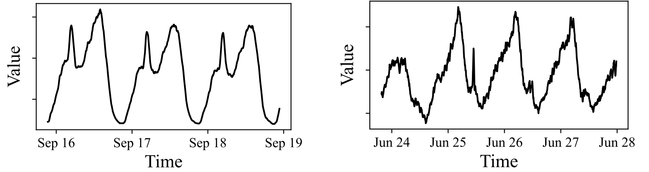
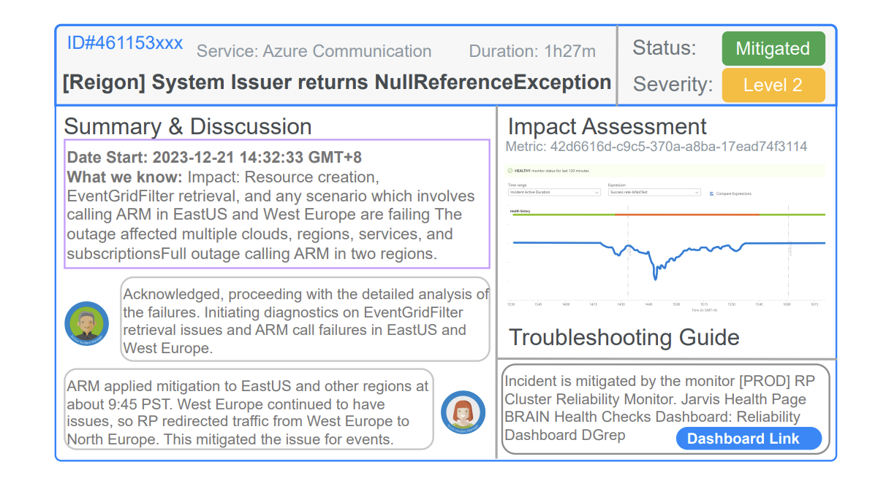
Service Monitoring
Monitoring cloud services:
  Understand the health status
  Ensure service stability and reliability
Metric data:
  Core data for service monitoring
  Uniformly sampled real-valued data
  Offer valuable insights into services
Incident data:
  Unexpected disruption or anomaly
  Usually triggered by engineers or metric anomaly detection
Example of metric data
Example of incident data
Notes:
First, let's talk about service monitoring. For online service systems, closely monitoring services can effectively understand the system's health status and ensure its stability and reliability.
Metrics and incidents are the core data in service monitoring. Metric data is typically presented as time series data.
Incidents are usually manually triggered by engineers or automatically triggered by anomaly detection in metrics. Engineers record a lot of information about metric anomalies in incidents, such as anomaly analysis and subsequent troubleshooting processes.

Slide 4
Metric Anomaly Detection
Metric Data
Time-series data collected from a myriad of sources
Reflect the health status of a service
Fundamental and important aspect of monitoring data analysis
Metric Anomaly Detection
Model and hyperparameter selection
Anomaly interpretation
Engineer-system interaction
Exiting algorithms still struggle to find widespread application in industry:
Industry needs Practical Anomaly Detection!
Notes:
In industry, metric data is usually subjected to anomaly detection to determine the system's health and ensure service quality.
Although many advanced machine learning-based anomaly detection models have been proposed in academia, simpler methods like dynamic thresholds are still pupular in industry.
There are three main reasons why existing anomaly detection models are difficult to promote in industry
They are model and hyperparameter selection, anomaly interpretation, and engineer-system interaction.

Slide 5
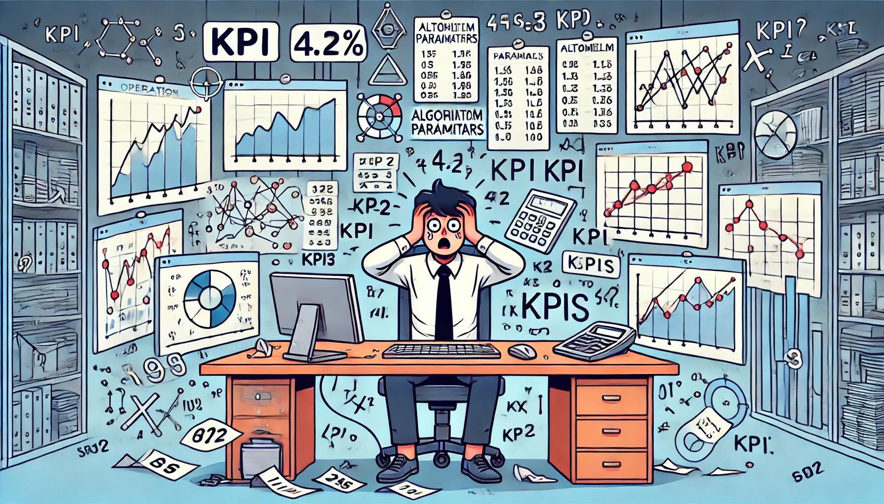
Model and Hyperparameter Selection
Existing anomaly detection models cannot perform well on different types of metrics.
It’s necessary to select appropriate algorithms and hyperparameters for different metrics.
Dealing with millions of metrics.
Difficulty in selecting algorithms and hyperparameters hinders the application of advanced anomaly detection models
Notes:
First, regarding model and hyperparameter selection, existing anomaly detection models based on machine learning cannot perform well on different types of metrics. It’s necessary to select appropriate algorithms and parameters for different metrics. However, in industry, for example at Microsoft, a large online service system faces millions of metrics. It is impractical to manually select configurations for each metric. Therefore, the difficulty in selecting algorithms and hyperparameters hinders the application of advanced anomaly detection models.

Slide 6

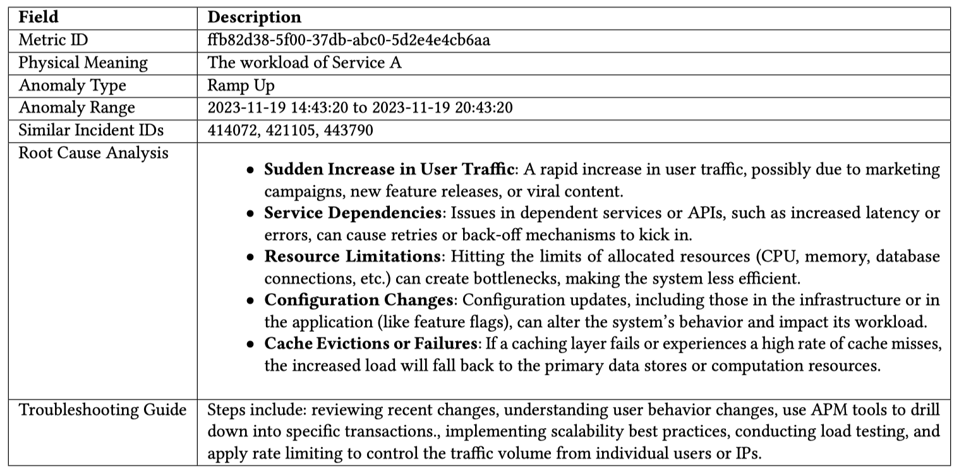
Binary Results of Anomaly Detection
Classical Results of Metric Anomaly Detection
I’ve no idea what should I do
Normal？
Abnormal？
Binary Anomaly Detection Result
Let’s troubleshoot
^{Service Engineer}
Practical Results of Metric Anomaly Detection
^{Anomaly Detection Report}
Notes:
The second reason hindering the promotion of anomaly detection algorithms in industry is the interpretation of anomalies. Traditional anomaly detection algorithms usually provide only binary results (anomaly or normal), making it difficult for engineers to determine what to do next. The engineers know nothing about the anomaly from the binary result.
They often need to spend a lot of time and rely on a lot of expert experience to handle anomalies. A practical result needs to provide more detailed anomaly reports to guide engineers in troubleshooting.

Slide 7

Unfriendly Interaction
Service Engineer
  Monitoring metric data
  Providing feedback on anomaly detection results
  Usually not an algorithm expert
Algorithm Engineer
  Developing anomaly detection models
  Tuning the model according to the feedback from service engineers
  Usually not an expert in metric data
The gap between service and algorithm engineers hinders the improvement of metric anomaly detection model through feedback
Notes:
Moreover, an unfriendly interaction process is also an important reason hindering the application of anomaly detection. There are two types of engineers in an anomaly detection system: service engineers and algorithm engineers. Service engineers are usually responsible for monitoring metrics, providing feedback on anomaly detection results, and handling anomalies. They are typically not algorithm experts. On the other hand, algorithm engineers are responsible for developing and maintaining anomaly detection algorithms and improving them based on engineer feedback. However, they are usually not experts in metric data. The gap between service and algorithm engineers hinders the improvement of metric anomaly detection models through feedback.

Slide 8
Practical Anomaly Detection
To understand practical anomaly detection, we focus on answering the following questions:
What are practical anomalies in cloud systems?
^{Q1}
How engineers comprehend practical anomalies?
^{Q2}
Capabilities practical anomaly detection systems have?
^{Q3}
Notes:
To understand practical anomaly detection, we focus on answering the following questions:
1. What are practical anomalies in cloud systems?
2. How do engineers comprehend practical anomalies?
3. What capabilities should practical anomaly detection systems have?

Slide 9
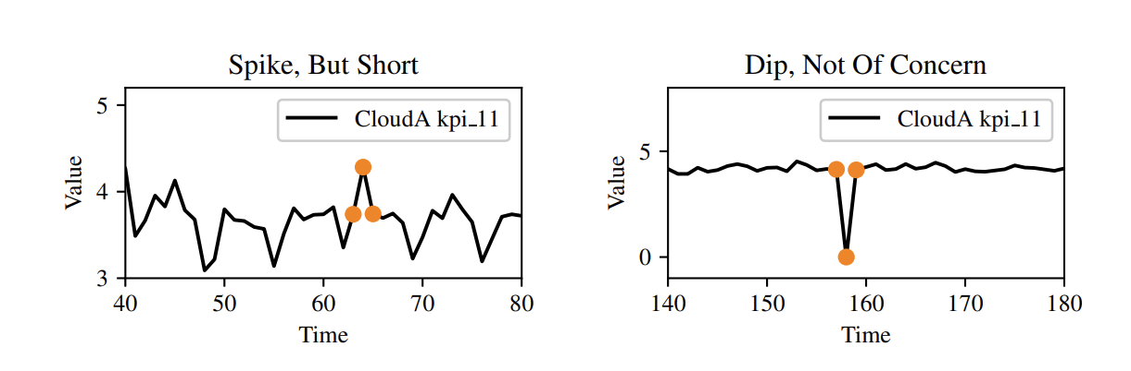
What is a practical anomaly?
Anomaly identified by advanced models do not always align with what engineers think.
A refined definition of a “practical anomaly” from an industrial standpoint:
  Practical anomalies are those data points that not only statistically diverge from the normal patterns but are also corroborated by related outage.
Examples of “impractical” anomaly in Microsoft’s cloud system.
The anomalies are marked by orange points.
Notes:
Let’s talk about the definition of practical anomaly. Many advanced anomaly detection algorithms cannot align with engineers' thinking. We believe that practical anomalies are those data points that not only statistically diverge from normal patterns but are also corroborated by related outages.

Slide 10

Practical Anomaly Interpretation
Most salient attributes of anomalies: duration and shape
Duration: the time span of an anomaly
  Critical attribute in anomaly classification
  Can be interpreted easily by service engineers
Shape: distinctive pattern of an anomalous sequence
  Provide critical diagnostic insights for engineers
  Shape types:
    spike, dip, level shift up, level shift down, ramp up ramp down ……
SE
Notes:
So, how do engineers interpret a practical anomaly? The most intuitive characteristics of anomalies are duration and shape. Duration is straightforward, representing the anomaly's duration, which is usually very intuitive. Therefore, our focus is on the shape of anomalies.

Slide 11
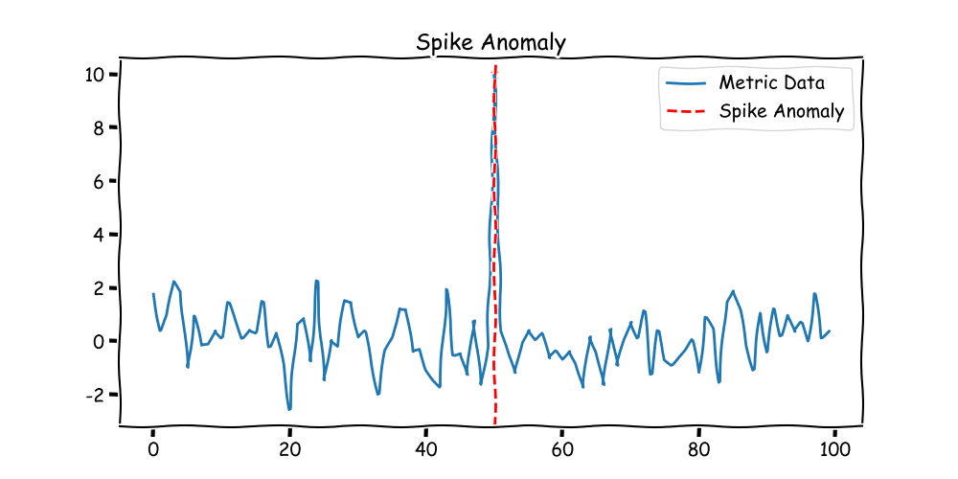
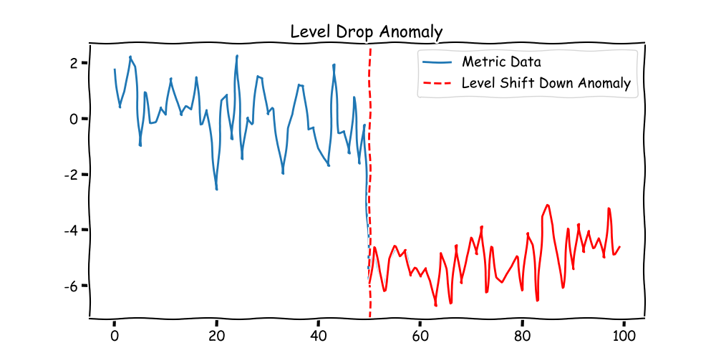
Practical Anomaly Interpretation
Why the Shape of an Anomaly is Important?
Differences in the shapes of anomalies usually signal different events occurring behind the anomaly.
Different events are usually assumed to have different troubleshooting processes.
The shape of anomalies is instructive for troubleshooting
Caused by a sudden surge in user traffic, possibly due to a promotional event.
Degradation in service quality due to a critical component failure or misconfiguration
Notes:
Why is the shape of anomalies important? We list two simple examples. We found that:
1. Differences in the shapes of anomalies usually signal different events occurring behind the anomaly.
2. Different events usually require different troubleshooting processes.
3. Therefore The shape of anomalies is instructive for troubleshooting.

Slide 12
Practical Anomaly Interpretation
Metric-Incident Pair:
  For each incident, the related metric details and the specific anomaly segment that triggered the incident are recorded.
  Encompassing a vast amount of expert knowledge and historical experience for understanding anomaly.
  Reviewing historical incidents of similar anomalies helps to understand the current anomaly.
The related metric and anomaly detection result
The Summary of the failure:
Interpretation from engineers
Root cause analysis
……
Notes:
To further interpret anomalies, we usually rely on incidents. Incidents record engineers' experiences in analyzing and handling anomalies. Reviewing historical incidents of similar anomalies helps understand the current anomaly. Extracting effective information from a large number of historical incidents is the most direct methods for service engineers to interpret anomalies.

Slide 13
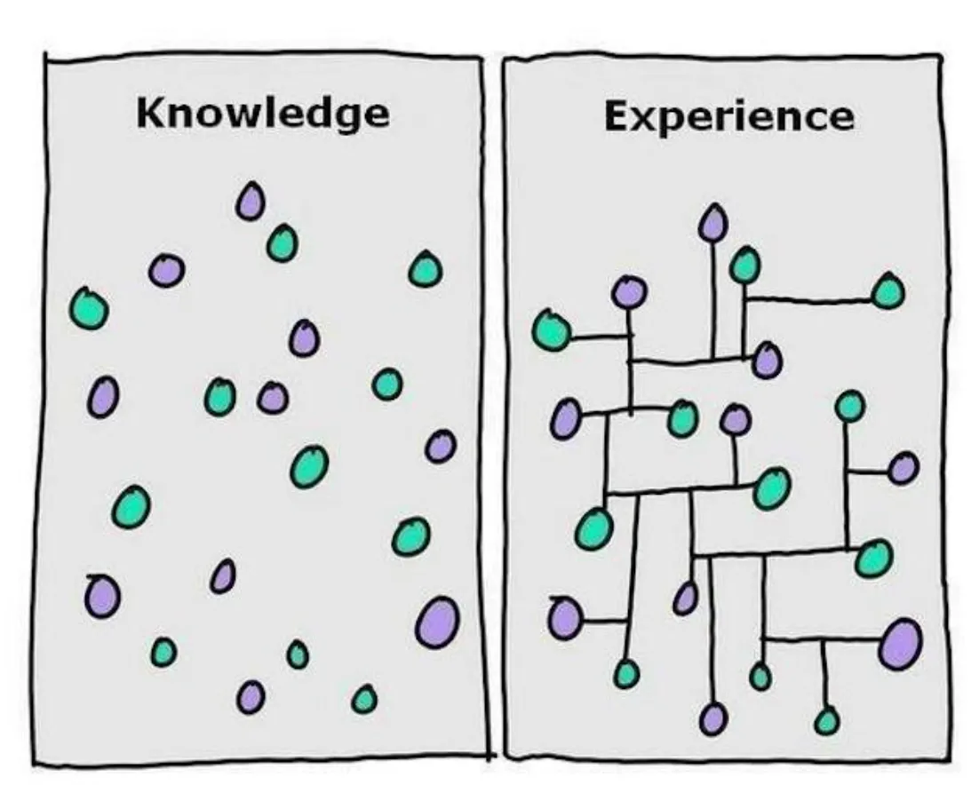


Capabilities of Practical Detection
A practical anomaly detection system in the industrial sector must achieve three capabilities:
  Inherit the long-term accumulated practical experience.
  Provide engineers with a comprehensive anomaly reports rather than detection results.
  A friendly interaction process with a low algorithmic threshold.
^{interaction}
^{Anomaly Report}
^{Anomaly Detection System}
^{Service Engineer}
Notes:
In the current industry, a practical anomaly detection system needs at least three capabilities:
1. Inherit long-term accumulated practical experience.
2. Provide engineers with comprehensive anomaly reports rather than binary detection results.
3. A friendly interaction process with a low algorithmic threshold.

Slide 14


Background
Design
Evaluation
Conclusion
Notes:
Next, I will introduce our solution.

Slide 15
MonitorAssistant
An LLM-based end-to-end practical anomaly detection system:
Three phases in MonitorAssistant’s workflow:
1. Configuration Recommendation
Monitor Configuration Infusion
2. Anomaly Alert
Practical Alert Generation
3. Feedback Loop
LLM-Engineer-In-The-Loop Interaction
Notes:
We propose MonitorAssistant, an LLM-based end-to-end practical anomaly detection system. MonitorAssistant's core capabilities span the entire anomaly detection process.
It provides configuration recommendations and can generate anomaly reports that are much more readable than binary results. It also offers an LLM-Engineer-In-The-Loop Interaction mechanism, helping service engineers directly feed expert knowledge back into the model.
Now, I will detail the implementation of MonitorAssistant's three core capabilities.

Slide 16
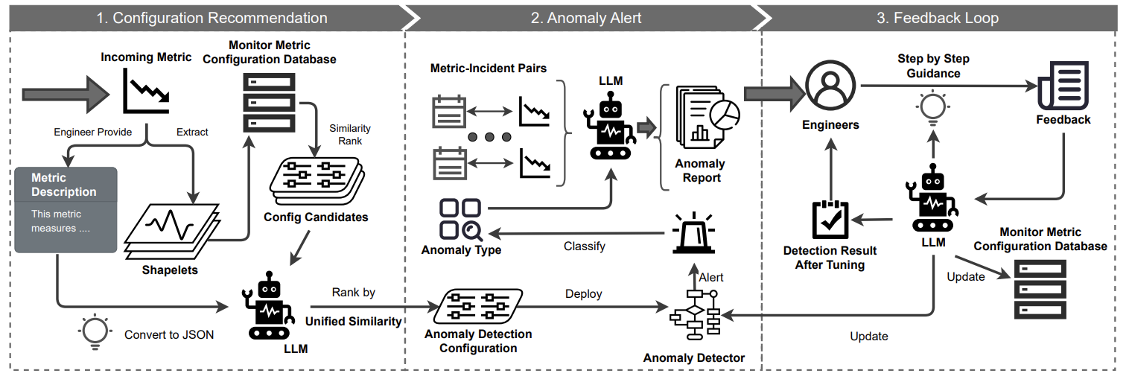
MonitorAssistant
An LLM-based end-to-end practical anomaly detection system:
Three phases in MonitorAssistant’s workflow:
Notes:
We propose MonitorAssistant, an LLM-based end-to-end practical anomaly detection system. MonitorAssistant's core capabilities span the entire anomaly detection process. It provides configuration recommendations and can generate anomaly reports that are much more readable than binary results. It also offers an LLM-Engineer-In-The-Loop Interaction mechanism, helping service engineers directly feed expert knowledge back into the model.
Now, I will detail the implementation of MonitorAssistant's three core capabilities.

Slide 17
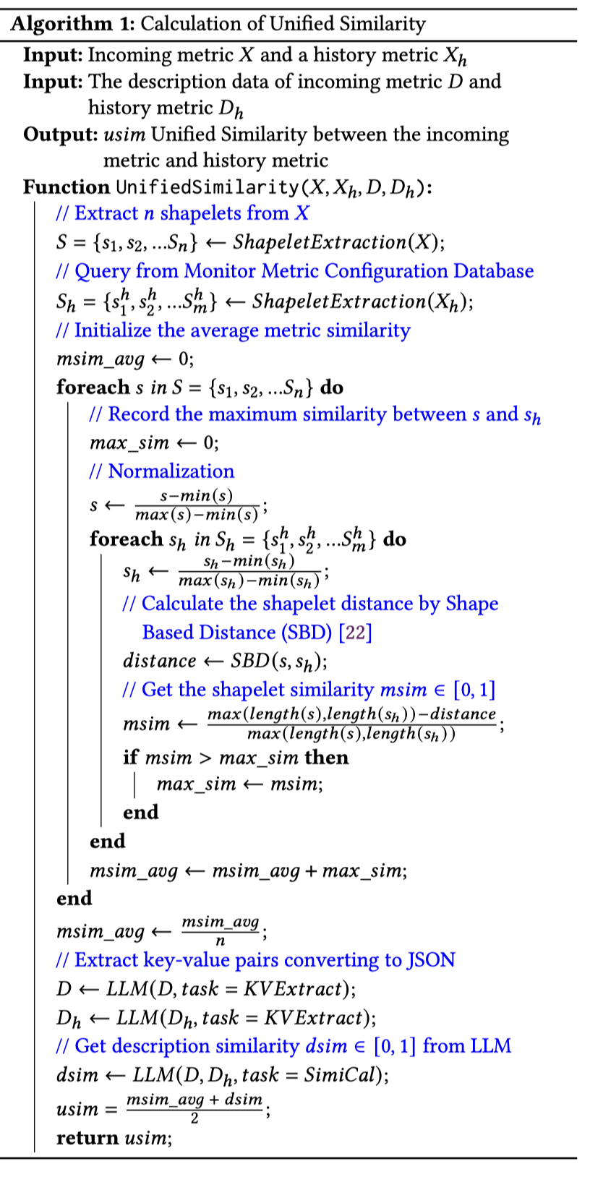
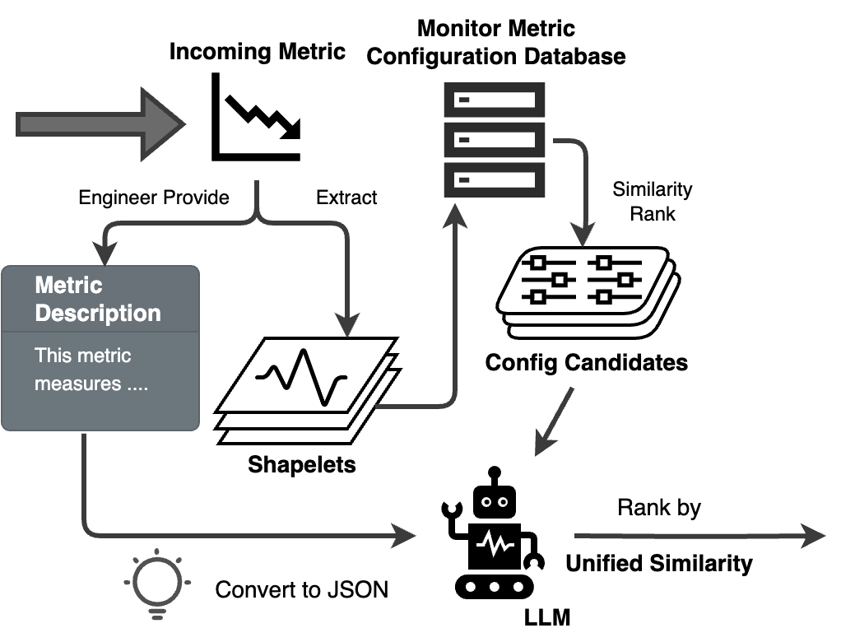
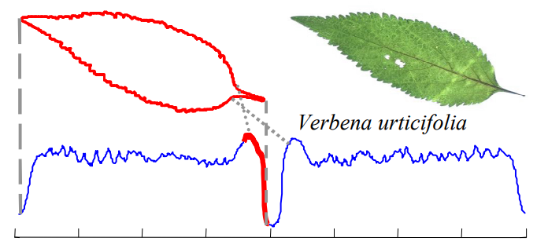
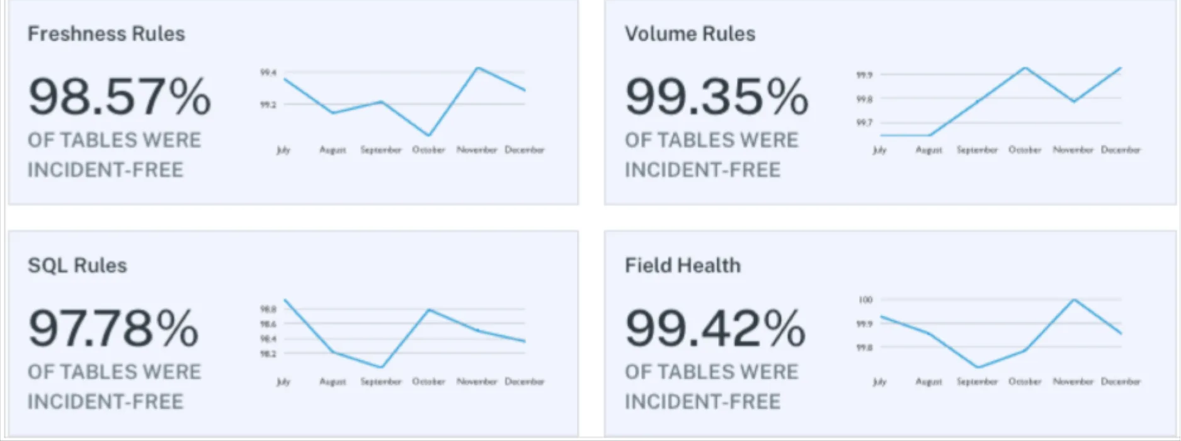
Monitor Configuration Infusion
Two core issue:
  Extract knowledge contained in historical anomaly detection
  Utilize knowledge to make reasonable recommendations
Extract knowledge:
  Shapelet Extraction
  Metric Description
Utilize knowledge:
  Unified Similarity
  LLM Ranking
^{Unified Similarity}
Notes:
First is the monitor configuration infusion. The core problems to solve for configuration recommendation are twofold: extracting information from historical configuration cases and using this information to recommend configurations.
For information extraction, we utilize two types of information: metric shapelet information, which reflects the shape characteristics of the curve through short curve segments, and metric description information, which provides background information on the curve.
An intuitive approach is to match these two types of information with historical curves. To this end, we propose unified similarity. Unified similarity utilizes the text understanding ability of large models to effectively combine shapelet and description information, finding similar metrics in history and recommending the algorithms and hyperparameter configurations of similar curves to the current metric.

Slide 18
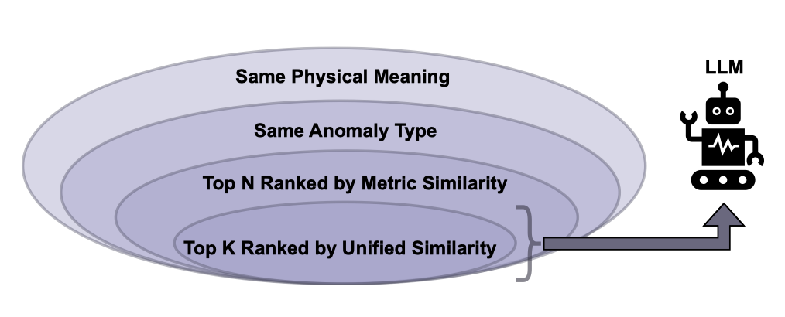
Practical Alert Generation
Understanding Anomalies
  a large amount of external information
  long-term accumulated expert knowledge
Metric-Incident Pair
  Involve external information
  Store expert knowledge
LLM can do a good job of drawing lessons from the history of incident,
but the question is which incidents LLM should use.
Intuition
  The number of incidents is huge.
  Similar incidents may have useful information
  Finding similar incidents through efficient hierarchical filtering
Notes:
For anomaly report generation, we use prompt engineering and the summary capabilities of large language models to summarize historical similar incidents, thus interpreting the current anomaly.
The problem we face now is which incidents LLM should use. A straightforward idea is to find similar incidents from historical incidents directly. However, the number of historical incidents is huge, and it is impractical to provide them all to LLM. If it were a human engineer, they would first refer to similar historical incidents when writing anomaly reports. Therefore, our core goal is to find a certain number of similar incidents and provide them to LLM for summarization. To this end, we propose a hierarchical filtering mechanism, which efficiently filters incidents to extract the most valuable ones. Then, we have LLM summarize information from these incidents to generate anomaly reports.

Slide 19
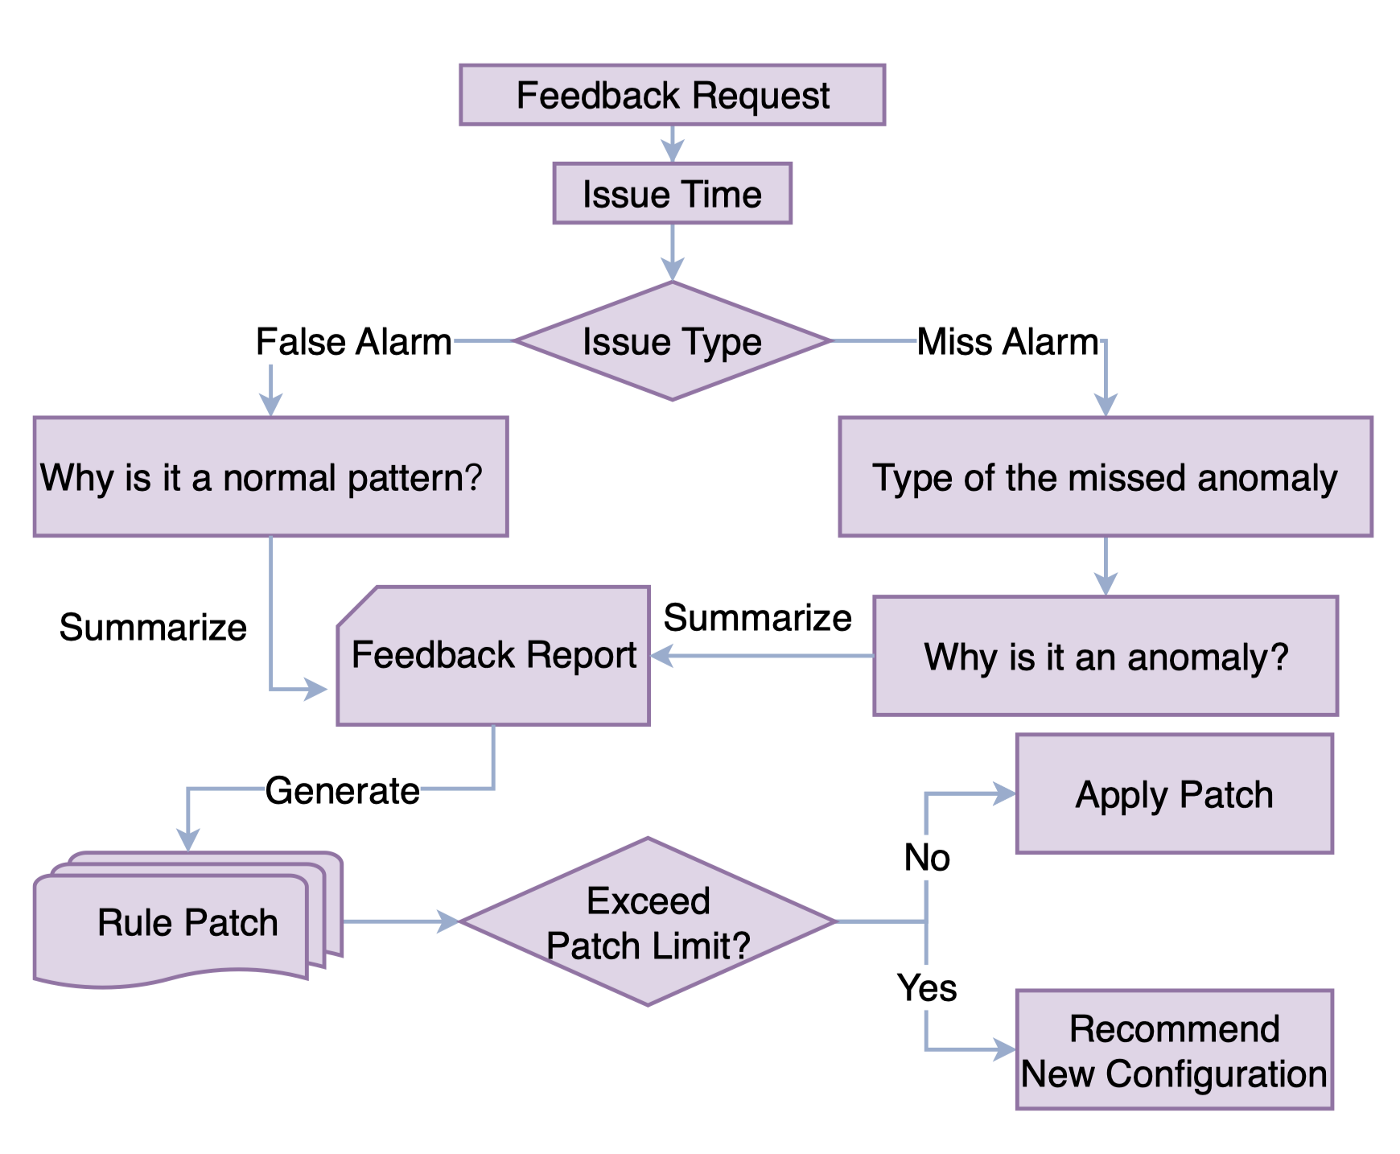
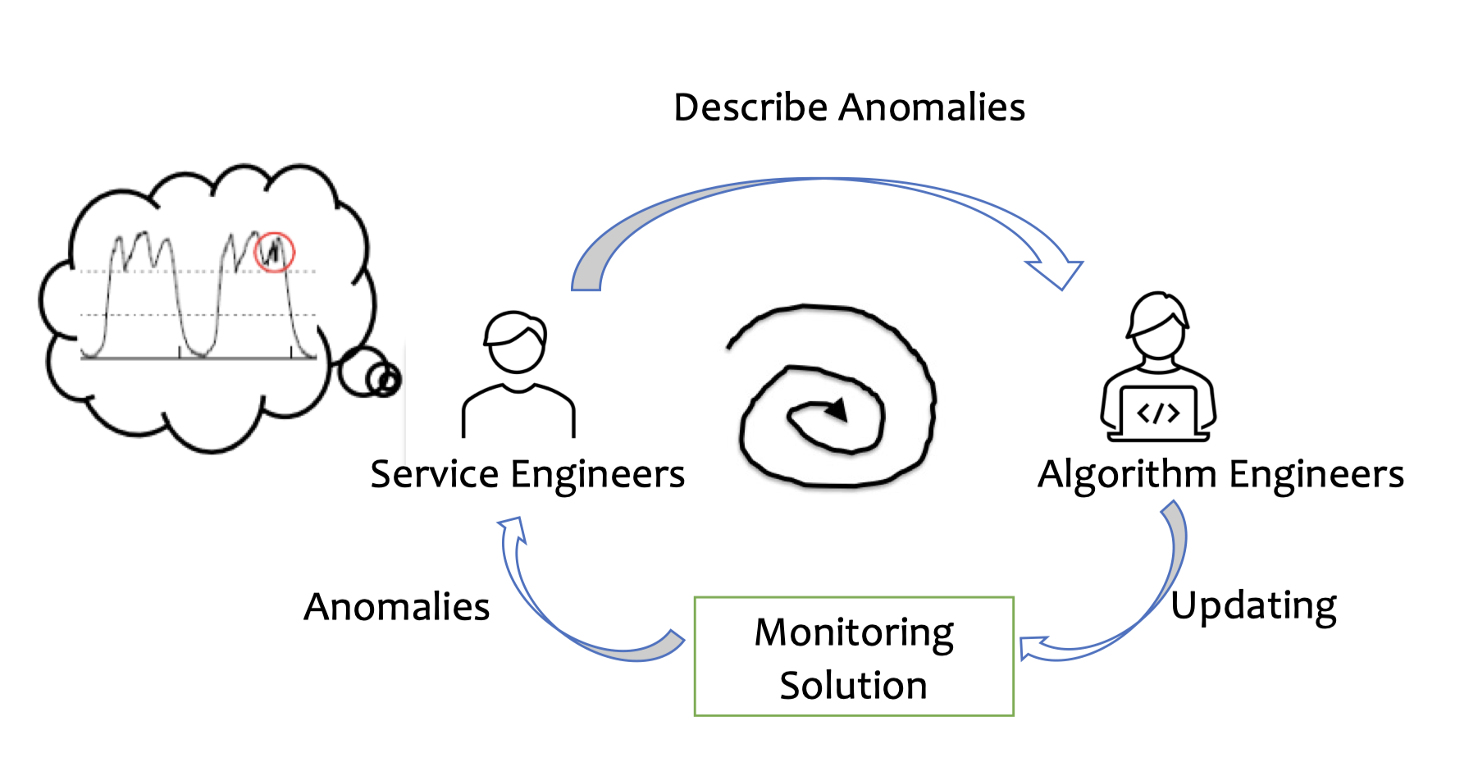
LLM-Engineer-In-The-Loop Interaction
Service engineers aren’t algorithm experts.
Our solution:
  Service engineers interact directly with an LLM.
  LLM provide step-by-step guidance.
The workflow of the step-by-step guidance in
LLM-Engineer-In-The-Loop Interaction.
Traditional Engineer-Model Interaction
Notes:
To better realize the interaction between engineers and the anomaly detection system, we designed an LLM-Engineer-In-The-Loop Interaction mechanism for MonitorAssistant. Based on extensive feedback from human engineers, we designed a feedback process template.
LLM guides engineers to provide effective feedback through natural language following this template. After collecting feedback, LLM generates rule patches for the current anomaly detection algorithm to address the issues raised by the engineers promptly. The engineers then review these patches. If they approve, the patches are applied to the current anomaly detection algorithm. Otherwise, the process iterates.

Slide 20

Background
Design
Evaluation
Conclusion
Notes:
Next, let's look at the practical performance of MonitorAssistant.

Slide 21
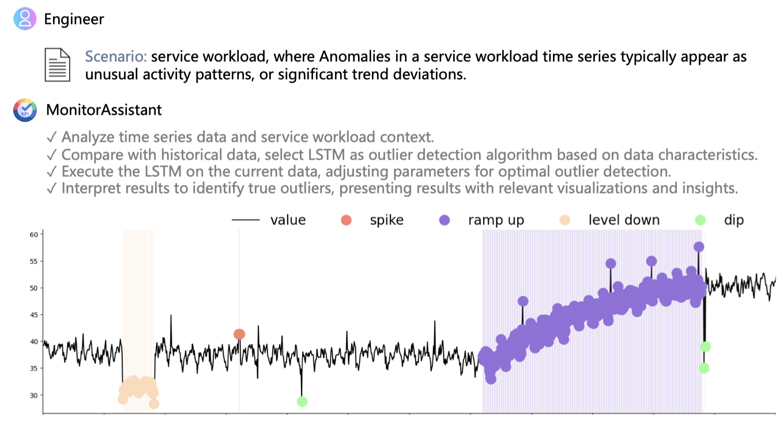
Case Study: Config Recommendation
Automatically recommend suitable anomaly detection model and hyperparameter.
Aligns with the engineers’ highlighted concern for the metric’s trend.
However, there is still room for improving anomaly detection performance.
Notes:
To verify the effectiveness of MonitorAssistant in industry, we conducted an empirical study.
First, we had engineers provide metric data. As shown, MonitorAssistant can automatically recommend suitable anomaly detection models and hyperparameters, aligning with the engineers' descriptions.
However, the result is not perfect and still has room for improvement, which we will address later.

Slide 22
Case Study: Anomaly Report
Anomaly Report
  Anomaly Type
  Similar Incident IDs
  Root Cause Analysis
  Troubleshooting Guide
Integrating the physical meaning
Integrating historical anomaly detection knowledge
Our anomaly reports extend traditional binary detection results to provide easier to understand and more readable results
Notes:
Next, let’s take a look at the anomaly report generated by MonitorAssistant.
The anomaly report includes the anomaly type, duration, and basic information about similar historical incidents. It also provides root cause analysis and troubleshooting suggestions. Although it is not as accurate as some specialized root cause analysis algorithms, it still offers engineers more ideas for handling the current anomaly.

Slide 23
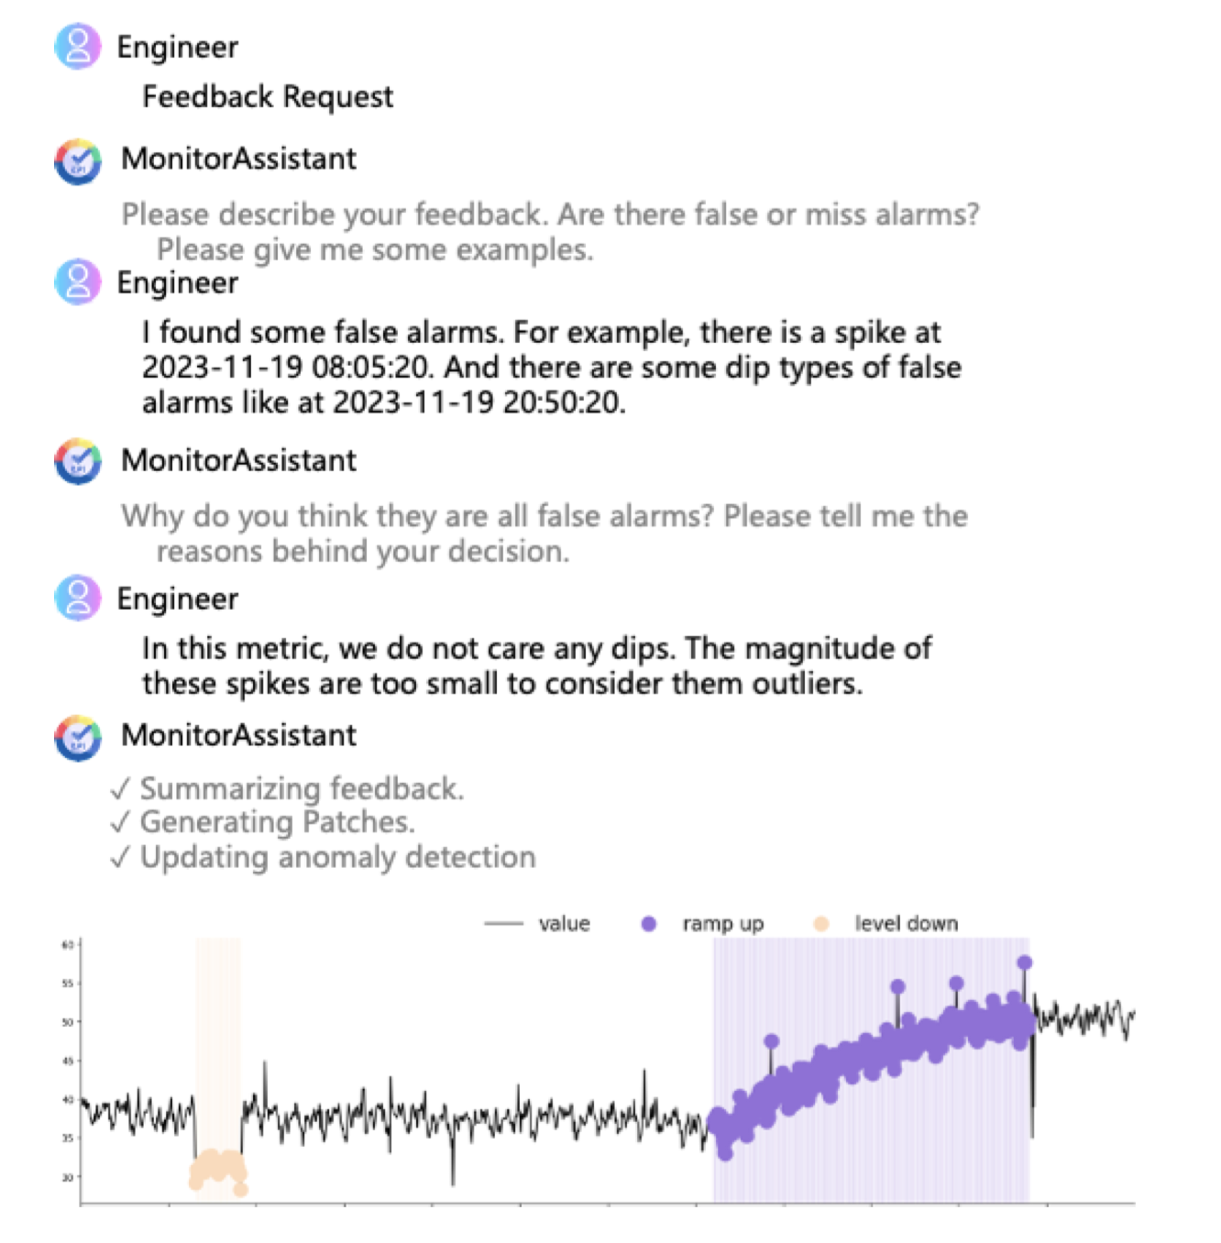
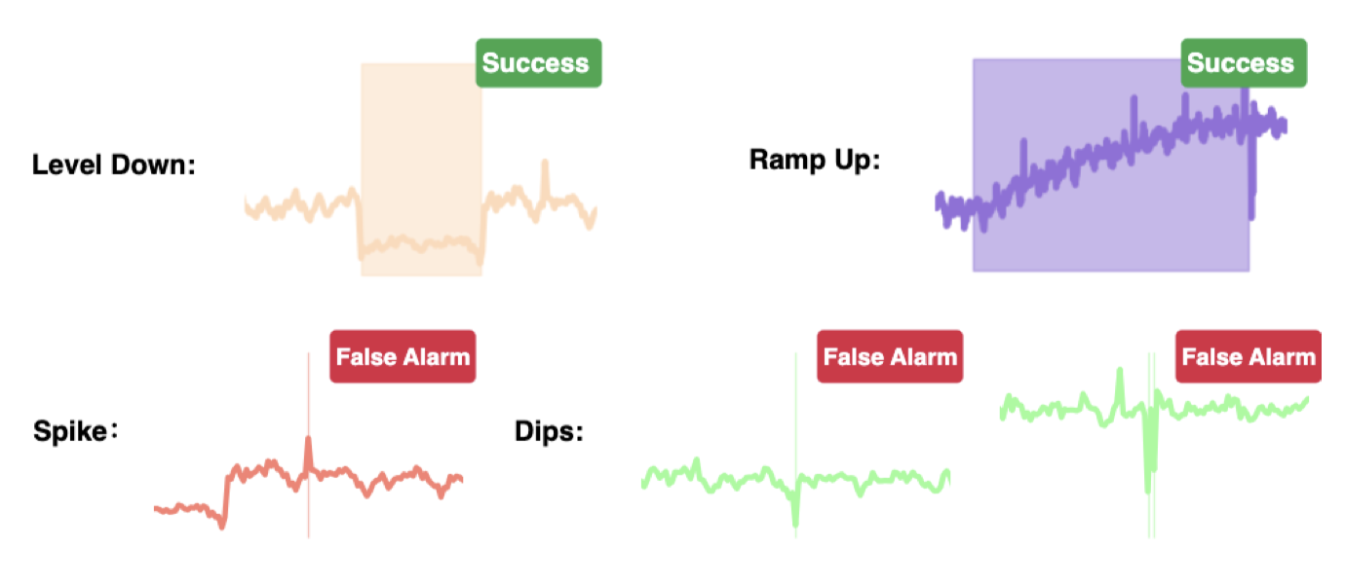
Case Study: Feedback Loop
Engineer send feedback request
LLM guides engineer using natural language to feedback
MonitorAssistant has the ability to learn by examples
Notes:
Earlier, we mentioned that the anomaly detection results are not perfect. Now we hope engineers can solve this issue through feedback. For this metric, we are not concerned with dip-type anomalies. We let engineers submit feedback, and LLM guides them to submit feedback in a standardized manner using natural language. The results show that MonitorAssistant has the ability to generalize, effectively resolving all similar dip-type false alarms while removing the specific dip-type false alarm pointed out by the engineers. This LLM-Engineer-In-The-Loop feedback mechanism significantly improves the efficiency of addressing feedback issues.

Slide 24

Background
Design
Evaluation
Conclusion
Notes:
Finally, let's summarize our work.

Slide 25
Conclusion
We reveal the distinct nature of practical anomaly detection in industry settings.
We propose MonitorAssistant the first end-to-end practical anomaly detection system based on LLM.
Simplifies the anomaly detection process, making it more accessible, interpretable and friendly for engineers
Bridge the gap between academic research and industrial needs in the realm of cloud service monitoring.
Notes:
1. We reveal the distinct nature of practical anomaly detection in industrial settings.
2. We propose MonitorAssistant, the first end-to-end practical anomaly detection system based on LLM.
3. It simplifies the anomaly detection process, making it more accessible, interpretable, and friendly for engineers.
4. It bridges the gap between academic research and industrial needs in the realm of cloud service monitoring.

Slide 26
Thanks
Q&A
Notes:
That all for my presentation. Thank you.

