Slide 1



DeST: An Unsupervised Decoupled Spatio-Temporal Framework for Microservice Incident Management
Xiaohui Nie, Hang Cui, Changhua Pei, Haotian Si, Ke Xiang,
Jingjing Li, Yanbiao Li, Gaogang Xie and Dan Pei
Computer Network Information Center, Chinese Academy of Sciences
‌Tsinghua University
Notes:
Hello everyone, I would like to give a introduction to our work on "DeST: An Unsupervised Decoupled Spatio-Temporal Framework for Microservice Incident Management" My name is Cui Hang

Slide 2
Outline
What's the Incident Management in microservice systems?
How to elegantly model microservice systems spatio-temporal?
Design of DeST
Performance
Notes:
I will structure my presentation into four parts. To begin, let me provide some background information., What's the Incident Management in microservice systems?

Slide 3






What's the Incident Management in microservice systems?
Cloud Service
Search Engine
Online Shopping
Social Network
Notes:
Microservice system is adopted by most service providers
With the increase of service nodes, every minute of downtime would cause billions of dollars in losses
So， more and more service providers require reliable anomaly detection systems.
随着服务节点的增加，
每分钟的停机将会造成数百万美元的损失
越来越多的服务厂商需要可靠的异常检测系统

Slide 4
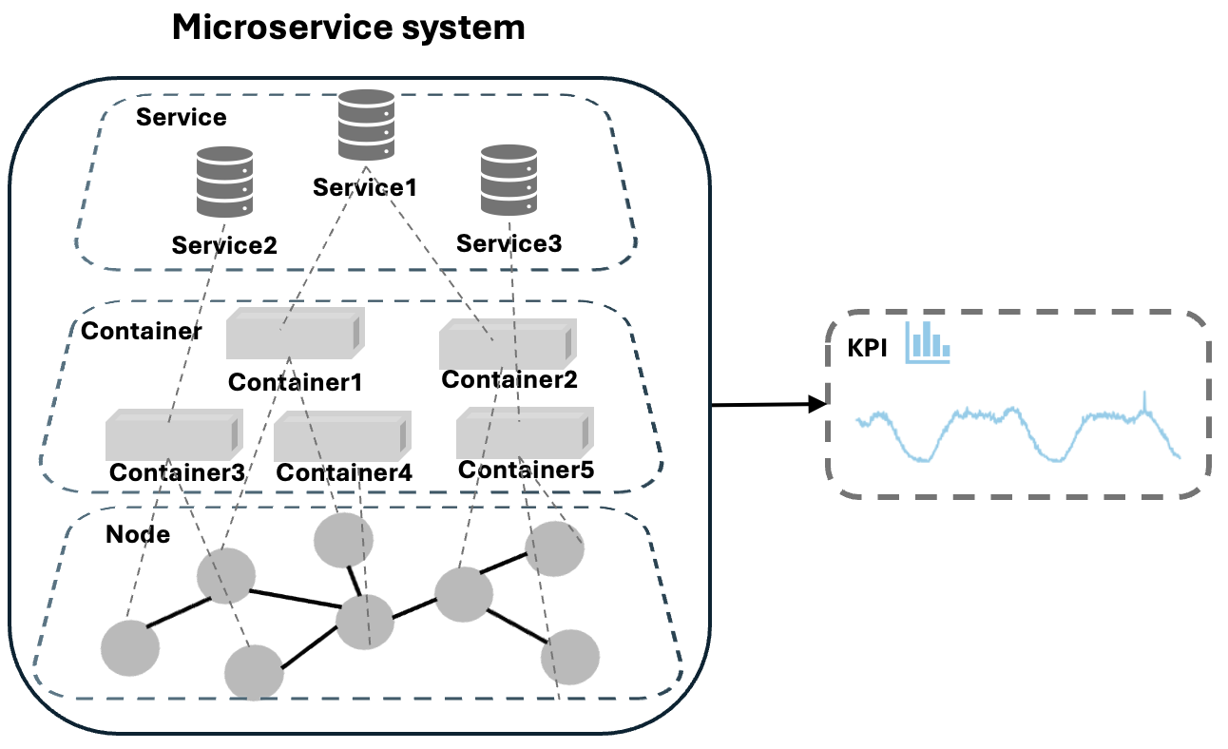
What's the Incident Management in microservice systems?
Notes:
Microservice systems generate a large number of Key Performance Indicators, logs, and traces every day
Service reliability engineers need to conduct operation of microservice systems based on these indicators, including anomaly detection and root cause location
How to build an efficient multimodal model with less cross-modal interference?
How can task-relevant knowledge be selectively routed to downstream modules?
How to efficiently model time-series data with transient noise?

Slide 5
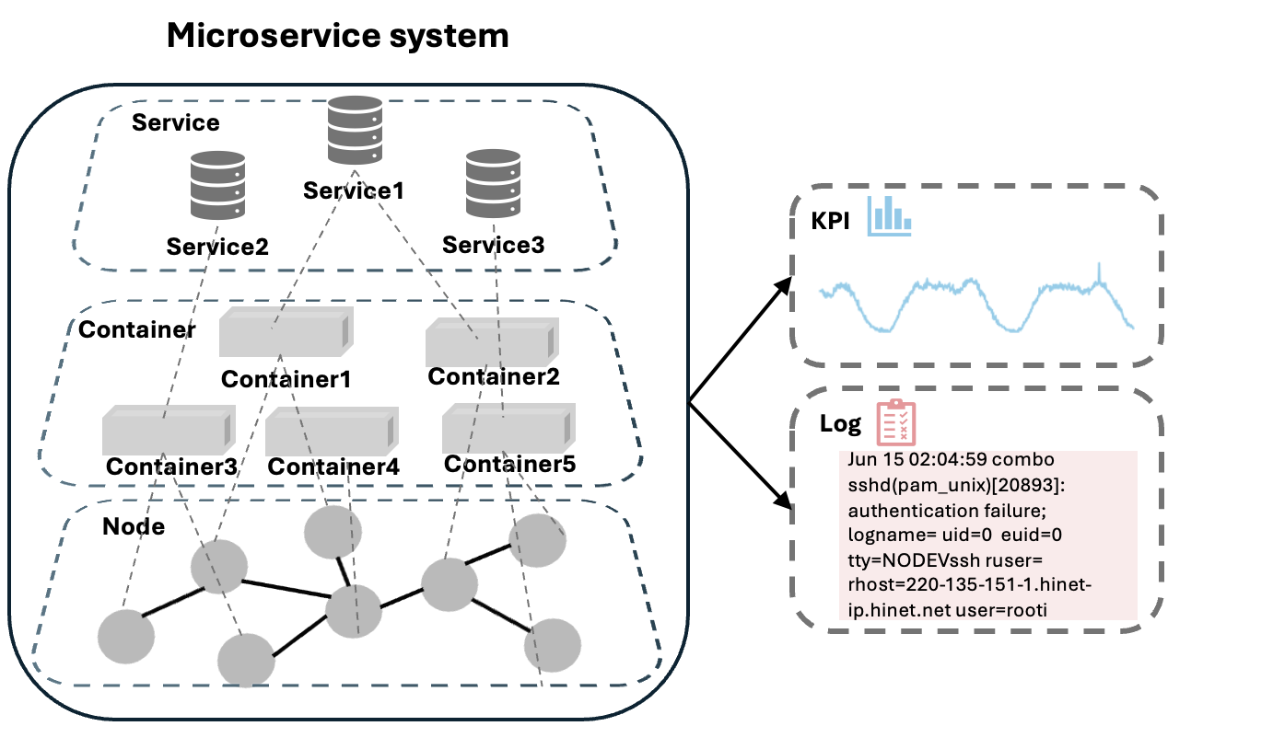
What's the Incident Management in microservice systems?
Notes:
Microservice systems generate a large number of Key Performance Indicators, logs, and traces every day
Service reliability engineers need to conduct operation of microservice systems based on these indicators, including anomaly detection and root cause location
How to build an efficient multimodal model with less cross-modal interference?
How can task-relevant knowledge be selectively routed to downstream modules?
How to efficiently model time-series data with transient noise?

Slide 6
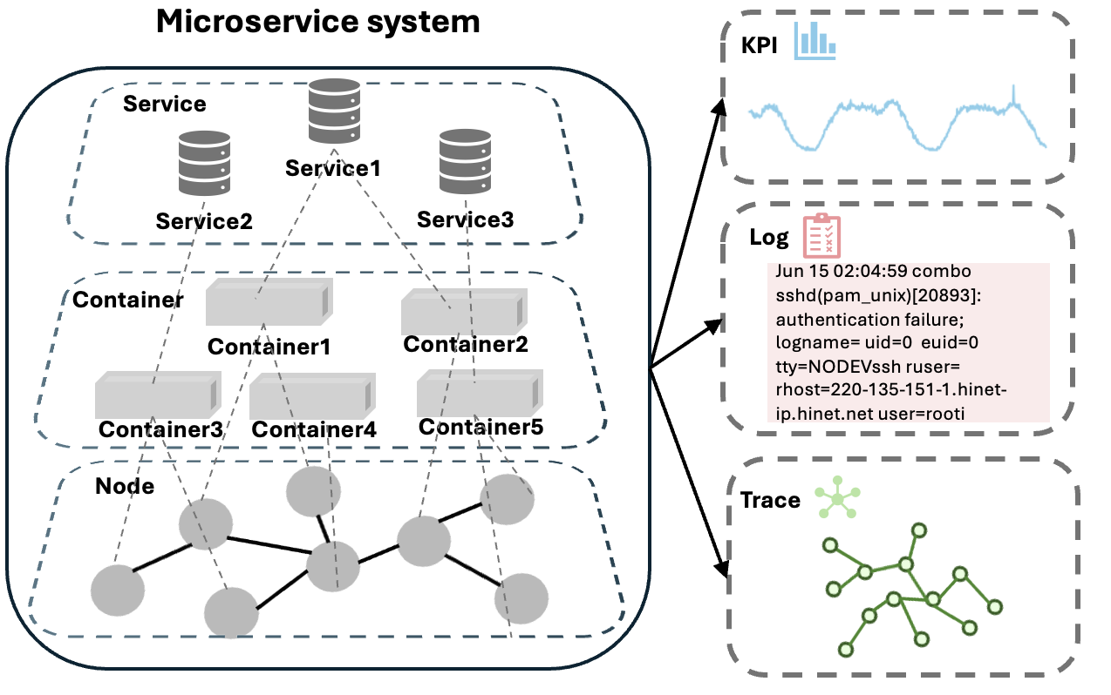
What's the Incident Management in microservice systems?
Notes:
Microservice systems generate a large number of Key Performance Indicators, logs, and traces every day
Service reliability engineers need to conduct operation of microservice systems based on these indicators, including anomaly detection and root cause location
How to build an efficient multimodal model with less cross-modal interference?
How can task-relevant knowledge be selectively routed to downstream modules?
How to efficiently model time-series data with transient noise?

Slide 7
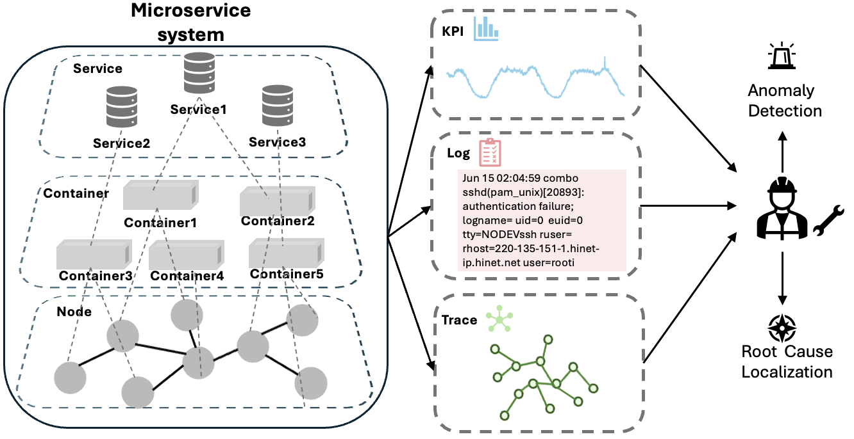
What's the Incident Management in microservice systems?
Notes:
Microservice systems generate a large number of Key Performance Indicators, logs, and traces every day
Service reliability engineers need to conduct operation of microservice systems based on these metrics, including anomaly detection and root cause location

Slide 8
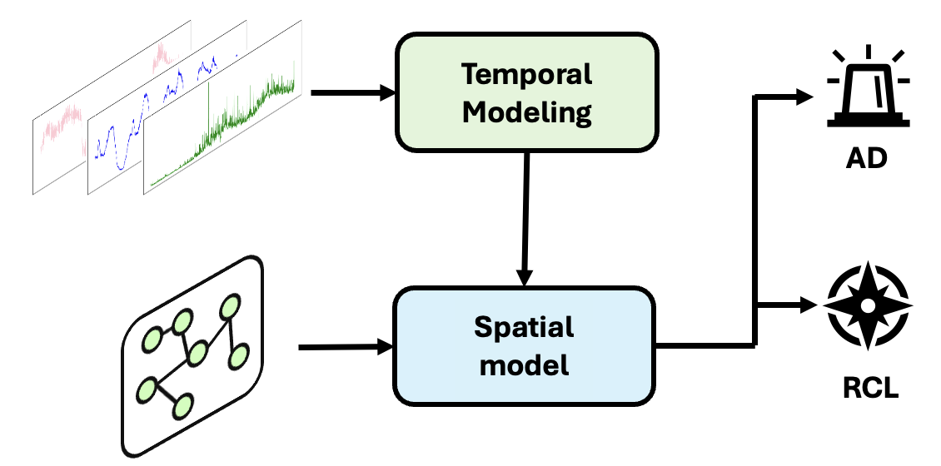
How to elegantly model microservice systems spatio-temporal?
How to build an efficient multimodal model with less cross-modal interference?
Notes:
Previous work transformed all modal-data into temporal and spatial modes
For the existing multimodal data, temporal modeling is conducted first, followed by spatial modeling
However, such a modeling is not elegant enough. As shown in the right figure, there are many cross-modal interferences
之前的工作将所有模态的数据转化为时间模态和空间模态
对已有的多模态数据先进行时间建模，随后进行空间建模
但是这样的建模并不够优雅，如右图所示，跨模态的干扰有很多

Slide 9
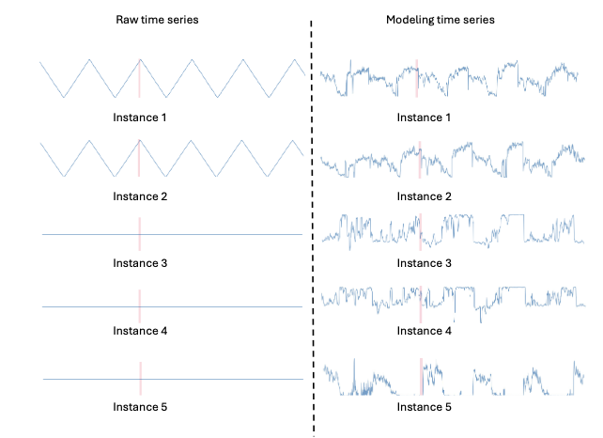
How to elegantly model microservice systems spatio-temporal?
How to build an efficient multimodal model with less cross-modal interference?
Notes:
Previous work transformed all modal-data into temporal and spatial modes
For the existing multimodal data, temporal modeling is conducted first, followed by spatial modeling
However, such a modeling is not elegant enough. As shown in the right figure, there are many cross-modal interferences
之前的工作将所有模态的数据转化为时间模态和空间模态
对已有的多模态数据先进行时间建模，随后进行空间建模
但是这样的建模并不够优雅，如右图所示，跨模态的干扰有很多

Slide 10
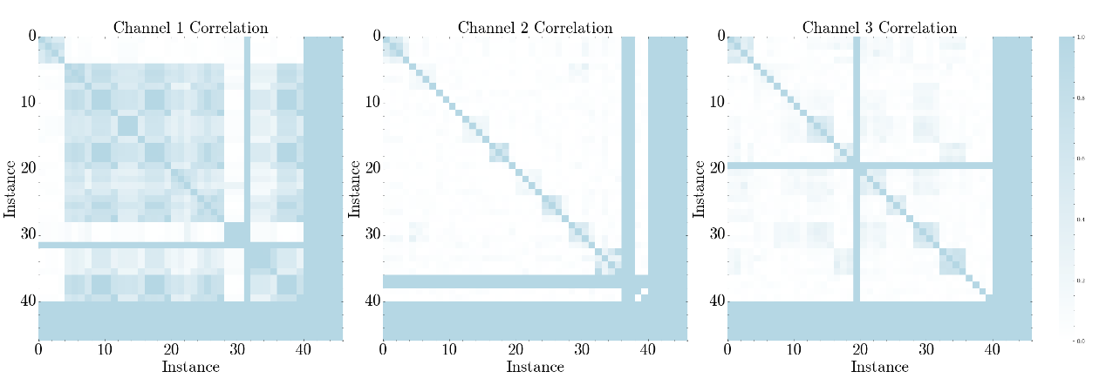
How to elegantly model microservice systems spatio-temporal?
Notes:
Why does this cross-modal interference occur?
We analyzed the dependencies between nodes for different metrics such as CPU usage and network latency
As shown in the figure, these dependencies constantly change among the metrics. A definite spatial modeling will blindly increase the interference in metric modeling
为什么会产生这种跨模态的干扰呢？
我们分析了对于指标（比如CPU使用率，网络延迟）节点与节点之间的依赖关系
如图所示，这些依赖关系在指标之间不断的变换，一个确定的空间聚合将会盲目的增加指标建模的干扰

Slide 11
How to elegantly model microservice systems spatio-temporal?
Notes:
Then how about we cancel this spatial information? However, cancelling spatial information will result in information loss:
We simulated a microservice system on the K8S cluster and used chaosmesh for anomalies injection.
那我们取消空间这维信息怎么样？但是取消空间信息将会造成信息损失：
我们在K8S集群上模拟微服务系统，并使用chaosmesh进行异常注入。
我们发现当一个节点发生异常时，周围的节点会发生明显的变化。
也就是说空间信息对于根因定位很有帮助

Slide 12
How to elegantly model microservice systems spatio-temporal?
Notes:
We found that when a node when an exception occurs, obvious change will happen around the node.
That is to say, spatial information is very helpful for root cause localization
那我们取消空间这维信息怎么样？但是取消空间信息将会造成信息损失：
我们在K8S集群上模拟微服务系统，并使用chaosmesh进行异常注入。
我们发现当一个节点发生异常时，周围的节点会发生明显的变化。
也就是说空间信息对于根因定位很有帮助

Slide 13
How to elegantly model microservice systems spatio-temporal?
Notes:
We found that when a node when an exception occurs, obvious change will happen around the node.
That is to say, spatial information is very helpful for root cause localization
那我们取消空间这维信息怎么样？但是取消空间信息将会造成信息损失：
我们在K8S集群上模拟微服务系统，并使用chaosmesh进行异常注入。
我们发现当一个节点发生异常时，周围的节点会发生明显的变化。
也就是说空间信息对于根因定位很有帮助

Slide 14
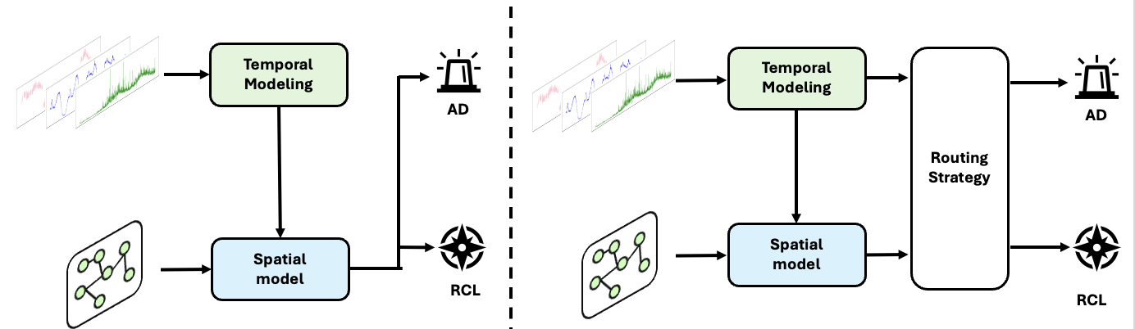
How to elegantly model microservice systems spatio-temporal?
Notes:
The above findings provide a perspective on how we can usa spatio-temporal information:
temporal information is used for anomaly detection
For root cause localization, temporal and spatial information are all used
以上的发现为我们如何利用时空信息提供视角：
对于异常检测利用时间信息
对于根因定位利用时间与空间信息

Slide 15
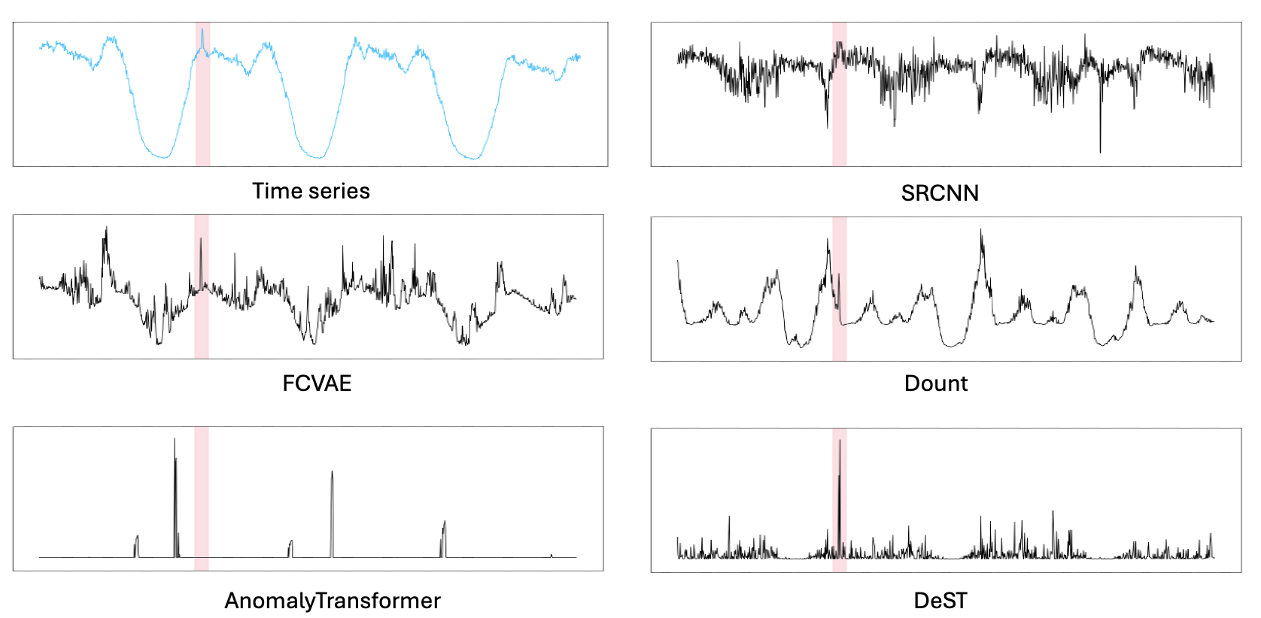
How to elegantly model microservice systems spatio-temporal?
Notes:
We find that, in addition to the interference between modalities, for microservice systems, due to the changes in users, the metric noise of the microservice systems themselves is also very large
我们发现除了模态之间的干扰之外，对于微服务系统来说，由于用户的变化，微服务系统自身的指标噪声也是很大的

Slide 16
Overview
Notes:
Based on the characteristics of multimodal data, we propose DeST, An Unsupervised Decoupled Spatio-Temporal Framework for Microservice Incident Management.
It follows the principle of decoupled spatio-temporal architecture design and uses temporal information for anomaly detection.
For time information, DeST uses an anti-noise differential time convolution for time series modeling, calculates the deviation between the predicted value and the true value for anomaly detection,
Root cause localization is carried out after aggregating spatial information
基于多模态数据的特点，我们提出了DeST，An Unsupervised Decoupled Spatio-Temporal Framework for Microservice Incident Management。
它遵循解耦的时空架构设计原则，利用时间信息进行异常检测。
对于时间信息，DeST使用抗噪声的差分时间卷积进行时间序列建模，计算预测值与真实值的偏差进异常检测，
聚合空间信息后进行根因定位

Slide 17
Overview
Notes:
For time information, DeST uses an anti-noise differential time convolution for time series modeling, calculates the deviation between the predicted value and the true value for anomaly detection,
基于多模态数据的特点，我们提出了DeST，An Unsupervised Decoupled Spatio-Temporal Framework for Microservice Incident Management。
它遵循解耦的时空架构设计原则，利用时间信息进行异常检测。
对于时间信息，DeST使用抗噪声的差分时间卷积进行时间序列建模，计算预测值与真实值的偏差进异常检测，
聚合空间信息后进行根因定位

Slide 18
Overview
Notes:
Root cause localization is carried out after aggregating spatial information
基于多模态数据的特点，我们提出了DeST，An Unsupervised Decoupled Spatio-Temporal Framework for Microservice Incident Management。
它遵循解耦的时空架构设计原则，利用时间信息进行异常检测。
对于时间信息，DeST使用抗噪声的差分时间卷积进行时间序列建模，计算预测值与真实值的偏差进异常检测，
聚合空间信息后进行根因定位

Slide 19



Anomaly Detection
Time steps
Log
Channels
KPI
Instances
Trace
Notes:
To be specific，First, we formalize the multimodal data into a 3D matrix including: Channels, Instances, and Time steps

Slide 20
Anomaly Detection
Time steps
Log
Channels
KPI
Instances
Trace
Notes:
Then we deal with the data in the time dimension

Slide 21
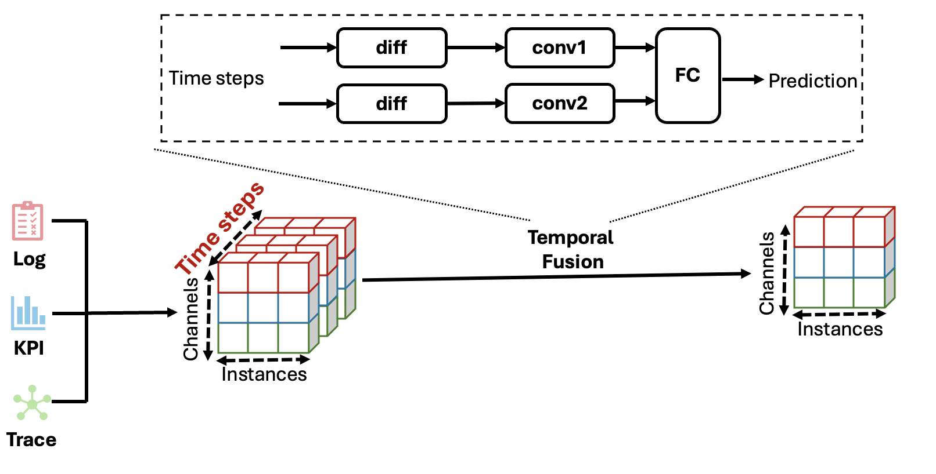
Anomaly Detection
Notes:
Through differential convolutional networks, we aggregate information in the temporal dimension

Slide 22
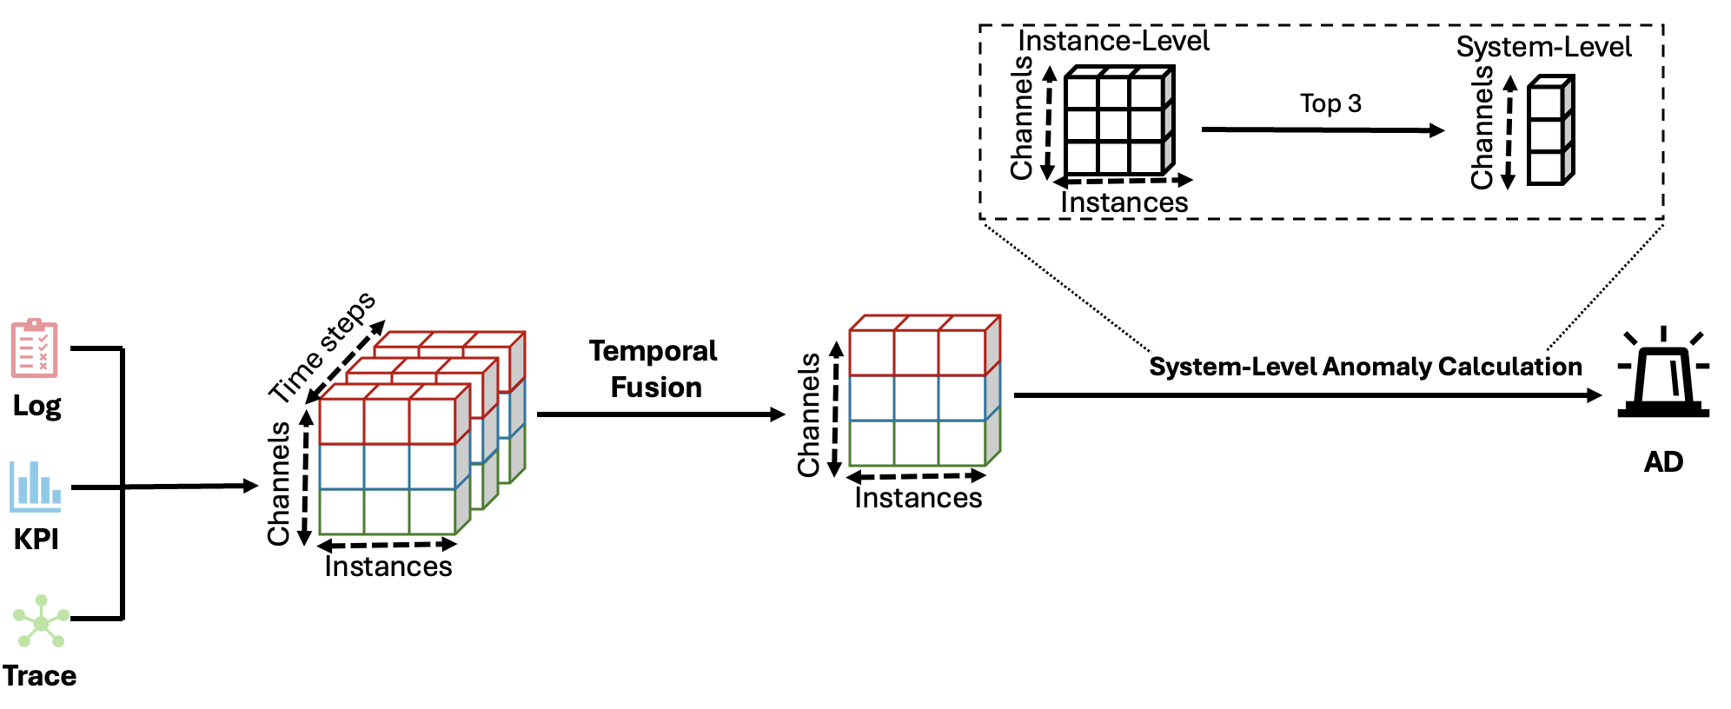
Anomaly Detection
Notes:
Then we aggregate system-level biases to conduct time series anomaly detection

Slide 23
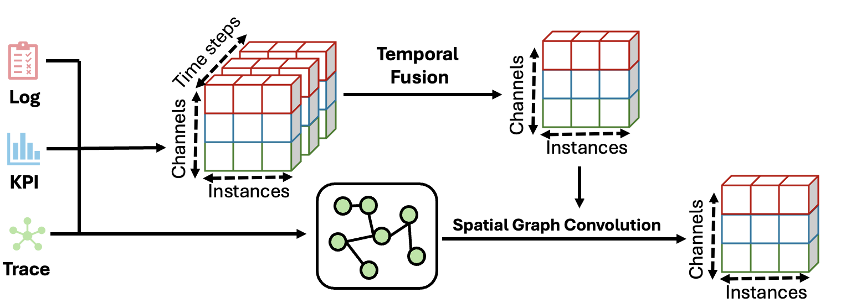
Root Cause Localization
Notes:
Then we began to aggregate spatial features
We conduct spatial modeling of the deviation of the nodes by using the topological information of trace

Slide 24
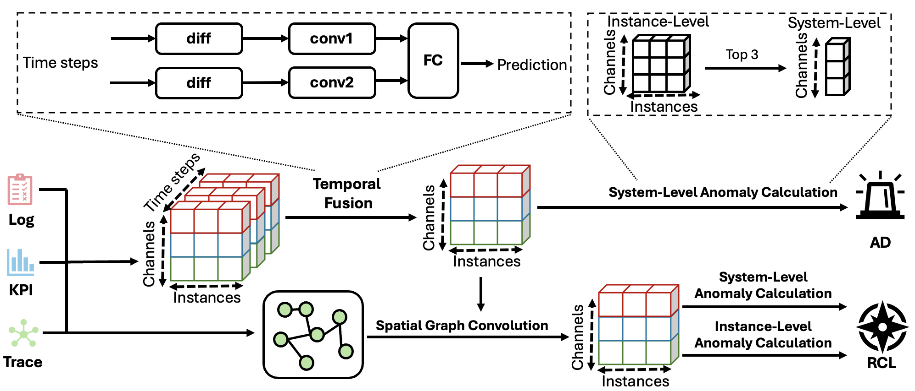
Root Cause Localization
Notes:
Finally, we calculate the cosine similarity of the system deviation and the node deviation for root cause localization

Slide 25
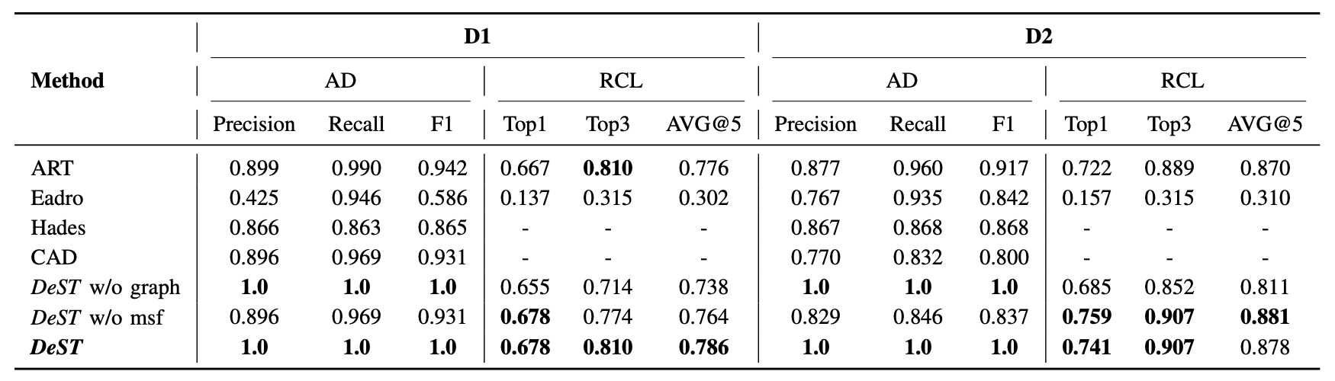
Evaluation
ASE 24
ISSRE 25
Notes:
This result demonstrates our accuracy rate in the joint task of anomaly detection and root cause localization

Slide 26
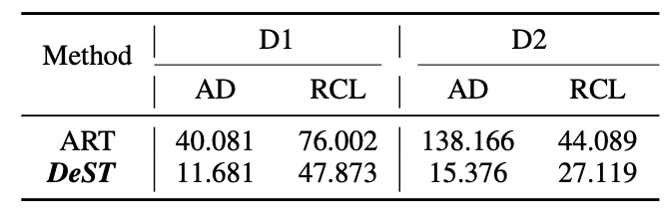
Evaluation
Notes:
This page mainly demonstrates the deployability of our method
The table shows the time consumption in the current dataset, measured in seconds
The picture represents that as time goes by, the consumption of our inference time increases linearly rather than exponentially
这页主要展示了我们方法的可部署性
表格展示了在当前数据集的时间消耗，以秒为单位
图片代表着随着时间增加我们的推断时间消耗线形增长而不是指数增长

Slide 27
Evaluation
Notes:
This page mainly demonstrates the deployability of our method
The table shows the time consumption in the current dataset, measured in seconds
The picture represents that as time goes by, the consumption of our inference time increases linearly rather than exponentially

Slide 28
Evaluation
Notes:
It is worth mentioning that our method achieved a perfect 1.0 score in anomaly detection

Slide 29
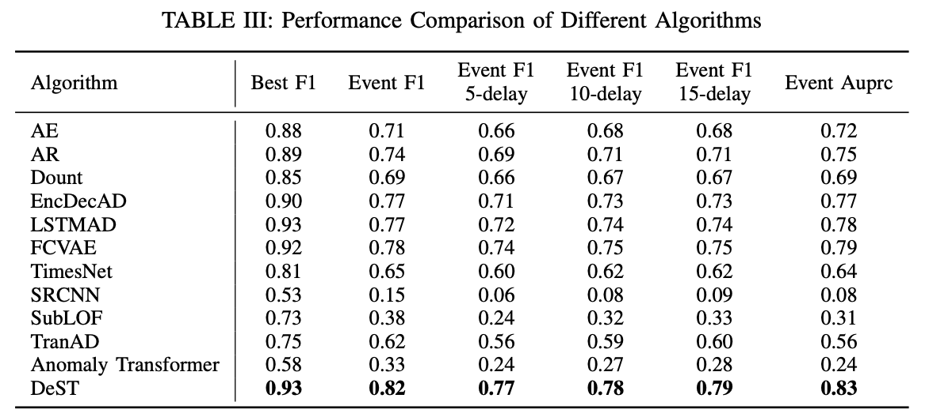
Microservice Systems
Notes:
We conducted multi-metric evaluations on the time series anomaly detection dataset of the microservice system, and our methods achieved the best results in all metrics

Slide 30
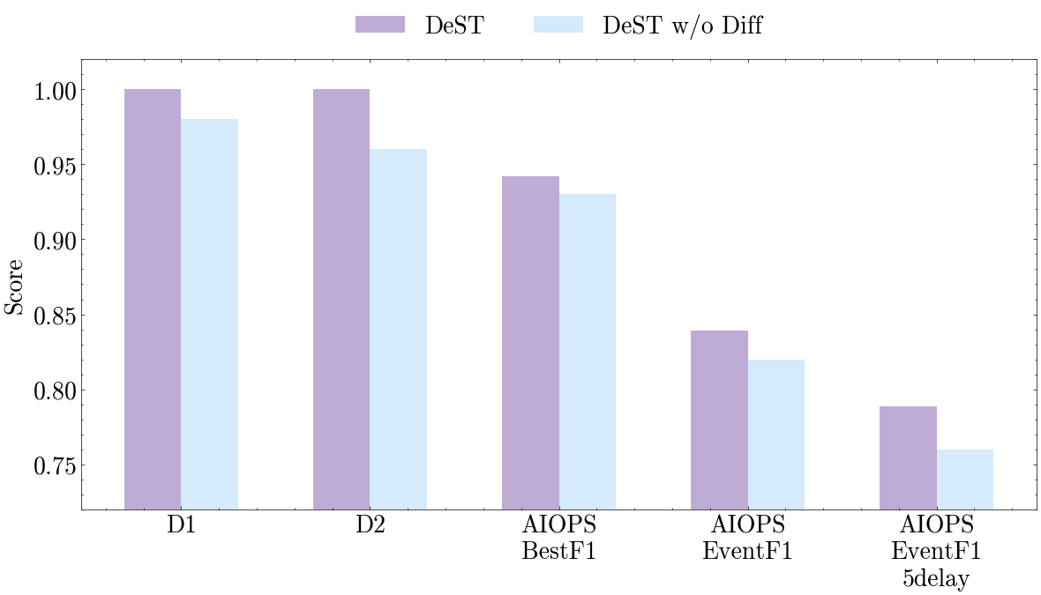
Microservice Systems
Notes:
Finally, we conducted an ablation experiment and proved that the good effect of our method was due to the the differential module

Slide 31
Thank you!
cuihang@cnic.cn
Computer Network Information Center, Chinese Academy of Sciences
‌Tsinghua University

