Slide 1


Research 19: Time Series Data II
ChatTS: Aligning Time Series with LLMs via Synthetic Data for Enhanced Understanding and Reasoning
Zhe Xie¹, Zeyan Li, Xiao He, Longlong Xu, Xidao Wen, Tieying Zhang, Jianjun Chen, Rui Shi, Dan Pei
1. Presenter. Email: xiez22@mails.tsinghua.edu.cn
Notes:
Good Afternoon! Today, I will present "ChatTS: Aligning Time Series with LLMs via Synthetic Data for Enhanced Understanding and Reasoning.”
I am Zhe Xie from Tsinghua University, and this work is conducted also with collaborators from ByteDance.

Slide 2
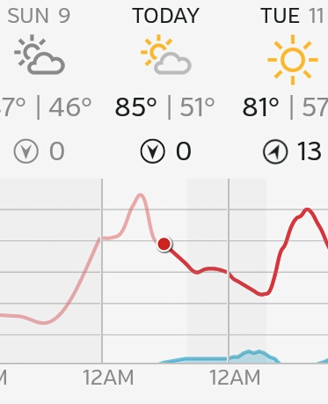
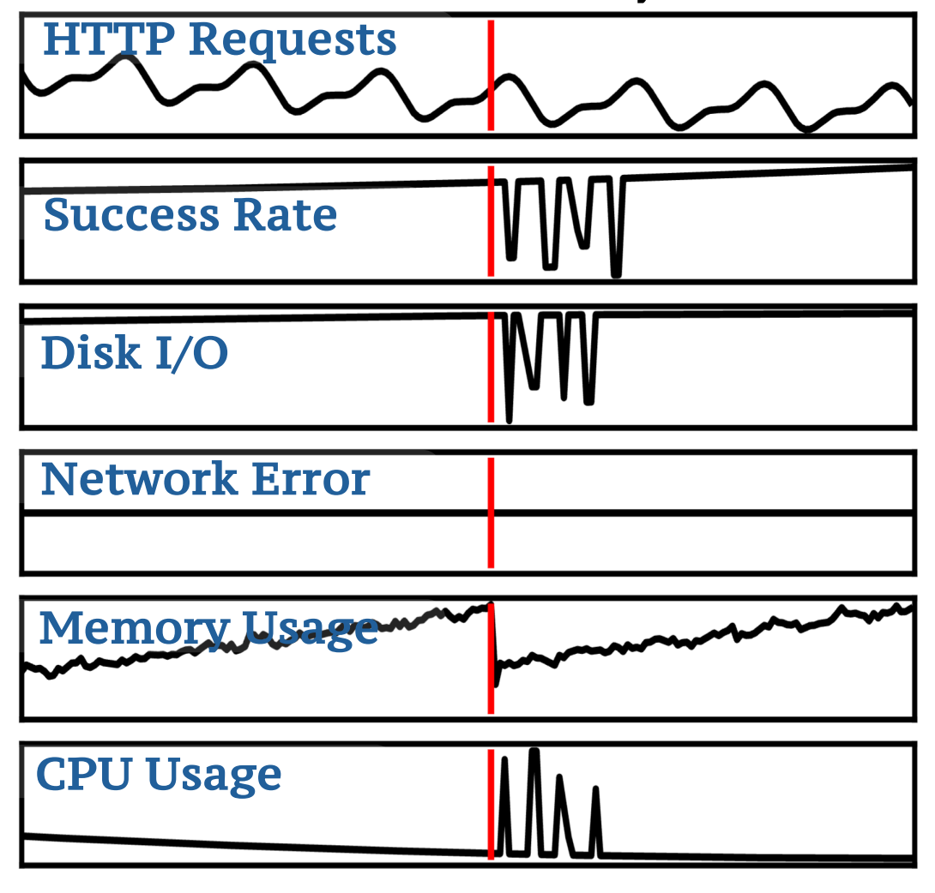
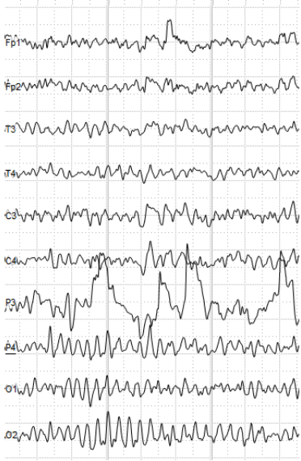
Background
Weather
AIOps
Health
Time series has been widely applied to different areas
Notes:
Nowadays, Time series has been widely applied to different areas

Slide 3
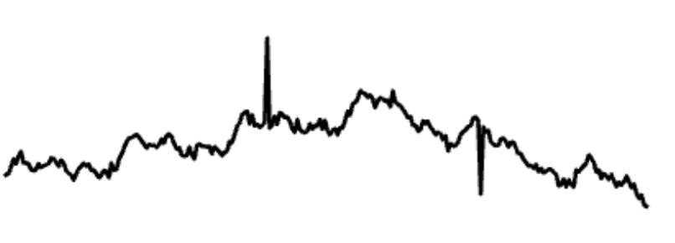

Time Series Understanding and Reasoning
Time Series
+
LLMs
Why do we need a Multi-modal LLM for time series understanding and reasoning?
Many real-world applications
AIOps, IoT, finance, health, etc.
Understanding what is happening according to the time series is important
Integrating time series analysis with existing pipelines
Chatbots, Agents, etc.
Existing LLMs still struggle to reason about time series
Especially for multivariate time series
Notes:
As the rapid development of LLMs, a question is that do we need a multimodal LLM for time series? And there are many reasons for that.
First, many real-world applications like AIOps, IoT, finance, and healthcare generate massive amounts of time series data. Understanding what's happening in these time series is crucial for decision making. Second, we want to integrate time series analysis with existing LLM pipelines like chatbots and agents. However, current LLMs still struggle to reason about time series data, especially multivariate time series with complex patterns.

Slide 4
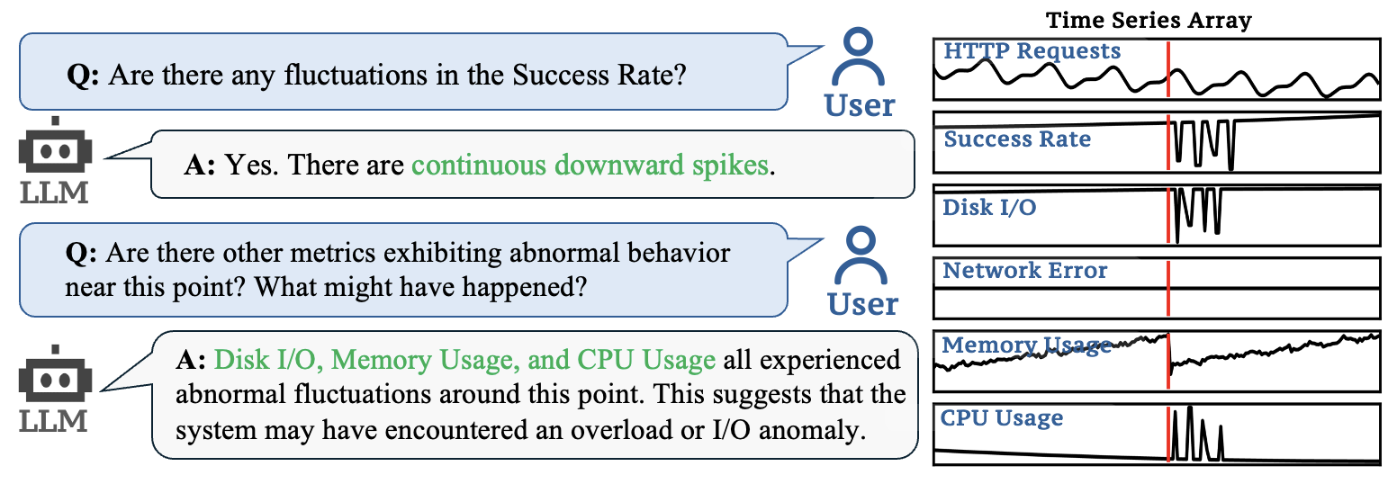
Problem Formulation
ChatTS
A Multimodal LLM built natively for time series as a core modality
Key Features
✅ Native support for multivariate time series
✅ Flexible input: Supports multivariate time series with different lengths and flexible dimensionality
✅ Conversational understanding + reasoning:
Enables interactive dialogue over time series to explore insights about time series
✅ Preserves raw numerical values:
Can answer statistical questions, such as "How large is the spike at timestamp t?"
✅ Easy integration with existing LLM pipelines, including support for vLLM
Notes:
This brings us to ChatTS - a multimodal LLM built natively for time series as a core modality.
ChatTS has several key features: it natively supports multivariate time series, handles flexible input lengths and dimensions, enables conversational understanding and reasoning, preserves raw numerical values for statistical questions, and easily integrates with existing LLM pipelines.

Slide 5
Challenges
Data scarcity: Unlike CV / Audio, there are almost no large-scale datasets containing text descriptions for time series.
High complexity: Time series contain trends, seasonality, local fluctuations, and noise, which require precise alignment to language.
Multivariate and variable length: Multivariate time series (MTS) with different lengths are difficult to handle.
Limited evaluation benchmarks: Existing benchmarks do not fully cover multimodal time series tasks.
Notes:
Building such a model faces several major challenges.
First, data scarcity - unlike CV or audio, we don't have large-scale datasets with text descriptions for time series. Second, high complexity - time series contain trends, seasonality, local fluctuations, and noise that require precise alignment to language. Third, handling multivariate and variable-length time series is technically difficult. Finally, we lack comprehensive evaluation benchmarks for multimodal time series tasks.

Slide 6
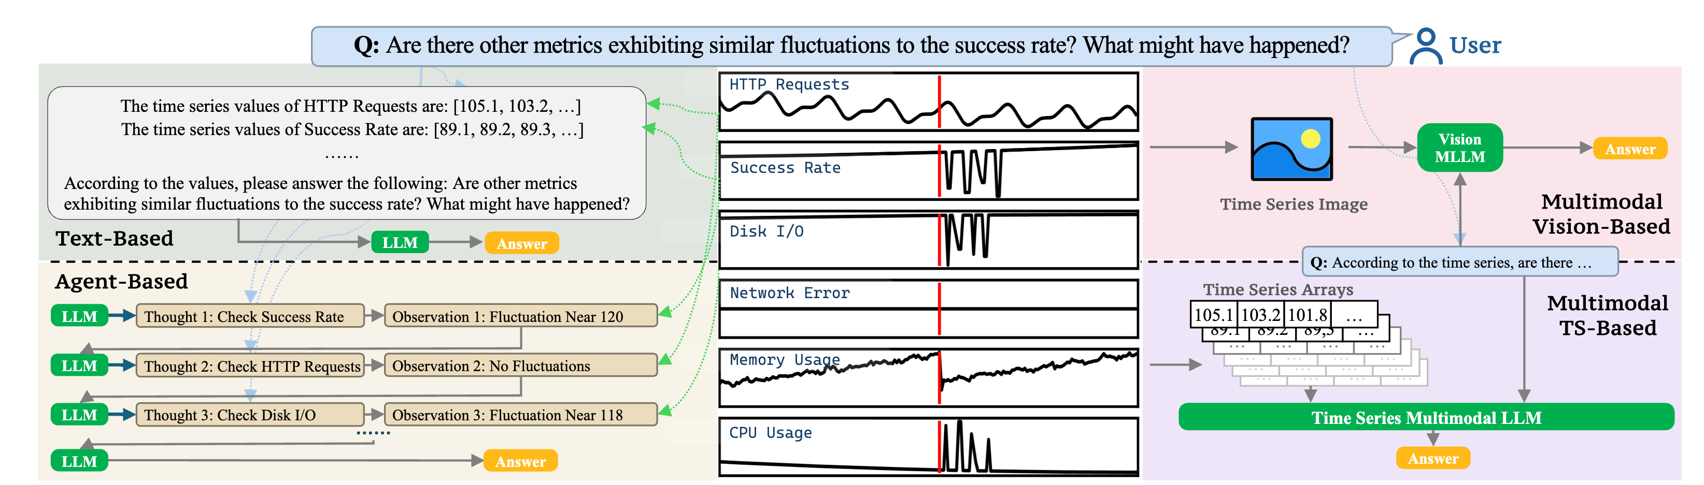
Existing Work
Text-Based
TS Array -> Text
Vision-Based
TS -> Image
Long Context Length
Detail Loss
Agent-Based
Extract TS Features with Tools
TS-MLLM
Native TS Embedding
Relies on Tool Accuracy
Keep Both Global and Detailed Information
Long Context Length
Very Little Token Usage
Notes:
Let me briefly review existing approaches that makes LLMs work for time series.
Text-based methods convert time series to text arrays, but it may suffer from long context length.
Vision-based methods convert time series to images, but may encounter detail loss.
Agent-based methods use tools to extract features, but rely heavily on tool accuracy.
Our approach uses native time series embedding to keep both global and detailed information while using very few tokens.
Therefore, existing work can hardly address all the challenges.

Slide 7
Synthetic Data
Core Idea: we propose to use synthetic text + time series pairs for model training.
Challenges of Using Synthetic Data:
Data Quality: The data must be accurate to ensure precise alignment
Data Diversity: The data must comprehensively cover diverse time series attributes to enable effective multimodal alignment
Existing time series generation methods fail to fully meet these requirements:
Human labelled data is very limited
Hard to ensure the quality and diversity of LLM-generated data
To address this gap, we propose a novel attribute-based method
Notes:
For the data challenges, in this work, our core idea is using synthetic text and time series pairs for model training.
The main challenges are ensuring data quality for precise alignment and data diversity to cover various time series attributes.
Existing methods don't meet these requirements well. Human-labeled data is limited, and LLM-generated data is hard to control for quality and diversity.
We propose a novel attribute-based method to address this gap.

Slide 8
Key Designs in Synthetic Data Generation
Attribute-Based Time Series Generator
Generated Time Series
Attribute Sampler
Attribute Pool
Model Training
Time Series Evol-Instruct
Generated Text
Attribute Selector: To produce highly controllable time-series data with precise attributes
Attribute-Based Time Series Generator: Generate time series that correspond exactly to the attribute pool using a rule-based approach.
Time Series Evol-Instruct: To construct large, diverse, and accurate datasets for complex question answering and reasoning
Notes:
Our synthetic data generation has three key components.
First, an attribute selector produces highly controllable time series data with precise attributes.
Second, an attribute-based time series generator creates time series that exactly correspond to the attribute pool using rule-based approaches.
Third, time series evol-instruct constructs large, diverse, and accurate datasets for complex question answering and reasoning.
This pipeline ensures both quality and diversity in our training data.

Slide 9
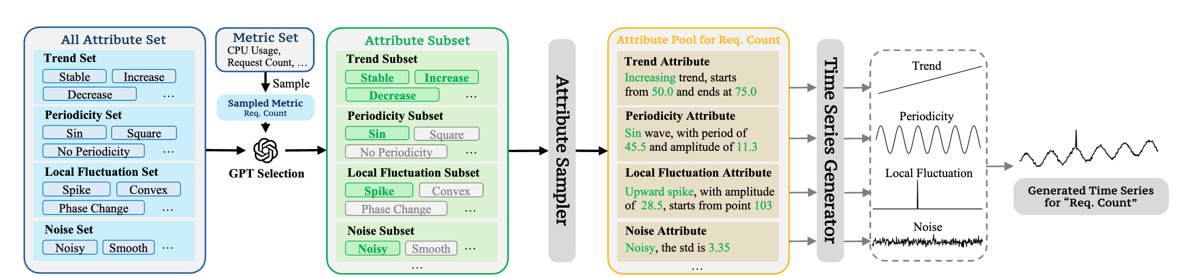
Attribute Selector and Time Series Generator
LLMs are used to select a physically meaningful subset from the All Attribute Set based on a randomly generated metric name
All time-series features are precisely described as attributes and stored in an Attribute Pool to ensure controllable attributes in Text + Time Series pairs
A rule-based approach is employed to generate time series from the attribute pool, ensuring complete controllability over all details.
Notes:
Here's how it works in detail.
We use LLMs to select physically meaningful attributes from a so called all attribute set based on randomly generated metric names.
All time series features are precisely described as attributes and stored in an attribute pool.
Then we use a rule-based approach to generate time series from this attribute pool, ensuring complete controllability over all details.

Slide 10
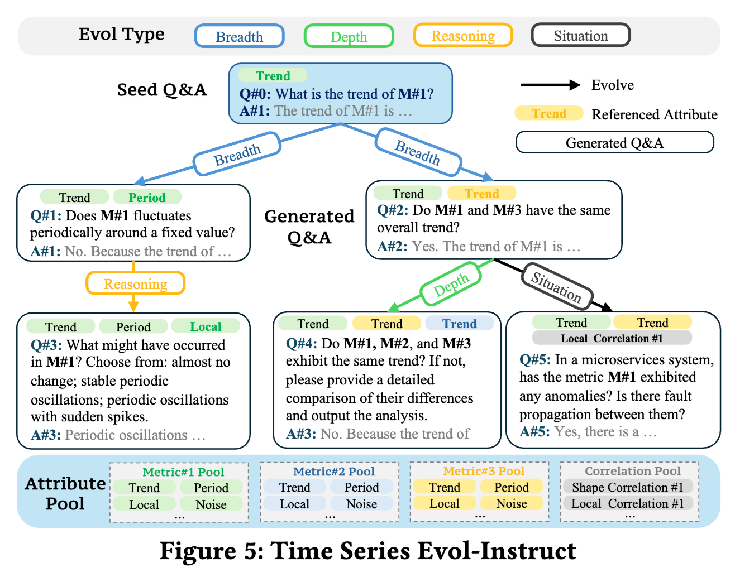
Time Series Evol-Instruct
We employ Time Series Evol-Instruct to generate a large amount of SFT text
Diversity: Each Evol step introduces several new attributes from the Attribute Pool as context, and generates a new QA from the given QA
Accuracy: Both the QA text and the context are jointly validated by an LLM-based validator
Notes:
For better question answering and reasoning, we employ time series evol-instruct to generate large amounts of supervised fine-tuning text.
For diversity, each evolution step introduces new attributes from the attribute pool as context and generates new question-answer pairs.
For accuracy, both the QA text and context are validated by an LLM-based validator to ensure quality.

Slide 11
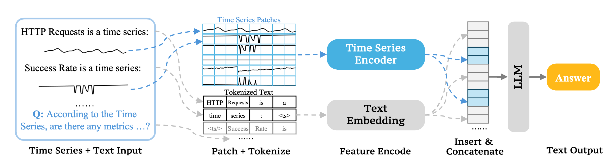
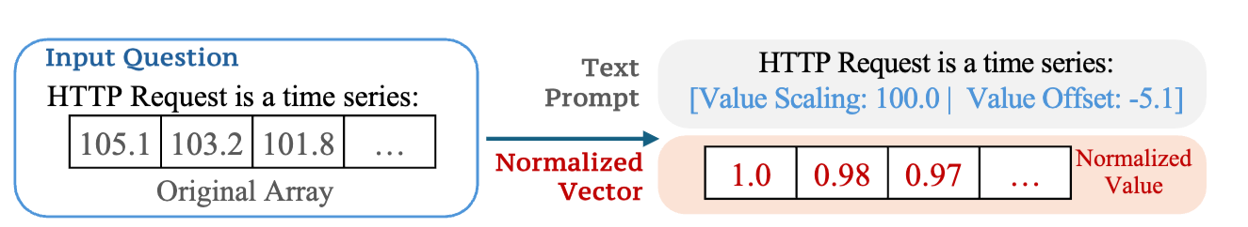
Model Structure
Model Structure
Value-Preserved Normalization
Time series are divided into patches and then encoded using a Time Series Encoder (5-layer MLP), which are inserted into the text embedding
We adopt a 0-1 normalization + textual description approach for TS:
This allows ChatTS to answer questions like: “Is this spike larger than 20?”
Notes:
To make a multimodal LLM for time series, we divide time series into patches and encodes them using a 5-layer MLP time series encoder.
These encodings are inserted into the text embedding space. We adopt a zero-one normalization plus textual description approach for time series. This design allows ChatTS to answer precise questions like "Is this spike larger than 20?" while preserving numerical accuracy.

Slide 12
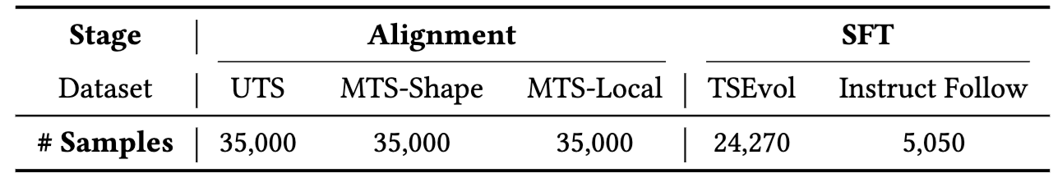
Model Training
Table: # Samples in Training Datasets
Training Process of ChatTS
Base Model:
ChatTS is trained on QWen2.5-14B-Instruct, with fine-tuning performed in two stages: Alignment + SFT.
Stage 1: Large-scale alignment training (Alignment)
Large-scale datasets constructed with a set of pre-defined templates
For initial alignment of time series modality in ChatTS
Stage 2: Supervised fine-tuning (SFT)
TSEvol dataset for better question answering and time series reasoning
An Instruct Following dataset for better question answering formats
Notes:
ChatTS is trained on Qwen2.5-14B-Instruct with two-stage fine-tuning.
Stage one is large-scale alignment training using predefined templates for initial time series modality alignment.
Stage two is supervised fine-tuning using our TSEvol dataset for better question answering and reasoning, plus an instruction following dataset for better response formats.

Slide 13


Evaluation – Alignment Tasks
Instruction
You are a time series analysis expert. In an Internet system, there are many monitoring metrics:
HTTP Request is a time series:
; Success Rate is a time series:
; …
Alignment Task: Seasonal
Q: What is the periodicity of HTTP Request? Please choose from: no periodic fluctuation, periodic fluctuation. If there is periodic fluctuation, describe the fluctuation frequency and amplitude.
A: Periodic fluctuation, each period is around 20.58 points, and the amplitude of the periodic fluctuation is around 31.51.
Alignment Task: Cluster
Q: From the perspective of the overall trend, which metric(s) have very similar trend with HTTP Request?
A: Disk Read per Second, Disk Write per Second.
Alignment Tasks (Categorical Metrics and Numerical Metrics)
Season (Contains / No periodic fluctuation, Period, Amplitude)
Trend (Increase / Decrease / Steady, Amplitude)
Local Fluctuations (Spike / Convex / …, Positions, Amplitudes)
Cluster
Correlation
Notes:
For evaluation, we set alignment tasks and reasoning tasks.
For alignment tasks, we test seasonal analysis, trend analysis, local fluctuation detection, clustering, and correlation analysis. For example, ChatTS can correctly identify periodic fluctuations, describe their frequency and amplitude, and find metrics with similar trends. These tasks test the model's basic understanding of time series patterns.

Slide 14
Evaluation – Reasoning Tasks
Instruction
You are a time series analysis expert. In an Internet system, there are many monitoring metrics:
HTTP Request is a time series:
; Success Rate is a time series:
; …
Reasoning Task: Inductive
Q: From the perspective of the overall trend, do HTTP Request and Success Rate have very similar trend? Just answer yes or no, and explain why they are correlated/no correlated considering their physical meaning in one sentence?
A: No. HTTP requests show traffic load, and success rate shows response quality. They may not always match.
Reasoning Task: Causal
Q: What might be inferred about the system from the Success Rate? Choose from: The system is functioning normally; An error occurred, and it has not recovered; a small number of request anomalies during a software update.
A: A small number of request anomalies during a software update.
Reasoning Tasks
Inductive (Reasoning about the physical meaning of a fluctuation/cluster/…)
Deductive (If ..., then …)
Causal (What can be inferred from the given TS?)
Comparative (Do these two time series remain consistent in trend?)
Notes:
For reasoning tasks, we evaluate inductive reasoning about physical meanings, deductive reasoning with if-then logic, causal inference from time series patterns, and comparative analysis between multiple time series. These tasks require deeper understanding beyond pattern recognition - they need domain knowledge and logical reasoning capabilities.

Slide 15
Evaluation – Settings
Baselines
Datasets
Text-Based
GPT-4o, Qwen
Vision-Based
GPT-4o + Matplotlib
Agent-Based
GPT-4o + React Agent
Dataset A:
Real-world timeseries, manually labelled
Dataset B:
Synthetic timeseries
MCQ 2:
A third-party dataset, for comparison reasoning
Notes:
We compare against several LLM baselines: from text-based method, vision-based method, to agent-based method.
We evaluate on real-world manually labeled datasets, synthetic datasets, and third-party benchmarks.

Slide 16
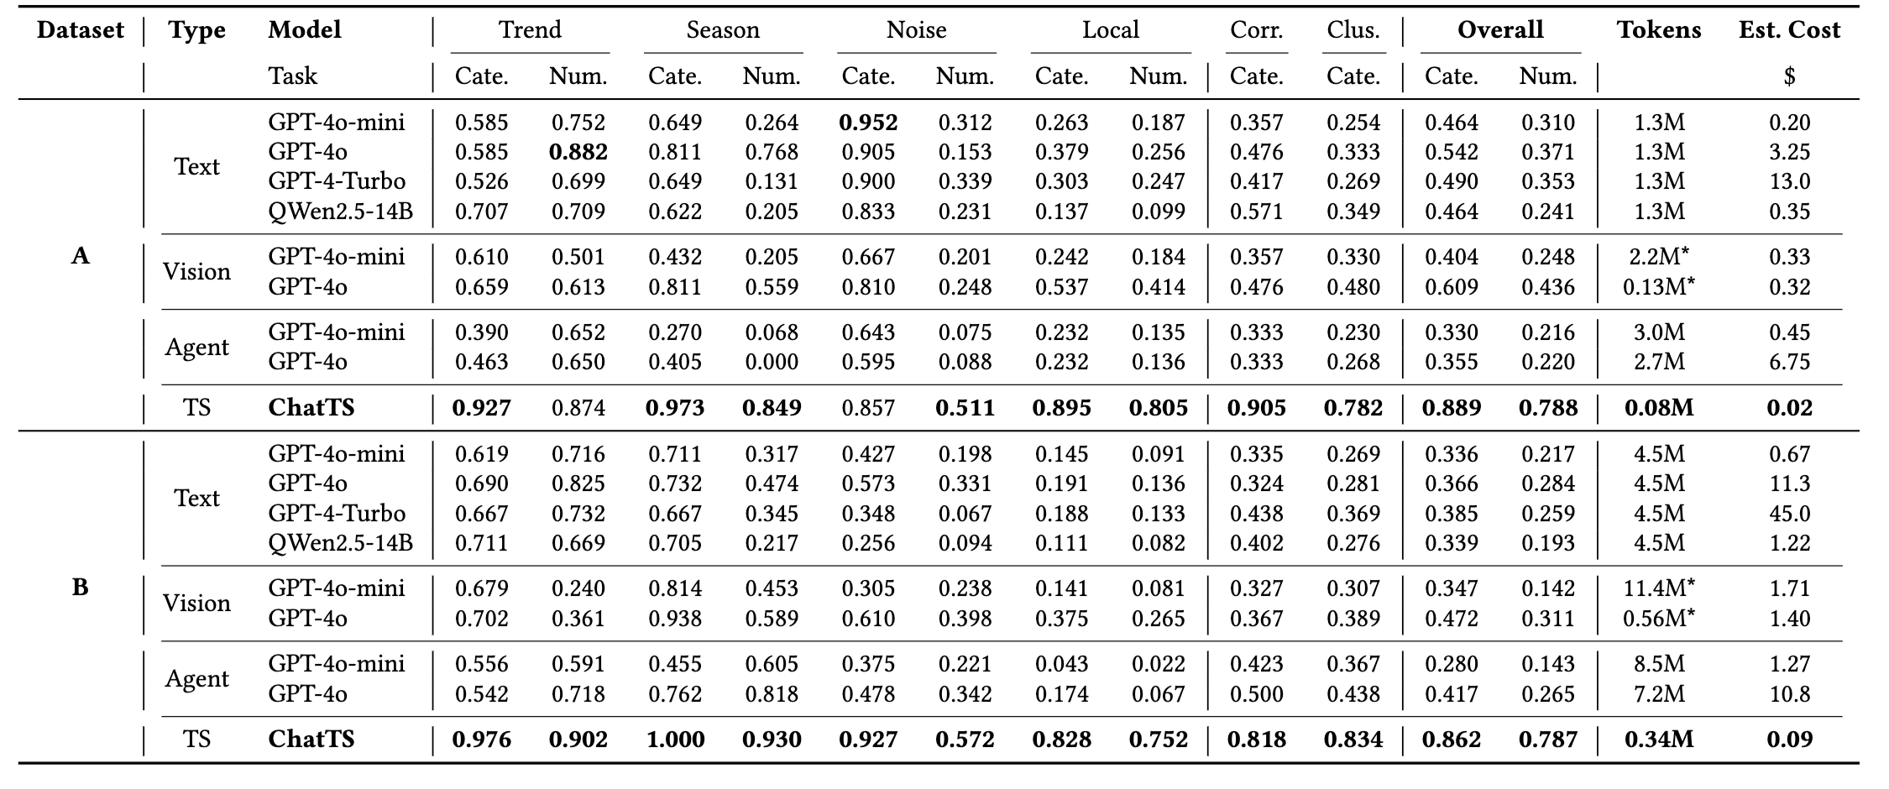
Evaluation – Results (Alignment Tasks)
46.0% Improvement on Alignment Tasks
ChatTS achieves better performance in almost all alignment tasks
Notes:
ChatTS achieves significantly better performance in almost all alignment tasks, with a 46% improvement overall.

Slide 17
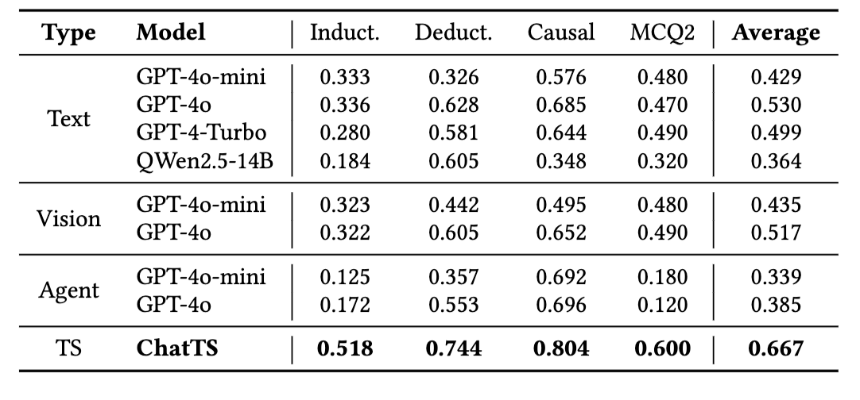
Evaluation – Results (Reasoning Tasks)
25.8% Improvement on Reasoning Tasks
ChatTS also demonstrates strong capability in reasoning tasks
Notes:
ChatTS also shows strong capability in reasoning tasks with a 25.8% improvement.

Slide 18
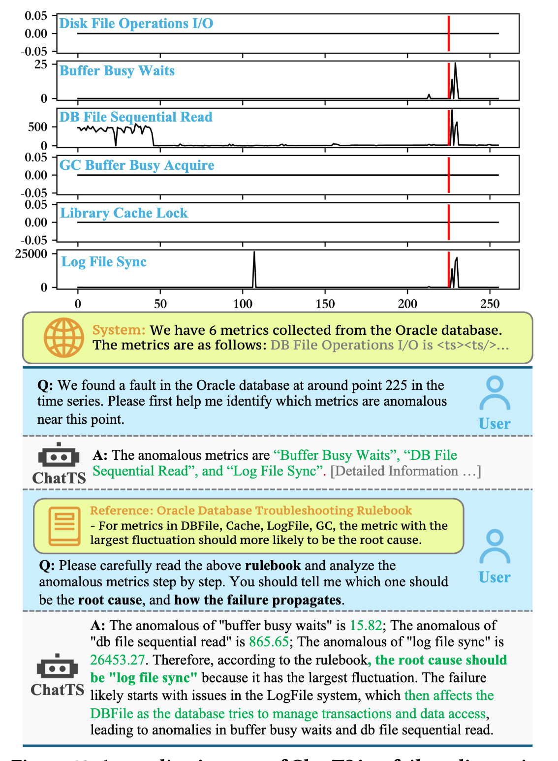
Case Study 1 – DB Operation
A failure occurred in the Oracle DB near point 225
Multivariate monitoring metrics are input to ChatTS
ChatTS successfully detects the anomalies
The operator asks ChatTS to locate the root cause
ChatTS analyzed all the metrics and output the root cause with the given rules after reasoning
Notes:
Finally, let me show you a real-world application.
In this database operation scenario, a failure occurred in an Oracle DB near point 225, which is reflected through the corresponding monitoring metrics.
We input these metrics to ChatTS, and it successfully detects anomalies around point 225.
And when asked by the operator, it also analyze all metrics to provide the correct root cause using the given domain-specific rules and reasoning about the amplitudes of the series.

Slide 19
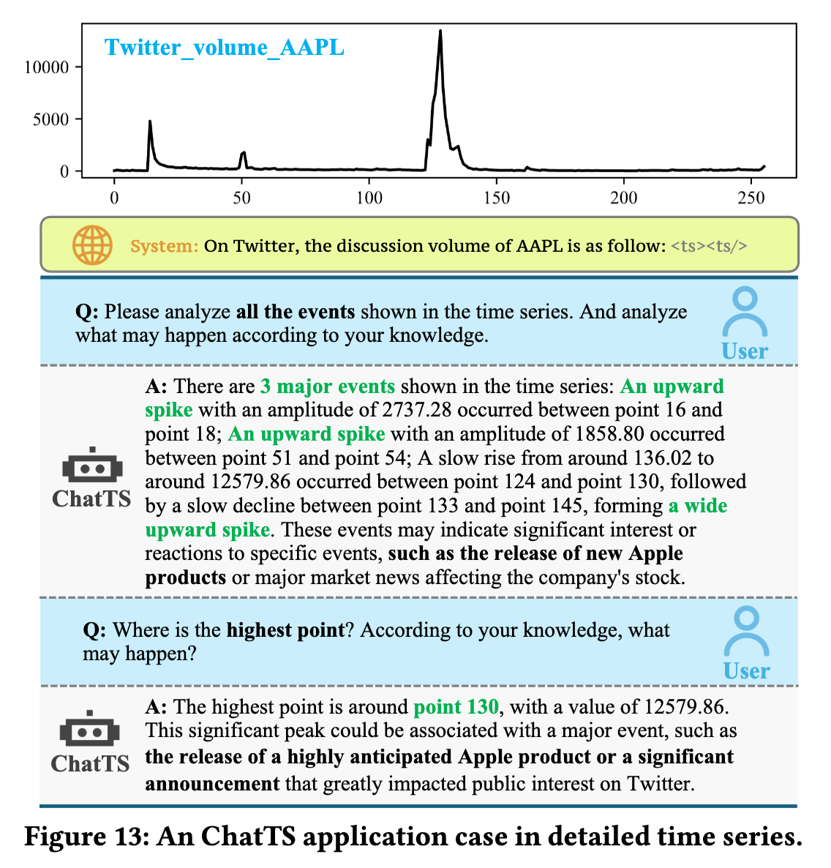
Case Study 2 – Social Media
The user asks ChatTS to analyze all the events in the given Twitter volume timeseries
ChatTS correctly understands the user’s purpose and analyzes the fluctuations
ChatTS is asked to give the highest point
ChatTS correctly gives the highest point and value, along with its physical meaning
Notes:
In this social media example, ChatTS analyzes Twitter volume time series. When asked to find the highest point, it correctly understands the user's intent, analyzes the fluctuations, and provides both the numerical value and its physical meaning in terms of social media activity patterns.

Slide 20
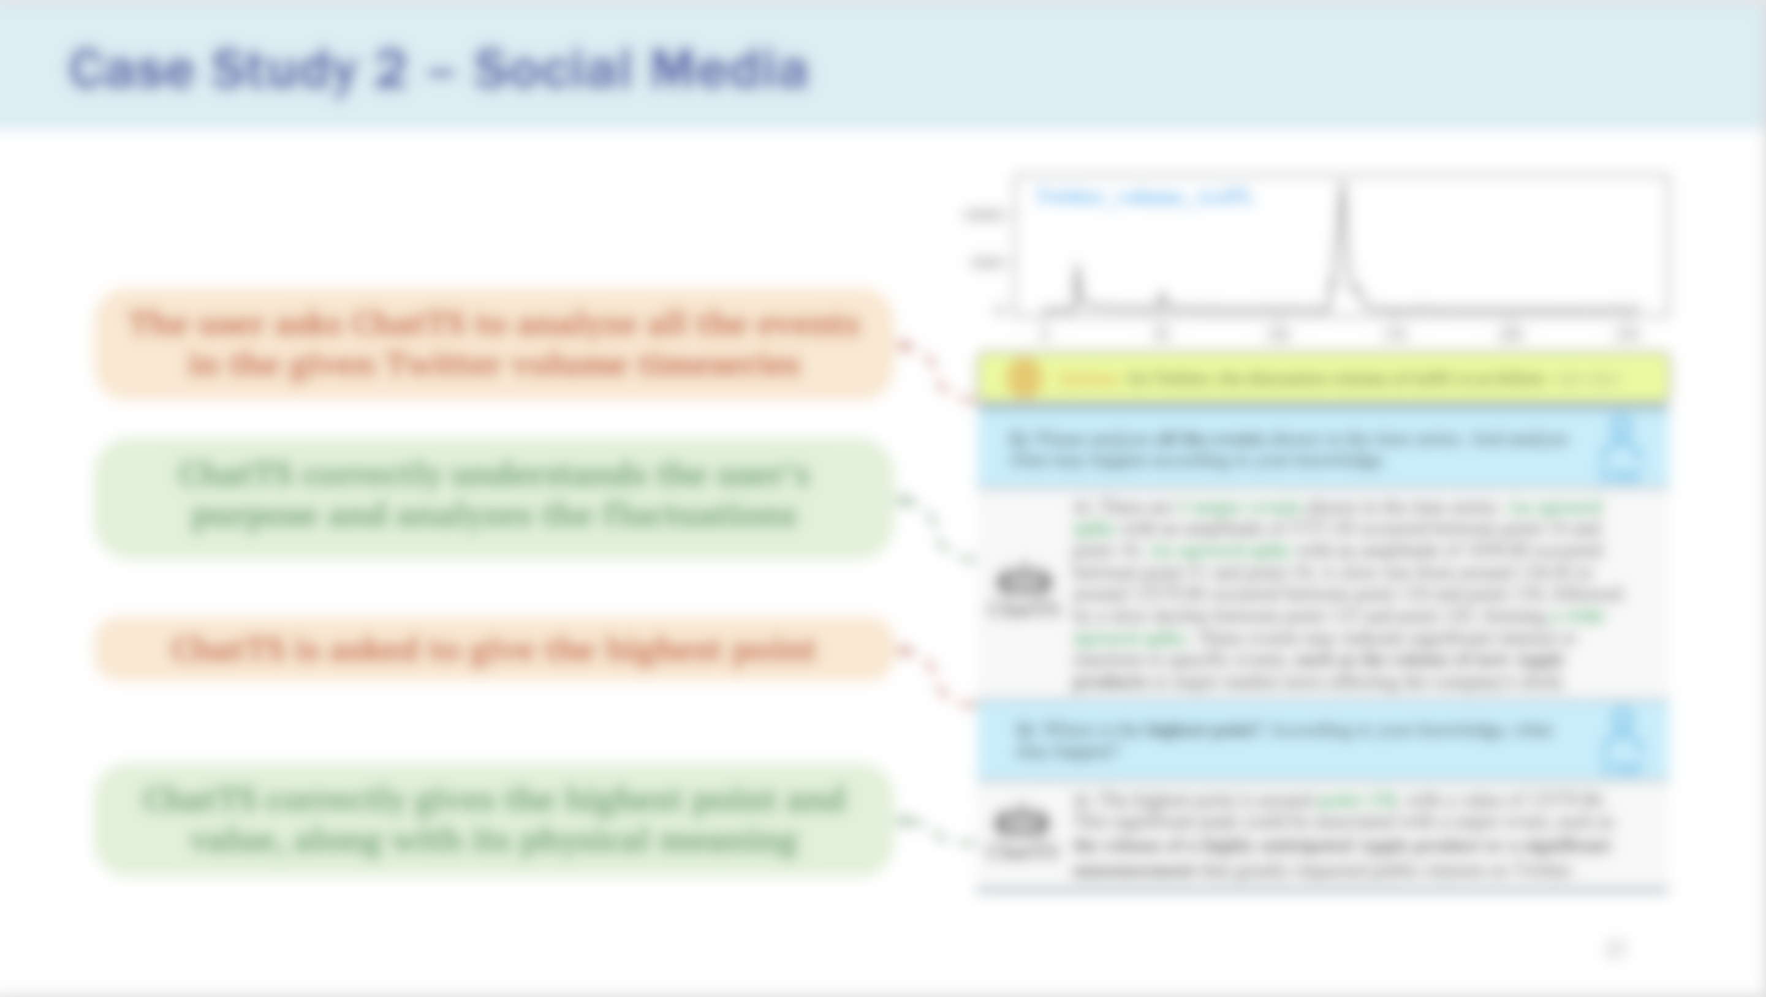
Case studies of ChatTS shows that it can:
Effectively leverages the strengths of LLMs in semantic understanding, contextual summarization, and reasoning
Accurately analyze both numerical values and patterns of multivariate time series
Can be easily applied to real-world problems
Notes:
These case studies show that ChatTS can effectively leverage LLM strengths in semantic understanding, contextual summarization, and reasoning.
It accurately analyzes both numerical values and patterns of multivariate time series, and can be easily applied to real-world problems across different domains.

Slide 21
Conclusion
TS-MLLM: We propose ChatTS, the first Time-Series Multimodal LLM that takes multivariate time series as input, focusing on question answering and reasoning
Timeseries + text data generation: We introduce an attribute-based time-series generation and TSEvol to generate diverse and accurate question–answer pairs
Significant improvement across alignment and reasoning tasks: ChatTS improves performance by 46.0% on alignment tasks and by 25.8% on reasoning tasks, substantially surpassing SOTA, including GPT-4o based on Vision/Text/Agent methods
Open-source code and data: We have released all the source code, trained model checkpoints, and evaluation datasets on GitHub and Huggingface
Notes:
To conclude, we propose ChatTS, the first time series multimodal LLM that takes multivariate time series as native input for question answering and reasoning. We introduce attribute-based time series generation and TSEvol to create diverse and accurate training data. ChatTS achieves significant improvements of 46% on alignment tasks and 25.8% on reasoning tasks, substantially surpassing state-of-the-art methods including GPT-4o based approaches. We've open-sourced all code, model checkpoints, and evaluation datasets.

Slide 22
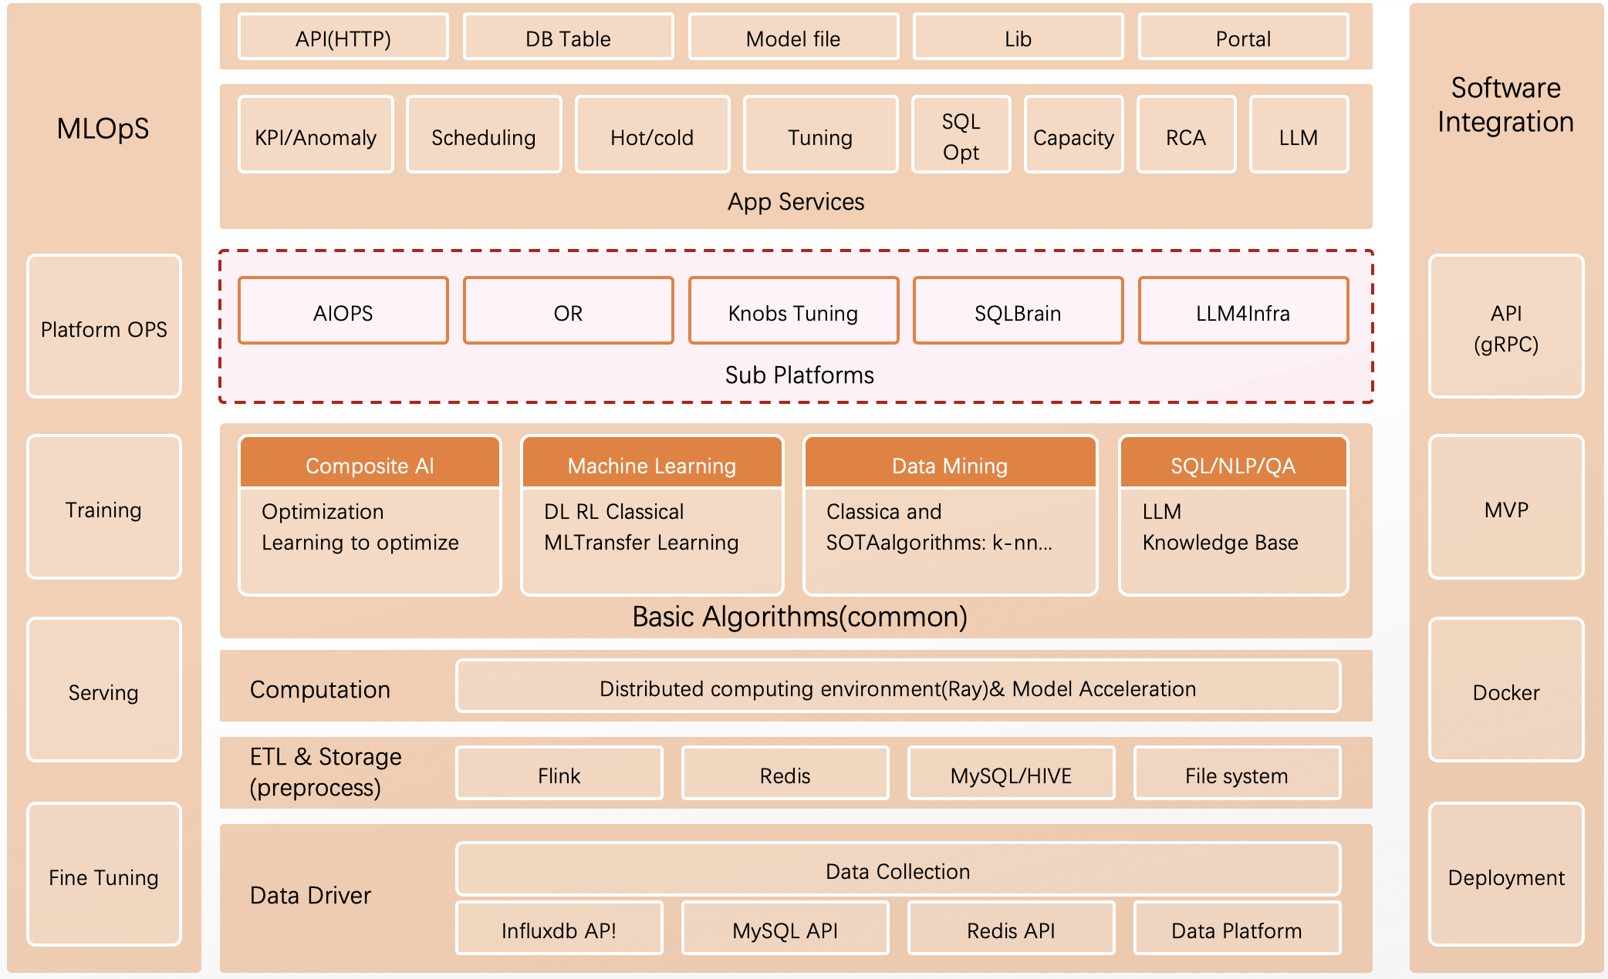
AI for Infra Platform -- ByteBrain
AI/LLM services for infrastructure and systems
Goal: Leverage AI to automatically optimize system performance and reduce labor and resource costs
Area: natural language processing (NLP), AIOps, AI for DB/Storage/Networking, and Operations Research
Notes:
This is our team, ByteBrain, which is ByteDance's cutting-edge AI for Infra platform that provides the AI/LLM services for infrastructure and systems
ByteBrain integrates AI innovations across various domains, including NLP, AIOps, AI for DB/Storage/Networking, and Operations Research.

Slide 23

Thank You!
ChatTS: Aligning Time Series with LLMs via Synthetic Data for Enhanced Understanding and Reasoning
Source Code: https://github.com/NetmanAIOps/ChatTS
Model: https://huggingface.co/bytedance-research/ChatTS-14B
Web Demo
Notes:
Our code is available on GitHub and our model is on Hugging Face. You can also scan this QR code to try ChatTS with this simple web demo. OK. Thank you for your attention. I'm happy to take your questions.

Slide 24
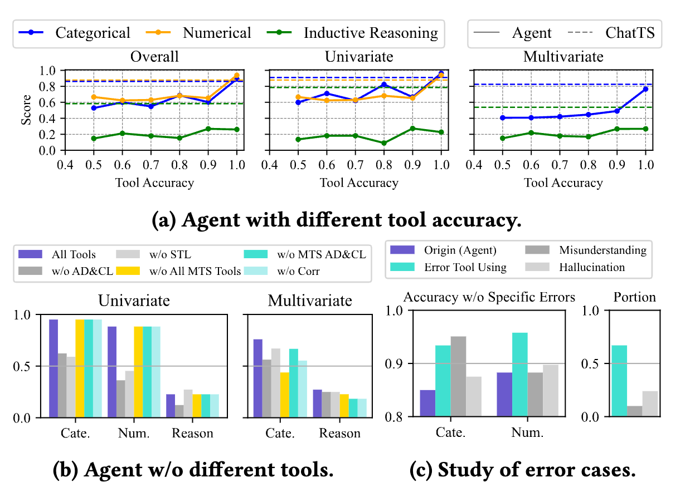
Evaluation – Results (Agents)
We use “perfect tools” based on labels to control the tool accuracy
Once the Tool’s accuracy drops to 90%, the Agent’s accuracy rapidly falls below that of ChatTS, indicating a strong sensitivity to Tool accuracy of Agents
In the MTS task, the Agent model consistently performs poorly, primarily due to incorrect Tool use, misinterpretation of questions, and hallucinations
Notes:
Nowadays, online applications like search engine, online shopping, social network and videos applications have been widely used in our daily life.

Slide 25
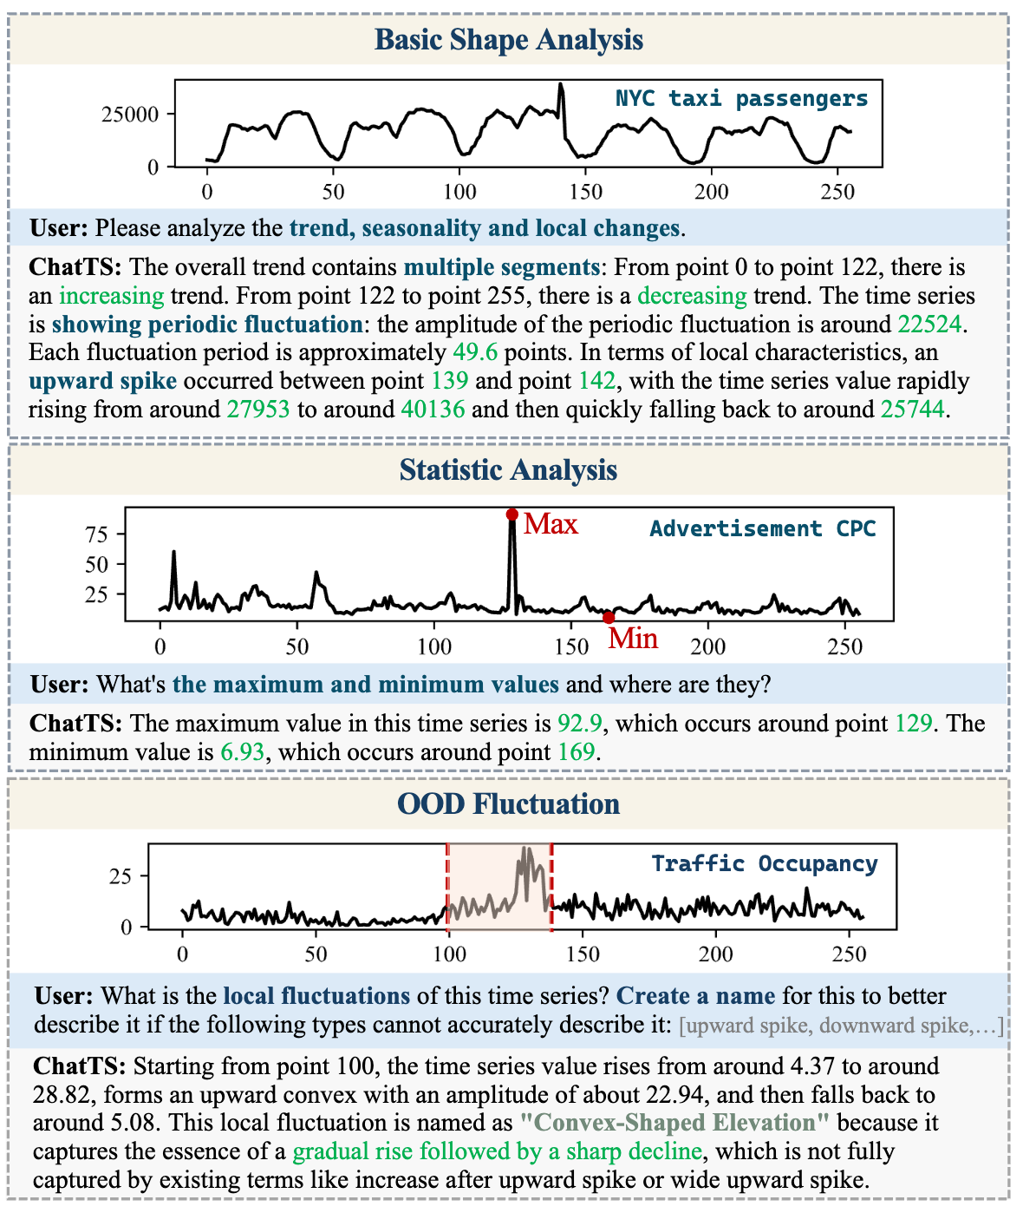
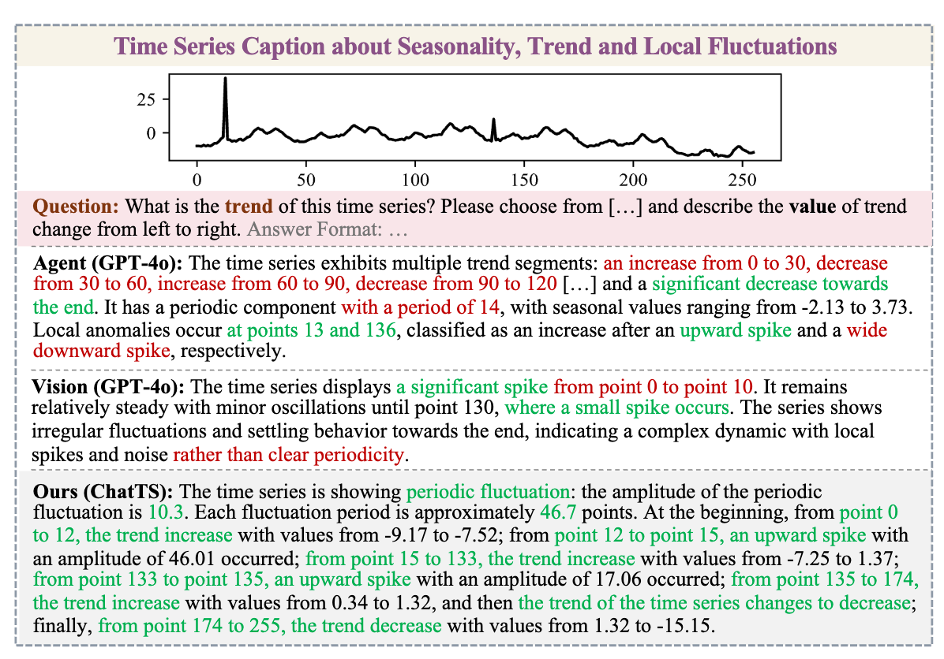
Case Studies 3 and 4
Notes:
Nowadays, online applications like search engine, online shopping, social network and videos applications have been widely used in our daily life.

Slide 26
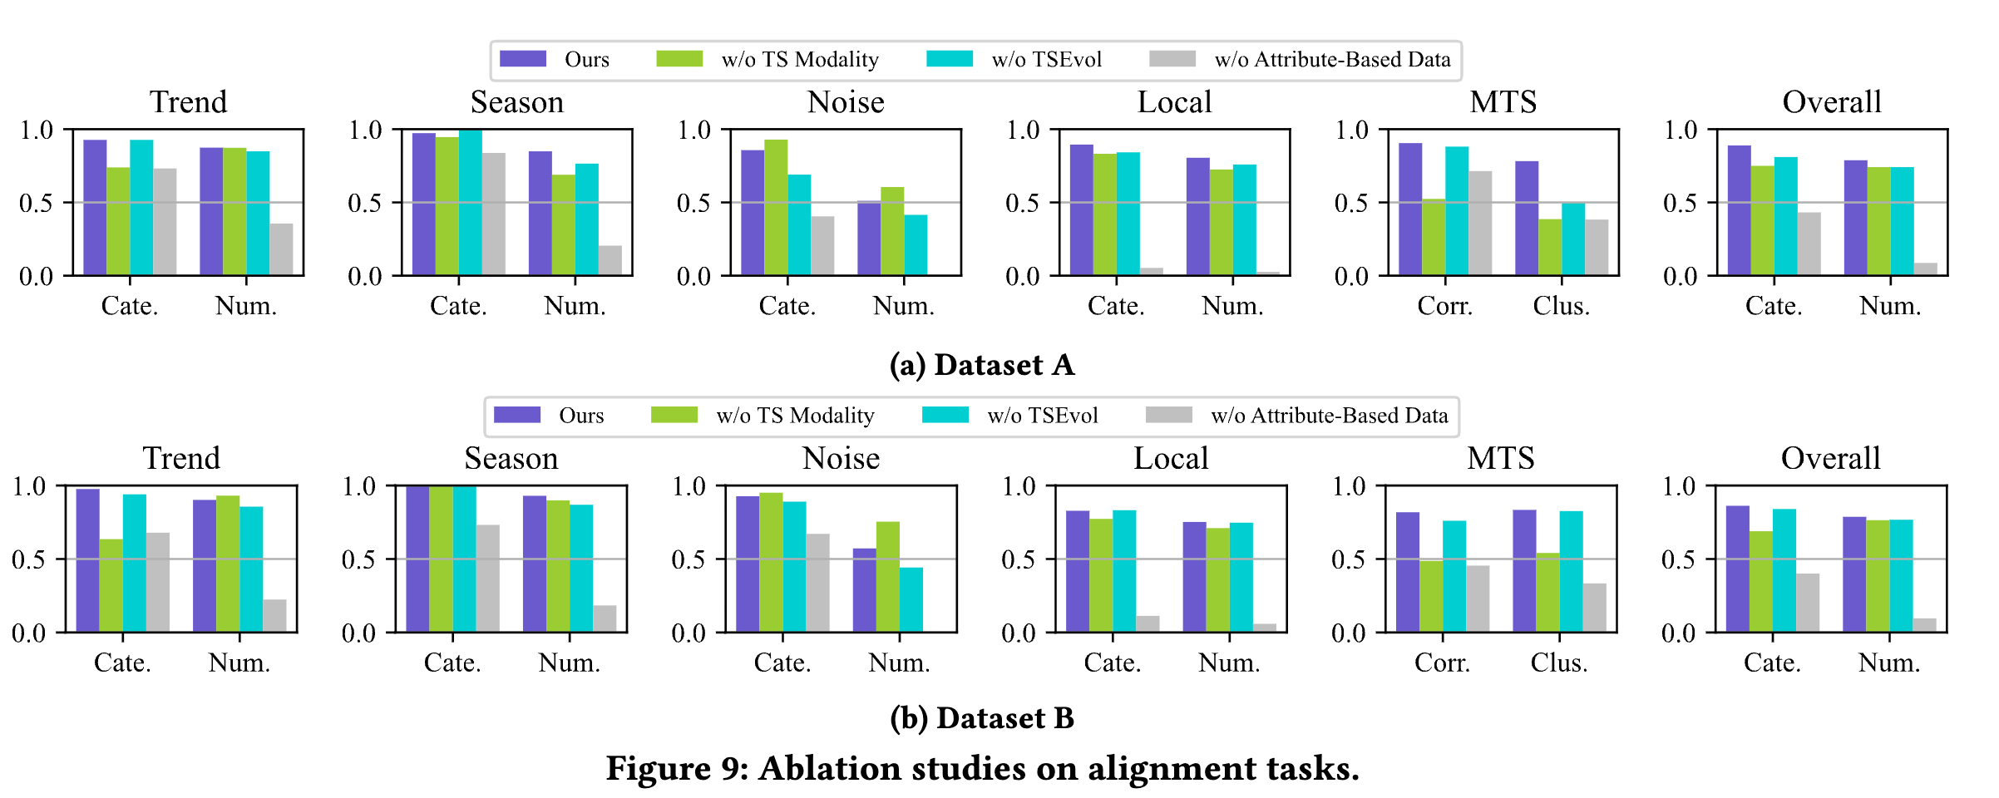
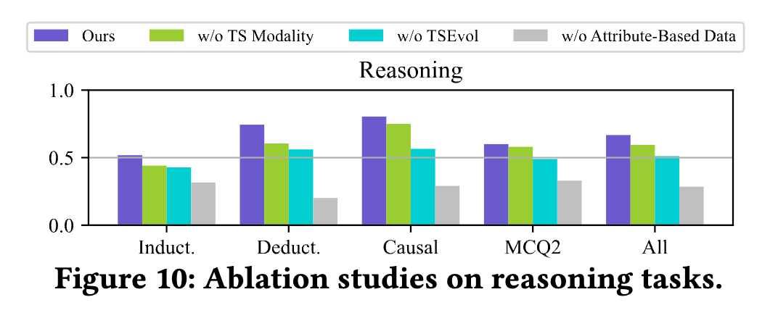
Evaluation – Results (Ablation Studies)
Notes:
Nowadays, online applications like search engine, online shopping, social network and videos applications have been widely used in our daily life.

Slide 27
Value-Preserved Time Series Normalization
Value-Preserved Time Series Normalization
To preserve value information while avoiding numerical explosion in NN, we adopt a normalization + textual description approach for TS
This allows ChatTS to answer questions like: “Is this spike larger than 20?”
Normalization: 0–1 scaling
Textual description: The two parameters of normalization (scaling and offset) are described in text form, allowing the model to understand the scaling factor applied to the current time series.
Notes:
Nowadays, online applications like search engine, online shopping, social network and videos applications have been widely used in our daily life.

