Slide 1
How Bad Are The Rogues’ Impact on Enterprise 802.11 Network Performance ?
Kaixin Sui, Dan Pei, Youjian Zhao, Zimu Li
Tsinghua University
Notes:
Hello everyone. My name is Kaixin Sui.
I’m from Tsinghua University.
Today I’m going to talk about How bad are the rogues impact on enterprise WiFi network performance.
And this is a joint work with Prof Dan Pei, Youjian Zhao, and Zimu Li.

Slide 2
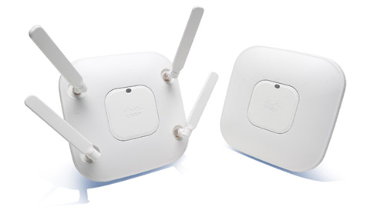
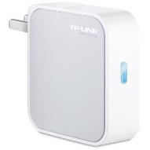
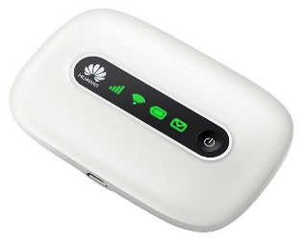
EWLAN, AC, EAP, and RAP
EWLAN (Enterprise WLAN)
EAP (Enterprise AP)
AC (Wireless Controller)
RAP (Rogue AP)
Security threat
Great impact on EWLAN performance
Notes:
I’ll explain some abbreviations. The EWLAN is short for enterprise WiFi network. Access points of the EWLAN are enterprise APs, we call them EAP for short. In the EWLAN, EAPs are controlled, configured and optimized centrally by wireless controllers, which are often called AC.
@ RAP represents the Rouge AP. A Rogue Access Point is a wireless access point installed on an enterprise network without authorization from the network administrator. RAPs not only pose serious security threat to the EWLAN , but also have great Impact on EWLAN Performance.

Slide 3
Chaotic RAP deployment in EWLAN
5GHz v.s. 2.4GHz of #RAP : 292 v.s. 15110
Focus on 2.4 GHz
Notes:
Some statistics about the number of rogue APs for our studied EWLAN. First of all, the number of RAPs in 2.4 GHz is much more than 5 GHz. It is because the technology for 5 GHz is newer than 2.4 GHz, and wireless card work with 5 GHz is more expensive and less common. Hence, our study focus on 2.4 GHz.

Slide 4
Chaotic RAP deployment in EWLAN
5GHz v.s. 2.4GHz of #RAP : 292 v.s. 15110
Focus on 2.4 GHz
#RAP v.s. #EAP in 2.4GHz : 15110 v.s. 2002
The RAP to EAP ratio > 7:1
Notes:
Second, There are more than 15 thousands unique RAPs surrounding 2002 EAPs in our campus. The number of RAPs is more than seven times that of the enterprise APs.

Slide 5
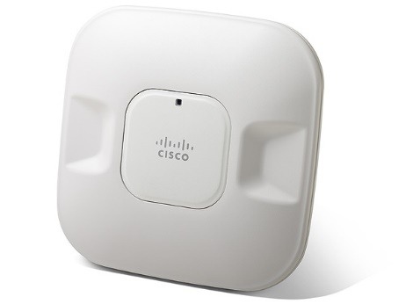
Chaotic RAP deployment in EWLAN
5GHz v.s. 2.4GHz of #RAP : 292 v.s. 15110
Focus on 2.4 GHz
#RAP v.s. #EAP in 2.4GHz : 15110 v.s. 2002
The RAP to EAP ratio > 7:1
Notes:
Lots of rogue APs are chaotic in the EWLAN.

Slide 6
Chaotic RAP deployment in EWLAN
5GHz v.s. 2.4GHz of #RAP : 292 v.s. 15110
Focus on 2.4 GHz
#RAP v.s. #EAP in 2.4GHz : 15110 v.s. 2002
The RAP to EAP ratio > 7:1
Chaotic RAPs may cause great performance degradation of EWLAN.
Our GOAL: Measure RAPs’ impact on EWLAN performance
Notes:
While the EAP placement, channel assignment, and transmission power levels are carefully designed by engineers and centrally optimized by the vendor software on AC for the EWLAN, the RAPs are placed and assigned channel totally at the will of the RAP owner, without any consideration of the EWLANs. Chaotic RAPs may cause great performance degradation of EWLAN. Our goal is to measure RAPs’ impact on EWLAN performance.

Slide 7
Data collection
EWALN of Tsinghua campus
4 km², 42000 students, 11000 faculties and staff
5 Weekdays (2014/07/14-18)
11 ACs (Cisco), 2002 EAPs (Cisco), 51269 EAP Clients
79 Buildings (5 types: administrative, classroom, cafeteria, department, dorm)
15110 RAPs , 44996 RAP Clients
Notes:
We study the EWLAN of Tsinghua campus. Our campus covers an area about 4 square kilometers, with 42 thousands students, 11 thousands faculties and staff. @ Our five weekdays dataset covers the 11 wireless controllers and 2,002 EAPs serve over 50 thousands WiFi devices in 79 buildings. @ The 79 buildings are divided into 5 types: administrative, classroom, cafeteria, department, and dorm, by the occupants and schedule of the building. @ In the five days, we detected over 15 thousands RAPs and 44 thousands RAP clients.

Slide 8
Data collection
EWALN of Tsinghua campus
4 km², 42000 students, 11000 faculties and staff
5 Weekdays (2014/07/14-18)
11 ACs (Cisco), 2002 EAPs (Cisco), 51269 EAP Clients
79 Buildings (5 types: administrative, classroom, cafeteria, department, dorm)
15110 RAPs , 44996 RAP Clients
Notes:
The number of EAP clients is similar to the number of RAP clients. This shows that almost every client of our campusEAP has access to some RAPs.

Slide 9
Data collection
EWALN of Tsinghua campus
4 km², 42000 students, 11000 faculties and staff
5 Weekdays (2014/07/14-18)
11 ACs (Cisco), 2002 EAPs (Cisco), 51269 EAP Clients
79 Buildings (5 types: administrative, classroom, cafeteria, department, dorm)
15110 RAPs , 44996 RAP Clients
One of the largest scale WiFi measurement
Notes:
To the best of our knowledge, our measurement is one of the largest-scale WiFi measurements so far.

Slide 10
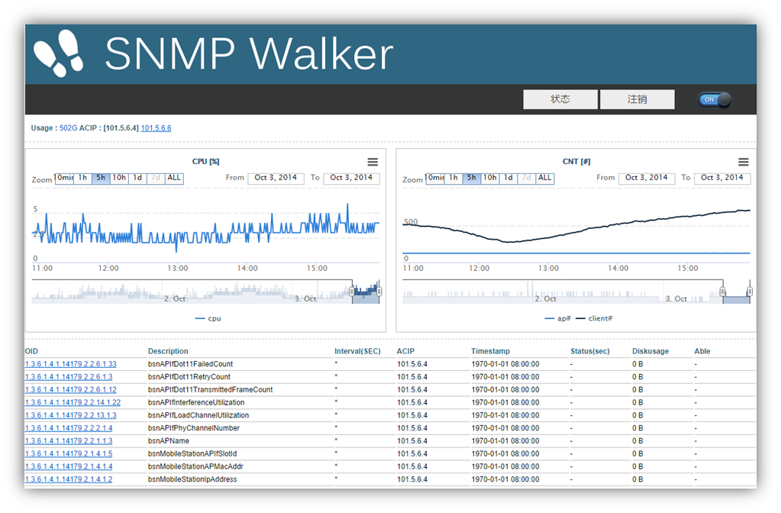
Data collection
SNMP Data without any additional measurement hardware
10 min interval
Notes:
We collect the SNMP data which are readily available at the AC vendor without any additional measurement hardware. We built a SNMP walker program to poll these SNMP objects at regular intervals (every 10 minutes) from 11wireless controllers.

Slide 11
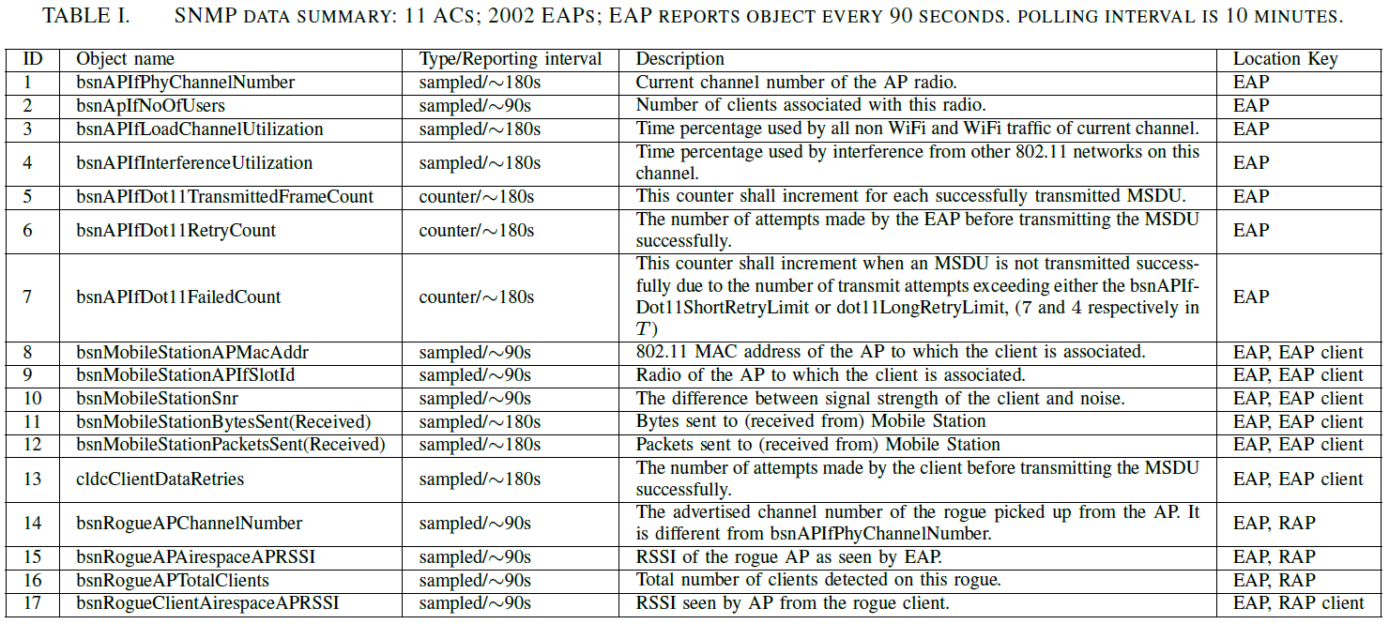
Data collection
SNMP Data without any additional measurement hardware
10 min interval
17 Objects
confirmed
Notes:
All the 17 SNMP objects used in this paper are summarized in the table. @ The objects descriptions drawn from our testbed experiments and Cisco guidance have been confirmed by Cisco engineers.

Slide 12
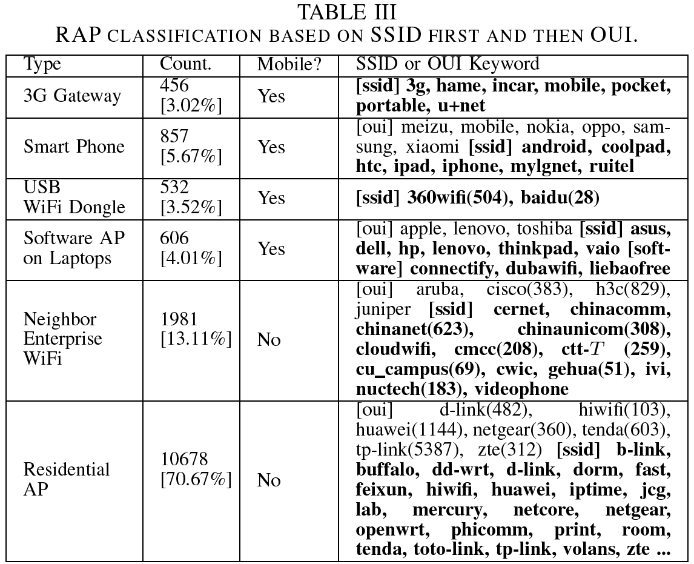
RAP Classification
Notes:
Using RAP SSID keywords and the manufacturer, we classify rogue APs into 6 types: 3 G gateway, smart phone, USB WiFi dongle, software AP on laptops, neighbor enterprise WiFi, and residential AP. We can see that the most dominant types are residential AP which are installed on campus. They contributes to more than 70% of all RAPs, and Aps from Neighbor EWLAN (e.g. installed by telecom companies) which contributes to about 13% of all RAPs. The other potentially mobile RAPs only contribute to less than 17% out of about 15 thousands RAPs. Also we find that the RAP has relatively stable channel and location. Only less than 8% of the rogue Aps are actually mobile.

Slide 13
RAP Impact: CS RAP and HT RAP
[CS RAP] Carrier Sense RAP
Impact: EAP Access Delay
[HT RAP] Hidden Terminal RAP
Impact: EAP Packet Loss
Client
CS RAP
EAP
HT RAP
Client
EAP
Collision Zone
Notes:
What is the RAP impact? According to CSMA/CA mechanism, EAP cannot send traffic but have to wait when hearing the channel is occupied. The carrier sense RAP, we called CS RAP, mainly competes for the same wireless spectrum with the EAP, which results in the increasing EAP access delay. Unlike CS RAP, the Hidden Terminal RAP, called HT RAP, does not postpone the EAP sending time, because EAP can barely hear the HT RAP traffic. The HT RAP leads to loss of packets sending from EAP to the client in the collision zone.
-------
The Hidden Terminal RAP, called HT RAP, leads to severe packet loss of EAP.
However, more seriously, without detecting the hidden packets in the channel based on CSMA/CA mechanism, the EAP considers the channel to be idle and sends its packet to EAP client.
There is a high probability that the packets from EAP loss on a collision with the hidden packets from RAP at the EAP client within the communication range of both EAP and RAP.

Slide 14
RAP Impact: CS RAP and HT RAP
[CS RAP] Carrier Sense RAP
Impact: EAP Access Delay
[HT RAP] Hidden Terminal RAP
Impact: EAP Packet Loss
Due to the totally different impacts on EAP
Notes:
Due to the totally different impacts on EAP

Slide 15
RAP Impact: CS RAP and HT RAP
[CS RAP] Carrier Sense RAP
Impact: EAP Access Delay
[HT RAP] Hidden Terminal RAP
Impact: EAP Packet Loss
Due to the totally different impacts on EAP
The CS RAP and HT RAP needs to be distinguished.
The impact of CS RAP and HT RAP needs to be measured respectively.
Notes:
The CS RAP and HT RAP needs to be distinguished.
The impact of CS RAP and HT RAP needs to be measured respectively.

Slide 16
Distinguish CS RAPs and HT RAPs
CS RAPs or HT RAPs?
RSSI = -75dBm
RSSI = -80dBm
RSSI = - 90dBm
RSSI = -95dBm
Use the RAP RSSI and CST to distinguish.
(Carrier Sense Threshold)
CST = -85dBm
RSSI is from SNMP
Notes:
How to identify CS RAPs and HT RAPs? @ We use the RAP RSSI and carrier sense threshold, called CST, to distinguish. @ The RAP RSSI is extracted from SNMP data. @ And the CST is set to be minus 85 dBm.

Slide 17
Distinguish CS RAPs and HT RAPs
CS RAPs or HT RAPs?
RAP ∈ CS RAP IF RSSI ≥ CST
CS RAP (RSSI ≥ CST)
HT RAP (RSSI < CST)
RSSI = -75dBm
RSSI = -80dBm
RSSI = - 90dBm
RSSI = -95dBm
Use the RAP RSSI and CST to distinguish.
(Carrier Sense Threshold)
CST = -85dBm
RSSI is from SNMP
Notes:
If an RAP RSSI is larger than or equal the carrier sense threshold, it belongs to the carrier sense RAP. @ So, the left 2 RAPs are CS RAPs of the EAP, and the right 2 RAPs are HT RAPs of the EAP.

Slide 18
Distinguish CS RAPs and HT RAPs
Why CST (Carrier Sense Threshold) = -85dBm ?
Empirical value : Nabeel Ahmed. Interference Management in Dense 802.11 Networks. PhD thesis.
Notes:
Why we choose minus 85 to be the carrier sense threshold? First, it is an empirical value. The CST indicates the minimum power/ energy that an RF receiver must receive to detect the transmission of a wireless signal, and most wireless card manufacturers conservatively set this threshold to a low value -85 dBm.

Slide 19
Distinguish CS RAPs and HT RAPs
Why CST (Carrier Sense Threshold) = -85dBm ?
Empirical value
Control experiment
EAP
EAP Client
RAP
RAP
Notes:
Also we conduct a control experiment for further validation. During the experiment, the EAP and RAP are in the same clean channel with no background traffic. @ EAP sends packets to its client, @ Meanwhile, RAP continues to generate interference traffic. @ We move the RAP further away from the EAP.

Slide 20
Distinguish CS RAPs and HT RAPs
Why CST (Carrier Sense Threshold) = -85dBm ?
-85dBm
EAP
Client
EAP
Client
RAP
RAP
CS RAP
HT RAP
Notes:
While the EAP gradually gets out of the RAP communication range and the EAP client is still in, @ the RAP completes the transition from CS RAP to HT RAP of the EAP. @ Here are the corresponding SNMP metrics of RAP RSSI, EAP retry count, and EAP channel utilization during the experiment. @ For the left white zone, the RAP is more like a CS RAP. Carrier sense impact is mainly represented on EAP such as low retry count, and high channel utilization used by both EAP and RAP. For the right shadow zone, the RAP is more like a HT RAP. Hidden terminal impact is mainly represented on EAP such as high retry count, and partly channel utilization used by EAP. As the RSSI of RAP decreases, the retry count and channel utilization of EAP show distinctive differences between two zones separated by minus 85 dBm. @ The experiment validates -85 dBm as the value of CST.
-------------
The channel utilization and interference utilization suddenly fall down when RAP RSSI < CST (-85 dBm), because the packets from RAP with RSSI below CST may not be received by the EAP wireless card. We call these packets hidden packets. Without detecting the hidden packets in the channel based on CSMA/CA mechanism, the EAP considers the channel to be idle and sends its packet to EAP client. There is a high probability that the packets from EAP loss on a collision with the hidden packets from RAP at the EAP client within the communication range of both EAP and RAP. As such, the retry count of EAP increases rapidly due to severe losses when RAP RSSI < CST (-85 dBm).

Slide 21
#CS RAP and #HT RAP - vary over time
Notes:
We calculated the number of CS RAP and HT RAP as time goes on for each building type. For example, the figure shows the RAP count of the dorm. We can see that the number of HT RAPs drop in the shadow zone, while the number of CS RAPs holds comparatively firm along with time.

Slide 22
#CS RAP and #HT RAP - vary over time
Human traffic has a significant impact on the RSSI of WiFi devices
Some HT RAPs disappear at the
Rush Hour : Multipath Fading
Human Traffic ->
#RAP ->
Notes:
Compare with the human traffic figure of the dorm, we find there is one interesting observation: the number of RAPs is usually lower when there are more human traffic. @ It is because more human traffic causes more multipath fading. The RAPs with very weak signal “appear” when the multipath fading is weak and “disappear” when the multipath fading is strong. The HT RAP count is less stable than the CS RAP count, because the HT RAP with low RSSI is easily faded by multipath fading.

Slide 23
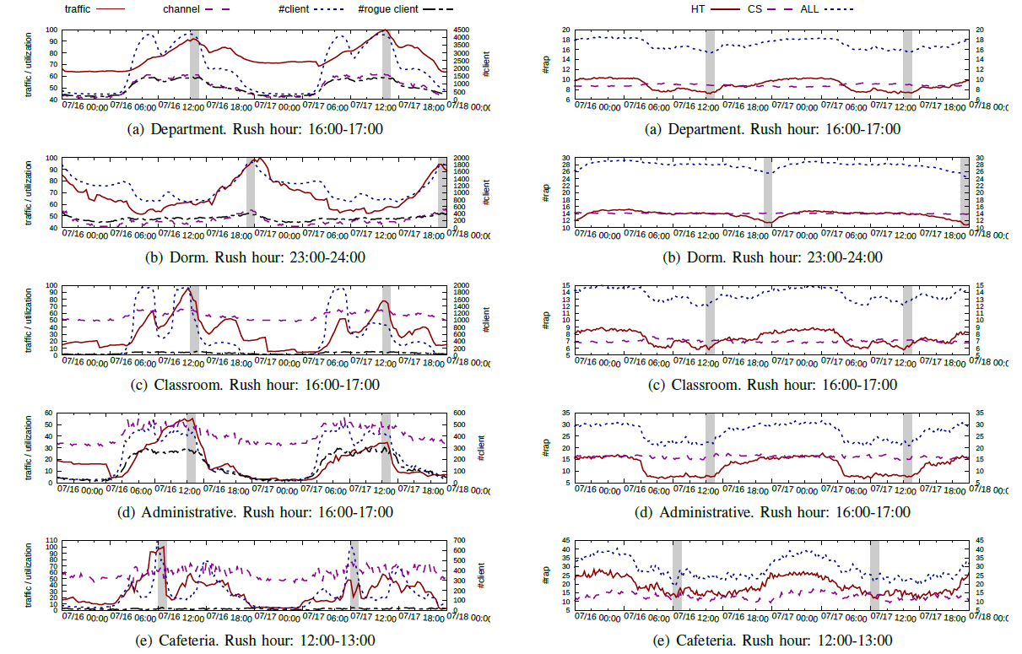
#CS RAP and #HT RAP - vary over time
Human traffic has a significant impact on the RSSI of WiFi devices
Some HT RAPs disappear at the
Rush Hour : Multipath Fading
Notes:
The observation is shown in all building types. So the human traffic has a significant impact on the RSSI of WiFi devices.

Slide 24
#CS RAP and #HT RAP - at an EAP
#CS RAP v.s. #EAP : 5 v.s. 1
#HT RAP v.s. #EAP : 15 v.s. 1
Large number of RAPs and more HT RAPs than CS RAPs.
Notes:
We also calculated the number of CS RAP and HT RAP in overlapping channels with an EAP for the 5 building types. @ On average, around 5 CS RAPs compete channel with the EAP. And around 15 HT RAPs might be potential hidden terminal nodes of the EAP. @ The large number of RAPs reinforces the significant concern about RAPs’ potentially large impact on EWLAN, especially the HT RAPs, because there are more HT RAPs than CS RAPs.

Slide 25
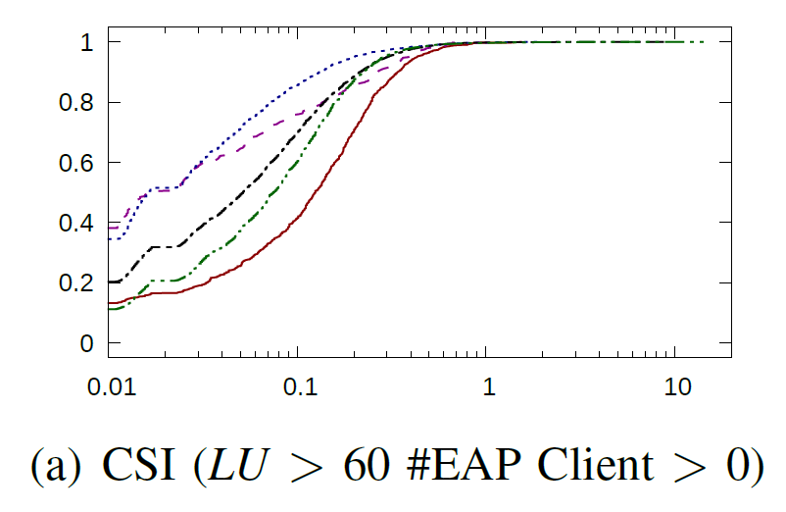
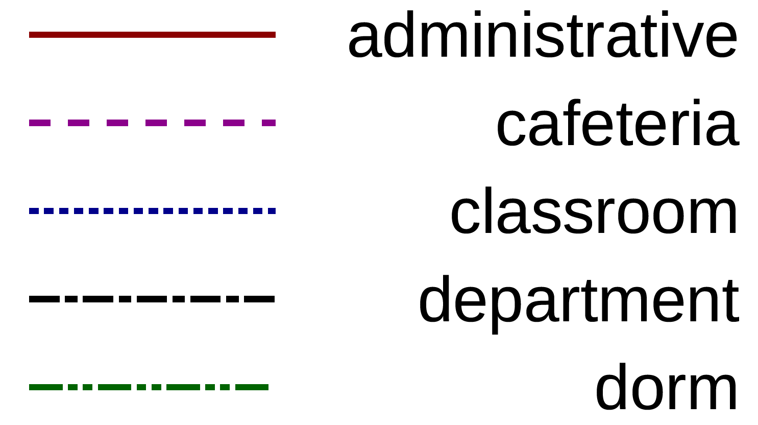
Measure RAPs' impact on EWLAN performance
CS RAP impact: EAP access delay
CSI (Carrier Sense Interference) when channel utilization is high
Not Severe (~ 5%, < 10% in most cases)
CSI = Interference Utilization / ( Channel Utilization - Interference Utilization )
The EAP placement, channel, and power are carefully designed and optimized by the vendor software for the EWLAN.
Notes:
Now we Measure the RAPs' impact on EWLAN performance. The CS RAP increase the EAP access delay. We measure the impact of CS RAP by the metric CSI carrier sense interference to roughly estimate the additional back-off time of EAP caused by CS RAP. When the channel utilization is high, the CSI is approximate the increased delay caused by the carrier sense interference. The larger the value for CSI, the more severe the EAP impacted by CS RAPs.
The CSI can be calculated using the objects about channel information in SNMP data according to the formula. @ The figure shows the CDF of CSI when one or more EAP clients associated during the channel heavy load time with channel utilization larger than 60. In our results, The CS RAP impact is not severe. On average carrier sense interference only cause 5% access delay increase at the MAC layer, and below 10% in most cases. @ The EAP placement, channel, and power are carefully designed and optimized by the vendor software for the EWLAN, so the carrier sense interference somehow can be avoided. Despite the large number of surrounding RAPs, the impact of CS RAP is not severely.
--------------
Note that with no access to the reliable non-WiFi data to filter the non-WiFi utilization from denominator, the CSI might be underestimated.

Slide 26
Measure RAPs' impact on EWLAN performance
HT RAP Impact: EAP packet loss
LOSSRATE of packets from EAP to high SNR clients
Notes:
The HT RAP leads to packet loss of EAP. We measure the impact of HT RAP by the metric LOSSRATE of packets from EAP to high SNR clients.

Slide 27
Measure RAPs' impact on EWLAN performance
HT RAP Impact: EAP packet loss
LOSSRATE of packets from EAP to high SNR clients
Filter the Packet Loss caused by Low SNR including
Non-WiFi Interference, Fading Channel, etc.
Notes:
Packet loss from EAP to high SNR EAP client is mainly caused by HT RAP. It can Filter the Packet Loss caused by Low SNR including Non-WiFi Interference or Fading Channel. We select 30 dBm as the high SNR threshold.

Slide 28
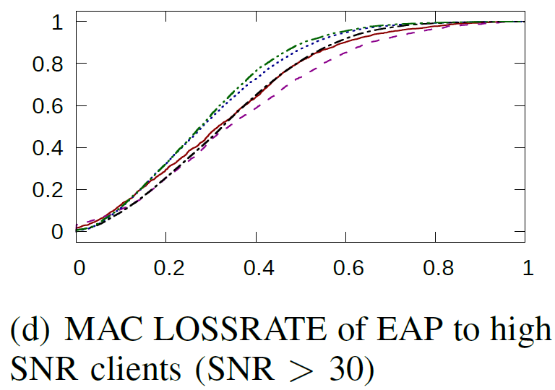
Measure RAPs' impact on EWLAN performance
HT RAP Impact: EAP packet loss
LOSSRATE of packets from EAP to high SNR clients
Severe (~ 30%, > 50% in 20% cases)
MAC LOSSRATE = (Retry Limit * Fail Count + Retry Count)/(Retry Limit * Fail Count + Retry Count + Success Count)
Current EAP software do nothing about HT RAPs. Operators should take more attention to HT RAPs to alleviate the LOSSRATE.
Notes:
The mac layer loss rate can be calculated using the objects about frame counter in SNMP data according to the formula. @ The figure shows the CDF of high SNR clients’ MAC loss rate for each building type. The impact of HT RAPs is much more severe. The MAC loss rate is around 30% on average. Critically, our campus EWLAN users suffer an extremely high MAC loss rate more than 50% in almost 20% cases. @ It is because the current EAP software simply ignore and do nothing about HT RAPs. Operators should take more attention to HT RAPs to alleviate the LOSSRATE.

Slide 29
Measure RAPs' impact on EWLAN performance
The overall impact of RAPs: IP layer delay at the WiFi hop
IMPACT
Severe (~ 50%, > 80% in 20% cases)
IMPACT = ( 1 + CSI ) * ( 1 + MAC LOSSRATE ) – 1
Notes:
Although CSI and LOSSRATE can measure the RAP impact from two different points of view, there is still lack of a directly quantified value to measure the overall impact. We define a new metric IMPACT to represent the overall impact derived from CSI and MAC LOSSRATE. One plus CSI means the total time to send a mac layer frame, one plus the loss rate means the number of frame sent for a success IP layer packet. And the IMPACT means the IP layer delay at the WiFi hop caused by RAPs. @ The figure shows that on average a fairly high increasing delay (over 50%) of the WiFi hop is caused by RAP.

Slide 30
Conclusion
The first large-scale measurement study on rogue APs’ impact on the EWLAN performance.
Propose a generic methodology to distinguish CS RAPs and HT RAPs, and roughly quantify their impact using only SNMP data.
Key findings of our studied EWALN
RAPs are chaotic in EWLAN.
Carrier sense interference due to RAPs are not severe.
Hidden terminal interference due to RAPs are much more severe.
(increasing up to 50% MAC loss rate)
Notes:
In conclusion, our work is the first large-scale measurement study on rogue APs’ impact on the EWLAN performance. @ We Propose a generic methodology to distinguish CS RAPs and HT RAPs, and roughly quantify their impact using only SNMP data. @ We also report the key findings of our studied EWALN that ….

Slide 31
Thank you !

Slide 32
Backups

Slide 33
INFORMATION ABOUT 79 BUILDINGS

Slide 34
Distinguish CS RAPs and HT RAPs
Why CST (Carrier Sense Threshold) = -85dBm ?
Empirical value
Minimum power that an RF receiver must receive to detect the transmission of a wireless signal.
Most wireless card manufacturers conservatively set this threshold to a low value -85 dBm.
Notes:
the CST indicates the minimum power/ energy that an RF receiver must receive to detect the transmission of a wireless signal
most wireless card manufacturers conservatively set this threshold to a low value -85 dBm.”

Slide 35
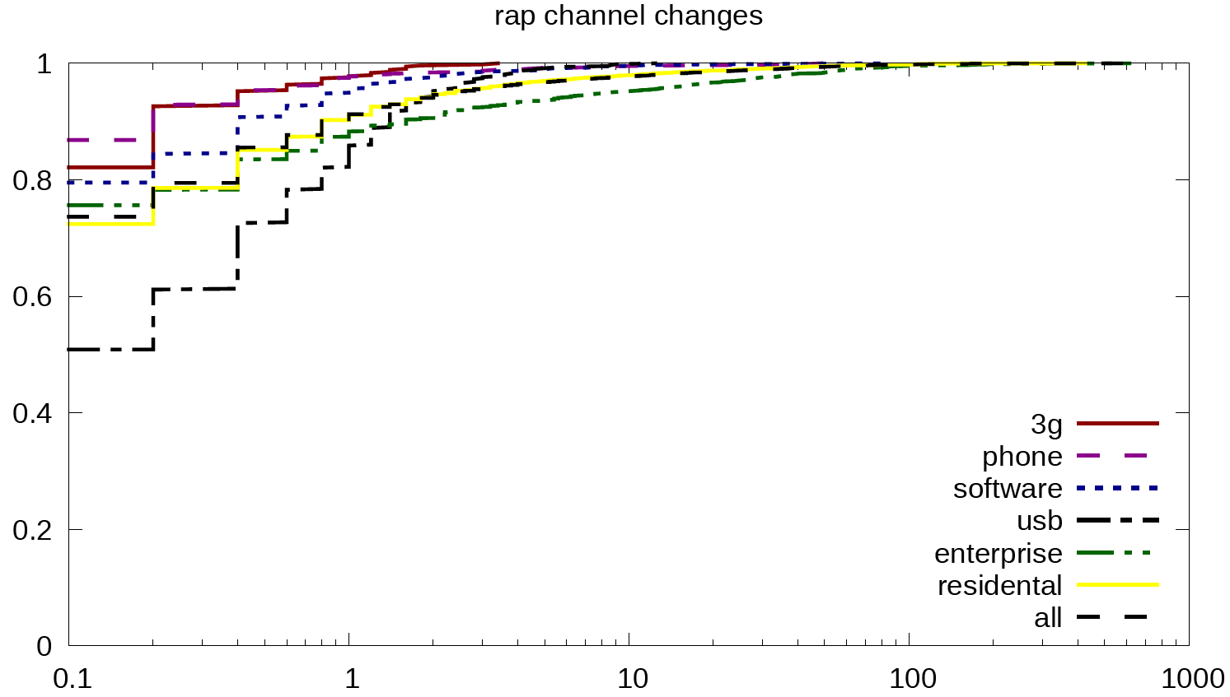
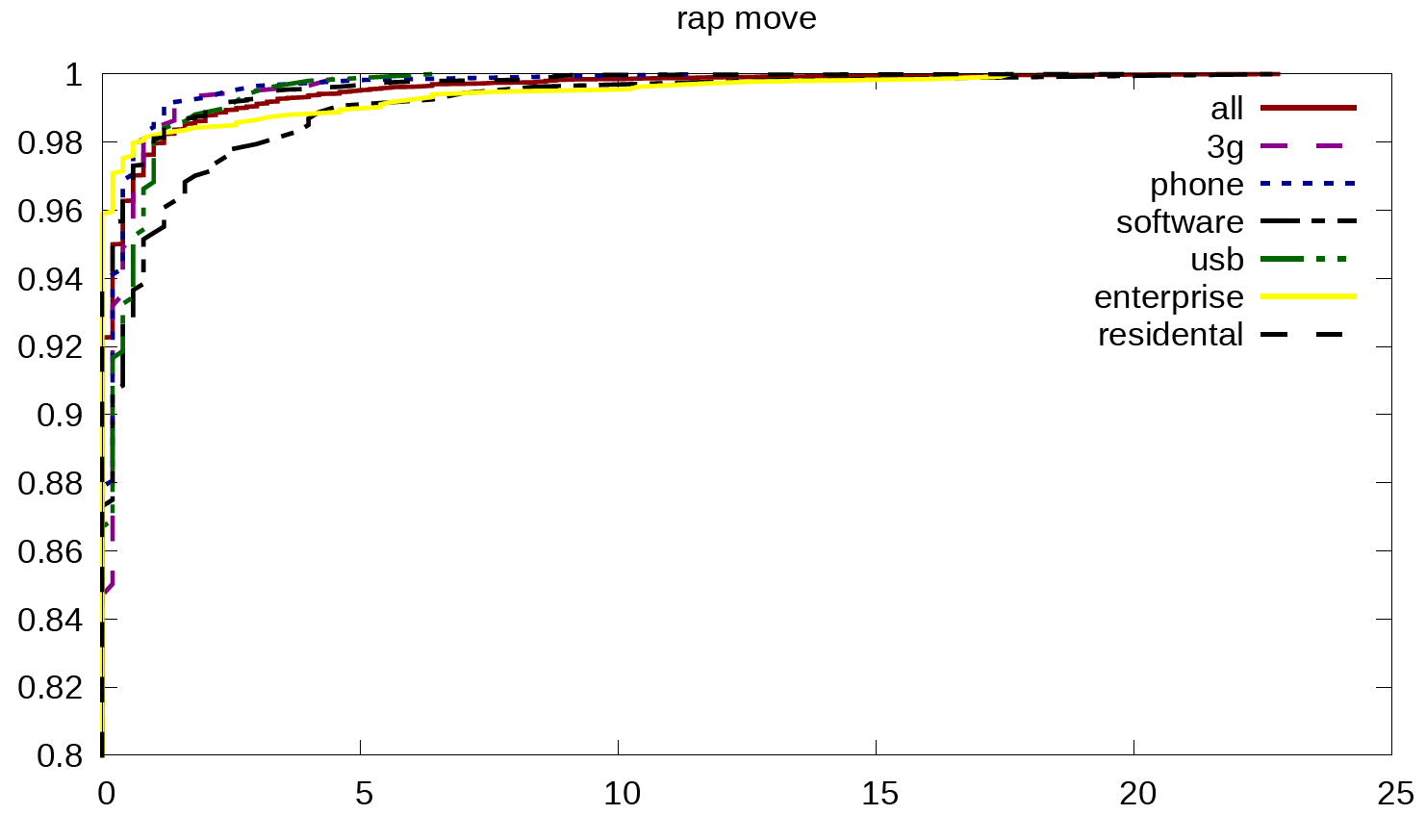
RAP Mobility
RAP has relatively stable channel and location.
Only < 8% of the RAPs are actually mobile.
Fake Move! Because some Enterprise AP use Extender to share one MAC.
Notes:
Also we find that the RAP has relatively stable channel and location. Only less than 8% of the rogue Aps are actually mobile. Fake Move! Because some Enterprise AP use Extender to share one MAC.

