Slide 1

Avoiding the Rush Hours:
WiFi Energy Management via Traffic Isolation
Justin Manweiler
Romit Roy Choudhury
ACM MobiSys 2011

Slide 2
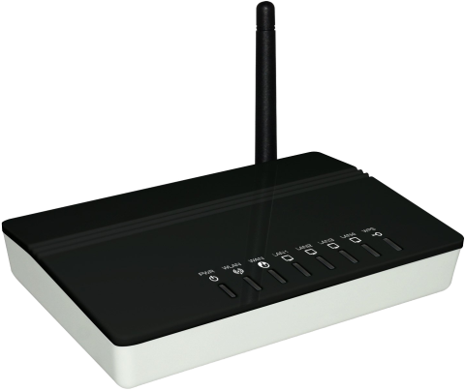
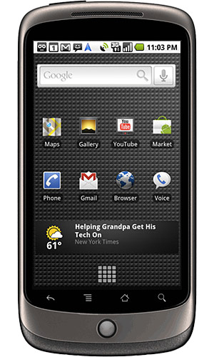
WiFi
: Saving Energy through Sleep
Between packet bursts, WiFi switches to low-power sleep mode
Zzz…
Zzz…
Time

Slide 3
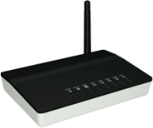




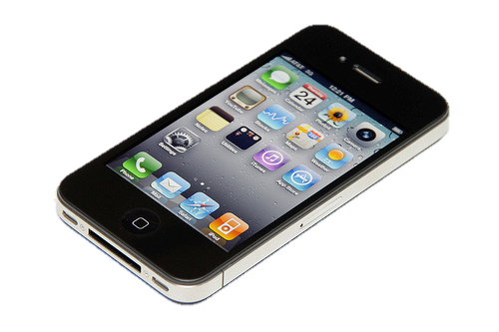
WiFi Sleep Under Contention
Zzz…
Zzz…
Time
Zzz…
Zzz…
Time

Slide 4

Beacon Wakeups
Bad wakeups =
burst contention
Traffic
Download
Key intuition: move beacons, spread apart traffic, let clients sleep faster

Slide 5
Measurements
Zzz…
Zzz…
vs
Energy performance on modern WiFi smartphones

Slide 6
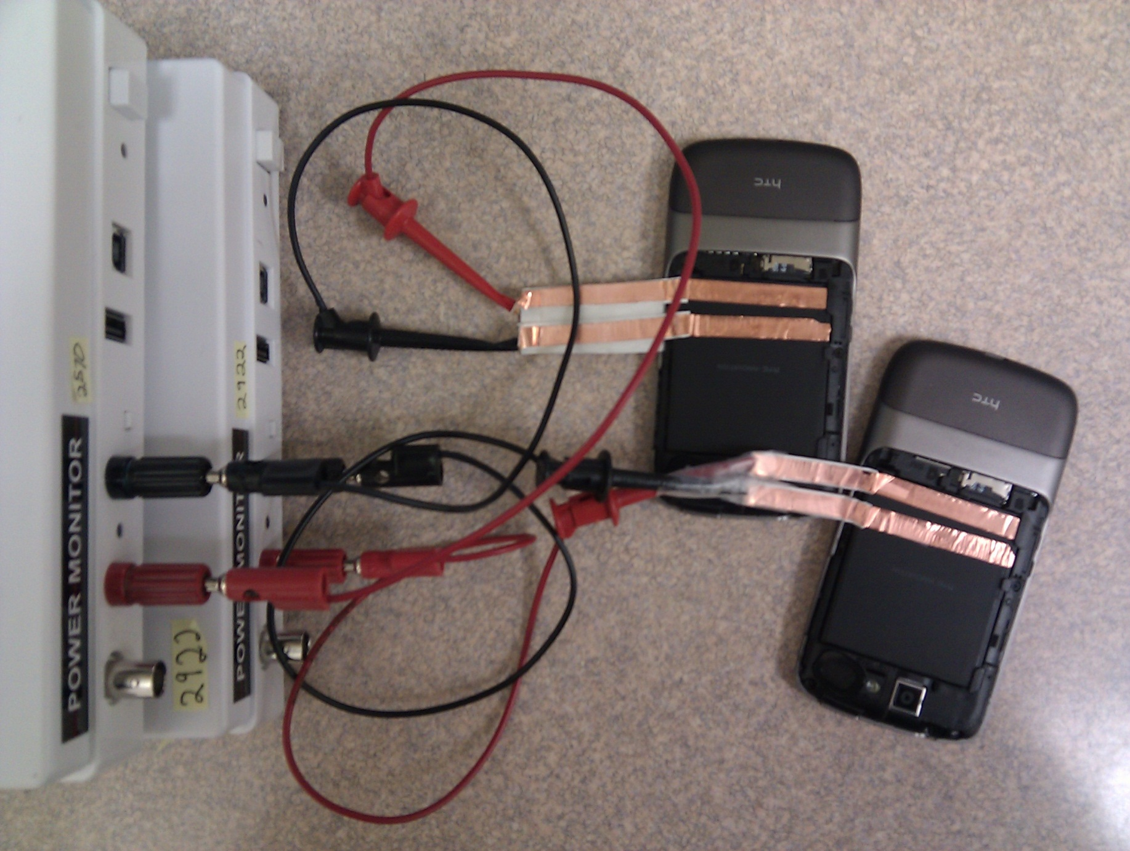
Measuring Power on Nexus One
Simultaneous measurements at 5K hertz

Slide 7
Energy Profile of Nexus One
Transmit/Receive
Beacon
Wakeups
Idle/Overhear
Deep
Sleep
Light Sleep
With contention:
↑ Idle/Overhear, ↓ Sleep

Slide 8
Energy Cost of Contention
Energy costs grow with number of contenders
File Download
Denser Neighborhood

Slide 9
Activity Percentages
Increasing time in
Idle/Overhear
Time
Transmit/Receive

Slide 10
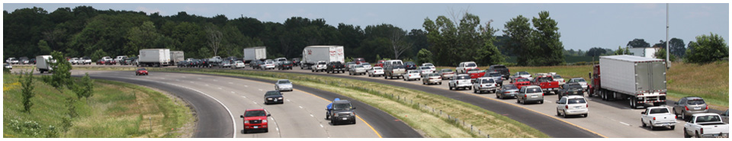
SleepWell Design
Seattle 520 bridge
Wakeup later / go home later
Smarter commute = save gas
Smarter beacons = save battery
Avoiding the rush hours to save energy

Slide 11
SleepWell Techniques
Traffic Monitoring
  APs maintain a map of peers in the wireless vicinity
Traffic Migration
  APs select a new beacon position based on heuristics
Traffic Preemption
  APs avoid traffic spillover into that of neighbors

Slide 12
Traffic Monitoring
beacon & traffic maps for the one-hop neighborhood

Slide 13


Traffic Migration
0
85
Expected share =
100/(n + 1) = 25 ms
75
25
Claim expected share from largest hole
70
CONVERGES
55
55
50

Slide 14
Traffic Preemption
0
75
25
Traffic preemption prevents spillover
50

Slide 15
Key Implementation Challenge
APs need to change the beacon timings
But, no 802.11 protocol support
Fortunately, clients synchronize to AP clocks
AP can change beacon by “lying” about the time
40
Fully 802.11 compatible AP:
Hostapd + modified Atheros Ath9k 802.11n driver

Slide 16

Rescheduling Client Wakeups
“hey client
this beacon is
60ms Late”
OK, I need to
wakeup in 40ms
Right
on time
I’ll adjust
my clock
I know client will
wakeup in 40ms
Yes, delayed
client by 40ms
0
0
Actual
Time
Client Clock
(sync to AP)
50
50

Slide 17
Energy TDMA

Slide 18
Energy Comparison (8AP)
802.11
SleepWell
File Download

Slide 19
Activity Percentages: 802.11
Transmit/Receive

Slide 20
Activity Percentages: SleepWell
Transmit/Receive

Slide 21
Youtube CDF, Instantaneous Power
SleepWell closely matches
zero-contention energy profile
8AP,
SleepWell
8AP, 802.11

Slide 22
Throughput under SleepWell
(per-link TCP on 4 AP testbed)
Negligible performance impact:
SleepWell just reorders traffic

Slide 23
Limitations
Not immediately suitable to interactive traffic (VoIP)
  True of 802.11 PSM in general
Legacy APs lessen energy savings
  Won’t preempt for SleepWell traffic
Contention from clients of the same AP
  Considered in NAPman [MobiSys 2010]

Slide 24
Prior Work
WiFi PSM Sleep Optimization
  NAPman, Catnap [MobiSys 10]
  μPM [MobiSys 08]
WiFi Duty Cycling
  Wake-on-Wireless [MobiCom 02] / revisited [MobiSys 07]
  Context-for-Wireless [MobiSys 07]
  Blue-Fi [MobiSys 09], Breadcrumbs [MobiCom 08]
  Also, Turducken, Coolspots, Tailender, etc.
Sensor network TDMA
  Z-MAC [SenSys 05]
  S-MAC [INFOCOM 02]

Slide 25
Conclusion
to
Zzz…
Zzz…
PSM is a valuable energy-saving optimization
But, PSM designed with a single AP in mind
Multiple APs induce contention, waste energy
Staggered wakeups → clients sleep through contention
SleepWell = PSM made efficient for high-density networks

Slide 26
Thank you!
Questions?
cs.duke.edu/~jgm
jgm@cs.duke.edu

