Slide 1

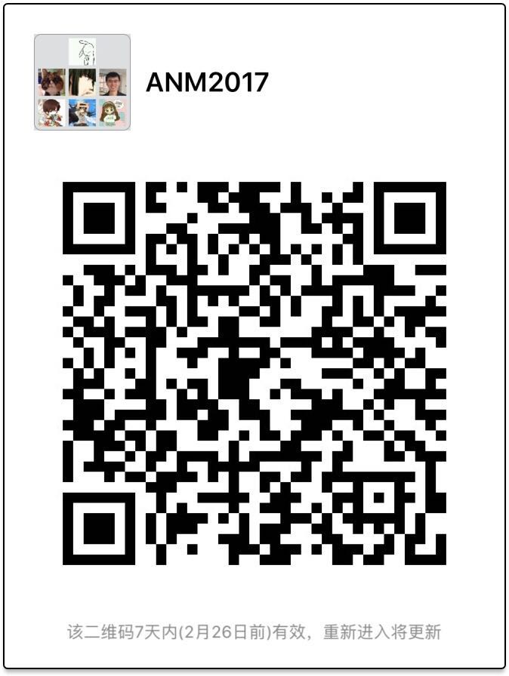

Advanced Network Management course#: 80240663
Spring 2017
Instructor: Dan Pei
peidan@tsinghua.edu.cn
Teaching Assistants:
Minghua Ma mmh16@mails.tsinghua.edu.cn
Yuan Meng myy0430@gmail.com
Please scan QR code to join class WeChat Group

Slide 2
Roadmap
Self-Introduction
Course Logistics
What is Network Management?
Course Projects
Computer Network Basics

Slide 3


How to pronounce “Pei”?
Just pronounce “Pei” as “Pay”
In fact, just call me “Dan”
I-M Pei: the famous architect who designed the glass pyramid
Louvre Museum

Slide 4
About the Instructor
Tenured Associate Professor. UCLA Ph.D. Joined Tsinghua CS Department in December 2012, with Government Endorsement (“ Recruitment Program of Global Talents”)
Homepage: http://netman.cs.tsinghua.edu.cn/~peidan
Previously a Principal Researcher at AT&T Research, a co-founder and founding CEO of a mobile health company in Beijing, before joining Tsinghua.
Supervised interns from CMU, Cornell, Princeton, UCLA, GaTech, Michigan, Northwestern etc. Now @ Google, MSR, IBM, Ohio State, Northeastern, HKUST etc. Currently supervising~20 of Ph.D. and M.S. students at Tsinghua
80+ Papers, 23 issued US Patents, ACM/IEEE Senior Member
Current research focus: Intelligent Operations through Machine Learning

Slide 5
Course Requirements
Goal: How to build intelligent operations system for the Internet
http://netman.cs.tsinghua.edu.cn/~peidan/ANM
Prerequisites: You are expected to be familiar with at least one programming language.
  If not, please quickly learn one, e.g. Python.
Encourage interaction and discussion --- stop me and ask questions at any time!

Slide 6
Course Info
Time:14:20pm-16:55pm every Monday
  Session 1: Network Basics, Machine Learning Basics
  Sessions 2 &3: Case Studies based on Conference Papers
Office Hours:
  After every class.

Slide 7
Grading:
Attendance: 10%
  Presence & Discussion during lecture.
Project: 90%
  5 tasks(10%,10%,10%,15%,15%, 30%)
  Presentation: 10%
A project team of 2 or 3 students
The final grade will be in letter grading scale (e.g., A,B,C,D)

Slide 8
Roadmap
Self-Introduction
Course Logistics
What is Network Management?
  Motivation
  Coverage
  Example research projects
Course Projects
Computer Network Basics

Slide 9



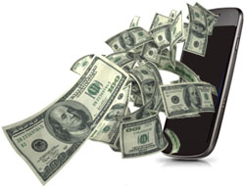
Example: Mobile Apps
Mobile apps are increasingly important for our daily lives
Faster response
Quality of
Experience (QoE)
Expect
Less energy
Less mobile data
Credits: Qi Alfred Chen’s IMC 2014 talk

Slide 10








> 1.5 Million Apps
> 300,000 Developers

Slide 11
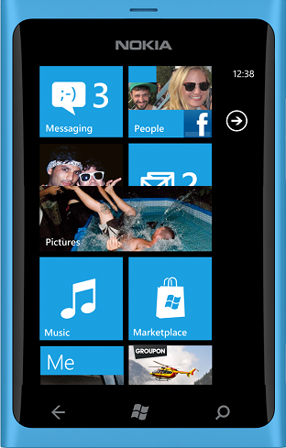


There’s an App
For That
But its slow
“… Too slow - killing the usefulness when you really need to go.”
Credits: Lenin Ravindranath’s OSDI 2012 talk

Slide 12







“So slow. Did an intern write this app??”
“Slower than a snail.”
“Slow and unresponsive like mud”
“Sluggish and freezes my HTC phone.”
“Very very slow compared to even browsing web.”
“Consistently 3 seconds behind where I touch.”
“Loading GPS data is *** slow”
Credits: Lenin Ravindranath’s OSDI 2012 talk

Slide 13
“So slow. Did an intern write this app??”
“Slower than a snail.”
Diverse environmental conditions
  Network connectivity, GPS signal quality, etc
Variety of hardware and OS versions
Wide range of user interactions
“Slow and unresponsive like mud”
“Sluggish and freezes my HTC phone.”
“Very very slow compared to even browsing web.”
Hard to emulate in the lab
“Consistently 3 seconds behind where I touch.”
“Loading GPS data is *** slow”
Performance problems are inevitable in the wild
Credits: Lenin Ravindranath’s OSDI 2012 talk

Slide 14

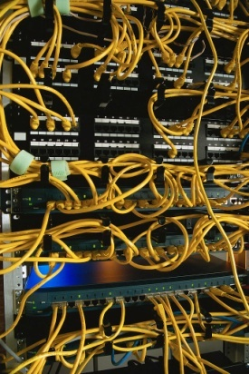








Complex Architecture of End-to-end Mobile Internet
Software/hardware
faults/bugs
Large-scale complex
applications
hundreds of devices
Dozens of device types

Slide 15
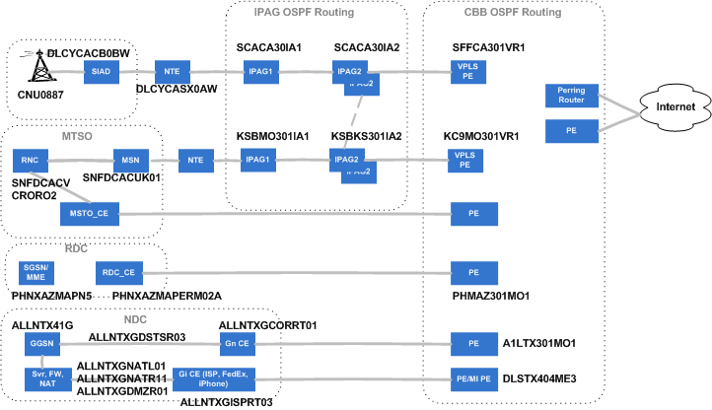
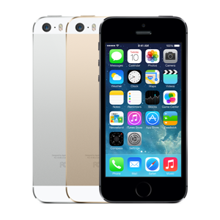
Complex Access Networks

Slide 16
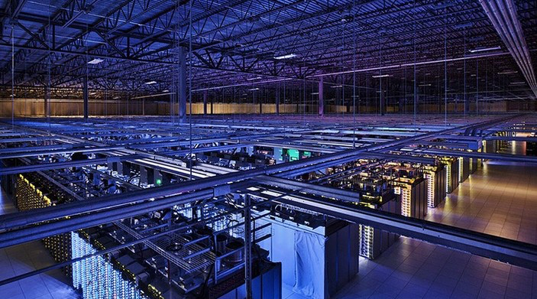
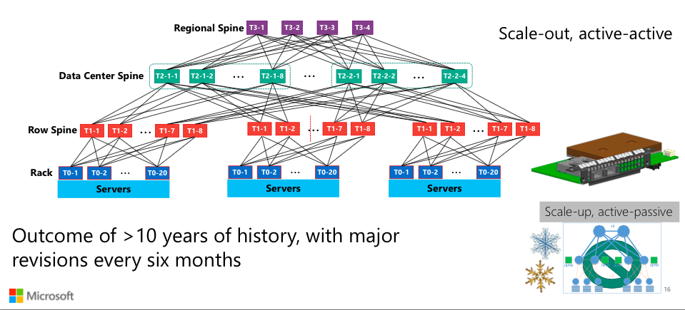
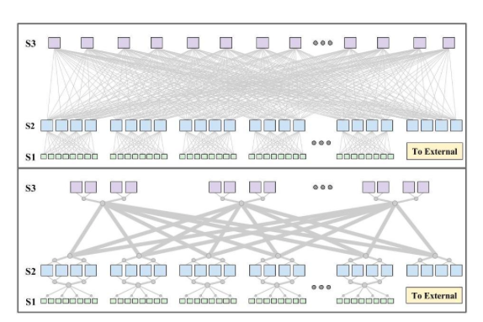
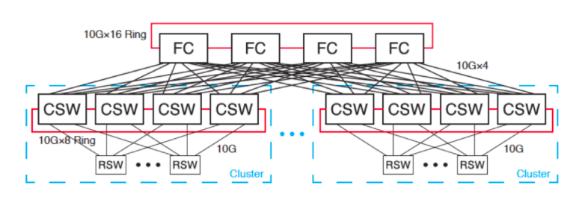
Complex Data Center

Slide 17
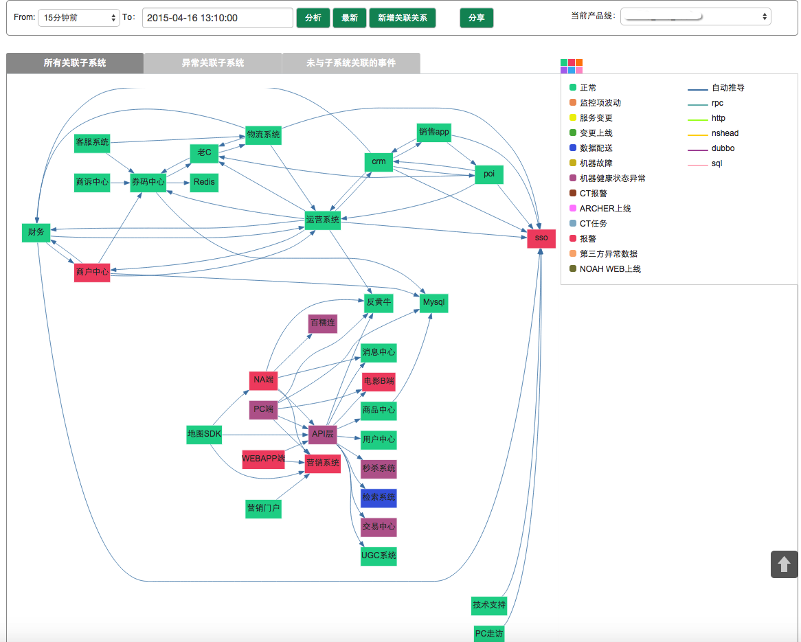
Complex Software Module Dependences
Query
Result
CDN DNS
TDO
BGW
BFE
PR-Nginx
UI-Nginx
VUI
ECOM
US
GSS
RS
ATTR DX
DA
AC
NDI
DISP DX
BC
BC
BS
BS
BS
BS
Notes:
Baidu: 2 万个

Slide 18
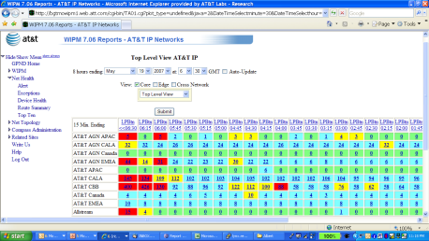
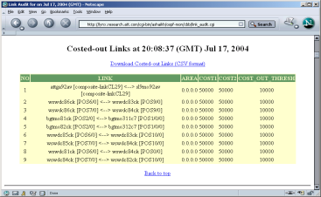
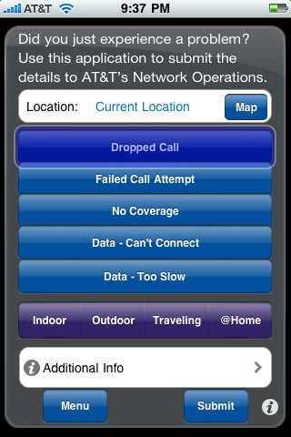


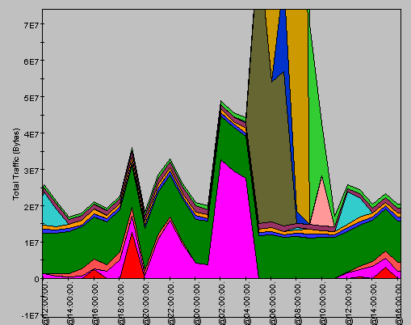
Network Management: blessed (by the value ) and doomed (by the volume, velocity, and variety ) of Big Data
End to end
service monitoring
(e.g., GSTool, RCAT,
WIPM)
Performance counters
(e.g., Compass, Optima)
Logs (workflow,
syslogs)
Routing
events (OSPF)
Lower layers
(e.g., SONET,
CNI)
Customer issues
(MTS, tickets, tweets)
Alarms, tickets
(e.g., Netcool, AOTS)
Troubleshooting
Customer
trouble tickets
Network
alerts
Network
Customers
Notes:
So many data that it appears that you can find clues for any problems.
Two many data to process efficiently and rapidly.

Slide 19


Mobile Application Performance Application: a vertical application of Big Data Analytics
Goals of
Internet Service
Management
Performance data
?
Automatic Operation
Less Manpower
Useful Insights
Better Designs
High Performance
More Revenue
New Opportunities
…
It is hard because it needs：
-- three types of expertise
-- collaboration between three types of people
(Developer)
Engineering
Python, Java…
Database, Visualizations
Hadoop, Spark, etc.
User behavior data
Social data
Big Data
Analytics
(Data Scientist)
Science
Clustering, Statistics, Classification, Association
(Domain Expert)
Domain
Knowledge
Networking, Web,
Wireless, Video
Commercial data
…
Credits: Dapeng Liu’s talk on Service Management
Notes:
In order to apply machine learning in the service management, we need different skills.
First, we should have knowledge of machine learning, such as classification, clustering,
so we know how to think a problem and how to exploit the data.
We also need engineering experience, so we can process the data and build related systems effectively.
Last, we also need the domain knowledge about the fields we study, for example, if we are solving a problem in a networking system, we should know how the system works, like the architectures and the protocols; and if we are faced with a Web service, we need to know how a Web page is generated and how it is delivered to users.

Slide 20




Collaborative iteration is slow
--- we need more automation!
Collaborative iteration
Excel, SQL
discuss on the goals from domain experts
data scientists define the precise goal and tell developers
Developers build the algorithms
Traditional iteration
goal
No
Micro-iteration
Satisfied ?
Graph and Table
Data scientists and developers propose new solution
Data scientist satisfied with the algorithms?
Unsatisfied or new requiremen?
Iteration
No
Yes
Yes
Domain experts satisified?
algorithm/system integration
report
Credits: Mingxuan Ni’s talk on Big Data 3.0

Slide 21
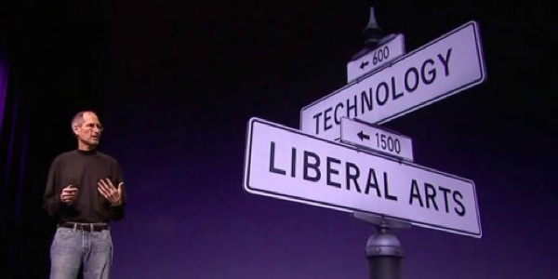
Creation of Apple Products:
Intersection of technology and liberal arts
The chase of the arts drives the technology to the extreme

Slide 22
Big Data Analytics = Science + Engineering + Arts
Arts
Engineering
Science
？
Why Arts?
  A Data Analytics Product has no precise definition or parameters at the startup of the project.
  Need to experiment on different analytical models and methods.
  New ideas are also born during try-and-err.
Larger Weights on Arts
  Technology can gradually solve science and engineering problems, but cannot do much in arts
  Computer/Engineering cannot replace artists, but could provide better tools for artists.
The ultimate goal of Big Data technology:
Automate as much as possible such that Artists (domain experts) can independently conduct data analysis
Credits: Mingxuan Ni’s talk on Big Data 3.0

Slide 23
Roadmap
Self-Introduction
Course Overview
What is Network Management?
  Motivation
  Coverage (See ANM Website)
  Example research projects
Course Projects
Computer Network Basics

Slide 24
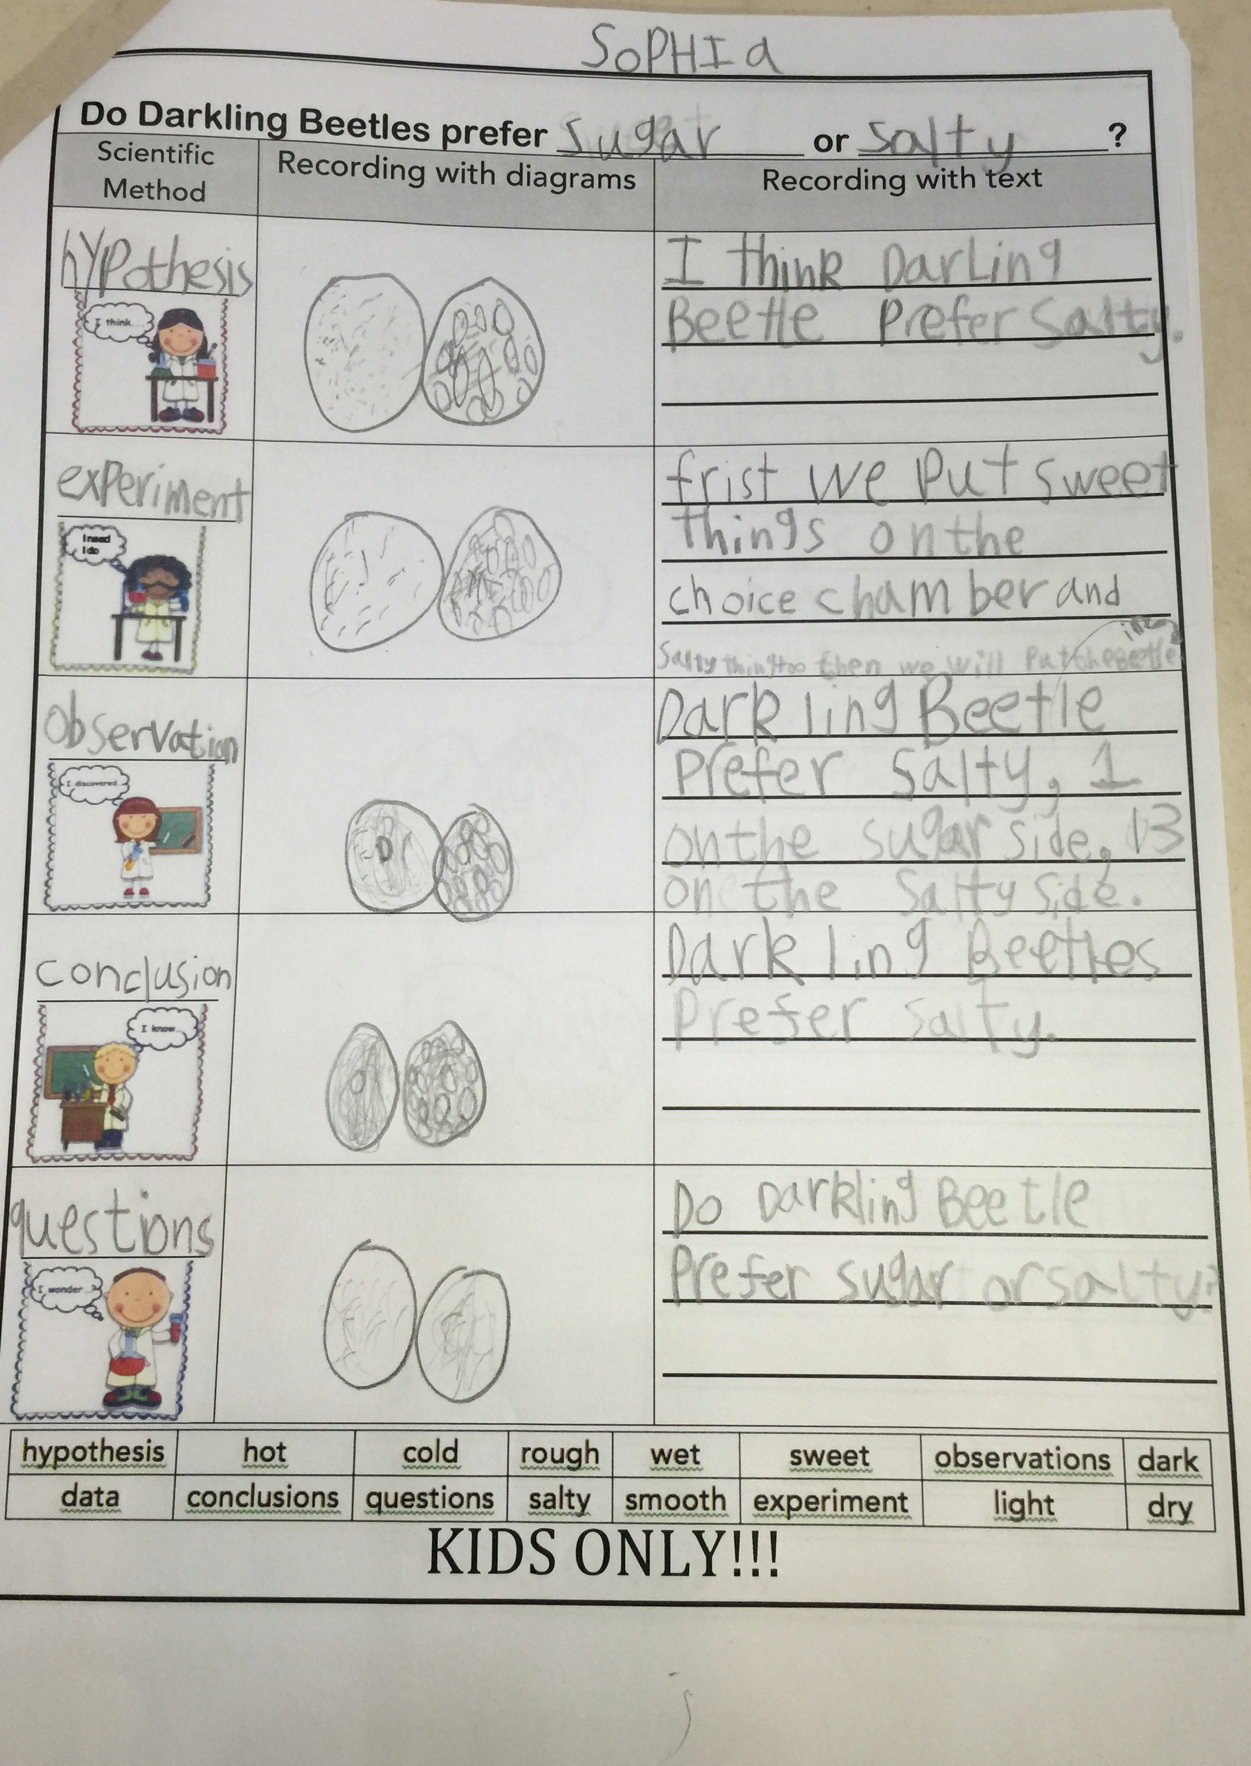
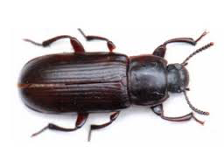
Scientific Experiment for a first grader

Slide 25
Experiments in Network Management
Have a hypothesis: Y increases when A increases, B decreases, or C&D together satisfy some conditions
Design experiments (process the data):
  Exploratory visualization using scatter plot, average bar/line; candle-stick, where y-axis is Y; x-axis is A (sometimes binned)
  Pearson/Kendall/Spearman Correlation: see if Y is correlated with A, B, based on the correlation score
  Linear Regression: find the co-effient Y=alpha + beta * A
  Information Gain: If A, B, C, D has any influence on Y
  Decision Tree: C>20& D<=5→Y is bad;
  Regression Tree: Y=alpha + beta *C + gamma*D if A>5 & D<=10
  Feature engineering, feature selection, model selection
  Machine learning: random forest etc.
  Deep learning
Observations
  E.g. Y increases when A increases; when C increase by s%, Y will increase by t%; explain why.
Conclusions

Slide 26
Papers and Slides
Already Posted on the course website
Lecture Coverage
  You were supposed to read these papers carefully
Reading List
  Relevant papers, read them if you have time

Slide 27
Why reading papers?
Purpose: background knowledge, algorithm, methodology, writing, principle, solution inspiration, evaluation methodology for the problem you are working on, and (sometimes) vision.
My strongly biased personal opinion: Papers are not for finding topics for your next paper.

Slide 28
What’s a good paper
  A new and important problem, solid solution.
  Old and challenging problem, a new simple but elegant solution, with straightforward insight and intuition behind it.

Slide 29
Using Google Scholar to find relevant papers (demo)
Browse latest proceedings of relevant conferences, find one relevant paper p. Relevant paper set S={p}
for (each new p in S) {
  Browse p’s references, and put relevant ones into S;
  Browse p’s citations in Google Scholar, and put relevant ones into S;
}

Slide 30
Roadmap
Self-Introduction
Course Logistics
What is Network Management?
  Motivation
  Coverage
  Example research project: Intelligent Operations through Machine Learning
Course Projects
Computer Network Basics

Slide 31
Roadmap
Self-Introduction.
Course Logistics
What is Network Management?
Course Projects
Computer Network Basics

Slide 32
Enjoy the course!

