Slide 1
Exploratory Experiment through Visualization
Dan Pei
Advanced Network Management, Tsinghua University

Slide 2
Roadmap
Background
Motivating Example: Storytelling with data
Introduction to Data Visualization
Microsoft PowerBI Demo

Slide 3
The value of data visualization
The ability to take data—to be able to understand it, to process it, to extract value from it, to visualize it, to communicate it—that’s going to be a hugely important skill in the next decades, ... because now we really do have essentially free and ubiquitous data. So the complimentary scarce factor is the ability to understand that data and extract value from it.
Hal Varian, Google’s Chief Economist
The McKinsey Quarterly, Jan 2009
Slides adopted from CSE 512 – Data Visualization, University of Washington, by Jeffrey Heer

Slide 4
What is Visualization?
“Transformation of the symbolic into the geometric” [McCormick et al. 1987]
“... finding the artificial memory that best supports our natural means of perception.” [Bertin 1967]
“The use of computer-generated, interactive, visual representations of data to amplify cognition.” [Card, Mackinlay, & Shneiderman 1999]
Slides adopted from CSE 512 – Data Visualization, University of Washington, by Jeffrey Heer

Slide 5
Why Create Visualizations?
Answer questions (or discover them)
Make decisions
See data in context
Expand memory
Support graphical calculation
Find patterns
Present argument or tell a story
Inspire
Slides adopted from CSE 512 – Data Visualization, University of Washington, by Jeffrey Heer

Slide 6
Experiments in Network Management
Have a hypothesis:
Y increases when A increases, B decreases, or C&D together satisfy some conditions
Design experiments (process the data):
Exploratory visualization using scatter plot, average bar/line; candle-stick, where y-axis is Y; x-axis is A (sometimes binned)
Pearson/Kendall/Spearman Correlation; see if Y is correlated with A, B, based on the correlation score
Linear Regression; find the coeffient Y=alpha + beta * A
Information Gain; If A, B, C, D has any influence on Y
Decision Tree,C>20& D<=5→Y is bad;
Regression Trees. Y=alpha + beta *C + gamma*D if A>5 & D<=10
Feature engineering, feature selection, model selection
Machine learning: random forest etc.
Deep learning:
Observations，e.g.:
Y increases when A increases;
when C increase by s%, Y will increase by t%;
Conclusions

Slide 7
Why Create Visualizations?
Answer questions (or discover them)
Make decisions
See data in context
Expand memory
Support graphical calculation
Find patterns
Present argument or tell a story
Inspire
Slides adopted from CSE 512 – Data Visualization, University of Washington, by Jeffrey Heer

Slide 8
Story Telling with Data
Figures copied from the book
“Story Teling with Data – a data visualization guide for business professionals”
By Cole Nussbaumer Knaflic

Slide 9
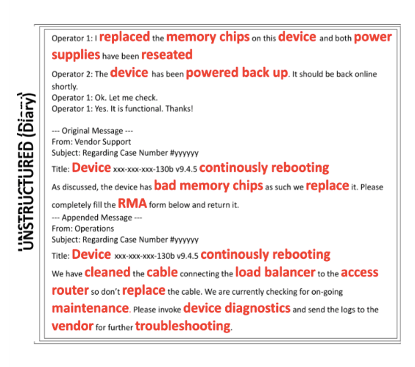
Background Information: “Ticket” in IT maintenance

Slide 10
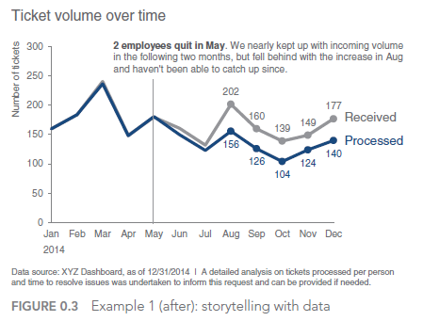
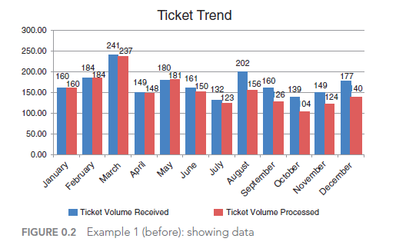
Story Suppose you manage an IT team and want to show the volume of incoming tickets exceeds your team’s resources

Slide 11
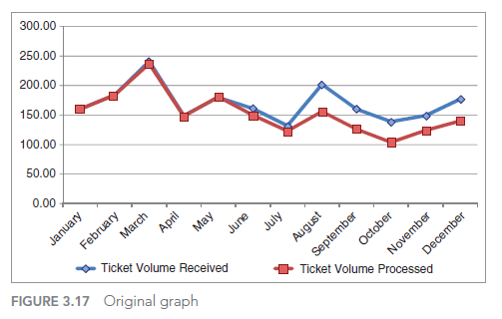
De-cluttering: step‐by‐step

Slide 12
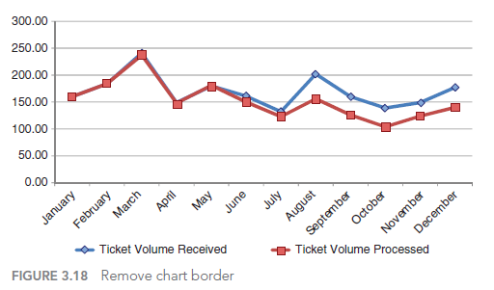
De-cluttering (1): Remove chart border

Slide 13
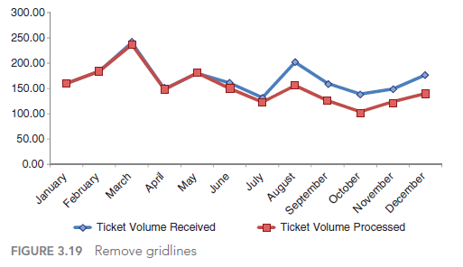
De-cluttering (2): Remove gridlines

Slide 14
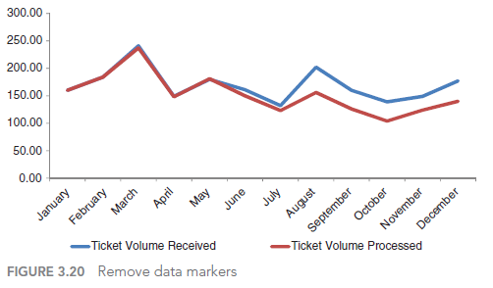
De-cluttering (3): Remove data markers

Slide 15
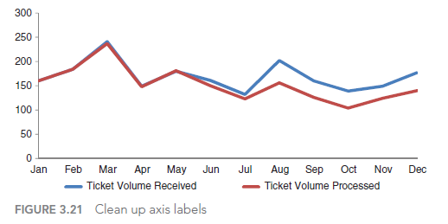
De-cluttering (4): Clean up axis labels

Slide 16
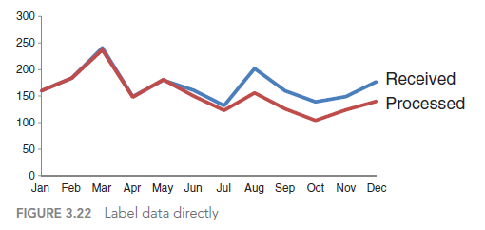
De-cluttering (5): Label data directly

Slide 17
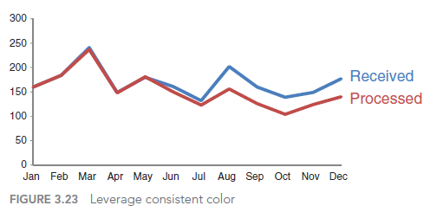
De-cluttering (6): Leverage consistent color

Slide 18
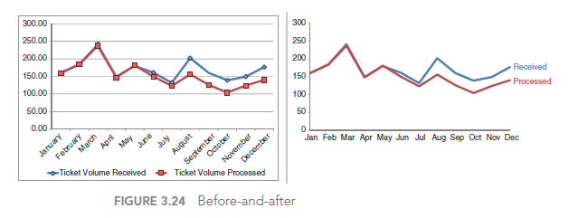
Are we done yet?

Slide 19
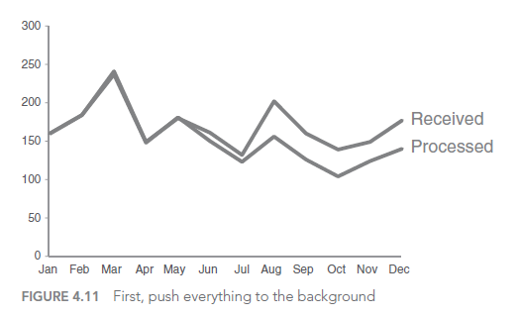
Focusing audience’s attention (1): Push everything to the background

Slide 20
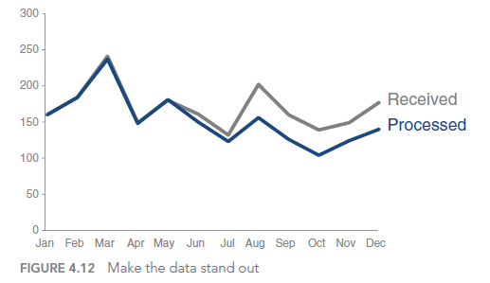
Focusing audience’s attention (2): Make the data stand out

Slide 21
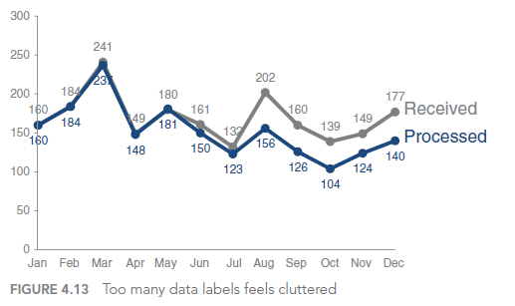
Focusing audience’s attention (3): Too many data labels feels cluttered

Slide 22
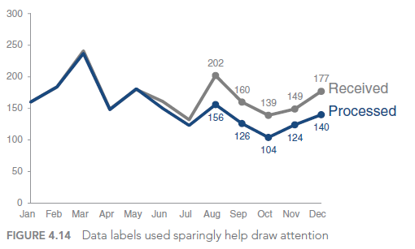
Focusing audience’s attention (4): Data Labels used sparingly help draw attention

Slide 23
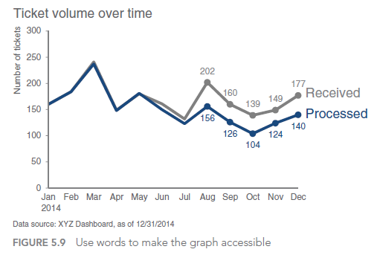
Use words to make the graph accessible

Slide 24
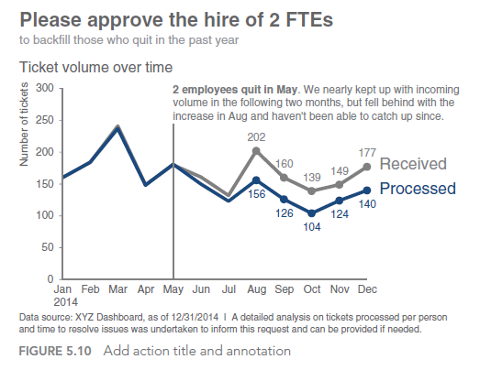
Add action title and annotation

Slide 25
Roadmap
Background
Motivating Example: Storytelling with data
Introduction to Data Visualization
Microsoft PowerBI Demo

Slide 26
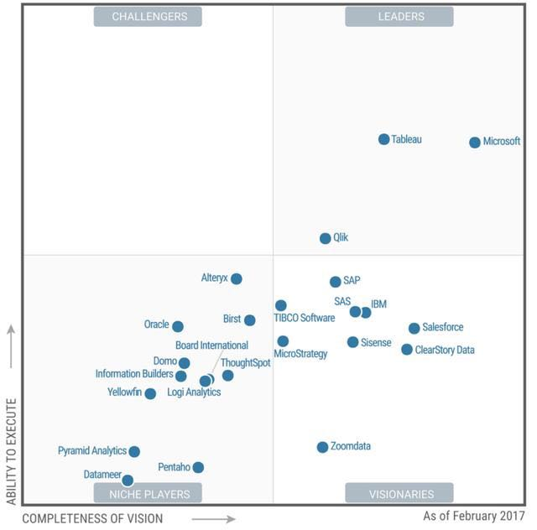
Where Power BI is in the Gartner magic quadrant

