Slide 1



Demystifying the Dark Side of the Middle
A Field Study of Middlebox Failures in Datacenters
Rahul Potharaju (Purdue University)
Navendu Jain (Microsoft Research)
October 23-25, 2013
IMC 2013

Slide 2
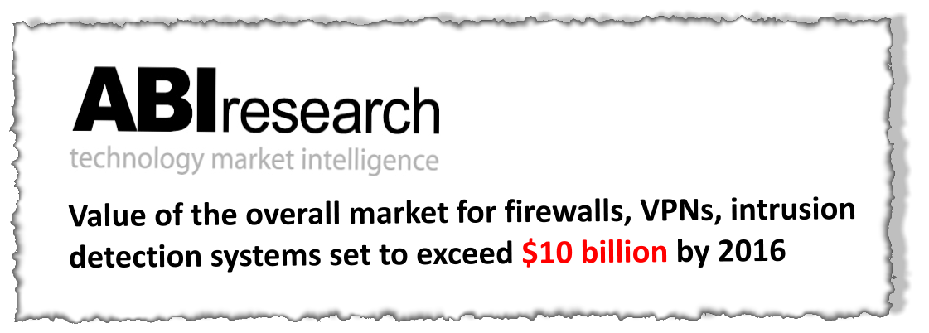
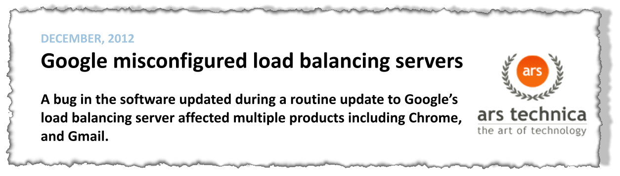
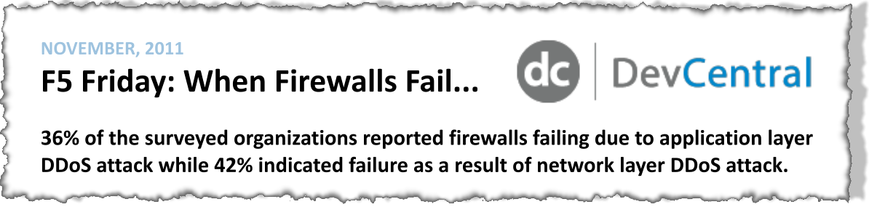
Middlebox reliability – Where do we stand today?
Contribute to 43% of high severity incidents despite being 11% of the population
AIM: Understand middlebox failures to improve service reliability
Source: High-Severity Incidents 2008-12

Slide 3








Inside a Datacenter
INTERNET
IDPS
IDPS
Access routers/
Core fabric
VPN
VPN
1:1 network redundancy
FIREWALL
FIREWALL
LOAD
BALANCER
LOAD
BALANCER
Aggregation switch
Top of Rack (ToR) switch
Note: Other configurations are possible e.g., firewalls at the network edge.
Servers

Slide 4
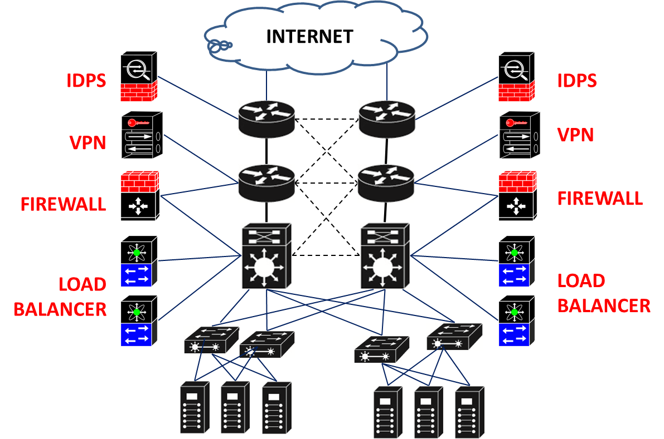
Aim: Data driven approach to improve middlebox reliability
Q1: Middlebox Failure Characteristics
How reliable are middleboxes?
How often do they fail and for how long?
?
Q2: Failure Root Causes
What causes middlebox failures?
What are the main resolution actions?
?
Q3: Middlebox Redundancy
Is middlebox redundancy 100% effective in masking failures?
Redundancy Group

Slide 5
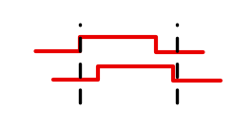

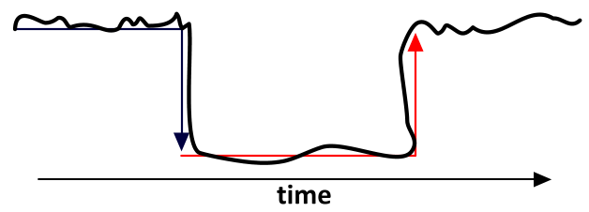
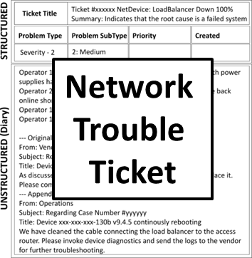
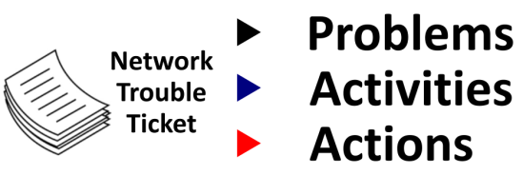

Extracting Impactful Failures
How to define a middlebox failure?
Faulty load balancers cause throughput loss
Misconfigured firewalls incorrectly forward traffic
Link Down
Switch
SYSLOG/SNMP Events
(July 2010-2012)
1.96M raw events
Firewall
What caused the failure?
1
Errr… did a service get impacted?
CHALLENGE:
How to remove duplicate events?
T1: Switch B is down
T2: Switch B is down
T3: ……………………….
Time-based Grouping
Switch B
T1: Switch B is down
T2: Switch B is up
T3: Switch B is down
2
CHALLENGE:
How to measure failure impact?
Failure Impact?
?
Overlapping Events
Switch A
Traffic Impact
Event A
Pick earliest
end time
Event B
3
CHALLENGE:
How to determine problem root cause?
Switch C
Pick earliest
start and
end time
Functional Impact
Event A
Event B
?
NOISY/REDUNDANT MESSAGES
Impactful Failures + Problem Root Causes
TIME
5

Slide 6
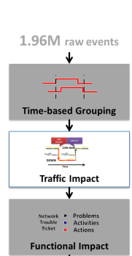
How to measure traffic impact?
KEY CHALLENGE-1
How do you compare the traffic distributions before and during the failure?
Traffic flowing on a link
LINK DOWN
Option 2: Large time window
(e.g., time of day, daily, weekly)
Problem: May be susceptible to time of day effects and assumes long-term predictability of traffic
Option 1: Small time window
(e.g., 5 minutes, 10 minutes)
Problem: May be susceptible to bursty traffic
Traffic before the failure
Traffic during the failure
Larger Time Window
Smaller Time Window
Time
KEY CHALLENGE-2
What time window to pick to compute the traffic distributions?

Slide 7

Traffic Impact: Use Mann-Whitney-Wilcoxon Test
KEY CHALLENGE-1
How do you compare the traffic distributions before and during the failure?
KEY CHALLENGE-1
How do you compare the traffic distributions before and during the failure?
Traffic flowing on a link
LINK DOWN
Traffic before the failure
Traffic during the failure
Time
Parameterize the time window size and compute the accuracy
KEY CHALLENGE-2
What time window to pick to compute the traffic distributions?
KEY CHALLENGE-2
What time window to pick to compute the traffic distributions?

Slide 8
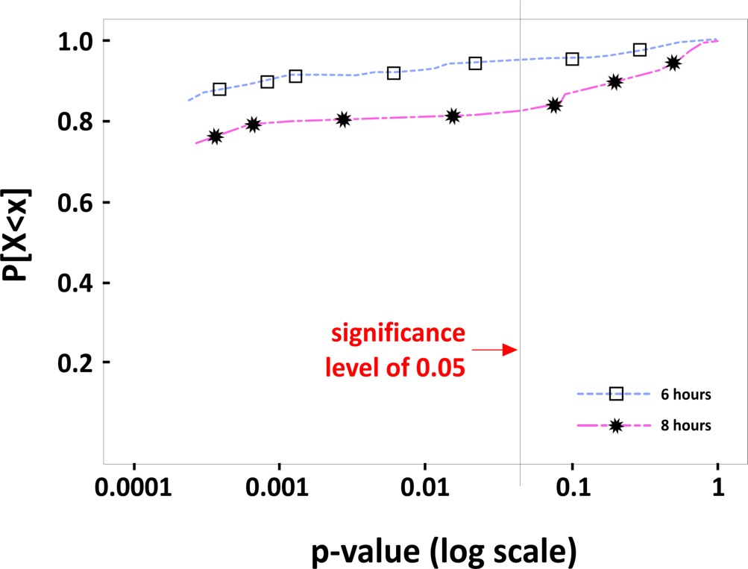

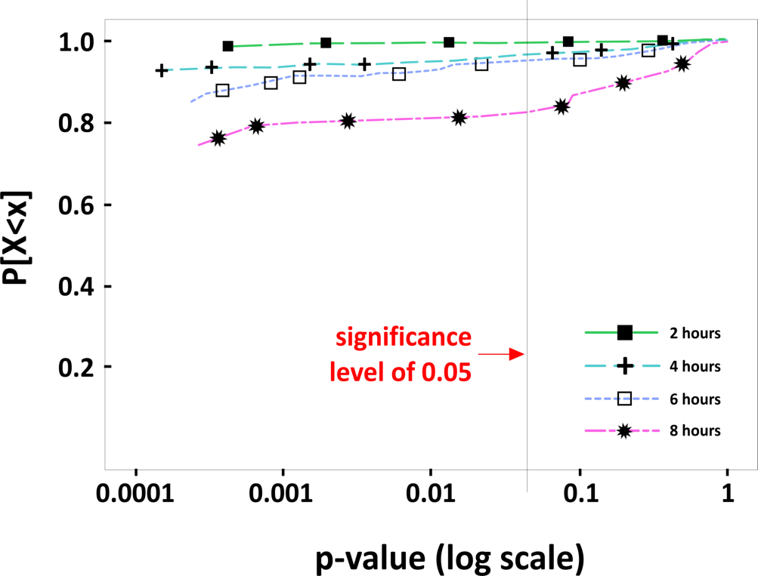
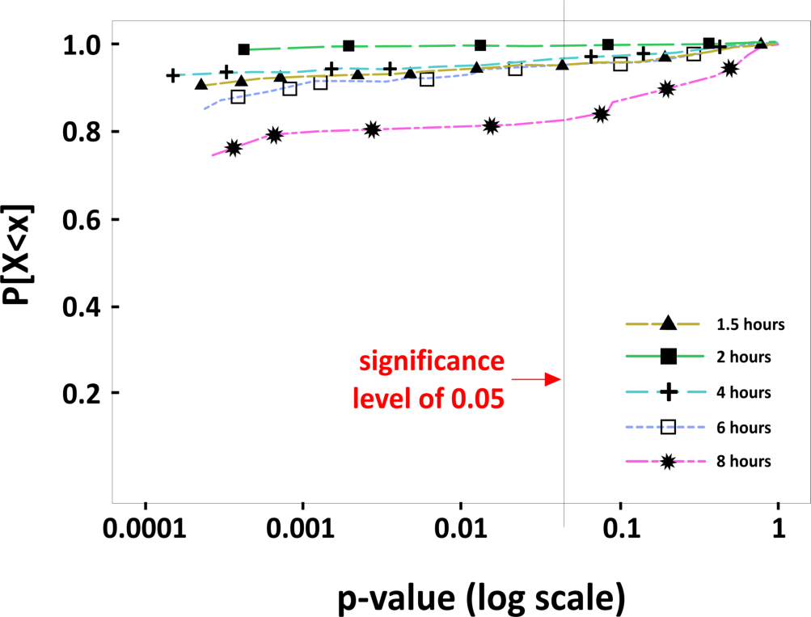
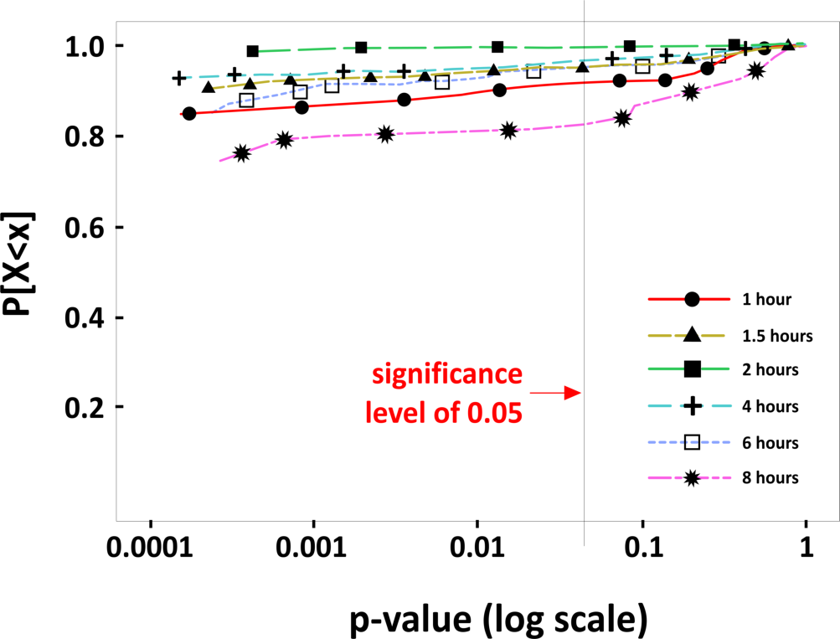
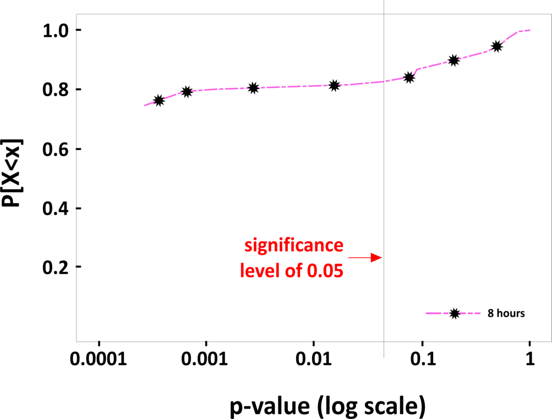
Traffic Impact: Use Mann-Whitney-Wilcoxon Test
Null Hypothesis: Traffic values observed before a failure and during a failure follow the same distribution
Time window
% where p
-
value < 0.05
Time window | % where p-value < 0.05
8 hours | 82.2%
6 hours | 91.1%
4 hours | 92.2%
2 hours | 99.3%
1.5 hours | 91.8%
1 hour | 88.7%
8 hours
82.2%
6 hours
91.1%
4 hours
92.2%
2 hours
99.3%
1.5 hours
91.8%
1 hour
88.7%

Slide 9
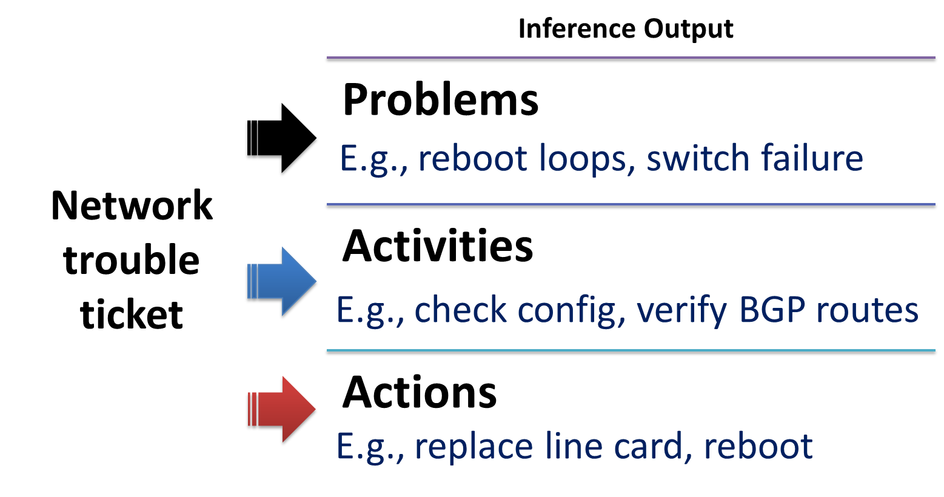
Extracting Impactful Failures
How to define a middlebox failure?
Faulty load balancers cause throughput loss
Misconfigured firewalls incorrectly forward traffic
Link Down
Link Down
Switch
Switch
SYSLOG/SNMP Events
(July 2010-2012)
SYSLOG/SNMP Events
(July 2010-2013)
1.96M raw events
1.96M raw events
Firewall
Firewall
1
1
CHALLENGE:
How to remove duplicate events?
CHALLENGE:
How to remove duplicate events?
Time-based Grouping
NETSIEVE
(NSDI’13)
2
2
CHALLENGE:
How to measure failure impact?
CHALLENGE:
How to measure failure impact?
Traffic Impact
3
3
CHALLENGE:
How to determine problem root cause?
CHALLENGE:
How to determine problem root cause?
Functional Impact
Impactful Failures + Problem Root Causes
Impactful Failures + Problem Root Causes
69K
9

Slide 10
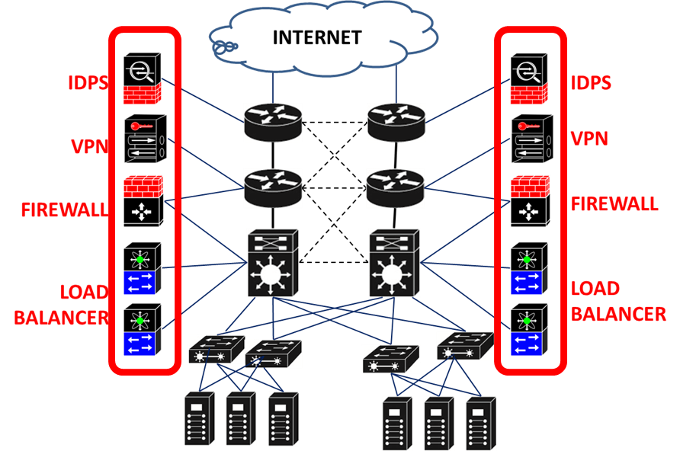
Q1: Middlebox Failure Characteristics
How reliable are middleboxes?
How often do middleboxes fail and for how long?

Slide 11
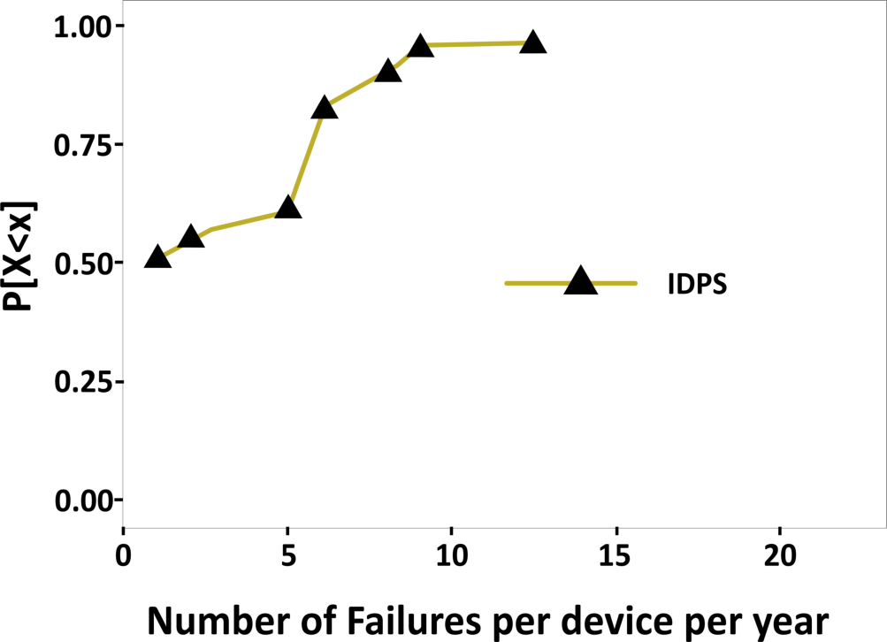
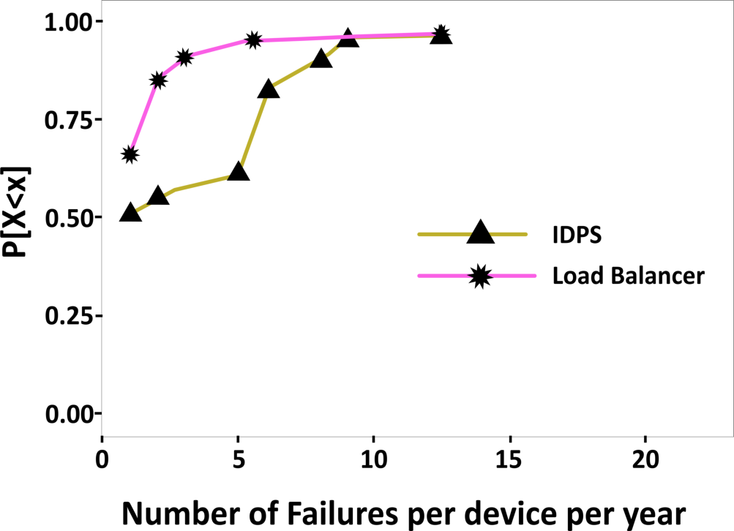
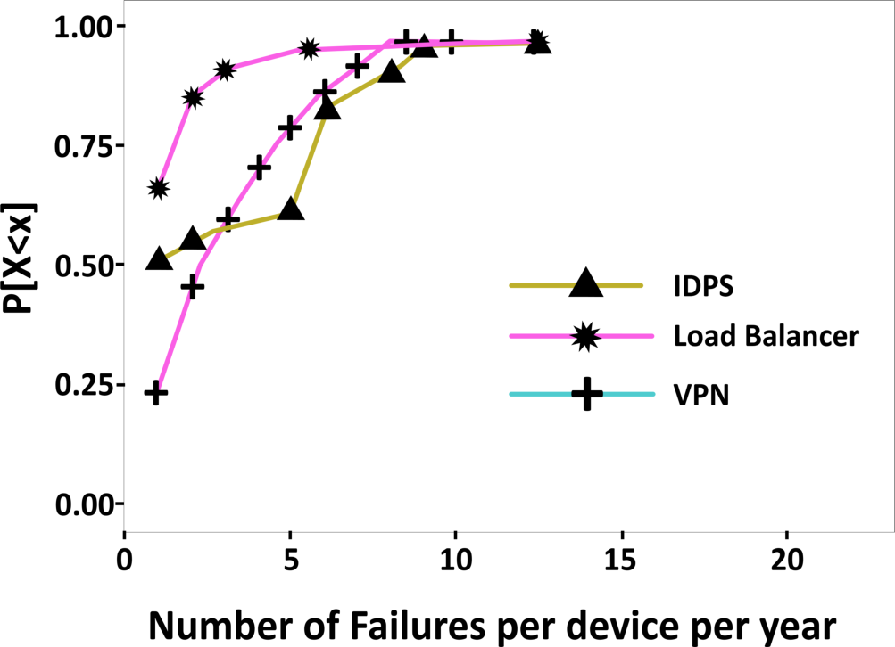
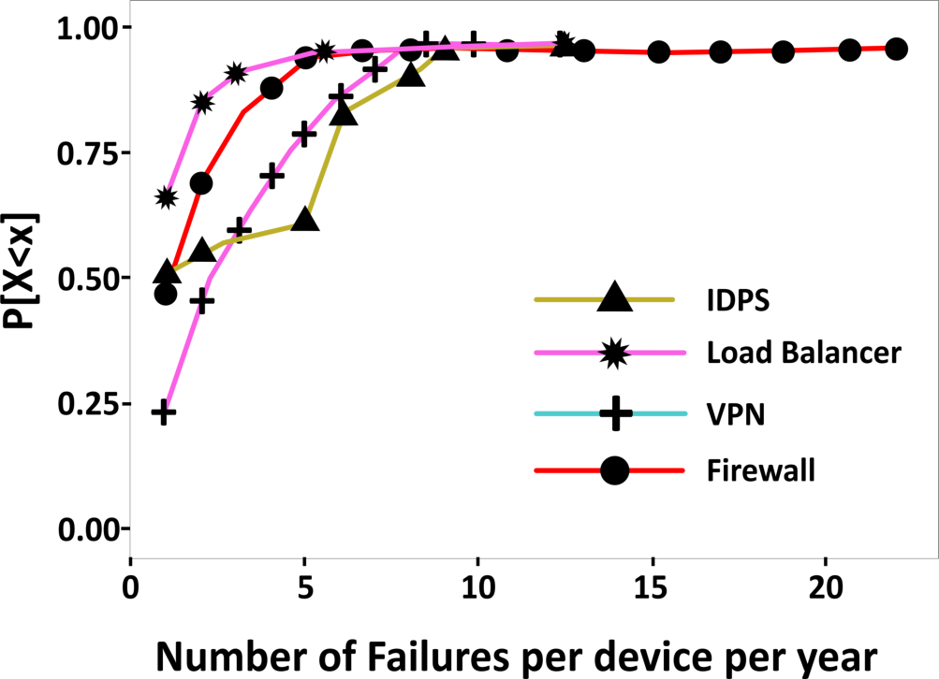
How reliable are middleboxes?
VPNs and Firewalls exhibited similar 95P values of 5-7 annual failures per device
Exhibit the highest 95P value of 8.3 failures per device per year
Exhibit the lowest 95P value of 3 failures per device per year
Firewalls exhibited a long tail of up to 24 failures per device per year
LB-1 and LB-3 – “few bad apples effect”
Faulty power supply units were replaced in isolation over two years
Memory errors masked by the quick-fix solution of reboots

Slide 12
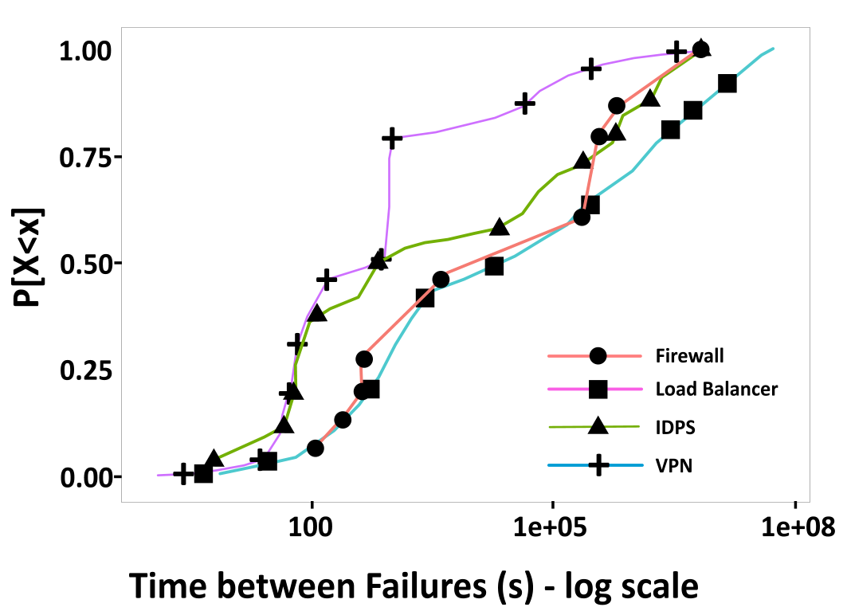
How often do middleboxes fail?
Failure prone devices exhibiting numerous failures within 10s of minutes to a few hours
Robust devices that fail at most once in one or two months
Time between failures (seconds) – log scale

Slide 13
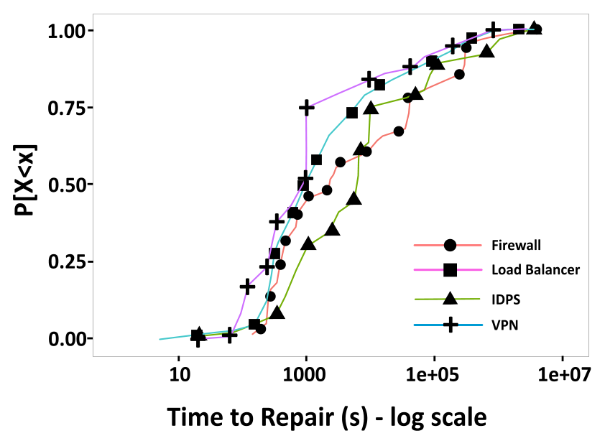
How long do middleboxes fail?
Short-lived transient failures lasting a few minutes
Long-term failures lasting ≈ 1-10 days – hardware replacements or complex software problems
Time to repair (seconds) – log scale

Slide 14
Takeaways: Middlebox Failure Characteristics
Most failures are short-lived
  Grey failures (connectivity errors, link flaps) lasting a few minutes to a few hours
  Long-term failures (hardware faults, software problems) lasting 1-10 days
Median number of annual failures is small (1-3), but there is a long tail
  IDPS exhibit highest annual failures per device (95P value of 8.3) while LBs exhibit lowest (95P value of 3)
Presence of the few bad apples effect
  COV >1 for LB-1 and LB-3
  Firewalls have a relatively long tail of up to 24 annual failures per device

Slide 15
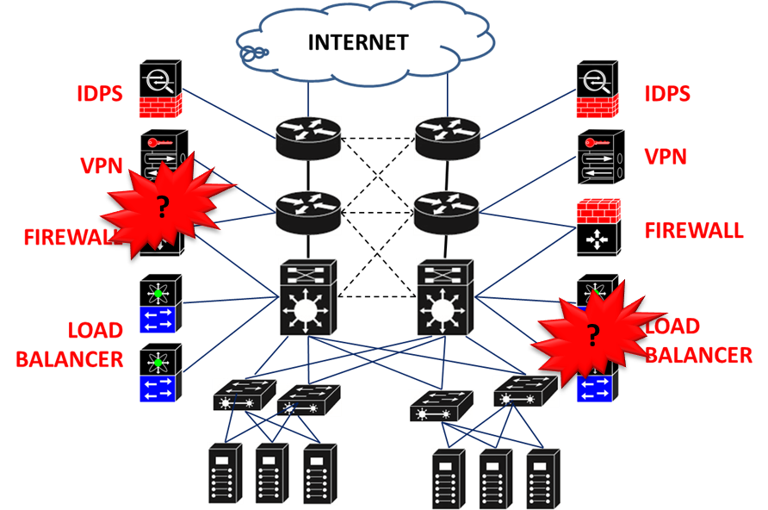
Q2: Failure Root Causes
What causes middlebox failures?
What are the main resolution actions?

Slide 16
What causes failures?
Device/neighbor unreachable, link flaps, ARP conflicts, address, parity errors, checksum failed
Faulty power supply units, memory errors, defective chassis/disks/line cards
Bad rules, VLAN misallocation, configuration conflict, mismatched crypto keys
High utilization and firmware bugs
Grey failures (connection errors/interface problems) are dominant
Hardware faults, misconfigurations and overload problems occur, but they are not in majority
Fraction of tickets (%)

Slide 17
What are the main resolution actions?
Disks and power supply units were among the most defective hardware components
Low cost solutions (cable cleaning/replacements, reboot) are typically explored first to mitigate service downtime
Component replacements was a majority fix
Software was relatively more stable for middleboxes
Fraction of tickets (%)

Slide 18
Summary: Root Cause Analysis
Grey failures are dominant:
  Implication: Develop robust network protocols (e.g., multi-path TCP) to route traffic around interfaces exhibiting intermittent connectivity
Wide variety of misconfigurations present:
  Implication: Develop Software-defined networks (SDN) based configuration management tools
Hardware faults, misconfigurations and overload problems are present; not in majority
Cable replacement and reboots are the most popular quick-fix solutions to mitigate middlebox problems

Slide 19
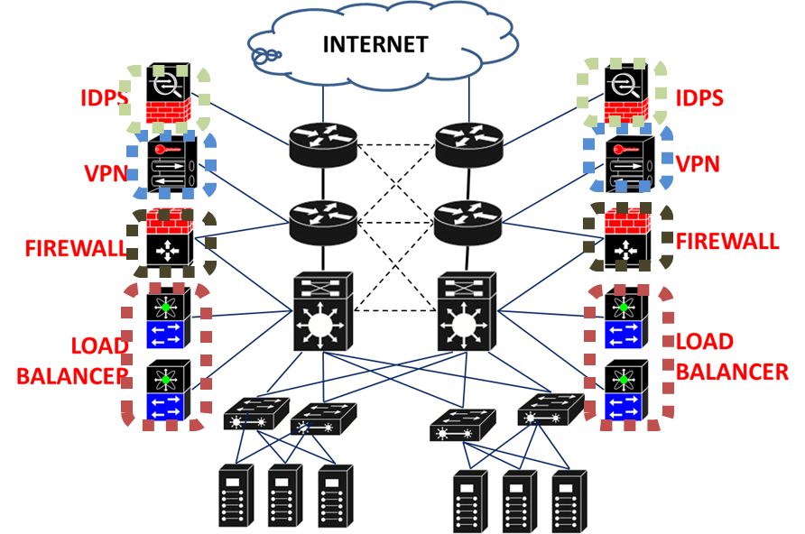
Q3: Middlebox Redundancy
Is middlebox redundancy 100% effective in masking failures?

Slide 20
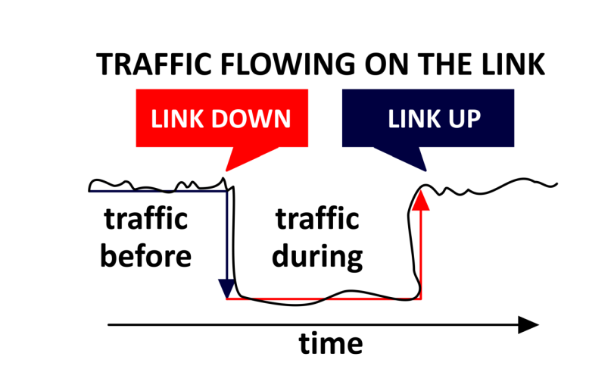

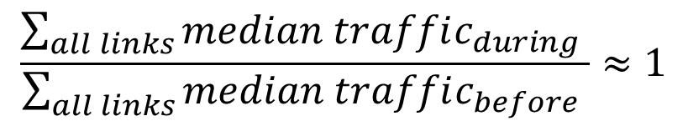
How to evaluate effectiveness of middlebox redundancy?
Redundancy group
Aggregation
Switches
ACTIVE
STANDBY
IDEA: Compare median traffic before and during the failure across all links in the redundancy group
Load
Balancers
ACTIVE
STANDBY
$$\frac{\sum_{all links}{median traffic_{during} }}{\sum_{all links}{median traffic_{before} }}≈1$$
Redundancy is
100% effective

Slide 21
How effective is middlebox redundancy?
Individual failures have the most impact
… but redundancy nearly masks these failures
improving the median traffic carried by 67%
What causes an unsuccessful redundancy failover?
Faulty failovers | Protocol bugs Bad cables Software version incompatibilities
Misconfigurations | Copy/paste errors Mismatched cryptographic keys Expired certificates
Other Middleboxes
Middlebox Type | % cases where redundancy group experienced simultaneous failure
Firewalls | 33%
IDPS | 1%
VPNs | 0%
Y = 1 ➔ No traffic loss
Median Normalized traffic
Network Layer

Slide 22
Conclusion
Goal: Data-driven approach to improve middlebox reliability
Key Findings:
  Grey failures (e.g., connectivity errors, interface flaps) dominate middleboxes
  Hardware faults, misconfigurations and overload problems are present but they are not in the majority
  Variety of misconﬁgurations such as incorrect rules, VLAN misallocation and mismatched cryptographic keys
  Middlebox redundancy is ineffective in 33% of the cases for Firewalls and Load balancers; nearly 100% effective for IDPS and VPNs
  Some types of middleboxes exhibit the few bad apples effect

Slide 23

Thank You
http://research.microsoft.com/projects/netwiser/

