Slide 1



Advanced Network Management a.k.a.
Artificial Intelligence for IT Operations (AIOps) course#: 80240663
Spring 2018
Instructor: Dan Pei
peidan@tsinghua.edu.cn
Teaching Assistants:
Nengwen Zhao znw17@mails.tsinghua.edu.cn
Please scan QR code to join class WeChat Group

Slide 2
Roadmap
Self-Introduction
Course Logistics
What is AIOps?
Course Coverage (Website)
Assignments and Projects
Internet Basics

Slide 3


How to pronounce “Pei”?
Just pronounce “Pei” as “Pay”
In fact, just call me “Dan”
I-M Pei: the famous architect who designed the glass pyramid
Louvre Museum

Slide 4
About the Instructor
Tenured Associate Professor. UCLA Ph.D. Joined Tsinghua CS Department in December 2012, with Government Endorsement (“ Recruitment Program of Global Talents”)
Homepage: http://netman.cs.tsinghua.edu.cn/~peidan (on campus access only)
Previously a Principal Researcher at AT&T Research, a co-founder and founding CEO of a mobile health company in Beijing, before joining Tsinghua.
Supervised interns from CMU, Cornell, Princeton, UCLA, GaTech, Michigan, Northwestern etc. Now @ Google, MSR, IBM, Purdue, Northeastern, HKUST
Currently advising~15 of Ph.D. and M.S. students at Tsinghua. Graduated 9 PhDs (3 went to MSRA, one went to Nankai University)
100+ Papers, 23 issued US Patents, ACM/IEEE Senior Member
Current research focus: Artificial Intelligence for IT Operations.
Research results reported by MIT Technology Review, Hacker’s News, etc.
Joint research with

Slide 5
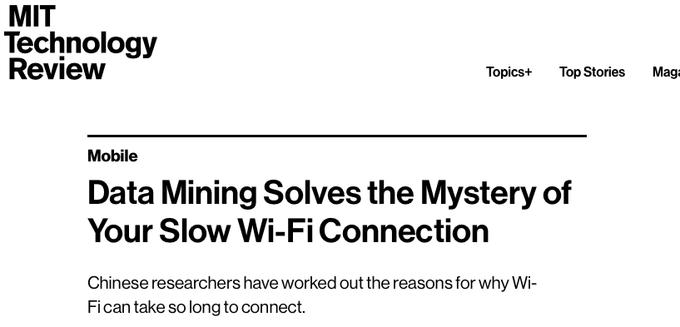

Slide 6
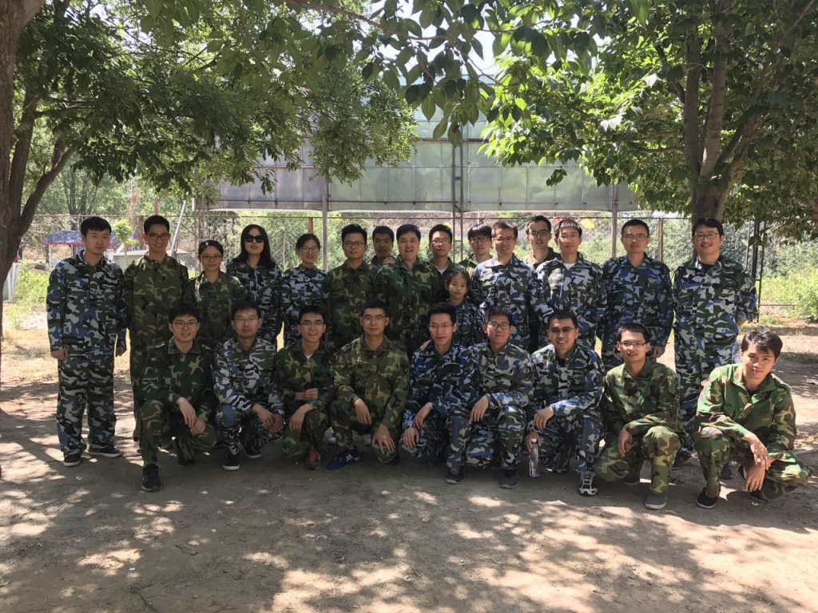
My Research Group: NetMan

Slide 7
Roadmap
Self-Introduction
Course Logistics
What is AIOps?
Course Coverage (Website)
Assignments and Projects
Internet Basics

Slide 8
Course Requirements
Course website (on campus access only): http://netman.cs.tsinghua.edu.cn/~peidan/ANM
Prerequisites: You are expected to be familiar with at least one programming language, preferably Python.
  If not, please quickly learn one.
Encourage interaction and discussion --- stop me and ask questions at any time!

Slide 9
Course Info
Time: Wednesday 13:30pm-16:55pm (Weeks 1,3-9,11-13)
  11 classes, each has four 45-minute sessions.
Session 1,2: Machine Learning Basics
Sessions 3,4: AIOps case studies based on papers from top conferences (tutorials or conference presentations)
Office Hours:
  After every class.

Slide 10
Grading:
Attendance: 10%
  Presence & Discussion during lecture.
Assignments: 30% (each student finish each assignment alone)
  Assignment 1: 15%
  Assignment 2: 15%
Project: 60% (A project team of 2 or 3 students)
  Ranking in algorithm competition & report: 50%
  Presentation (scored by all students, TA, and instructor): 10%
The final grade will be in letter grading scale (e.g., A,B,C,D)

Slide 11
Roadmap
Self-Introduction
Course Logistics
What is AIOps?
Course Coverage (Website)
Assignments and Projects
Internet Basics

Slide 12
Roadmap
Self-Introduction
Course Logistics
What is AIOps?
Course Coverage (Website)
Assignments and Projects
Internet Basics

Slide 13
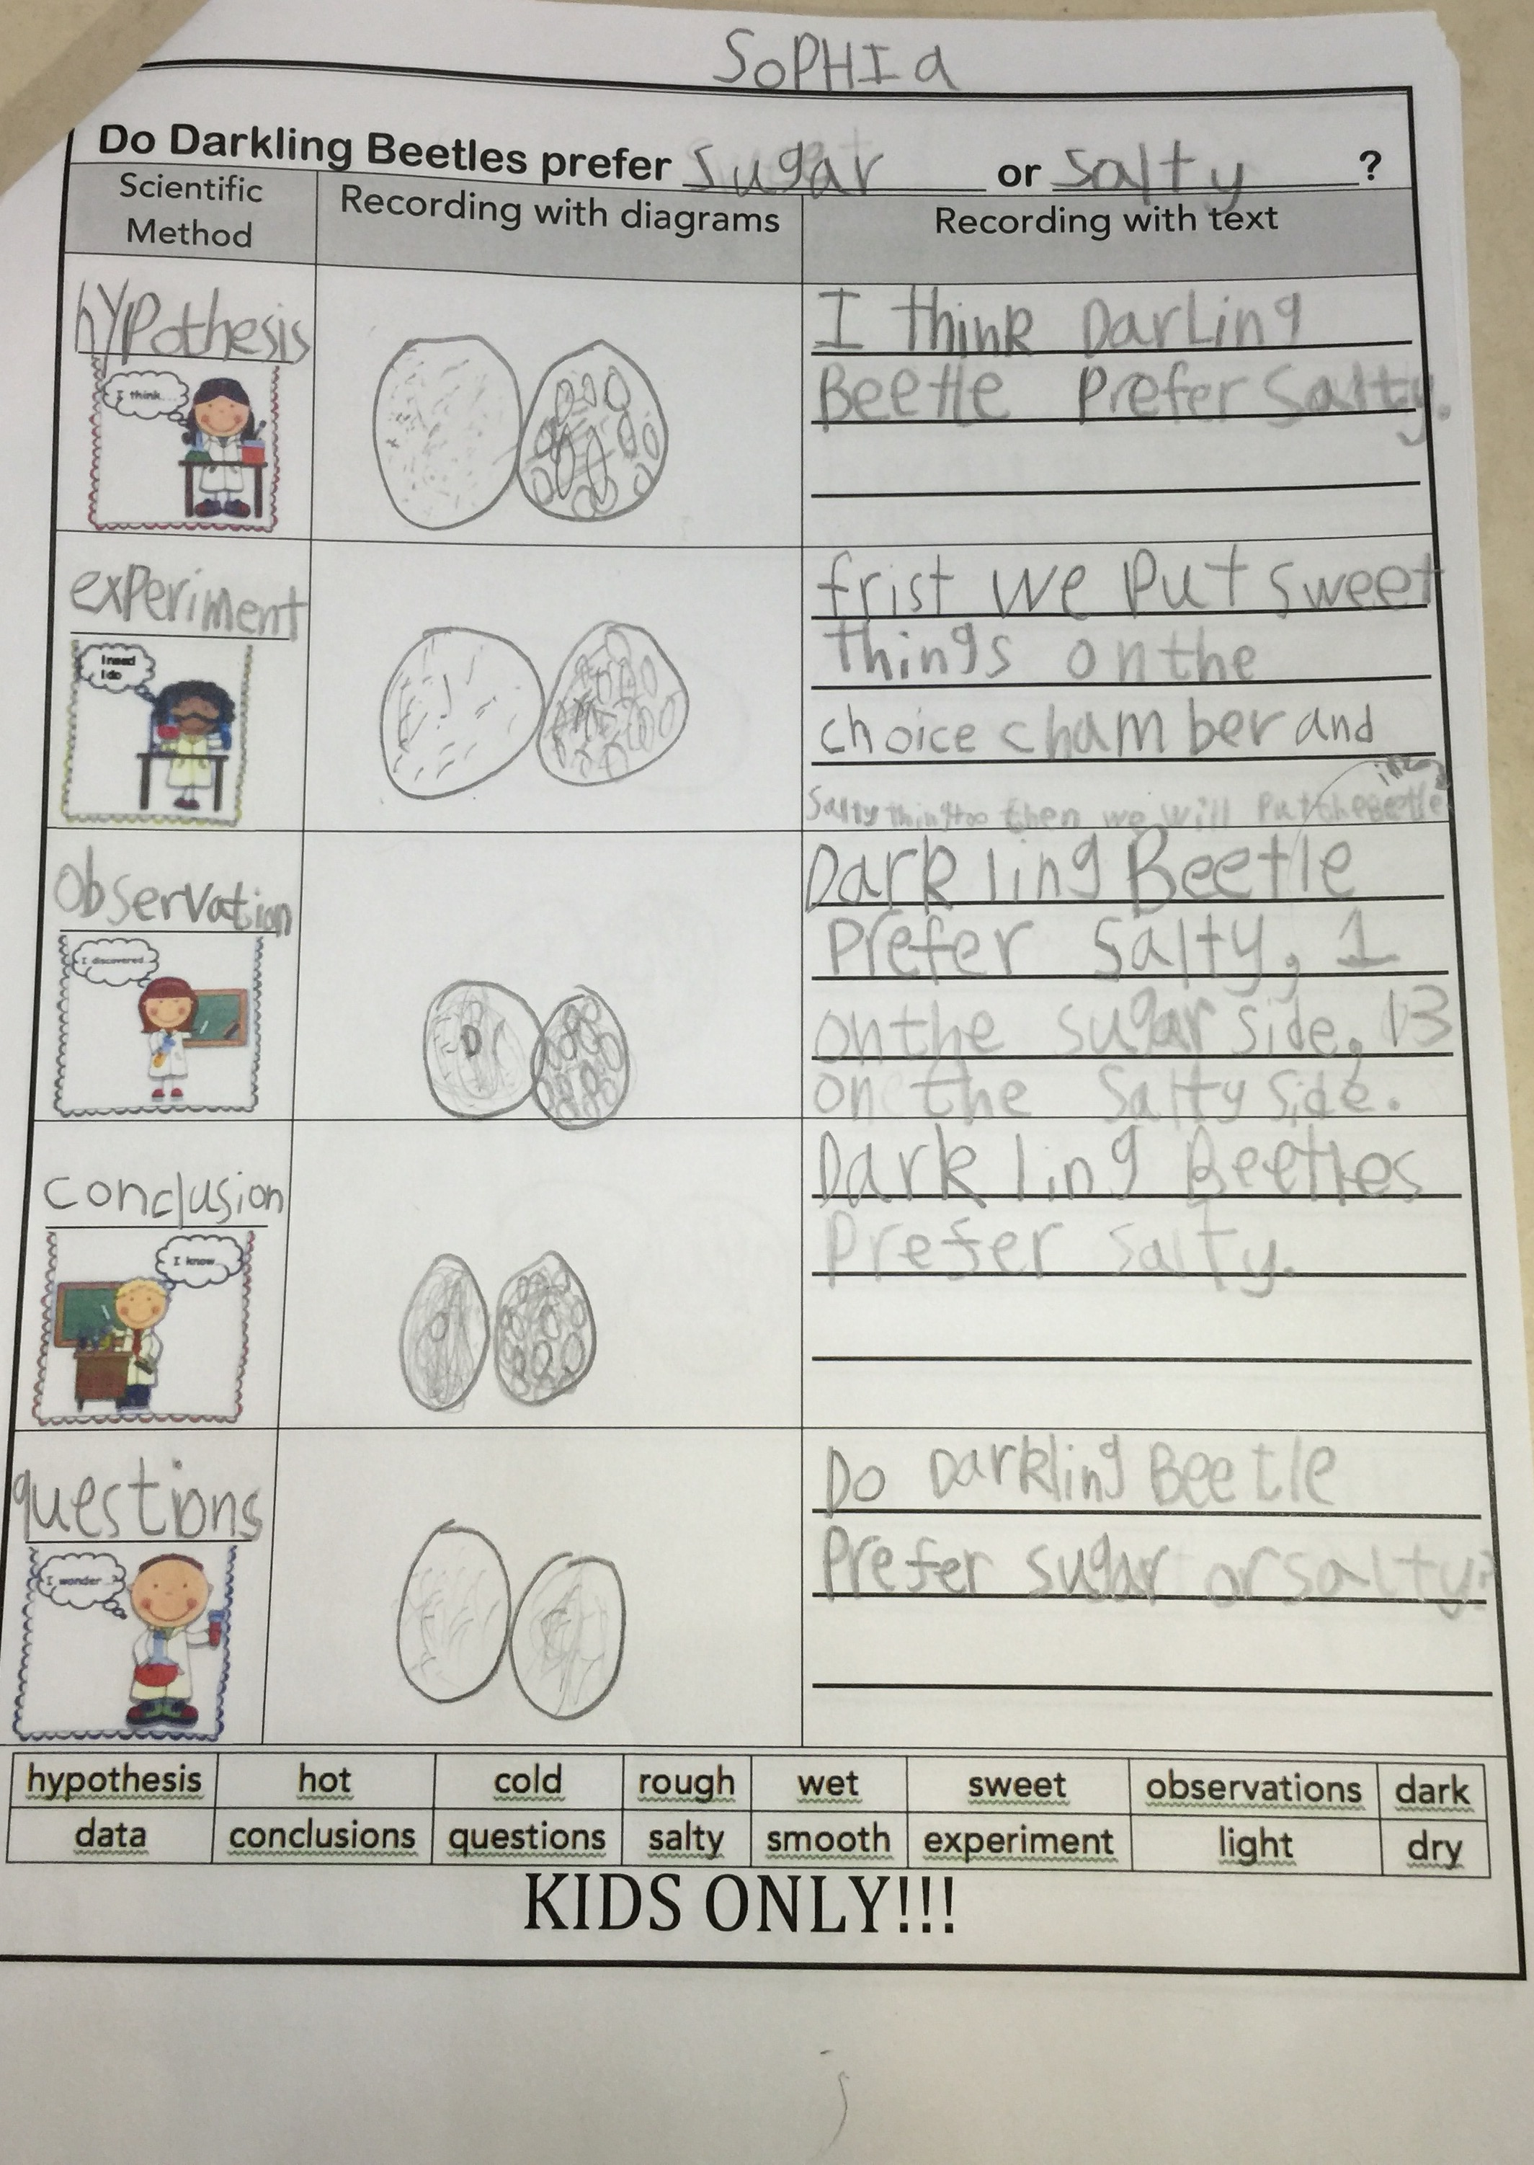
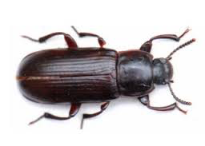
Scientific Experiment for a first grader

Slide 14
Experiments in AIOps
Have a hypothesis: Y increases when A increases, B decreases, or C&D together satisfy some conditions
Design experiments (process the data):
  Exploratory visualization using scatter plot, average bar/line; candle-stick, where y-axis is Y; x-axis is A (sometimes binned)
  Pearson/Kendall/Spearman Correlation: see if Y is correlated with A, B, based on the correlation score
  Linear Regression: find the co-effient Y=alpha + beta * A
  Information Gain: If A, B, C, D has any influence on Y
  Decision Tree: C>20& D<=5→Y is bad;
  Regression Tree: Y=alpha + beta *C + gamma*D if A>5 & D<=10
  Feature engineering, feature selection, model selection
  Machine learning: random forest etc.
  Deep learning
Observations
  E.g. Y increases when A increases; when C increase by s%, Y will increase by t%; explain why.
Conclusions

Slide 15
Papers and Slides
Already Posted on the course website
Lecture Coverage
  You were supposed to read these papers carefully
Reading List
  Relevant papers, read them if you have time

Slide 16
Why reading papers?
Purpose: background knowledge, algorithm, methodology, writing, principle, solution inspiration, evaluation methodology for the problem you are working on, and (sometimes) vision.
My strongly biased personal opinion: Papers are not for finding topics for your next paper.

Slide 17
What’s a good paper
  A new and important problem, solid solution.
  Old and challenging problem, a new simple but elegant solution, with straightforward insight and intuition behind it.

Slide 18
Using Google Scholar to find relevant papers (demo)
Browse latest proceedings of relevant conferences, find one relevant paper p. Relevant paper set S={p}
for (each new p in S) {
  Browse p’s references, and put relevant ones into S;
  Browse p’s citations in Google Scholar, and put relevant ones into S;
}

Slide 19
Roadmap
Self-Introduction
Course Logistics
What is AIOps?
Course Coverage (Website)
Assignments and Projects
Internet Basics

Slide 20
Roadmap
Self-Introduction
Course Logistics
What is AIOps?
Course Coverage (Website)
Assignments and Projects
Internet Basics

Slide 21
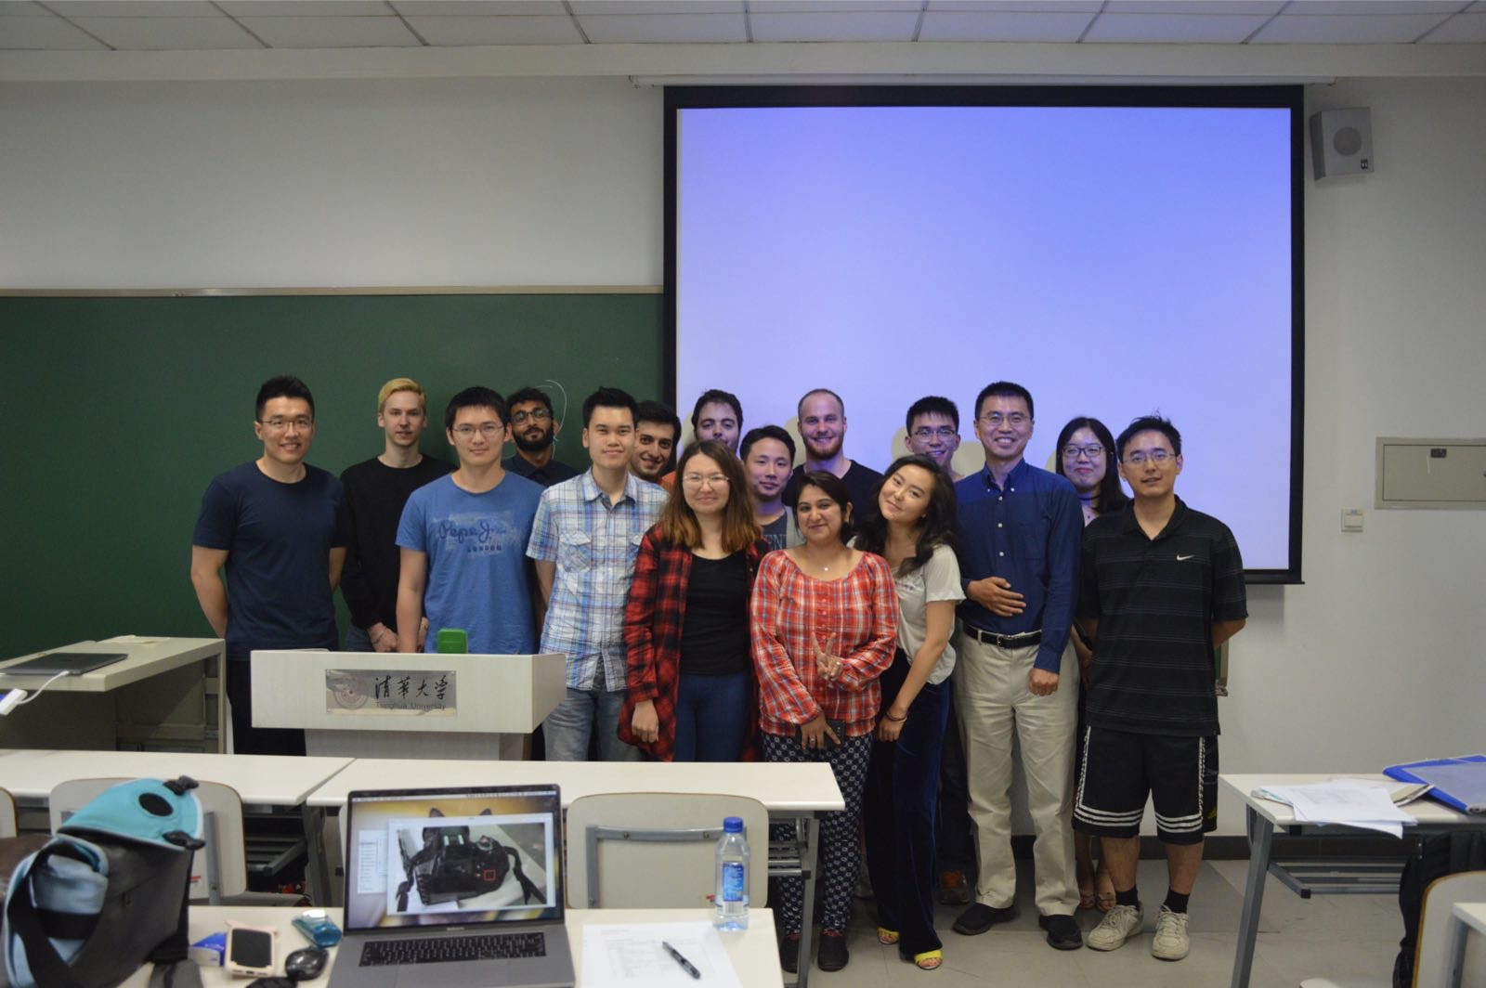
Enjoy the course!

