Slide 1





Rahul Potharaju (Purdue University)
Navendu Jain (Microsoft Research)
October 1-3, 2013
SoCC 2013

Slide 2
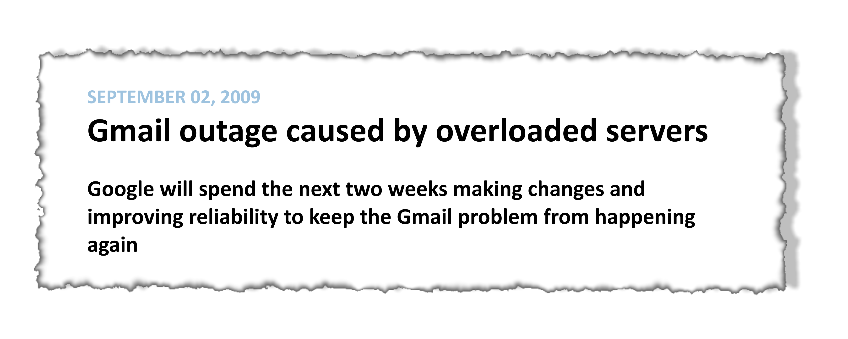
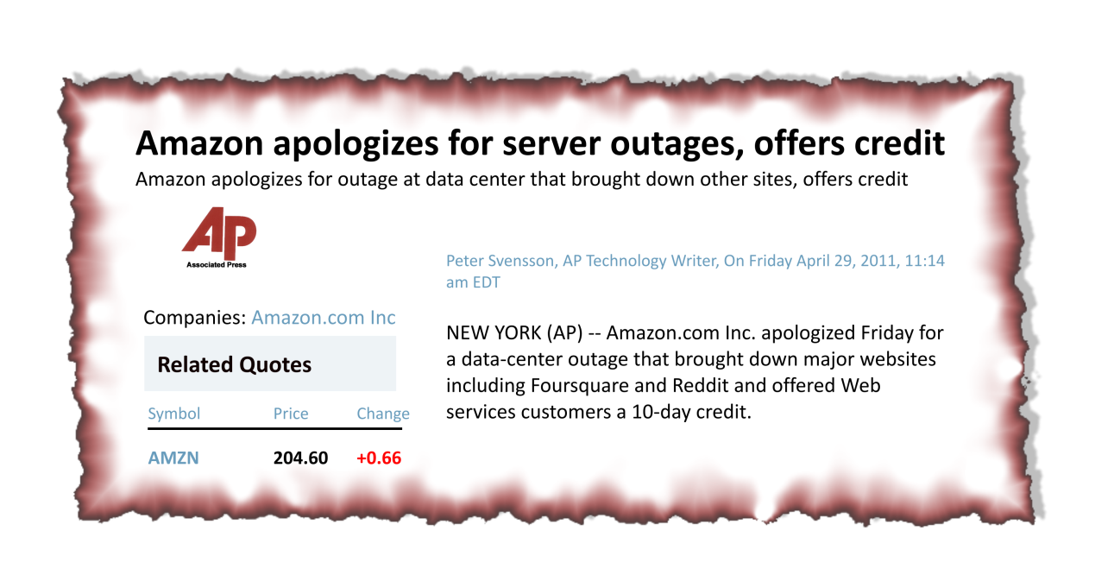
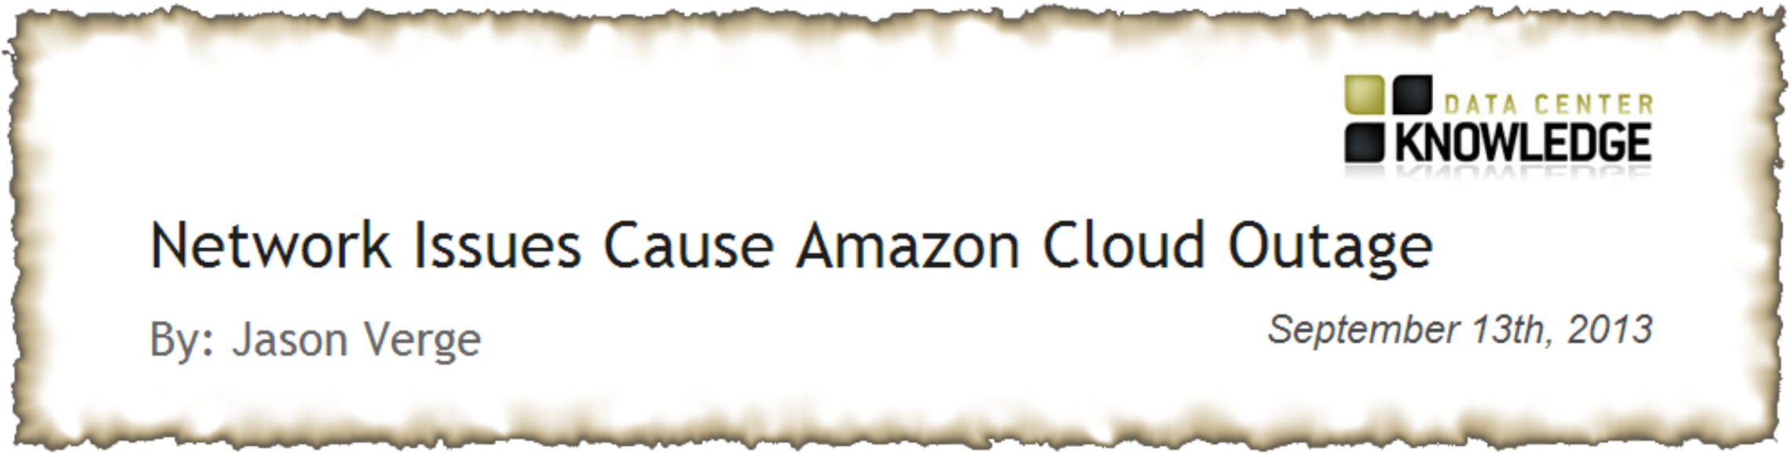
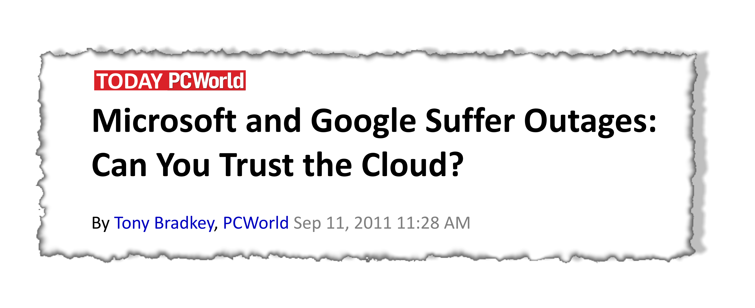

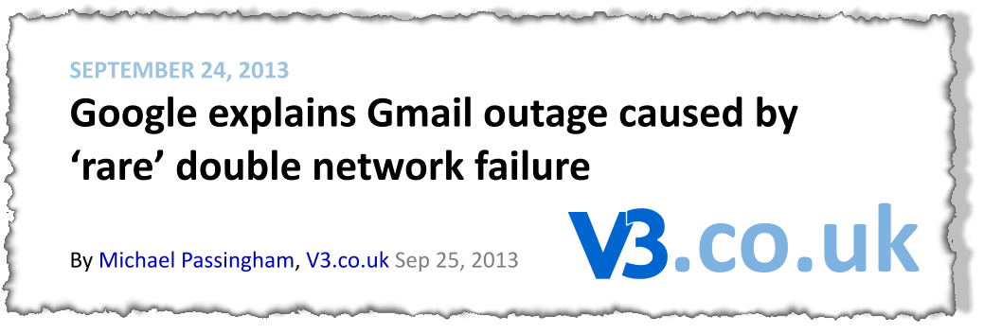
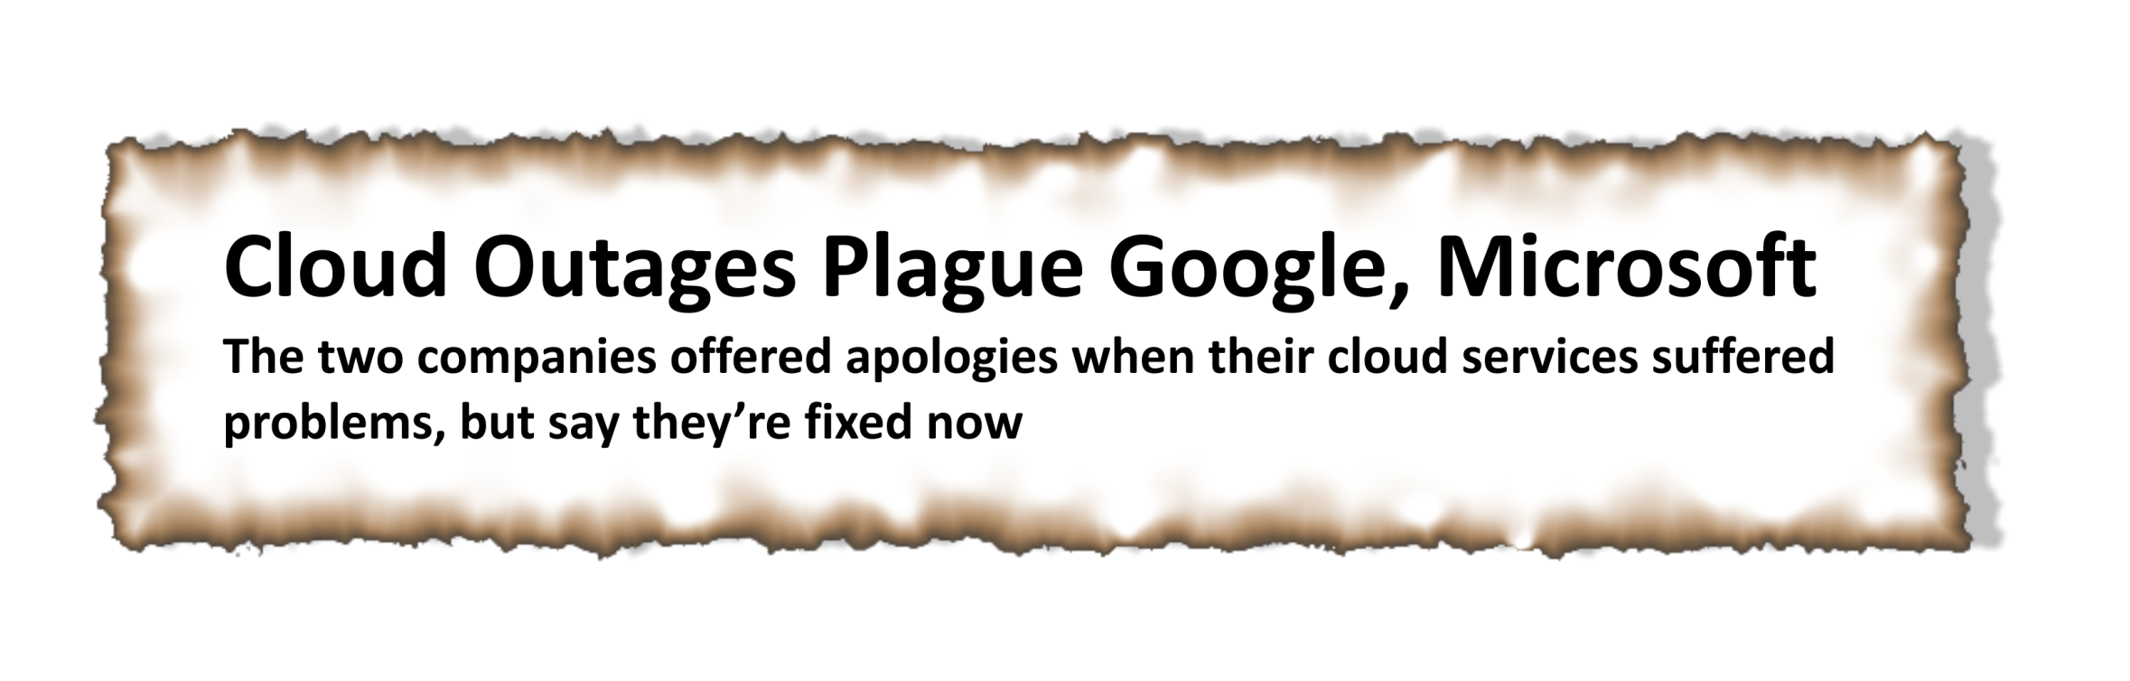
Service Reliability – Where do we stand today?

Slide 3
How do network failures impact services?
Replication problems due to stale data; timeouts when uploading files
High latency from web to db tiers; parity errors on switches
Latency, content rendering and timeouts for CDN services
Dropped connections; loss of application packets
Failures causing service impact (%)
Authentication issues
Type of Service Impact
* Data source: High-severity incidents (2008-13)

Slide 4
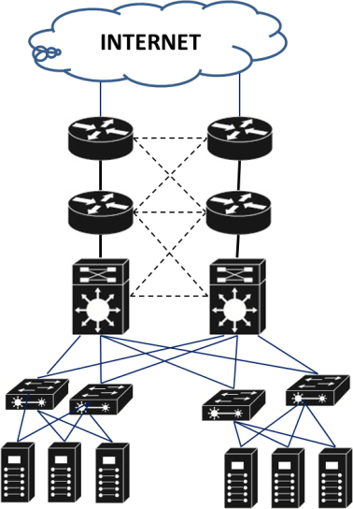
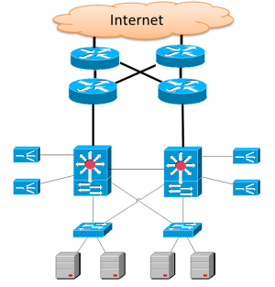




Inside a Datacenter
Long-haul fiber links
INTERNET
Access routers/
Core fabric
1:1 network redundancy
Aggregation switch
Top of Rack (ToR) switch
Servers

Slide 5
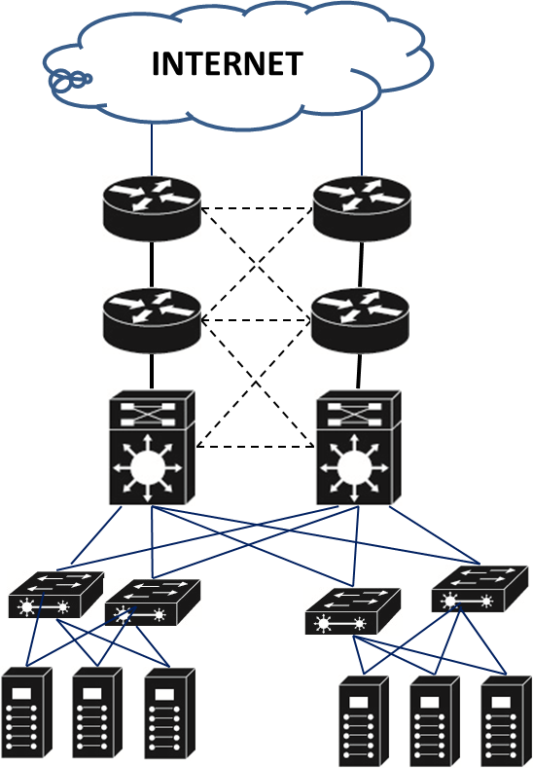
Aim: Data driven approach to improve service reliability
Q2: Network failures
What are their root causes?
Q1: Network domain availability
How many independent network domains do we need to deliver 99.99% availability?
Access routers
?
NETWORK DOMAIN
?
Aggregation switches
Q4: Capacity vs. Availability
How reliable are expensive scale-up switches vs. commodity scale-out ones?
Q3: Failure Analysis
How effective are repairs in fixing failures?
Top-of-Rack switches

Slide 6
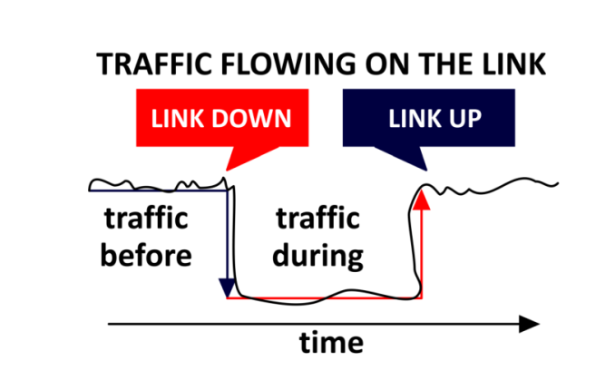
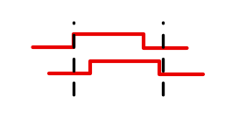

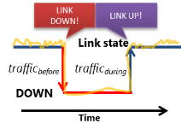

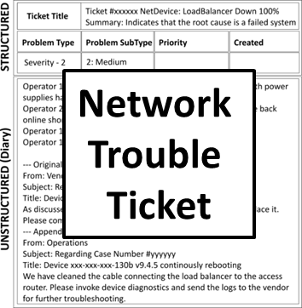

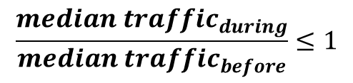
Extracting Impactful Failures
Link Down
Switch B
SYSLOG/SNMP Events
(July 2010-2013)
23M raw events
What caused the failure?
Switch A
Errr… did a service get impacted?
1
Time-based Grouping
CHALLENGE:
How to remove duplicate events?
T1: Switch B is down
T2: Switch B is down
T3: ……………………….
Switch B
T1: Switch B is down
T2: Switch B is up
T3: Switch B is down
2
Traffic Level Impact
?
CHALLENGE:
How to measure failure impact?
Overlapping Events
Switch A
Network
Traffic Data
A
Pick earliest
end time
B
A
Pick earliest
start and
end time
3
Switch C
B
CHALLENGE:
How to determine problem root cause?
Service Level Impact
$$\frac{median traffic_{during}}{median traffic_{before}}≤1$$
Network
Trouble Tickets
?
TIME
NOISY/REDUNDANT MESSAGES
Impactful Failures + Problem Root Causes
59.8K
6

Slide 7
Q1: Network domain availability
How effective is network redundancy?
How many independent network domains are needed to deliver an uptime SLA of 99.99%?
NETWORK DOMAIN

Slide 8


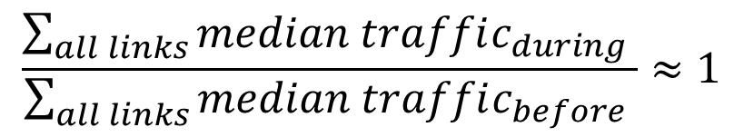
How to evaluate effectiveness of network redundancy?
Redundancy group
Access routers
ACTIVE
STANDBY
X
ACTIVE
STANDBY
IDEA: Compare median traffic before and during the failure across all links in the redundancy group
Aggregation switches
$$\frac{\sum_{all links}{median traffic_{during} }}{\sum_{all links}{median traffic_{before} }}≈1$$
Redundancy is
100% effective

Slide 9
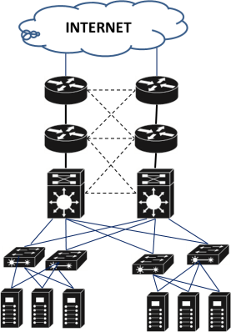
How effective is network redundancy?
Network redundancy reduces traffic loss by 21%
AGG-ToR link failures have the most impact
Redundancy least effective at the AR–AGG layer
Inter-datacenter link failures are completely masked
… but redundancy nearly masks these failures
Y = 1 ➔ No traffic loss
Median Normalized traffic
Network Layer

Slide 10

How many independent network domains to meet uptime SLA?
Solve for the minimum integer n
$$1−{\left(1−r\right)}^{n}≥SLA_{availability}$$
Number of domains for SLA = 99.9%
(maximum 8.76 hours of downtime per year)
Median Normalized traffic
$$n= 3 independent network domains$$
Number of domains for SLA = 99.99%
(maximum 52 minutes of downtime per year)
$$n= 4 independent network domains$$

Slide 11
Q2: Failure Root Causes
?
Are hardware faults dominant?
How frequent are software bugs?
Are humans making mistakes?
?

Slide 12
What causes intra-DC network failures?
Faulty cables/optical transceivers, protocol convergence delays
Hardware failures are significant
Incorrect routes, connecting the wrong neighbor
Fraction of tickets (%)

Slide 13



What causes inter-DC failures?
Recent efforts to increase WAN utilization:
Software-driven WANs: Hong et al. (Sigcomm 2013)
B4: Jain et al. (Sigcomm 2013)
NetStitcher: Laoutaris et al. (Sigcomm 2011)
Physical layer problem (e.g., fiber cuts) triggers an optical re-route
High number of packet errors or discards. Route re-convergence takes 2x-3x longer than expected
Fraction of tickets (%)

Slide 14
Q3: Failure analysis
How effective are repairs in fixing failures?
?
?

Slide 15


Are repairs effective?
Increasing trend – Repairs are not quite effective
Exhibit a decreasing trend to fail after each repair
Probability(2nd failure | 1st Failure)
Probability(3rd failure | 2nd failure)
Probability(1st failure)
Likely reasons
ToRs are low-priority devices; quick-fix solutions (e.g., reboot) risks delaying finding the true root cause
Probability of failure

Slide 16
Q4: Capacity vs. Availability
How reliable are expensive scale-up switches vs. commodity scale-out ones?

Slide 17
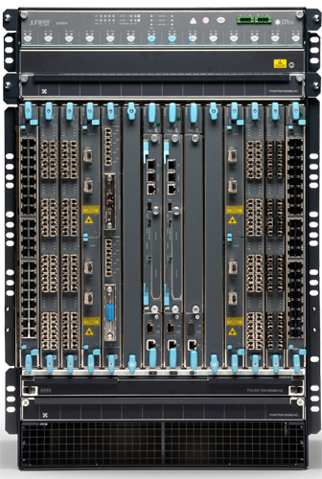
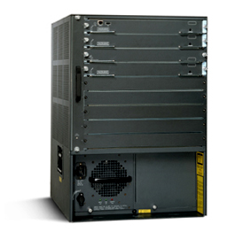
Scale-up vs. Scale-out
 |  | Switch-A (Scale-up) | Switch-B (Scale-out)
 | Capacity | High | Low | Capacity
 | Cost ($/port) | High | Low | Cost ($/port)
 | Management | Easy | Hard | Management
 | Reliability | ?? | ?? | Reliability

Slide 18
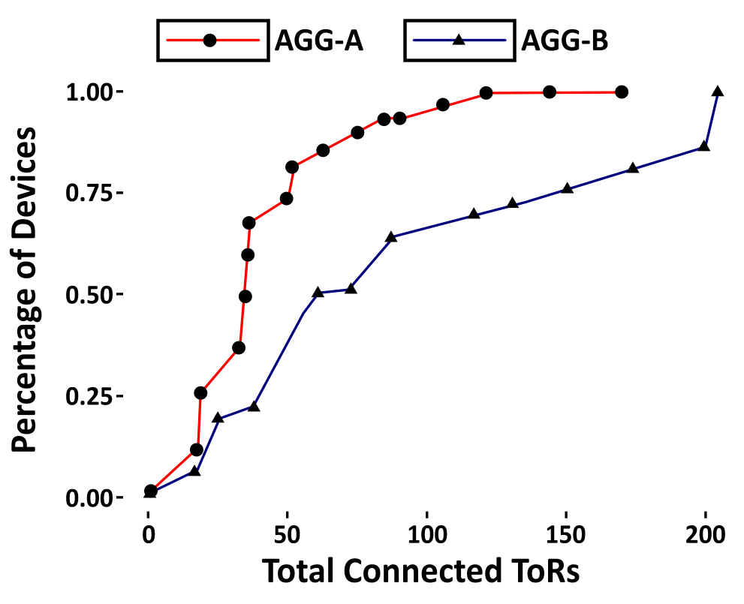
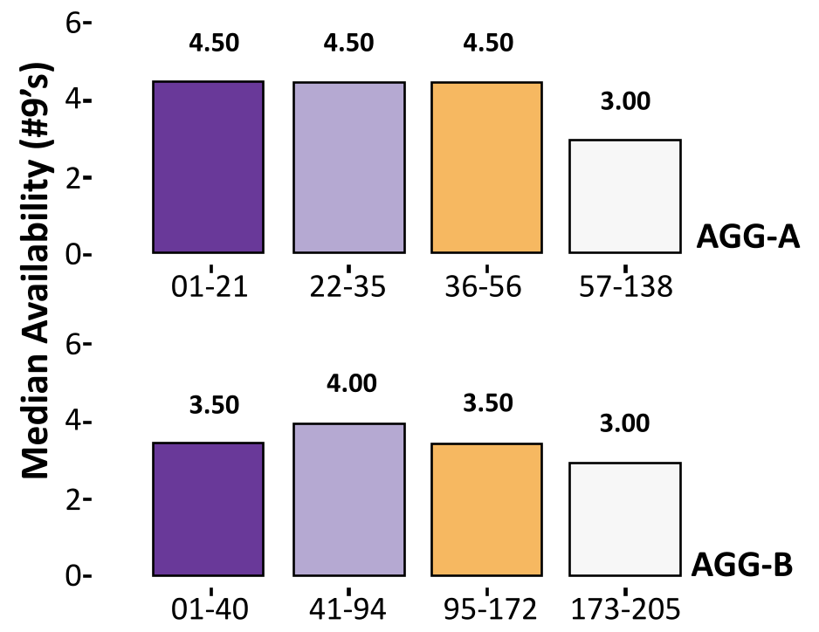
Distribution of ToR counts across AGGs
1
Port count utilization > 50%
Low median availability (~ 99.9%)
Compute the distribution of #ToRs connected to AGGs
Aggregation switch
Category 4 (High TOR Count)
Port count utilization < 50%
High median availability (~ 99.99%)
Category 3
2
Categorize the AGGs based on quantiles
Category 2
Category 1 (Low TOR Count)
3
Compute AGG availability based on the number of logged failures
Top-of-Rack switch
Scale-out switches deliver relatively higher availability
18

Slide 19
Conclusion
Goal: Data-driven approach to improve service reliability
[Q1]: How many independent network domains do we need to meet an uptime SLA?
  Build multiple small network domains: 3 for 99.9% availability; 4 for 99.99% availability
[Q2]: What causes network failures?
  Intra-DC problem causes: Interface errors, hardware failures, and unexpected reboots
  Inter-DC problem causes: Link flapping, high link utilization, and unplanned changes
[Q3]: Are repairs effective in fixing device failures?
  Repairs are relatively more effective for ARs and AGGs; not for ToRs
[Q4]: How reliable are expensive scale-up switches vs. commodity scale-out ones?
  Scale-out switches deliver relatively higher availability
Future Work: Study the overall impact of redundancy mechanisms at storage, compute, and network layers

Slide 20

Thank You
http://research.microsoft.com/projects/netwiser/

