Slide 1


Learning Scheduling Algorithms for
Data Processing Clusters
Hongzi Mao, Malte Schwarzkopf, Shaileshh Bojja Venkatakrishnan,
Zili Meng, Mohammad Alizadeh
Notes:
Hi, I’m Shaileshh. I’ll be presenting our work “Learning Scheduling Algorithms for Data Processing Clusters”. This is a joint work with Hongzi, Malte, Mohammad from MIT, and Zili from Tsinghua. The first author Hongzi cannot travel due to visa issues but he will present the second half of this talk remotely.

Slide 2

Motivation
Scheduling is a fundamental task in computer systems
Cluster management (e.g., Kubernetes, Mesos, Borg)
Data analytics frameworks (e.g., Spark, Hadoop)
Machine learning (e.g., Tensorflow)
Efficient scheduler matters for large datacenters
Small improvement can save millions of dollars at scale
Notes:
Scheduling is a fundamental task in many computer systems. It serves as a core component in cluster managers like Kubernetes and Mesos, or data analytics frameworks such as Spark and Hadoop MapReduce. Improving the efficiency of a cluster scheduler is the key to save operation cost.
[Click]
And today’s large enterprises – like Google, Facebook and Amazon – deploy the cluster infrastructure in the scale of billions or tens of billions dollars.
At this scale, even a fraction of improvement in the scheduling efficiency can save millions of dollars.

Slide 3
Designing Optimal Schedulers is Intractable
Must consider many factors for optimal performance:
Job dependency structure
Modeling complexity
Placement constraints
Data locality
……
Graphene [OSDI ’16], Carbyne [OSDI ’16]
Tetris [SIGCOMM ’14], Jockey [EuroSys ’12]
TetriSched [EuroSys ‘16], device placement [NIPS ’17]
Delayed Scheduling [EuroSys ’10]
……
No “one-size-fits-all” solution:
Best algorithm depends on specific workload and system
Practical deployment:
Ignore complexity → resort to simple heuristics
Sophisticated system → complex configurations and tuning
Notes:
However, designing efficient cluster schedulers often needs to consider many different factors. This requires very good understanding of the system and the workload.
For example, scheduling jobs with dependency structure is inherently NP hard.
Besides the algorithmic challenges, there are also model complexity. It’s very hard to accurately model the intricacy of a complex system. As an example, in datacenter with different network quality, it is hard to trade-off between massive distributed computation and data communication over the network. The right balance really depends on the particular system.
Also, practical scheduling often becomes a messy problem with all sorts of constraints – there can be hard constraints like hardware placement constraints and soft constraints such as data locality constraints.
[Click]
Because of the complexity and potential efficiency improvement on the table, there has been a HUGE body of prior work and human ingenuity gone into this domain that each targets a specific aspect of the scheduling problem.
However, in practice, if we look at the state-of-the-art cluster deployment, they either side-step the complexities and resort to simple heuristics 启发式 such as fair sharing or even FIFO scheduler;
Or in other cases, the more sophisticated system involves very complex configurations, which require expert tuning with dozens of parameters at the same time.
[Click]
As a result, there isn’t really a fixed "one-size-fits-all" scheduling algorithm that performs optimally in all scenarios. The optimal solution really depends on the specific workload and the specific system it is deployed on.

Slide 4
Can machine learning help tame the complexity of
efficient schedulers for data processing jobs?
Notes:
Therefore, centered around our research, we ask can we use machine learning to help taming the complexity of building an optimal cluster scheduler? In other words, can we use machine learning to automate the process of finding highly performant schedulers in different workloads and different systems?

Slide 5


Decima: A Learned Cluster Scheduler
Learns workload-specific scheduling algorithms for jobs with dependencies (represented as DAGs)
“Stages”: Identical tasks that can run in parallel
Executor 1
Executor 2
Scheduler
Data dependencies
Job 2
Job 3
Executor m
Job DAG
5
Notes:
In our work, we build Decima, which learns strong, workload-specific scheduling algorithms automatically through experience.
[Click]
We focus on schedu ling jobs that are structured as directed-acyclic-graphs or DAGs, which is a common abstraction to many modern computing clusters, like Spark or Hadoop MapReduce cluster.
[Click]
In this setting, each node of the graph represents a computation stage. Each stage contains identical tasks that can run in parallel. So if a stage is assigned with more cores, the tasks run concurrently and finish faster.
[Click]
The edge in the graph represents data dependency. This means the child stage can not start to run, until all its parent stages have completed.

Slide 6
Decima: A Learned Cluster Scheduler
Learns workload-specific scheduling algorithms for jobs with dependencies (represented as DAGs)
Server 1
Server 2
Scheduler
Server m
Job 3
Job 2
Job 1
Notes:
In a typical datacenter, users continuously submit many different jobs online over time.
And the task for a scheduler is to map the pending computation stages onto available servers to run.

Slide 7
Design overview
Notes:
In our design, Decima uses reinforcement learning to automatically learn workload-specific scheduling algorithms.
[Click]
For concreteness we develop Decima in the context of Spark.
[Click]
At a high level, a Decima scheduling agent observes the information of all available jobs and the status of the servers at every scheduling event.
[Click]
The agent then takes a scheduling action, which uses a special neural network to map certain amount of servers onto each job.
[Click]
As a feedback, the cluster environment sends the agent a reward signal corresponding to the runtime of the jobs.
Trained with reinforcement learning, Decima explores different scheduling policies and improves its performance with large amount of interacting experience with the cluster environment.

Slide 8
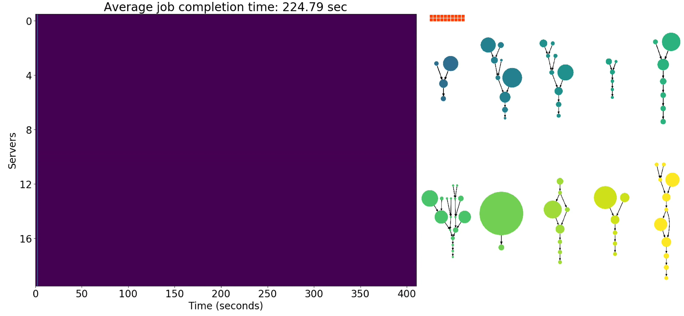
Demo
Scheduling policy: FIFO
Number of servers working on this job
Average Job Completion Time:
225 sec
Notes:
Before we go into the technical details, let’s first see how different schedules make a difference in terms of job runtime with a demo.
Here, different jobs are marked with different colors. The size of each node corresponds to the log scale of total work in that computation stage.
[Click]
On top of each job, we use orange squares to visualize the number of servers working on the job.
[Click]
On the left hand side, we will animate the schedule of the jobs on a canvas.
[Click]
The x-axis is the time
[Click]
And the y-axis shows the status of 20 servers. The color on the canvas will show which server is working on which job from the right. The purple color means the server is idle.
Our goal is to minimize the average job completion time.
[Click]
So let’s first see what a first-in-first-out schedule looks like. Each red line indicates a job completion event.
As expected, this simple scheduler reserves the servers to the jobs, at the order of their arrivals. Since it does not consider the size of the job or resource sharing, when a big job blocks ahead of many small jobs, this significantly increases the average job completion time. In this example, the average job completion time is 225 seconds.

Slide 9
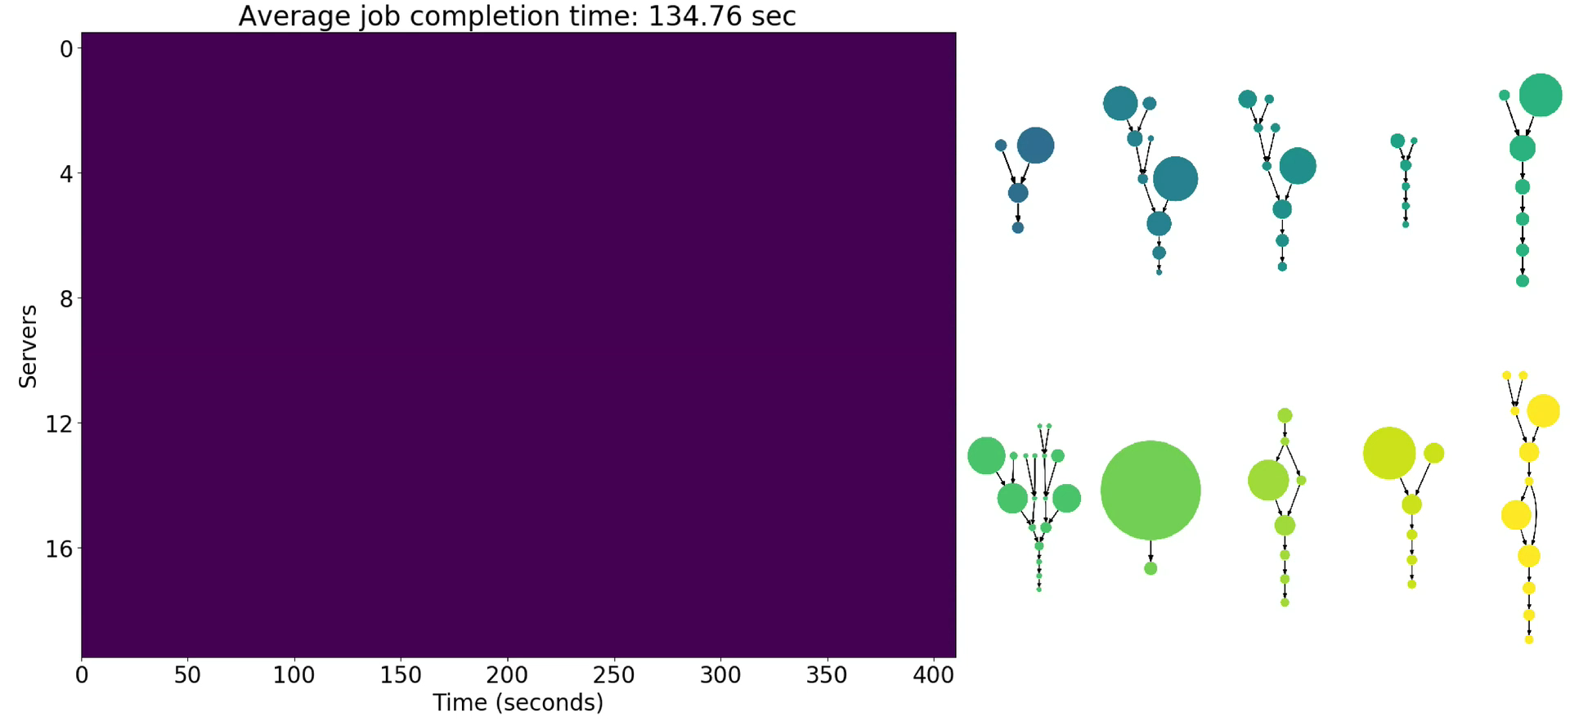
Scheduling policy: Shortest-Job-First
Average Job Completion Time:
135 sec
Notes:
Now, let’s look at shortest job first,
[Click]
which reorders the execution based on the total work of the job and it assigns all servers to a job at a time.
Even though this is a very simple heuristic, just by finishing small jobs quickly early on, this already improves the average job completion time by almost a half compared to the FIFO scheme. At the end, the average job completion time is 135 seconds.

Slide 10
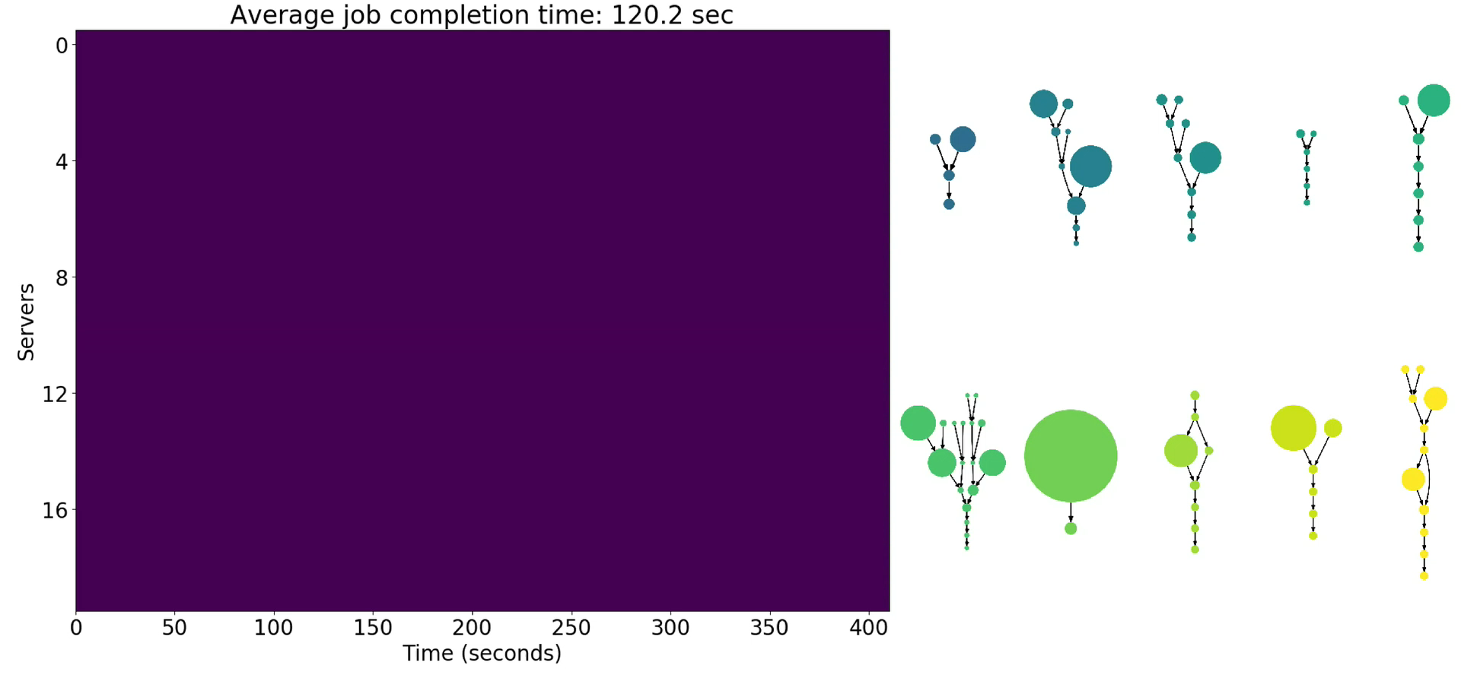
Scheduling policy: Fair
Average Job Completion Time:
120 sec
Notes:
Another widely used heuristic is fair sharing.
[Click]
It equally spreads out the servers to all jobs. And when a job is done, the other active jobs will equally share the servers that just become free. In this case, each server has a higher chance to have available tasks to run. This keeps the servers busy at all time and improves resource utilization.

Slide 11
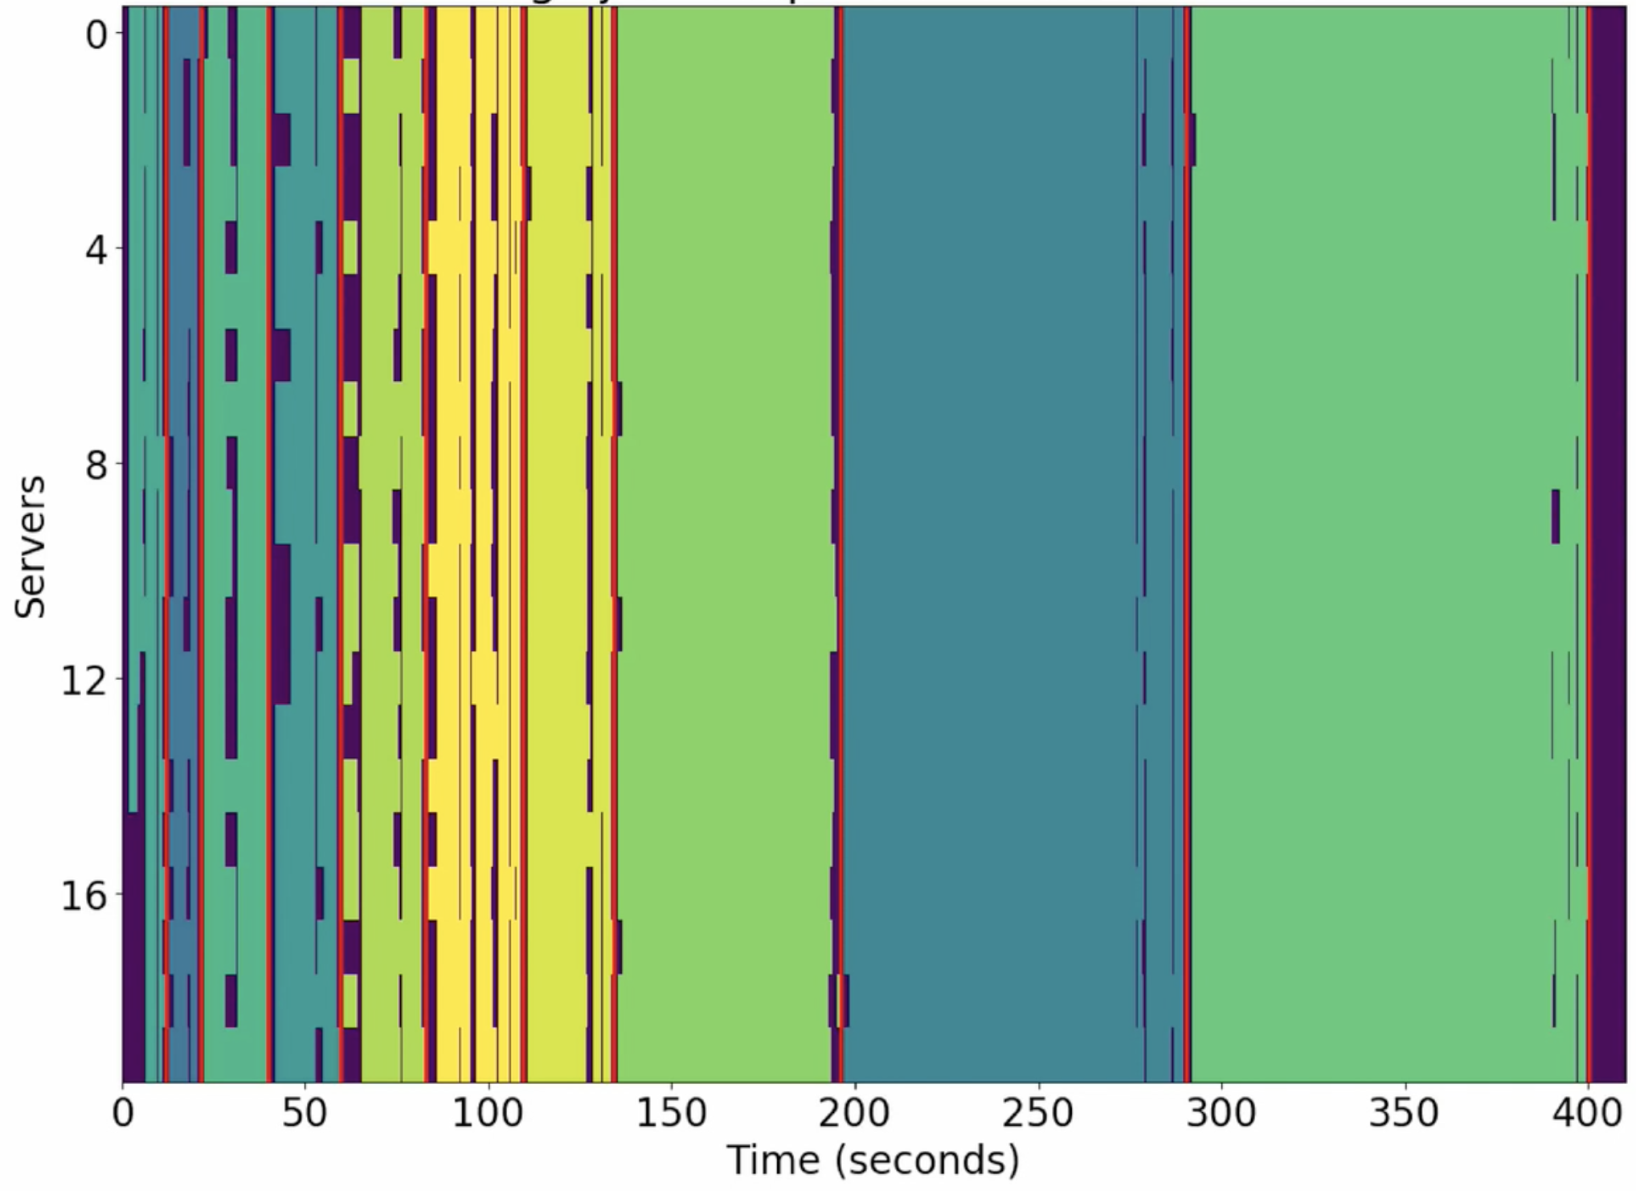
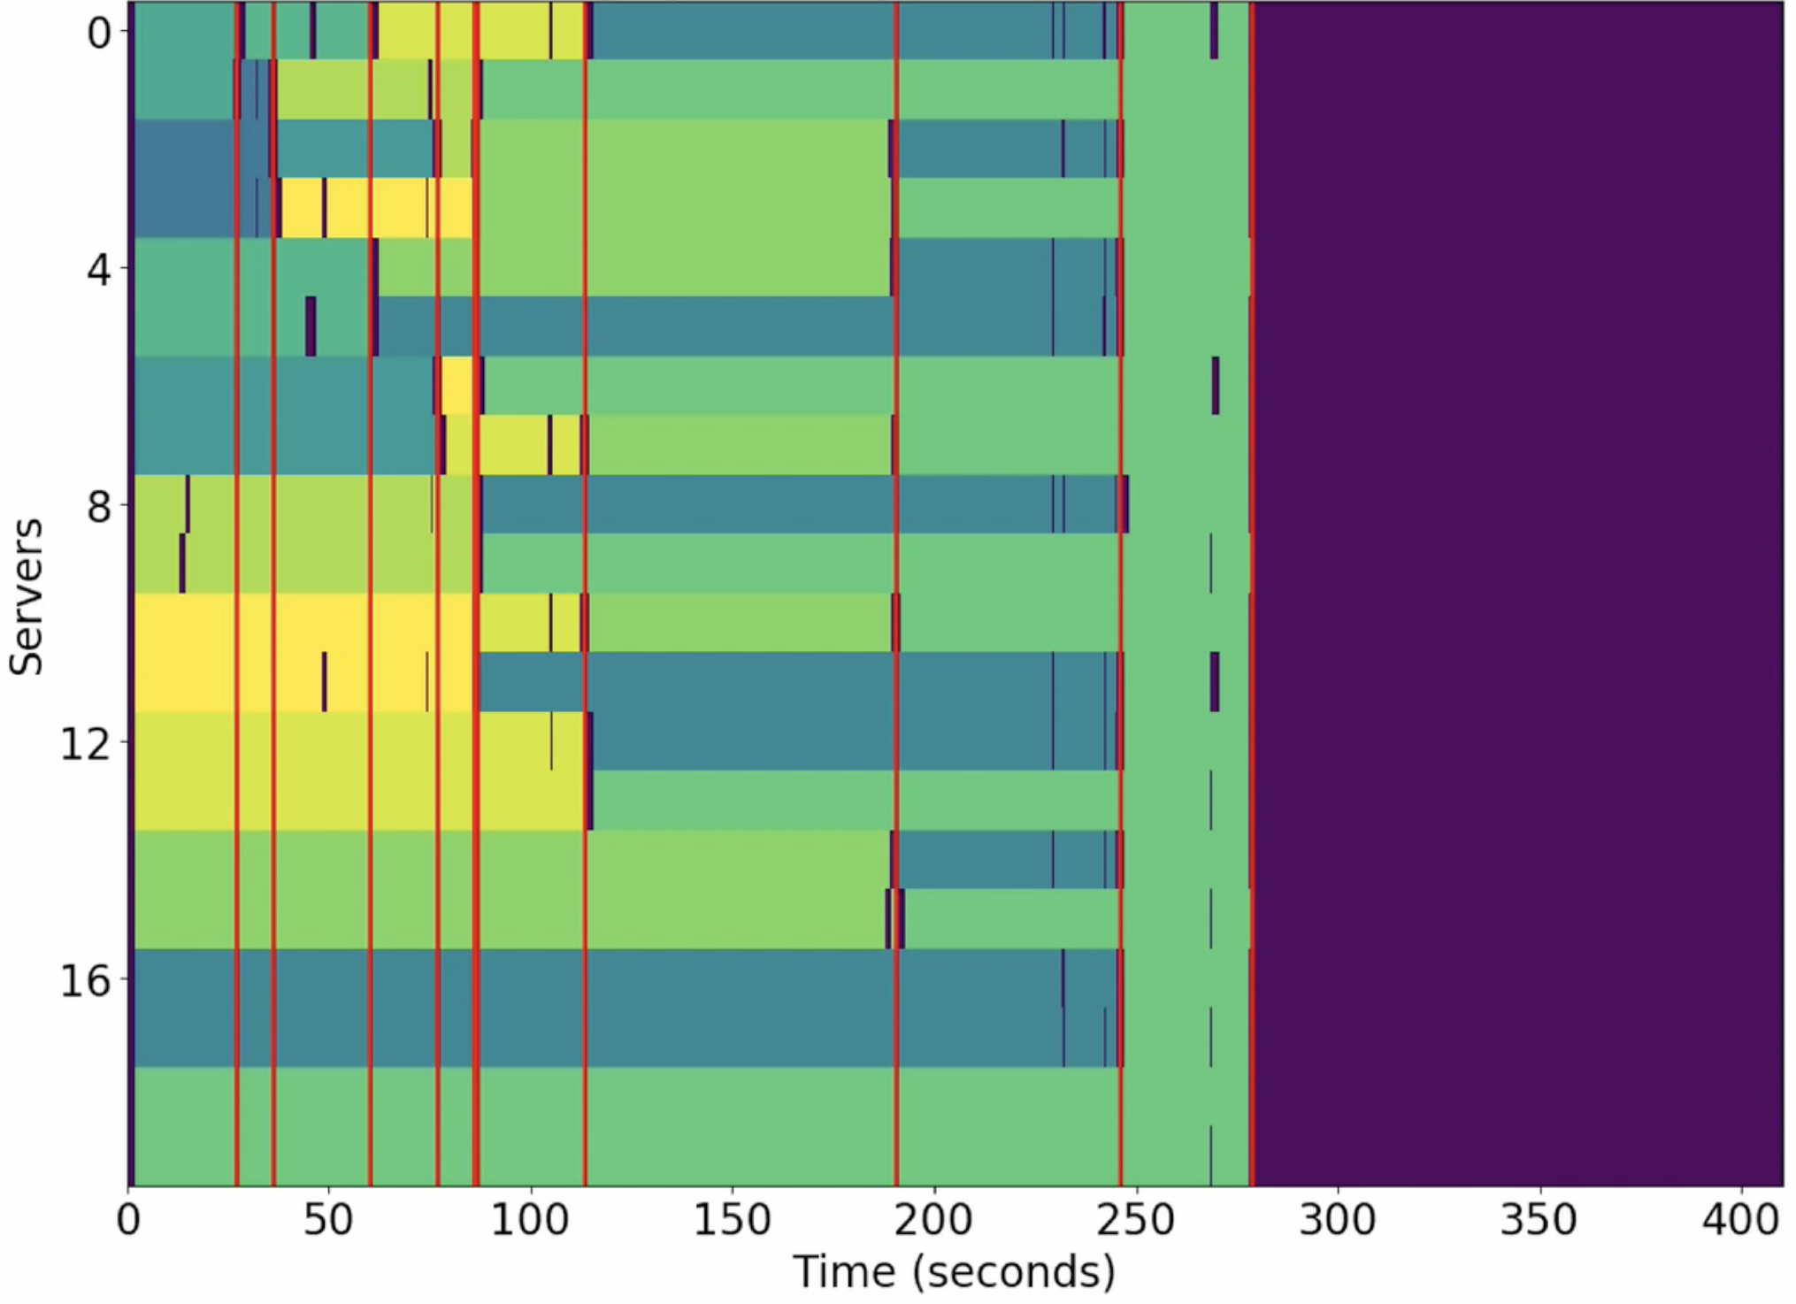
Shortest-Job-First
Fair
Average Job Completion Time:
135 sec
Average Job Completion Time:
120 sec
Notes:
Now let’s compare shortest job first and fair sharing for a second.
We would expect shortest job first to perform pretty good on average job completion time, but it turns out fair sharing is doing a lot better even though it doesn’t prioritize any small jobs.
[Click]
This is because in practice, shortest job first can generate more work.
And it turns out that the idle server time in shortest jobs first, don’t actually cover for all the extended areas.
The bulk part actually comes because each parallel server has to individually read shards of data. For some jobs, the IO dominates over the benefit of parallel compute. In other words, each job has an inherent, efficient degree of parallelism. Assigning more servers beyond the efficient point generates unnecessary work.

Slide 12

Scheduling policy: Decima
Average Job Completion Time:
98 sec
Notes:
Decima learns to leverage the advantages from shortest job first and fair sharing
[Click]
It learns to selectively focus the servers on certain small jobs to finish them quickly, while still leaving no resource idle. And more importantly, Decima learns to give each job the right amount of server so that it doesn’t generate unnecessary IO work. At the end, Decima outperforms other heuristics and achieves 89 seconds average job completion time.

Slide 13
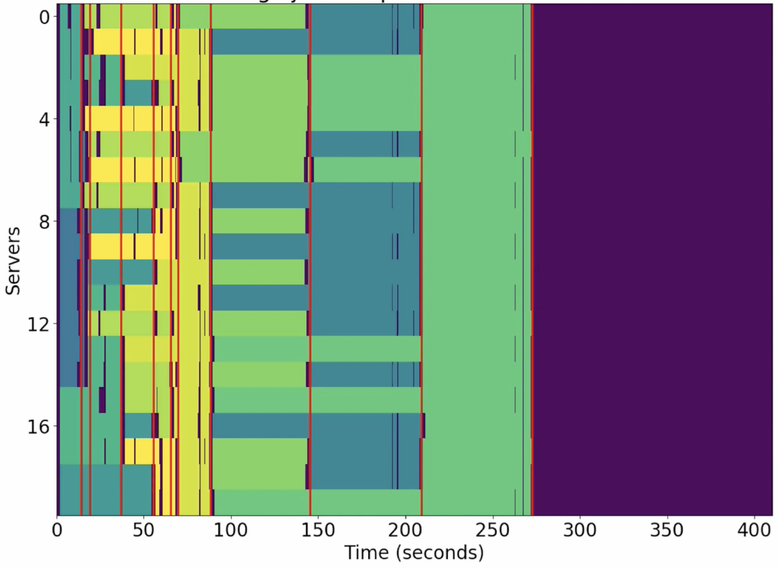
Decima
Fair
Average Job Completion Time:
98 sec
Average Job Completion Time:
120 sec
Notes:
Comparing Decima to Fair sharing,
[Click]
Decima is able to prioritize jobs much better, where it packs many small jobs to finish early on.
[Click]
And at the same time, it still uses the resource as efficient as the fair scheme.
So on this simple demo, an optimal scheduler has to weigh all different factors, like the ordering of the jobs, the resource sharing, and the inherent degree of parallelism. Optimizing the scheduler based on different systems and different workload is very tedious and difficult. Decima automates the process of finding an efficient scheduling policy using the experience of interacting with a cluster.

Slide 14
Contributions
1. First RL-based scheduler for complex data processing jobs
2. Scalable graph neural network to express scheduling policies
3. New learning methods that enables training with online job arrivals
Notes:
Our main contributions with Decima is that it is the first time to show it is even possible to apply reinforcement learning to cluster scheduler that can handle complex data processing jobs.
[Click]
To successfully learn efficient scheduling algorithms in practice, we encountered several challenges. Decima goes beyond just applying off-the-shelf reinforcement learning algorithms.
The cluster needs to handle job DAGs with arbitrary shape and size. We therefore develop a special graph neural network that can process this kind of input and express scheduling actions.
[Click]
Moreover, we develop new learning methods that enables reinforcement learning training for jobs with online, stochastic arrival pattern.

Slide 15
Encode scheduling decisions as actions
Server 1
Job DAG 1
Server 2
Set of identical
free executors
Server 3
Server 4
Job DAG n
Server m
Notes:
To use reinforcement learning, we first need to express the scheduling problem in RL framework. Scheduling is essentially expressing a mapping between runnable stage and available servers. Now the question is how we encode this mapping to make reinforcement learning training easier.

Slide 16
Option 1: Assign all Executors in 1 Action
Server 1
Job DAG 1
Server 2
Server 3
Server 4
Job DAG n
Problem: huge action space
Server m
Notes:
As a simple attempt, one option is to just directly ask the agent to
[Click]
output the mapping. This immediately results
[Click]
in an exponentially large action space because the action space has to contain every single possible mapping.
This quickly becomes infeasible to express when the number of jobs or servers becomes large.

Slide 17
Option 2: Assign One Executor Per Action
Server 1
Job DAG 1
Server 2
Server 3
Server 4
Job DAG n
Problem: long action sequences
Server m
Notes:
Another option is to output the mapping through a sequence of actions. Each action decides the assignment of one node onto a single server. Each action only needs to pick the node, so this reduces the action space to number of nodes in the system.
[Click]
But this will lead to very long action sequence because at each scheduling event there can be as many actions as the number of free servers. Long action sequence is known to be a hard problem for reinforcement learning since it is hard for assign credit to an action for the reward signal.

Slide 18
Decima: Assign Groups of Executors per Action
Server 1
Use 1 server
Job DAG 1
Server 2
Use 1 server
Server 3
Use 3 servers
Server 4
Job DAG n
Action = (node, parallelism limit)
Server m
Notes:
Decima uses a two-dimensional action design to balance between the size action space and the length of action sequence. For each action, it outputs a node selection and the number of servers assigned to this node.
[click]
So from a pool of identical servers, at each step, we will pick a node and specify a number for how many servers to run this node.
[click]
In the next round, we will pick a different node, and assign it some servers from the remaining pool.
[click]
This process continues until all available servers have destined nodes to run.
By expressing the parallelism limit as a single number at each action, this design increases the action space a little bit but reduces the sequence length by a lot.
In our experiment, we also find this is the only design that allows us to efficiently train Decima

Slide 19
Process Job Information
Node features:
# of tasks
avg. task duration
# of servers currently assigned to the node
are free servers local to this job?
Job DAG 1
Arbitrary number of jobs
Job DAG n
Notes:
Now we need a way to process the job information.
Notice that standard RL applications use neural network to process vectorized features like images.
But our scheduling problem requires the RL agent to take graph structured input.
[Click]
Each node in the graph, embed the information in a raw feature vector, which includes information like the number of tasks, the task duration, number of servers already assigned to the node and so on.
[Click]
Also, the number of jobs in the system is not pre-determined with online job arrival.
Therefore, we need a scalable way to process the information embedded in any number of job DAGs.

Slide 20

Graph Neural Network
8
6
3
2
Score on each node
Job DAG
Notes:
To do this, we adopt the idea of graph neural network.
In the interest of time, I can’t go into the details.
[Click]
But the high level concept is that graph neural network can express multiple functions over the graph, like assigning scores to each node.
What makes GNN scalable is that the function is broken into small, local operation everywhere in the graph. In our paper, we also describe how we customize GNN for our scheduling application.

Slide 21
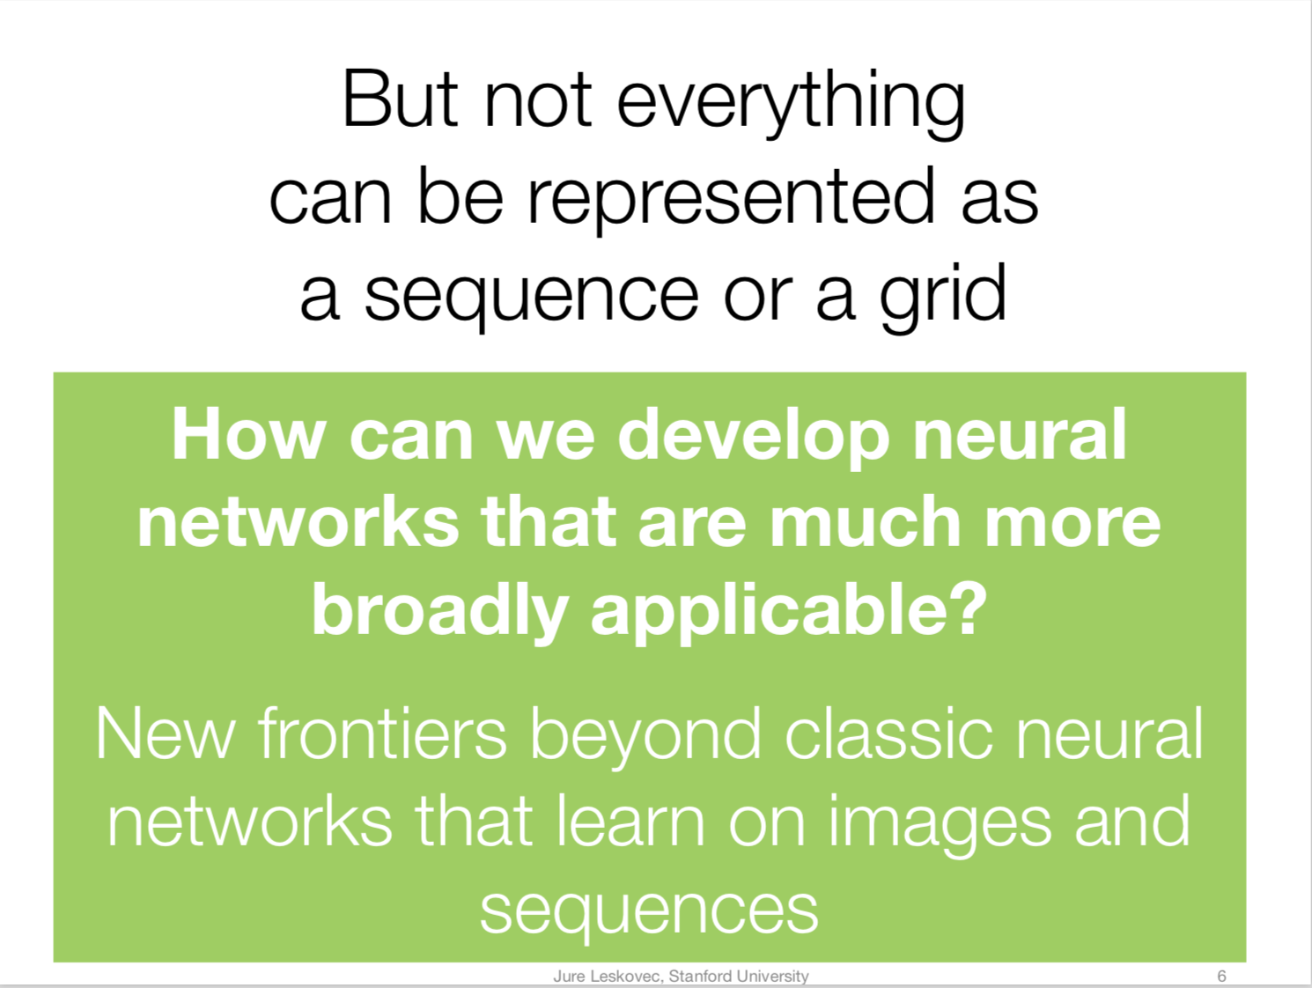
How Powerful are Graph Neural Networks [KDD2019], Jure Leskovec et al.

Slide 22
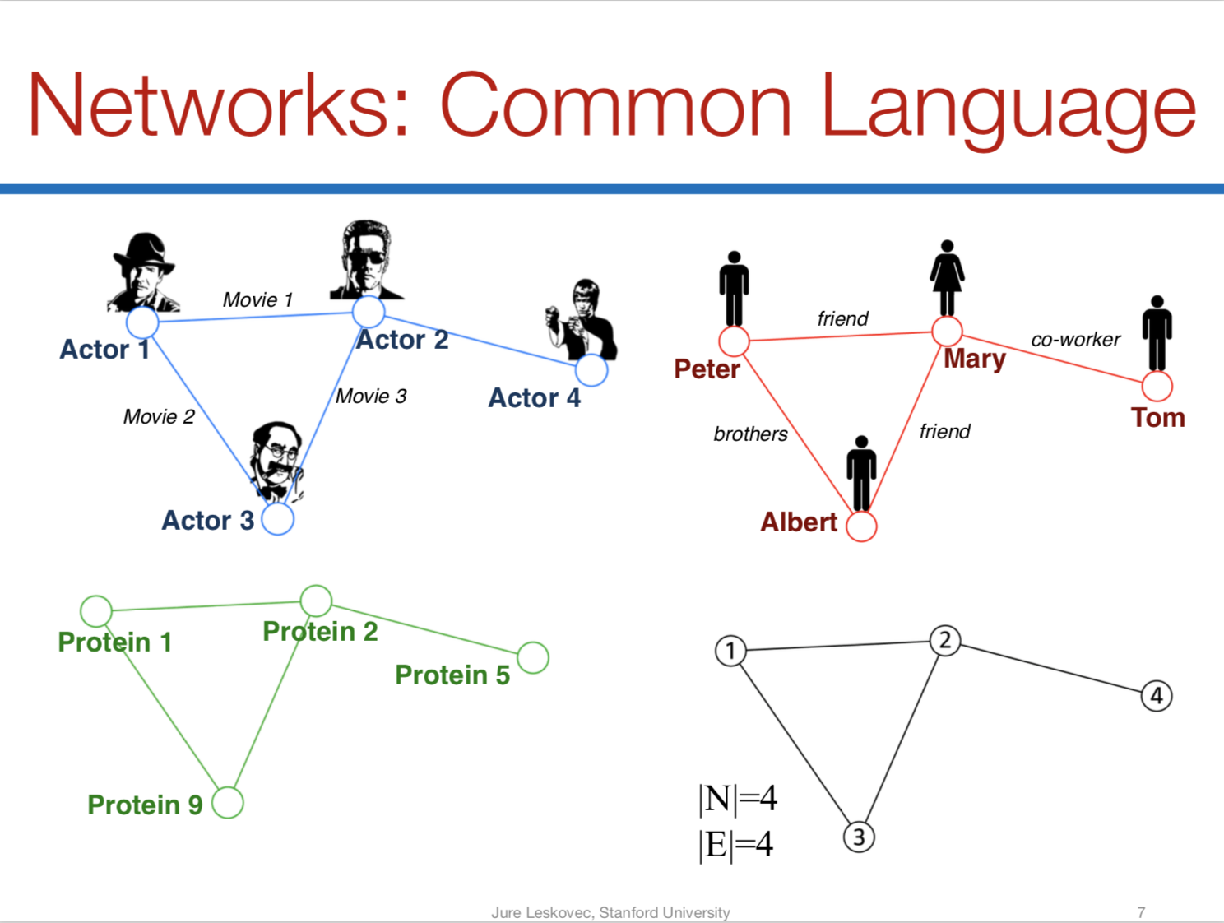

Slide 23
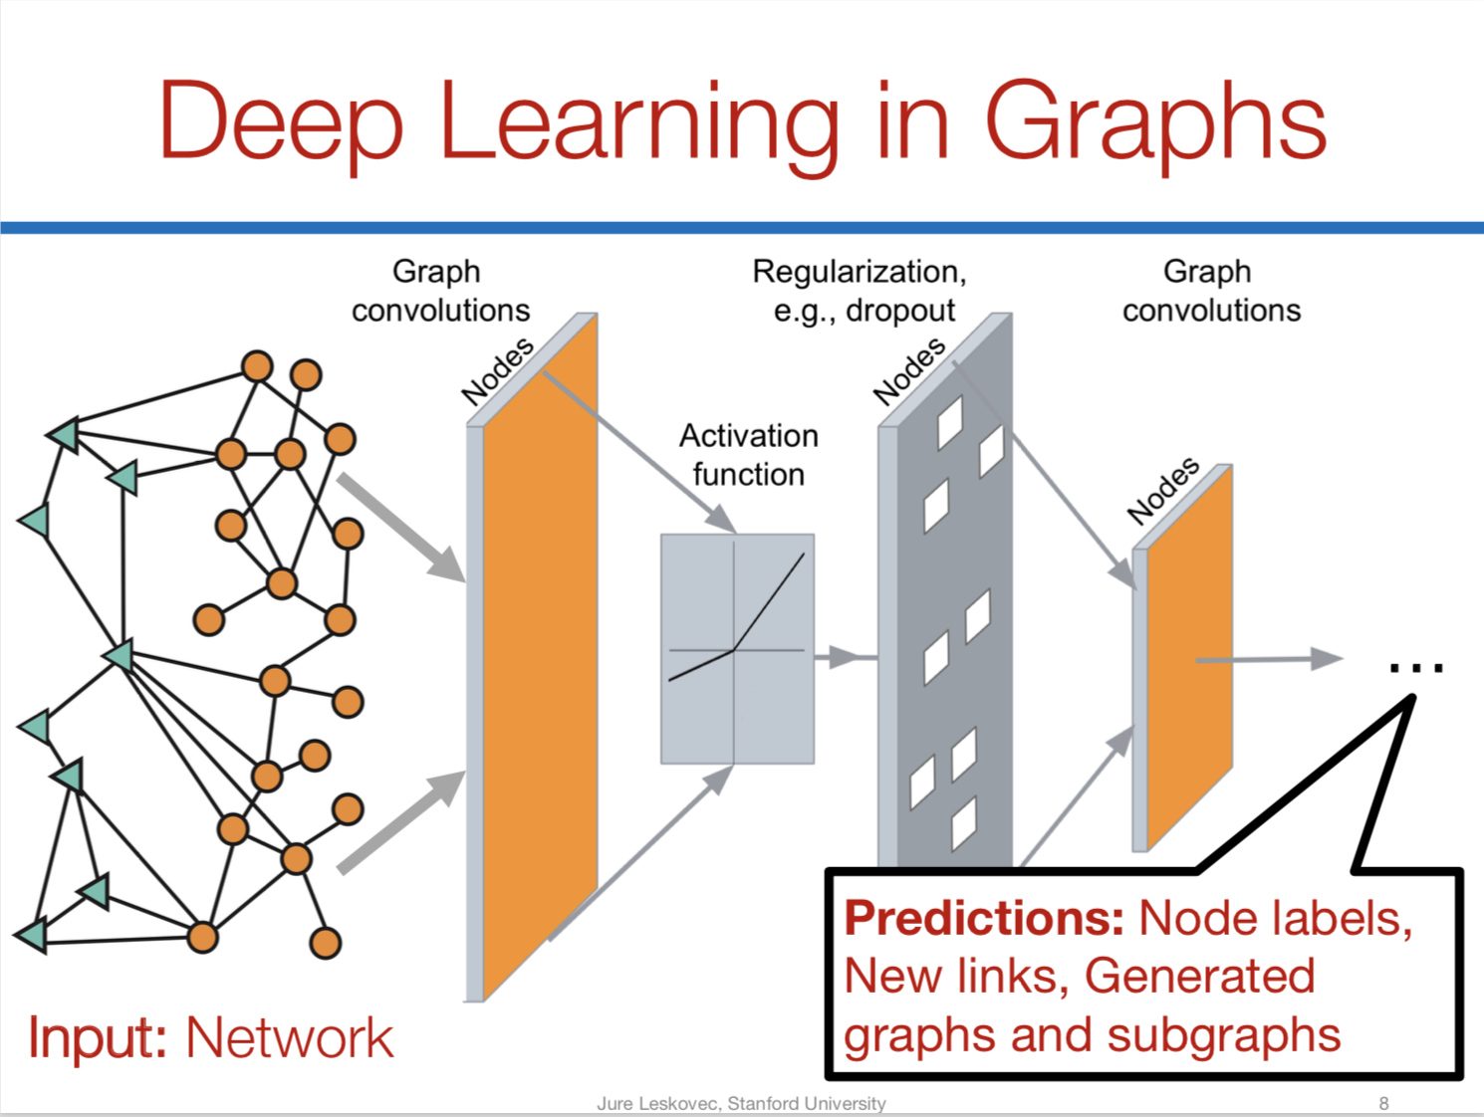

Slide 24
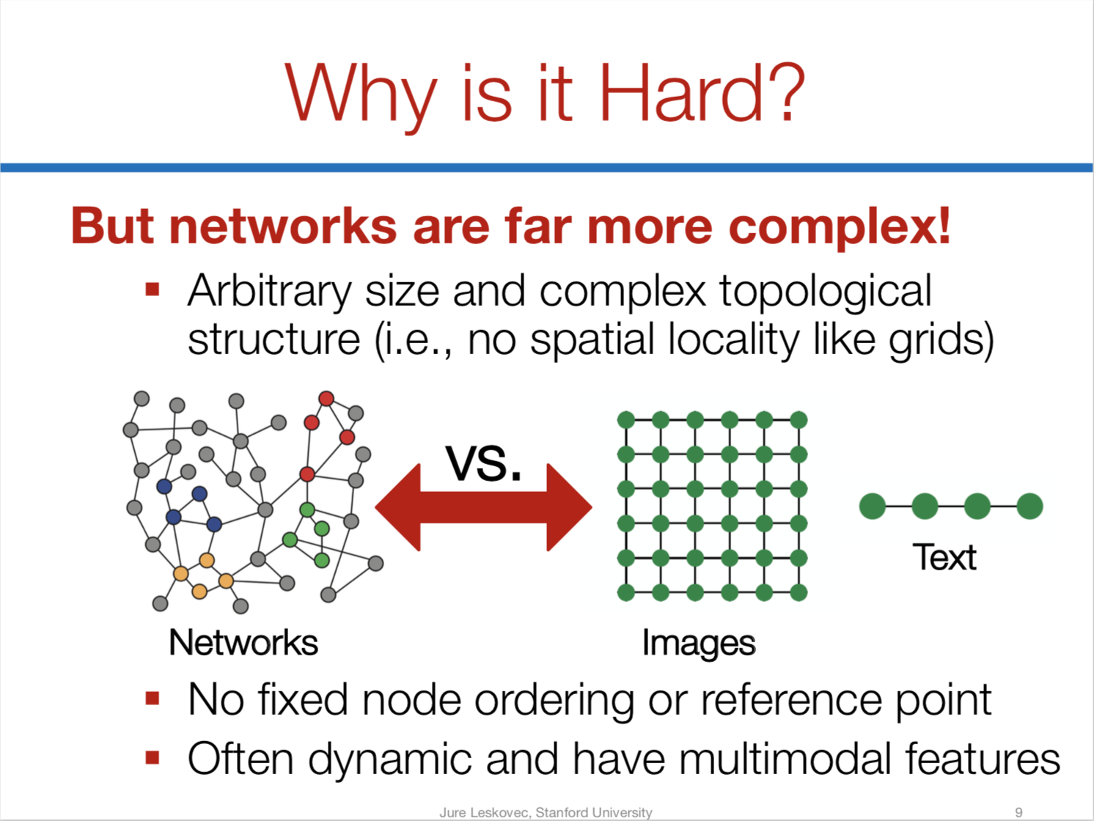
Notes:
任意大小和复杂的拓扑结构（即没有像网格那样的空间局部性）；
无固定节点顺序或参考点；
通常是动态的，具有多模态特征；

Slide 25
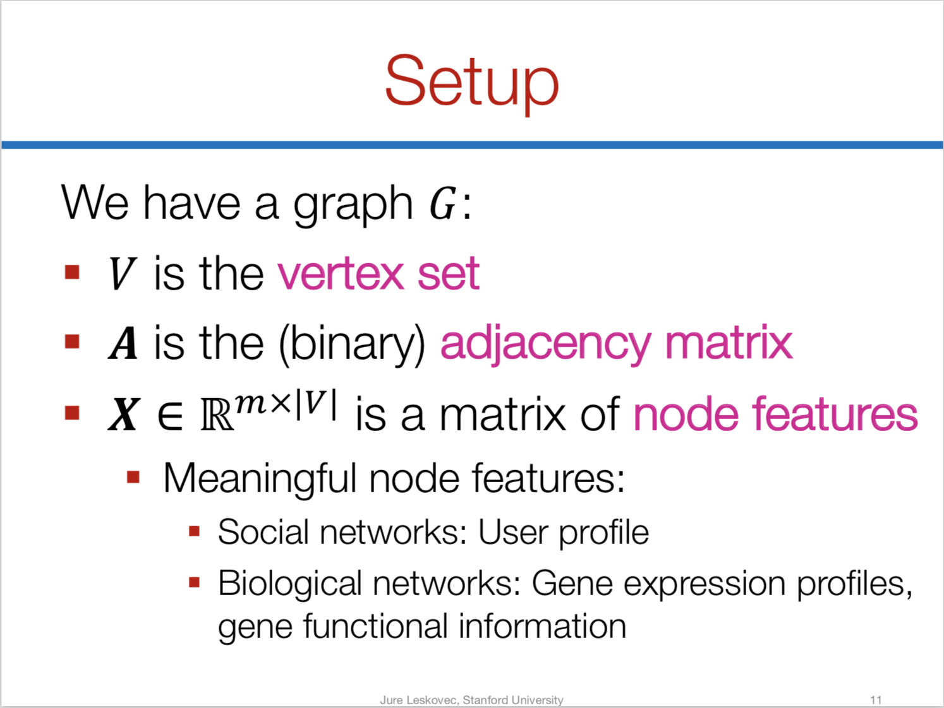

Slide 26
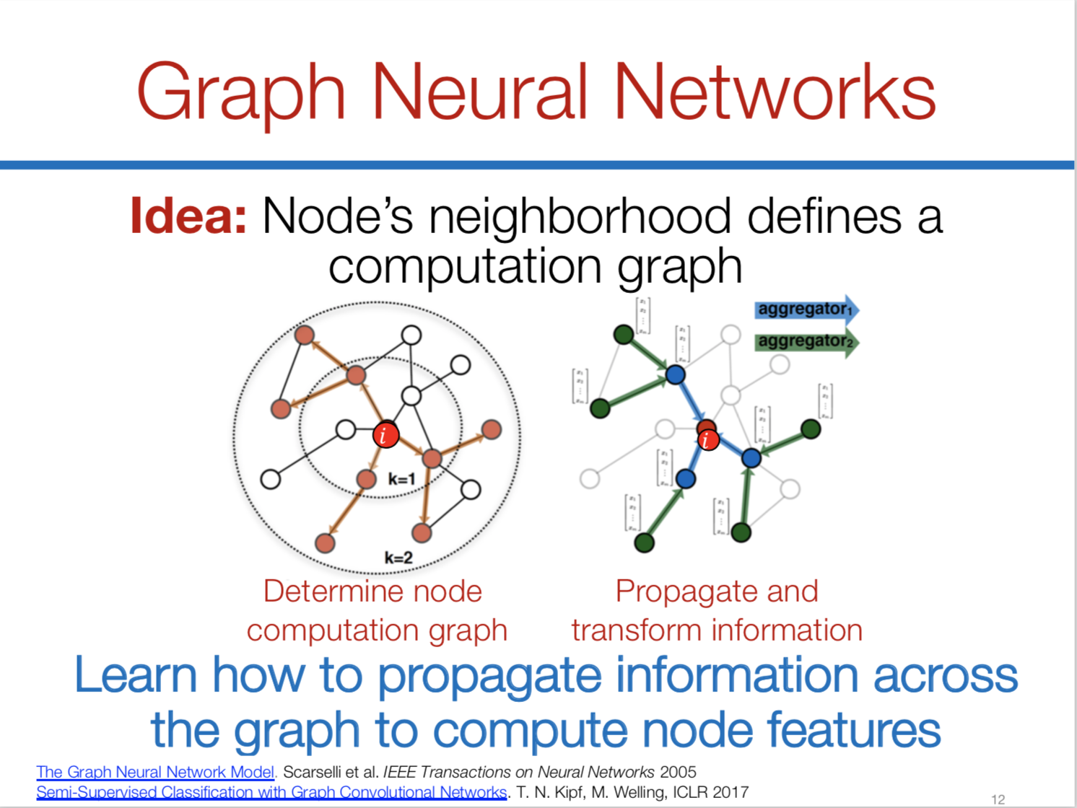
i
k=1
k=2

Slide 27
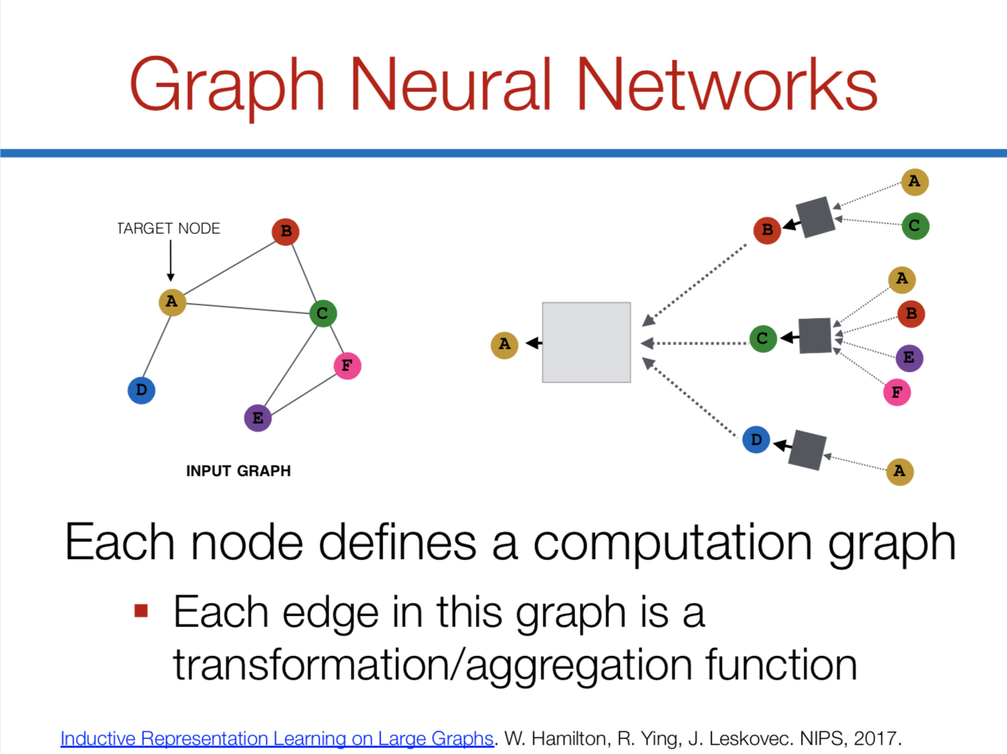

Slide 28
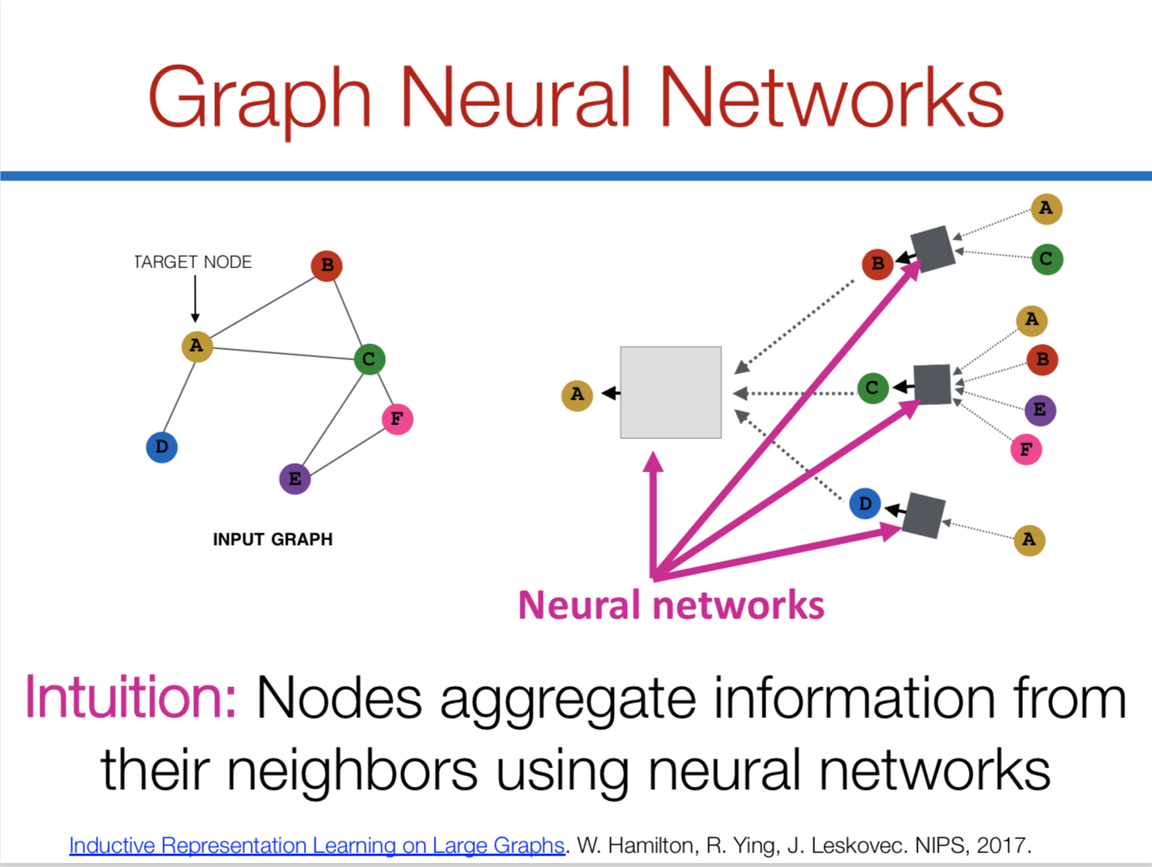

Slide 29
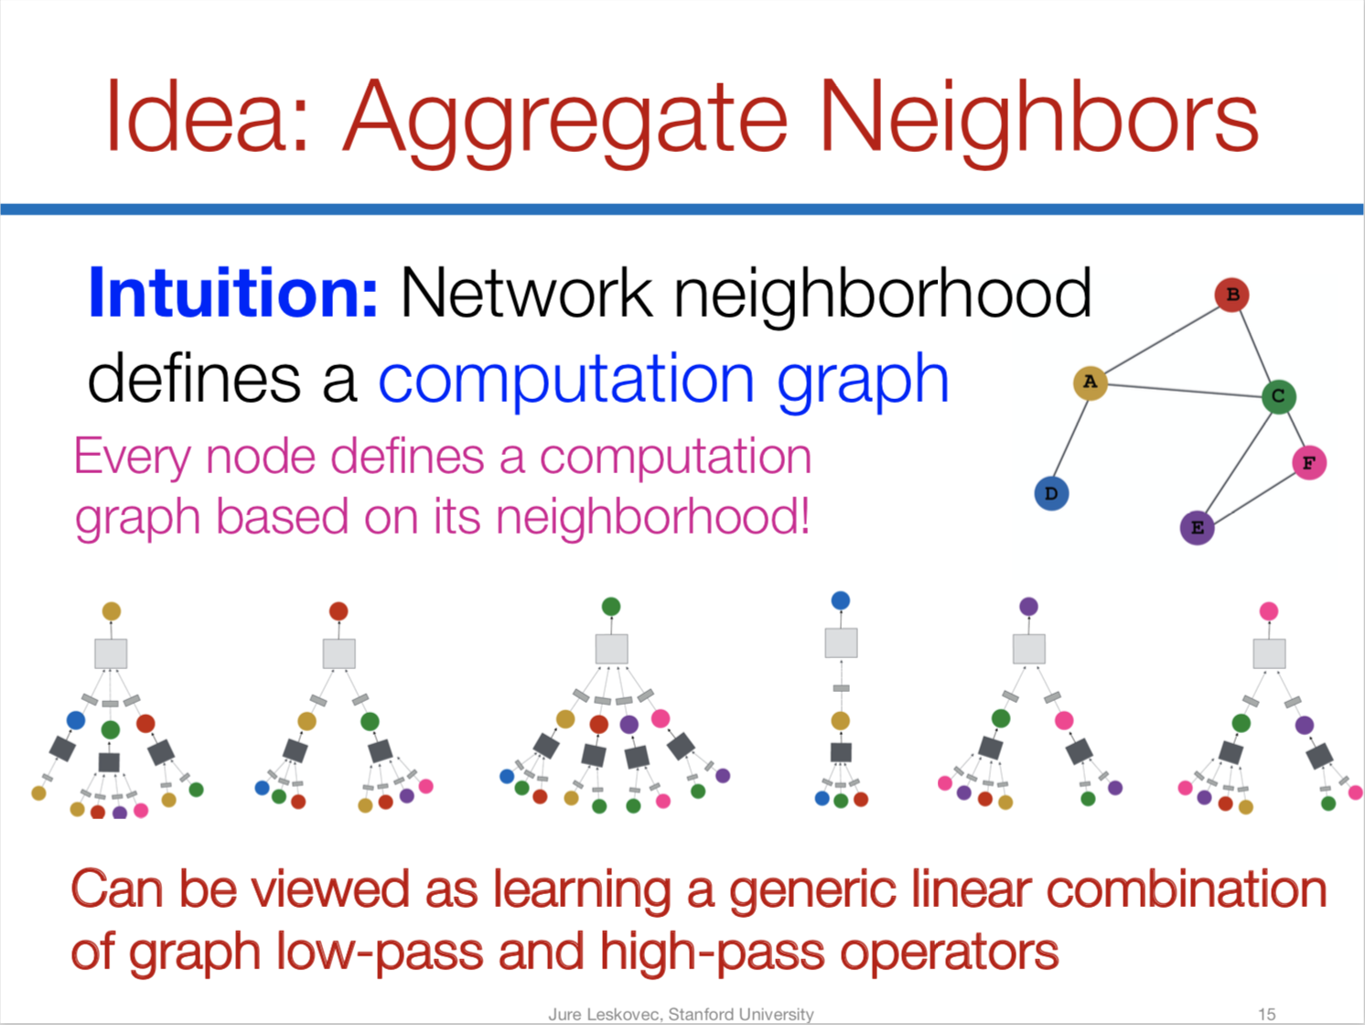

Slide 30
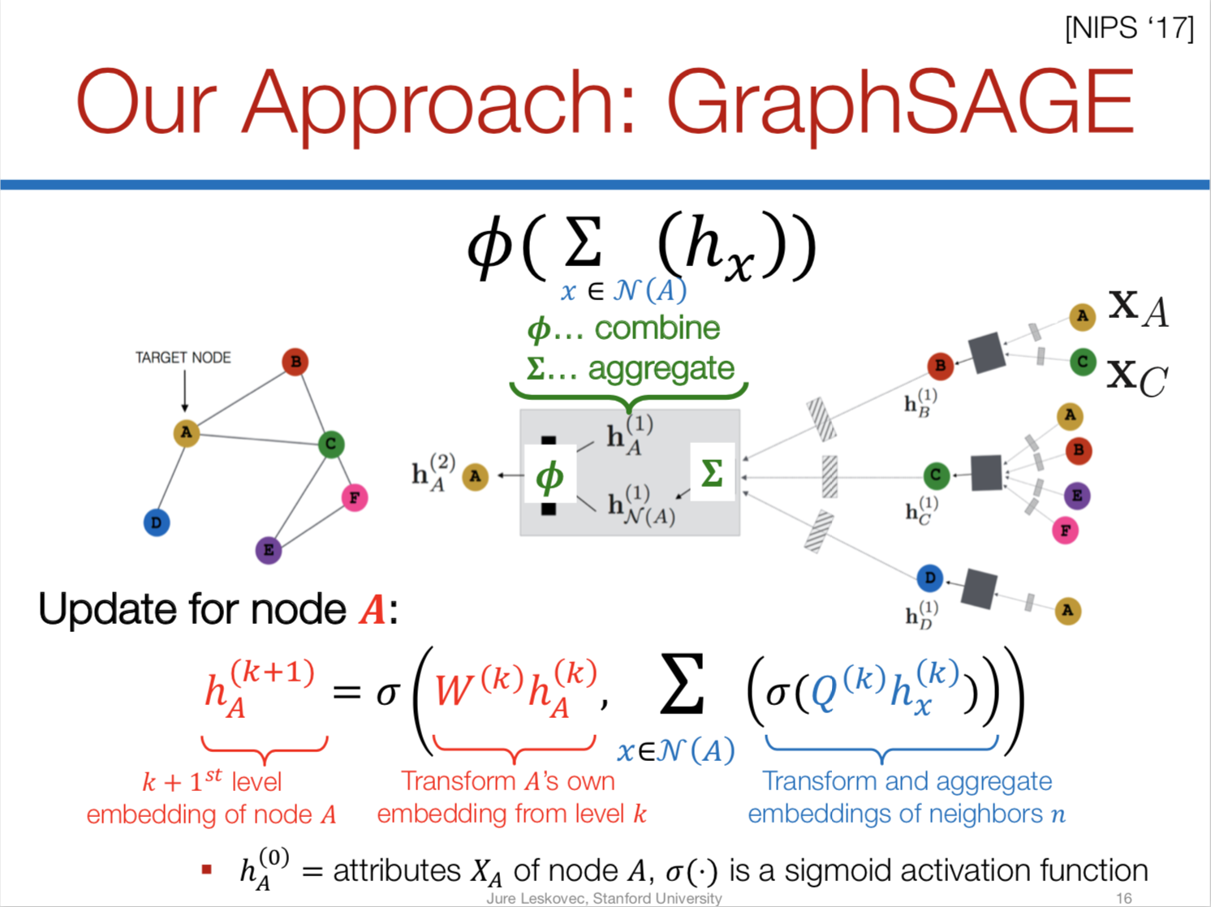

Slide 31
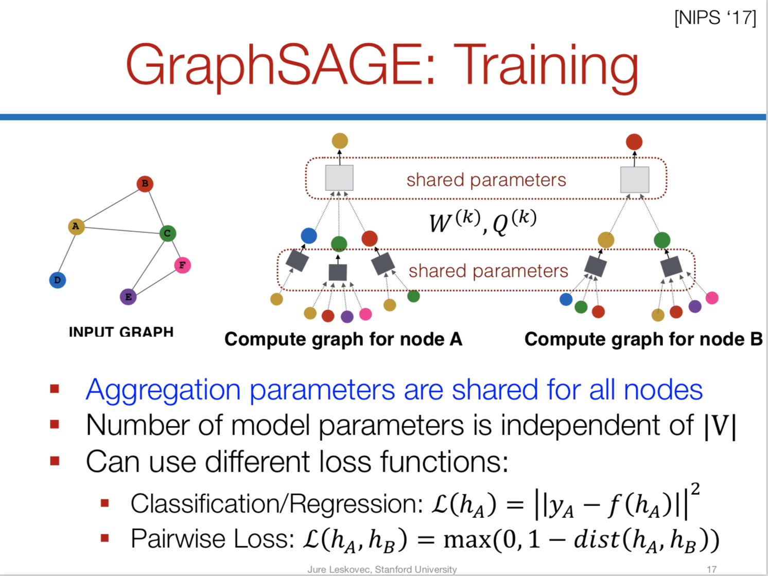

Slide 32
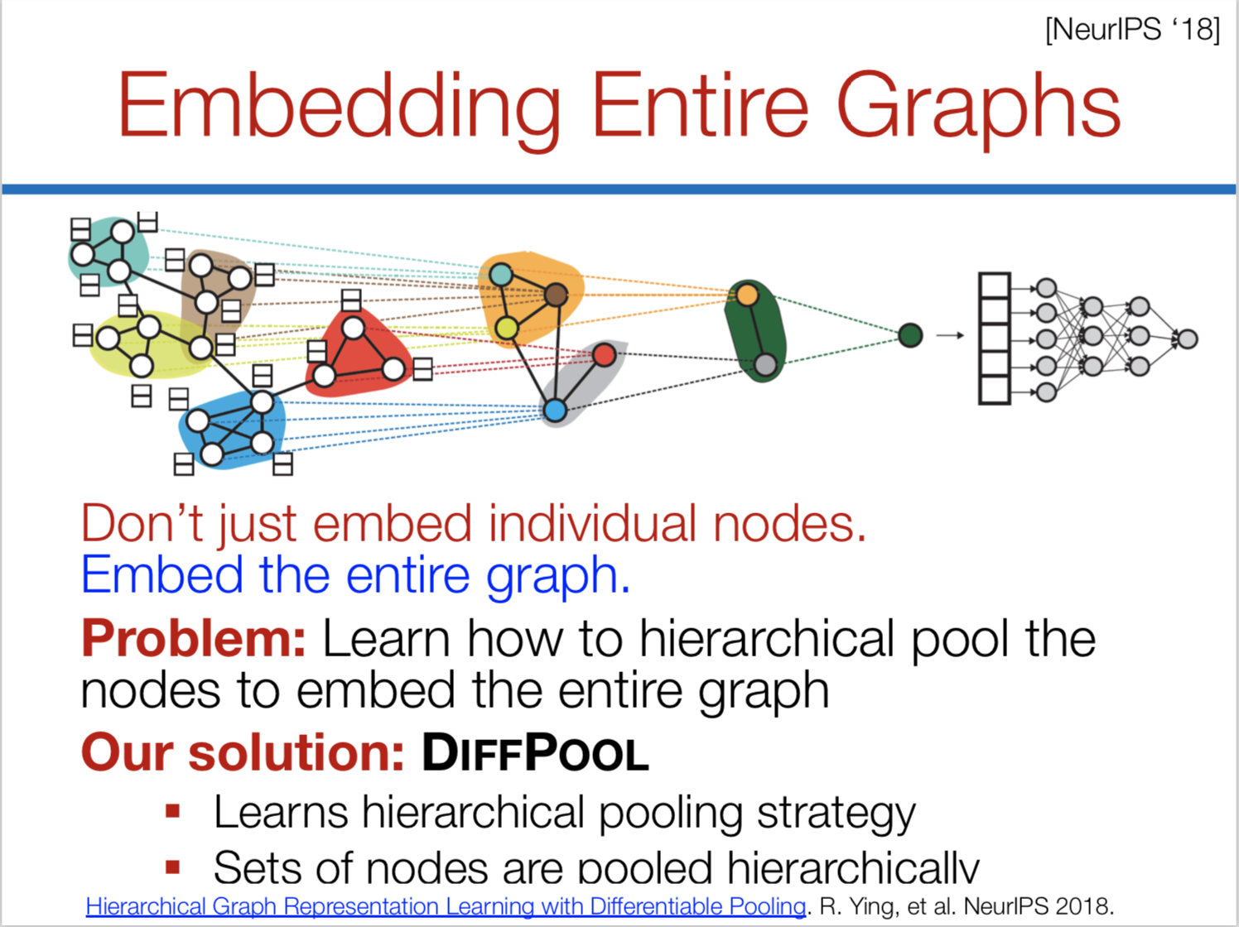

Slide 33
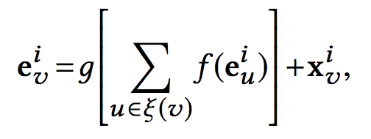
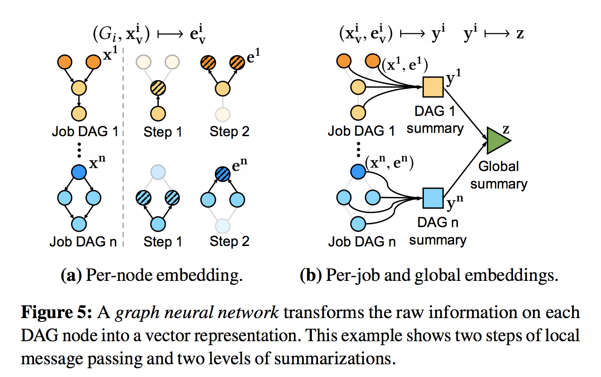
Graph Neural Network in Decima
f() and g() are non-linear transformations over vector inputs, implemented as (small) neural networks
per-node embeddings
  capture information about the node and its children
  e.g., #tasks at the node, and the aggregated work along the critical path starting from the node
per-job embeddings
  aggregate information across an entire job DAG
  e.g., the total work in the job
a global embedding
  combines information from all per-job embeddings into a cluster-level summary
  e.g. , the number of jobs and the cluster load
can learn the critical path
Node v’s children
Notes:
the graph embedding takes as input the job DAGs whose nodes carry a set of stage attributes (e.g., the number of remaining tasks, expected task duration, etc.), and it outputs three different types of embeddings:
(1) per-node embeddings,whichcaptureinformationaboutthenode
and its children (containing, e.g., aggregated work along the crit-
ical path starting from the node);
(2) per-job embeddings,whichaggregateinformationacrossanentire
job DAG (containing, e.g., the total work in the job); and
(3) a global embedding,whichcombinesinformationfromallper-job embeddings into a cluster-level summary (containing, e.g., the
number of jobs and the cluster load).

Slide 34
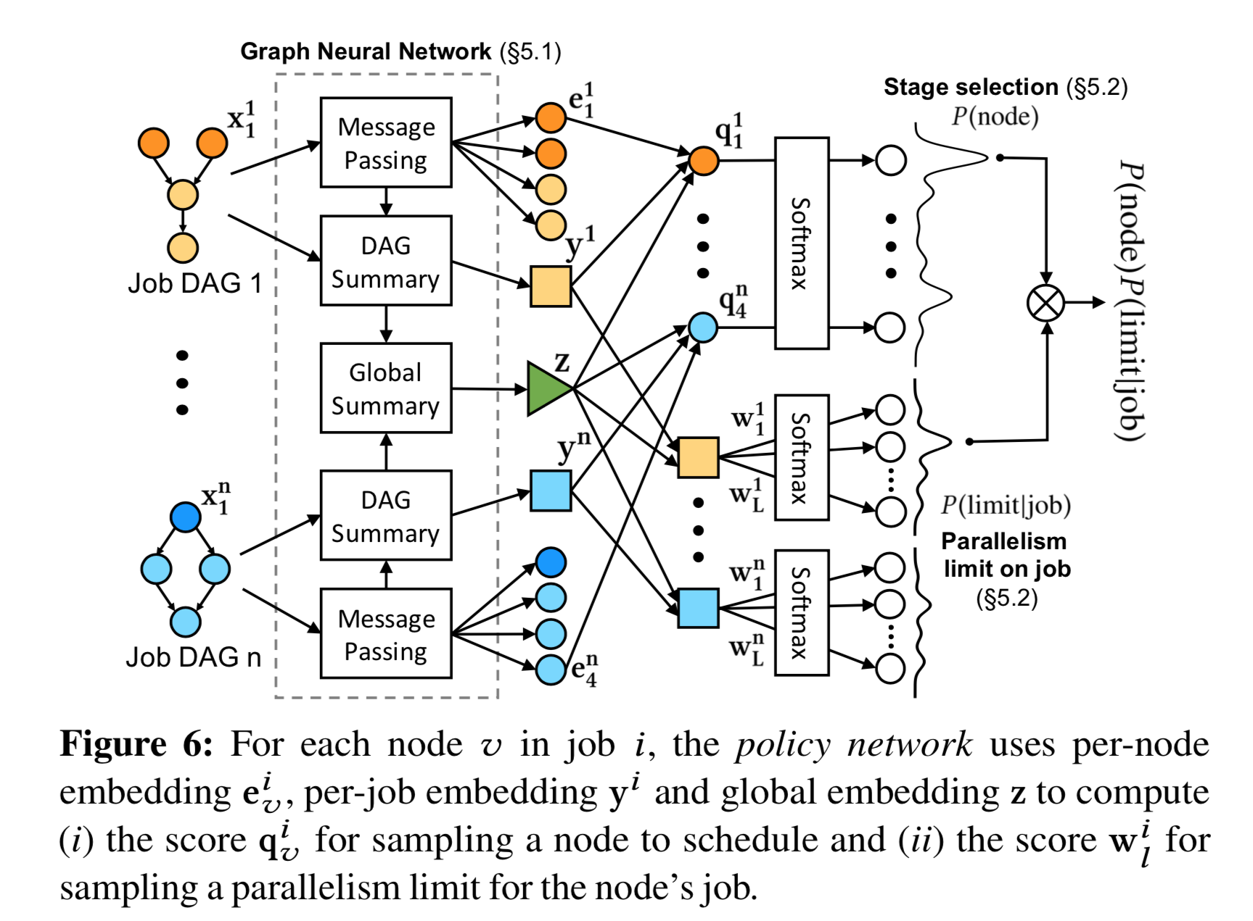

Slide 35


Training
Generate experience data
Reinforcement learning training
Decima agent
cluster
Notes:
Now we established the problem setup in RL framework. We need to do training. Reinforcement learning trains the agent using experience data. The agent interacts with the environment and records tuples of state-action-rewards – under a certain occasion, I take an action, what’s the impact. Reinforcement learning will change the agent parameter for better rewards. To do this kind of training in our scheduling problem, there’s a few challenges.

Slide 36
Handle Online Job Arrival
The RL agent has to experience continuous job arrival during training.
→ inefficient if simply feeding long sequences of jobs
Initial random policy
Number of backlogged jobs
Time
Notes:
The first challenge I want to highlight, is that in practice jobs arrive in a continuous streaming fashion.
[Click]
To handle the continuous job arrival, the reinforcement learning agent has to experience this arrival pattern during training.
[Click]
Why is this difficult? Well, we find that the training is very inefficient if we just simply feed the agent with many long sequences of jobs right from the beginning.
The reason is that the RL training starts from scratch – the initial random policy performs very poorly. The agent can not schedule to finish the jobs as quickly as they arrive.
[Click]
If we monitor the number of backlogged jobs in the system over time,
[Click]
we will see the agent is simply overwhelmed by too many jobs coming. And the jobs just keep queuing up without being processed.
[Click]
This happens for all initial training iterations.

Slide 37
Handle Online Job Arrival
The RL agent has to experience continuous job arrival during training.
→ inefficient if simply feeding long sequences of jobs
Initial random policy
Number of backlogged jobs
Waste training time
Time
Notes:
Now, letting the agent explore beyond a few steps in these early iterations wastes training time
because this overloaded cluster scenarios will not occur with a reasonable scheduling policy – clusters normally don’t operate in this region – the learned policy would not generalize if we keep training it with the experience data from this region

Slide 38
Handle Online Job Arrival
The RL agent has to experience continuous job arrival during training.
→ inefficient if simply feeding long sequences of jobs
Initial random policy
Number of backlogged jobs
Early reset for initial training
Time
Notes:
So what we do is to early terminate the RL exploration for the initial iterations so that the agent can reset and try again from an idle cluster state.

Slide 39
Handle Online Job Arrival
The RL agent has to experience continuous job arrival during training.
→ inefficient if simply feeding long sequences of jobs
Curriculum learning
Increase the reset time
As training proceeds, stronger policy keeps the queue stable
Number of backlogged jobs
Time
Notes:
As the training progresses, the agent improves its scheduling policy and can keep the cluster stable for longer time.
[Click]
At this point, we gradually increase the job sequence length to let the system run longer before resetting. This makes the scheduling problem more challenging and steers the agent to learn stronger scheduling policies over time.
[Click]
This concept of increasing the learning difficulty level during training, is a form of curriculum learning.
Humans and animals learn much better when the examples are not randomly presented but organized in a meaningful order which illustrates gradually more concepts, and gradually more complex ones. Here, we formalize such training strategies in the context of machine learning, and call them “curriculum learning”.

Slide 40
Variance from Job Sequences
RL agent needs to be robust to the variation in job arrival patterns.
→ huge variance can throw off the training process
Notes:
The second challenge we discovered is more subtle. A strong scheduler needs to be robust to variations in the job sequences. It is also well known that in practice the job size distribution is heavy tailed, which create huge amount of variance. In order for the scheduling agent to learn robust scheduling policy against workload variation, we need the training dataset to contain a wide variety of job arrival patterns.
Now this variance in the job arrival pattern can throw off the reinforcement learning training process.

Slide 41
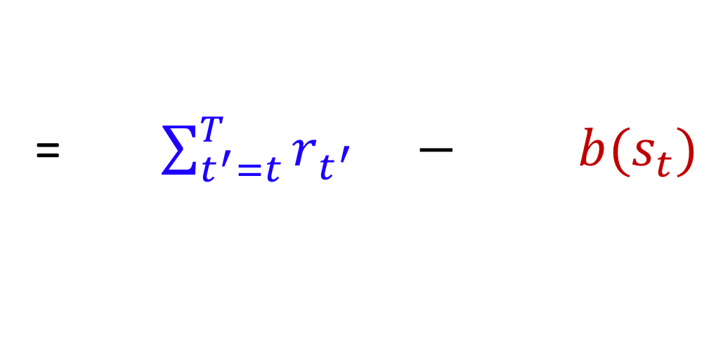
Variance from Job Sequences
Future
workload #1
action a_{t}
Job size
Must consider the entire job sequence to score actions
Future
workload #2
Time
t
Score for action a_{t} = (return after a_{t}) $−$ (average return)
= $\sum_{t^{′}=t}^{T}{r_{t^{′}}} − b(s_{t})$
Notes:
Let me use an example to show this problem
[Click]
Let’s say we have a few jobs arrived over time. At time t, we make a scheduling action a_t.
[Click]
Recall that reinforcement learning trains the scheduling agent by assessing how good the action is from empirical data.
[Click]
It compares the empirical total reward following the action a_t with an average case baseline for state s_t. And reinforcement learning will increase the probability of the actions that lead to better-than-average rewards.
[Click]
Now after this scheduling action, just by chance there can be a burst of large jobs coming in the near future. Under this workload, the cluster is inferentially overloaded and every scheduling policy will need to take a long time to drain all the jobs. As a resuslt, the reward you receive will be very low for these large jobs.
[Click]
By contrast, a stream of small jobs is easier to handle. Any sensible scheduling policy will finish these jobs quickly and you will receive large rewards.
However, notice that the difference in reward has nothing to do with the action at step t. It’s purely due to the randomness in the job arrival pattern.
This randomness confuses the training algorithm because it relies on the reward to assess the action.
[Click]
To remove this variance, we need to explicitly take the job arrival pattern into account when estimating the score for the actions.

Slide 42
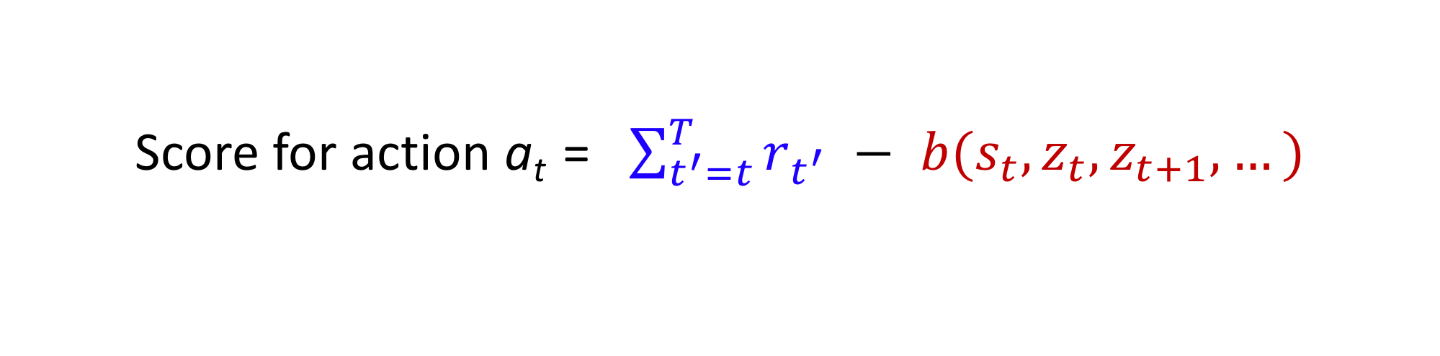
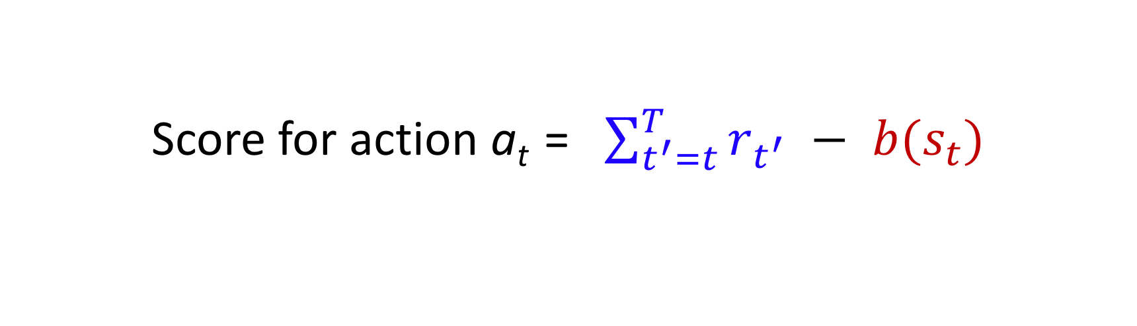
Input-Dependent Baseline
Score for action a_{t} = $\sum_{t^{′}=t}^{T}{r_{t^{′}}} − b(s_{t})$
Score for action a_{t} = $\sum_{t^{′}=t}^{T}{r_{t^{′}}} − b(s_{t},z_{t},z_{t+1},…)$
Average return for trajectories from state s_{t}
with job sequence z_{t}, z_{t+1}, …
Broadly applicable to other systems with external input process:
Adaptive video streaming, load balancing, caching, robotics with disturbance…
Variance reduction for reinforcement learning in input-driven environments. Hongzi Mao, Shaileshh Bojja Venkatakrishnan, Malte Schwarzkopf, Mohammad Alizadeh. International Conference on Learning Representations (ICLR), 2019.
Notes:
Intuitively, we want the average case baseline to depend not only on the current state, but the job arrival pattern as well. This is the idea behind an “input-dependent” baseline.
[Click]
What this new baseline means is that we want to estimate the average case reward, condition on the particular job arrival sequence that we encountered during training.
This method removes the variance from the job sequence. In our experiment, we also empirically find that it improves the performance of our scheduling policy especially when handling long sequences of job arrival.
[Click]
In fact, this technique of removing variance is applicable to many other systems that have an external input process. For example, it also applies to adaptive video streaming with the network bandwidth as external input. Even robotic applications with external disturbance can benefit from this approach. We published an ICLR paper with more mathematical details.
-
visualize z_t, z_t+1, ..

Slide 43
Decima vs. Baselines: Batched Arrivals
20 TPC-H queries sampled at random; input sizes: 2, 5, 10, 20, 50, 100 GB
Decima trained on simulator; tested on real Spark cluster
Decima improves average job completion time by 21%-3.1x
over baseline schemes
Notes:
Now I’ll show you a wide range of experiments that we did.
We first compare Decima with existing scheduling heuristics.
Here is an experiment with batch job arrival. The workload is 20 TPC-H jobs with different sizes
We train Decima with a Spark simulator. After training we evaluate Decima with unseen job combinations on a real Spark cluster.
The testbed has 50 CPUs.
For this problem, we actually sit and try very hard to hand tune a strong heuristic. The blue line is a tuned weighted fair scheme based on job size and resource sharing.
[Click]
From this CDF, Decima improves the average job completion time by 21% to 3 times over the
baseline schemes.
-
Tuned weighted fair

Slide 44
Decima with Continuous Job Arrivals
1000 jobs arrives as a Poisson process with avg. inter-arrival time = 25 sec
Better
Decima achieves 28% lower average JCT than best heuristic,
and 2X better JCT in overload
Notes:
A more realistic evaluation is with continuous job arrivals. Here we run 1000 jobs with a Poisson arrival over a period of 12 hours.
The figure on the top shows a time-series of the number of concurrent jobs in the system. We only show Decima and the best comparing heuristic.
[Click]
The bottom figure shows Decima's job runtime relative to the heuristic at each one hour period. The bar plots below one means Decima finishes the jobs faster.
On average, Decima achieves 28% lower average completion time than the best heuristic.
[Click]
More importantly, in the busy period when the cluster is heavily loaded, in which case the scheduling problem becomes more challenging, Decima achieves almost 2X better runtime than the baseline.
-
Better arrow
bottom, top, green, red, decima better
Opt. change to tuned

Slide 45
Understanding Decima
Tuned weighted fair
Decima
Tuned weighted fair
Decima
Notes:
Now to better understand what Decima is doing to outperform other schemes,
we plot the job runtimes for those 1000 streamed jobs in the y-axis, and we put the corresponding total work of each job in the x-axis. Each dot represents a job.
Empirically, Decima finishes small jobs particularly faster.
[Click]
On the right, we look at the number of servers assigned to different jobs.
[Click]
We can see that Decima prioritize small jobs by assigning them with more servers.
Notice that Decima learns to give the small jobs a right amount of servers but not too many servers, because otherwise the cluster would have been overloaded with unnecessary IO work, similar to the shortest job first you saw in the demo.

Slide 46
Flexibility: Multi-Resource Scheduling
Industrial trace (Alibaba):
20,000 jobs from
production cluster
Multi-resource requirement:
CPU cores + memory units
Notes:
Decima can also apply the same learning method to other scheduling problems like multi-resource packing
Here we use a month-long production trace from Alibaba. We train Decima using the first half of the trace and evaluate the scheduling performance on the second half.
Each job in the system requires a minimum amount of memory to run.
Using the same training method but only adding the memory requirement in the feature, Decima can learn strong scheduling policy that outperform state-of-the-art schemes like Graphene and Tetris
-
(Graphene simplified)

Slide 47
Other Evaluations
Impact of each component in the learning algorithm
Generalization to different workloads
Training and inference speed
Handling missing features
Optimality gap
Notes:
Due to time limit, I can’t cover all the details in our evaluation.
[Click]
But our paper describe the impact of each component in our learning algorithm.
[Click]
We evaluate the generalization of the learned policies in different workload or in larger clusters.
[Click]
We also measure the training and inference speed,
[Click]
how Decima handles missing features such as task duration,
[Click]
and a comparison to the offline optimal.

Slide 48

Summary
Decima uses reinforcement learning to generate workload-specific scheduling algorithms
Decima employs curriculum learning and variance reduction to enable training with stochastic job arrivals
Decima leverages a scalable graph neural network to process arbitrary number of job DAGs
Decima outperforms existing heuristics and is flexible to apply to other applications
http://web.mit.edu/decima/
Notes:
As a summary, Decima uses reinforcement learning to generate workload-specific scheduling algorithms.
Decima goes beyond just applying existing RL methods.
We developed new learning algorithms so that Decima can handle stochastic job arrivals.
Decima leverages a specially designed graph neural network to process job information and map it to an efficient scheduling action
In our experiments, Decima is able outperform existing scheduling heuristics and the techniques we build are applicable to many other systems.
More information and open sourced code can be found in our website.
With that, I’m happy to take any questions.
Thank you.

Slide 49
Critics
Depend on knowing job duration and tasks dependency
Training time: 10000 iteration (5 seconds/it). more than 12 h
=> Motivation
  Characterize workload
  Predict workload (arrival rate, job run time)
  Challenges: how to classify workload

