Slide 1




CoFlux: Robustly Correlating KPIs by Fluctuations for Service Troubleshooting
Ya Su¹, Youjian Zhao¹, Wentao Xia¹, Rong Liu², Jiahao Bu¹, Jing Zhu¹,
Yuanpu Cao³, Haibin Li¹⁴, Chenhao Niu¹, Yiyin Zhang⁵, Zhaogang Wang⁵, Dan Pei¹
1
2
3
4
5
Notes:
Thanks for the kind introduction
Hello, everyone. It’s a pleasure to be here and an honor to present my work.
I’m Ya Su from Tsinghua University. I’m going to talk about “CoFlux: Robustly Correlating KPIs by Fluctuations for Service Troubleshooting”.

Slide 2
Outline
Background
Algorithm
Evaluation
Case Studies
Notes:
My presentation includes four parts: background, algorithm, evaluation and case studies

Slide 3
Outline
Background
Algorithm
Evaluation
Case Studies
Notes:
First, let’s start with the background of this work

Slide 4







Internet-based Services
Internet-based services are everywhere.
Service interruptions are inevitable.
Service Troubleshooting is necessary but challenging because of the interweaved anomalies.
Notes:
Nowadays, Internet-based services, such as google, BING, EBAY and facebook, have become an indispensable part of our daily life. (点)
However, service interruptions are inevitable due to many reasons, such as network outages, server breakdown and malicious attacks. (点)
To keep the service reliable, operators take great efforts to do service troubleshooting, but this work is still very challenging, because when an incident trigger anomalies in some KPIs, then they may propagate to more KPIs to form interweaved anomalies.

Slide 5
KPIs and Fluctuations
KPIs (Key Performance Indicators): A set of performance metrics that monitor the service.
Fluctuations (or Flux-features): Anomalous changes in KPIs which could be indicated by prediction errors.
Notes:
During service operation, operators monitor various time series data called Key Performance Indicators such as success ratio and number of request.
Well, what are Fluctuations (or flux-features) in our paper? we use prediction errors to indicate them.
In general, normal points can be well predicted with small prediction errors,
but fluctuations are anomalous changes which are hard to be predicted with large prediction errors.
They don’t conform to the expected behavior and have difference with the normal pattern, for example, jitters and dips, just like the figure shows.

Slide 6
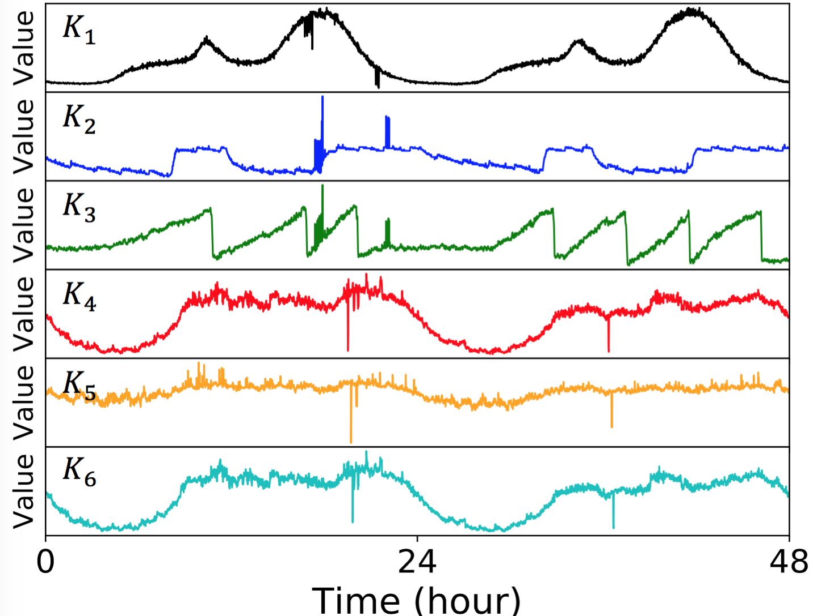
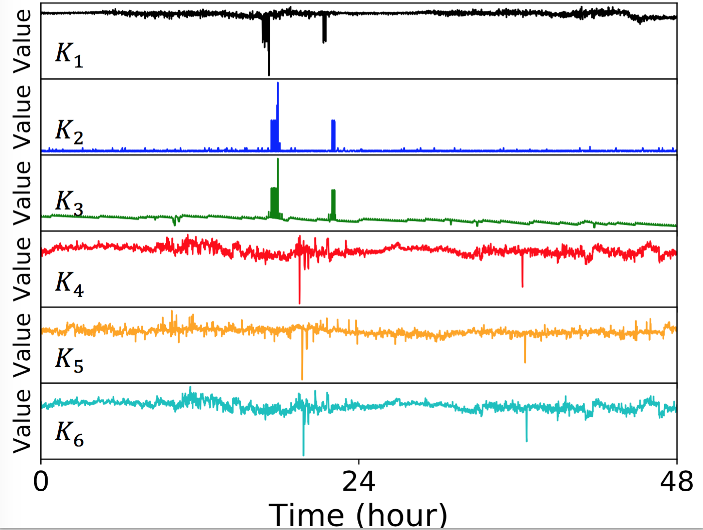
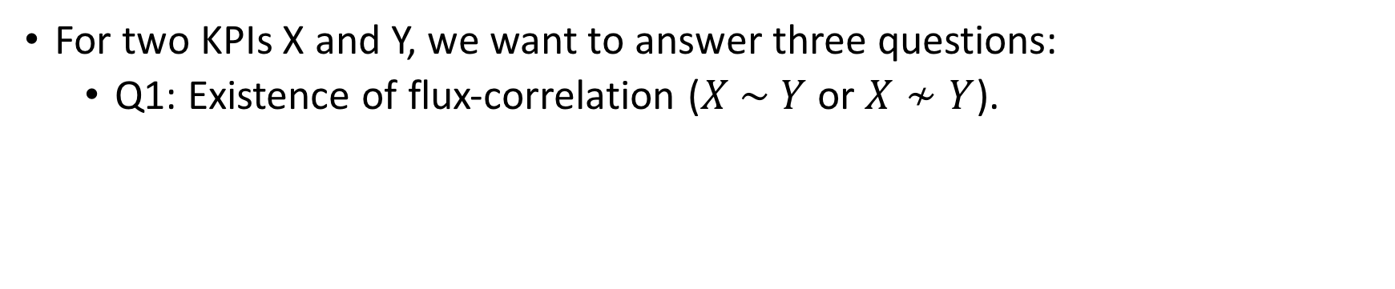
Flux-correlation
For two KPIs X and Y, we want to answer three questions:
  Q1: Existence of flux-correlation ($X \sim Y$ or $X≁Y$).
If yes, then:
(a) Six KPIs
(b) Fluctuations (Flux-feature) of the KPIs in (a)
Notes:
In this study, we want to learn the flux-correlation for a KPI pair with answering three questions.(点)
Question 1, we determine whether their fluctuations are correlated.
For example, figure shows six KPIs and their flux-features. (点)
The flux-features of K1 and K2 look highly correlated, so they are flux-correlated(点)
K1 and K4 are not flux-correlated. (点)
If two KPIs are flux-correlated, we then answer Question 2 and 3:

Slide 7
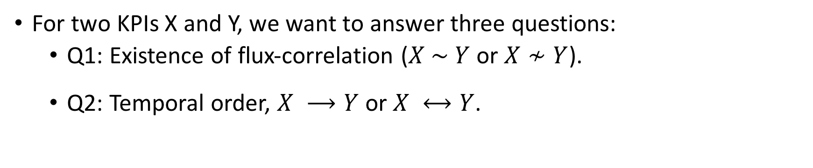
Flux-correlation
For two KPIs X and Y, we want to answer three questions:
  Q1: Existence of flux-correlation ($X \sim Y$ or $X≁Y$).
  Q2: Temporal order, $X ⟶Y$ or $X ⟷Y$.
If yes, then:
(a) Six KPIs
(b) Fluctuations (Flux-feature) of the KPIs in (a)
Notes:
Question 2, temporal order, the fluctuations from two flux-correlated KPIs may be synchronized or shifted by some intervals. (点)
In the figure, the fluctuations of K2 and K3 happen at the same time. (点)
While K1 fluctuates before K2.
sɪŋkrənaɪzd

Slide 8
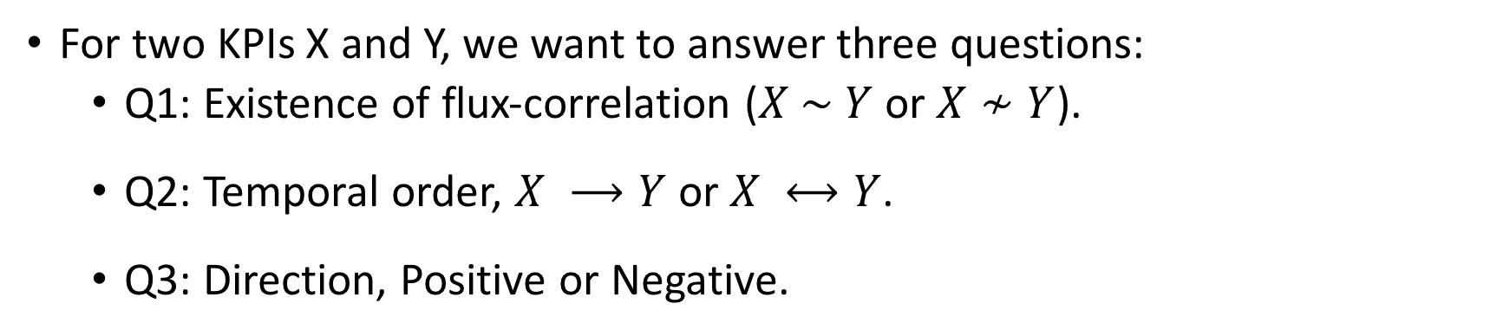
Flux-correlation
For two KPIs X and Y, we want to answer three questions:
  Q1: Existence of flux-correlation ($X \sim Y$ or $X≁Y$).
  Q2: Temporal order, $X ⟶Y$ or $X ⟷Y$.
  Q3: Direction, Positive or Negative.
If yes, then:
(a) Six KPIs
(b) Fluctuations (Flux-feature) of the KPIs in (a)
Notes:
Question 3, direction, the flux-correlation of two KPIs can be positive or negative. If the fluctuation of X is an increase but the corresponding fluctuation of Y is a decrease, their flux-correlation is negative. On the other hand, it is positive. (点)
In the figure, K2 and K3 have positive flux-correlation (点)
but K1 is negatively flux-correlated with K2

Slide 9

Goal
Alert Compression
Flux-correlations of KPIs
Service
Troubleshooting
Recommending TOP N causes
Constructing Fluctuation Propagation Chains
Notes:
Our goal is to determine the flux-correlations of two KPIs which can assist the operators to do service troubleshooting via alert compression, recommending Top N causes, and constructing fluctuation propagation chains

Slide 10
Related Work
 | Traditional Correlation methods |  |  |  |  | Statistical models from other fields
 | Pearson Correlation | Spearman Correlation | Granger causality ^{[ICDM 2012]} | Cross Correlation | J-measure ^{[SIGKDD 2014]} | SIG ^{[DSN 2010]} | VARMA | Co-Integration
Fluctuation analysis | ✘ | ✘ | ✘ | ✘ | ✔ | ✔ | ✘ | ✘
Temporal order | ✘ | ✘ | ✔ | ✔ | ✘ | ✔ | ✘ | ✘
Direction | ✔ | ✔ | ✘ | ✔ | ✘ | ✘ | ✘ | ✘
Notes:
Although flux-correlation is very important, there exist little related work. The existed work can be divided into two categories: traditional correlation methods and statistical models from other fields
Pearson and Spearman Correlation focus on linear and rank correlation of KPIs,
Granger causality identifies the correlation between two KPIs by whether one is useful for forecasting another.
Cross correlation aims at measuring the shape similarity of KPIs.
They cannot work well with fluctuations especially when two KPIs have different directions or phase shift.
J-measure is designed for event correlation and cannot be used here directly. Thus, we need to detect anomalies first, which is also very difficult.
SIG aims at characterizing the anomalous interactions among KPIs. However, it focuses on the outliers and cannot identify other anomalies.
VARMA and Co-Integration have been developed to analyze correlations in stock price changes, and they cannot solve our problem, either.

Slide 11
Challenges
Challenge 1: To the best of our knowledge, there is no generic mechanism for fluctuation extraction.
Challenge 2: Flux-correlation should not be based on anomaly detection of because of its difficulty.^{[IMC 2015]}
Challenge 3: Two flux-correlated KPIs may present
different patterns.
Notes:
Well, our challenges can be summarized as follows:
First, to the best of our knowledge, there is no generic method for fluctuation extraction. Different KPIs have different characteristics and need specific models to capture the fluctuations. It would be time-consuming and unrealistic to search a suitable model for each KPI. (点)
Second, one may want to apply anomaly detection results on flux-correlation, which is not suitable. Because model selection and threshold determination highly depend on specific characteristics of KPIs and users’ sensitivity preferences. (点)
At last, two flux-correlated KPIs may present different patterns which complicate the analysis.

Slide 12
Outline
Background
Algorithm
Evaluation
Case Studies
Notes:
Well, to solve the flux-correlation problems, I will talk about the design of our algorithm in detail

Slide 13
Model Architecture
Existence of
Flux-correlation
KPI1
KPI1’s amplified flux-features
If yes
Feature
engineering
Correlation
measurement
Temporal order
Direction
KPI2
KPI2’s amplified flux-features
CoFlux
Notes:
At a high level, our Algorithm CoFlux contains two components.
The first component, Feature engineering, takes a pair of KPIs as its input, and extract a set of amplified flux-features as its output.
The second component, Correlation measurement, calculates the pairwise correlation over the flux-features by Cross-correlation. Then, the maximum one is used to determine the final results.

Slide 14
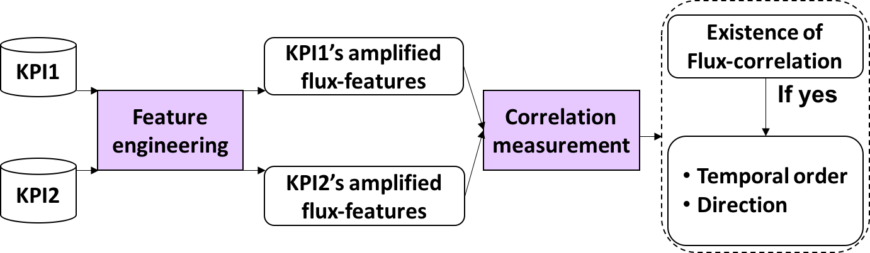
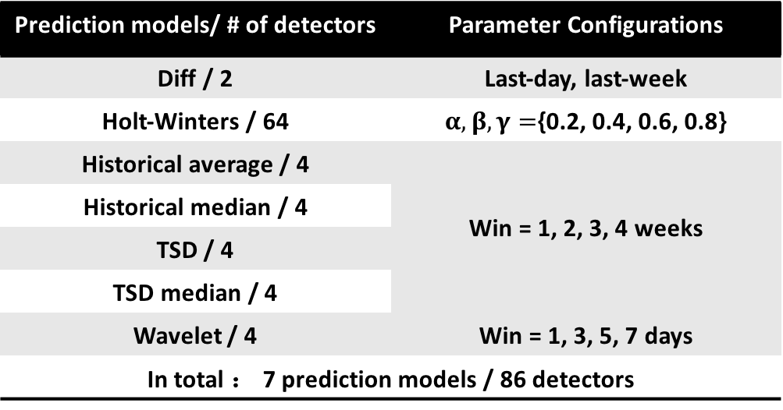
Feature engineering
Feature extraction: Apply time series prediction models with parameters as flux-feature detectors.
Prediction models and detectors
Prediction models/ # of detectors | Parameter Configurations
Diff / 2 | Last-day, last-week
Holt-Winters / 64 | $α, β, γ=${0.2, 0.4, 0.6, 0.8}
Historical average / 4 | Win = 1, 2, 3, 4 weeks
Historical median / 4
TSD / 4
TSD median / 4
Wavelet / 4 | Win = 1, 3, 5, 7 days
In total ： 7 prediction models / 86 detectors
Challenge
1 & 2
Notes:
As mentioned challenge 1 and 2 before, our KPIs have different shapes and the flux-correlation should not be based on anomaly detection.
To solve these two challenges, in feature engineering, we carefully select 7 widely-used models, and for each KPI, they produce 86 flux-features.
Certainly, our feature extraction module can be configured with other models or parameter values if needed.

Slide 15
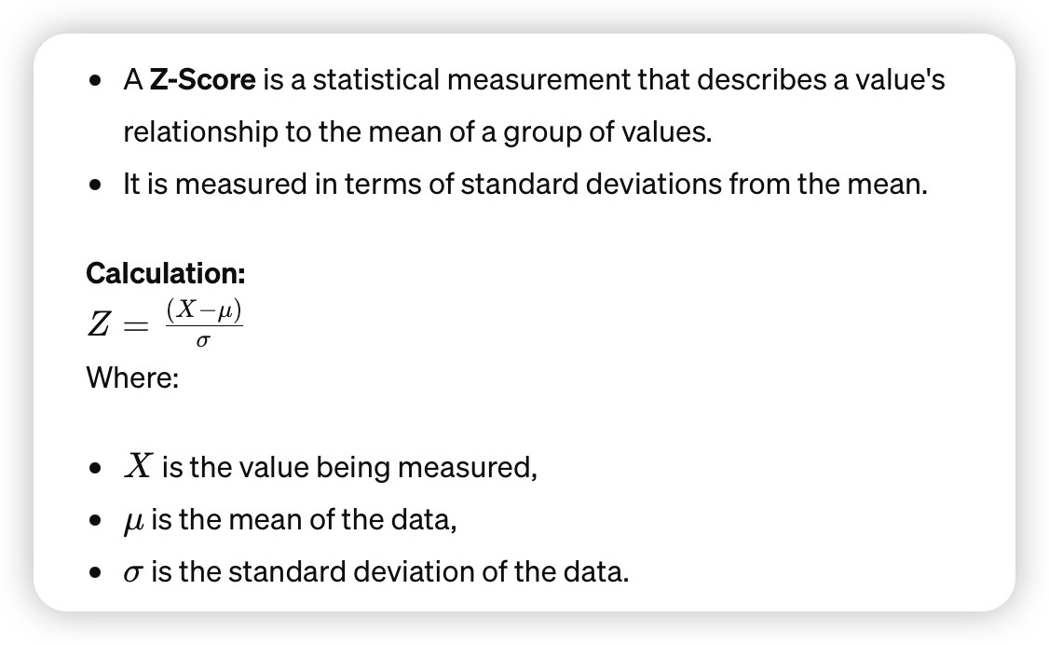

Feature engineering
Feature amplification:
  Apply z-score to normalize the flux-feature.
  To reduce the influence of noises, we use modified exponential activation to strengthen large fluctuations.
Challenge
1 & 2
Notes:
After feature extraction, we get 86 raw flux-features for each KPI.
Different KPIs usually have different scales and units, and we apply z-score to normalize each flux-feature.
Moreover, in general, most values in a KPI look quite normal and slightly deviate from forecast values mainly due to noises. To reduce the influence of noises, we use modified exponential activation to strengthen large fluctuations.
ˈdiːvieɪt
ˈstreŋθn

Slide 16
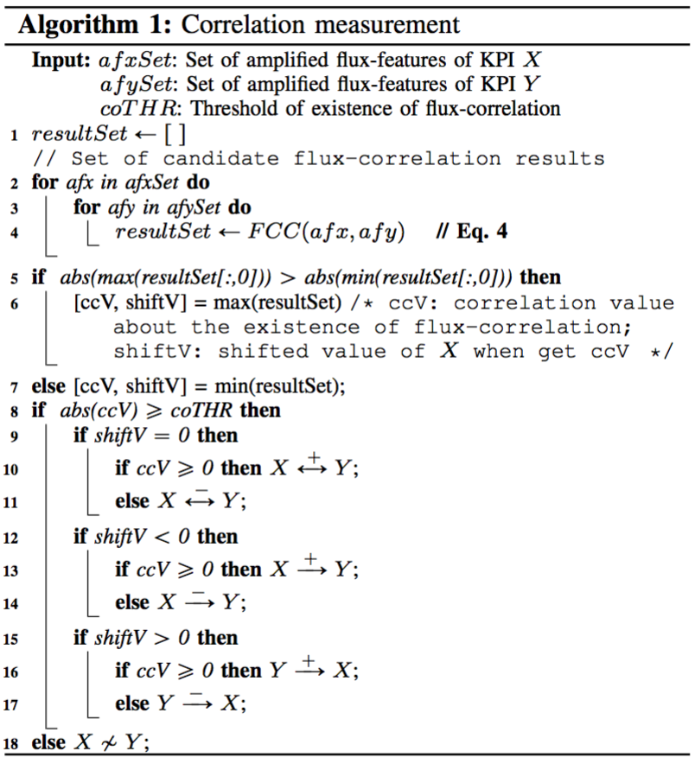
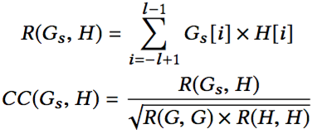
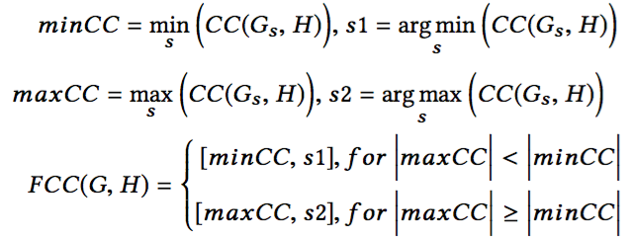
Correlation measurement
We apply the Cross-correlation to measure the correlation results of flux-features.
Challenge 3
Notes:
For correlation measurement, we measure the flux-correlation by Cross-correlation, because it can measure the shape similarity of two flux-features well with considering their phase shift.
We calculate the correlations for all flux-feature pairs and the maximum absolute value is selected as the final score.
If it is below the threshold, X is not flux-correlated with Y; otherwise they are flux-correlated. If X and Y are flux-correlated, we continue to find out the temporal order and direction. The temporal order can be determined by the shifted value of X
This direction are indicated by the final score.

Slide 17
Outline
Background
Algorithm
Evaluation
Case Studies
Notes:
Well, let’s move on the evaluation part.

Slide 18
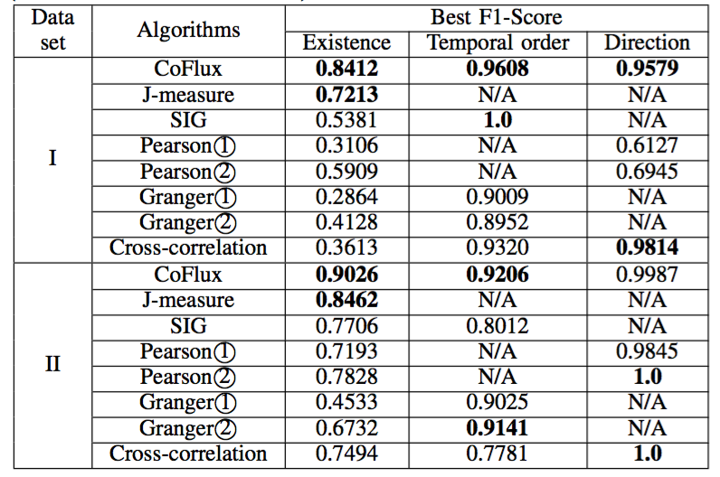
CoFlux VS Baseline Models
Best F1-scores of eight algorithms
Datasets:
  Dataset I: flux-correlated KPIs with different time series characteristics.
  Dataset II: flux-correlated KPIs with homogeneous time series characteristics.
Notes:
We obtained two datasets, whose flux-correlated KPIs are with different and homogeneous characteristics.(点)
The table shows the best F1-Scores of CoFlux and baselines.
The overall best F1-Scores of CoFlux for the two datasets are better than all baselines, with the results that over 0.84, 0.92, 0.95 for three Questions,
hɒməˈdʒiːniəs

Slide 19
Analysis about CoFlux
Top 5 detectors which give the flux-correlation results.
Efficiency by varying data length.
Notes:
Then, let’s see the analysis about CoFlux:
First, the proportion of Top 1 detector is no more than 20%, and the total proportion of Top 5 detectors in each dataset is less than 50%. Therefore, we can conclude that it is necessary to include a variety of detectors to robust CoFlux. (点)
Second, we consider the efficiency.
As shown in the right figure, the execution time ranges from 15 to 180 seconds as the data length increases from 5k to 50k. Considering CoFlux is offline, the time is acceptable.
ɪˈfɪʃnsi

Slide 20
Analysis about CoFlux
PRCs about the existence of flux-correlation among CoFlux and its variants.
Notes:
At last. We can see that, without amplification and Cross-correlation , the performance of CoFlux degrades significantly, which indicates their benefits.

Slide 21
Outline
Background
Algorithm
Evaluation
Case Studies
Notes:
Well, Let’s move on the case studies part.

Slide 22
Goal
Alert Compression
Flux-correlations of KPIs
Service
Troubleshooting
Recommending TOP N causes
Constructing Fluctuation Propagation Chains
Notes:
Well, remember that the goal of CoFlux is to do service troubleshooting via alert compression, recommending Top N causes, and constructing fluctuation propagation chains

Slide 23
Clustering KPIs for alert compression
Heat map visualization for clustering results of 24 KPIs.
Notes:
Figure shows 3 of the clusters composed of 24 KPIs used by CoFlux.
Apparently, KPI pairs within a cluster have stronger flux-Correlation than those outside it.
Then we can monitor all KPIs within a cluster as a whole, and raise only one alert when anomalies occurred at these KPIs.

Slide 24
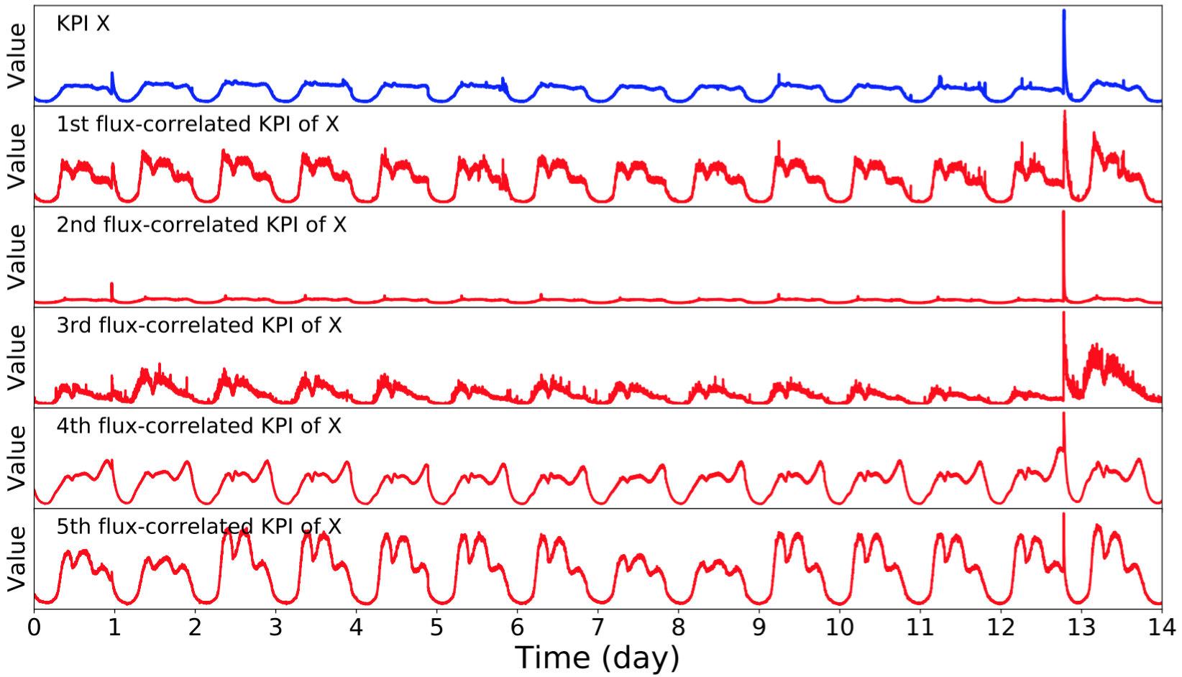
Recommending Top N flux-correlated KPIs
Top 5 flux-correlated KPIs for a given KPI X.
Notes:
This figure shows a given KPI and its Top 5 flux-correlated KPIs.
Clearly, these KPIs are highly flux-correlated with the given KPI.
Thus, when the given KPI suffers from an anomaly, operators can narrow down their analysis scope to the Top N KPIs for more efficient diagnosis
ɪˈfɪʃnt
ˌdaɪəɡˈnoʊsɪs

Slide 25
Constructing fluctuation propagation chains
Fluctuation propagation chains of a database
service constructed by the operators
Fluctuation propagation chains of a database
service constructed by CoFlux
Notes:
Fluctuation propagation chains are extremely useful in root cause analysis, but this requires deep domain knowledge of the KPIs.(点)
Fortunately, CoFlux can help for the chain construction.
Compare the two figures which are created by operators manually and CoFlux automatically, apparently, CoFlux can almost replicate the chains created by operators.

Slide 26
Conclusion
To the best of our knowledge, this paper is the first attempt to formulate flux-correlation and study it in detail in the domain of Internet service operations management.
CoFlux includes a robust set of flux-features and a robust Correlation score.
Our extensive experiments have demonstrated that CoFlux significantly outperforming the baseline algorithms and their variants.
Notes:
Finally, let me conclude my presentation.
First, to the best of our knowledge, this paper is the first attempt to formulate flux-correlation and study it in detail in the domain of Internet service operations management.
Second, CoFlux includes a robust set of flux-features and a robust Correlation score.
At last, Our extensive experiments have demonstrated that CoFlux significantly outperforming the baseline algorithms and their variants

Slide 27
Thank you!
Q & A
su-y16@mails.tsinghua.edu.cn
IWQOS 2019
Notes:
That’s all, thank you for your attention

