Slide 1
Correlation & Linear Regression
Slides adopted from the Internet

Slide 2
Roadmap
Linear Correlation
Spearman’s rho correlation
Kendall’s tau correlation
Linear regression

Slide 3
Linear correlation

Slide 4
Recall: Covariance

Slide 5
Interpreting Covariance
cov(X,Y) > 0 X and Y are positively correlated
cov(X,Y) < 0 X and Y are inversely correlated
cov(X,Y) = 0 X and Y are independent

Slide 6
Correlation coefficient
Pearson’s Correlation Coefficient is standardized covariance (unitless):

Slide 7
Calculating by hand…

Slide 8
Correlation
Measures the relative strength of the linear relationship between two variables
Unit-less
Ranges between –1 and 1
The closer to –1, the stronger the negative linear relationship
The closer to 1, the stronger the positive linear relationship
The closer to 0, the weaker any positive linear relationship

Slide 9
The strength of the relationship depends on the decimal value.
-1
0
+1

Slide 10
The strength of the relationship depends on the decimal value.
-1
0
+1

Slide 11
The strength of the relationship depends on the decimal value.
-1
0
0.2
weak
+1

Slide 12
The strength of the relationship depends on the decimal value.
-1
0
+1

Slide 13
The strength of the relationship depends on the decimal value.
-1
0
0.8
strong
+1

Slide 14
The strength of the relationship depends on the decimal value.
-1
0
+1

Slide 15
The strength of the relationship depends on the decimal value.
0.2
weak
-1
0
+1

Slide 16
The strength of the relationship depends on the decimal value.
-1
0
+1

Slide 17
The strength of the relationship depends on the decimal value.
0.8
strong
-1
0
+1

Slide 18
The strength of the relationship depends on the decimal value.
-1
0
+1

Slide 19
Scatter Plots of Data with Various Correlation Coefficients
Y
Y
Y
X
X
X
r = -1
r = -.6
r = 0
Y
Y
Y
X
X
X
r = +1
r = +.3
r = 0
Slide from: Statistics for Managers Using Microsoft® Excel 4th Edition, 2004 Prentice-Hall

Slide 20
Linear Correlation
Linear relationships
Curvilinear relationships
Y
Y
X
X
Y
Y
X
X
Slide from: Statistics for Managers Using Microsoft® Excel 4th Edition, 2004 Prentice-Hall
Notes:
curvilinear英[ˌkɜːvɪˈlɪniə(r)]美[ˌkɜːrvɪˈlɪniər]
adj.曲线的; 由曲线组成的;[例句]The cairo terminolo

Slide 21
Linear Correlation
Strong relationships
Weak relationships
Y
Y
X
X
Y
Y
X
X
Slide from: Statistics for Managers Using Microsoft® Excel 4th Edition, 2004 Prentice-Hall

Slide 22
Linear Correlation
No relationship
Y
X
Y
X
Slide from: Statistics for Managers Using Microsoft® Excel 4th Edition, 2004 Prentice-Hall

Slide 23
Simpler calculation formula…
Numerator of covariance
Numerators of variance

Slide 24
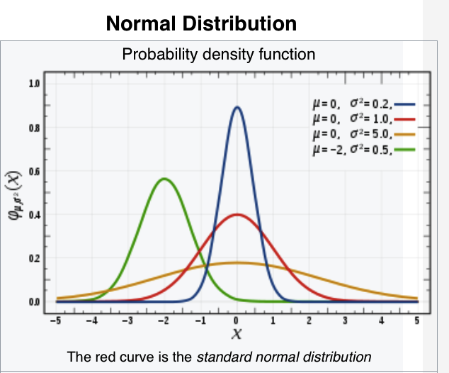
Pearson r correlation assumptions
Both variables should be
normally distributed
A straight-line (linear) relationship between two variables
Data are normally distributed around the regression line

Slide 25
Roadmap
Linear Correlation
Spearman’s rho correlation
Kendall’s tau correlation
Linear regression

Slide 26
Spearman’s Rank-Order Correlation
For Independence Questions

Slide 27
Welcome to the Spearman’s Rho Test of Independence Learning Module

Slide 28

(i.e., does not assume data distribution)
Spearman’s “Rho’ is a non-parametric analogue to the Pearson Product Moment Correlation.
roduct Moment Correlation).

Slide 29
Spearman’s “Rho’ is a non-parametric analogue to the Pearson Product Moment Correlation.
Spearman’s Rho is designed to estimate the coherence or lack of coherence of two variables (as in the Pearson Product Moment Correlation).

Slide 30
Spearman’s “Rho’ is a non-parametric analogue to the Pearson Product Moment Correlation.
Spearman’s Rho is designed to estimate the coherence or lack of coherence of two variables (as in the Pearson Product Moment Correlation).
It is calculated based on the rank-ordered (ordinal) data rather than the means and standard deviation used in the Pearson Product Moment Correlation.

Slide 31
Here is an illustration of the difference between a Pearson Correlation and a Spearman’s Rho

Slide 32
Here is an illustration of the difference between a Pearson Correlation and a Spearman’s Rho
Are race times of athletes who participated in both biking and running competitions independent of one another? (This is a Pearson Correlation question because we are dealing with continuous variables)

Slide 33
Here is an illustration of the difference between a Pearson Correlation and a Spearman’s Rho
Are race times of athletes who participated in both biking and running competitions independent of one another? (This is a Pearson Correlation question because we are dealing with continuous variables)
Individuals | Biking Event race times | Running Event race times
Bob | 4.5 hours | 4.0 hours
Conrad | 7.0 hours | 2.5 hours
Dallen | 5.2 hours | 2.8 hours
Ernie | 6.0 hours | 2.9 hours
Fen | 6.3 hours | 3.3 hours
Gaston | 5.1 hours | 2.3 hours

Slide 34
Here is an illustration of the difference between a Pearson Correlation and a Spearman’s Rho
Are race times of athletes who participated in both biking and running competitions independent of one another? (This is a Pearson Correlation question because we are dealing with continuous variables)
This is a Spearman’s Rho question if we are dealing with rank ordered or ordinal data:

Slide 35
This is a Spearman’s Rho question if we are dealing with rank ordered or ordinal data:
Individuals | Biking Event race times | Running Event race times
Bob | 1st | 6th
Conrad | 6th | 2nd
Dallen | 3rd | 3rd
Ernie | 4th | 4th
Fen | 5th | 5th
Gaston | 2nd | 1st

Slide 36
In summary, if at least one of two variables to be correlated are based on an underlying ordinal measurement, the Spearman’s Rho is an appropriate estimate.

Slide 37
In summary, if at least one of two variables to be correlated are based on an underlying ordinal measurement, the Spearman’s Rho is an appropriate estimate.
For example -

Slide 38
Interval or continuous Data
Ordinal or rank-ordered Data
Individuals | Biking Event race times in minutes | Running Event placement
Bob | 55 | 6th
Conrad | 25 | 2nd
Dallen | 29 | 3rd
Ernie | 33 | 4th
Fen | 39 | 5th
Gaston | 23 | 1st

Slide 39
Interval or continuous Data
Ordinal or rank-ordered Data
For example –
Individuals | Biking Event race times in minutes | Running Event placement
Bob | 55 | 6th
Conrad | 25 | 2nd
Dallen | 29 | 3rd
Ernie | 33 | 4th
Fen | 39 | 5th
Gaston | 23 | 1st
Because this data is ordinal or rank ordered we will use Spearman’s Rho

Slide 40
Interval or continuous Data
Ordinal or rank-ordered Data
For example –
or
Individuals | Biking Event race times in minutes | Running Event placement
Bob | 55 | 6th
Conrad | 25 | 2nd
Dallen | 29 | 3rd
Ernie | 33 | 4th
Fen | 39 | 5th
Gaston | 23 | 1st

Slide 41
For example –
or
Interval or continuous Data
Ordinal or rank-ordered Data
Individuals | Biking Event race times in minutes | Running Event placement
Bob | 55 | 6th
Conrad | 25 | 2nd
Dallen | 29 | 3rd
Ernie | 33 | 4th
Fen | 39 | 5th
Gaston | 23 | 1st
Ordinal or rank-ordered Data
Interval or continuous Data
Individuals | Biking Event placement | Running Event race times
Bob | 1st | 4.0 hours
Conrad | 6th | 2.5 hours
Dallen | 3rd | 2.8 hours
Ernie | 4th | 2.9 hours
Fen | 5th | 3.3 hours
Gaston | 2nd | 2.3 hours

Slide 42
For example –
or
Interval or continuous Data
Ordinal or rank-ordered Data
Individuals | Biking Event race times in minutes | Running Event placement
Bob | 55 | 6th
Conrad | 25 | 2nd
Dallen | 29 | 3rd
Ernie | 33 | 4th
Fen | 39 | 5th
Gaston | 23 | 1st
Ordinal or rank-ordered Data
Interval or continuous Data
Individuals | Biking Event placement | Running Event race times
Bob | 1st | 4.0 hours
Conrad | 6th | 2.5 hours
Dallen | 3rd | 2.8 hours
Ernie | 4th | 2.9 hours
Fen | 5th | 3.3 hours
Gaston | 2nd | 2.3 hours
Because this data is ordinal or rank ordered we will use Spearman’s Rho

Slide 43
If both variables are on an interval scale, but one or both are significantly skewed, then Spearman’s Rho is an appropriate estimate that compensates for distortion of the mean.

Slide 44
If both variables are on an interval scale, but one or both are significantly skewed, then Spearman’s Rho is an appropriate estimate that compensates for distortion of the mean.
For example:

Slide 45
If both variables are on an interval scale, but one or both are significantly skewed, then Spearman’s Rho is an appropriate estimate that compensates for distortion of the mean.
For example:
Interval normally distributed Data
Interval –heavily skewed data
Individuals | Biking Event race times | Running Event race times
Bob | 4.5 hours | 4.0 hours
Conrad | 4.6 hours | 2.5 hours
Dallen | 4.7 hours | 2.8 hours
Ernie | 5.0 hours | 2.9 hours
Fen | 20.0 hours | 3.3 hours
Gaston | 28.0 hours | 2.3 hours

Slide 46
If both variables are on an interval scale, but one or both are significantly skewed, then Spearman’s Rho is an appropriate estimate that compensates for distortion of the mean.
For example:
Interval normally distributed Data
Interval –heavily skewed data
Individuals | Biking Event race times | Running Event race times
Bob | 4.5 hours | 4.0 hours
Conrad | 4.6 hours | 2.5 hours
Dallen | 4.7 hours | 2.8 hours
Ernie | 5.0 hours | 2.9 hours
Fen | 20.0 hours | 3.3 hours
Gaston | 28.0 hours | 2.3 hours

Slide 47
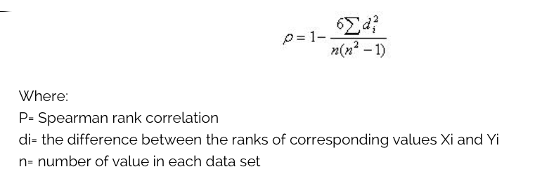
How to calculate Rho?

Slide 48
Spearman’s Rho renders a result that is similar to the Pearson Correlation

Slide 49
Spearman’s Rho renders a result that is similar to the Pearson Correlation
-1
0
+1

Slide 50
Spearman’s Rho renders a result that is similar to the Pearson Correlation
Therefore it shares the same properties as these other methods:
-1
0
+1

Slide 51
Spearman’s Rho renders a result that is similar to the Pearson Correlation
Therefore it shares the same properties as these other methods:
  It ranges from -1 to +1.
-1
0
+1

Slide 52
Spearman’s Rho renders a result that is similar to the Pearson Correlation
Therefore it shares the same properties as these other methods:
  It ranges from -1 to +1.
  It’s direction is determined by the sign (- +)
-1
0
+1

Slide 53
Spearman’s Rho renders a result that is similar to the Pearson Correlation
Therefore it shares the same properties as these other methods:
  It ranges from -1 to +1.
  It’s direction is determined by the sign (- +)
  The closer the value is to -1 or +1, the stronger the relationship
-1
0
+1

Slide 54
Spearman’s Rho renders a result that is similar to the Pearson Correlation
Therefore it shares the same properties as these other methods:
  It ranges from -1 to +1.
  It’s direction is determined by the sign (- +)
  The closer the value is to -1 or +1, the stronger the relationship
  The closer the value is to 0, the weaker the relationship.
-1
0
+1

Slide 55
Spearman’s Rho renders a result that is similar to the Pearson Correlation
Therefore it shares the same properties as these other methods:
  It ranges from -1 to +1.
  It’s direction is determined by the sign (- +)
  The closer the value is to -1 or +1, the stronger the relationship
  The closer the value is to 0, the weaker the relationship.
-1
0
+1
A result like this would be evidence of independence

Slide 56
It differs from Kendall’s Tau in one simple way. The Spearman’s Rho CANNOT handle ties. The Kendall’s Tau can:

Slide 57
It differs from Kendall’s Tau in one simple way. The Spearman’s Rho cannot handle ties. The Kendall’s Tau can:
For example:

Slide 58
It differs from Kendall’s Tau in one simple way. The Spearman’s Rho cannot handle ties. The Kendall’s Tau can:
For example:
      *use Kendall’s Tau when there are rank ordered ties.
Individuals | Rank order for Biking Event | Rank order for Running Event
Bob | 1st | 1st
Conrad | 2nd | 1st
Dallen | 2nd | 2nd
Ernie | 3rd | 3rd
Fen | 4th | 4th
Gaston | 5th | 4th

Slide 59
Spearman’s Rho Assumptions
non-parametric: it does not assume any assumptions about the distribution of the data
Is the appropriate correlation analysis when the variables are measured on a scale that is at least ordinal.
Scores on one variable must be monotonically related to the other variable.
Cannot deal with ties

Slide 60
Roadmap
Linear Correlation
Spearman’s rho correlation
Kendall’s tau correlation
Linear regression

Slide 61
What is a Kendall Tau?

Slide 62
Kendall’s Tau is a nonparametric analogue to the Pearson Correlation.

Slide 63
Similar to Spearman’s Rho, Kendall’s Tau operates on rank-ordered (ordinal) data but is particularly useful when there are tied ranks.

Slide 64
Let’s consider an investigation that would lend itself to being analyzed by Kendall’s Tau:

Slide 65
An iron man competition consists of three consecutive events:

Slide 66

An iron man competition consists of three consecutive events: Biking 110 miles,

Slide 67

An iron man competition consists of three consecutive events: Biking 110 miles, Swimming 2.5 miles

Slide 68

An iron man competition consists of three consecutive events: Biking 110 miles, Swimming 2.5 miles and Running 26.2 miles

Slide 69
An iron man competition consists of three consecutive events: Biking 110 miles, Swimming 2.5 miles and Running 26.2 miles. Researchers are interested in the relationship between the rank ordered results from the biking and the running events.

Slide 70
An iron man competition consists of three consecutive events: Biking 110 miles, Swimming 2.5 miles and Running 26.2 miles. Researchers are interested in the relationship between the rank ordered results from the biking and the running events.

Slide 71
An iron man competition consists of three consecutive events: Biking 110 miles, Swimming 2.5 miles and Running 26.2 miles. Researchers are interested in the relationship between the rank ordered results from the biking and the running events. Here is the data for 6 individuals who competed:

Slide 75
Because both variables are expressed as rank ordered data, we will use either a Kendall’s Tau or a Spearman’s Rho.

Slide 76
Because both variables are expressed as rank ordered data, we will use either a Kendall’s Tau or a Spearman’s Rho.
Note – even if only one variable were ordinal and the other were scaled or nominal, you would still use Kendall’s Tau or a Spearman’s Rho by virtue of having one ordinal variable.

Slide 77
Because there are ties in the data, we will use Kendall’s Tau instead of the Spearman’s Rho.

Slide 78
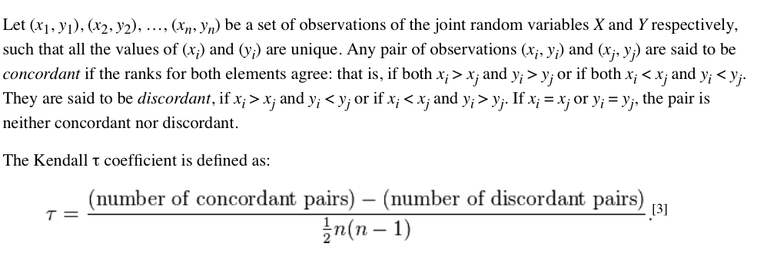
How to calculate Tau?

Slide 79
Because there are ties in the data, we will use Kendall’s Tau instead of the Spearman’s Rho.
Concordant pairs: (Bob,Dallen), (Bob, Ernie)，(Bob, Fen), (Bob,Gaston), (Conrad,Ernie)….

Slide 80
Kendall’s Tau renders a result that is similar to Spearman’s Rho and the Pearson Correlation
Therefore it shares the same properties as these other methods:
  It ranges from -1 to +1.
  It’s direction is determined by the sign (- +)
  The closer the value is to -1 or +1, the stronger the relationship
  The closer the value is to 0, the weaker the relationship.

Slide 81
Kendall’s Tau renders a result that is similar to Spearman’s Rho and the Pearson Correlation
Therefore it shares the same properties as these other methods:
  It ranges from -1 to +1.
  It’s direction is determined by the sign (- +)
  The closer the value is to -1 or +1, the stronger the relationship
  The closer the value is to 0, the weaker the relationship.
-1
0
+1

Slide 82
Kendall’s Tau renders a result that is similar to Spearman’s Rho and the Pearson Correlation
Therefore it shares the same properties as these other methods:
  It ranges from -1 to +1.
  It’s direction is determined by the sign (- +)
  The closer the value is to -1 or +1, the stronger the relationship
  The closer the value is to 0, the weaker the relationship.
-1
0
+1

Slide 83
Kendall’s Tau renders a result that is similar to Spearman’s Rho and the Pearson Correlation
Therefore it shares the same properties as these other methods:
  It ranges from -1 to +1.
  It’s direction is determined by the sign (- +)
  The closer the value is to -1 or +1, the stronger the relationship
  The closer the value is to 0, the weaker the relationship.
-1
0
+1

Slide 84
Kendall’s Tau renders a result that is similar to Spearman’s Rho and the Pearson Correlation
Therefore it shares the same properties as these other methods:
  It ranges from -1 to +1.
  It’s direction is determined by the sign (- +)
  The closer the value is to -1 or +1, the stronger the relationship
  The closer the value is to 0, the weaker the relationship.
-1
0
+1

Slide 85
Kendall’s Tau renders a result that is similar to Spearman’s Rho and the Pearson Correlation
Therefore it shares the same properties as these other methods:
  It ranges from -1 to +1.
  It’s direction is determined by the sign (- +)
  The closer the value is to -1 or +1, the stronger the relationship
  The closer the value is to 0, the weaker the relationship.
-1
0
+1

Slide 86
Kendall’s Tau renders a result that is similar to Spearman’s Rho and the Pearson Correlation
Therefore it shares the same properties as these other methods:
  It ranges from -1 to +1.
  It’s direction is determined by the sign (- +)
  The closer the value is to -1 or +1, the stronger the relationship
  The closer the value is to 0, the weaker the relationship.
-1
0
+1

Slide 87
Kendall’s Tau Assumptions
non-parametric: does not assume any assumptions about the distribution of the data
Is the appropriate correlation analysis when the variables are measured on a scale that is at least ordinal.
Can deal with ties

Slide 88
Binned Kendall’s Correlation
Use this “binned” Kendall correlation under two scenarios, even if there are no ties:
Skewed data distribution
  To this end, we look at the average value for each bin and compute the correlation on the binned data.
Amount of the data so large that rank correlation is computationally expensive
  The binned correlation retains the qualitative properties that we want to highlight with lower compute cost.

Slide 89
Roadmap
Linear Correlation
Spearman’s rho correlation
Kendall’s tau correlation
Linear regression

Slide 90
Suppose we have a linear correlation, but what about the slope and intercept?
Y
X
Y
X
Slide from: Statistics for Managers Using Microsoft® Excel 4th Edition, 2004 Prentice-Hall

Slide 91
Linear regression
In correlation, the two variables are treated as equals. In regression, one variable is considered independent (=predictor) variable (X) and the other the dependent (=outcome) variable Y.

Slide 92
What is “Linear”?
Remember this:
Y=mX+B?
m
B

Slide 93
What’s Slope?
A slope of 2 means that every 1-unit change in X yields a 2-unit change in Y.

Slide 94
Prediction
If you know something about X, this knowledge helps you predict something about Y. (Sound familiar?…sound like conditional probabilities?)

Slide 95
Regression equation…
Expected value of y at a given level of x=

Slide 96
Predicted value for an individual…
y_{i} = α + β*x_{i} + random error_{i}
Fixed – exactly on the line
Assumption: Follows a normal distribution

Slide 97
Estimating the intercept and slope: least squares estimation
** Least Squares Estimation
A little calculus….
What are we trying to estimate? β, the slope, from
What’s the constraint? We are trying to minimize the squared distance (hence the “least squares”) between the observations themselves and the predicted values , or (also called the “residuals”, or left-over unexplained variability)
Differencei = yi – (βx + α) Differencei² = (yi – (βx + α)) ²
Find the β that gives the minimum sum of the squared differences. How do you minimize a function? Take the derivative; set it equal to zero; and solve. Typical max/min problem from calculus….
From here takes a little math trickery to solve for β…

Slide 98
Resulting formulas…
Slope (beta coefficient) =
Intercept=
Regression line always goes through the point:

Slide 99
Relationship with correlation
In correlation, the two variables are treated as equals. In regression, one variable is considered independent (=predictor) variable (X) and the other the dependent (=outcome) variable Y.

Slide 100
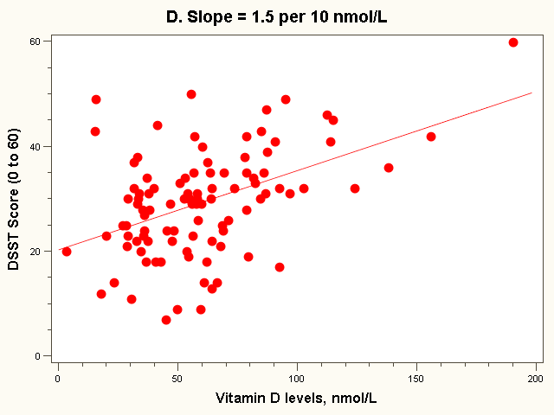
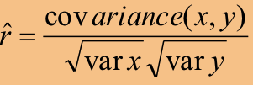
Example:
SDx = 33 nmol/L
SDy= 10 points
Cov(X,Y) = 163 points*nmol/L
Beta = 163/33²
= 0.15 points per nmol/L
= 1.5 points per 10 nmol/L
r = 163/(10*33) = 0.49
Or
r = 0.15 * (33/10) = 0.49

Slide 101
Pearson r correlation assumptions
Both variables should
be normally distributed
A straight-line (linear) relationship between two variables
Data are normally distributed around the regression line

Slide 102
Summary
Assumptions | Pearson r /linear regression | Spearman’s Rho | Kendall’s Tau
distributions of two variables | both are normally distributed | no assumption | no assumption
variable property | both are numbers | at least ordinal | at least ordinal
relationship between two variables | linear
misc. | data are normally distributed around the regression line | cannot deal with tie | can deal with ties

Slide 103
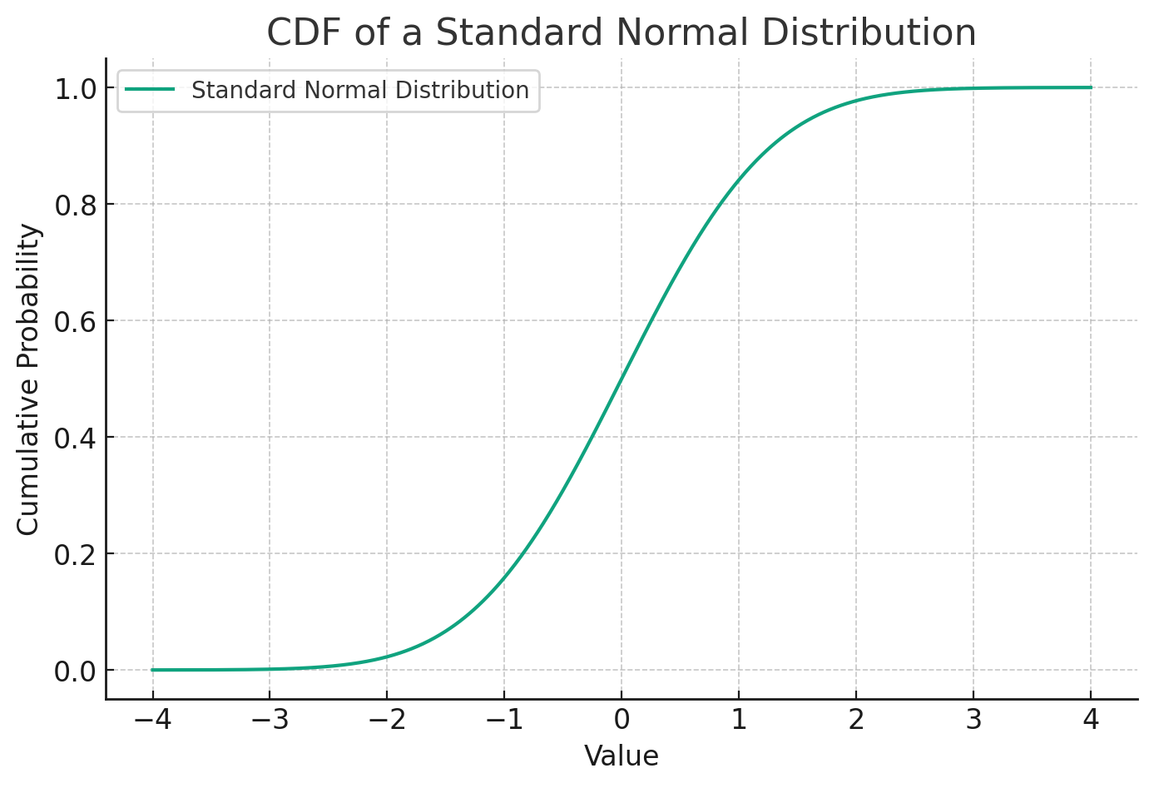
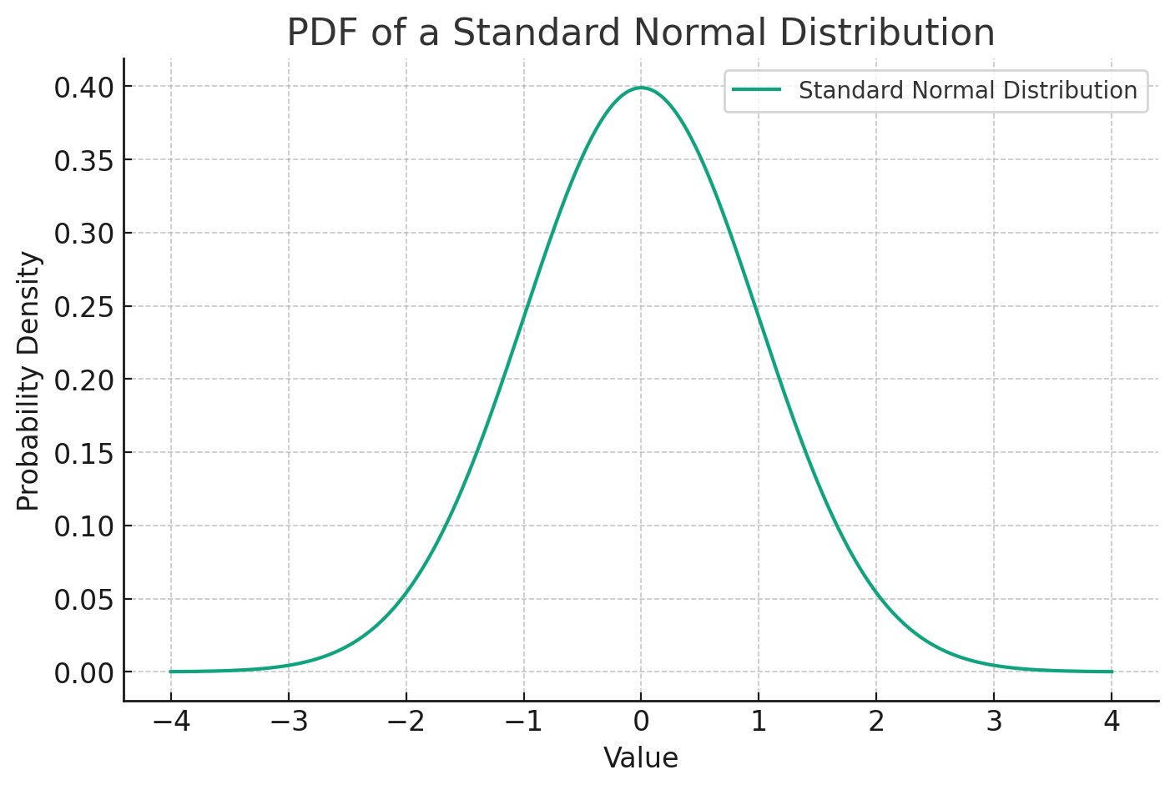
CDF (Cumulative Distribution Function)
A CDF graph stands for Cumulative Distribution Function graph. It is a type of graph used in statistics to show the probability that a random variable X takes a value less than or equal to x. Essentially, it illustrates the cumulative probability for each value in the dataset, which means for any point x on the graph, the Y-axis represents the probability that the random variable will take a value less than or equal to x.
The CDF graph starts at 0 and increases monotonically to 1 as you move along the x-axis, representing all possible values of the random variable. It provides a visual representation of the distribution of data points, helping to understand the spread, central tendency, and variability of the data.

