Slide 1


Video Streaming on the Internet
Computer Networking: A Top Down Approach
6th edition
Jim Kurose, Keith Ross
Addison-Wesley
Adopted from JFK/KWR’s Slides
All material copyright 1996-2012
J.F Kurose and K.W. Ross, All Rights Reserved
Notes:
A very brief version, slide 8, 9, 56…

Slide 2



















What’s the Internet: “nuts and bolts” view
PC
millions of connected computing devices:
  hosts = end systems
  running network apps
mobile network
server
wireless
laptop
global ISP
smartphone
home
network
communication links
  fiber, copper, radio, satellite
  transmission rate: bandwidth
regional ISP
wireless
links
wired
links
Packet switches: forward packets (chunks of data)
  routers and switches
router
institutional
network
Notes:
2

Slide 3
What’s the Internet: a service view
mobile network
Infrastructure that provides services to applications:
  Web, VoIP, email, games, e-commerce, social nets, …
provides programming interface to apps
  hooks that allow sending and receiving app programs to “connect” to Internet
  provides service options, analogous to postal service
global ISP
home
network
regional ISP
institutional
network

Slide 4
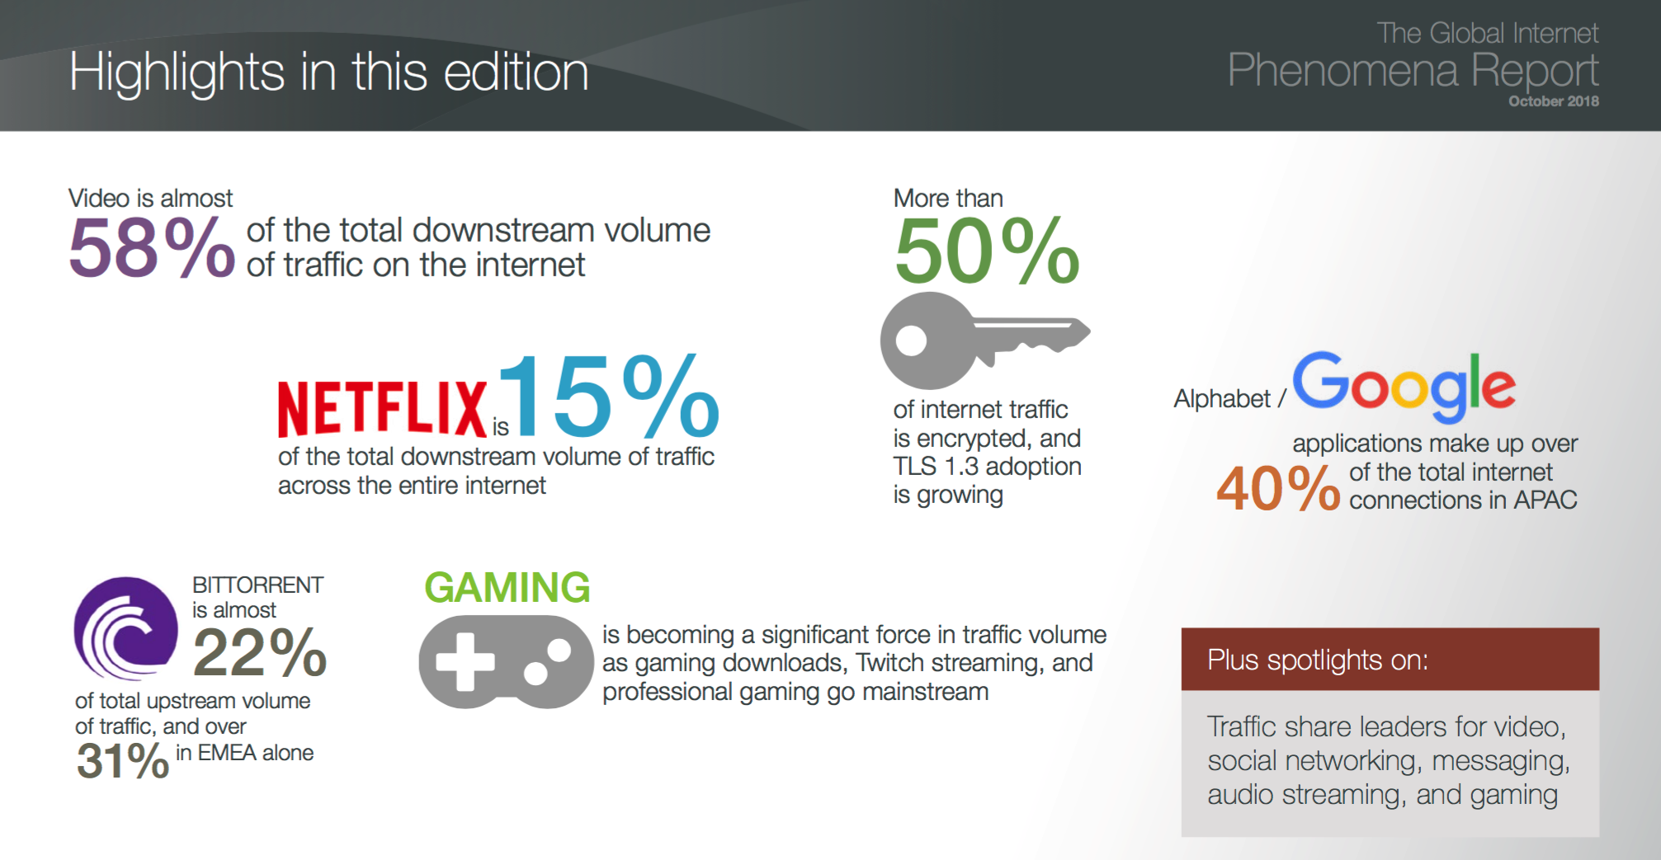

Slide 5

Quality of Experience (QoE) today is not ideal

Slide 6


Users start leaving if video doesn’t play in 2 seconds
https://gigaom.com/2012/11/09/online-viewers-start-leaving-if-video-doesnt-play-in-2-seconds-says-study/
Video: La Luna (Pixar 2011)
Notes:
When we stream a video from the internet, we all have this annoying experience -- the video suddenly gets stuck and starts rebuffering ..
Studies actually show that users start leaving if the video doesn’t play in 2 seconds.
And given that fact that video streaming has been dominating today's internet traffic, this kind of bad experience will lead to tremendous loss of users. Therefore industry and academia have devoted lots efforts to improve video streaming experience.

Slide 7

Multimedia: video
spatial coding example: instead of sending N values of same color (all purple), send only two values: color value (purple) and number of repeated values (N)
video: sequence of images displayed at constant rate
  e.g. 24 images/sec
digital image: array of pixels
  each pixel represented by bits
coding: use redundancy within and between images to decrease # bits used to encode image
  spatial (within image)
  temporal (from one image to next)
……………………...…
……………………...…
frame i
temporal coding example: instead of sending complete frame at i+1, send only differences from frame i
frame i+1

Slide 8


Streaming stored video:
Cumulative data
2. video
sent
video
recorded (e.g., 30 frames/sec)
3. video received,
played out at client
(30 frames/sec)
network delay
(fixed in this example)
time
streaming: at this time, client
playing out early part of video,
while server still sending later
part of video

Slide 9
Streaming stored video: challenges
continuous playout constraint: once client playout begins, playback must match original timing
  … but network delays are variable (jitter), so will need client-side buffer to match playout requirements
  video packets may be lost, retransmitted

Slide 10
Web and HTTP
First, a review…
web page consists of objects
object can be HTML file, JPEG image, Java applet, audio file,…
web page consists of base HTML-file which includes several referenced objects
each object is addressable by a URL, e.g.,
www.someschool.edu/someDept/pic.gif
host name
path name

Slide 11


HTTP overview
HTTP: hypertext transfer protocol
Web’s application layer protocol
client/server model
  client: browser that requests, receives, (using HTTP protocol) and “displays” Web objects
  server: Web server sends (using HTTP protocol) objects in response to requests
HTTP request
PC running
Firefox browser
HTTP response
HTTP request
server
running
Apache Web
server
HTTP response
iphone running
Safari browser
Notes:
[uh-pach-ee]

Slide 12
Adaptive Multi-Bit Rate with HTTP Streaming （1）
Client-centric architecture with stateful client and stateless server
  Standard server: Web servers
  Standard Protocol: HTTP
  Session state and logic maintained at client
Video is broken into multiple chunks
Chunks begin with keyframe so independent of other chunks
A series of HTTP progressive downloads of chunks
Playing chunks in sequence gives seamless video

Slide 13
Adaptive Multi-Bit Rate with HTTP Streaming （2）
Encode video at different levels of quality/bandwidth
Client can adapt to different bit rates within a single session by requesting different sized chunks
Chunks of different bit rates must be synchronized
  All encodings have the same chunk boundaries and all chunks start with key frames, so you can make smooth splices to chunks of higher or lower bit rates

Slide 14
HTTP Chunking Protocol
Server
Client
HTTP Adaptive Player
B1
A1
A2
…
…
A1
A1
A1
A2
B1
B2
…
…
HTTP GET A1
B2
HTTP GET B2
Cache
B1
B2
Web browser
Web server
Web server
HTTP
HTTP
TCP
TCP

