Slide 1

Opprentice: Towards Practical and Automatic Anomaly Detection Through Machine Learning
Dapeng Liu, Youjian Zhao, Haowen Xu, Yongqian Sun, Dan Pei, Jiao Luo, Xiaowei Jing, Mei Feng
Notes:
Thank you for the introduction. Hello everyone, I’m Dapeng from Tsinghua University
Today, I’ going to talk about Opprentice, a practical and automatic anomaly detection framework based on machine learning
This is a joint work with collaborators from Tsinghua University, Baidu, and PetroChina

Slide 2
KPIs and Anomaly Detection
Page views (PV) of Baidu
KPIs (Key Performance Indicators): A set of performance measures that evaluate the service quality
Notes:
To monitor the service quality, service providers often collect a set of performance measures, which are usually called key performance indicators or KPIs.
For example, this is one-week data of the page views of Baidu. It measures how many search queries are submitted from users to Baidu. This KPI is very important because it has a great impact on the advertising revenue.

Slide 3
KPIs and Anomaly Detection
Page views (PV) of Baidu
KPIs (Key Performance Indicators): A set of performance measures that evaluate the service quality
KPI anomalous (unexpected) behaviors → Potential failures, bugs, attacks...
Notes:
We see that beyond those regular behaviors, the KPI can show some anomalous or unexpected behaviors.
These behaviors often indicate potential failures, bugs, attacks and so on

Slide 4
KPIs and Anomaly Detection
Page views (PV) of Baidu
KPIs (Key Performance Indicators): A set of performance measures that evaluate the service quality
KPI anomalous (unexpected) behaviors → Potential failures, bugs, attacks...
Anomaly detection matters: Find anomalous behaviors of the KPI curve
→ Diagnose and fix it
→ Avoid further influences and revenue losses
Notes:
As a result, anomaly detection really matters for service providers. In this work, the anomaly detection means to find anomalous behaviors of the KPI curve.
** Click
Then we can diagnose whether these behaviors are really caused by a problem. If so, we should fix it to avoid further influences or revenue losses.

Slide 5
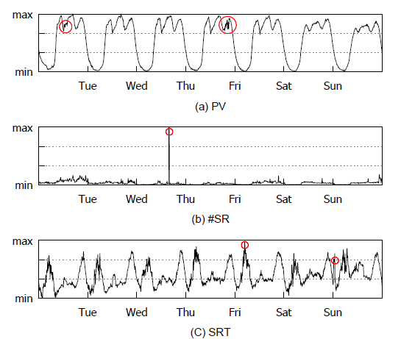
How to Build an Anomaly Detection System
Domain experts (Operators)
Responsible for the KPIs
Knowing the KPI behaviors well
Developers
Building the detection system
Knowing several anomaly detectors
Simple threshold
Historical Average
Wavelet
Holt-Winters
…
Notes:
Now the question is how can we build an anomaly detection system?
**Click
Overall, there are two characters involved.
The first one is domain expert. #Explain…
**Click
The second one is developers. #Explain…

Slide 6
How to Build an Anomaly Detection System
In practice, it is more complex
Describe anomalies
Operators
Developers
Notes:
However, in practice, building an anomaly detection system is more complex.
** Click
First, operators need to tell developers how anomalies look like? or what kinds of anomalies they care?

Slide 7
How to Build an Anomaly Detection System
In practice, it is more complex
Describe anomalies
Operators
Developers
Select detectors &
Tune parameters
Detection
System
Wavelet
Moving Average
Holt-Winters
…
Notes:
Then, to detect those anomalies, developers have to select suitable detectors and tune their internal parameters.
Sometimes, one detector is not sufficient enough, and they have to combine multiple detectors such as using majority-vote.

Slide 8
How to Build an Anomaly Detection System
In practice, it is more complex
Describe anomalies
Operators
Developers
Select detectors &
Tune parameters
Detection
System
Anomalies
Wavelet
Moving Average
Holt-Winters
…
Notes:
The detection system starts to work and report anomalies to operators.
However, because operators may not describe the anomalies precisely, or developers cannot select or tune detectors well, the detection system is often inaccurate at the beginning

Slide 9
How to Build an Anomaly Detection System
In practice, it is more complex
Describe anomalies
Operators
Developers
Select detectors &
Tune parameters
Detection
System
Anomalies
Wavelet
Moving Average
Holt-Winters
…
Notes:
So, it usually takes operators and developers a lot of efforts to repeat this process again and again, but at last the system may still not work, generating many false positives or false negatives, and operators are not willing to use it.
This is one important reason that many proposed detectors are not being used in practice.

Slide 10
How to Build an Anomaly Detection System
Challenges
Describe anomalies
Selecting and combining suitable detectors are tricky
2.
Operators have difficulties to precisely and formally define anomalies in advance
1.
3.
Detectors are not intuitive to tune
Operators
Developers
Select detectors &
Tune parameters
Detection
System
Anomalies
Wavelet
Moving Average
Holt-Winters
…
Notes:
In summary, there are three main challenges in building an anomaly detection system.
First, …
Second…
Third…(Especially for those complex dectors)
Because of these practical challenges, building an anomaly detection system requires a lot of manual efforts.
This is the problem we want to solve in this paper. We want to reduce the efforts of building an anomaly detection system. But how can we do that?

Slide 11

Notes:
This is a poster of the movie Chappie. Chappie is a police robot. After he is upgraded by a scientist, he can learn from human. For example, His mother teaches him how to draw pictures, and his father, a bad guy, teaches him how to rob with a gun.
So we were thinking why can’t the anomaly detection system learn from operators by itself, without the help of developers.

Slide 12

(Operators’ apprentice)
Notes:
So we propose Opprentice, that is, operators’ apprentice, a framework to learn anomaly detection from operators.

Slide 13
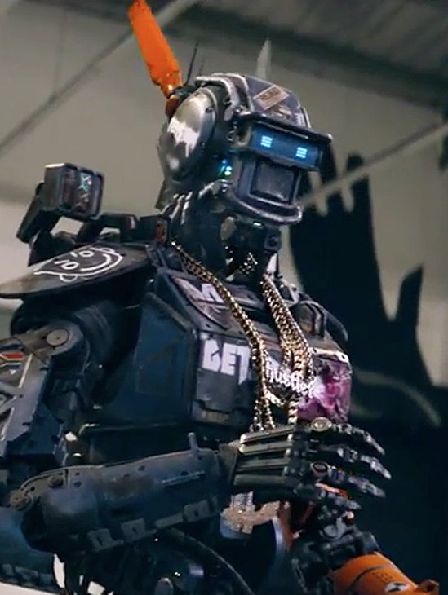






A More Natural Way
Opprentice
OP
PV
Detectors
Parameters
Notes:
We know that given a KPI curve, it is more easy for operators to tell whether there exist anomalous behaviors on the curve. So, operators only need to show Opprentice some anomaly cases and he will deal with the rest of things, such as selecting detectors and tuning parameters.

Slide 14

Design Goal
Label
Anomaly
Detection
Operators
Accuracy preference
(Precision & recall)
Opprentice
Provide
Notes:
So this is the system we want to build.
Basically, we only require operators to do two things: label some anomaly cases in historical data, and provide their detection accuracy preference in the form of precision and recall.
The rest of things are all handled by Opprentice automatically.

Slide 15
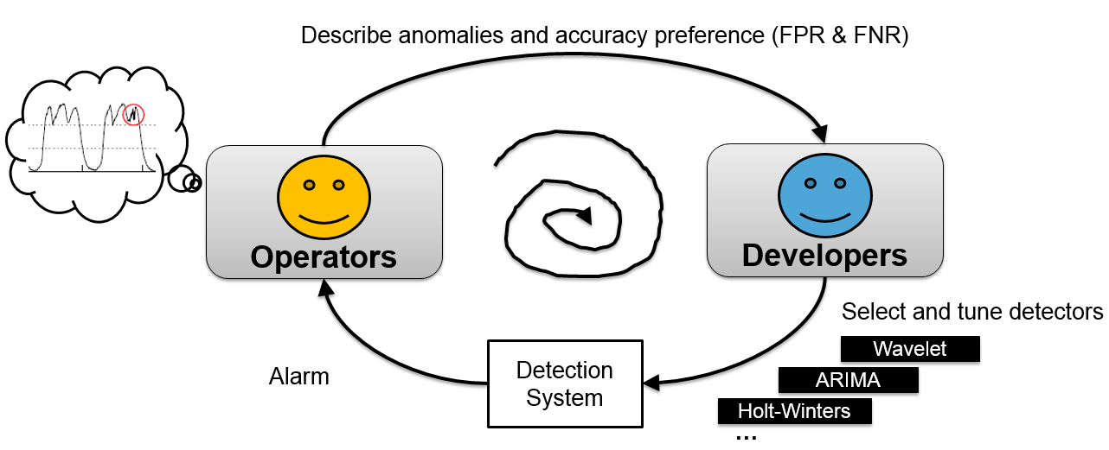
Design Goal
vs.
Label
Anomaly
Detection
Operators
Accuracy preference
(Precision & recall)
Opprentice
Provide
Notes:
We see that, when compared with the traditional way, operators do not need to formally define anomalies any more but only label some anomaly cases, which are much easier for them.
What's more, no developers are needed to select and tune many complex detectors, all those things are done automatically by Opprentice

Slide 16
Outline
Background and Motivation
Key Ideas
Results
Conclusion
Notes:
Next, I will show you the key ideas of how we achieve this

Slide 17
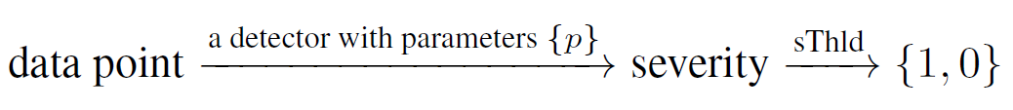
Key Ideas
Detector model:
Notes:
First, we use a uniform model to represent how different detectors work.
It is basically a two-step process.

Slide 18
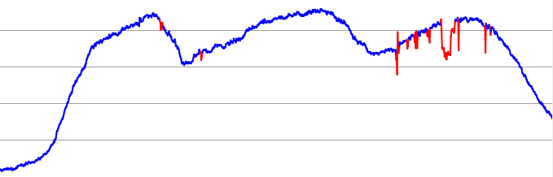
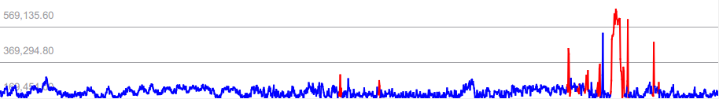


Key Ideas
Detector model:
For example
$$value$$
$severity=\frac{|value−μ|}{σ}$
Historical
Average
Notes:
For example，this is our KPI data. The red parts are the anomalies labeled by the operators.
** Click
If we apply a detector, historical average for example, to this data, it will generate the anomaly severity for each data point. This detector measure the severity using how many times of the standard deviation each point is away from the average. The higher the severity is, the more anomalous the data point is.

Slide 19
A generalized model of anomaly detection algorithm based on time series algorithm
$$value$$
$severity=\frac{|value−μ|}{σ}$
1
Historical
Average
sThld
0
Notes:
Then, we need to set a severity threshold to decide anomalies.
So, this is a general detector model. Different detectors basically work in these two steps, except that they use different techniques or algorithms to measure the severities.

Slide 20
Key Ideas
Detector model:
For example
$$value$$
$severity=\frac{|value−μ|}{σ}$
1
Historical
Average
sThld
0
Anomaly feature
Notes:
In Opprentice, we do not let each detector determine the anomaly by itself. Instead, we only use the severity as the anomaly feature.

Slide 21
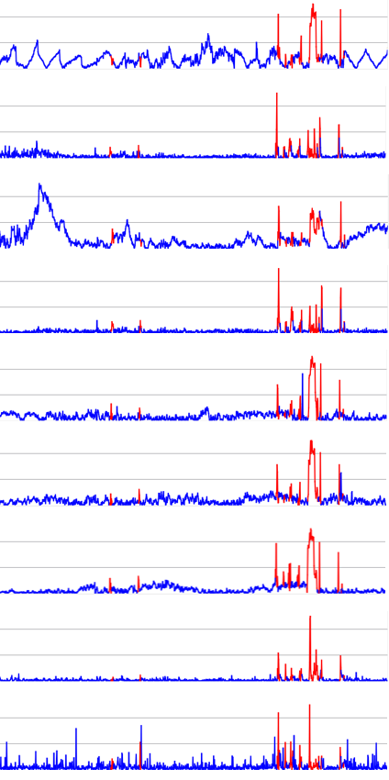
Key Ideas
Historical average-4 season
EWMA-0,7
WMA-WIN30
Extract features
Differencing-last slot
Detector
Configurations
Differencing-last season
KPI data
(Detectors with
different parameters)
Differencing-last day
Time series decomposition
HW 0.2 0.2 0.2
HW 0.5 0.7 0.7
Notes:
Multiple detectors with different parameters are used simultaneously to extract different anomaly features of the data.
We call a combination of a detector and its specific parameters a configuration.

Slide 22
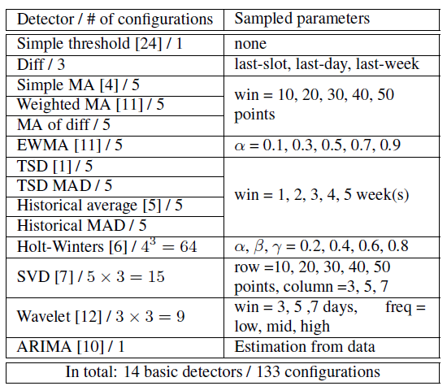
Key Ideas
Historical average-4 season
EWMA-0,7
WMA-WIN30
Extract features
Differencing-last slot
Detector
Configurations
Differencing-last season
KPI data
(Detectors with
different parameters)
Differencing-last day
Time series decomposition
HW 0.2 0.2 0.2
HW 0.5 0.7 0.7
Notes:
We broadly select 14 detectors and sample some parameters. Finally, we get 133 configurations. In other words, we have 133 anomaly features.

Slide 23
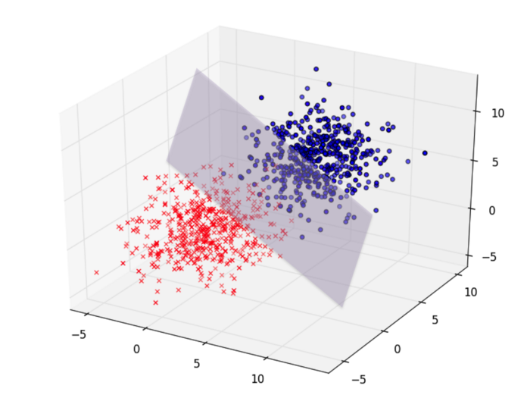
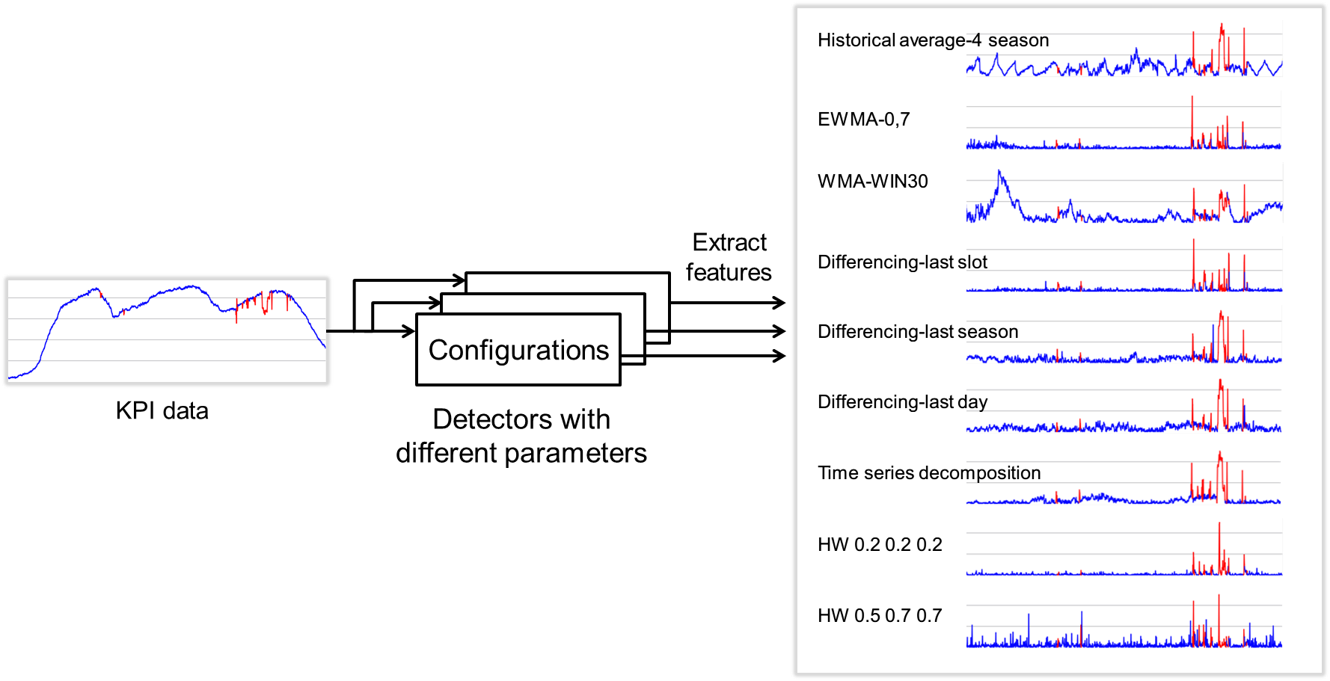
Key Ideas
Classification in the feature space
(Supervised machine learning)
Notes:
If we consider each feature as one dimension, then each data point can be projected into a multi-dimensional space. Here is a 3D space example. The red points are corresponding to those anomalies labeled by operators.
We can use supervised machine learning to do the classification in this multi-dimensional feature space.
And the classification model is used for future anomaly detection.

Slide 24
Key Ideas
Classification in the feature space
(Supervised machine learning)
Notes:
So we see, the key idea behind this design is that, operators actually have the domain knowledge of anomalies in their mind, but it is difficult for them to formally define it. So, we use machine learning to model those anomaly concepts from historical cases.
This space is just like the brain of Opprentice.
In this process, machine learning will automatically find the classification boundaries in the feature space. In other words, it can select which detectors and parameters are suitable for detecting those anomalies cared by operators.

Slide 25
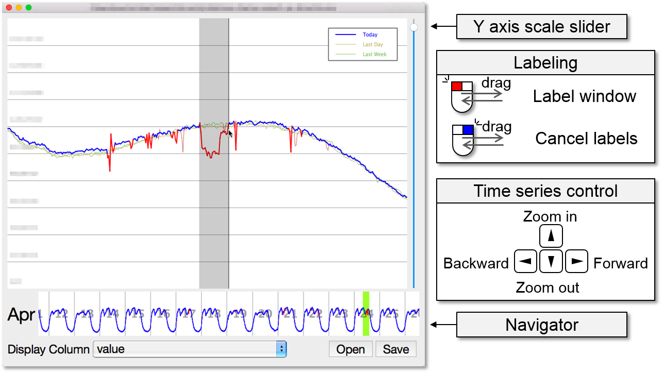
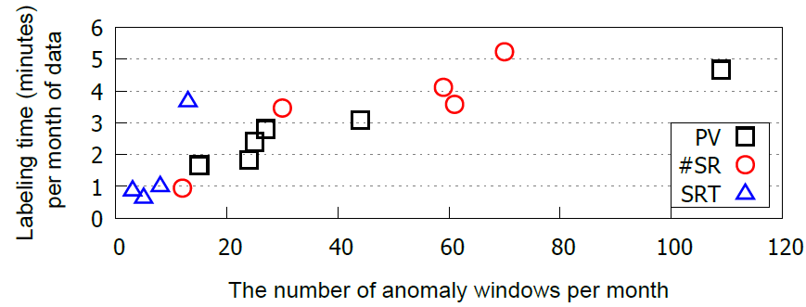
Address Challenges of Designing Opprentice
Labeling overhead
  Solution: an effective labeling tool
Notes:
There are several challenges in the design of Opprentice.
The first one is how to solve the labeling overhead? Our solution is to develop an effective labeling tool. This is the user interface of our labeling tool.
Labeling with this tool won’t cost much time, actually less than 6 minutes for each month of data according to our use experience.

Slide 26
Address Challenges of Designing Opprentice
Labeling overhead
  Solution: an effective labeling tool
Incomplete anomaly types in the historical data
  Solution: incremental re-training with new data
Notes:
The second one is that the historical data may not contain all kinds of anomaly types. Our solution is to incrementally re-train Opprentice with the latest data

Slide 27
Address Challenges of Designing Opprentice
Labeling overhead
  Solution: an effective labeling tool
Incomplete anomaly types in the historical data
  Solution: incremental re-training with new data
Class imbalance problem
  Solution: adjusting classification threshold (cThld) based on the preference
Notes:
The third challenge is the class imbalance problem. That is, anomalies are infrequent in the data, so they are often ignored by classification algorithms.
To solve this challenge, we adjust the classification threshold based on the accuracy preference to give higher priority of the anomaly class

Slide 28
Address Challenges of Designing Opprentice
Labeling overhead
  Solution: an effective labeling tool
Incomplete anomaly types in the historical data
  Solution: incremental re-training with new data
Class imbalance problem
  Solution: adjusting classification threshold (cThld) based on the preference
Irrelevant and redundant features
  Solution: random forests
Notes:
And Last, because we want to save manual efforts, the detectors and their parameters are used without carefully evaluation, so many of the features provided by these detectors could be irrelevant or redundant.
To solve this problem, we conducted experiments on different machine learning algorithms, and find that the random forest, an ensemble based machine learning algorithm, turns out to be more accurate and robust to irrelevant and redundant features.

Slide 29
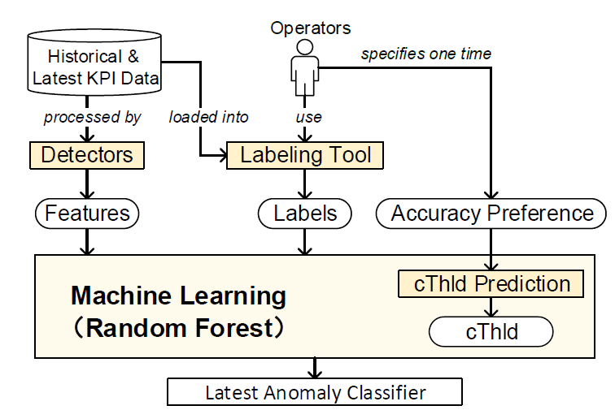
Design Overview
Training a classifier
See the paper for full details
Notes:
This is the design overview of Opprentice.
First we train the anomaly classifier. Give the KPI dataset, dozens of detectors extract the features, and operators provide the anomaly labels. The features and labels are used to train a random forest classifier. Besides, operators specify their accuracy preference in the form of precision and recall. It is used to adjust the classification threshold of the random forest.
The classifier is incrementally re-trained with the latest data. For example, we can do it once a week.

Slide 30
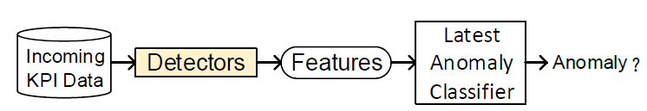
Design Overview
Training a classifier
See the paper for full details
Detecting anomalies
Notes:
For the detecting process, the same detectors extract the features of the incoming data. Based on these features, the latest classifier will decide the class of each data point, anomaly or not.
Please read our paper for the details of each component.

Slide 31
Outline
Background and Motivation
Key Ideas
Results
Conclusion
Notes:
I will show you the evaluation results of Opprentice

Slide 32
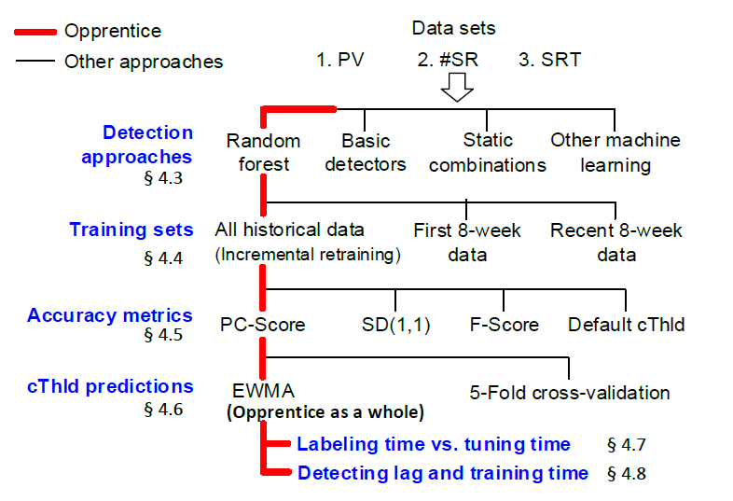
Evaluation
Notes:
This is our evaluation flow. We use three representative KPIs from Baidu. They are labeled by the operators. We compare different components of Opprentice with other methods.
With all these four parts combined together, we get Opprentice as a whole here.
We also evaluate the labeling time, the online detecting lag and the offline training time of Opprentice.

Slide 33
Evaluation
Notes:
Let’s firs look at the comparison between the random forest and the basic detectors and two static methods for combining different basic detectors.

Slide 34
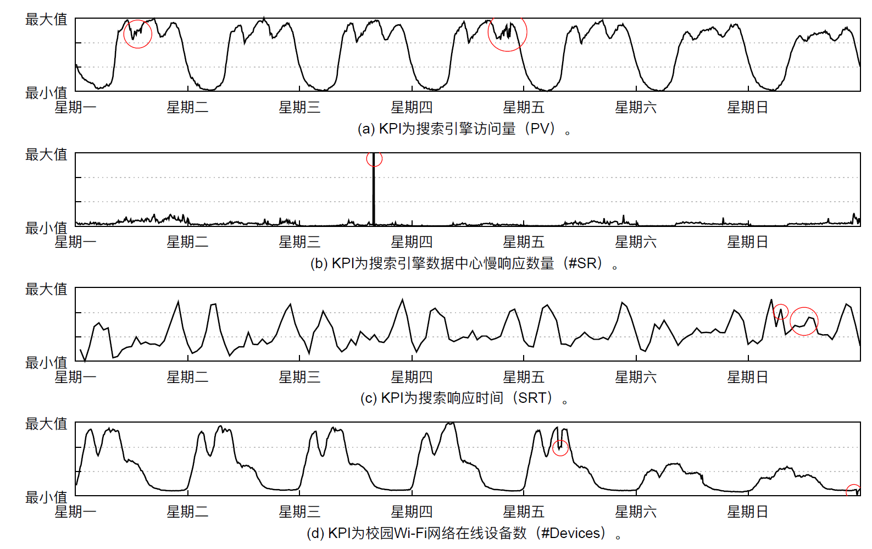
Evaluation
KPIs from the real world
Search PV (25 weeks) ）
Baidu
#slow queries（19 weeks）
Search Response Time（16 weeks）
Tsinghua Enterprise WiFi
#online devices (15 weeks）

Slide 35
Random forests vs. Basic Detectors and Static Combinations
Random forest
Notes:
This figure shows the precision-recall curves, or PR curves on the PV dataset. The results of the other two KPIs are similar.
Empirically, the area under the PR curve is larger, the detection approach is better. We see that random forest outperforms other detection approaches, including the top-3 best basic detectors, and two static combination methods (majority-vote and normalization schema).

Slide 36
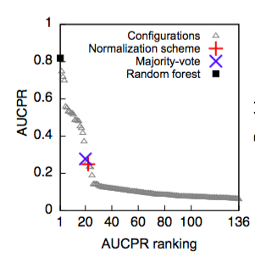
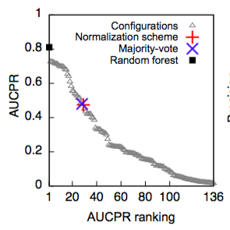
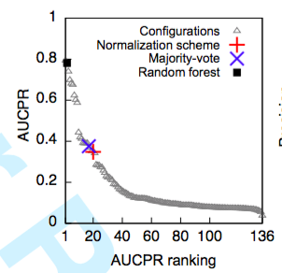
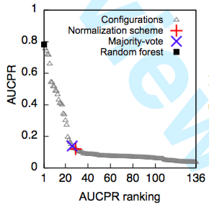
Evaluation
KPI：百度搜索访问量
Compared with all existing detectors（Four KPIs）
first
first
second
first

Slide 37
Evaluation
Notes:
We also compare the random forest with other machine learning algorithms.

Slide 38
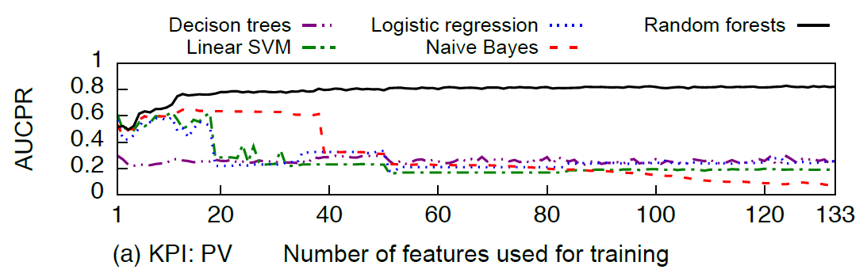
Random Forests vs. Other Learning Algorithms
(The order of features is based on mutual information)
Notes:
AUCPR means the area under the PR-curve, and it is the larger the better. In order to see how different machine learning algorithms perform when faced with irrelevant and redundant features, we rank the 133 features based on mutual information, a typical feature selection method, and add the features one by one.
We see that the random forest is almost not affected when we use more features, on the other hand, the performance of other learning algorithms decreases a lot. The result shows that the random forest is more robust to irrelevant and redundant features

Slide 39
Evaluation
See the paper for full details
Notes:
I will just skip other detailed results, and show the performance of Opprentice as a whole. In this step, we compare the EWMA used by Opprentice to predict the classification threshold with another method 5-fold cross-validation.

Slide 40
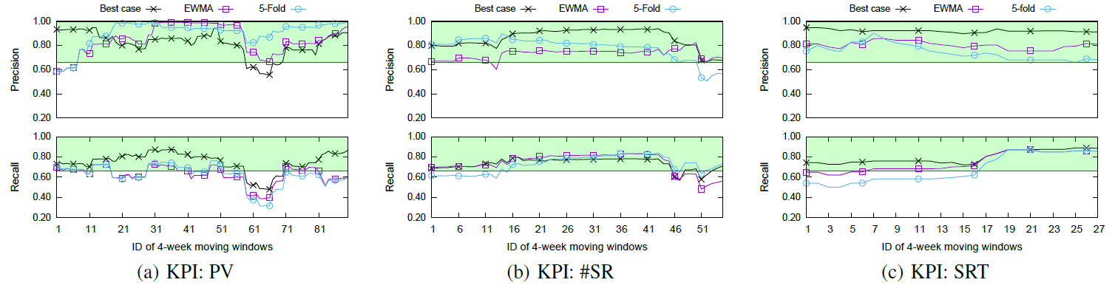
Opprentice as a whole
Oracle mode
(best case)
5-Fold
Opprentice
Opprentice achieves
40%
23%
110%
more points inside the preference regions than 5-Fold cross-validation
Notes:
The green regions represent the preference of precision and recall given by the operator. Overall, we see that for the three KPIs, Opprentice can satisfy or approximate the preference most of the time.
When compared with 5-fold cross-validation, Opprentice achieves more points in those preference regions.
However, we found that this cross-validation method does not work quite well in our problem (§5.6). A potential explanation is that, as shown in Fig. 7, the best cThlds can differ greatly over weeks. As a result, in the cross-validation, the cThld that achieves the highest average performance over all the historical data might not be similar to the best cThld of the future week.

Slide 41
Opprentice as a whole
Oracle mode
(best case)
5-Fold
Opprentice
Opprentice achieves
40%
23%
110%
more points inside the preference regions than 5-Fold cross-validation
Notes:
We also notice that it is not easy to achieve high precision and recall all the time. This is because we use a fixed size window to calculate the precision and recall, and the anomalies could be very few sometimes, for example, less than 4% in some weeks. In this situation, even missing just a few anomalies can greatly decrease recall. But on the other hand, the absolute number of false negatives is also very low, so it is actually not that bad as it looks. Anyway, we can still improve the detection accuracy in the future by using more detectors and better machine learning algorithms.

Slide 42
Conclusion
Opprentice is an automatic and accurate machine learning framework for KPI anomaly detection
Opprentice bridges the gap in applying complex detectors in practice
The idea of Opprentice
  i.e., using machine learning to model the domain knowledge
could be a very promising way to automate other service managements
Opprentice
Defining anomalies
Selecting detectors
Tuning detectors
Notes:
In summary
First, #Read#
Second, Opprentice bridges the gap in applying complex detectors from literatures in practice
Third, #Read# , Such as diagnosing root causes

Slide 43
Thank you
liudp10@mails.tsinghua.edu.cn
Notes:
So, that’s all for Opprentice, and I’m happy to take questions now
Thank you.

