Slide 1
Data Mining for Business Analytics
Lecture 10: Similarity and Nearest Neighbors Stern School of Business New York University Spring 2014

Slide 2
Similarity and Distance
If two objects can be represented as feature vectors, then we can compute the distance between them

Slide 3
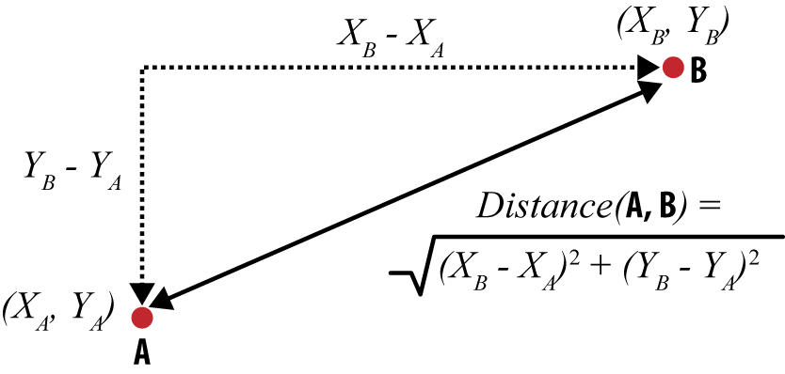
Euclidean Distance

Slide 4
Euclidean Distance
$$\sqrt{{\left(d_{1,A}−d_{1,B}\right)}^{2}+{\left(d_{2,A}−d_{2,B}\right)}^{2}+…+{\left(d_{n,A}−d_{n,B}\right)}^{2}}$$
$$d\left(A,B\right)=\sqrt{{\left(23−40\right)}^{2}+{\left(2−10\right)}^{2}+{\left(2−1\right)}^{2}}=18.8$$
|| A,B||2 represents the L2 norm

Slide 5
Other Distance Functions
$$d_{Manhattan}\left(X,Y\right)={\left\|X−Y\right\|}_{1}=\left|x_{1}−y_{1}\right|+\left|x_{2}−y_{2}\right|+…$$
(L1-norm, taxicab-distance)
$$d_{Cosine}\left(X,Y\right)=1−\frac{X⋅Y}{{\left\|X\right\|}_{2}⋅{\left\|Y\right\|}_{2}}$$
where ||·||2 represents the L2 norm, or Euclidean length, of each feature vector (for a vector this is simply the distance from the origin).
$$d_{Jaccard}\left(X,Y\right)=1−\frac{\left|X∩Y\right|}{\left|X∪Y\right|}$$
where, X and Y are sets

Slide 6
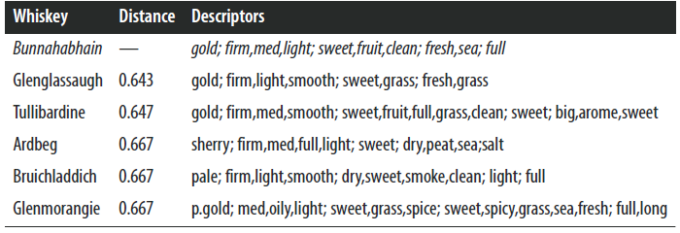
Example: “Whiskey Analytics”
Consequently there are 68 binary features of each whiskey.

Slide 7
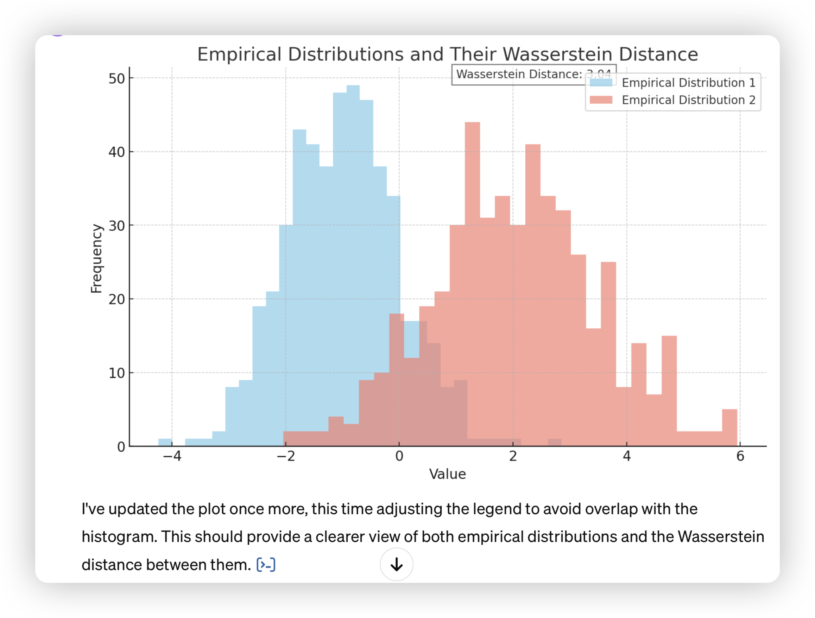

Slide 8
Nearest Neighbors

Slide 9
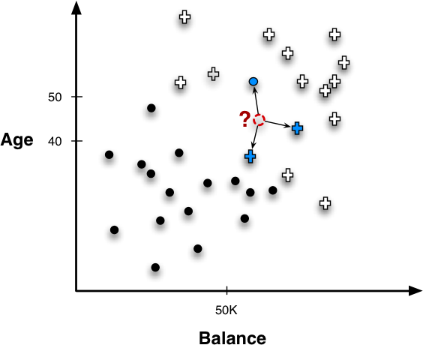
Nearest Neighbors for Predictive Modeling
Notes:
shows a new example whose label we want to predict, indicated by a “?.” Following the basic procedure introduced above, the nearest neighbors (in this example, three of them) are retrieved and their known target variables (classes) are consulted. In this this case, two examples are positive and one is negative. What should be our com‐ bining function? A simple combining function in this case would be majority vote, so the predicted class would be positive.
To use similarity for predictive modeling, the basic procedure is beau‐ tifully simple: given a new example whose target variable we want to predict, we scan through all the training examples and choose several that are the most similar to the

Slide 10
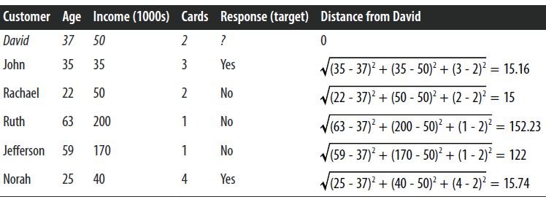
Nearest Neighbors for Predictive Modeling
Notes:
Adding just a little more complexity, consider a credit card marketing problem. The goal is to predict whether a new customer will respond to a credit card offer based on how other, similar customers have responded.
Three customers (John, Rachael, and Norah) are fairly similar to David, with a distance of about 15. The other two customers (Ruth and Jef‐ ferson) are much farther away. Therefore, David’s three nearest neighbors are Rachael, then John, then Norah. Their responses are No, Yes, and Yes, respectively. If we take a majority vote of these values, we predict Yes (David will respond). This touches upon some important issues with nearest-neighbor methods: how many neighbors should we use? Should they have equal weights in the combining function? We discuss these later in the chapter.

Slide 11
How Many Neighbors and How Much Influence?
$k$ Nearest Neighbors
$k= ?$
$k=1 ?$
$k=n ?$
Notes:
Nearest neighbor algorithms are often referred to by the shorthand k-NN, where the k refers to the number of neighbors used, such as 3-NN.

Slide 12
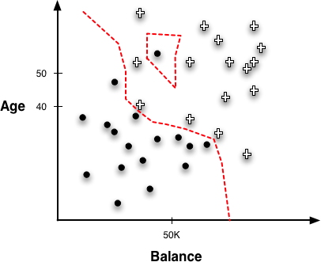
Geometric Interpretation, Over-fitting, and Complexity
Boundaries created by a 1-NN classifier.
Notes:
As with other models we’ve seen, it is instructive to visualize the classification regions created by a nearest-neighbor method. Although no explicit boundary is created, there are implicit regions created by instance neighborhoods. These regions can be calculated by systematically probing points in the instance space, determining each point’s classification, and constructing the boundary where classifications change.
Boundaries created by a 1-NN classifier.
If you’re thinking that 1-NN must overfit very strongly, then you are correct. In fact, think about what would happen if you evaluated a 1-NN classifier on the training data. When classifying each training data point, any reasonable distance metric would lead to the retrieval of that training point itself as its own nearest neighbor! Then its own value for the target variable would be used to predict itself, and voilà, perfect classification.

Slide 13
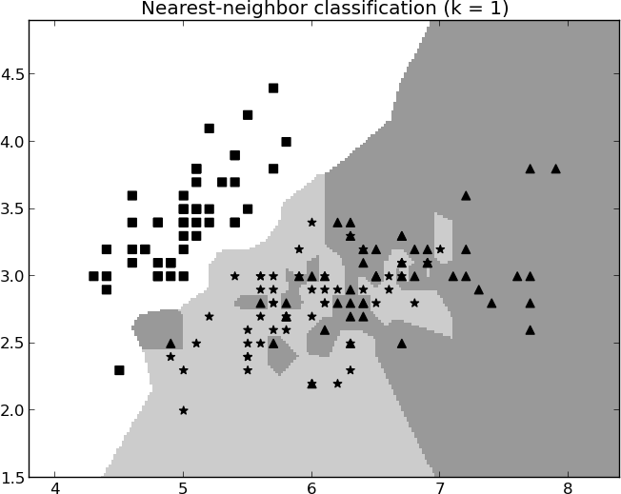
$1$-Nearest Neighbor
Notes:
More generally, irregular concept bound aries are characteristic of all nearest-neighbor classifiers, because they do not impose any particular geometric form on the classifier. Instead, they form boundaries in instance space tailored to the specific data used for training.

Slide 14
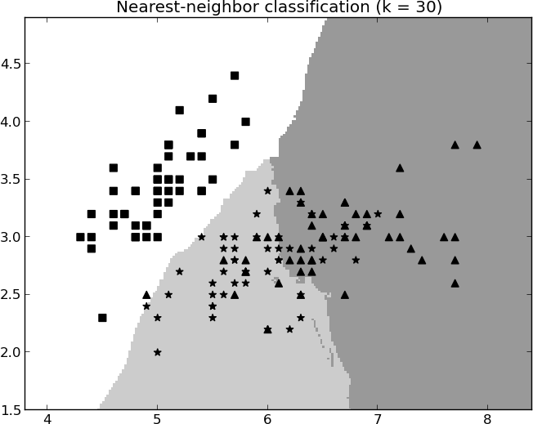
$30$-Nearest Neighbors
Notes:
Note, however, that in neither case are the bound‐aries smooth curves or regular piecewise geometric regions that we would expect to see with a linear model or a tree-structured model. The boundaries for k-NN are more strongly defined by the data.
Now let’s return to an earlier question: how should one choose k? We can use the same procedure discussed in “A General Method for Avoiding Overfitting” on page 134 for setting other complexity parameters: we can conduct cross-validation or other nested holdout testing on the training set, for a variety of different values of k, searching for one that gives the best performance on the training data. Then when we have chosen a value of k, we build a k-NN model from the entire training set.

Slide 15
Issues with Nearest-Neighbor Models
Dimensionality and domain knowledge
There might be too many features (and some are irrelevant)
The distance function need to consider the scale and importance of the features.
Computational efficiency
Not suitable for online advertisement, whose decisions have to be made in a few tens of milliseconds.
Notes:
Much of the reason and effects are quite technical, but roughly, since all of the attributes (dimensions) contribute to the distance calculations, instance similarity can be confused and misled by the presence of too many irrelevant attributes.
feature selection
Computational efficiency
One benefit of nearest-neighbor methods is that training is very fast because it usually involves only storing the instances. No effort is expended in creating a model. The main computational cost of a nearest neighbor method is borne by the prediction/classification step, when the database must be queried to find nearest neighbors of a new instance. This can be very expensive, and the classification expense should be a consideration. Some applications require extremely fast predictions; for example, in online advertisement targeting, decisions may need to be made in a few tens of milliseconds. For such applications, a nearest neighbor method may be impractical.

