Slide 1
Transfer Learning
All slides adopted from the Internet.

Slide 2
Transfer Learning By Human
Credit: An Introduction to Transfer Learning, Georgian Impact Blog
Notes:
What is Transfer Learning?
As humans, we find it easy to transfer knowledge we have learned from one domain or task to another. When we encounter a new task, we don’t have to start from scratch. Instead, we use our previous experience to learn and adapt to that new task faster and more accurately[1].
For example, if you have any experience programming with Java, C/C# or any other programming languages, you’re already familiar with concepts like loops, recursion, objects and etc (Figure 1, a). If you then try to pick up a new programming language like python, you don’t need to learn these concepts again, you just need to learn the corresponding syntax. Or to take another example, if you have played table tennis a lot it will help you learn tennis faster as the strategies in these games are similar (Figure 1, b).

Slide 3
Transfer Learning uses knowledge from other existing domains (source) during the learning process for a new domain (target)
Credit: An Introduction to Transfer Learning, Georgian Impact Blog
Notes:
Despite the remarkable results, these models are data hungry and their performance relies heavily on the quality and size of training data.
However, in real-world scenarios, large amounts of labeled data are usually expensive to obtain or not available which means performance is low or projects are abandoned entirely. What’s more, these models still lack the ability to generalize to any situation beyond those they encountered during training[2], so they are limited in what they can achieve.

Slide 4
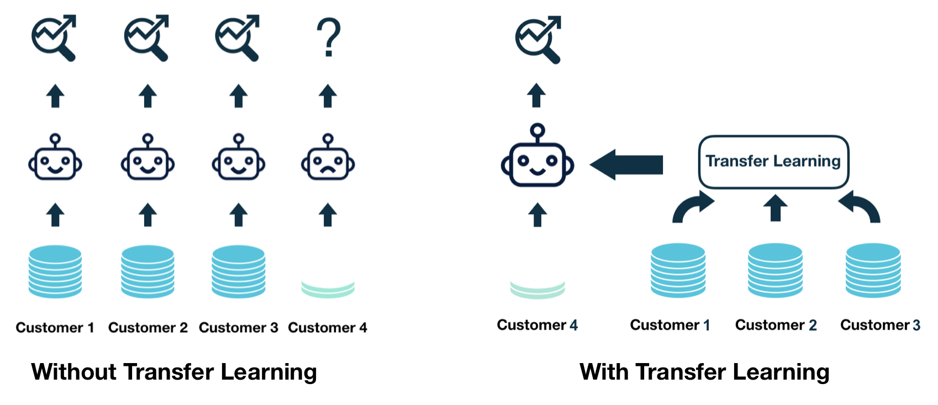
Motivating Example: On-boarding new customer
Credit: An Introduction to Transfer Learning, Georgian Impact Blog

Slide 12
Transfer learning addresses these three questions
What information in the source is useful and transferable to target?
What is the best way of transferring this information?
How to avoid transferring information that is detrimental to the desired outcome?

Slide 13
Notation: Task
Task: Given a specific domain 𝔇, a task 𝒯={𝑌, 𝒇(.)} consists of two parts:
A label space 𝑌
A predictive function 𝒇(.), which is not observed but can be learned from training data {(𝑥ᵢ, 𝑦ᵢ)| i ∈ {1, 2, 3, …, N}, where 𝑥ᵢ ∈ 𝑋 and 𝑦ᵢ ∈ 𝑌 }.
From a probabilistic viewpoint, 𝒇(𝑥ᵢ) can also be written as p(𝑦ᵢ|𝑥ᵢ), so we can rewrite task 𝒯 as 𝒯={𝑌, P(𝖸|Ｘ)}.
In general, if two tasks are different, then they may have different label spaces(𝑌t ≠ 𝑌s) or different conditional probability distributions (P(𝖸t|Ｘt) ≠ P(𝖸s|Ｘs)).

Slide 14
Definition of Transfer Learning
Given a source domain 𝔇s and corresponding learning task 𝒯s, a target domain 𝔇t and learning task 𝒯t, transfer learning aims to improve the learning of the conditional probability distribution P(𝖸t|Ｘt) in 𝔇t with the information gained from 𝔇s and 𝒯s, where 𝔇t ≠ 𝔇s or 𝒯t ≠ 𝒯s.
If we take this definition of domain and task, then we will have either 𝔇t ≠ 𝔇s or 𝒯t ≠ 𝒯s
  𝑋t ≠ 𝑋s
  P(Ｘt) ≠ P(Ｘs)
  𝑌t ≠ 𝑌s
  P(𝖸t|Ｘt) ≠ P(𝖸s|Ｘs)

Slide 15
Homogeneous v.s. Heterogeneous Transfer Learning
Credit: An Introduction to Transfer Learning, Georgian Impact Blog

Slide 16
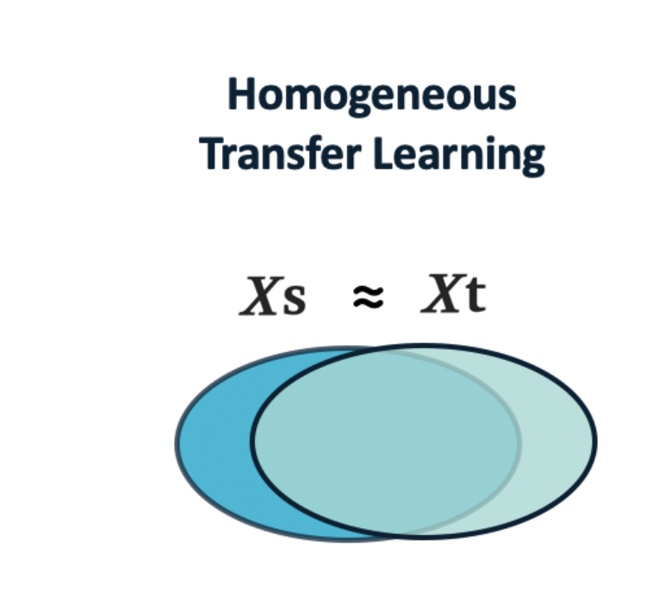
Homogeneous Transfer Learning
In homogeneous transfer learning， we have the situation where 𝑋t = 𝑋s and 𝑌t = 𝑌s. Therefore, we want to bridge the gap in the data distributions between the source and target domains, i.e. address P(Ｘt) ≠ P(Ｘs) and/or P(𝖸t|Ｘt) ≠ P(𝖸s|Ｘs). The solutions to homogeneous transfer learning problems use one of the following general strategies:
Trying to correct for the marginal distribution differences in the source and target ( P(Ｘt) ≠ P(Ｘs)).
Trying to correct for the conditional distribution difference in the source and target (P(𝖸t|Ｘt) ≠ P(𝖸s|Ｘs)).
Trying to correct both the marginal and conditional distribution differences in the source and target.
Credit: An Introduction to Transfer Learning, Georgian Impact Blog

Slide 17
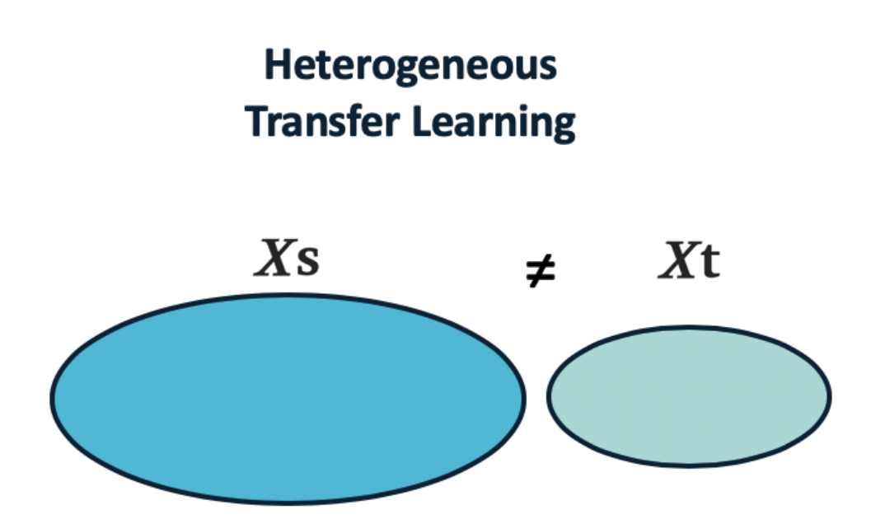
Heterogeneous Transfer Learning
In heterogeneous transfer learning, the source and target have different feature spaces 𝑋t ≠ 𝑋s (generally non-overlapping) and/or 𝑌t ≠ 𝑌s, as the source and target domains may share no features and/or labels.
Heterogeneous transfer learning solutions bridge the gap between feature spaces and reduce the problem to a homogeneous transfer learning problem where further distribution (marginal or conditional) differences will need to be corrected.
Credit: An Introduction to Transfer Learning, Georgian Impact Blog

Slide 18
Transfer Learning Solutions
Credit: An Introduction to Transfer Learning, Georgian Impact Blog

Slide 21
1. Instance-Based Transfer Learning
A source sample’s probability of being in target domains
Instance-based transfer learning methods try to reweight the samples in the source domain in an attempt to correct for marginal distribution differences. One common solution is to train a binary classifier that separates source samples from target samples and then use this classifier to estimate the source sample weights. This method gives a higher weight to the source samples that are more similar to target samples.
Credit: An Introduction to Transfer Learning, Georgian Impact Blog

Slide 22
2. Feature-based transfer Learning (for both homogeneous and heterogenous transfer learning)
This approach discovers underlying meaningful structures by transforming both of the domains to a common latent feature space — usually of a low dimension — that has predictive qualities while reducing the impact of marginal distribution differences between the domains.
Credit: An Introduction to Transfer Learning, Georgian Impact Blog
Notes:
Although the high-level goal behind these methods (improving the performance of a target learner) is very different from the objective in representation learning, the idea behind them is fairly close

Slide 32
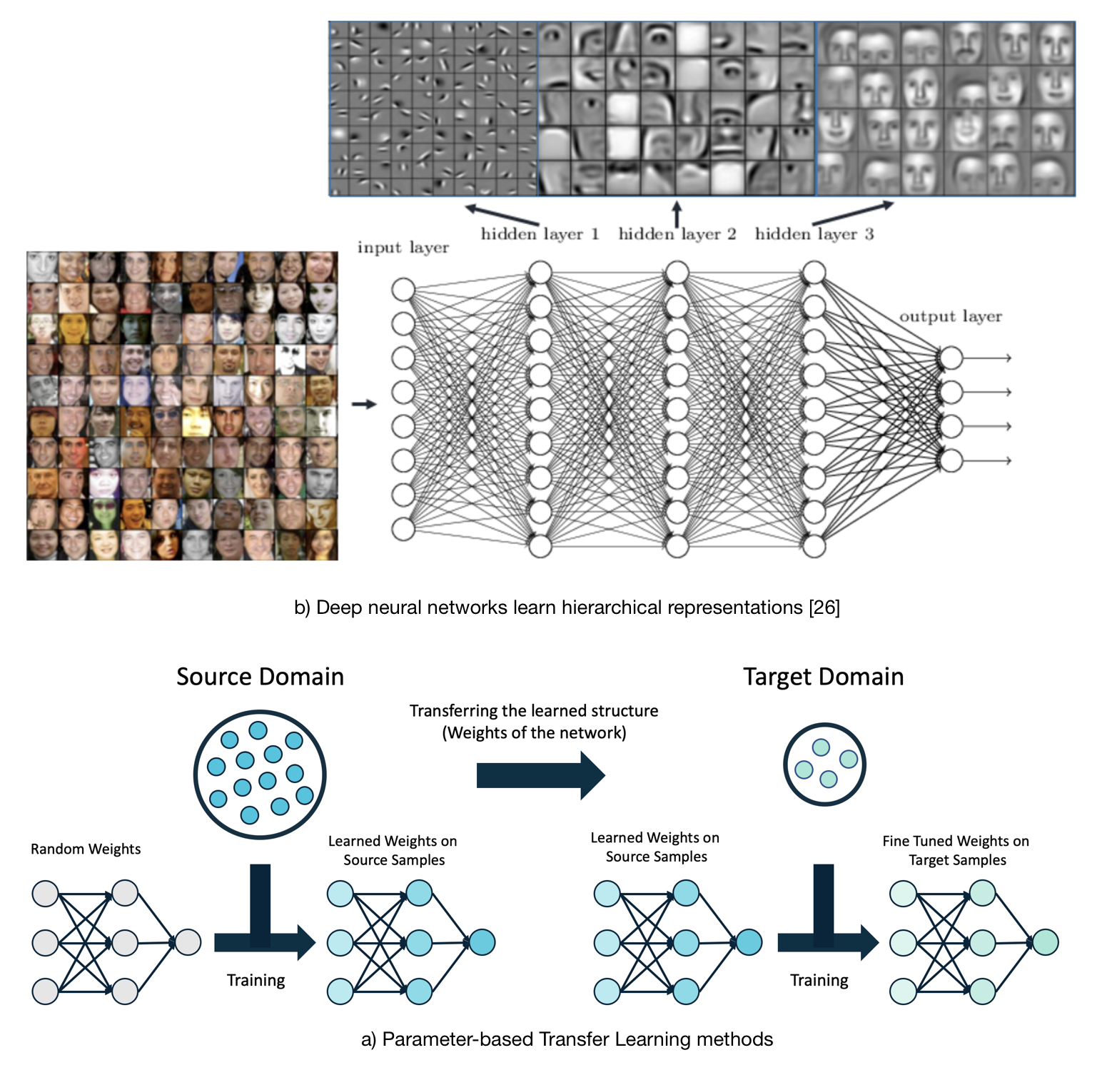
3. Parameter-based Approaches
Idea: a well-trained model on the source domain has learned a well-defined structure, and if two tasks are related, this structure can be transferred to the target model.
How: Instead of starting with random weights, start with the previously trained weights from another similar domain (source) and then fine-tune the weights specifically for a new domain (target).
  Save time
  Requires much less labeled data.
  Improve robustness
Notes:
Traditionally when training a deep neural network, the model starts with randomly initialized weights close to zero and adapts its weights as it sees more and more training samples. However, training a deep model in this way requires a lot of time and effort to collect and label data.

Slide 33
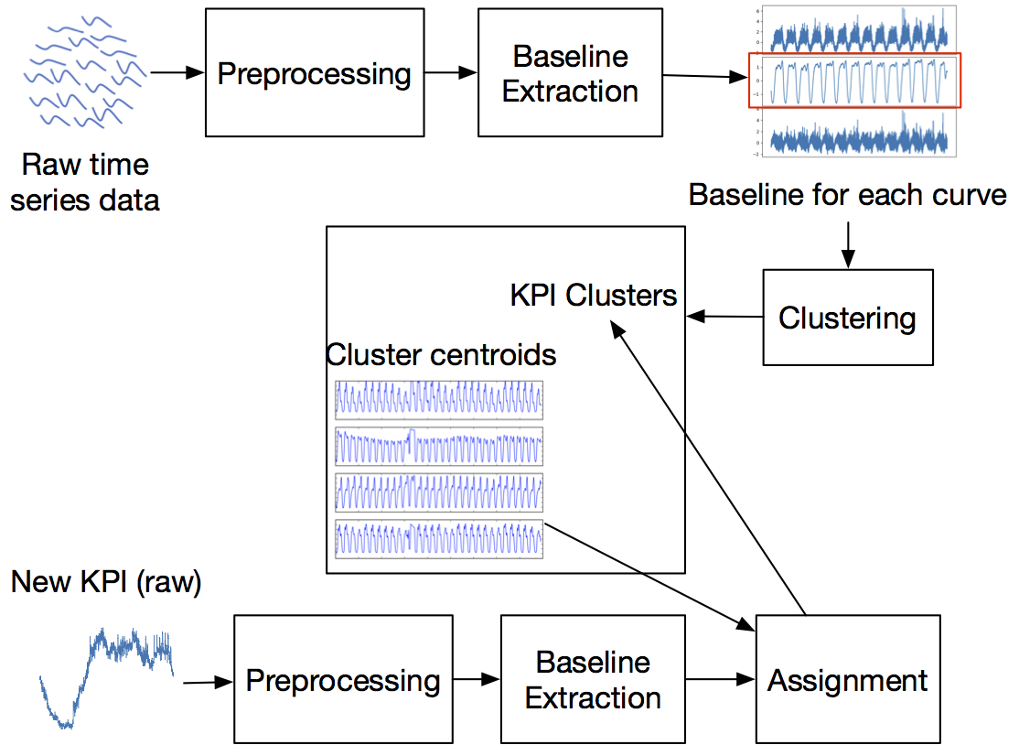
ROCKA: Clustering + Transfer Learning to reduce training overhead
IWQoS 2018
 | Original DONUT [WWW2018] | ROCKA+DONUT+KPI-specific threshold | ROCKA+DONUT
Avg. F-score | 0.89 | 0.88 | 0.76
Total training time (s) | 51621 | 5145 | 5145
Notes:
小范围数据验证（48条KPI），直接使用聚类中心的异常检测model和threshold用于同类其他KPI异常检测，性能下降普遍低于15%，时间开销节省90%。
normalized version of cross-correlation

Slide 35
Notes:
The last transfer learning category (and also the newest) is to transfer the knowledge through learning the common relationships between the source and target domains[21, 22]. In the following, we provide an example here in the context of sentiment analysis.
As you see in Figure 10, the frequency of used words in different review domains (here Movie and Food) is very different, but the structure of the sentences is fairly similar. Therefore, if we learn the relationship between different parts of the sentence in the Food domain, it can help significantly with analyzing the sentiment in another domain (here Movie)[21].

Slide 36
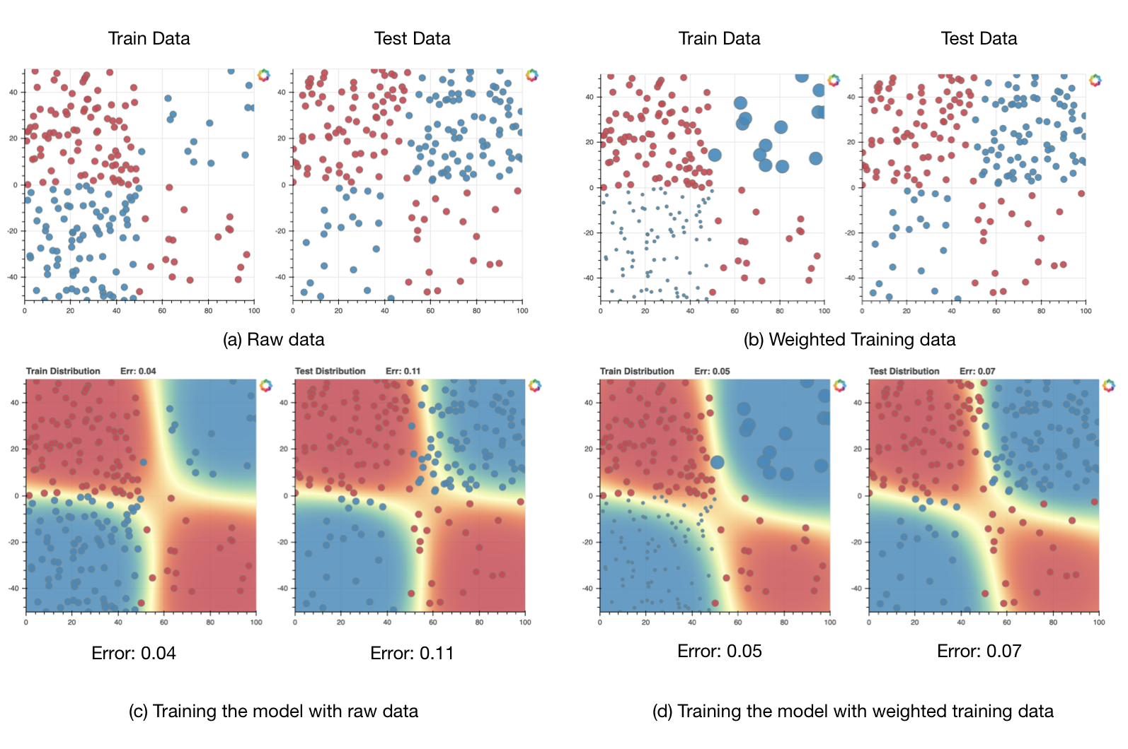
Real-World Application: Dealing with Domain Shift/Concept Drift
Credit: An Introduction to Transfer Learning, Georgian Impact Blog
Notes:
Figure 13. The raw data and the reweighted samples based on the method in Dataset Shift in Machine Learning (Quiñonero-Candela) [24] are shown in Figures (a) and (b) respectively. Figures (c) and (d) show the SVM binary classifier (with RBF kernel) trained with raw data and reweighted samples correspondingly. comparing figures (c) and (d) we can see that the error on the test set has decreased from 0.11 to 0.07 (around 36%).

Slide 37
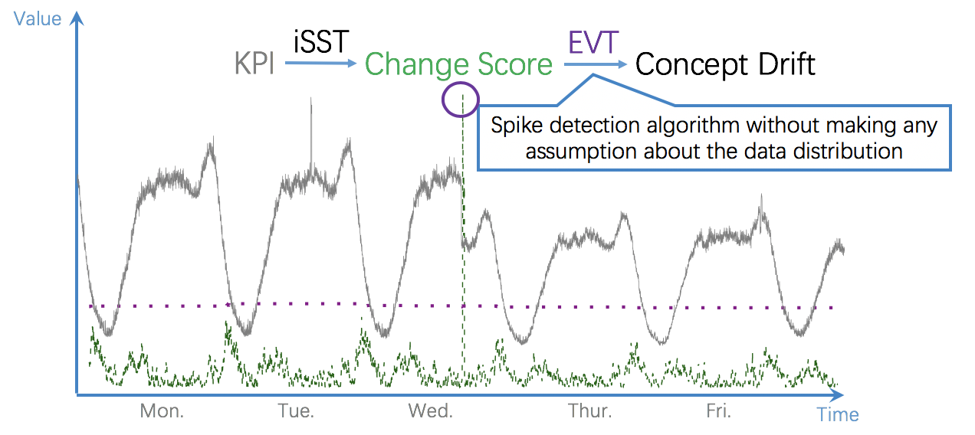
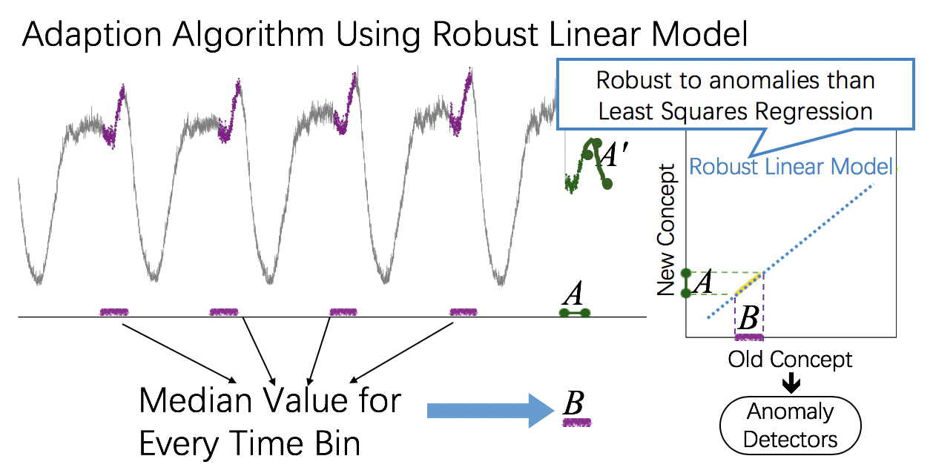
StepWise: Robust and Rapid Adaption for Concept Drift
in Software System Anomaly Detection
iSST-EVT
Semi-Automatic
RLM-Adaption
KPI Streams
Improved
Singular Spectrum Transform
Concept
Drift
Difference in
Differences
Expected
Robust
Linear Model
Anomaly
Detectors
Score
Threshold
Unexpected
Extreme Value
Theory
Software Change
Roll Back
Old Concept,
New Concept
Notes:
在剧变检测方面我们用了
[click]增强型奇异谱变换和极值理论自动选取阈值，能够应对大量的KPI；其次分类符合预期的concept drift需要人工确认，因为运维工程师需要对导致不合理剧变的上线操作进行回滚
[click]而符合期待的我们用鲁棒线性模型做适应。这套框架在搜狗完成了原型并且用于实际检测上线剧变。

